Slide 1
◀
▶
Korean 2 class week5
Yery Kim / Myeng wha Kim

Slide 2
◀
▶
Index
Past tense marker
Today’s words
Conversation
Koran culture
Today’s K-POP

Slide 3
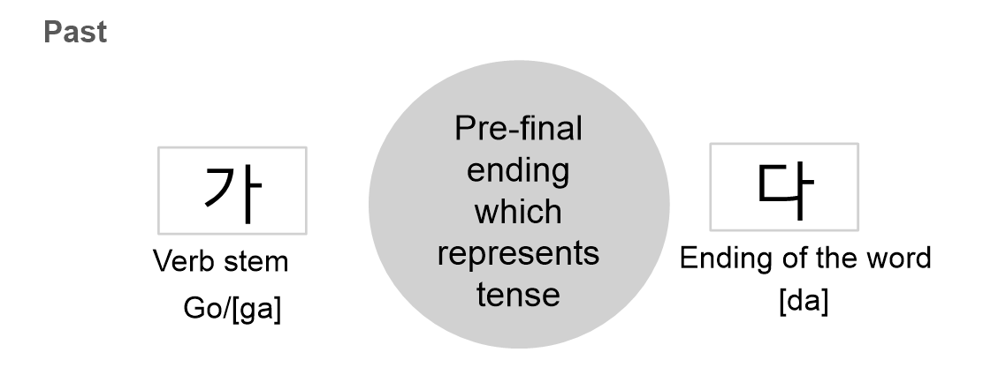
◀
▶
1. Past tense marker 었, 았

Slide 4
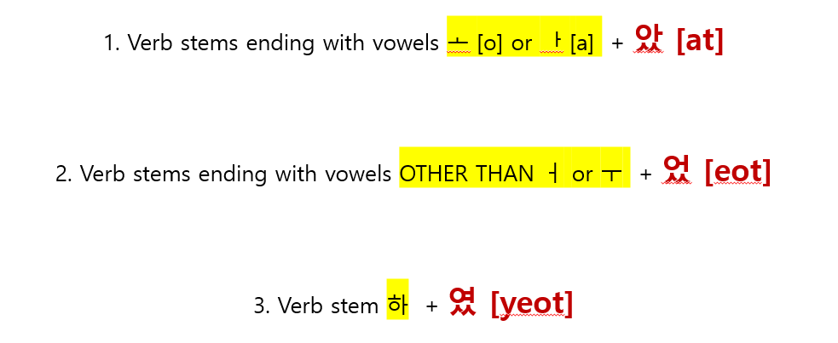
◀
▶
1. Past tense marker 었, 았
e.g. 선생님이 영어를 가르치셨어요
Stem : 가르치 → 치 is not bright vowel → past tense : 었
2. Honorific suffix :시
3. Speech level ending: 어요 (polite)
4. 가르치 + 시었 + 어요
5. 시었 → 셨
=가르치셨어요
-았-[at] / -었-[eot]
ends in a bright vowel

Slide 5
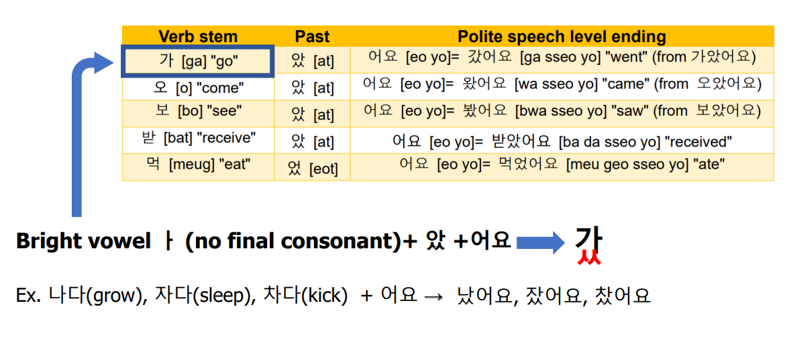
◀
▶
1. Past tense marker 었, 았

Slide 6
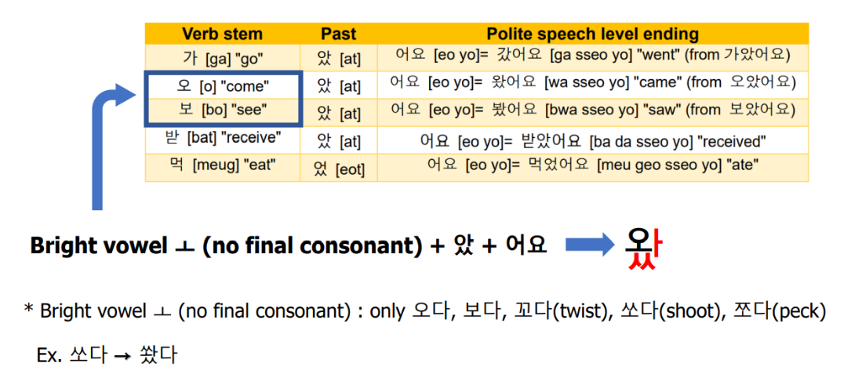
◀
▶
1. Past tense marker 었, 았

Slide 7
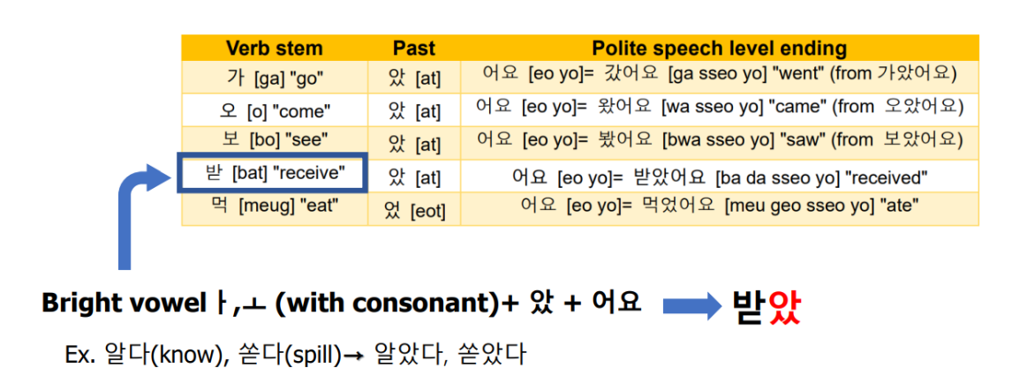
◀
▶
1. Past tense marker 었, 았

Slide 8
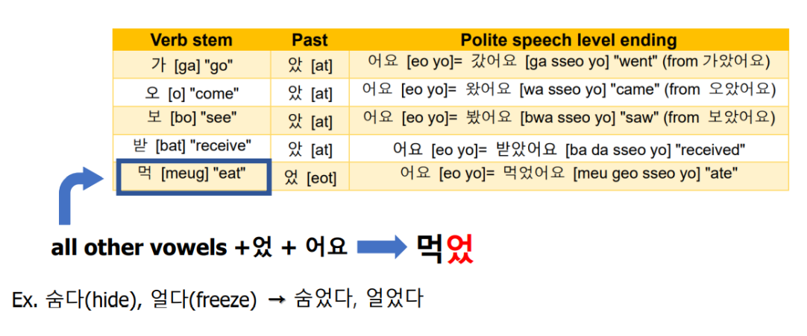
◀
▶
1. Past tense marker 었, 았

Slide 9
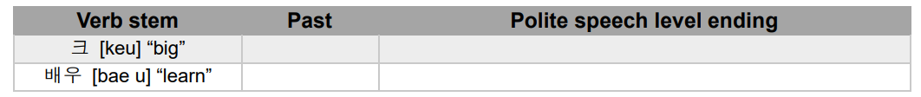
◀
▶
1. Past tense marker 었, 았
Exercise 1. Fill out the blanks with proper answers in Korean
Exercise 1. Fill out the blanks with proper answers in Korean
컸다
컸어요
배웠다
배웠어요
Exercise 2. Change the following sentence into past tense and translate the sentences into English
넥타이를 맸다
넥타이를 매다. “wear a tie” [neg ta I leul mae da] → ___________
아침 8 시에 해가 뜨다. “The sun rises at 8 in the morning”
[a chim 8 si e hae ga tteu da]→___________
아침 8시에 해가 떴다

Slide 10
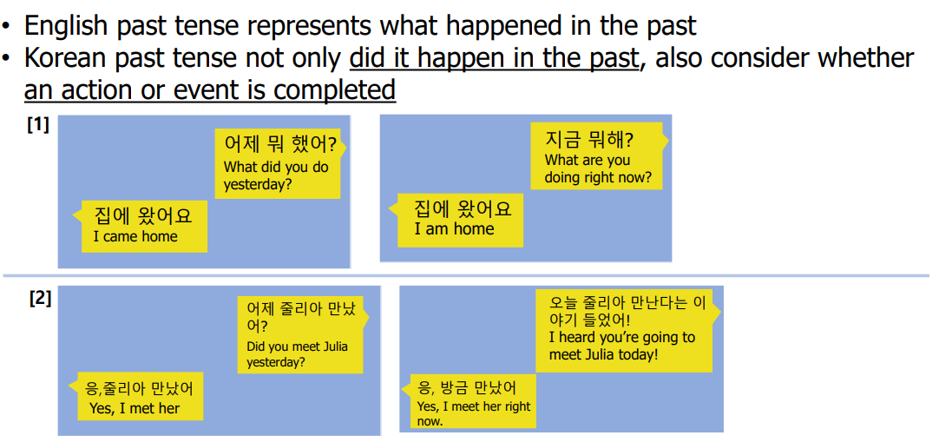
◀
▶
1. Past tense marker 었, 았
Subtle differences

Slide 11
◀
▶
1. Past tense marker 었, 았
바지를 입었어요 [ba ji leul i beo sseo yo]
1) “(I) wore a pants”
2) “(I) am wearing a pants” (As a result of the complete action of wearing pants)
Exercise 3. Look at the following sentence and write two corresponding interpretations in English
커피를 마셨어요. [keo pi leul ma syeo sseo yo]
→ (2) 한국어 수업 숙제를 했어요. [han gug eo su eob sug je leul hae sseo yo]
(I) drank coffee/ (I) am drinking coffee
(I) did Korean class assignment./ (I) am doing Korean class assignment

Slide 12
◀
▶
Today’s words
◼ Vocabulary
선생님 [seon saeng nim] n.teacher
아침 [a chim] n.morning, breakfast
점심 [jeom sim] n.lunch
저녁 [jeo nyeog] n.dinner, evening
해 [hae] n. the sun
집 [jib] n. house, home
바지 [ba ji] n. pants
커피 [keo pi] n. coffee
어제 [eo je] n. yesterday
영화 [yeong hwa] n. movie
친구 [chin gu] n. friend
강도 [gang do] n. robber/ v. robbery
시민 [si min] n.citizen
인질 [in jil] n. hostage
도둑질 [do dug jil] n.theft / v. rob
요리하다 [yo li ha da] v. cook
수업 [su eob] n. class, course, lesson
숙제 [sug je] n. homework, assignment
밥 [bab] n. rice, meal, food
영어 [yeong eo] n. English
넥타이 [neg ta i] n.neckti
강도 [gang do] n. robber/ v. robbery
시민 [si min] n.citizen
인질 [in jil] n. hostage
도둑질 [do dug jil] n.theft / v. rob
요리하다 [yo li ha da] v. cook
수업 [su eob] n. class, course, lesson
숙제 [sug je] n. homework, assignment
밥 [bab] n. rice, meal, food
영어 [yeong eo] n. English
넥타이 [neg ta i] n.neckti

Slide 13
◀
▶
Conversation
HaYun: What did you do yesterday?
MinJun: I had dinner at home with a friend and watched a movie.
HaYun: Really? Which movie did you watch?.
MinJun: I watched an action movie that robbers took citizens as hostages and steal money, but it wasn't as good as I thought.
HaYun: I see. How was the meal?
MinJun: It was really delicious. I will cook it next time
하윤: 너 어제 뭐 했어?
민준: 친구랑 집에서 저녁 먹고 영화 봤어.
하윤: 진짜? 어떤 영화 봤어?
민준: 강도가 시민들을 인질로 잡고 도둑질 하는 액션
영화를 봤는데 생각보다 별로였어.
하윤: 그렇구나. 밥은 맛있었어?
민준: 정말 맛있었어. 다음에 내가 요리해 줄게!

Slide 14
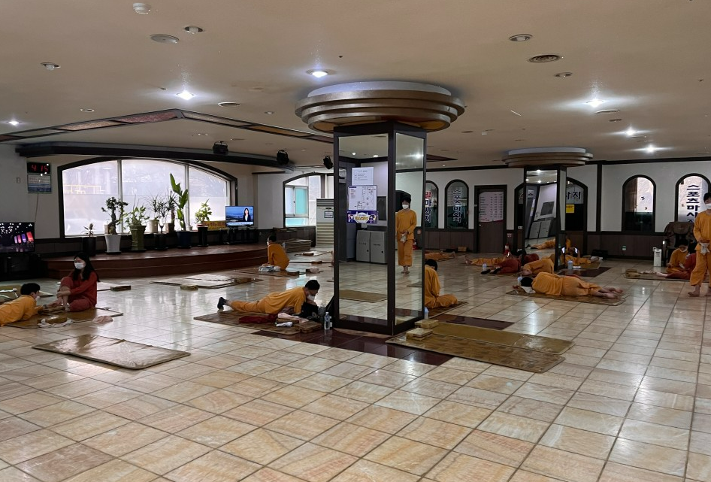
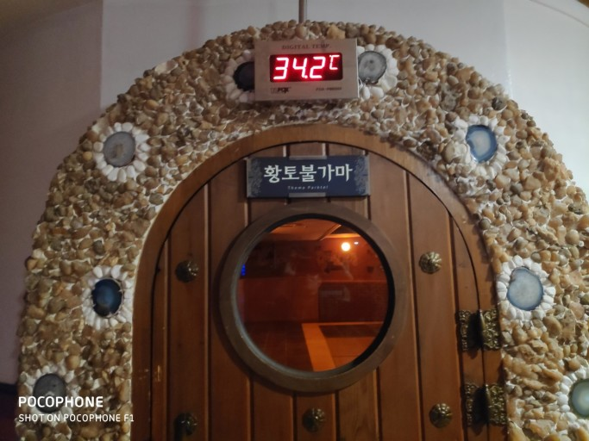
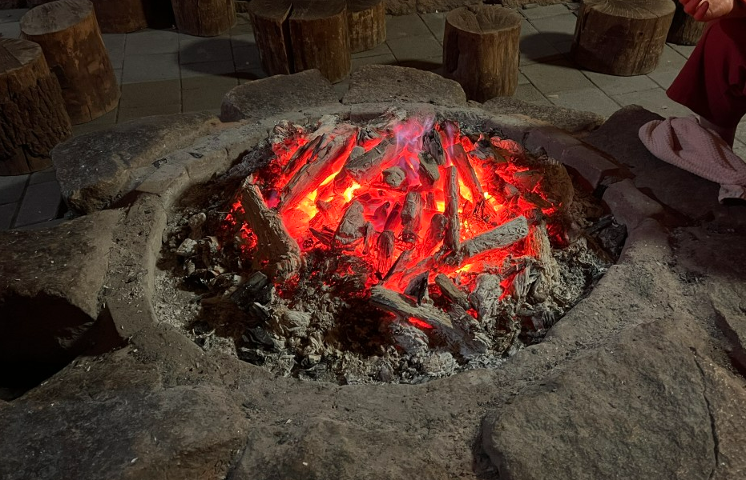
◀
▶
Korean culture – Unique places to go
Korean Sauna
1. 찜질방[jjim.jil.bang]
Korean Sauna
A place to take a shower, sleep and rest
Admission Fee: around 200czk
Notes:
Hot room with heat of charcoal or red clay soils

Slide 15
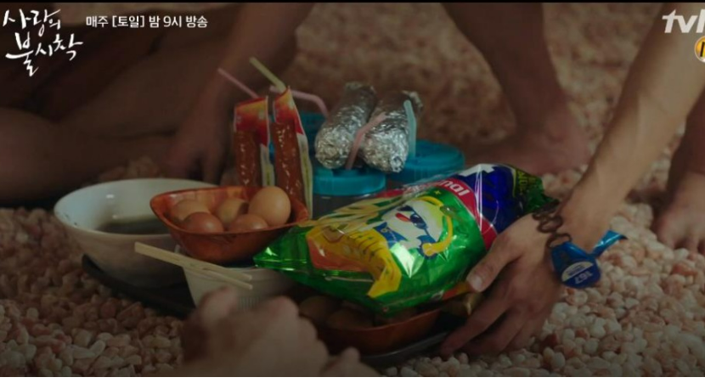
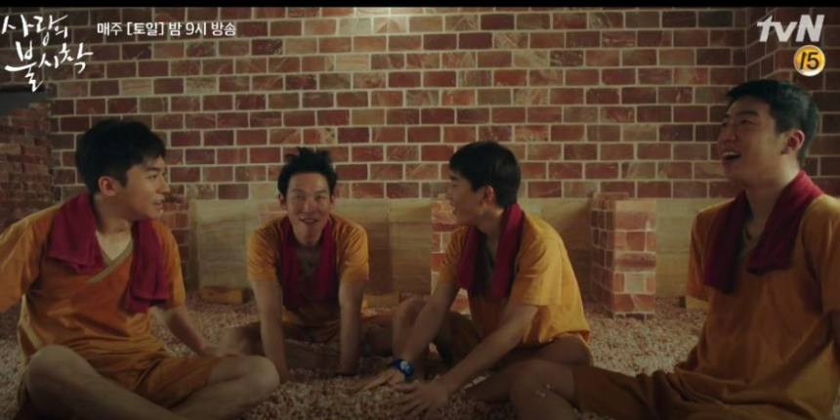
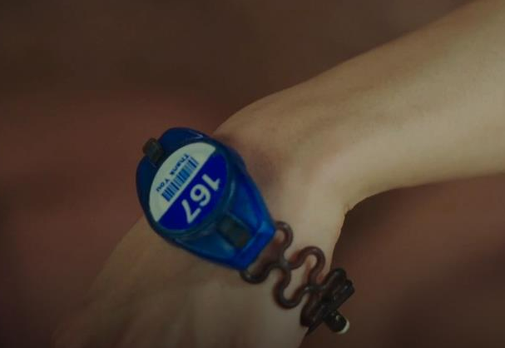
◀
▶
Korean culture – Unique places to go
Korean Sauna
1. 찜질방[jjim.jil.bang]
=> “This place even gives you free food if you just scan this bracelet“
사랑의 불시착[sa.lang-ui bul.si.chak]
= Crash Landing on You
*the bracelet is the key to your locker and it could record your payment which are combined to pay at the end of your visit
“This place is like heaven”

Slide 16
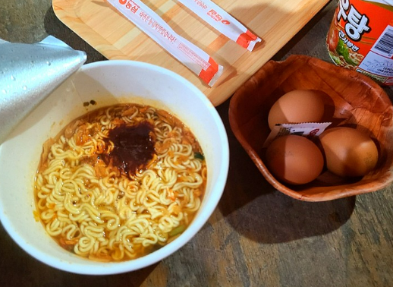
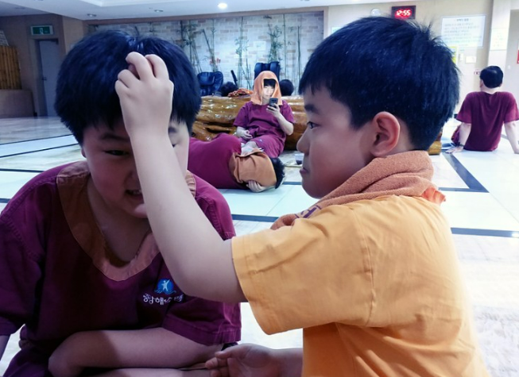
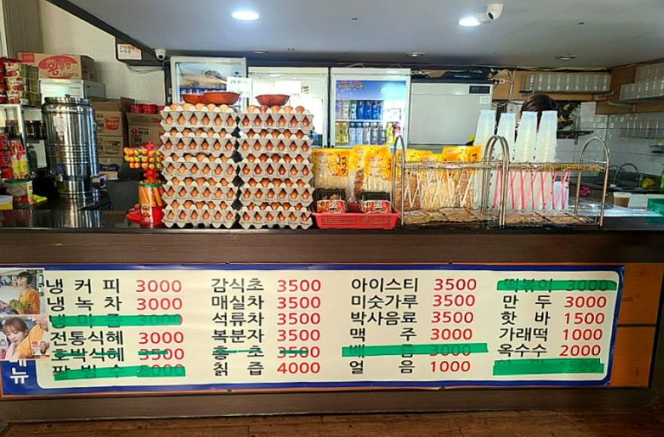
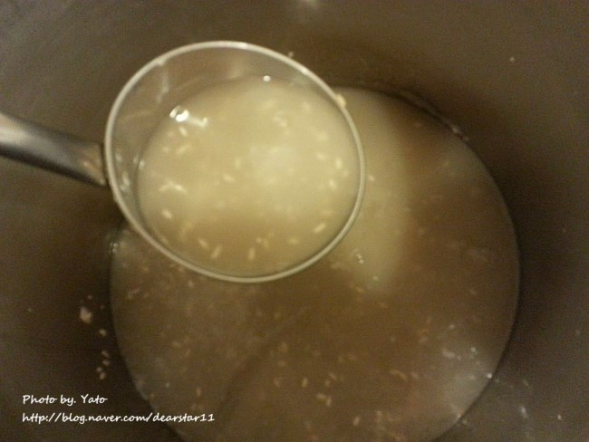
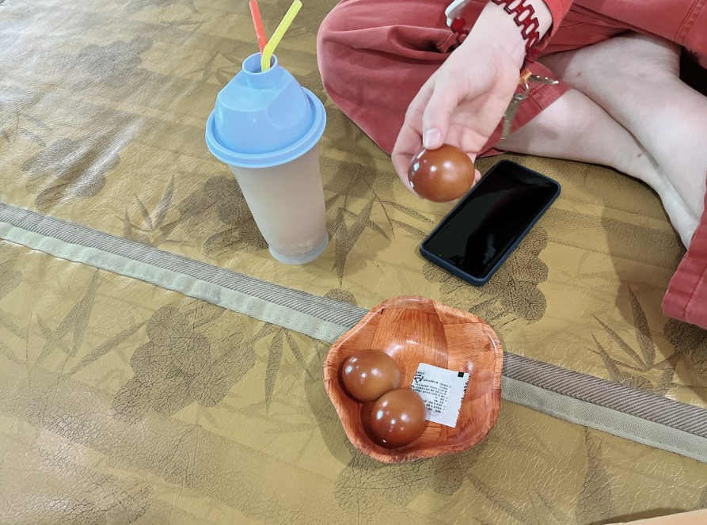
◀
▶
Korean culture – Unique places to go
Korean Sauna
1. 찜질방[jjim.jil.bang]
식혜->
계란->
Notes:
Smoky flavered egg.

Slide 17
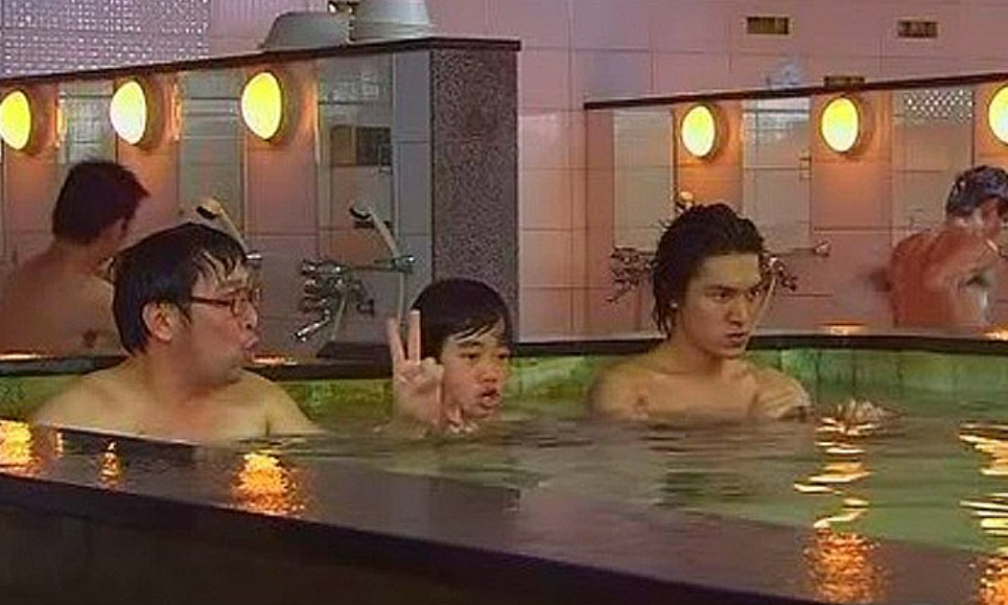
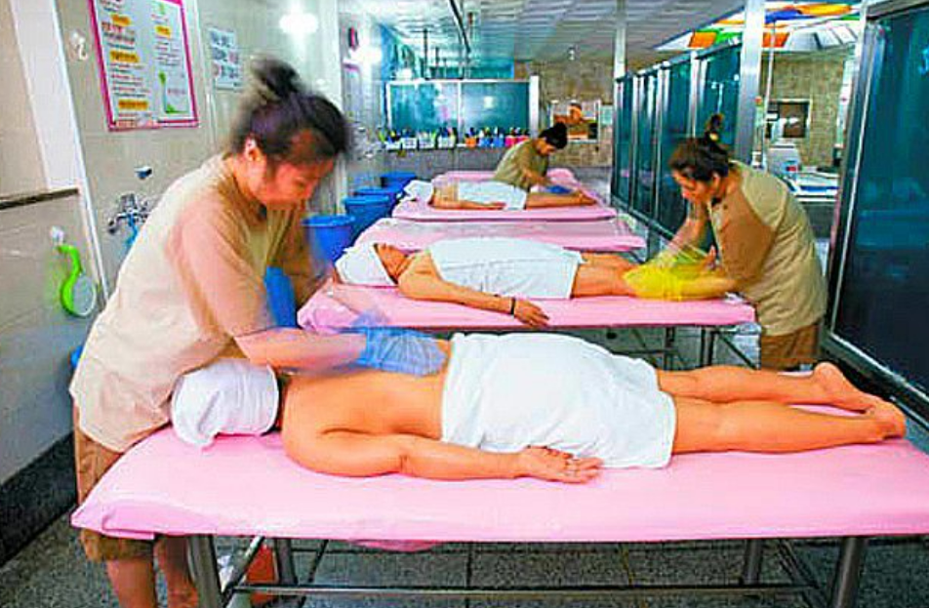
◀
▶
Korean culture
1. 찜질방[jjim.jil.bang]
Hot Tub & Scrubing Service

Slide 18
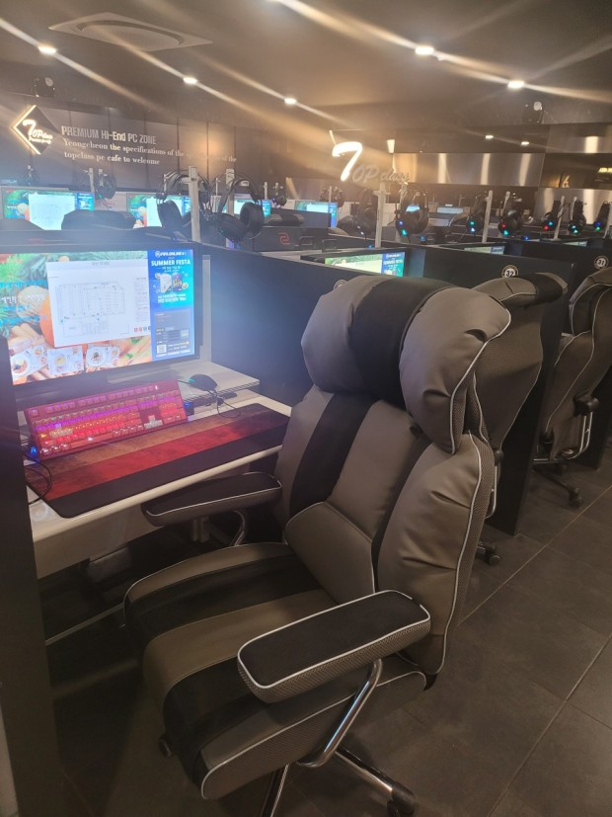
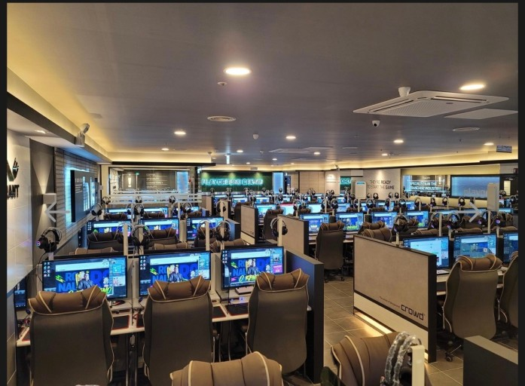
◀
▶
Korean culture
2. PC방
Big screen
Gaming keyboards
Comfortable chairs
Known for the place with the fastest computer
Most people visit this place to play games

Slide 19
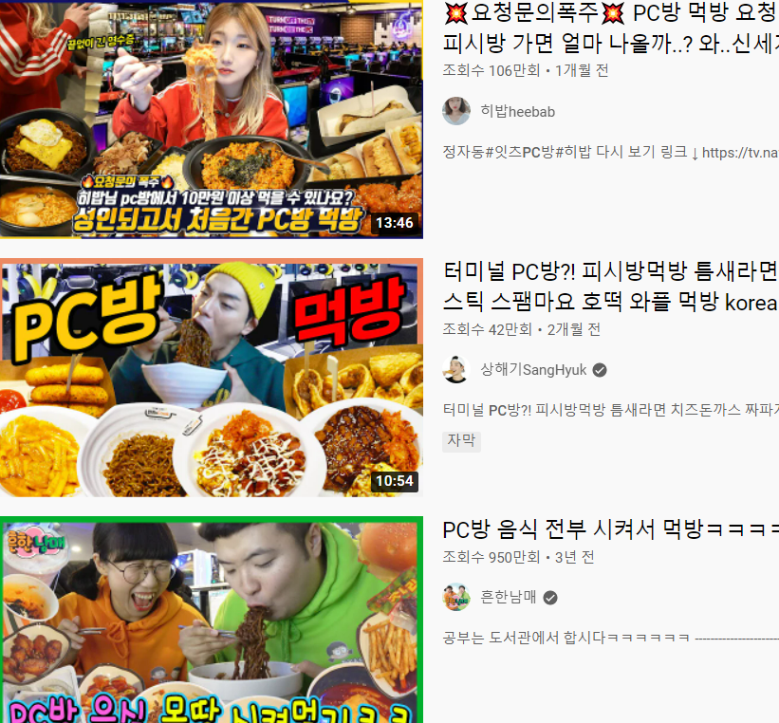
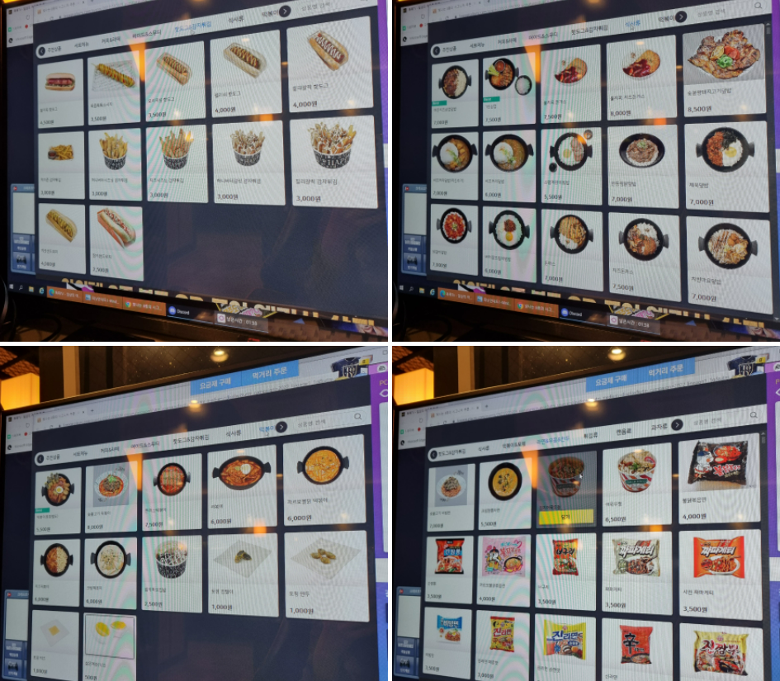
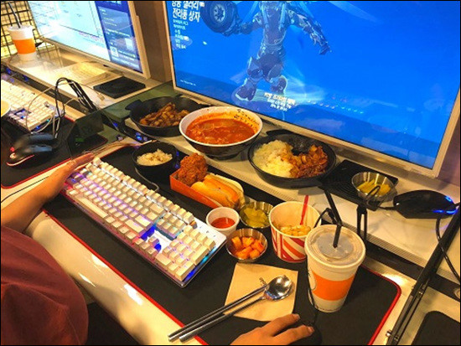
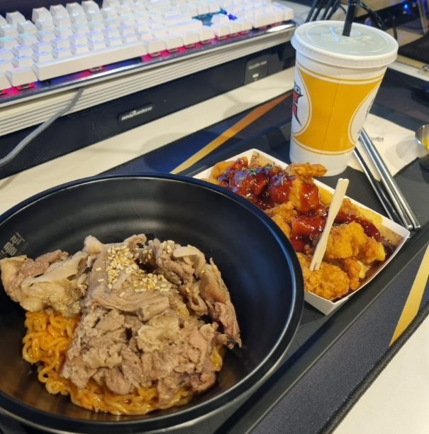
◀
▶
Korean culture
2. PC방

Slide 20
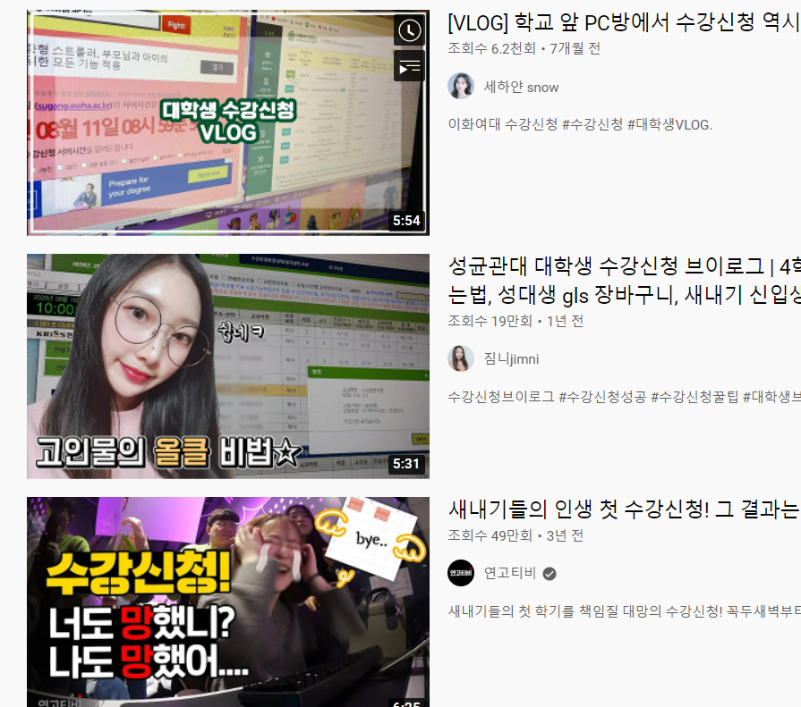
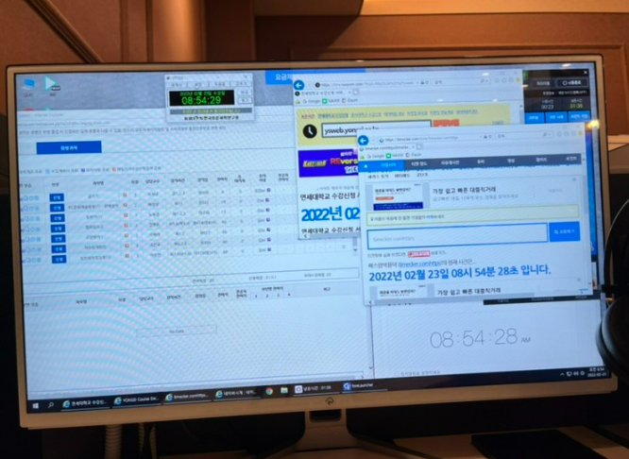
◀
▶
Korean culture
2. PC방
A lot of university students come to this place in the start of the semester to enroll in the course they want to attend.

Slide 21
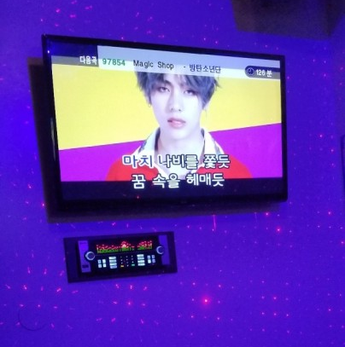
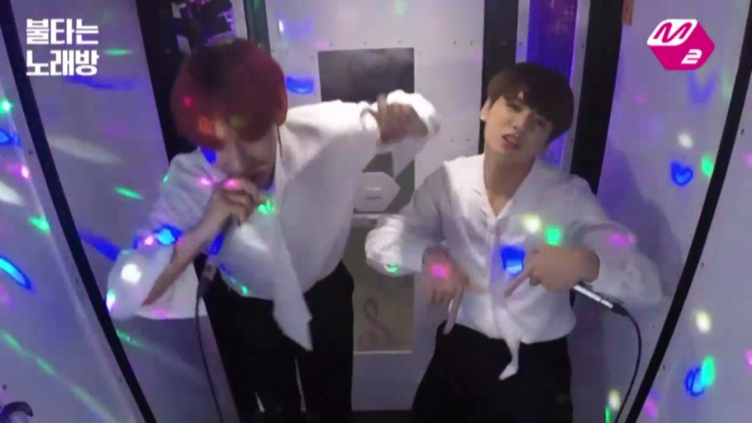
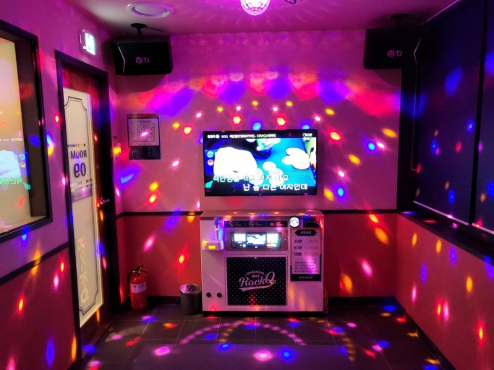
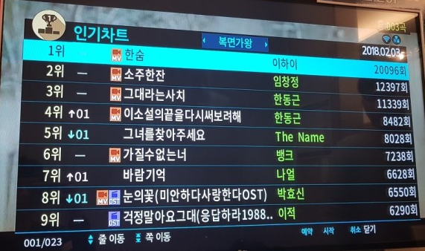
◀
▶
Korean culture
3. 노래방[no.lae.bang]
With friends, after drinking alcohol
Fee: 1hour= around 200~650czk / 2 song= around 10czk

Slide 22
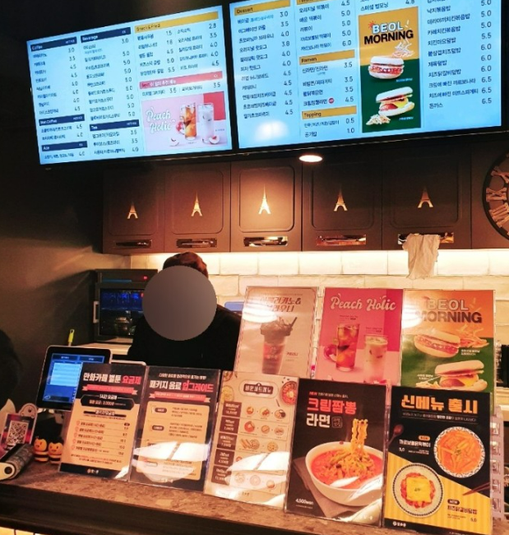
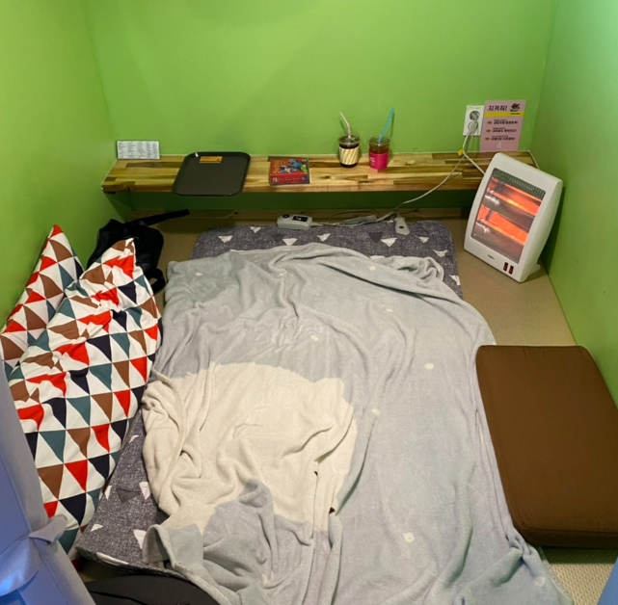
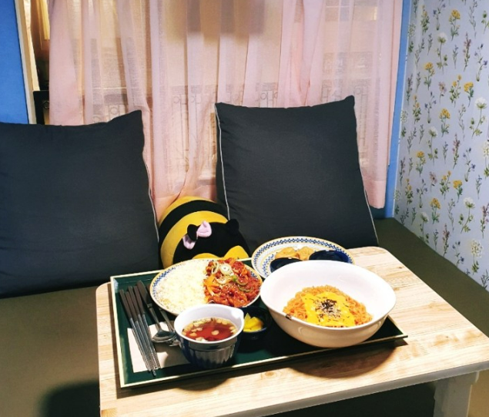
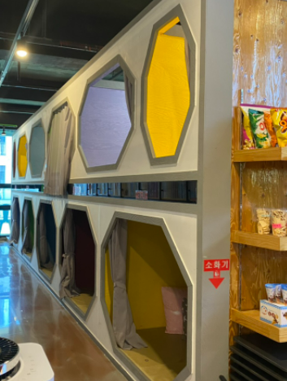
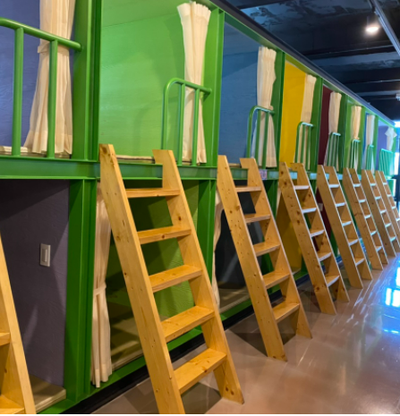
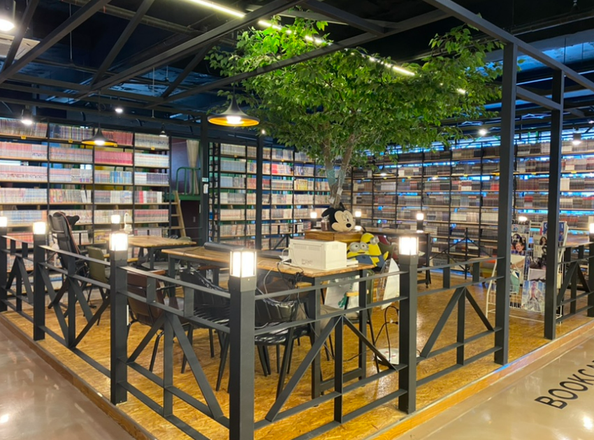
◀
▶
Korean culture
4. 만화카페[man.hwa.kape]
Fee
1h + drink = 100czk
2h + drink = 150czk
….
All day = 300czk

Slide 23
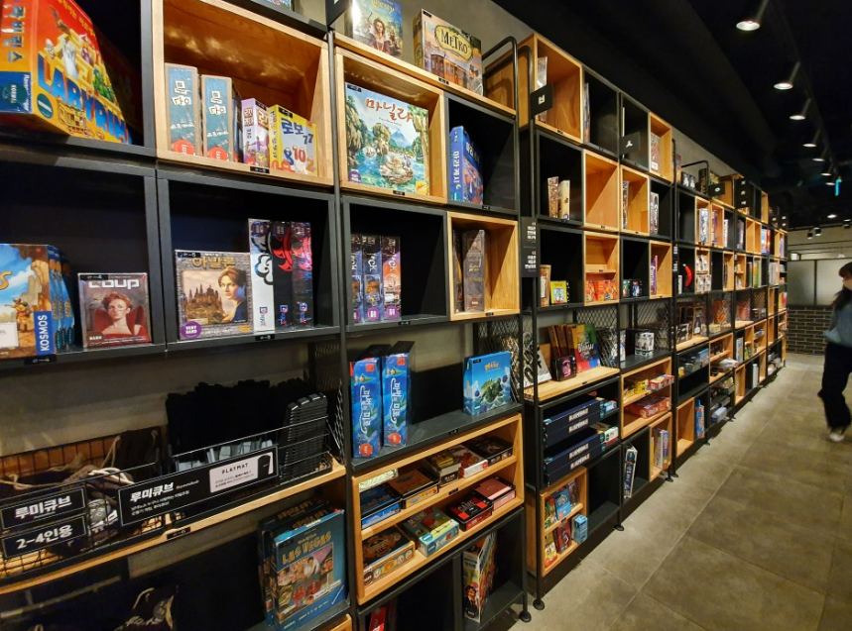
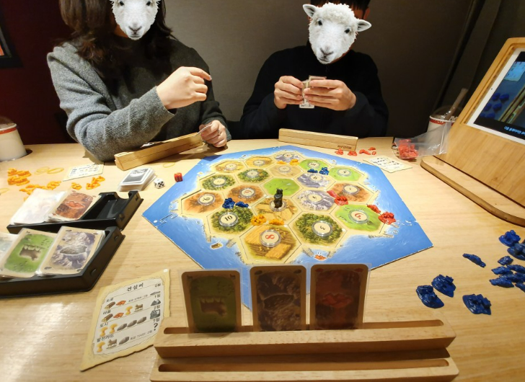
◀
▶
Korean culture
5. 보드게임 카페 = board game cafe

Slide 24
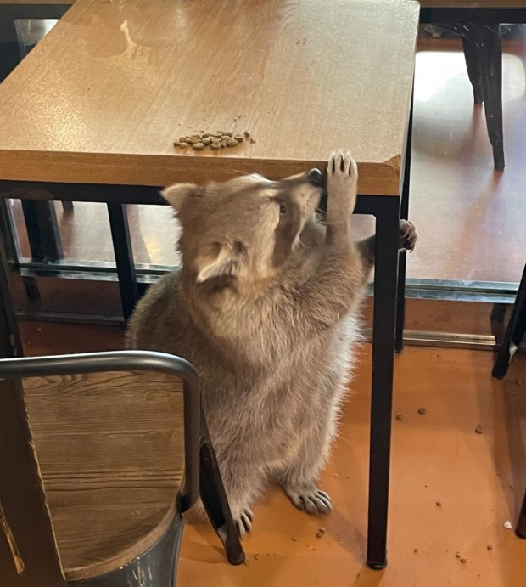
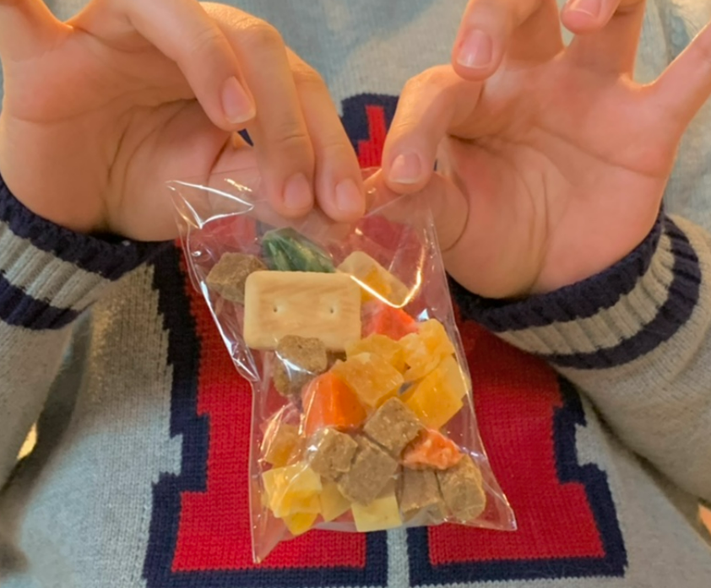
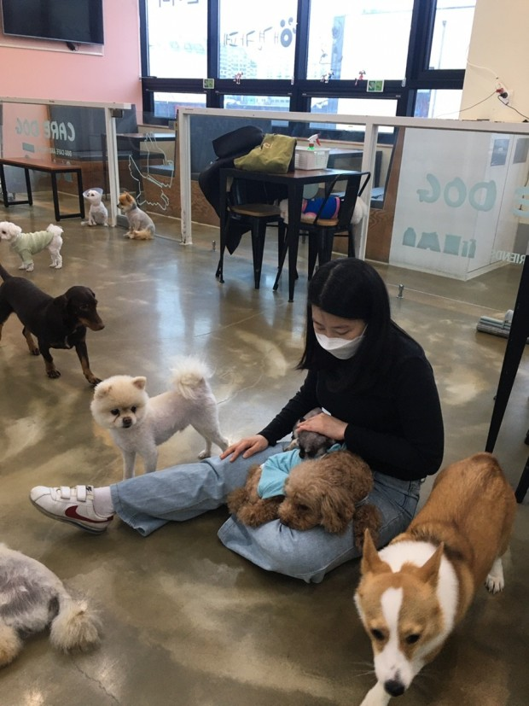
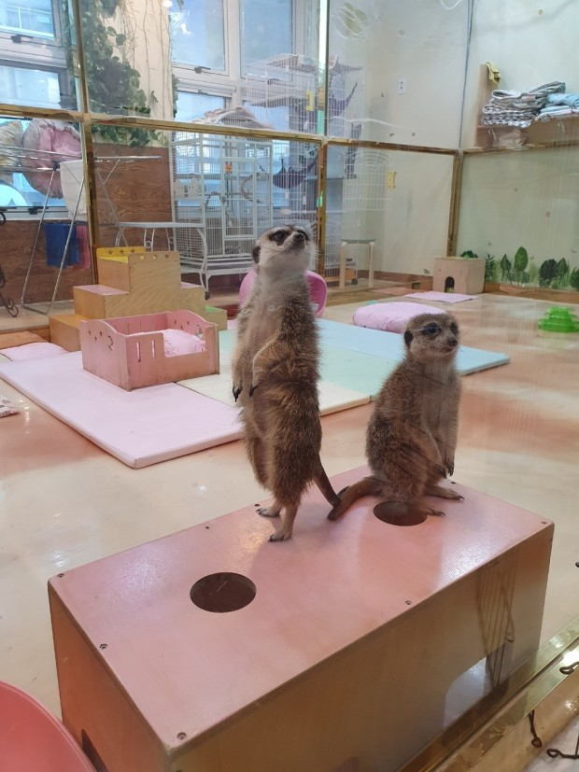
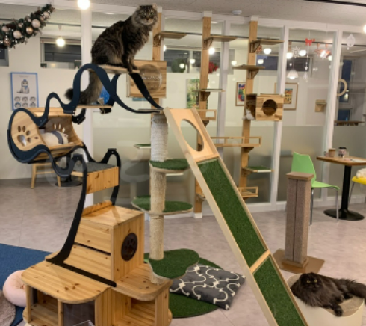
◀
▶
Korean culture
6. 동물 카페[dong.mul.kape]

Slide 25
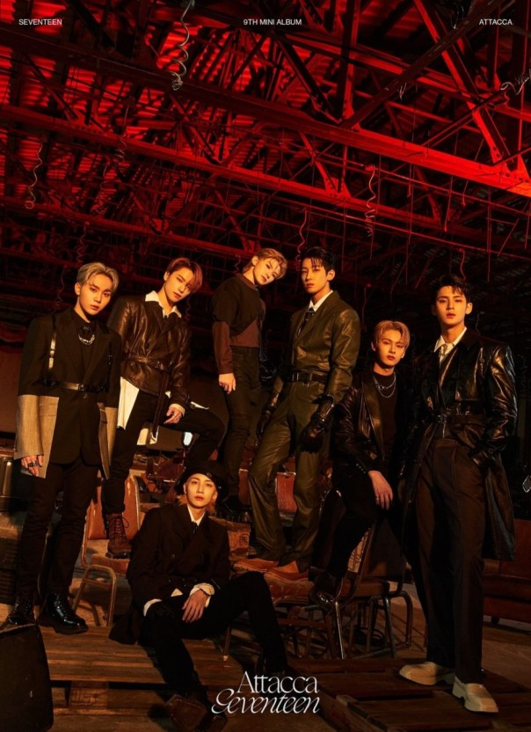
◀
▶
Today’s K-POP
Seventeen – Rock with you
SEVENTEEN (세븐틴) 'Rock with you' Official MV - YouTube

Slide 26
◀
▶
Thank you

