Slide 1
Korean 4 - week 3
Yery Kim

Slide 2
  Index
Grammar
Exercise
Today’s word

Slide 3
01
  Negation (부정문)
Using ‘안’ [an]
Using ‘못’ [mot]
It is used
1. Indicate that a certain action
does not occur
A certain state does not
3. Simply denies an objective fact
by the will of the subject to perform the action
It is used
Indicate that the ability for the subject's will is insufficient
Or it cannot happen due to other circumstances

Slide 4
01
  Negation (부정문)
Using ‘안’ [an]
Using ‘못’ [mot]
I didn’t meet him
나는 그를 안 만났다.
[naneun geuleul an man-natda]
I didn’t eat it
나는 그것을 안먹었다.
[naneun geugeos-eul an neog-eot da]
I couldn’t meet him
나는 그를 못 만났다.
[naneun geu-leul mot man-natda]
I couldn’t eat it.
나는 그것을 못 먹었다.
[naneun geugeos-eul mot meog-eot da]

Slide 5
01
  Negation (부정문) – ‘안’
There are mainly two ways to make “안” [an] negative sentence
1. Adding 안 [an] before a verb
2. Using the negative verb ending, -지 않다 [ ji an-ta]
Do not go → verb : 가다 + speech-level ending : -아요,어요 (Polite/Declarative) → 안 + 가요 = 안 가요
Exercise (speech-level ending is Intimate/Interrogative : 어/아)
1. do not eat (먹다)
2. do not drink (마시다)
3. do not learn (배우다)
→ 안 먹어?
→ 안 먹어?
→ 안 마셔?
→ 안 마셔?
*end with vowel “l” + 어 → ㅕ
*end with vowel “l” + 어 → ㅕ
→ 안 배워?
*end with vowel “ㅜ” + 어 → ㅝ

Slide 6
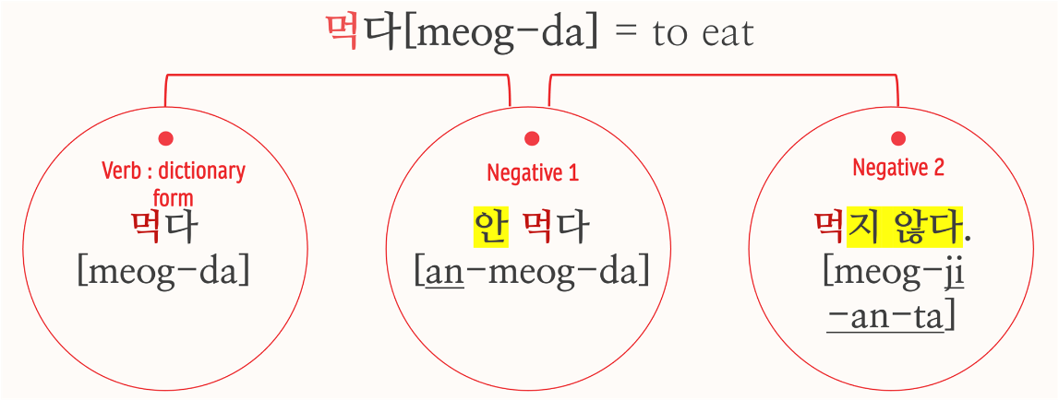
01
  Negation (부정문)
Verb

Slide 7
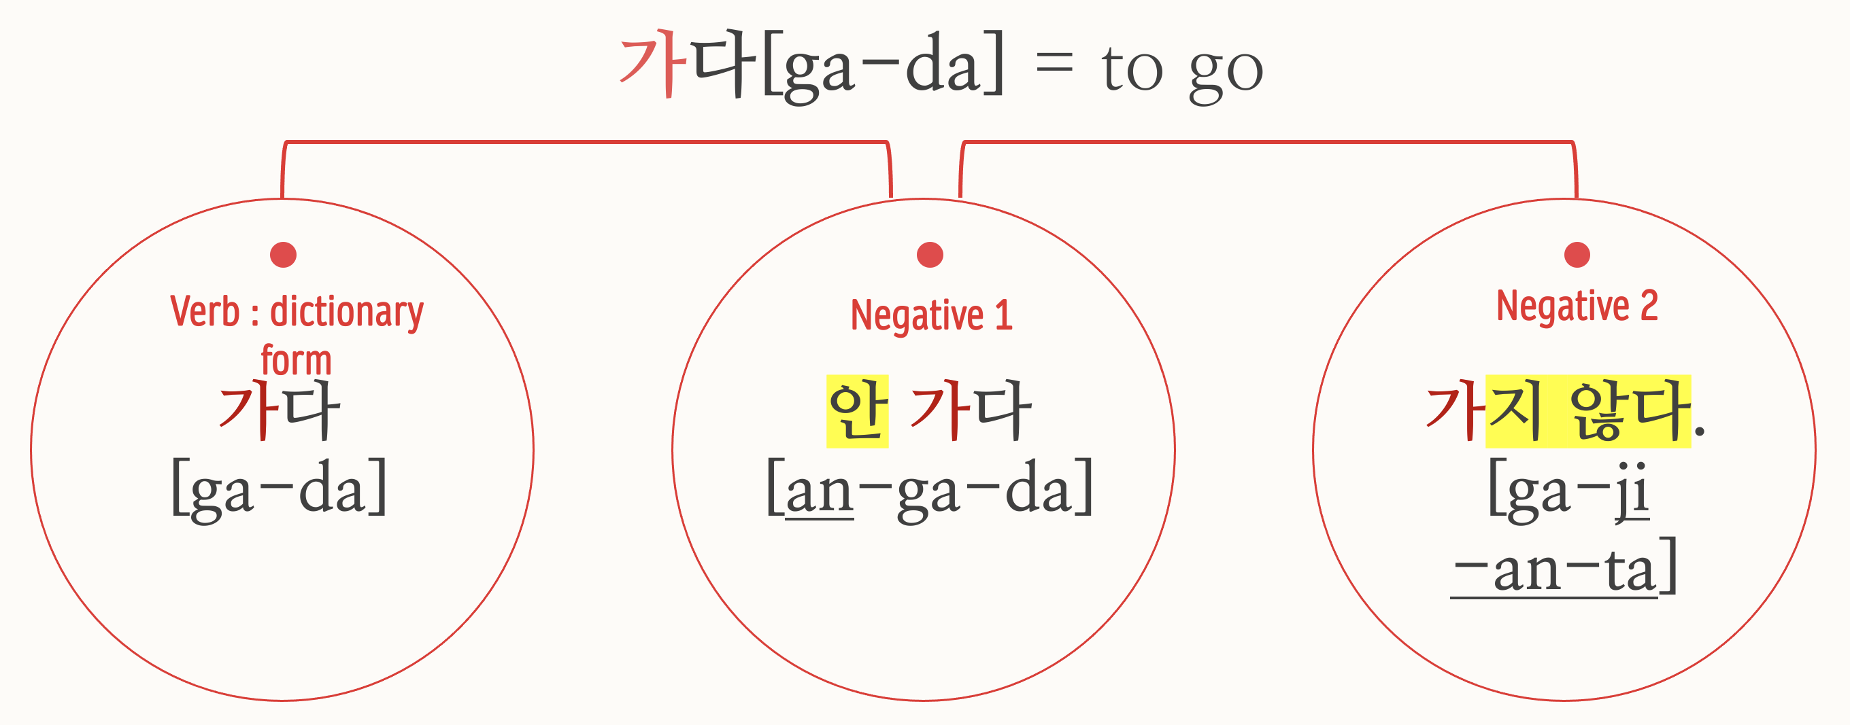
01
  Negation (부정문)
Verb

Slide 8
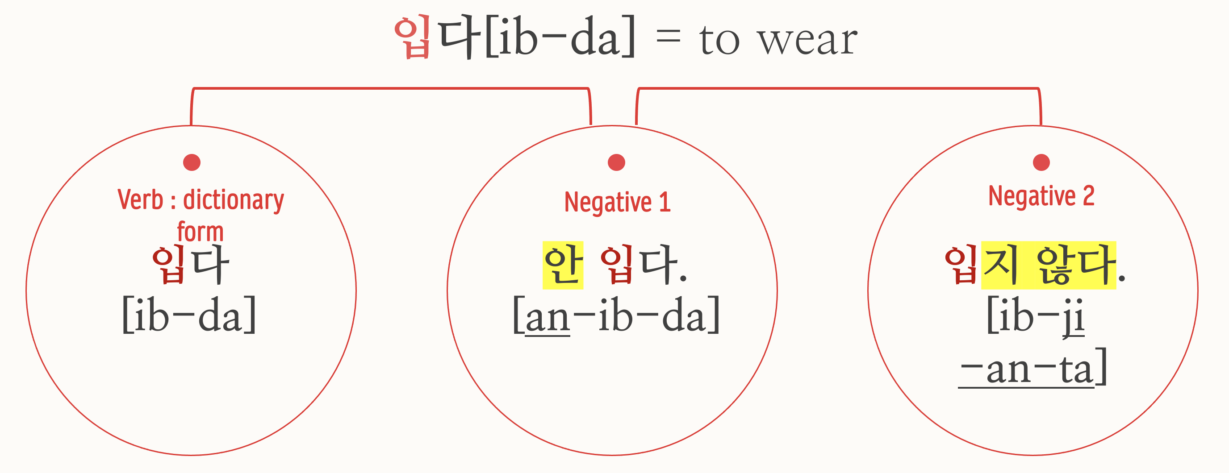
01
  Negation (부정문)
Verb

Slide 9
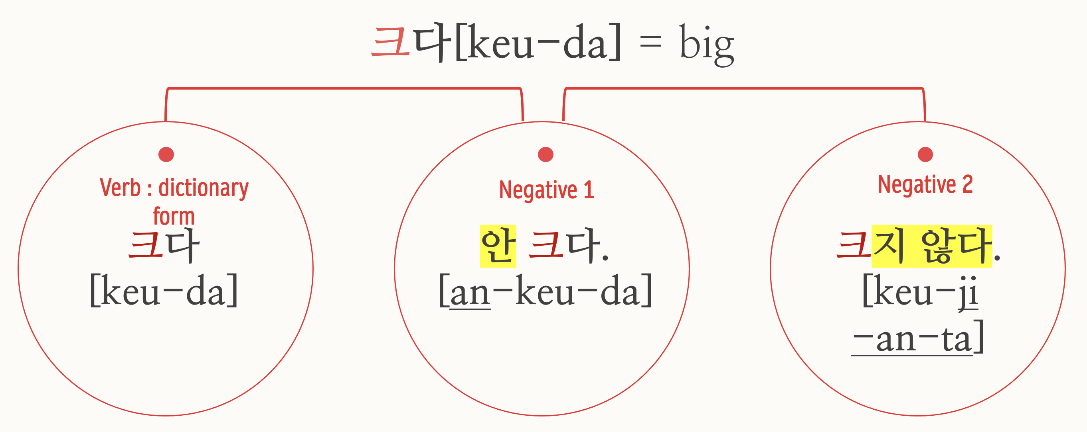
01
  Negation (부정문)
Adjective

Slide 10
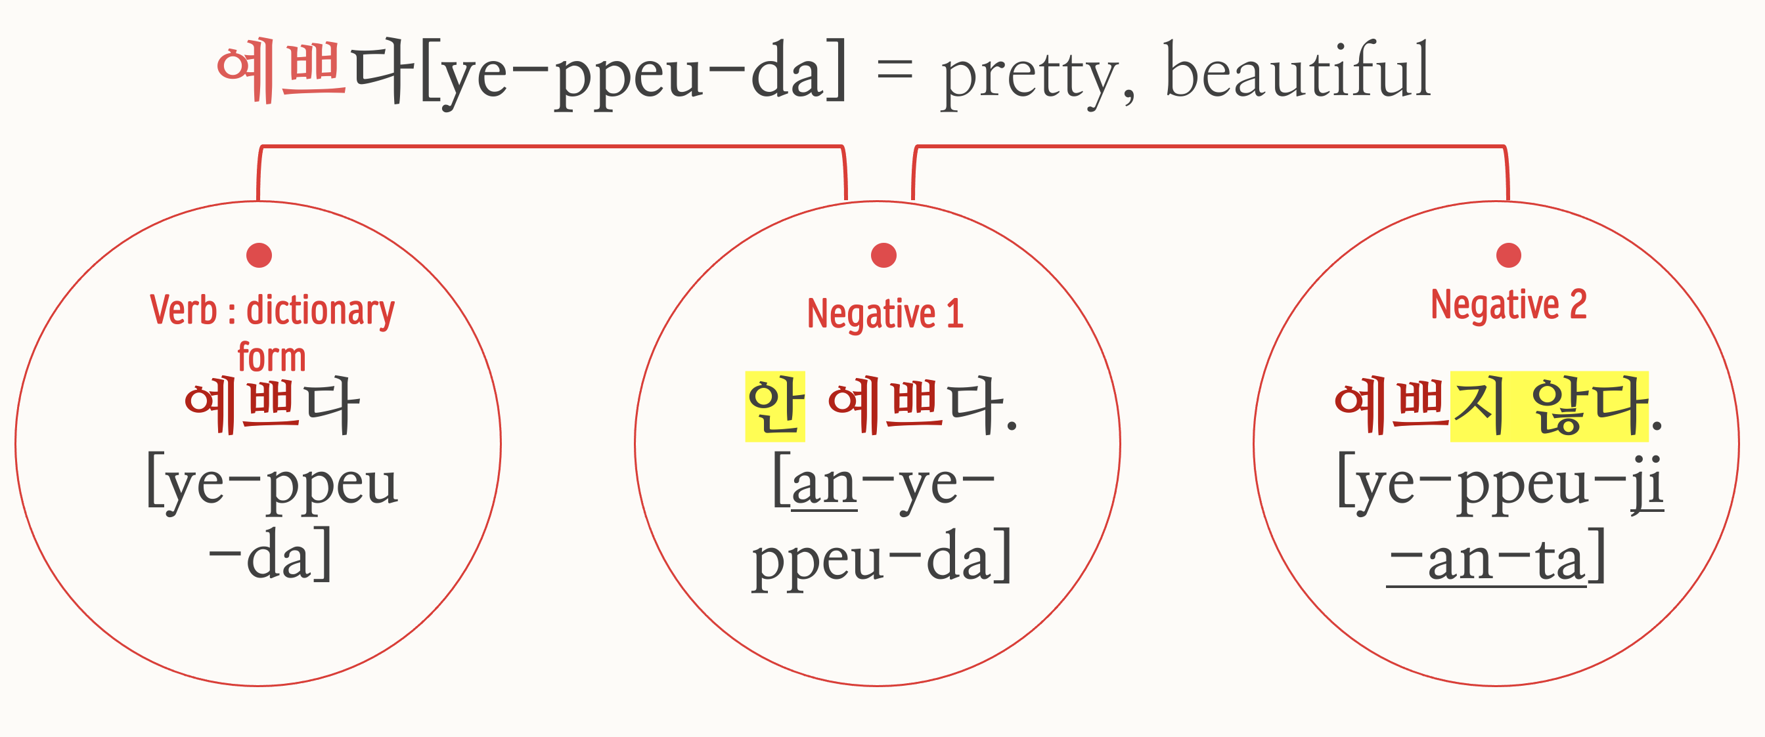
01
  Negation (부정문)
Adjective

Slide 11
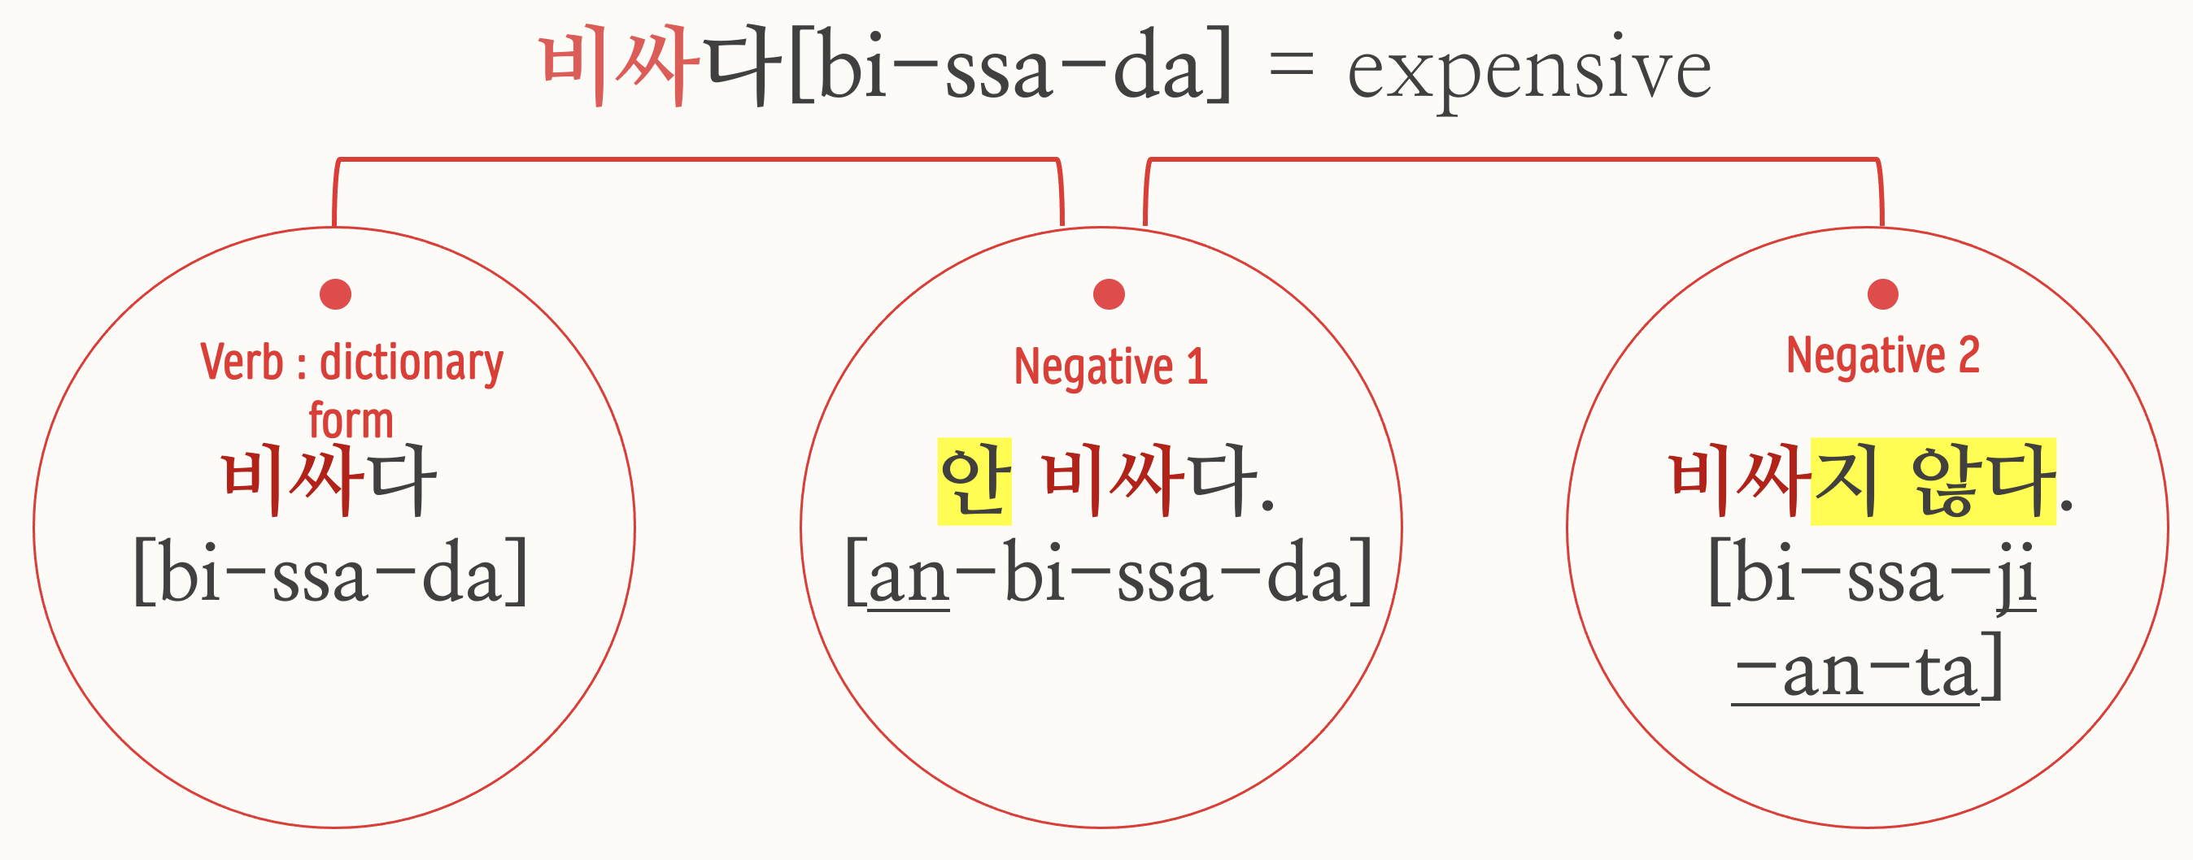
01
  Negation (부정문)
Adjective

Slide 12
01
  Negation (부정문) – ‘못’
There are mainly two ways to make “못” [mot] negative sentence
1. Adding 못 [mot] before a verb
2. Using the negative verb ending, -지 못하다 [ ji mot-hada]

Slide 13
01
  Negation (부정문) – ‘못’
Since the negative 못 refers to one’s ability or volition, it cannot be used with the adjectives which describe states or quantity
-못 높아요high (x) , 못 좁아요narrow (x), 못 많아요a lot (x), 못 적어요a few (x)
cannot make → verb: 만들다 + speech-level ending(Polite/Declarative) :
-아요,어요 → 못 + 만들어요 =못 만들어요
Exercise (speech-level ending (Polite/Declarative) : -아요,어요 )
1. cannot sell (팔다)
2. cannot sleep (자다)
3. cannot run (달리다)
→ 못 팔아요
*end with bright vowel “ㅏ,ㅗ＂→ 아요
→ 못 자요
→ 못 달려요
*end with vowel “l” + 어 → ㅕ

Slide 14
01
  Negation (부정문)
먹다 [meok-da] = eating
먹다
[meog-da]
못 먹다
[mot-meog-da]
먹지 못하다
[meogji-mot-hada]

Slide 15
01
  Negation (부정문)
보다 [boda] = see
보다
[boda]
못 보다
[mot boda]
보지 못하다
[boji mot hada]

Slide 16
01
  Negation (부정문)
Question 1.
Yeri had so many classes today that she wanted to eat (먹다), but she couldn’t
안[an] 먹었다
못[mot] 먹었다
Question 2.
Taeyong was able to go (가다) to school today, but he was too sleepy to go to school so he was absent.
안[an] 갔다
못[mot] 갔다
Question 3.
Namjun traveled to Poland by bus, but the person next to him was so loud that he couldn’t sleep (자다)
자지 않았다 [jaji-an-ta]
자지 못했다 [jaji-mot-haet da]

Slide 17
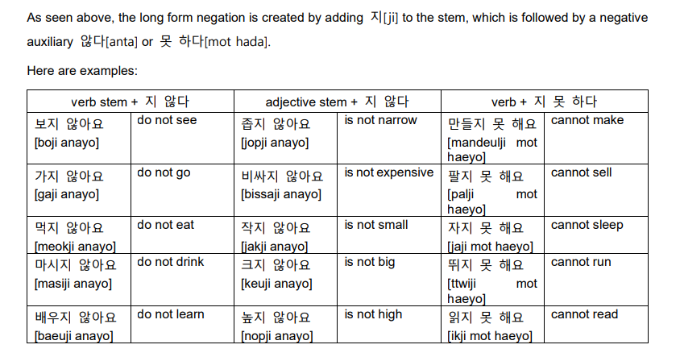
01
  Negation (부정문)

Slide 18
01
  Negation (부정문)-’말다’
For imperative and propositive sentences, the negative auxiliary verb 말다 is used instead
When you use 말다 into imperative or propositive, you have to notice that the stem 말 changes to 마 and 맙. This is due to the fact that 말다 is a ㄹ irregular verb
To conjugate ㄹ irregular verbs with endings starting with ㄴ,ㅂ,or ㅅ, ㄹ is dropped from the verb stem.
Consequently, the stem 말 loses ㄹ, as it is conjugated with the deferential imperative and propostive ending –십시오, and 십시다 (since the ending begins with ㅅ)
말다
→ 말다 + 십시오
→ 마십시오
→ 살다 + ㅂ시다
살다
→ 삽시다

Slide 19
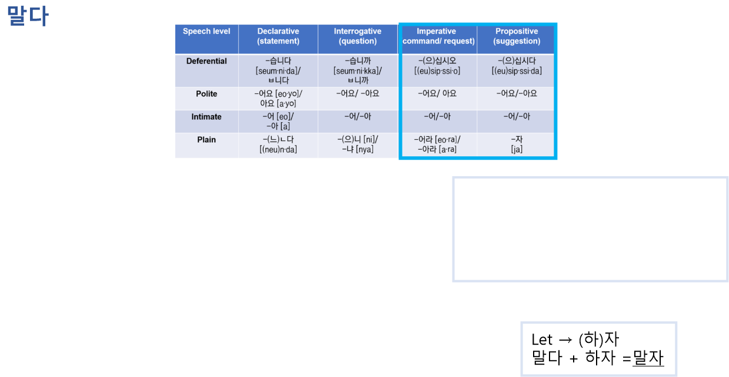
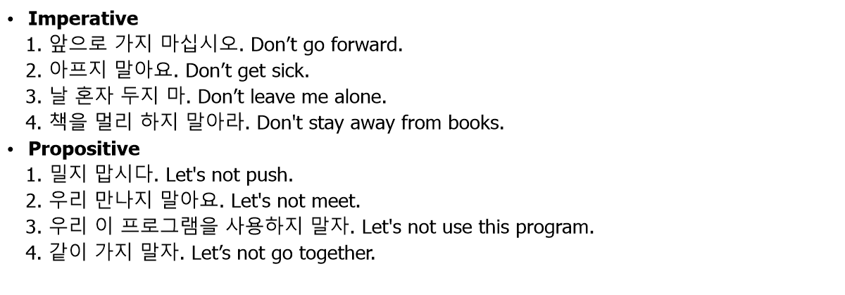
01
  Negation (부정문)
말 + connective ending = 말아
Ex. 비교하지 말아 주세요.
말 + sentence-closing ending =마(라)
Ex. 비교하지 마라
말아라 = 마라 = (마)

Slide 20
01
  Negation (부정문)
1.말다
-말을 하려다 말다. I was going to talk but I stopped.
-밥을 먹다 말다. I was eating but I stop.
2.말아요
-같은 주제를 사용하지 말아요. Don't use the same topic.
-뛰어 다니지 말아요. Don’t run.
3.맙시다
-자연을 훼손시키지 맙시다. Let's not destroy nature.
-술을 마시지 맙시다 Let's not drink.
4.마십시오/마십쇼
-잔디밭에 들어오지 마십시오. Don't come into the grass.
-동상을 만지지 마십시오. Don't touch the statue.
5.말아라/마라
-동생 때리지 말아라 Don't hit your younger brother.
-울지 마라. Don't cry.
-하다 말다 하지 말아라.
Don't do it over and over again.
-하지 말라고 하지 말아요.
Don't tell me not to do it.
-하지 말라는 행동만 골라서 하네.
You only choose what you're told not to do.

Slide 21
  Exercise
A: 교수님이 과제로 내주신 책 읽었어?
Did you read the book that the professor gave you for assignment?
B: ( ). 그걸 하루 안에 읽는 건 불가능 해.
No, I couldn’t read it. It's impossible to read it in one day.
A: 교수님은 무슨 생각으로 그런 어려운 책을 추천 해주신 걸까? 학생의 마음을 ( ).
Why did the professor recommend such a difficult book? It seems that professor can’t read the student's mind.
B: 우리 그냥 과제 ( ).
Let's just not do our homework.
A: 그래. 어차피 읽어도 ( ).
Yeah. I don't think I'll understand even if I read it anyway.
B: 좋은 학점 ( ).
I don't want to get a good grade.
아니 못 읽었어
*read 읽다
못 읽는 것 같아
*do 하다
하지 말자
*understand 이해하다
*I think ~것 같아
이해 못 할 것 같아
안 받을래
*get 받다

Slide 22
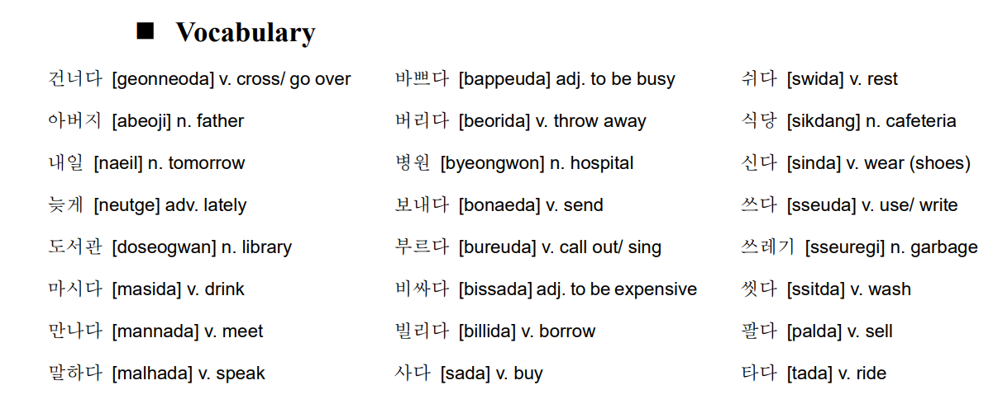
  Today’s word

Slide 23
Thank you
Yery Kim

