Slide 1
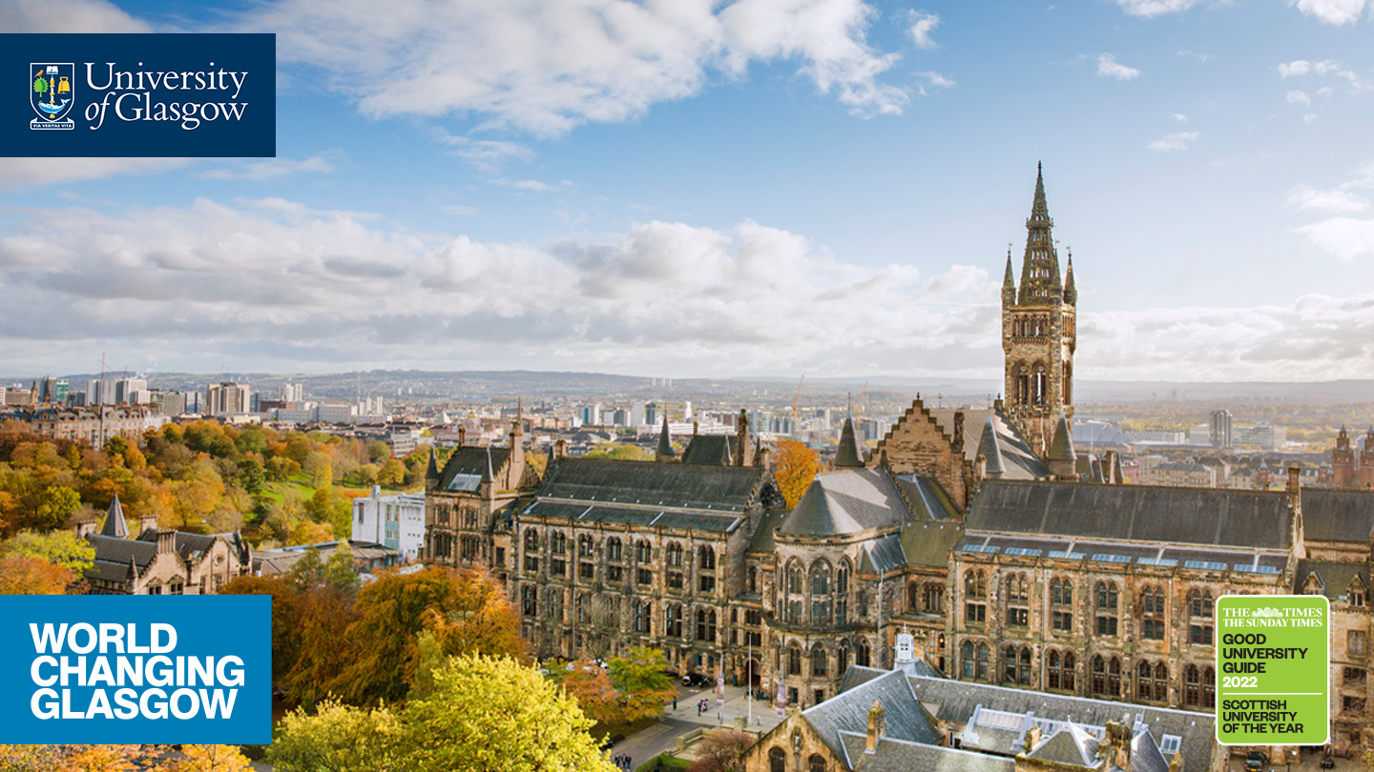
Contemporary Scottish Research
The Glaswegian Context
Nate Lindgren Haj Bakir

Slide 2
Glaswegian research
Seeing Speech project (2011-2019) UofG one of 6 universities
NOW: Perception of sung vowels and /s/ in transgender Glaswegians

Slide 3
Religion in (socio)phonetics
(London)Derry - McCafferty (2001) found no difference among Protestant and Catholic Northern Irish Christians
Alam’s (2015) on young South Asian Muslim Glaswegian women
  Community of Practice was statistically significant for /t/ and /i ʉ/
Then – why is the UK treating all South Asians as homogenous?
Do Punjabi heritage speaking Sikhs and Muslims speak identical Glaswegian?

Slide 4
Isolation, integration, and variation: a sociophonetic study on the role of religion in Sikh and Muslim Glaswegian
Glottals in three phonetic contexts
  Intervocalic e.g., Scottish
  Pre-vocalic word-boundary e.g., get a
  Pre-pausal e.g., that…
Young, second generation, male Glaswegians
Sikh or Muslim, with Punjabi spoken at home
Interview register

Slide 5

Examples (Sikh – Raj Singh from the Punjabi band Tigerstyle)
Intervocalic: both of us ended up joining the Scottish police force
Pre-vocalic: I’m trying [to] get a budget
Pre-pausal: there’s no way we could ever afford that… em

Slide 6
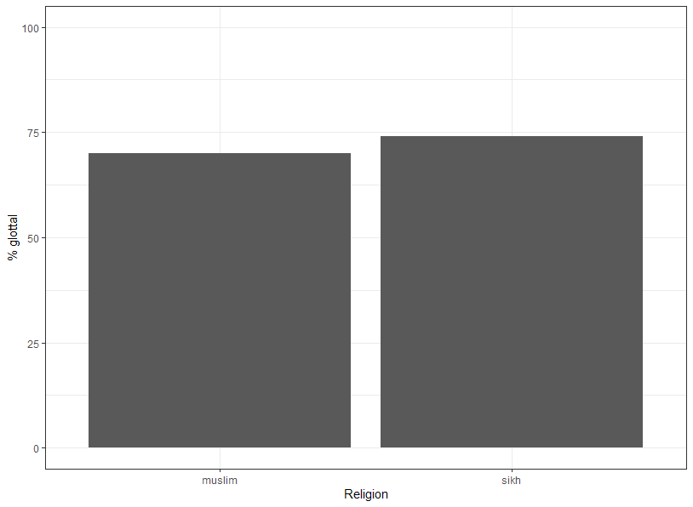
Findings

Slide 7
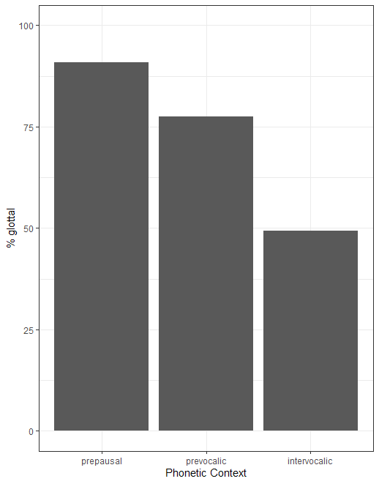
Findings

Slide 8
Findings
No significant difference in linguistic pattern or freq from each other!
Also – no difference in pattern or freq from white Glaswegians (Stuart-Smith 1999)
What it means:
  Overt variable
  Identify as Glaswegian
  Census data

Slide 9
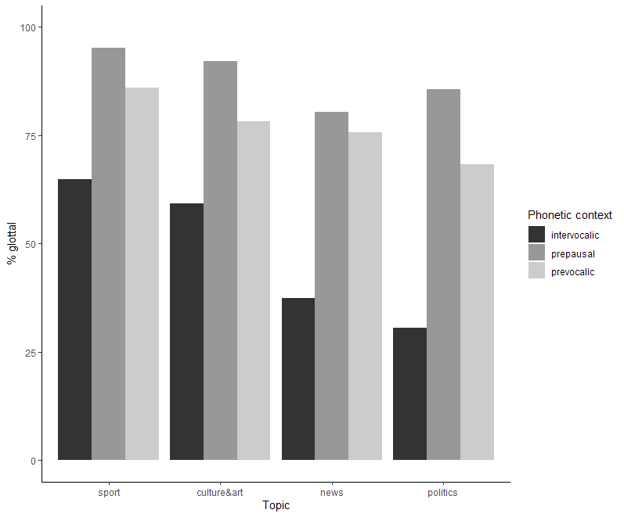
Findings
Formal topic caused over-correction compared to white Glaswegians at the same register (Schleef 2013)

Slide 10
Future research
Look at less overt features
  Retroflex /d t/ e.g., talk, do
  VOT in /p t k b d g/ (Punjabi has “true” voiced stops)
  Vowel quality e.g., FLEECE, BOOT, GOAT, FACE vowels
  Liquids /l r/
Broader participant pool
  Age – adolescent pre- or post-9/11
Spontaneous speech
In depth interviews

Slide 11
Bibliography
Alam, F. (2015) ‘Glaswasian?’ A Sociophonetic Analysis of Glasgow-Asian Accent and Identity. PhD Thesis, University of Glasgow.
McCafferty, K. (2001) Ethnicity in Language Change: English in (London)Derry Northern Ireland. Amsterdam: John Benjamins Publishing Company
Schleef, E. (2013) Glottal replacement of /t/ in two British capitals: effects of word frequency and morphological compositionality. Language Variation and Change, 25, pp. 201- 223.
Seeing Speech: https://www.seeingspeech.ac.uk/
Stuart-Smith, J. (1999) Glottals past and present: a study of T-glottalling in Glaswegian. Leeds Studies in English, 30, pp. 181-204.

Slide 12
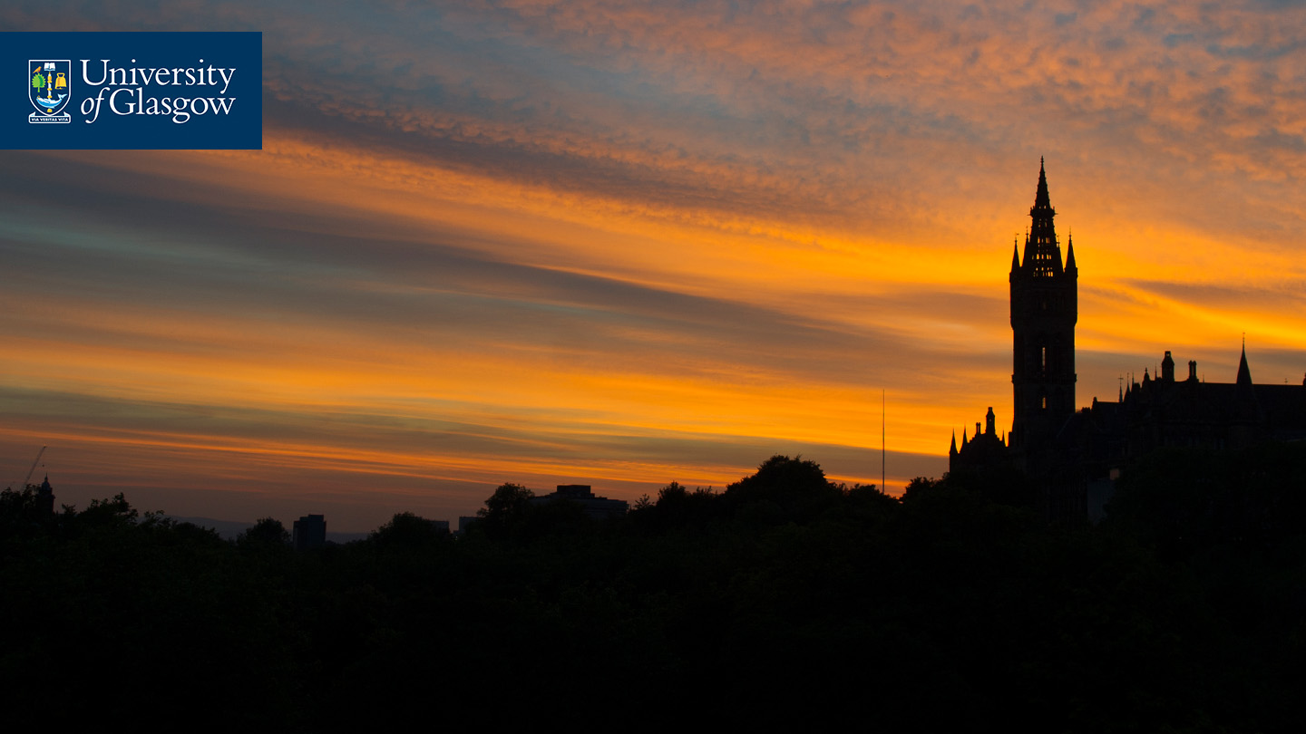


Thank you!
Nate Lindgren Haj Bakir
2298547L@student.gla.ac.uk
#UofGWorldChangers
@UofGlasgow

