Slide 1
How to speak Manc
Bc. Martina Ez-Zahrany

Slide 2
Today is gonna be the day that they're gonna throw it back to you
By now you shoulda, somehow, realised what you gotta do
I don't believe that anybody feels the way I do about you now
Who is the interpret?

Slide 3
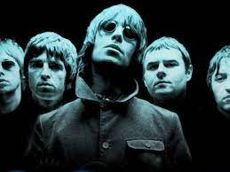
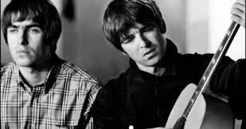
OASIS
Liam & Noel Gallagher
Manchester-born singers

Slide 4
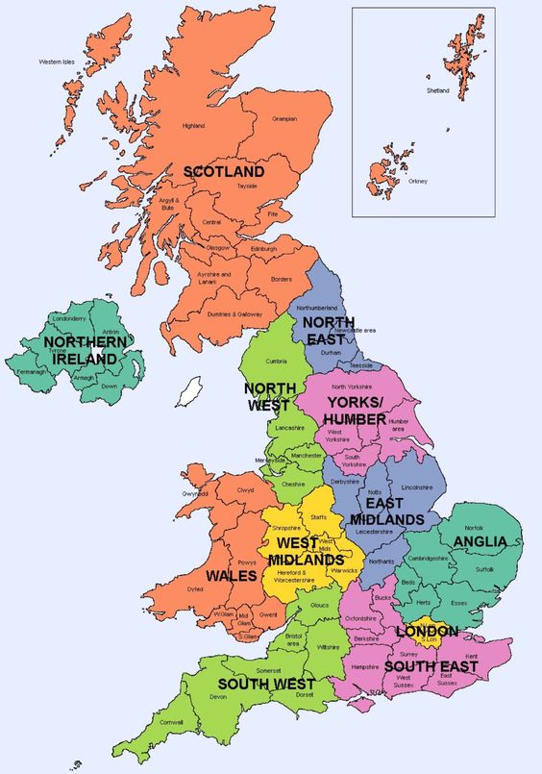
Manchester
North West England

Slide 5
Mancunian
BrE /mæŋˈkjuː.ni.ən/
Irregular demonym (= a term describing inhabitants of a particular place)
(compare: Liverpool – Liverpudlian, Glasgow – Glaswegian, Newcastle – Geordie, etc.)
N a person from Manchester in north-west England
Adj. from or connected with the city of Manchester in north-west England (e.g. M. singer)
Latin word for the area „Mancunium“

Slide 6
History
Roman fort Mamucium - AD 79
6th, 7th century - Northumbria
Britons, Angles, Danes
14th cent. – Flemish weavers
16th cent. – wool trade
Industrial Revolution – cotton-mills, cotton import
Transport – Bridgewater Canal 1761, Liverpool and Manchester Railway 1830

Slide 7
History
'Cottonopolis' – population explosion – Irish 15% in 1851, Scottish 2% in 1871, Welsh
Jewish immigrants from Central and Eastern Europe
Germans, Italians
Manchester Ship Canal 1894 – workers from Africa, Asia, Middle East, Scandinavia
Chinatown – second in the UK, third largest in Europe
Asian community

Slide 8
North vs South
Great Vowel Shift – North less affected
Foot x strut split (South)
/ʌ/ x /ʊ/ as in butter, up
/ɑ:/ x /a/ as in bath, grass, laugh

Slide 9
Middle North (Wells) – densely populated industrial belt, Manchester, Huddersfield, Bradford, Leeds, Sheffield – typical northern accents
Geographically very close to Liverpool, but markedly different accent; much more similar to Lancashire and southern Yorkshire (Trudgill)

Slide 10
Manc x RP (vowels)
No /ʌ/ vowel
/u:/ in book, look, cook
No /a:/ vowel
Nasality (twang)
Final –y (in words like really) realised as /e/ instead of RP /i:/

Slide 11
Manc x RP (consonants)
T-glottalization /ʔ/ as in get out of, alright
Final /ŋ/ as in thing, long realised as /ŋg/
H-dropping word initial as in hand /ænd/
Th-fronting – three=free (homophones)
Non-rhotic in comparison to some other accents in the same area

Slide 12
Grammatical features
RP: I was sitting x Manc: I was stood
RP: I was, he/she was x Manc: I were, he/she were
Tag: innit
RP: You have written/He has taken x Manc: You have wrote/He has took

Slide 13
Manc slang
Rhyming slang (compare to Cockney)
Newton Heath = teeth
Salford Docks = socks
Kahoot
Manc slang in a poem (by Manc poet Argh Kid)
https://www.manchestereveningnews.co.uk/news/greater-manchester-news/argh-kid-national-poetry-day-11991211

Slide 14
Where can you hear/listen to Manc?
Coronation Street (soap opera)
Shameless (comedy)
Life on Mars (BBC crime drama)
Ideal (BBC sitcom)
VOQUENT – database of voices, voice actors according to accents
https://www.voquent.com/voice-actors/find/?search=search&search=Search&uniqueAccent[]=1117&free-text=&voice-id-input=&&pagenum=1
YT:
Learn Liam Gallagher‘s Mancunian Accent (Eat Sleep Dream English)
https://www.youtube.com/watch?v=ibTUQHkBiWM&ab_channel=EatSleepDreamEnglish
746. Karl Pilkington‘s 3-Minute Wonders / Manchester Accent (Luke‘s English Podcast)
https://www.youtube.com/watch?v=L-EHQSbAXRk&ab_channel=Luke%27sEnglishPodcast
Lancashire vs Yorkshire Accent, Culture, and Making Tea (English Like a Native)
https://www.youtube.com/watch?v=CEyulxp8up0&ab_channel=EnglishLikeANative

Slide 15
Sources:
https://www.mmu.ac.uk/news-and-events/news/story/?id=3687
https://www.theguardian.com/uk-news/2021/oct/01/ya-cheekeh-monkeh-recording-manchester-accent-diversity
https://www.bl.uk/collection-items/manchester-accent-stan-and-vera-working-life-before-world-war-two
https://www.dynamicdialects.ac.uk/accent-map/
https://tvtropes.org/pmwiki/pmwiki.php/UsefulNotes/BritishAccents
https://www.atlasobscura.com/articles/demonyms-linguistics-nicknames
https://lagb-education.org/wp-content/uploads/2016/01/manchester.pdf
http://usir.salford.ac.uk/id/eprint/37766/1/Howley_2015_PhDThesis.pdf
Wells, J.C. Accents of English 2. The British Isles
Trudgill, P. The Dialects of England
Hughes, A., Trudgill, P., Watt, D. English Accents & Dialects

Slide 16
Thank you for your attention!

