Slide 1
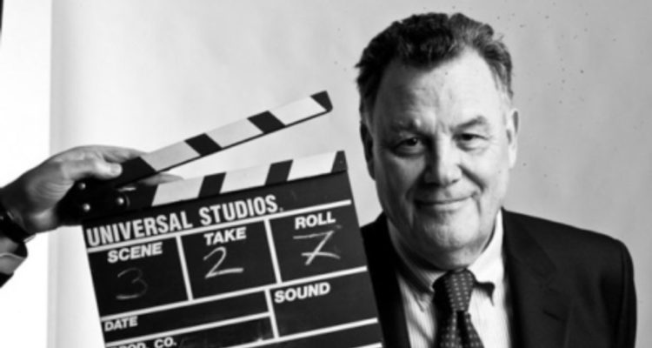
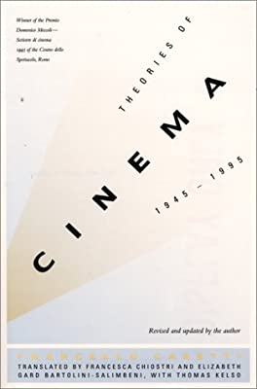
Francesco Casetti: Theories of Cinema 1945-1995
https://books.google.cz/books?id=H2UnUmWnHmEC&pg=PP9&hl=cs&source=gbs_selected_pages&cad=3#v=onepage&q&f=false

Slide 2

Edward Branigan – Warren Buckland (eds.), The Routledge Encyclopedia of film theory
https://www.routledge.com/The-Routledge-Encyclopedia-of-Film-Theory/Branigan-Buckland/p/book/9781138849150

Slide 3
Postwar theories
„theories“ till 1945 – Béla Balázs; Siegfried Kracauer; Rudolf Arnheim; Soviet, French and German avant-garde…: see the course History of Central European Culture + lectures on realism, soviet montage, and modernity
Continuity: from pre-war to post-war theories: valorization of cinema´s realistic dimension
Discontinuity:
1/ acceptance of cinema as a cultural fact (not a „new medium“ anymore); „Filmology“ movement since 1947
2/ scholarly background, expertise --- specialization – theorethical language, jargon (not only technical terms)
3/ separation between theory and practice
4/ internationalization of the debate

Slide 4
paradigms
Ontological theories: André Bazin: „What is Cinema?“; essence; realistic theories (Siegfried Kracauer, André Bazin); language (Jean Mitry)
Methodological theories: from which standpoint cinema should be studied? What is pertinent? Semiotics; Sociology; Psychology; Psychoanalysis…; analysis – knowledge – data collection – experts – correctness (not „truth“)
Field theories: which problems does cinema give rise to? Neither essence nor pertinence, but a „problem“; induction; questions such as: questioning cinema´s modes of representation (feminist film theory; Bellour; Bordwell); analysing audiences´ positions (Odin; theory of enunciation); questioning political validity of cinema (Screen theory of the 1970s)

Slide 5
Preliminary programme
Cinema and Modernity
Soviet montage and the case of Dziga Vertov
Film Realism and Neo-Realism
Auteur Theory
Semiotics and Cinema
Cognitivism and Cinema
Post-Semiotics
READING WEEK
Production Studies: John T. Caldwell
Film and Sociology: Theory of Field
Film and Sociology: Art Worlds

Slide 6
Homework for the next Tuesday
500 words long essay: which theoretical concept from the field of film studies you would like to learn about, and why; how film theory could be helpful for you (for your diploma thesis, research project, etc.); what is your favorite concept in film theory, and why.
Essays - delivered to the folder in IS untill Sunday

Slide 7
System of evaluation
Presentation: ca 7 minutes; explanation of the main arguments in the assigned reading, ONCE IN THE SEMESTER - 25%
Reading carts: 1 page (1.800 signs)-long resume of the main argument in the paper assigned for reading, WEEKLY – 25%
Research project – application of a concept: 4-5 pages (7.200-9.000 signs) – brief proposals discussed at the last lecture; final project delivered before the oral exam
Oral exam – knowledge of the lectures and readings (30%) + discussion over the project (20%)
60% - minimum for passing the course

Slide 8
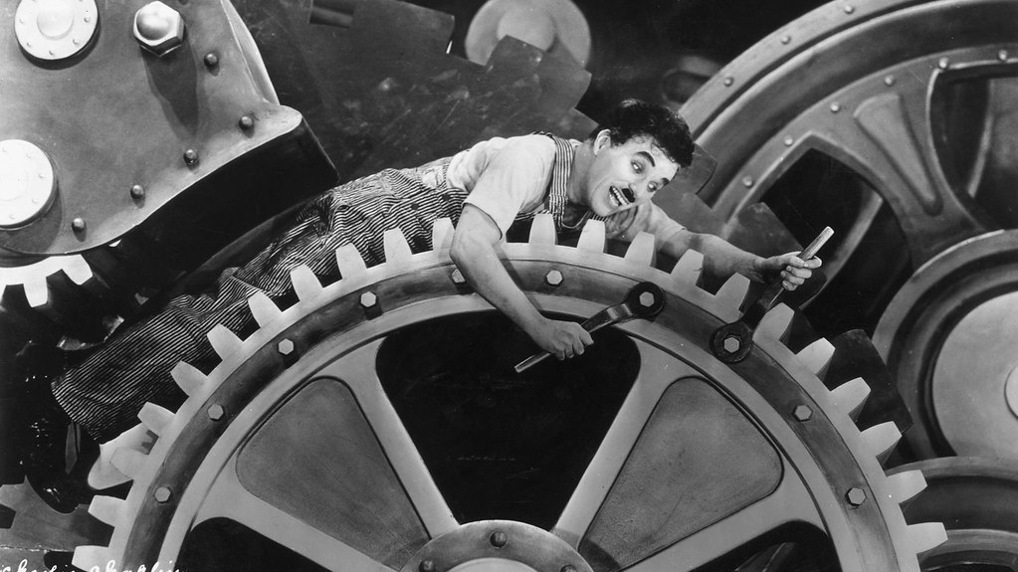
Cinema and modernity

Slide 9
jazz
https://www.kouricikralik.cz/
http://www.starapekarna.cz/s/jazz-blues-brno-2023
https://www.metromusic.cz/
https://www.alterna.cz/
https://www.sonomusicclub.cz/
https://www.cabaretdespeches.com/
https://www.jazzfestbrno.cz/en/program-2023-2/

Slide 10
Editing, cinematography, filmamkers´ choices – historical poetics; - Analysis of Audiovisual Form, CMAa04; Art Worlds
Film as reproduction of reality
Realism; realistic style; ethical dimension of realism
Sociology of cinema production – John Caldwell, production studies
Theory and history of film reception – CMAa05 Intro to communication studies + CMAa14 – Resarch in Cinema and Theatre History
Auteurism
Structuralism and/or/counter Auteur theory
Celebrities – History of Central European Culture III
Anthropological research; film as a document
Animation
Documentary film and indexicality

Slide 11
Introduction to Media and Communication Studies
1 Communication and media studies: basic definition
2 Communication: basic definition, types of communication
3 Communication models
4 Media organizations and economic conditions of media functioning
5 Media Content Creators
6 Communication, meaning, signification, sign models
7 Reading week
8 Visual Culture
9 Communication, Signs and Codes
10 Politics of representation
11 Ideology, hegemony
12 Effects of the media on the audience
13 Research of audiences and receptions

Slide 12
1/ what is „modernity“?
2/ did cinema (and photography) speed-up modernity?
3/ How modernity influenced social conditions (and human senses)?
4/ How were these modernity effects represented in media?
5/ how cinema was believed to help people to adapt for modernity?
6/ how – and why - modernity can be represented in films?

Slide 13
1/ What is „modernity“?
From around 1880 to the end of World War I, these decades saw the most profound explosion of industrialization, urbanization, migration, transportation, economic rationalization, bureaucratization, mass communication, mass amusement, and mass consumerism
The second industrial revolution
Modernity – Wikipedia
https://en.wikipedia.org/wiki/Second_Industrial_Revolution
rapid urbanization and population growth
extensive migration and emigration
the rise of the nation-state
the establishment of stable and predictable legal codes and institutions
the explosion of forms of mass communications and mass amusements as well as mass merchandising and consumerism
the expansion of heterosocial public circulation and interaction (epitomized by the entrance of women into public space)
the separation of workplace and household, shifting of the primary unit of production from the extended family to the factory
the decline of the large extended family due to urbanization and emigration as people moved to follow jobs outside the household

Slide 14
Rationality
(calculation of means for achieving clearly defined goles; instrumental reason)
Mobility and Circulation
(Modern transportation and communications technologies exploded traditional relationships between time and space)
Sensory Complexity and Intensity

Slide 15
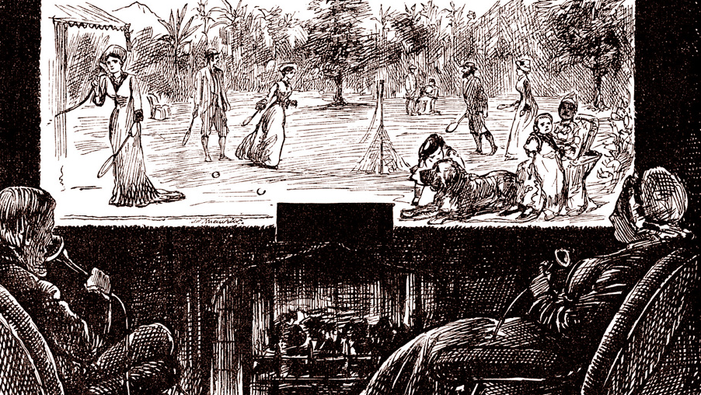
Telephonoscope, 1878 https://en.wikipedia.org/wiki/Telephonoscope

Slide 16
2/ Did cinema (and photography) speed-up modernity?

Slide 17
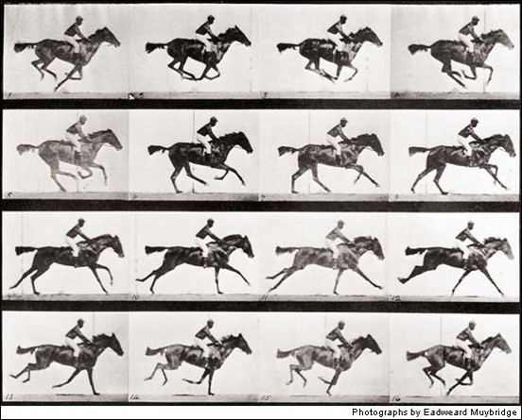
Film and photography as components of modernity
Eadweard Muybridge, O Zoopraxógrafo (1975) Zoopraxographer - Legendado : Vintage Movie : Free Download, Borrow, and Streaming : Internet Archive
Thom Andersen, 1975, UCLA

Slide 18
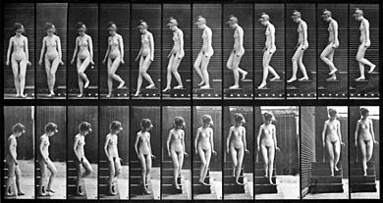
E. Muybridge: The Human Figure in Motion (1907)

Slide 19
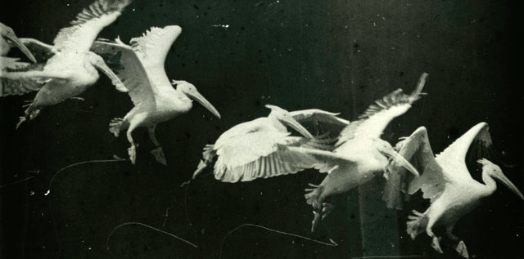
photographic gun
Physiologist Étiene-Jules Marey (1830–1904), France
1882 – photographic gun

Slide 20
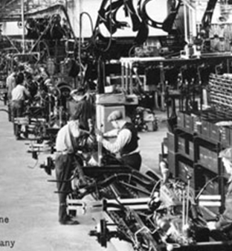
Muybridge – chronophotography – assembly lines in Philadelphia.
Henry Ford: analysis of movement for assembly lines; 1913 – film department (educational movies).

Slide 21
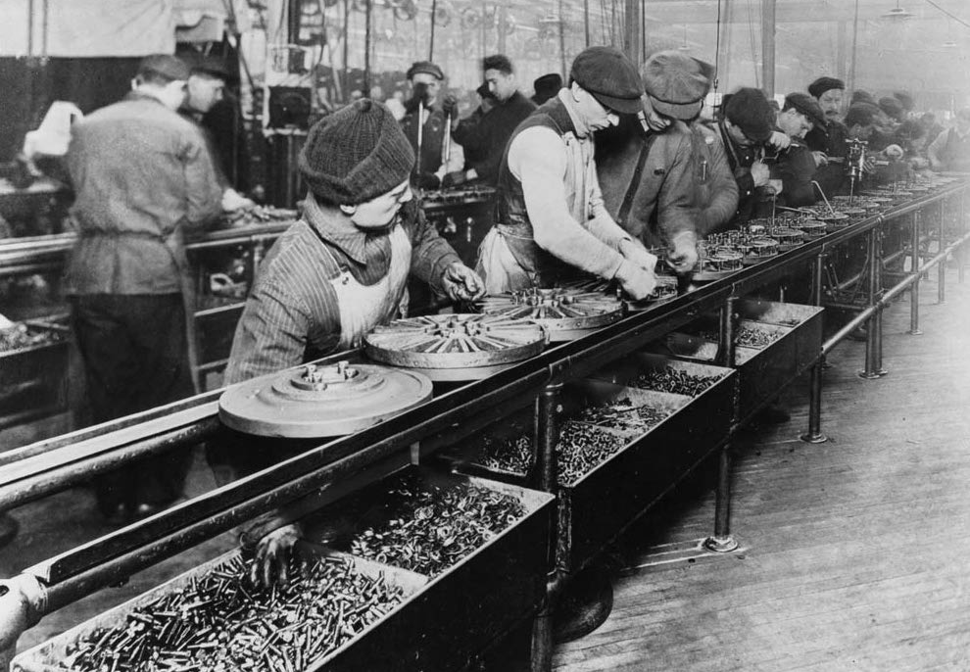
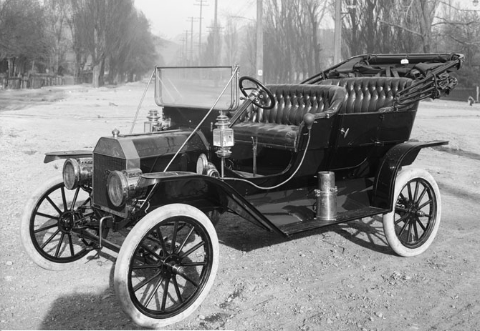
Ford T and an assembly line in ford´s factory

Slide 22
3/ How modernity influenced living conditions (and human senses)?

Slide 23
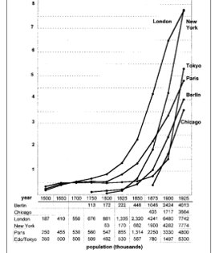
Demographic changes

Slide 24
modernity, Zlin, TomáŠ BaŤa, Frederick Winslow Taylor, Henry ford
3/12 Výroba války - Industrie - Roboti nastupují | Česká televize (ceskatelevize.cz)
Ca 3.00-5.00
Taylorism in USSR: Aleksei Gastev; Vsevolod Meyerhold (biomechanics)

Slide 25
4/ How were these modernity effects represented in media?
Ben Singer, Modernity, Hyperstimulus, and the Rise of Popular Sensationalism, in: Cinema and the invention of modern life, 1995

Slide 26
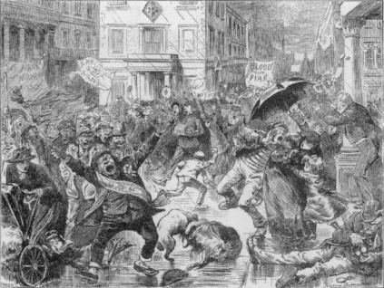
A quiet Sunday in London. Punch, 1886

Slide 27
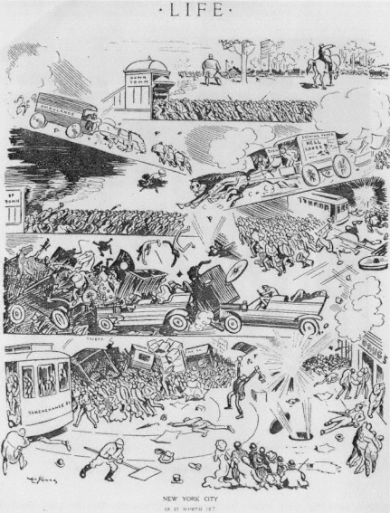
New York: is it worth of it? Life, 1909

Slide 28
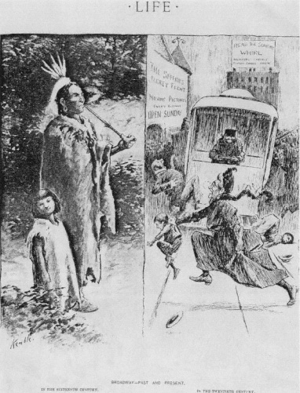
Broadway: then and now. Life, 1900

Slide 29
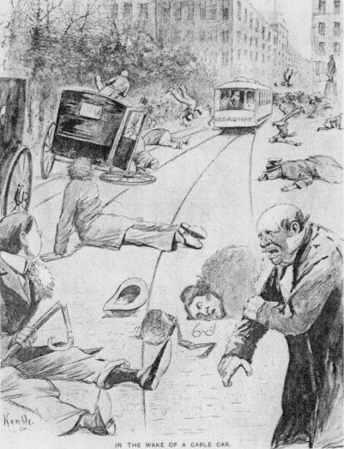
Life, 1895

Slide 30
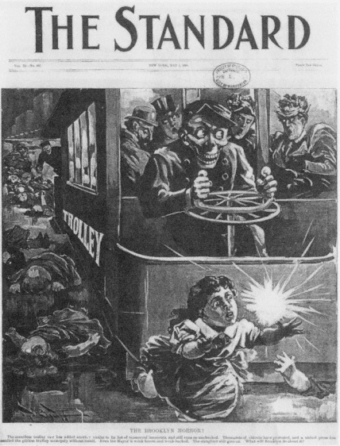
The Standard, 1895. „a merciless trolley has another victim on the list…“
"The merciless trolley car has added another victim to its list of massacred innocents and still runs on unchecked. Thousands of citizens have protested and a united press has assailed the pitiless trolley monopoly without result. Even the Mayor is weak-kneed and weak-backed. The slaughter still goes on. What will Brooklyn do about it?"

Slide 31
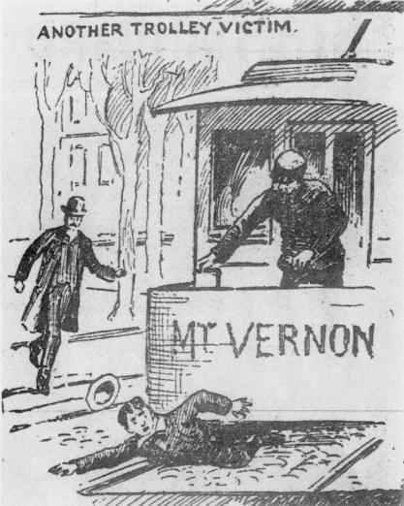
New York World, 1896

Slide 32
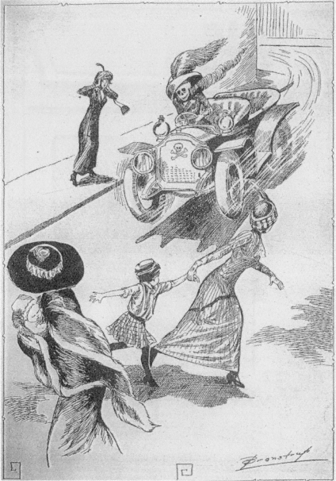
Cartoons, 1913. „drivers with no licence…“

Slide 33
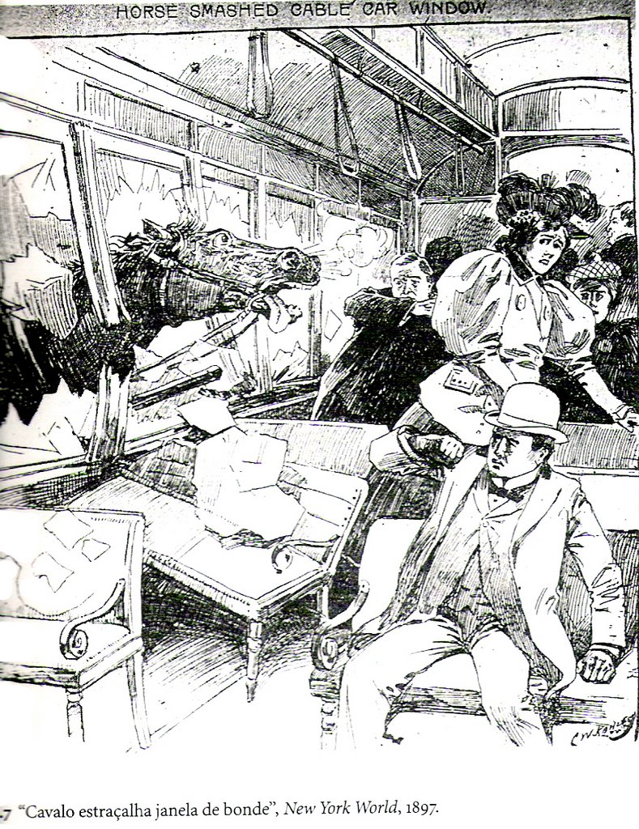

Slide 34
Newark daily advertiser, 1894
„Isaac Bartle, a prominent citizen of New Brunswick, was instantly killed at the Market street station of the Pennsylvania Railroad this morning. His body was so horribly mangled that the remains had to be gathered up with a shovel and taken away in a basket. ... He was ground into an unrecognizable mass under the wheels of a heavy freight engine. The engine struck Mr. Bartle in the back and dragged him several yards along the track, mangling his body in a horrible manner. Almost every bone was broken, the flesh was torn away and distributed along the track, and so completely was the body torn apart that the coins and knife in the trousers pocket were bent or broken, and the checkbook, pocketbook, and papers were torn in pieces“

Slide 35
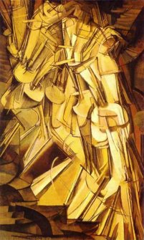
Marcel Duchamp: Nude descencing a Staircase (1912)

Slide 36
5/ how cinema was believed to help people to adapt for modernity?

Slide 37
Georg Simmel (1858–1918)
„Berliner Gewerbe-Ausstellung“, an essay from 1896: modern personality demands compensation for the uniformity in labour devided into segments: cummulation of attractions, fast changes of emotions, etc.
Sociologists, theatre critics, journalists writing on the correlation between situation of modernity and a demand of attractions and „shocks“
German theatre critic Hermann Kienzl (1911) in a newspaper column: "The big-city soul, eternally tormented by something, curious and unanchored, rushing from one fleeting impression to the next, is quite rightly a cinematic soul. ... And because the city dweller is as accustomed to nervous stimulation as the arsenic user is to his poison, he is grateful for a film that offers him a story about cops and robbers that is only about one minute long.“

Slide 38
G. Simmel, The metropolis and mental life, 1903
„There is perhaps no psychic phenomenon which has been so unconditionally reserved to the metropolis as has the blasé attitude. The blasé attitude results first from the rapidly changing and closely compressed contrasting stimulations of the nerves. From this, the enhancement of metropolitan intellectuality, also, seems originally to stem. Therefore, stupid people who are not intellectually alive in the first place usually are not exactly blasé. A life in boundless pursuit of pleasure makes one blasé because it agitates the nerves to their strongest reactivity for such a long time that they finally cease to react at all. In the same way, through the rapidity and contradictoriness of their changes, more harmless impressions force such violent responses, tearing the nerves so brutally hither and thither that their last reserves of strength are spent; and if one remains in the same milieu they have no time to gather new strength. An incapacity thus emerges to react to new sensations with the appropriate energy. This constitutes that blasé attitude which, in fact, every metropolitan child shows when compared with children of quieter and less changeable milieus.“

Slide 39
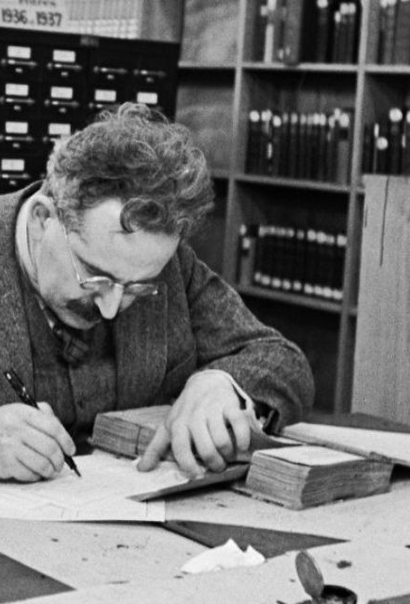
Walter benjamin (1892-1940)
journalist; Frankfurter Zeitung​
personal ties to the „Frankfurt School“ and philosophical ties to Marxism; friendship with Bertolt Brecht
Jew; 1933 emigrated to Paris, was interned there, after his release he tried to escape to the USA; in September 1940 he committed suicide

Slide 40
The Work of Art in the Age of Mechanical Reproduction (1935)
Benjamin analysed three changes in the sphere of arts:
In the mode of production (mechanical reproduction)
litography, photography, film
In the essence of the art (lost aura)
„Even the most perfect reproduction of a work of art is lacking in one element: its presence in time and space, its unique existence at the place where it happens to be. … that which withers in the age of mechanical reproduction is the aura of the work of art.“
In perception (shock)

Slide 41
"The artistic form of the film corresponds to the growing threat to life that today's man is supposed to face. The need to expose oneself to the effects of shock is a kind of human adaptation to the expected dangers that threaten from all sides. The film responds to changes that go deeper into the apperceptive system than is experienced by every pedestrian in the private sphere of existence, and than is experienced on a historical scale by every citizen of today's state.“
„Perception in a distracted state, which is becoming increasingly evident in all areas of art and is symptomatic of profound changes in apperception, has found its field of experience in film. Since the actual form of the account is a shock in the film, it is this mode of reception that is welcomed.“
https://web.mit.edu/allanmc/www/benjamin.pdf
"The perception shaped by shock applies in the film as a formal principle. The jerky movement that determines the rhythm of production in the assembly line is fundamental to the film reception" (Benjamin, On Certain Motifs in Baudelaire).

Slide 42
Benjamin si přizpůsobil teorii navrženou Freudem v eseji “Mimo princip slasti“
„S traumatickým působením těchto šoků se nemusí počítat tehdy, když je vědomí pohotově zaregistruje“ (srov. Benjamin, 1979 – O některých motivech u Baudelaira).
Mechanická reprodukce zrušila pojmy jako je tvořivost, génius, věčná hodnota, tajemství – ale mnohost kopií také nahradila auru, kterou vytvářelo umělecké dílo. Aura závisí na distanci, úctě, autenticitě, originalitě. Umělecké dílo je tak součástí rituálu a udržuje si kultovní hodnotu spojenou s tradičními hierarchiemi. Současně se proměnila i praxe recepce a diváctví. Umění bylo chápáno jako pohlcující pozornost diváka – oproti tomu technologie jako je film nabízejí nový modus recepce ve stavu rozptýlení, což lépe odpovídá tempu a velikosti publika.
Divák může být účastníkem uměleckého díla; aura byla stržena. Pracovní funkce aparátu je vložena do reprezentovaného. Divák vidí objekt z perspektivy modu produkce: film sleduje z pozice kamery. Oko kamery je testem – kamera může vynechat toho, kdo nevyhovuje „testu“, kamera testuje vše před ní – a když divák zaujme pozici kamery, stává se kritikem. Jsme ovšem kritici ve stavu rozptýlení (Zerstreutheit).
Dialektika mezi rozptýlením a šokem: rozptýlení je stavem, ve kterém dochází k šoku, bez rozptýlení by šok nebyl možný

Slide 43
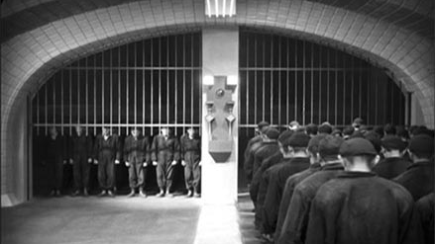
6/ how – and why - modernity can be represented in films?

Slide 44
Representation of modernity
Western modernity / Socialist modernity
the stress that socialist societies placed on industrialization, secularization and universal education represented an alternative version of modernization

Slide 45
Modern times (1936) / The bright Path (1940)
(9) Chaplin Modern Times-Factory Scene (late afternoon) – YouTube
Světlyj puť (The Bright Path; Grigorij Alexandrov, 1940) 1:03-1:10
(31) The Bright Path (comedy, directed by Grigory Alexandrov, 1940) - YouTube

Slide 46
homework
To read: Tom Gunning, Modernity and Early Cinema. In: Richard Abel, Encyclopedia of Early Cinema, 2005
Homework for everybody, inspired by the reading: find an early movie (ideally, from the country of your origin) and briefly explain its connection to „modernity“ (1 slide, about 4-5 sentences; + ca 5 slides with screenshots from the movie)
To present: Tom Gunning, Heard over the phone: The Lonely Villa and the de Lorde tradition of the terrors of technology. Screen 32, 1991 (Alexandra) 5-7 minutes, presentation till Monday via e-mail: skopalí@phil.muni.cz
How modern technology influenced film style?
What is the relationship between modernity and film stories?
To watch: The lonely Villa (D.W. Griffith, 1909), 12 min. - (25) The Lonely Villa (1909) – YouTube

Slide 47
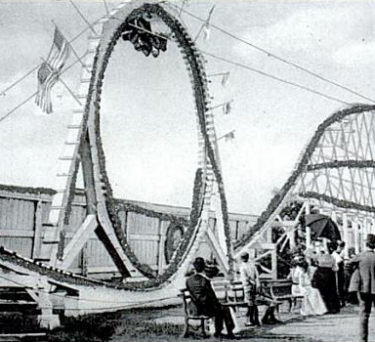
Cinema of attractions

Slide 48
Modernity and (early) cinema
Significance of cientific research
Second industrial revolution
Modernity and early cinema: an OBVIOUS topic?
Direct address to the audiences
Factors of stylistic change: modernity + changing audiences, industry re-organization; attracting middle class audiences

Slide 49
The term “attractions”, as used by Gunning, comes from Sergei Mikhailovich Eisenstein and his attempt to find a new model and mode of analysis for the theater
What happened to the cinema of attraction[s]? The period from 1907 to about 1913 represents the true narrativization of the cinema

Slide 50
Cinema of attractions vs. Narrative cinema
Gunning uses the concept of the attraction to identify a break in cinema production from 1906, after which narrative began to dominate. Narrative cinema does not simply replace the cinema of attractions, but absorbs it, as can be seen in prolonged action sequences in contemporary blockbusters, or other moments of spectacle, such as song and dance sequences in musicals, or, more generally, in cinema’s tendency to fetishize women, to put women on display for the male gaze.

Slide 51
the ‘modernity thesis’ emphasized the extent to which early movies reflected the shocks, thrills and fragmented experiences of modern urban life, and speculated that this kind of cinema worked as a catalyst for the experience of modern life by influencing human perception. The modernity thesis proposed that the disruptive economic, social and cultural effects of urbanization and industrialization created a state of:
constant sensory change,
nervous stimulation,
feverish stress,
speed and bodily peril,
and that cinema both reflected this state and was a consequence of it, promoting a particular gaze or form of perception.
Tom Gunning suggested that movies reflected modernity’s disruption of social order by representing ‘the experience of urban life with its threats and danger’, embracing ‘modern technology or new environments’.
Referring to modernity as a culture of shocks and cinema as a reflection of this, Gunning’s concept of the cinema of attractions identified a type of filmmaking that solicited spectator attention through visual curiosity, exciting spectacle, surprise, newness, fragmentation and montage.

Slide 52
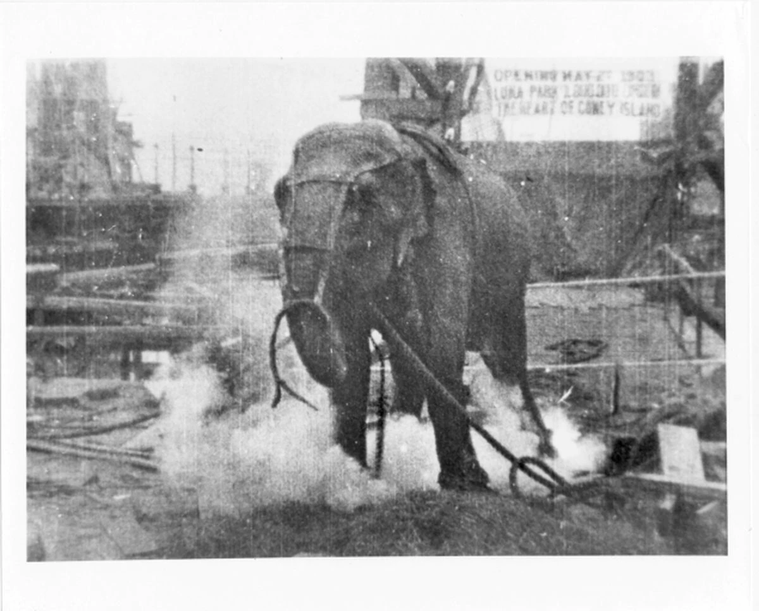
The Great Train Robbery (Edwin Porter, 1903)
(20) "The Great Train Robbery" (1903) - 1080p HD - YouTube
Loie Fuller (1905)
https://www.youtube.com/watch?v=Dda-BXNvVkQ
Electrocutting an Elephant (T. A. Edison, 1903)
(38) Electrocuting an Elephant (1903) - Topsy | WARNING: Viewer Discretion - Thomas Edison - YouTube

Slide 53
The lonely villa
Relation of new forms of filmic narration to the way technology structures modern life – both thematic and structural relation
Transitional period: 1907-1913
Simultaneity – demands more abstract sense of the interrelation of space and time
Modern technology used to naturalize film´s power to move through space and time
(38) College Chums (1907) Edison – YouTube 1.50, Edwin Porter
After 1908: parallel editing for potraying a phone conversation
Edwin Porter: Heard over the Phone (1908)

Slide 54
The lonely Villa (D.W. Griffith, 1909), 12 min. - (25) The Lonely Villa (1909) – YouTube
Tom Gunning, Heard over the phone: The Lonely Villa and the de Lorde tradition of the terrors of technology. Screen 32, 1991 (Alexandra)
7.20

Slide 55
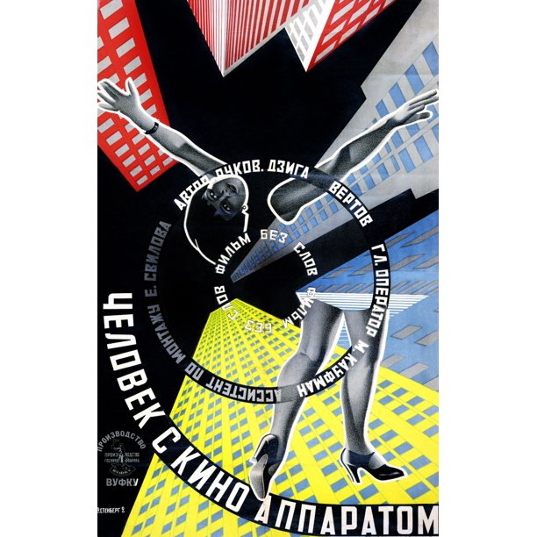
Montage theory

Slide 56
What is cutting/editing/montage?
What is Soviet montage?
How Kuleshov defined montage?
What were the sources of montage theory?
What types of montage Eisenstein defined?
Does „Kuleshov´s effect“ really work?
How was the theory of montage applied since the 1930s?
What was Dziga Vertov´s conception of cinema?

Slide 57
Reading/watching
Man with a Movie Camera (Dziga Vertov, 1929)
Essay „Kino-Eye“ by Vertov
Vlada Petric, Dziga Vertov as Theorist. Cinema Journal 18, 1978, no. 1, pp. 29-44
Farbod Honarpisheh, The Oriental „Other“ in Soviet Cinema, 1929-34. Critique: Critical Middle Eastern Studies 14, 2005, no. 2, pp. 185-201 (Anastasia G.)

Slide 58
What is cutting/editing/montage?
Cutting: according to an early filmmaking tutorial, to cut a picture is to remove the unneeded
Editing: cutting according to continuity rules; borrowed from print media, the term came into use early in the 1910s when the way action would be segmented and assembled came to be seen as the responsibility of those who wrote for films rather than those who staged and cut their scenes. In the mid-1910s, the term editor, or cutting editor, slipped from pre- to post-production, and is in use to this day.
Montage may mean one of two things: a fast-paced sequence designed to bridge a lapse of days or decades, or the practice of editing based on theory. The term itself came from the French word montage via Russian montazh and settled in English in or soon after the 1920s

Slide 59
What is Soviet montage?
Distinct from the American way of joining shots, montage in the French and Soviet sense did not focus so much on storytelling needs. For French avantgardists, montage was more likely to be about the rhythm and musicality of action than about action per se (Jean Epstein); and when montazh was theorized in Soviet Russia, it was typically about the construction of meaning that emerges not within but between shots.
Lev Kuleshov, Dziga Vertov, Vsevolod Pudovkin, and Sergei Eisenstein
Americanitis

Slide 60
How Kuleshov defined montage?
Will spaces match if someone walking along a street in Moscow waves her hand to someone descending Capitol Hill in Washington?
Such explorations occurred in a constructivist environment. To make, to build, and to assemble were the right words to be used in Constructivist studio talk instead of ‘create’, as was the word things (veshchi) instead of ‘works of art’.
Lev Kuleshov: what really mattered was ‘not the demonstration of the content of the shots as such, but their organization, combination and construction, that is, the interrelationship of shots, their sequence, the replacement of one shot by another’
the average shot lengths of the feature films Kuleshov made between 1924 and 1926 were as low as 4.3, 3.6, and 4.1 seconds. Only the fastest of Keystone slapstick comedies had been cut as fast in the United States. By increasing the speed, Kuleshov made cutting more salient than the story it served. For Kuleshov cutting, not acting or action, was the ‘true essence’ of film.

Slide 61
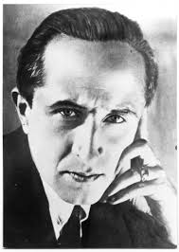
Lev Kuleshov, Americanitis
„The secret of mastery over cinematic material—the essence of cinematography—lies in its composition, the alternation of photographed pieces. In the main, for the organization of impressions, what is important is not what is shot in a given piece, but how the pieces in a film succeed one another.“
Creative geography
The Extraordinary Adventures of Mr. West in The Land of The Bolsheviks – YouTube
19-22
1.13-1.15

Slide 62
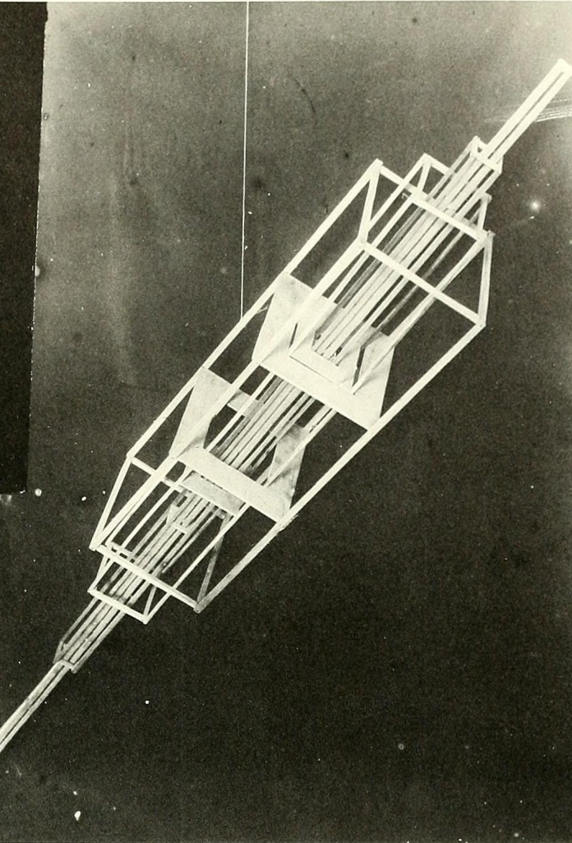
What were the sources of montage theory?
Constructivism – Monoskop
Constructivism: art used for agitational and promotional purposes. Constructivism seeks to create socially useful art. It compares a work of art to a machine; creation is the process of constructing from parts, i.e., assembling - putting together the parts of a machine; the artist is an engineer organizing the raw material into a whole
Gustav Klutsis, Hanging Construction, 1921

Slide 63
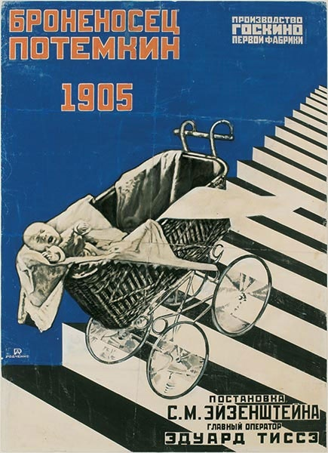
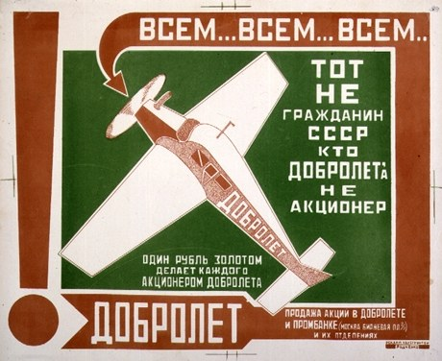

Alexandr Rodčenko

Slide 64
Kuleshov and constructivism
Alexander Rodchenko - spatial constructions, 1919-21 - sculptures assembled from wooden segments, completely standardized - the value of the object could not be in the parts alone, they were completely identical - but in their combination. Rodchenko refused to attribute autonomy to natural objects - in this case, wood was stripped of all associations with the realm of nature (trees) and subordinated to human design (industry).
Kuleshov achieved a similar effect - he subjected the "found material" to his editing, depriving the images of their autonomy by suppressing the original associations of the objects represented.

Slide 65
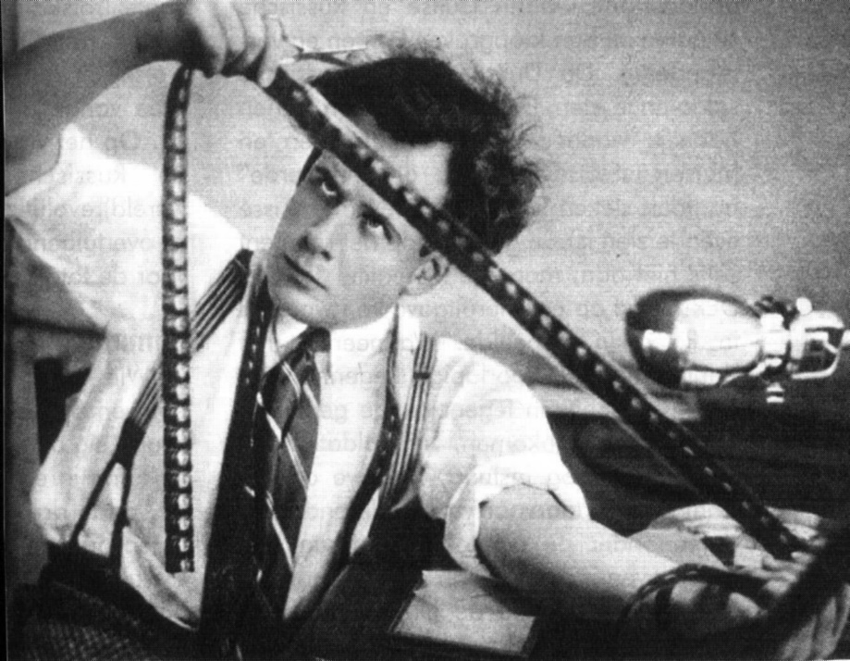
What types of montage Eisenstein defined?
In 1923 Eisenstein published an essay entitled ‘The Montage of Attractions’, which argued that the task of the (theatre) director was to push the spectator through a preplanned series of shocks regardless of whether the play really occasioned them.
Theory of intellectual montage: meaning is generated via colliding rather than linking neighbouring shots. In October (1928) Eisenstein tested this principle, hoping to generate ‘abstract concepts’ by way of juxtaposing artefacts found in the Winter Palace (icons, Fabergé eggs, Rodin’s sculpture, Napoleon statuettes, a clockwork peacock) and historical figures of 1917.

Slide 66
Dialectical clash of shots; conflict – within and between shots; principle of dominants
Metric Montage:
the absolute length of the shot is the dominant feature. The conflict is purely the length of the shot - the pace of the cut regardless of the content of the shot; shot length is determined by a regular metric arrangement; the proportional relationship of shots within a sequence remains the same
Rhythmic Montage:
editing is based not only on metric requirements, but also on the content of the footage; e.g., it is a common practice that large units are in longer shots than details; it is based on the rhythm of movement within shots. Rhythm can reinforce or contradict the metric.
Potemkin - the steady rhythm of the soldiers' feet descending the stairs breaks the metrical pace of the cut. It maintains the tension of the sequence
Battleship Potemkin (1925) - Full Movie; English – YouTube
49-55
(38) Eisenstein's Methods of Montage Explained | Russian Soviet Montage Theory | VIDEO ESSAY - YouTube

Slide 67
Tonal Montage:
the dominant emotional tone of the shot becomes the basis of the cut;
the montage is based on the emotional tone of the part, on its dominance.
Potemkin - fog at the beginning of the third part - the basic tonal dominant here is the lighting - the light qualities that subordinate the other elements. The tonal montage is not so much about the rhythm or content of the shots, but rather their texture. It's about the expressive visual quality of the shot.
1.01.30
Overtonal Montage:
the last one being superior to the first three because, rather than operating through a single dominant, it works on the viewer through multiple stimulants found within shots.
Instead of a dominant, all the stimulating elements are involved, understood as a complex (Old and New (General Line - 1929)): a procession of peasants pleading for an end to the drought - edited to emphasize secondary expressive qualities: the solemn movement of the icons; the rapture of the pleading peasants; the scorching sun; the burning thirst).
(38) Old and New / General Line (1929) movie - YouTube
25-28

Slide 68
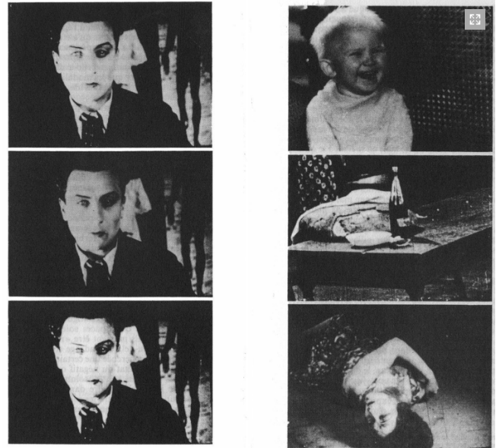
Does „Kuleshov´s effect“ really work?
(38) "Daisy" Ad (1964): Preserved from 35mm in the Tony Schwartz Collection – YouTube

Slide 69
How was theory of montage applied since the 1930s?

Slide 70
Bertold Brecht
Marxist thinker and a playwright; he argued that people tend to regard as ‘natural’ such aspects of social life that are historical and thus changeable. Brecht advocated formal abstraction that would guarantee a distance between reality and representation, so as to politicize aspects of social life that one considers as unquestionable. To achieve this he proposed the Verfremdungseffekt (‘making the familiar strange’), which aims at preventing the actor and the audience empathizing with the characters on stage. The actor should not ‘become’ the character, while the director should point to the fictionality of the material, so as to prevent the audience’s empathetic identification with the story and arouse their critical reflection.
cinema could become a means of teaching historical awareness and revealing that social reality is not natural but subject to change.

Slide 71
Brecht distinguished between the reproductive and the constructive use of the medium: reproducing the empirical reality versus showing that what appears as ‘real’ is subject to transformation, because reality is socially constructed.
As such, a constructive use of the medium presupposed the presentation of a familiar reality in such a way that it would appear strange and changeable. The key principle of the constructive method is montage, a term he employs in his theatre writings too.
Montage stresses representational discontinuity and serves the role of isolating moments that can reveal aspects of social reality which are not necessarily visible. Brecht’s understanding of montage as a radical formal structure was very influential in the post-1968 film theory.

Slide 72
Stephen Heath on Brecht, 1970´s
Brecht’s aim was to encourage a reading attitude in the auditorium, which would prevent the audience from being completely absorbed by dramatic action. Heath argues that cinema can accomplish this by employing an aesthetics of interruptibility, which gives the audience the ability to be inside and outside the film. Interruptibility can be achieved by way of montage sequences that disrupt the narrative flow and give the audience the chance to step out of the story and reflect on it.

Slide 73
André Bazin against montage
Bazin advocated certain formal realist principles, such as the long take and deep focus, on the grounds of their ability to incorporate aspects of reality that did not serve dramaturgical purposes. For Bazin, this type of cinema gave the audience a more direct access to reality than a type of cinema based on montage sequences.

Slide 74
Critical reflection – historicity of montage´s reception
The core of Brecht’s theory is that forms are changeable and historically defined. In the course of time, certain formal elements become de-radicalized, whereas others require reassessment. Currently, Hollywood employs montage sequences not to engage the audience politically, but to increase the pleasures of narrative consumption. On the other hand, contemporary films by the Dardenne brothers and Béla Tarr, which follow long-take Bazinian aesthetics, challenge our habitual viewing of films in a more effective way. The prerequisite for making the familiar strange is to understand the historicity of both the term ‘familiar’ and ‘defamiliarization’.
Nevertheless, Heath’s essays are valuable – Heath invivtes us to think of film as a productive rather than a reflective medium, pointing to the fact that realism in film is a set of conventions, rather than the authentic reproduction of social reality.

Slide 75
homework
To watch: Man with a Movie Camera (Dziga Vertov, 1929)
To read:
Essay „Kino-Eye“ by Vertov
Vlada Petric, Dziga Vertov as Theorist. Cinema Journal 18, 1978, no. 1, pp. 29-44
Homework for everybody, inspired by the reading:
Watch the movie Man with a Movie Camera and identify a sequence or a shot that might be interpreted as application of Vertov´s theory of filmmaking. Make screenshots and explain in a paragraph the connection to Vertov´s theory. Make it clear that your observation is based on Petric paper; rephrase Petric, do not repeat Petric´s text. Be ready to explain your observation at the lecture.
To present: Farbod Honarpisheh, The Oriental „Other“ in Soviet Cinema, 1929-34. Critique: Critical Middle Eastern Studies 14, 2005, no. 2, pp. 185-201 (Anastasia G.)
Present the main argument of the paper and answer this question as well: What – and why – WAS represented in the three movies discussed in the paper – and, even more importantly, what WAS NOT represented?

Slide 76
Sight and Sound poll:
The Critics’ top 20 Greatest Films of All Time
Jeanne Dielman, 23, quai du Commerce, 1080 Bruxelles (Chantal Akerman, 1975)
Vertigo (Alfred Hitchcock, 1958)
Citizen Kane (Orson Welles, 1941)
Tokyo Story (Yasujiro Ozu, 1953)
In the Mood for Love (Wong Kar-wai, 2001)
2001: A Space Odyssey (Stanley Kubrick, 1968)
Beau travail (Claire Denis, 1998)
Mulholland Dr. (David Lynch, 2001)
Man with a Movie Camera (Dziga Vertov,1929)
Singin’ in the Rain (Stanley Donen and Gene Kelly, 1951)

Slide 77
What was Dziga Vertov´s conception of cinema?
Vertov’s idea came from music theory: What is found between two shots should be called interval. In music, each note has its own pitch, yet it is not the pitch as such but intervals between pitches that turns discrete sounds of music into music. So in films: every film shot has its own length and scale and is characterized by the speed and direction of the moving objects being shown, and yet it is not these parameters per se but intervals and variations between them that give to films their dynamic form.

Slide 78
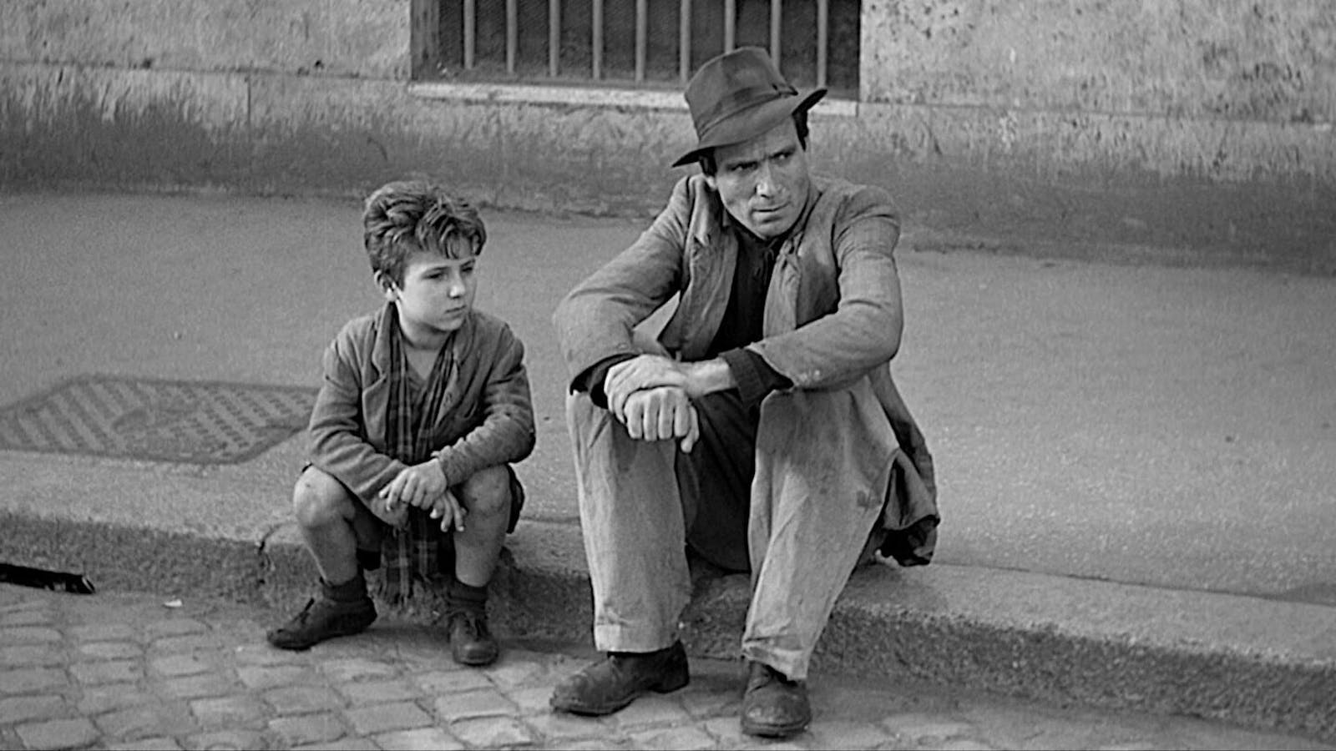

Slide 79
realism
Conventionality of Realism (according to Kristin Thompson)
Neorealism
André Bazin
Neoformalist approach to Realism and Bicycle Thieves (Vittorio de Sica, 1948)
Cognitivist approach to (Documentary) Realism

Slide 80
Kristin Thompson and Realism in the cinema (bicycle thieves)
Common assumptions:
Realism depends on a natural relationship of the artwork to the world – TRUE or FALSE?
Realism is an unchanging, permanent set of traits shared by all works perceived as realistic – TRUE or FALSE?
Yours entry essays:
„Characters are prototypes of real people, weather, locations, events“
„there is no idealization in realistic films“
„realistic movies raise timeless questions“

Slide 81
Thesis I
realism is an effect created by the artwork through the use of conventional devices.
relationship to the world:
There is no natural relationship between the artwork and the world: many different styles have been historically justified to their publics as “realistic.’
Any artwork can be said to be realistic on the grounds of some criterion or other:
Surrealism: the logic of dreams
Pop Art: mundane objects as museum pieces;
abstract art: capturing a spiritual reality;
In this very broad sense, all art has natural links to reality, for no one could create perceptual objects wholly apart from some aspect of one’s experience of the world

Slide 82
Neoformalist´s Realism
Thompson: „For neoformalists, the concept of types of motivation is the main tool for distinguishing realism—realistic motivation is one of the four types (the others being compositional, artistic, and transtextual).
Motivations are sets of cues within the work that allow us to understand the justification for the presence of any given device.
If the cues ask us to appeal to our knowledge of the real world (however mediated that knowledge may be by cultural learning), we can say that the work is using realistic motivation.
And if realistic motivation becomes one of the main ways of justifying the work’s overall structures, then we generalize and perceive the work as a whole as realistic.
Our ideas about reality: culturally determined.
Sources of our knowledge: Interaction with nature and society; awareness of aesthetic canons of realism in a given period of an art form

Slide 83
Thesis II
No set of traits can define realism for all time
If realism is a formal effect of the work, then what we perceive as realistic should change over time, as norms and viewing skills change
We always perceive the work against shifting norms. Realism, as a set of formal cues, changes over time, as does any style.
Realism come and go in cycles. After a period of defamiliarization, the traits originally perceived as realistic will become automatized by repetition. A new sort of realism will appear, with its own defamiliarizing abilities.

Slide 84
Possible indexes of realism
Depth of psychology in - as in the films of Ingmar Bergman and Michelangelo Antonioni
refusal to reveal characters inner states (as in late Bresson films) (like objectivity on the part of the narration)
Ambiguous or unhappy endings

Slide 85
Postwar theory
Essential connection between photographic image and reality
Changed values; reaction to totalitarianism
Empiricaly rich images surpass ideology
Siegfried Kracauer (1889-1966): cinema can safe human from alienating modernity; S. Kracauer, Theory of Film. The Redemption of Physical Reality (1960); two „traditions“: ´Méliés/Lumiére
André Bazin: Cinema can return spiritual dimension back to us

Slide 86
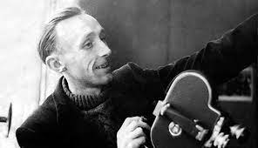
André Bazin (1918-1958)

Slide 87
Bazin and theory of film image
The Ontology of the Photographic Image (1958)
Film as a fingerprint, an extension of the world
Myth of total cinema
Realism determines film´s tabu: no falsification of reality; no cut in a scene which needs to be made in one long také
Citizen Kane and 17mm lenses; close to natural perception
Plurality of reality meanings; viewer should be provided with the liberty to assing his own meaning to reality
William Wyler, deep space, liberalism, democracy
Richard Linklater: Waking Life (2001) 54.30-59.00

Slide 88
homework
To watch: Bicycle Thieves (Vittorio de Sica, 1948)
(57) Bicycle Thieves - Masterpiece by Vittorio De Sica - Full Movie by Film&Clips – YouTube
To read:
Kristin Thompson, Realism in the Cinema: Bicycle Thieves, In K. Thompson, Breaking the Glass Armor. Princeton University Press, 1988
Homework for everybody, inspired by the reading:
Identify and describe any aspect of the movie „Bicycle Thieves“ and explain how it supports (or subverts) realistic motivation. Provide a reference to Thompson´s text
To present (Farah): Hamid Naficy, Neorealism Iranian Style. In: Giovacchini, S – Sklar, R: Global Neorealism. The Transnational History of a Film Style, 2012
What are the characteristic features of the Neorealist „film school“?
How they can be applied to Iranian Art House Cinema?
How Abbas Kiarostami followed – and undermines – (neo)realist conventions?

Slide 89
Bazin on The best years of our lives (1946)
P. 14 – Bazin, William Wyler, or the Jansenist of directing
2.00.00-2.05.00
„The depth of field of Wyler … the perfect neutrailty and transparency of style, which must not interpose any filter, any refractive index, between the reader´s mind and the story“ – „Styleless Style“

Slide 90
André bazin and the historicity of neorealism
According to Bazin, ‘neorealism tends to give back to the cinema a sense of the ambiguity of reality’ (see the contrast to the montage theory)
‘ambiguity of reality’ involves neorealism being characterized as a ‘styleless style’ – with long takes that don’t interrupt the flow of time, deep space, and action by non-professional actors in real locations utilizing no staging or special lighting. With the crucial help of a long-take style, neorealist cinema is designed to preserve the experiences of everyday life
Andre Bazin on Bicycle Thieves: the finest example of the Italian Neorealist trend – due to the elements of chance in its narrative
Four years later Bazin declared, “It took Umberto D to make us understand what it was in the realism of Ladri di Biciclette that was still a concession to classical dramaturgy.“

Slide 91
neorealism
Sources:
Film critics and filmmakers revolt against melodramas of the fascist era
„Verism“ – Giovanni Verga; Luchino Visconti, La Terra Trema, 1948
Roberto Rossellini: Rome, Open City (1945); Paisá (1946); Germany, year zero (1948); Vittorio de Sica: Bicycle Thieves (1948; scriptwriter: C. Zvattini)
„Neorealism“ – used for Italian movies by French critics in 1948
Cesare Zavattini: respect to facts and reality; moral aspect of real life represented: we need to know each other; unique value of cinema: to represent everydayness

Slide 92
Cognitive film theory
WHY realism works?
The philosopher and cognitive theorist Noël Carroll is interested in the ability of Hollywood-style filmmaking to provoke the ‘intense engagement’ of audiences. Spectatorial faculties are stimulated by film form. In short, this power is about what film does, rather than about an essentialist notion of what it is.
Realism is reframed by Carroll as power, but as a power to stimulate the mind rather than as a power to deceive it.
Noël Carroll: The power of movies. Daedalus 114, no. 4, 1985, pp. 79-103

Slide 93
Erotetic narrative
pictorial representation, variable framing, and erotetic narrative.
Each of these capacities addresses ‘the cognitive faculties of the audience’
Erotetic narrative is narrative based on an ongoing series of questions being posed and answered from one shot, scene, sequence, or act of the film to the next
Later scenes in erotetic narratives ‘answer’ questions posed in earlier scenes, or they provide material for formulating possible answers to questions prompted or suggested earlier.
Movies thus unfold in constant dialogue with the minds of their viewers, who recognize their pictures, are guided by their framings and camera movements, and who ask questions and assess answers as prompted by the unfolding of the film.

Slide 94
Cognitivism and realism
Torben Grodal, Docudrama and the Cognitive Evaluation of Realism. In Catalin Brylla – Mette Kramer (eds.), Cognitive Theory and Documentary Film. Palgrave Macmillan, 2018
cognitive and emotional base of viewers’ experience of the “real” in documentaries
Docudrama: a film that fully or partially presents real events, using the same tools as fiction film but with the intention of providing a „true picture“
an analysis of the cognitive and emotional mechanisms viewers use to evaluate the realism of the media they consume; trust
Documentaries and docudramas need to entertain, but their main purpose is to provide information about the world

Slide 95
Cognitivism and documentary
Carl Plantinga’s cognitive-perceptual theory of spectatorship
Carl Plantinga: Characterization and Character Engagement in the Documentary. In: Catalin Brylla, Mette Kramer (eds.), Cognitive Theory and Documentary Film. Palgrave Macmillan, 2018

Slide 96
Characterization and character engagement
AVR (Assertion of Veridical Representation) - a documentary relies on showing reality rather than merely asserting it
Characterization is a construction because the images and sounds that represent the character are not neutral and transparent but carefully constructed and chosen to portray them in a specific way to narrativize a character
in the context of a documentary, it involves putting them in a moral and/or sociopolitical context that implies a favorable or unfavorable judgment
The necessity of selection and omission, emphasis, emplotting and point of view mean that the documentary filmmaker’s characterization of that person is a construction

Slide 97
When a film is released into the public arena, it is often identified as either documentary or fiction
If it is identified as a “documentary,” this implies an implicit contract between the filmmaker and the audience: the audience takes it to be a film in which the images and sounds, claims and implications are asserted to be veridical—that is, accurate or reliable guides to the film’s subject
In the case of a documentary film - the filmmaker affirms the reliability of the images and sounds he or she has used
If the viewers later learn that the images and sounds were misleading, then they will assume that:
the filmmaker was incompetent or dishonest
the film is not a documentary but propaganda or advertising

Slide 98
The other half of the contract inherent in documentaries as “asserted veridical representations” is that whatever the propositions implied or asserted in the film, they are true reflections of the actual world
when the voiceover narrator presents claims something, or when parallel editing strongly implies a relationship of similarity between two events, the audience takes all of these as the assertion about the world
The implicit “contract” between documentary filmmaker and audience stipulates that the film’s images and sounds are presented as reliable guides to what characters actually said or did, or how they appeared

Slide 99
To characterize, or not?
Flat and round characters
Character templates
Allegiance for a character
To read: Carl Plantinga: Characterization and Character Engagement in the Documentary. In: Catalin Brylla, Mette Kramer (eds.), Cognitive Theory and Documentary Film. Palgrave Macmillan, 2018
Homework for everybody, inspired by the reading:
Choose one of the following movies: Roger and Me (Michael Moore, 1988), The Eagle Huntress (Otto Bell, 2016), Standard Operating Procedure (Errol Morris, 2008)
Write a paragraph on each of these topics: does the movie use flar or round characters? Does it use character templates? Does it build up an allegiance for a character (explain on an example of the movie´s character)

Slide 100
homework
To read: Carl Plantinga: Characterization and Character Engagement in the Documentary. In: Catalin Brylla, Mette Kramer (eds.), Cognitive Theory and Documentary Film. Palgrave Macmillan, 2018
Homework for everybody, inspired by the reading:
Choose one of the following movies: Roger and Me (Michael Moore, 1988), The Eagle Huntress (Otto Bell, 2016), Standard Operating Procedure (Errol Morris, 2008).
Write a paragraph on each of these topics: does the movie use flar or round characters? Does it use character templates? Does it build up an allegiance for a character (explain on an example of the movie´s character);
To present (Rion): Torben Grodal, Docudrama and the Cognitive Evaluation of Realism. In Catalin Brylla – Mette Kramer (eds.), Cognitive Theory and Documentary Film. Palgrave Macmillan, 2018
Film: The Queen (Stephen Frears, 2006)
describe the strategies used in the movie The Queen to represent the queen, the prime minister, and and other characters; explain how a viewer handles with the textual information provided by the movie

Slide 101
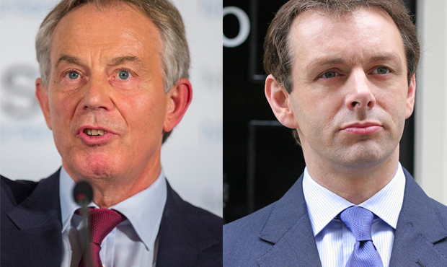
Tony blair/michael sheen

Slide 102
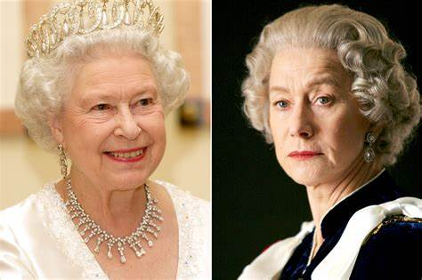
Elizabeth II/helen mirren

Slide 103
Docudrama and the Cognitive Evaluation of Realism
“docudrama”
Grodal: „The experience of what is real in a docudrama like The Queen is based on a series of different cognitive mechanisms and on the knowledge possessed by the individual viewer … facts are sampled by the filmmaker according to a specific purpose and are processed by the individual viewer according to their cognitive capacity and personal knowledge … Viewers’ experience of realism and their perception of the truthfulness of documentaries and docudramas are based on procedures that are related to an individual’s knowledge, cognitive skills and emotional involvement“

Slide 104
Perception, Emotion, Cognition and Motor Action
Suspension of belief
„terrorist attack in New York“ - information that demands action will receive more scrutiny than information that has less immediate relevance for activity. Thus, a documentary may have different consequences in terms of viewers’ future actions or potential actions
Reality check - The Queen may not have the same action potential for an international audience as it does for a British one, especially in relation to British general elections or attitudes towards the British monarchy. Viewers in Britain, therefore, might be expected to perform a more thorough reality check of the film in order to seek guidance for their action potentials
the memories were stored as mediated perceptions and mediated knowledge
The use of archive footage strengthens the credibility of the staged elements
a perceptual realism through physical resemblance
Real places: realism by means of metonymy between the real events and the fictitious events

Slide 105
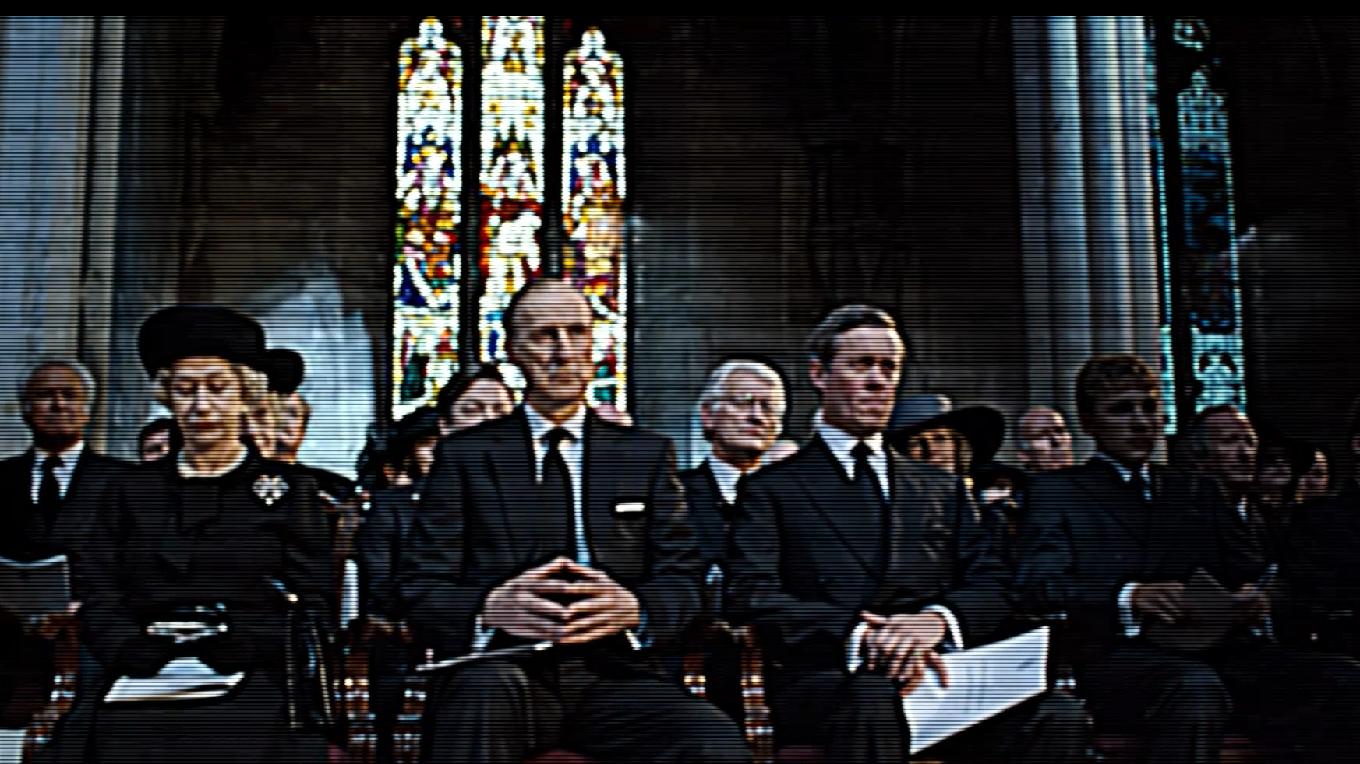
The queen

Slide 106
The 1990s TV images still bore the mark of indexicality for a 2006 viewer
folk psychological schemas of psychological realism - these may include personality and social-role schemas (of how a servant, a minister or a queen might behave, in both public and private). As long as the portrayal does not conflict with the viewer’s psychological schemas or explicit knowledge there is no reason for a significant reality check
Symbolism: activate reality-checking mechanism
sad or painful events are generally perceived as more real than joyful ones due to the urgency of pain
Diana´s funeral: The viewer feels part of a ritual community
the docudrama takes a strong pro-monarchy position --- the perception of realism in the film will partly depend on the political convictions of the individual viewer

Slide 107
Characterization and Character Engagement in the Documentary
characterizations, whether flat or round, clear or ambiguous, are always constructions
Documentaries do not merely show, they also “tell.” The other half of the contract inherent in documentaries as “asserted veridical representations” is that whatever the propositions implied or asserted in the film, they are true reflections of the actual world

Slide 108
Standard Operating Procedure (e. morris, 2008) and flat characterization
There is “complete absence of the voices of the Iraqi detainees” who were tortured by American soldiers at the Abu Ghraib prison during the Iraq War.
Bill Nichols criticizes Morris’s decision to only display still photographs of the Iraqi prisoners’ degradation, and not to humanize or characterize them by providing any further information or footage about who they are. The film features extended interviews with many of the guards responsible for the prisoners’ torture, but gives “no voice whatsoever” to their victims
Bill Nichols addressing Morris: „your response is a strangely clinical and dissociated curiosity. Where is the moral center to their testimony? To your film? To your perspective?“

Slide 109
Roger and Me (M. moore, 1988) and character templates
Michael Moore gives many of the people represented in the film flat characterizations. He uses “associative editing“
59.30
many filmmakers have a particular sort of character in mind even before the filmmaking process begins
the documentary “tradition of the victim”, or search for the exotic “other”
There is also what might be termed the “tradition of the villainous capitalist” seen in the films of Moore

Slide 110
The eagle huntress (2016) and „character engagement“
The filmmaker employs various techniques to encourage the viewer to form attitudes and perspectives towards, or antipathies and allegiances for or against, various characters
the viewer’s allegiance with a character is created in large part through moral judgment: when a viewer perceives that a character behaves morally, they are more likely to “care” or “root” for, and generally take a sympathetic interest in, the character and their circumstances and goals
A form of moral or sociopolitical judgment via implicit approval or disapproval of one or more of the characters. This is an important form of characterization
„REALITY CHECK“?

Slide 111
Ethics of documentary according to plantinga
one of the ethical obligations of filmmakers is to represent the truth, as they understand it, to the best of their ability
A duty of care is an ethical or legal obligation that entails that a person or organization avoids acts or omissions that can be reasonably foreseen to cause harm to others

Slide 112
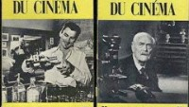
Auteur theory (W. dixon)

Slide 113
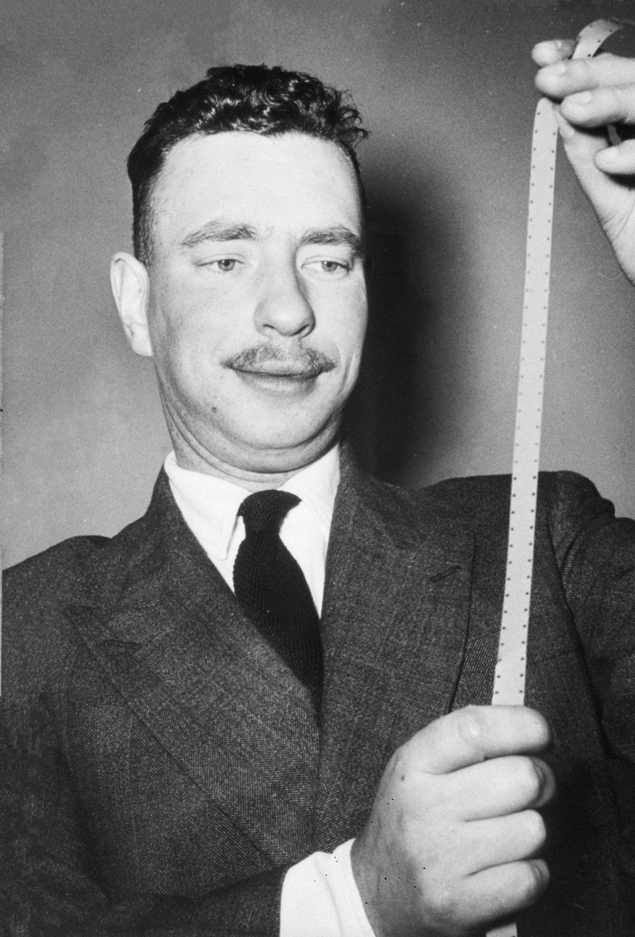
Alexandre Astruc
The Birth of a New Avant-Garde: La Caméra-Stylo. L´Écran francais (1948)

Slide 114
auteur criticism
Traditional auteur criticism, developed in the journal Cahiers du cinéma in the 1950–60s and by Andrew Sarris in the U.S., privileged the director’s individual subjectivity: their intuition, spontaneous creativity, and personal expression.
The distinctive properties that define an auteurist’s films are thought to be located in a purely personal or subjective vision. Auteur critics also value the unity of style and themes that a director is able to impose on his or her films. That is, the auteur critic seeks to identify throughout the same director’s corpus (whatever the genres involved) a pattern of thematic preoccupations and similarities in visual style.
One of the most important aspects of an auteur analysis therefore involves analysing an individual film’s style and themes within the context of a director’s entire output.

Slide 115
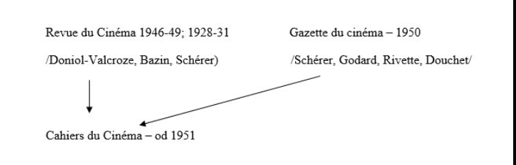

Slide 116
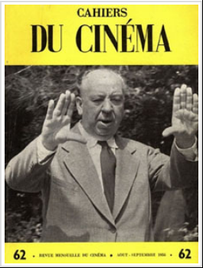
Autorství

Slide 117
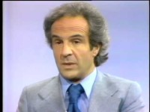
Francois Truffaut

Slide 118
Andrew Sarris – auteurism in the U.s.
For Andrew Sarris, the auteur theory is based on three premises: technical competence; personal style; and, most importantly, interior meaning.
He defined interior meaning as ‘the tension between a director’s personality and his material’ (implicit theme)
Andrew Sarris (1928–2012)
Book American Cinema. Directors and Directions 1929–1968 (1968)
Sarris vs. Pauline Kael

Slide 119
Peter Wollen in Signs and Meaning in the Cinema (1972)
Wollen and other structuralists replace individual expression, personal psychology, and subjective vision with an emphasis on an impersonal system of underlying codes and structures
When speaking or when making a film, the individual simply actualizes one possible combination of codes from the underlying system. His or her consciousness does not spontaneously create, for consciousness is determined and controlled by underlying structures
The primary aim of structuralism is to study this underlying system
signifiers

Slide 120
structuralist method of analysis
The structuralist method of analysis entails deciphering an underlying latent structure
The structural approach to auteur criticism focuses on theme.
Peter Wollen sees the stylistic approach as superficial; for him, auteurs are distinguishable in terms of the thematic deep structures at the centre of their films. Wollen attempts to make auteur studies rigorous by following this three-step process:
he isolates a director’s ultimate themes,
reduces them to binary oppositions,
identifies their different combinations.
One assumption in Wollen’s structural auteur theory is that auteurs create their own specific universe – their own system of beliefs, thinking, and behaviour – by combining several binary themes in distinct ways
Directors are „structures“, not real people – „Ford“, not Ford, „Hawks“, not Hawks

Slide 121
poststructural theory
Subsequent waves of poststructural theory further destabilized authors’ grasps on ‘‘their’’ texts
Texts owe a great deal to its intertextual forbearers. Shakespeare can only be considered a singular author of Hamlet if we foolishly imagine the text to have no past or future
Roland Barthes announced ‘‘The Death of the Author.’’ ‘‘it is language which speaks, not the author,’’ so that ‘‘[l]inguistically, the author is never more than the instance writing.’’ (1977)
Barthes: ‘‘the birth of the reader must be at the cost of the death of the Author’
Writing of ‘‘the author function,’’ Foucault stated that the author is a projection’ – but an important one
There is no such thing as a text that simply is; there are only texts that become and that will continue to become. if authorship is seen as an act of creation, once we recognize that texts never stop being created

Slide 122
When is the Author?
Jonathan Gray asks, When is the Author? In: A Companion to Media Authorship, Gray – Derek Johnson (eds.)
Authors are those figures who exert particular power across a text’s life to change its meaning and character;
Text is always open, never concluded or complete, and thus any notion of authorship based on the assumption that the text has already been created is a problematic one
authors are individuals who have been given authority, this demands that we shift focus to exploring:
who decided that they get authority
what methods they used to obtain that authority
what processes are in place to gain authority
what institutions assign authority
production cultures research in media studies of examining how discourses of authorship are constructed, and how they set the rules of authorship
Authors: marketing teams; readers; below-the-line workers

Slide 123
homework
Homework for everybody:
John Thornton Caldwell, production culture. Industrial reflexivity and critical practice. Duke university press, 2008 Industrial auteur theory (above the line/creative), pp. 197-216 (231)
To watch: Lost in La Mancha (2002, Keith Fulton, Louis Pepe)
Apply Caldwell´s text to analyse how „auteur“ and „authorship“ are constructed, presented, branded in the Lost in La Mancha documentary
To present (Luca):
To read: John Thornton Caldwell, Authorship below-the-line. In: Jonathan gray, derek johnson eds., A companion to media authorship. Wiley-blackwell, 2013
To watch: any making-of documentary
Apply Caldwell´s text to analyse the way below-the-line workers are presented in the making-of-film of your choice. What kind of authority and creativity is assigned to them in the documentary? Who, how, and why presents this authorial vision of Below-the-Line professions?

Slide 124
Semiotics in film theory
Semiotics denies realist film theories – film as a language is not about real experience; film has no connection to a referent
Imagaes have no double articulation (phonemes, morphemes)
No direct communication
Langue, parole / system, event (history)

Slide 125
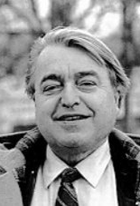
Cinema is not „langue“ (is not a Language system)
Christian Metz, Le cinéma: Langue ou langage. Communications, 1964
Langage et cinéma (1974) – a movie is a text; a text is a set of codes; a text is dynamic process of writing – ècriture
1970s and textual analysis:
Raymond Bellour, Dudley Andrew, David Bordwell, Dominique Chateau, Thierry Kuntzel, Francois Jost, Stephen Heath, Paul Willemen

Slide 126
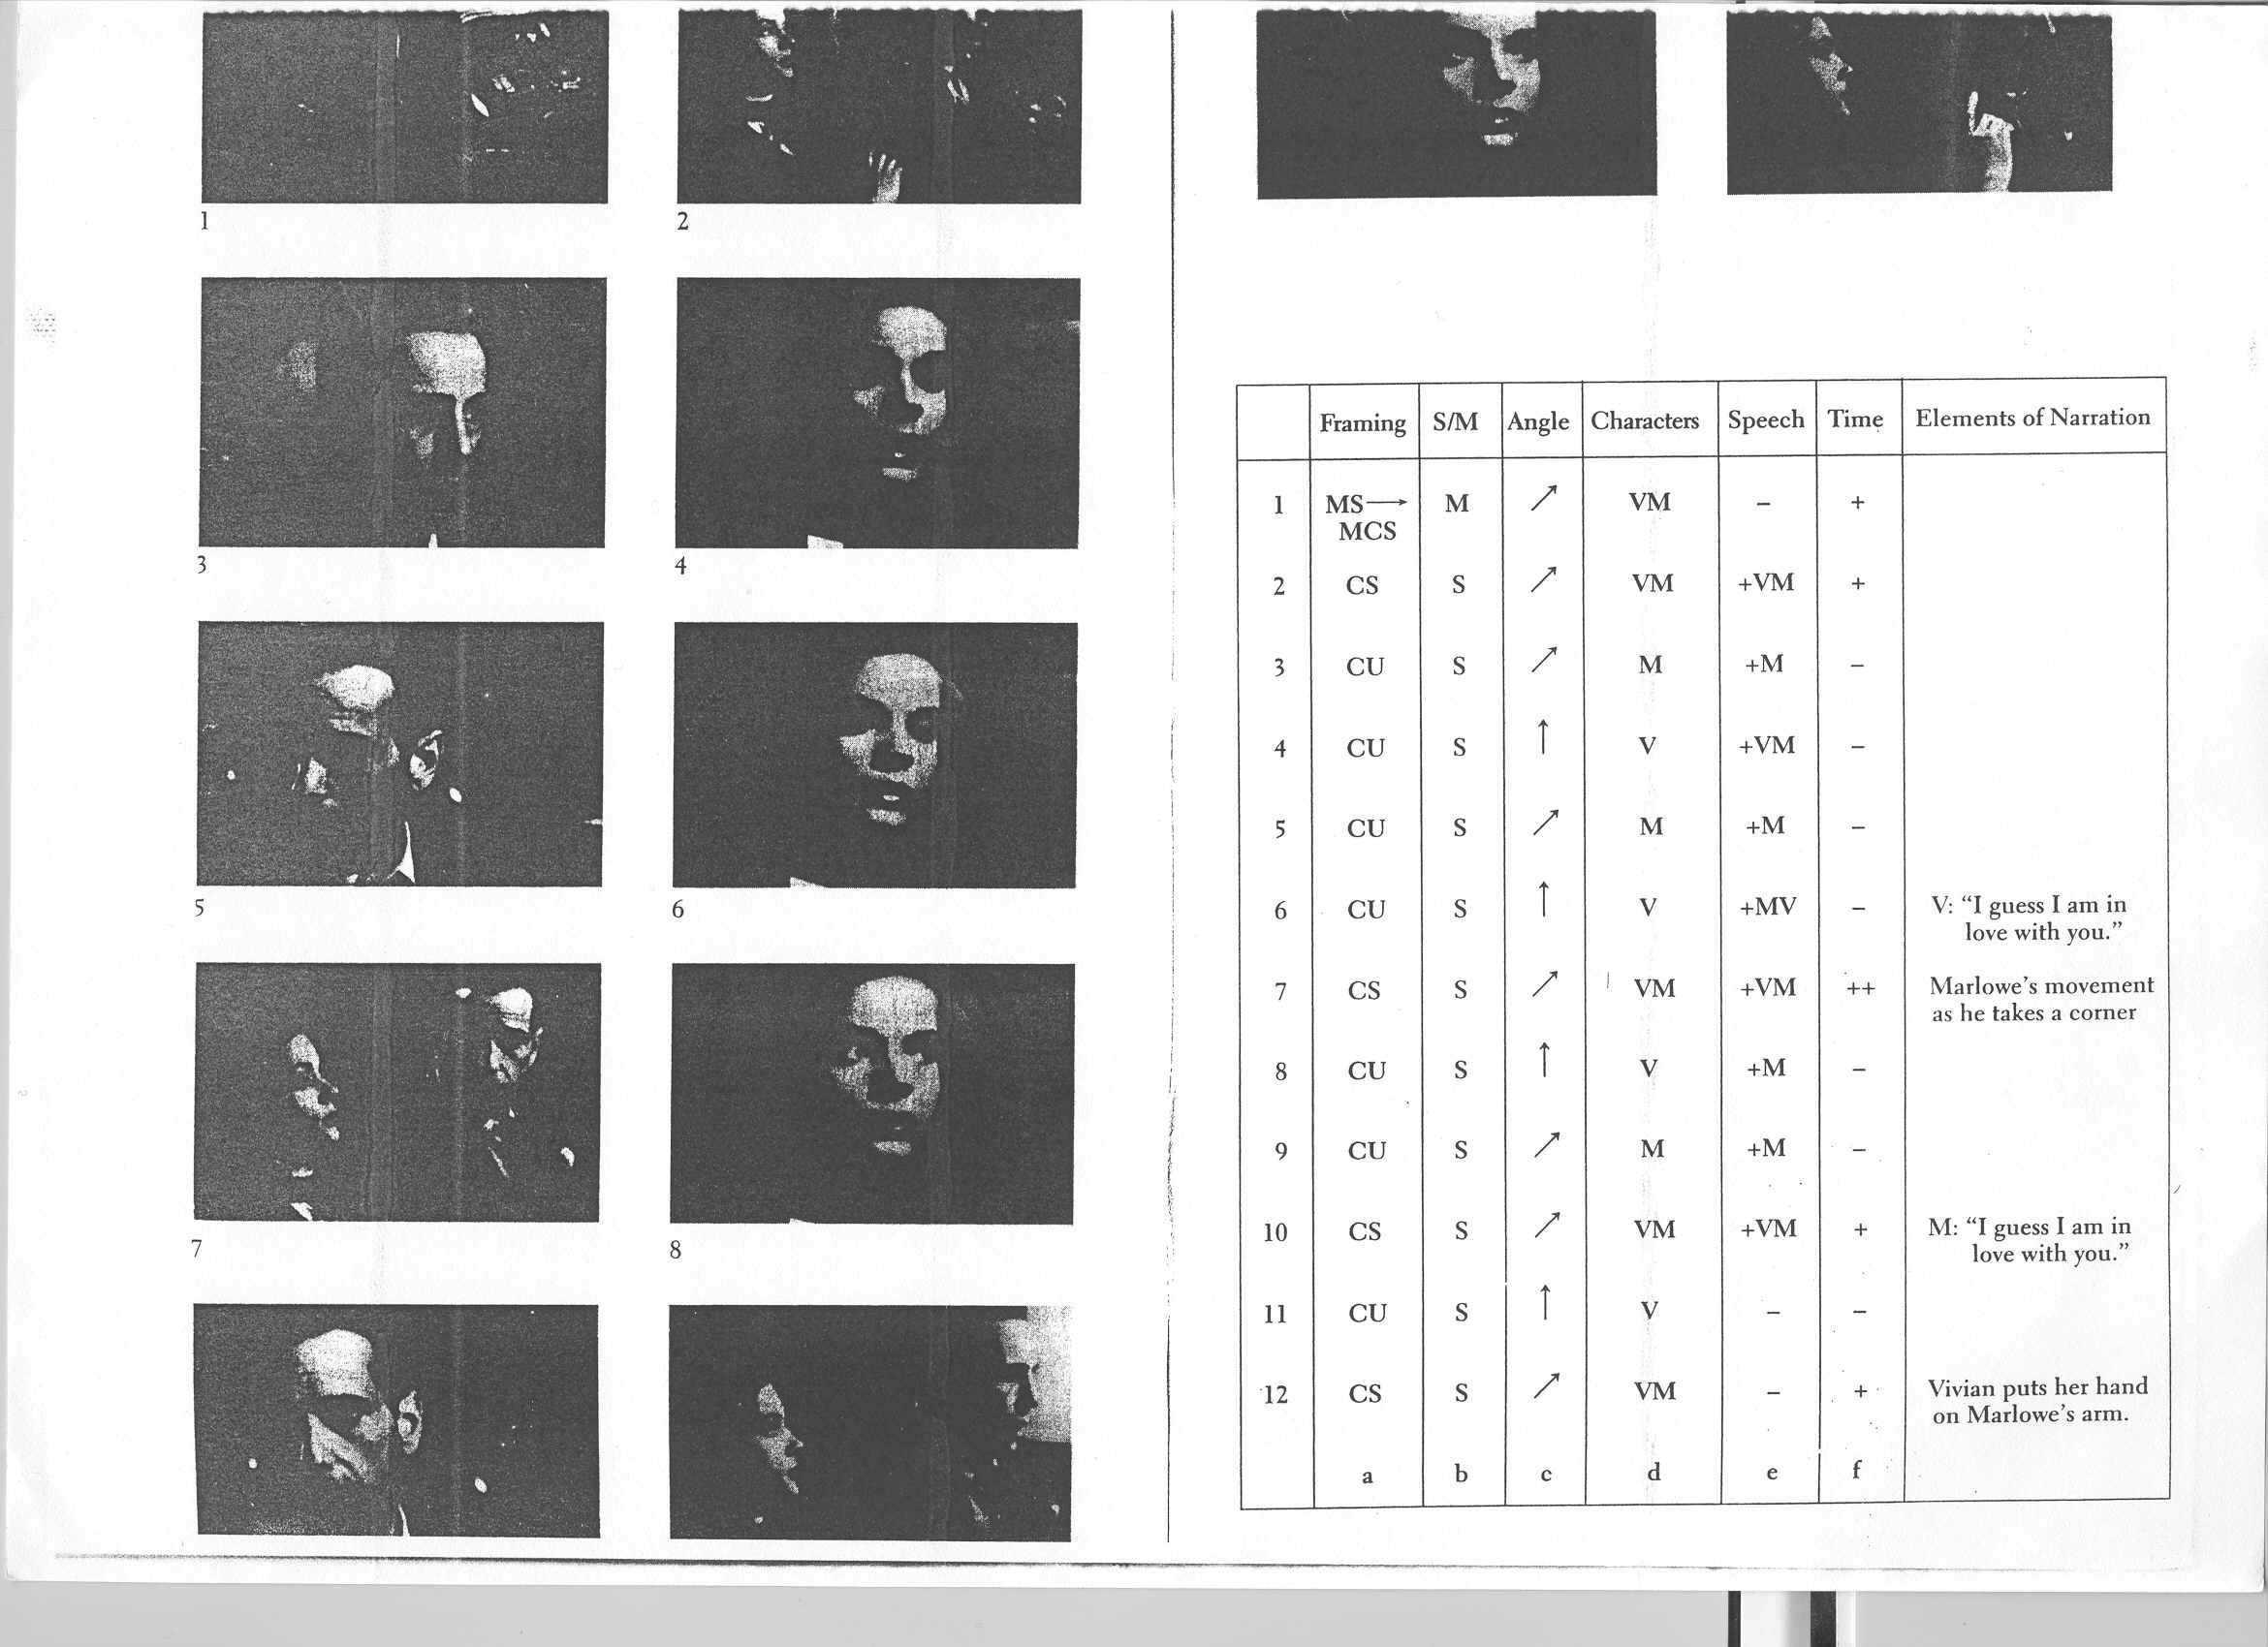
Raymond Bellour, the obvious and the code (screen 4, 1974)

Slide 127
The Big Sleep (howard Hawks, 1946)
1.44.00
12 shots; a specific unit of code
Segment: a moment in the filmic chain which is delimited both by an elusive but powerful sense of dramatic or fictional unity, and by the more rigorous notion of identity of setting and characters of the narrative
„ What I want to show here is how the simplest narrative fact imaginable - two characters talking in a car - can come to set into play a series of elementary but subtle operations which ensure its integration into the development of a narration. It is on this level that the — relative — poverty of this segment is exemplary“

Slide 128
three specific codes: The first three concern variations in scale between the shots (medium shot, medium-close shot, close-up), whether they are static or moving, and camera angle (symbolised by the arrow).
three non-specific codes: the presence or absence of this or that character or characters from the units considered, whether they express themselves in dialogue or not, and whether these units are of greater or lesser duration
a discontinuity capable of ensuring a certain degree of variation of the filmic space within the given time / This variation, which the narrative adopts as one of its basic options is, on the other hand, limited by a profound tendency towards repetition

Slide 129
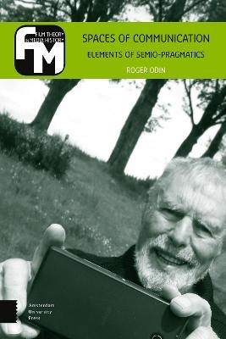
Roger odin´s Semio-pragmatics

Slide 130
pragmatics
Pragmatics: understanding language is not simply a matter of knowing the meaning of words and the grammatical relations between them, but depends on knowing how to use language in various contexts
Semantic theory: successful communication is an automatic process regulated and determined in advance by a system of codes
Pragmatic theory: meaning is not determined in advance – it is temporarily fixed when language is used in various contexts.

Slide 131
the act of seeing a film is a social fact obtained by adopting a role that regulates the production of the film text
meaning is not just a matter of text, but of context.
What a film means depends not only on what it says and how it says it, but also on where and when it says it and to whom
Role of specific institutional framings
Odin proposes the concept of alternative „readings“ - “documentarizing reading”, e.g. - and suggests that certain films lent themselves to such readings, or rather advertised themselves to invite such readings; whether a film was a documentary was a matter of framing and reading
Vinzenz Hediger, A Democracy of Readings and Objects: Roger Odin´s Contribution to the Theory of Film. Amsterdam UP, 2022
Warren Buckland, The Cognitive Semiotics of Film. Cambridge UP, 2009

Slide 132
space of communication
The space of communication is created when sender and receiver employ the same competence – the same mode – in the making and reading of a film
A space of communication is a space in which the production of meaning and affects are harmoniously formed during the filmmaking and the reading

Slide 133
modes of reading
Typology of modes of reading:
the spectacular, the fictionalizing, the energetic, the private, the argumentative/persuasive, the artistic, the aesthetic modes, etc.
institutional frameworks: e.g., the cinema, the art world, the school, the family
(another mode of reading and space of communication: academic readings of film and the space of the university)
Modes are competences of reading (making meanings and affects); application of the same mode of reading by „sender“ and „receiver“ creates „space of communication“

Slide 135
Modes – a typology
The spectacle mode - the spectator perceives the film as a spectacle; it minimizes interaction between the spectator and filmed events
The fictional mode - the spectator ‘resonates’ to the rhythm of the narrated events; a correlation between the film-spectator relation and the relations manifest in the diegesis
‘dynamic’ mode - the spectator ‘resonates’ to the rhythm of the film’s sounds and images (Moroder’s version of Metropolis, 1984); colorization – surface of the image
(98) Metropolis (Giorgio Moroder's Edition) – YouTube
3-5, 43-45
The home movie mode – adopted by a spectator when the film depicts spectator’s past lived experiences
Production of meaning and affect – implemented in seven possible modes

Slide 136
Types of mode
The documentary mode - informs the spectator of real events. What makes a documentary is the meeting of a certain mode of reading with a suitable text; real status of its enunciator
The instructional (or persuasive) mode - the spectator draws a moral, or truth
The artistic mode - the film is perceived, usually by a cinephile spectator, as the work of an auteur
The aesthetic mode - the spectator focuses on the technical work that has gone into the creation of the images and sounds
the modes (and operations) are not presented as textual features embedded in films. No film is inherently a fictional, documentary, or avant-garde film, because its mode is only determined through the process of reading

Slide 137
operations
1. Figurativization
2. Diegetization
3. Narrativization
4. Monstration (cinema combines monstration and narration, since the shot shows space, whereas the cut /and, more generally, editing/ introduces temporal and narrative articulation between shots)
5. Belief
6. Mise en phase (the moments in a film when the relation between film and spectator ‘resonates’ with the relations manifest in the film’s diegesis; a shipwreck scene [in order to create mise en phase] will be filmed using blurred images, staccato camera movements, misframings, etc. to the point of illegibility, to realize in the film-spectator relation the aggressivity manifest in the storm)
7. Fictivization (fictive origin of the enunciator; the spectator no longer feels interpellated as a real person having to take seriously what is narrated to him)
Films of different modes implement different operation

Slide 138
Institutions are constraints: textual and contextual constraints
Odin: „A priori, the spectator can make any mode function on any film (or fragment of film); in reality, we are always subject to constraints that limit this possibility.
Textual constraints: all films tend to block the working of certain modes of production of meaning and affects; contextual constraints: seeing a film is always made in an institutional framework which governs our way of producing meaning and affects.
Tthese two types of constraint can be reduced to one: institutional constraints“
The external and material dimension of institutions consists of the places in which the film is projected – commercial cinemas (for films realized within the fictional, spectacle, and dynamic modes), art house cinemas (films of the aesthetic and artistic modes), schools (films of the instructional mode) and so on

Slide 139
Documentary mode: real enunciator textual cues (to construct the real enunciator)
difference between the fiction and documentary modes: in the operation of fictivization. In the fiction film, the enunciator and addressee are modalized as imaginary (or absent)
Documentarizing reading strategy adopted by film spectators
textual cues that privilege the documentarizing reading in the documentary film
textual figures prompt the reader to take the cameraperson as the embodiment of the real enunciator. These figures include a blurred image, jolting camera movements, hesitant pan shots, abrupt editing, long sequence shots, insufficient light, film grain, direct sound (as opposed to studio sound), and real background ambience
For the reader, the real enunciator could be:
the camera; the cameraman; the director; the specialist (instructional movies); the society (symptomatic reading)

Slide 140
The Home Movie Mode
shown within the domestic space, in which both the enunciator and addressees are family members
to be seen by those who have lived (or seen) what is represented on the screen
The home movie recalls a previous series of events; it does not need to narrate those events.
For the relevant members of the family, the home movie generates pleasure through the diegetic and narrative poverty of its images
The home movie functions to guarantee the institution of the family (in French - film de famille): ‘‘The home movie is not an innocent film; it contributes in its own way to the maintenance of a certain order.’

Slide 141
Home movies – textual characteristics
Textual characteristics prompting the spectator to read a movie as a home movie:
Absence of closure
Linearity (discontinuous linearity)
Spatial indeterminacy – unclear relations between the shots
Disregarding the 180 degree axis; disregarding diegetization
Blurred images
Address to the camera
Inaudible or absent sound

Slide 142
Spectator, Film and the Mobile Phone
the communication space of film p (the film made to be seen on a mobile): emphasis is placed here on the medium, where it is up to the viewer to adapt to the portable object, and learn to use it;
with p film, we are in a meta-reading in which the mobile creates a reservoir of questions that the viewer has to ask if s/he wants to take these films made on mobiles seriously
„making of“ mode

Slide 143
“making of” mode
the spectator at the Pocket Film Festival is very different from the normal cinema spectator, who never considers what camera was used to make a film, or how this might have influenced the film
The process is the reverse of “cinema,” where impersonal utterance comes first, although it is also possible to use a camera to say “I“ (as in any number of diary films)

Slide 144
Semio-pragmatics
Homework for everybody:
To read: Roger Odin, Reflections on the Family Home Movie as Document: A Semio-Pragmatic Approach. In: Patricia Zimmermann – Karen L. Ishizuka (eds.), Mining the Home Movie. University of California Press, 2008
To watch: A Song of Air (Merilee Bennett, 1987)
(74) A Song of Air - YouTube(74) A Song of Air - YouTube
To answer: Choose a scene or a sequence from the movie A Song of Air. Interpret the segment in 1/ the mode of home movie 2/ in the mode of documentary

Slide 145
presentations
To present (Emil):
To read: Roger Odin, Spectator, Film and the Mobile Phone. In: Ian Christie (ed.), Audiences. Amsterdam University Press 2012, 155-169
To watch: any mobile phone film
To answer: What is „p film“ communication space? What does it mean to make a movie in this space? What does it mean to view a movie in this space? (i.e., why and how people make and watch movies made on mobile phones?) What is „making of“ mode?) Use clips from a mobile phone film in your presentation
To present (Javkhlan):
To read: Roger Odin, The Space of Communication and Migration: The Example of the Home Movie, 123-139. In: Odin, Spaces of Communication, AUP 2022
To watch: any TV show using home movies
To answer: How home movies are used in television shows? How the mode of mode of making meaning changes when home movies migrate to television, and what ethical questions these changes might rise? Use any example you can find – and show clips during your presentation

Slide 146
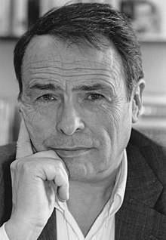
Pierre bourdieu (1930-2002)
French sociologist
Main works:
Bourdieu, P. 1984 [1979]. Distinction, R. Nice (trans.). Cambridge: Polity. [Originally published as La distinction: Critique sociale du jugement (Paris: Les Editions de Minuit).]
Bourdieu, P. 1988a [1984). Homo Academicus, P. Collier (trans.). Cambridge: Polity. [Originally published as Homo Academicus (Paris: Les Editions de Minuit).]
Bourdieu, P. 1990c [1980]. The Logic of Practice, R. Nice (trans.). Cambridge: Polity. [Originally published as Le sens pratique (Paris: Les Editions de Minuit).
Bourdieu, P. 1996a [1992]. The Rules of Art, S. Emanuel (trans.). Cambridge: Polity. [Originally published as Les regies de Part: Genese et structure du champ litteraire (Paris: Seuil).]
Bourdieu, P. 1998b [1996]. On Television and Journalism. London: Pluto. [Originally published as Sur la television, suivi de L'Emprise du journalisme (Paris: Raisons d'agir).]

Slide 147


Slide 148
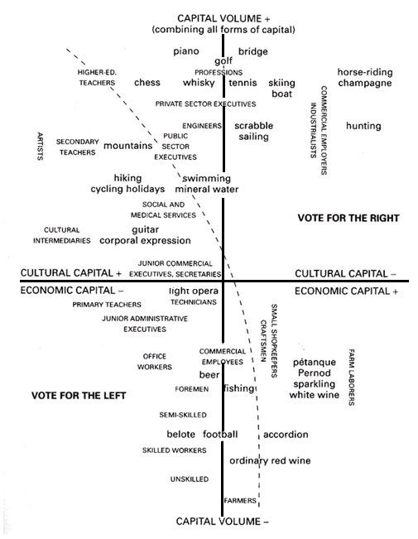

Slide 149
Field of cultural production
A field is "a separate social universe having its own laws of functioning independent of those of politics and the economy . . . and which is constituted as it establishes its autonomy".
There is a large number of fields—literary, philosophical, educational, juridical, medical, and so forth
concept of a "field" of cultural production focuses on the relations between cultural producers, on one side, and consumers, on the other side
(fields of restricted production / fields of large-scale production)
The goal: to explain the process whereby certain cultural products and practices legitimately gain and retain high status
Principles of hierarchization: autonomous (field´s own norms) / heteronomous

Slide 150
Field, capital, habitus
Differentiated societes – social life takes place in more social fields (artistic, media, political, etc.)
Social field is relatively autonomous section of social space – a section with its own rules and structured according its own system of capital distribution
Capital:
Economic (physical and financial)
Social (network of potentially useful social ties)
Cultural (objective /books/; incorporated /competencies.../, institutionalized /diploma.../)
Any other kind of capital which might be exchanged into symbolic capital (physical capital, e.g., in the field of boxing)
Symbolic capital – any of the previous kinds of capital whenever they are perceived from the point of view of classfication and prestige

Slide 151
Social space is a relational space – positions in capital distribution are mutually related (a high position is defined towards a low position, not as „substantially high” position)
Habitus = system of individual dispositions to perceive, think, and act in a certain way. They are the result of the action of objective structures to which the actor is exposed for a long time. The actor perceives the world from his position in social space - this objective position in social space "sediments" into the mind and body of the social actor. The perception and thinking of the actor adapt to the social position he occupies. Habitus is an internalized social position

Slide 152
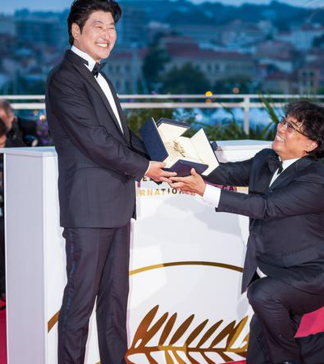
Cultural field…
… comes into being when cultural production begins to enjoy autonomy from other existing fields in terms of the type of capital available to cultural producers. In any given field, „actors“ engage in competition for capital.
Autonomy of the field: depends on a distinct form of symbolic capital available to consecrate cultural products
For example, the literary field has achieved a high degree of autonomy; it offers prestigious prizes and critical success that constitute the symbolic capital that may serve as an alternative to economic capital for authors

Slide 153


Specific capital

Slide 154
differences between fields of arts
1/ canonic art works and their conventions
There are certain canonic film works whose characteristics can act as touchstones from which experimentation should take place. Birth of a Nation (1915), in which D . W. Griffith invented many of the standards for narrative storytelling in film, is one such touchstone. Citizen Kane (1941) is another.
2/ the sources of recognition
In addition to knowing the language of film conventions, a film artist will be familiar with the field's specialized system for recognizing excellence. Artistic merit will be awarded by winning the right awards at the right film festivals; by being of interest to and approved by the right film scholars;
by being well reviewed by the right critics; and by recognition from other highly regarded film artists. A film artist will seek this symbolic capital.
Shyon Baumann, Hollywood Higbrow. From Entertainment to Art (Princeton: Princeton University Press, 2007)

Slide 155
fields of restricted production / fields of large-scale production
In fields of restricted production, cultural goods are produced for an audience whose members are primarily cultural producers themselves. This is a relatively small audience with a great deal of cultural capital available for appreciating art.
In contrast, fields of largescale production are organized to create cultural goods that will appeal to nonproducers of cultural goods and as large a market as possible.
These two categories represent ends of a continuum along which all cultural production can be classified.
Symbolist poetry is a good example of a field of restricted production. The audience for Symbolist poetry is small (even smaller than the audience for poetry in general), and the audience members are quite often poets or authors themselves.
Rock music is a good example of a field of large-scale production. A major goal of the producers of rock music is to appeal to as many people as possible, the vast majority of whom are not musicians and who require less of cultural capital to appreciate the music.

Slide 156
homework
To read: James English, The Economy of Prestige, pp. 1-16, Introduction: Prizes and the Study of Culture + pp. 217-246, Strategies of Condescension, Styles of Play
To watch: any clip from an award ceremony
Homework for everybody, inspired by the reading:
analyse the ceremony and the clip, provide an interpretation of the ceremony´s and the award´s role in the „economy of prestige“; do not forget to refer to John English´s chapters as a background for your interpretation and make it clear that you read and understood English´s arguments.
DO NOT FORGET PROVIDE BIBLIOGRAPHICAL REFERENCES TO THE ASSIGNED TEXT
To present (Anastasia):
Marijke de Valck, Fostering art, adding value, cultivating taste. In: de Valck - Brendan Kredell - Skadi Loist (eds.), Film Festivals: History, Theory, Method, Practice. London – New York: Routledge, 2016, pp. 100-116
Briefly introduce to the audience the IDFA film festival; describe the three issues of festival discourse identified by the researchers (aesthetic/political; TV/cinema aeusthetics; true-value); compare the system of competition and award at IDFA with documentary film festival in Jihlava, Czech Republic: Ji.hlava IDFF (ji-hlava.com). Finally and most importantly: explain the distribution of cultural and social capital at IDFA film festival.

Slide 157
Howard S. Becker on Pierre bourdieu
„He puts this description in the language of "field." … There is a defined and confined space, which is the field, in which there is a limited amount of room, so that whatever happens in this field is a zero-sum game. If I have something, you can't have it. Naturally, then, people struggle and fight over the limited space. The people who control the limited space try to keep it all for themselves and their allies and prevent newcomers from getting any of it.
Bourdieu described the social arrangements in which art is made - what he calls a field - as if it were a field of forces in physics rather than a lot of people doing something together. The principal entities in a field are forces, spaces, relations, and actors (characterized by their relative power) who develop strategies using the variable amounts of power they have available. The people who act in a field are not flesh-and-blood people, with all the complexity that implies, but rather caricatures…“

Slide 158
field
An artistic field is a structure of relations between positions
a position in the artistic field is an artistic position featuring the type of art produced
Fields of restricted and large-scale production
One of the most reliable indications that a field has been constituted: biographers, art and literature historians, all people who ‘make out a case for the preservation of what is produced in the field, who have an interest in that preservation’

Slide 159
two types of relationships govern the dynamics in a field:
1/ the struggle for dominance between positions in the field itself
2/ the relationship of (elements in) the field to (elements in) the environment, especially to the field of power (heteronomy)
the specific capital to be accumulated in the field is artistic prestige. Prestige is strongly connected to consecration; consecration generates prestige

Slide 162
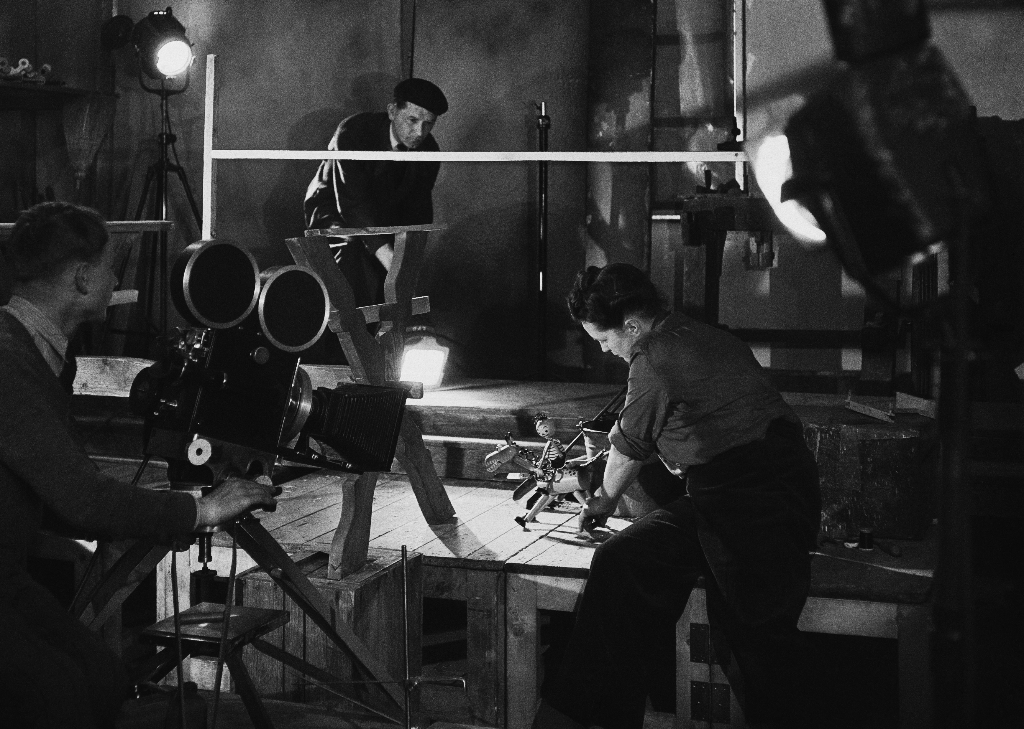
Coordination and conventions rule them all

Slide 163
ART WORLDS
Howard S. Becker: Art Worlds. Berkeley: University of california press, 1982
Howard S. Becker (1928), Sociologist, University of Chicago
Art worlds consist of all the people whose activities are necessary to the production of the works which that world define as art.
Members of art worlds coordinate the activities by which work is produced by referring to a body of conventional understandings embodied in common practice and in frequently used artifacts.
The same people often cooperate repeatedly, even routinely, in similar ways to produce similar works, so that we can think of an art world as an established network of cooperative links among participants.
If the same people do not actually act together in every instance, their replacements are also familiar with and proficient in the use of those conventions, so that cooperation can proceed without difficulty. Conventions make collective activity simpler and less costly in time, energy, and other resources; but they do not make unconventional work impossible, only more costly and difficult.

Slide 164
SYMBOLIC INTERACTION
Any human event can be understood as the result of the people involved … continually adjusting what they do in the light of what others do, so that each individual's line of action "fits" into what the others do.
That can only happen if human beings typically act in a nonautomatic fashion, and instead construct a line of action by taking account of the meaning of what Otllers do in response to their earlier actions.

Slide 165
Becker on bourdieu
„He puts this description in the language of "field." … There is a defined and confined space, which is the field, in which there is a limited amount of room, so that whatever happens in this field is a zero-sum game. If I have something, you can't have it. Naturally, then, people struggle and fight over the limited space. The people who control the limited space try to keep it all for themselves and their allies and prevent newcomers from getting any of it.
Bourdieu described the social arrangements in which art is made-what he calls a field-as if it were a field of forces in physics rather than a lot of people doing something together. The principal entities in a field are forces, spaces, relations, and actors (characterized by their relative power) who develop strategies using the variable amounts of power they have available. The people who act in a field are not flesh-and-blood people, with all the complexity that implies, but rather caricatures…“

Slide 166
Becker on becker
„The idea of world, as I think of it, is very different. Of course, it is still a metaphor. But the metaphor of world contains people, all sorts of people, who are in the middle of doing something that requires them to pay attention to each other, to take account consciously of the existence of others and to shape what they do in the light of what others do. … they develop their lines of activity gradually, seeing how others respond to what they do and adjusting what they do next.“

Slide 167
Art Worlds: networks of cooperating people
How we can identify an Art World?
1/ we look for groups of people who cooperate to produce things that they call art;
2/ we look for other people who are also necessary to that production, gradually building up as complete a picture as we can of the entire cooperating network that radiates out from the work in question
The world exists in the cooperative activity of those people, not as a structure or organization.
The result of sociology of art is not an aesthetic judgment, but an understanding of the cooperative networks which make art work possible

Slide 168
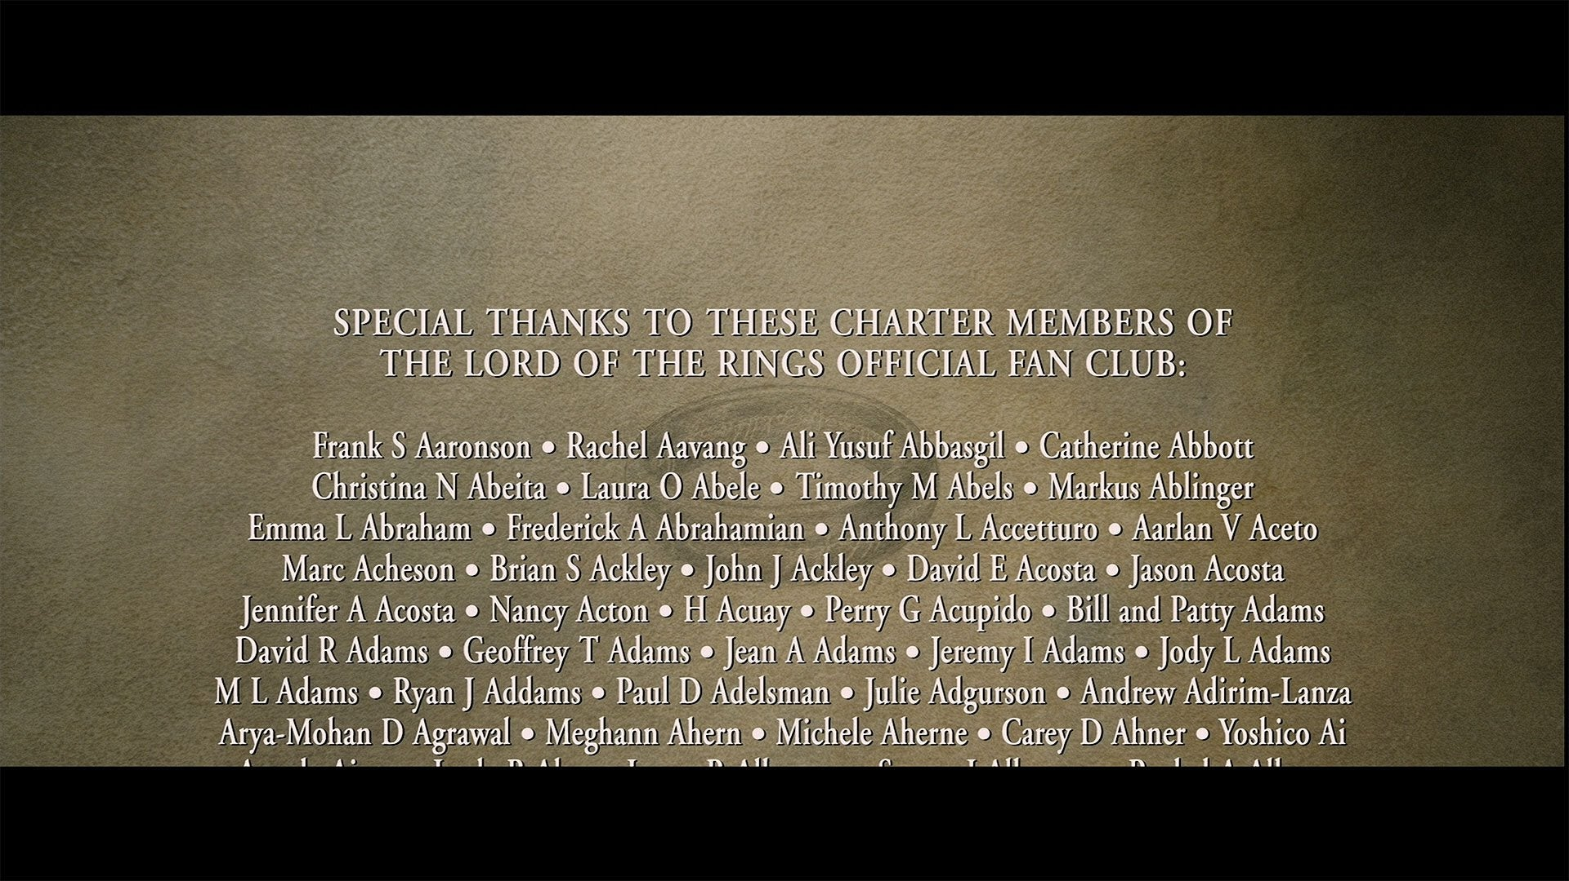

Slide 169
The division of labor
1978 film Hurricane
The film employed a director of photography, but Sven Nykvist did not actually operate the camera; Edward Lachman did that.
Lachman, however, did not do all the jobs associated with operating the camera;
Dan Myhram loaded it and, when the focus had to be shifted in the course of filming a scene, Lars Karlsson "pulled" the focus.
If something went wrong with a camera, camera mechanic Gerhard Hentschel fixed it.
Film credits – art world – their role for careers
Composers/performers in music (Igor Stravinsky – pieces designed to be playable by a pianist of no greater virtuosity than himself; vs. Contemporary division)

Slide 170
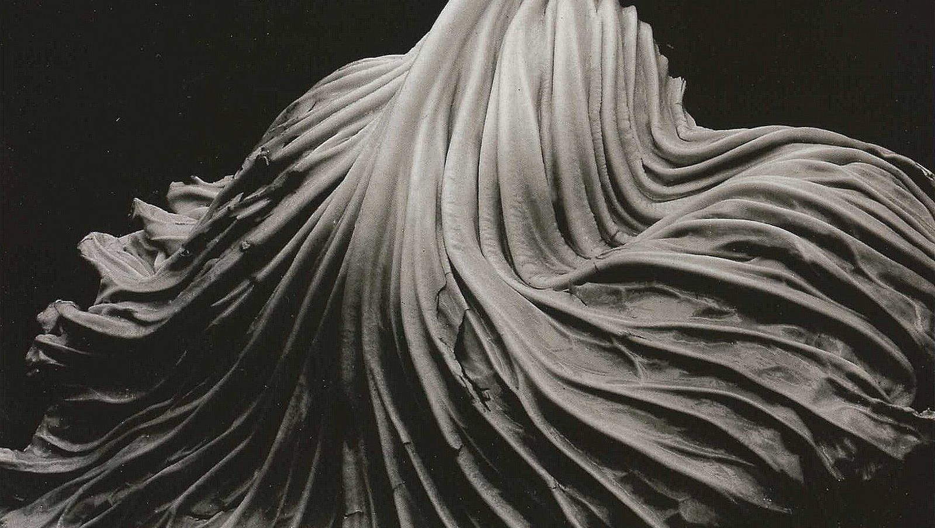

Edward Weston vs. Henri Cartier-Bresson
Weston made his own prints

Slide 171
Schools of activity
(Samuel Gilmore: Schools of activity and Innovation. The Socioogical quarterly 29, 1988, no. 2)

Slide 173
homework
Homework for everybody:
Howard Becker, Art Worlds, Chapter „Conventions“, pp. 40-67. University of California Press, 2008 (first in 1982)
Describe your own experience with learning and using art conventions. What art world do you participate in (as a consumer or as an artist)? What research questions might a researcher ask such an art world and its conventions? (provide references to Becker´s book)
To present (Danylo):
To read: Jeffrey K. Ruoff, Home Movies of the Avant-Garde: Jonas Mekas and the New York Art World. Cinema Journal 30, 1991, no. 3
When – and how – had the art world of avantgarde been established? What were the obligatory conditions for creation of the art world? What was the role of Mekas in the process of the art world´s creation? What we can learn about the Art World from Mekas´ movies?
Use clips from Walden by J. Mekas for illustration of the paper´s theses

Slide 174




Representation and heritage
Working title films (Four weddings and a funeral; notting hill; Bridget jones´s diary)

Slide 175
Representation and heritage cinema
(123) Stuart Hall's Representation Theory Explained! Media Studies revision – YouTube

Slide 176
codes
signs are not meaningful in isolation, but only when they are interpreted in relation to each other
production and interpretation of texts depends upon the existence of codes or conventions for communication
codes provide a framework within which signs make sense
Textual codes: aesthetic codes within the various expressive arts (poetry, drama, painting, sculpture, music, etc.) - including classicism, romanticism, realism;
Interpretative codes: ideological codes: More broadly, these include codes for encoding or decodint texts - dominant (or 'hegemonic'), negotiated or oppositional. More specifically, we may list the 'isms', such as individualism, liberalism, feminism, racism, materialism, capitalism, progressivism, conservatism, socialism, objectivism, consumerism and populism; (note, however, that all codes can be seen as ideological).
(see Daniel Chandler, Semiotics for Beginners)

Slide 178
Cultural history and representation of history
a filmed history, like a painted history or a written history, is an act of interpretation.
Andrzej Wajda’s Danton (1982). His decision to begin with the Terror, rather than with the more positive early phase of the Revolution, makes the thrust of his interpretation clear enough.
it might be argued that before studying the film, you should study the director. Wajda is a Pole with a long history of films that commented on the events of his time in his Danton, the role of the secret police, the purges, and the show trials make his allegorical intentions clear enough.
a film is the result of a collaborative enterprise in which the actors and camera crew play their parts alongside the director, not to mention the writer of the screenplay and the novel from which the film is so often adapted – so that historical events reach the viewer only after passing through a double filter, literary as well as cinematographic.
(Peter Burke)

Slide 179

Siegfried kracauer (1889-1966)
From Caligari to Hitler: A Psychological History of the German Film. Princeton: Princeton University Press, 1947
socio-cultural analysis of German films from 1918-1935 with the aim of defining mass psychology: "The film of a nation reflects its mentality", Kracauer argues, and relies on the fact that film is a team work, not an individual one, so it suppresses individual uniqueness in favour of what is common to multiple people.

Slide 180
According to Kracauer, films appeal to a multitude of audiences, popular film themes aim to satisfy an existing mass desire.
Kracauer argues: Even Nazi films, although the product of propaganda, reflected certain national characteristics. This is even more true in a free competition environment: general discontent will be reflected in revenues, and since the film industry is interested in profit, it will try to adapt as quickly as possible to the change in mental climate. American audiences may be getting what Hollywood wants them to want; but in the long run, it is public desires that determine the nature of Hollywood films. Kracauer argues that the methodology he used allows for the study of mass behavior in the U.S. and elsewhere.

Slide 181

Kracauer gives a portrait of the "German soul" as masculine, masochistic, "caught between revolt and obedience". He starts from the premise of the sociology of film, i.e. that national films reflect the mentality of the nation, that they reveal deep layers of the collective mentality.
However, Kracauer's research was selective in his choice of films - he omitted those that contradicted his thesis, such as comedies, operettas, and popular parodies, working with only about 8 percent of the films made in the period 1919-33 (about 100 films out of more than 1,000 films produced in Germany in those years).
Kracauer's association of representation with social motifs is simplistic and deterministic. Moreover, he proceeds from effect to presumed cause, from the historical fact of Hitler's rise to power to the determination of causes in the psychological predisposition of the German people.
Yet his work is important: it shows that film is important not only for aestheticians but also for historians and sociologists. Kracauer presents the film as an essential document for understanding how culture represents itself.

Slide 182
Pierre Sorlin (Sociologie du cinéma, 1977)
although film somehow shows society, it never duplicates reality, it only selects fragments from it, endowing them with meaning and making them functional within the story.
No society appears on the screen as it is, its representation is in accordance with the demands of the expressive means of its time, the director's choice, the audience's expectations.
Film always shows only the visible side of society, that is, what the image-maker is trying to capture and what the audience accepts without surprise.
Through filmmakers and viewers, society reveals its habits, mental schemas, points of attention. Through the visible side, society reveals its interests; it reveals the horizons of what it considers appropriate for discussion.
The visible and the representable shows the orientation of society. It is a way of seeing and knowing about the world - it is a mentality or ideology.
Here we are very far from Kracauer's mimetic model: cinema does not represent society, but only what society considers representable. Cinematography makes it possible to distinguish the visible from the invisible and thus to discern the ideological limits of the perception of its time; it tells us what society sees, what key images it turns its attention to. It also informs us about what it overlooks, censors or prohibits.
Cinematography does not reproduce the reality of society, but the way in which society deals with reality.

Slide 183
heritage cinema
British costume dramas of the 1980s and 1990s that detailed aspects of the English past and that shared emphasis on the upper and upper middle classes
Nostalgic and conservative celebration of the values and lifestiles of the privileged classes
125 films
Representation of the history of English cultural heritage
Whose heritage is being projected? (contradictory traditions competing for attention)
National identity is represented in the films as bounded to the upper and upper middle classes
Andrew Higson, English Heritage, English Cinema. Costume Drama Since 1980 (Oxford University Press, 2003)

Slide 184
homework
Andrew Higson, English Heritage, English Cinema. Costume Drama Since 1980 (Oxford University Press, 2003) – chapter „Case Study II: Elizabeth
Demjan: pp. 195-233
Englishness
Discourses around the film
What were „target audiences“ in the promotional campaign?
What other audiences were addressed by the movie?
What is platform release?
What generic identity was constructed for the movie?
--------
Yelyzaveta, pp. 233-256
Casting, stars – how – and why – Higson studies them?
How the marketing was designed? What was the role of heritage tourism in the marketing campaign?
How history was represented in the movie? How critics responded to the representation, and why?

Slide 185
project
Abstract
(brief, clear presentation of the project´s theses – 900 characters)
Subject matter of the project, contemporary state of the research
(what is the topic of your research, what has already been researched on it, with what results – 2500-3600 characters)
Goals of the project, its essence and value
(what do you want to find out or confirm, and why it might be important for other researchers 2500-3600 characters)
Methodological framework
(what methodology and theorethical approach you will apply for the research – 1800 characters)

