Slide 1
Session 1: Introduction
Questions or suggestions?
Speak to me or send me an email:
Julia Secklehner – secklehner@phil.muni.cz

Slide 2
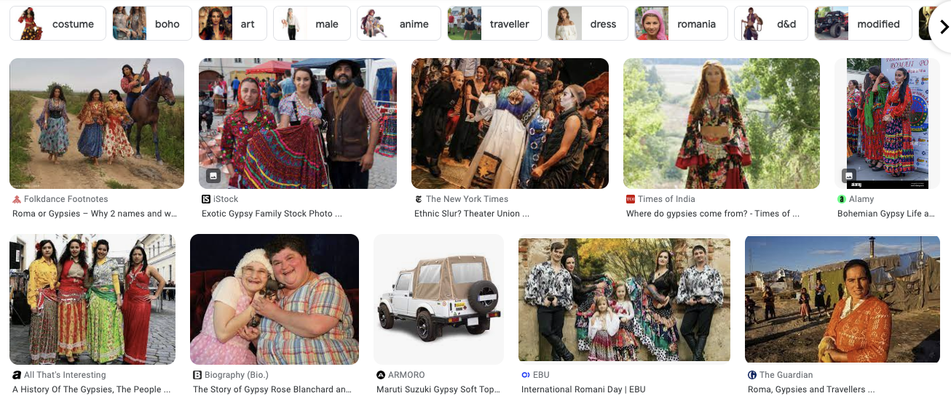

Slide 3
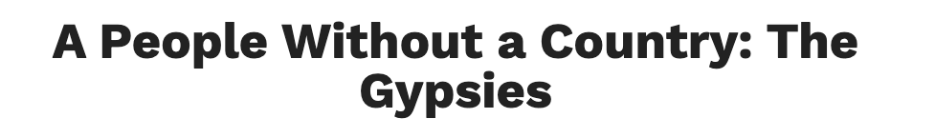
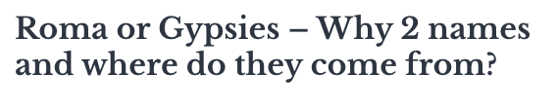
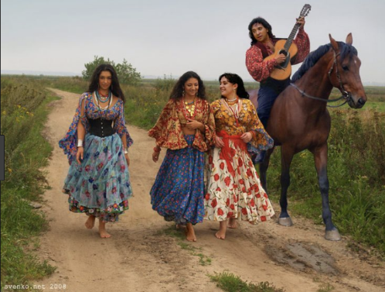
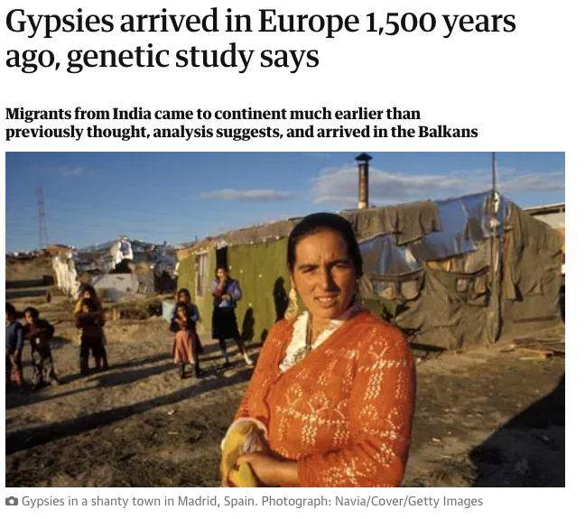
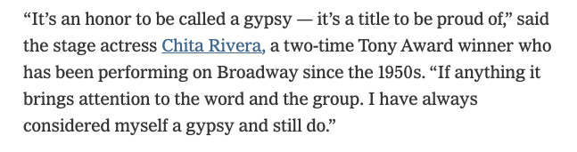
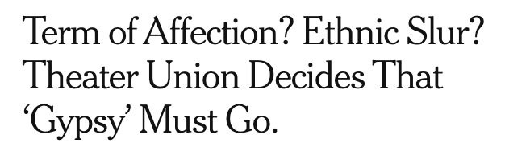

Slide 4
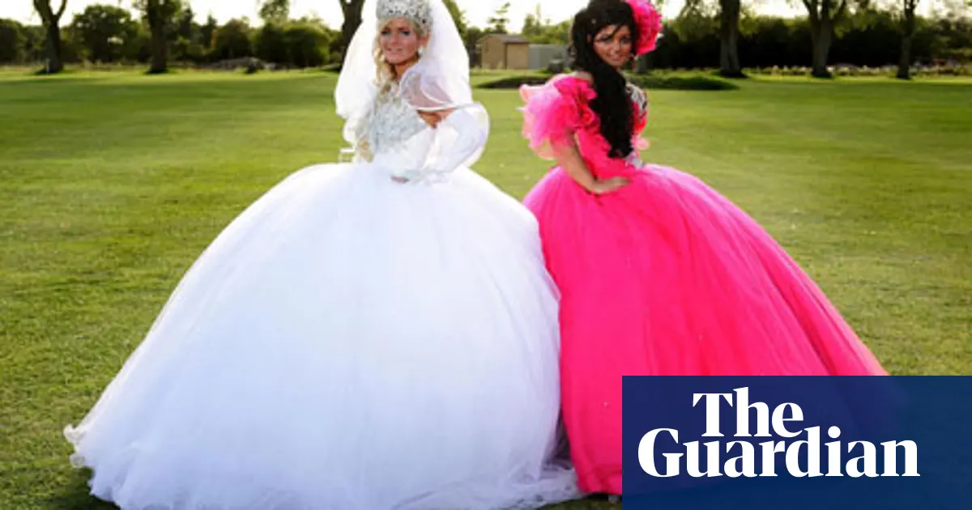
https://youtu.be/KW89-wcKg4Y

Slide 5
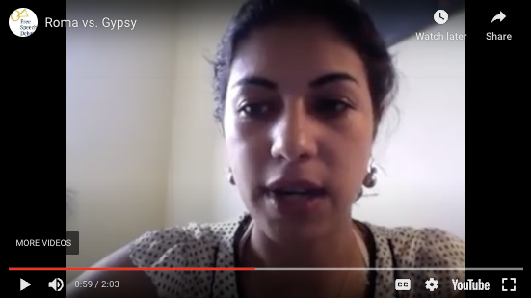
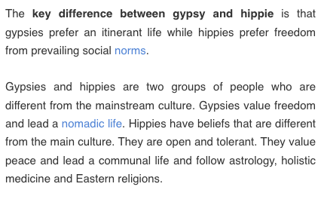
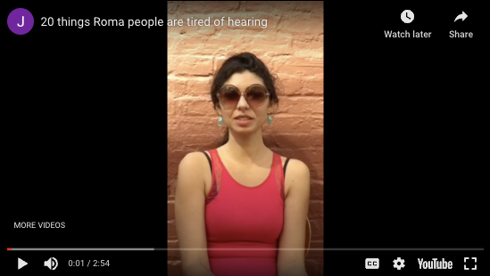
Trivial and dagerous stereotypes? Roma & “Gypsies”
https://youtu.be/2C3WETz0SN8
https://youtu.be/QmOyG1yz9G8

Slide 6
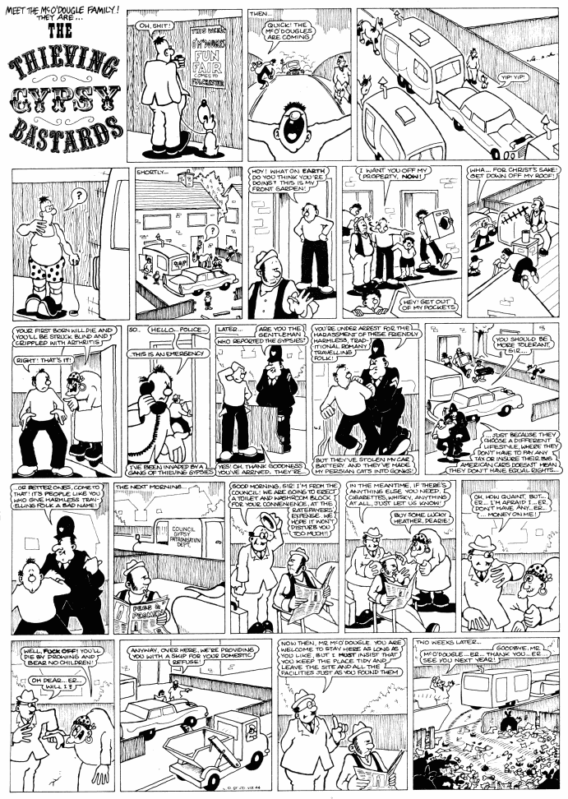
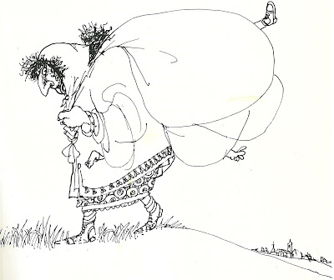
[T]heories which they [scientists] take for granted: they have absorbed them from their intellectual environment or from tradition. Since few of these theories are consciously held,they are prejudices in the sense that they are held without critical examination, even though they may be of great importance for the practical actions of people.
Popper K (2000) In Search of a Better World: Lectures and Essays from Thirty Years (trans. Laura J Bennett). London: Routledge.

Slide 7
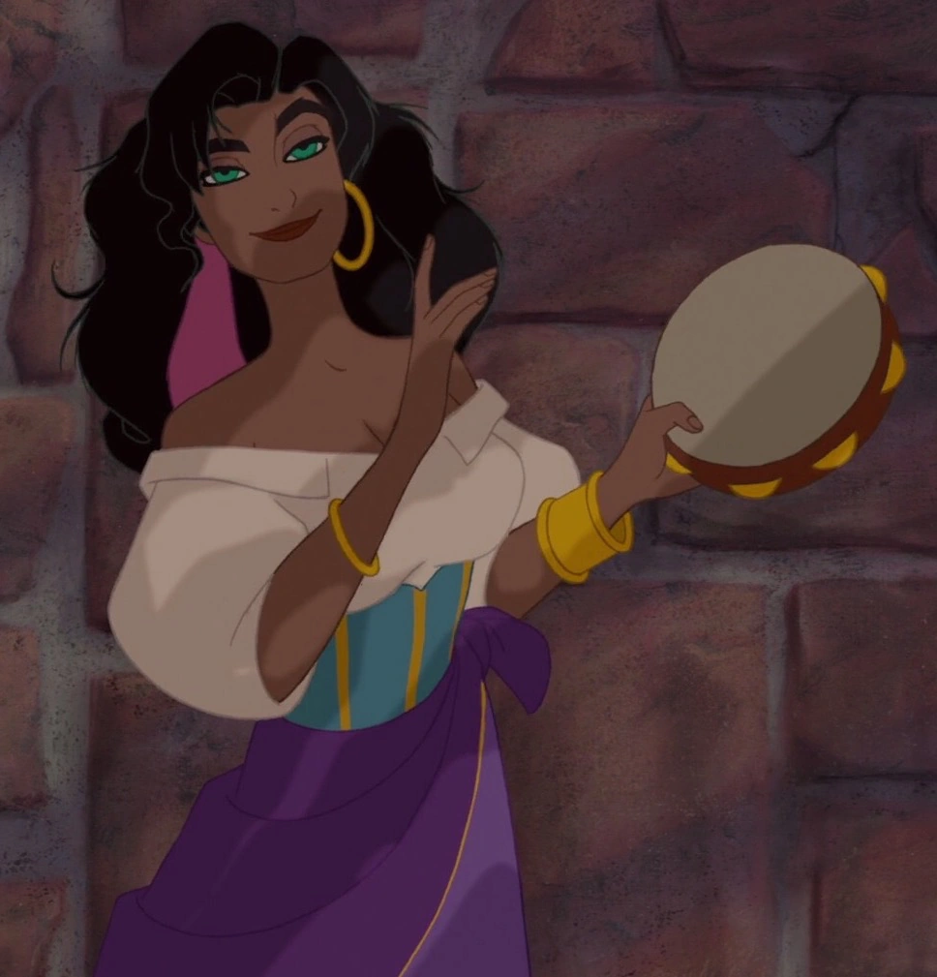
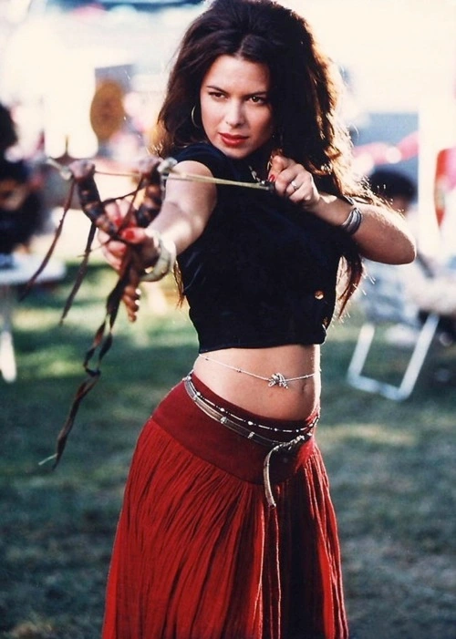

Slide 8
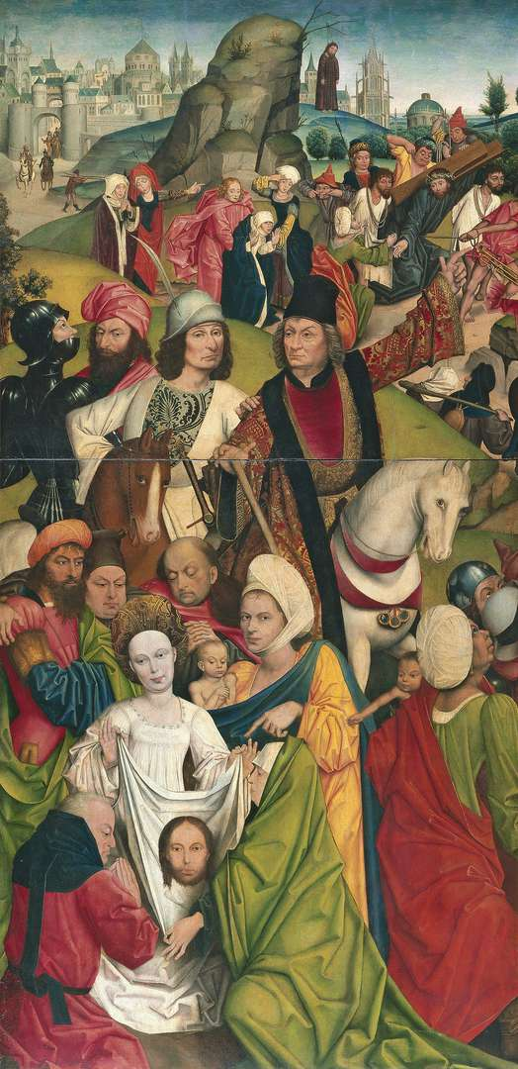
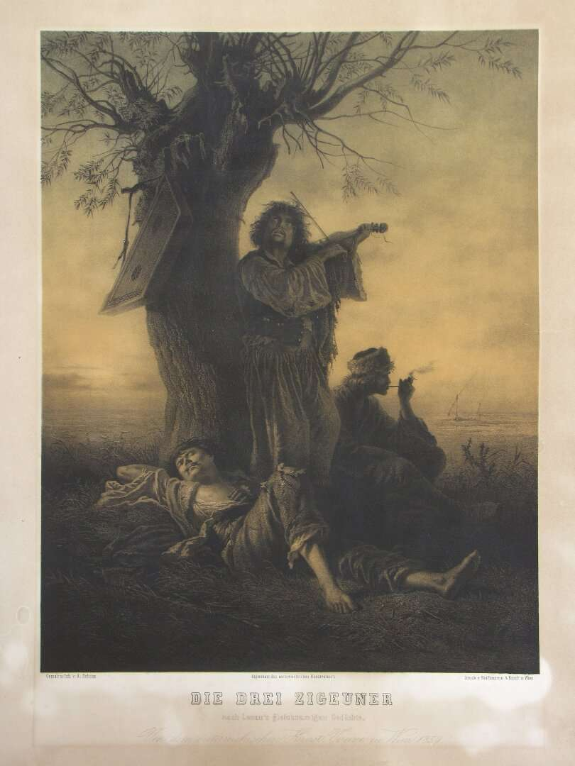
Alois Schönn | Three Gypsies | lithography | Austria | 1859 | vis_00027
Derick Baegert | Christ Bearing the Cross | painting | unknown | 1477 - 1478 | vis_00042

Slide 9


Karel Hynek Mácha, Cikáni (1835)
Karel Anton, Cikáni (1921)

Slide 10
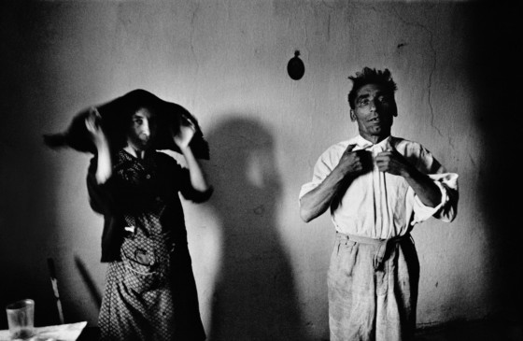
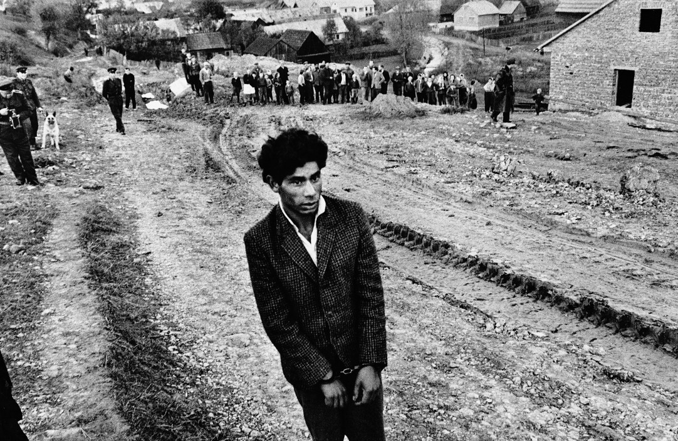
Josef Koudelka, Gypsies, 1967
Josef Koudelka | Gypsies Gypsies. Velka Lomnica, Czechoslovakia. 1966. © Josef Koudelka | Magnum Photos
Josef Koudelka | Gypsies Reconstruction of a homicide. In the foreground: a young gypsy suspected of being guilty. Jarabina, Czechoslovakia. 1963. © Josef Koudelka | Magnum Photos

Slide 11
„The understanding of the Gypsy identity among the non-Roma is vague, which usually results in prejudice. There are many reasons for that: the association of Roma with the Islamic takeover of parts of the Christian world; color prejudice, specifically the association of darkness with sin; the exclusionary nature of Romani culture, which does not encourage intimacy with non-Roma and creates suspicion on the part of those excluded; fortune-telling, which inspired fear but had to be relied upon as a means of livelihood in response to legislation curtailing Romani movement and choice of occupation; the unchallenged function of the "gypsies" as a population upon which mainstream notions of immorality and lawlessness can be projected and thereby serve to define that mainstream's own boundaries; the fact that Roma have no territorial, military, political, or economic strength and are therefore easily targetable as scapegoats because they cannot retaliate; and the fact that the "gypsy" persona has an-again unchallenged-ongoing function as a symbol of a simpler, freer time, a representation that is becoming more and more attractive in an increasingly complex and regimented world.“
Ian Hancock, 1997, “The Struggle for the Control of Identity”, Transitions Vol. 4, No. 4

Slide 12
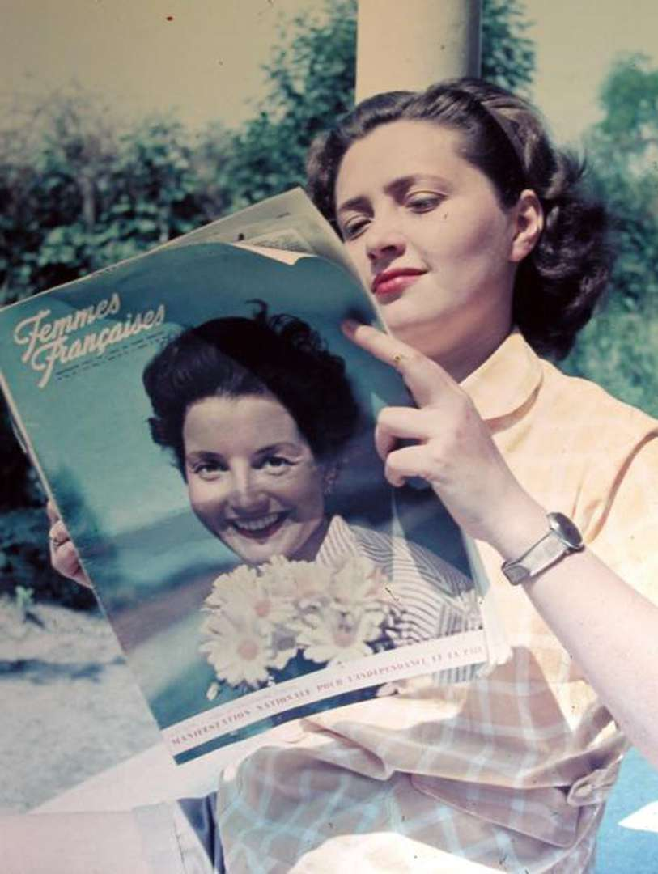
„The Gypsy image must be deconstructed and replaced by a more accurate one-in the bureaucratic structures as well as in the textbooks“
Ian Hancock, 1997, “The Struggle for the Control of Identity”, Transitions Vol. 4, No. 4
unknown | Ohne Titel | photography | unknown | 1947 | pho_00028

Slide 13
What will be our key terms?
Stereotype
Prejudice
Intersectionality
Postcolonialism
Visuality
Gender
Whiteness
Decolonising

Slide 14
participation
active participation in seminars/lectures (30%);
presentation of a selected case study (30%);
A short essay on a selected case study (40%)

Slide 15
What do you want to know?
Expectations from the course
Materials you expect to study
Places to visit

