Slide 1
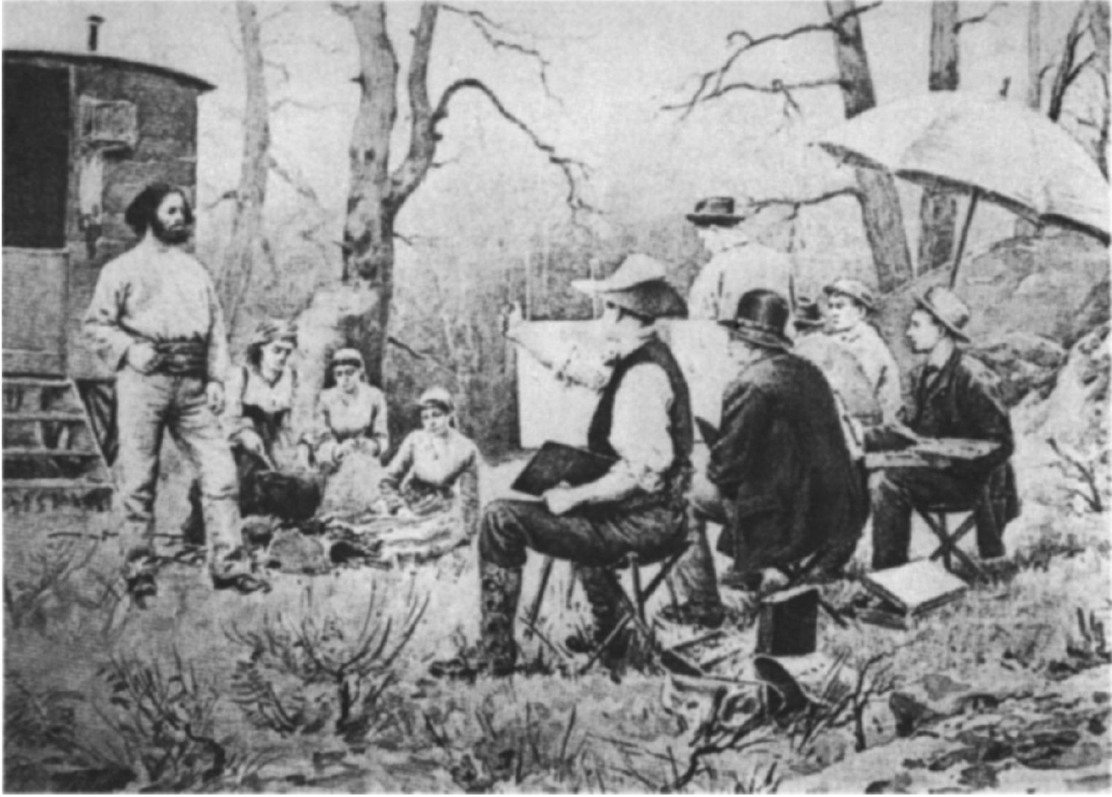
Who are the real Bohemians?
Artists and cultural appropriation
2 March 2023

Slide 2
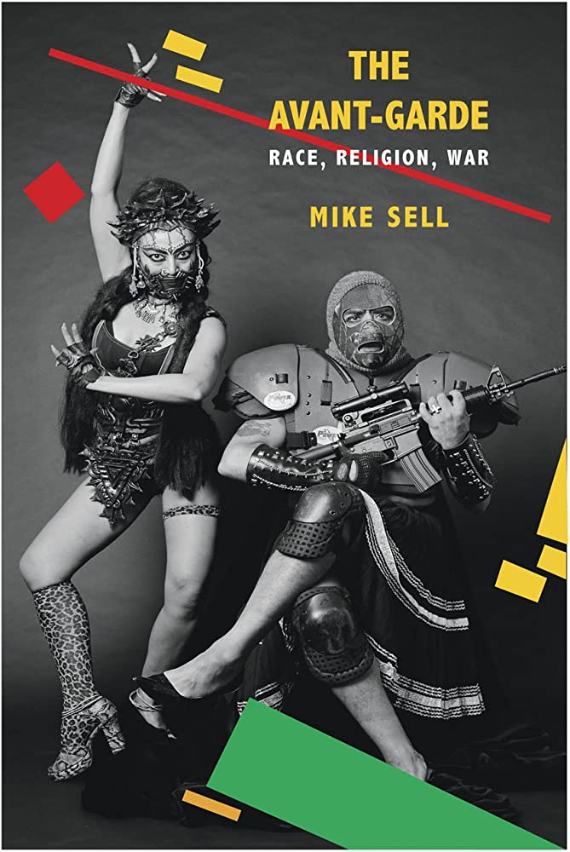
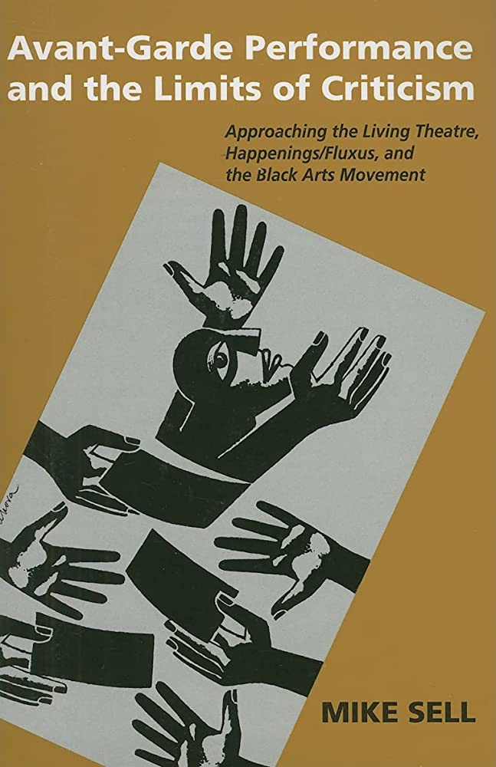
The Avant-Garde: Race Religion War (University of Chicago 2011)
Avant-Garde Performance and the Limits of Criticism (University of Michigan 2005)
Mike Sell. (2007). Bohemianism, the Cultural Turn of the Avantgarde, and Forgetting the Roma. TDR (1988-), 51(2), 41–59. http://www.jstor.org/stable/4492759

Slide 3

Memory theatre –
“texts … about the struggle to remember in the face of poverty, cultural marginalization … and a form of memory, as they all aim to recover that which has been discarded”
Broadway promotional poster for Rent (1996)
https://en.wikipedia.org/wiki/Rent_%28musical%29#/media/File:Rentpostera.jpg

Slide 4
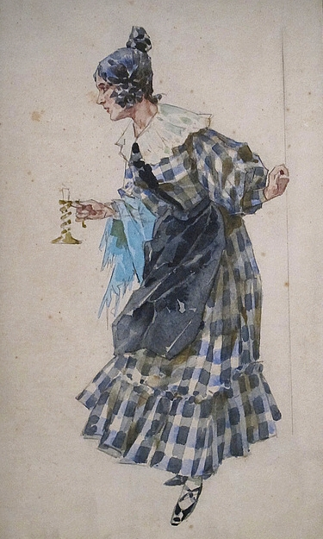
Bohemian style as a 19th century sub-culture, focusing on non-conventional lifestyles and, usually, life within a commune
often male dominated, but also women represented (often through they eyes of male writers and artists), e.g. Mimi in Puccini’s La Bohéme
Nostalgic and “outrageous” – visually represented through different tropes depending on the time: shifting visualisation, but same concept
The bohéme and the avant-garde, 1820s France: concerns with (selective) historical consciousness
Mimi's costume for Act I of La Bohème for the premiere performance, Torino, 1896. Archivio Ricordi Milano

Slide 5
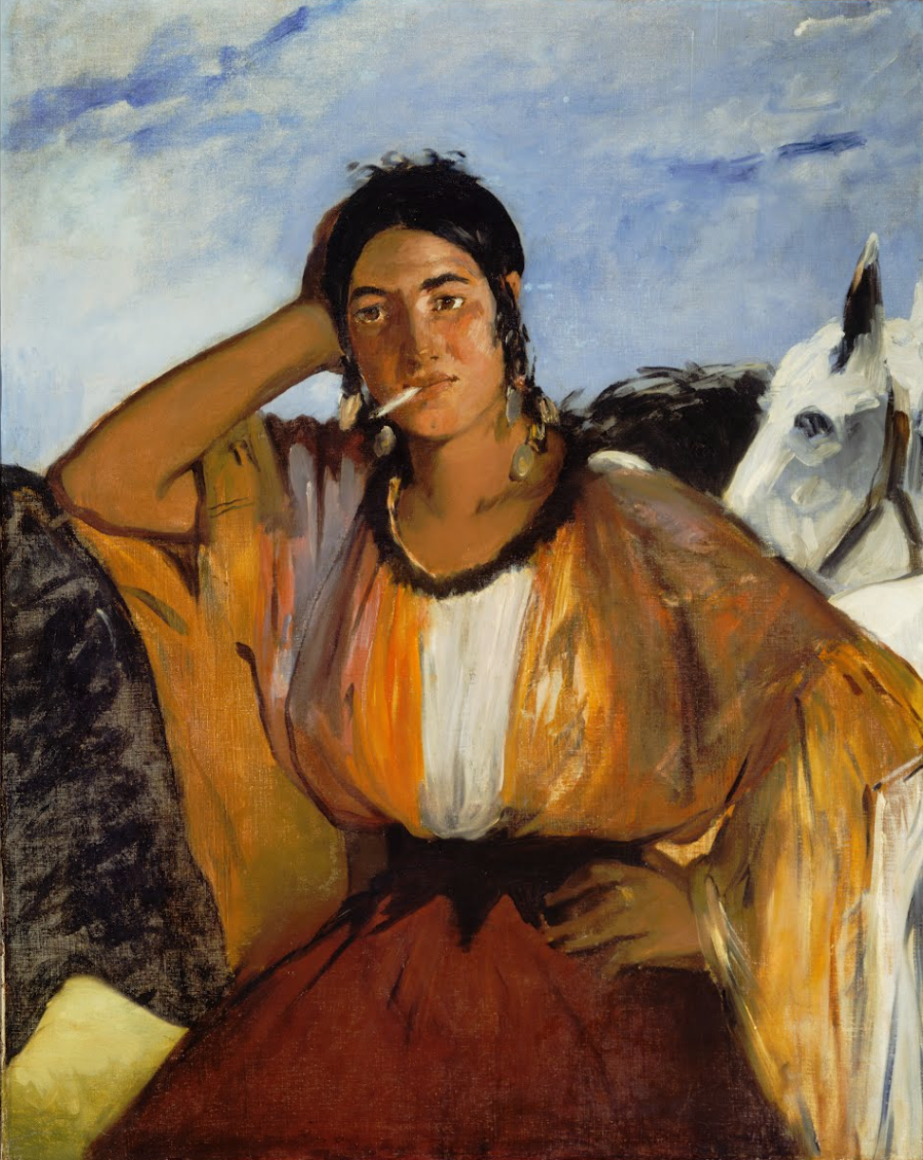
“But the bohemian also forgets, and what has been forgotten and how it has been forgotten prove on close inspection to be of real significance to our broader understanding of cultural provocation and politics. That's what I'll be doing here-describing what and how the bohemian forgets even as she proclaims an especially radical form of remembering .”
What is remembered and how?
What is it used for and appropriated for?
Eduard Manet, Gypsy with a Cigarette, 1862
Pinceton University Art Museum

Slide 6
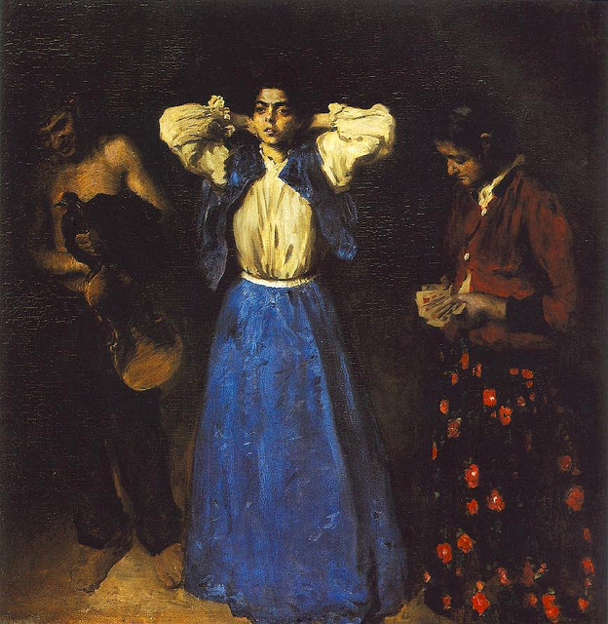
The Bohéme and the avant-garde
Nostalgic and “outrageous” – visually represented through different tropes depending on the time: shifting visualisation, but same concept
The bohéme and the avant-garde, 1820s France: concerns with (selective) historical consciousness
But this act of "bohemianized" memory proves highly selective even at its most critically aware.
Specific way of presentation
bohemia's function as one of a handful of cultural, political, and ethical tendencies out of which comes the avantgarde
Károly Ferenczy, Gypsies, 1901
Hungarian National Gallery

Slide 7
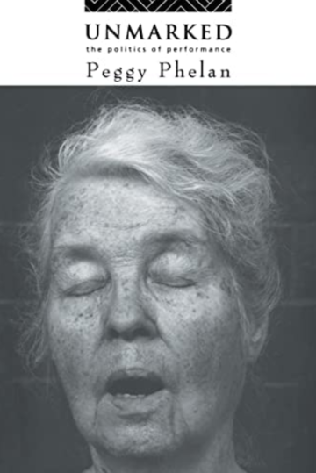
An "invisible thing" that is "not necessarily 'not-there,"' a "void" that is "empty, but [...] not a vacuum”
(Toni Morrison [1989] 2004:2306).
“The special talent of bohemians has always been the ability to discover new ways of living, ways that confront and/or avoid authority in new, surprising, and always interesting ways. Indeed, more than just a counterculture, bohemia is, in many respects, a seedbed for the very concept of culture”
“Like the fantasy of erotic desire which frames love, the distortions of forgetting which infect memories, and the blind spots laced through the visual field, a believable image is the product of a negotiation with an unverifiable real. “ (Phelan, 1)
“The pleasure of resemblance and repetition produces both psychic assurance and political fetishization. Representation reproduces the Other as the Same.”
(Phelan, 3)
Peggy Phelan, Unmarked: The Politics of Performance, Routledge 1993

Slide 8
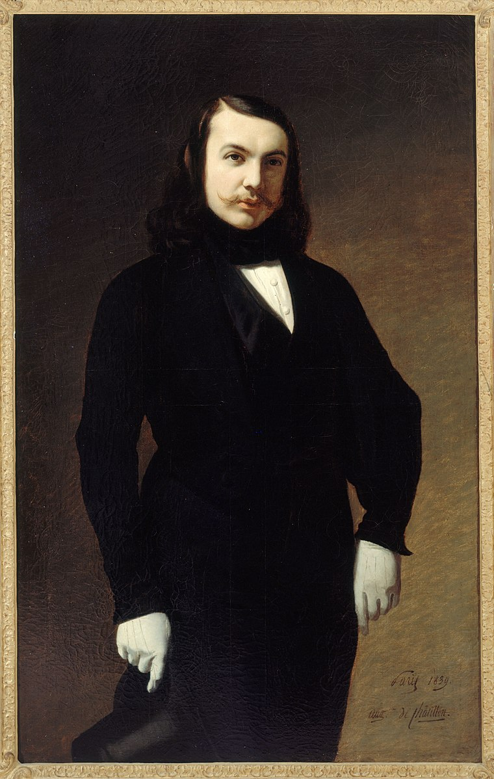
mimicking – appropriating – mythologizing – erasing
"theatricalized authenticity" and exoticism
to enforce feelings of belonging and authenticity
But what is at stake?
the cultural turn of the avantgarde in the mid-19th century as a racialist turn
gestures, clothes, lifestyle, and interior: visibility politics
Auguste de Chatillon, Portrait de Théophile Gautier, 1893, City Museum of Paris

Slide 9
Barbizon school
romanticism, realism, landscape painting
France, mid-19th century
Founders Théodore Rousseau and Jean-François Millet
Gustave Bourgain (1856–1918)
Jean Richepin (1849–1926), posing in front of the wagon
Multiple layers of “bohemianism”
Gustave Bourgain, Gypsies, 1890
(printed in Sell)

Slide 10
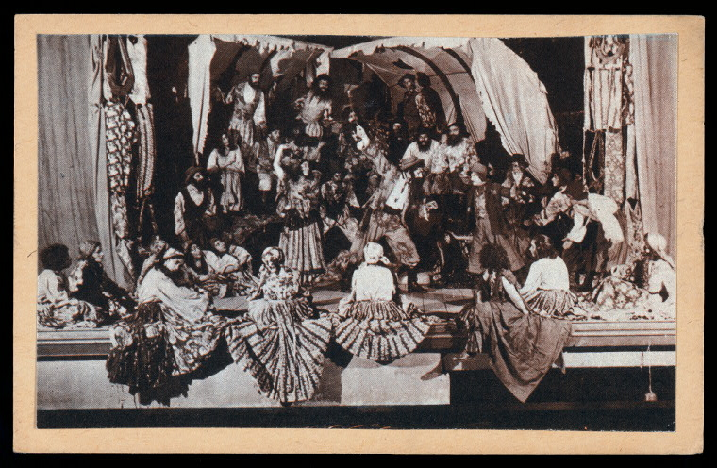
Theatricalized authenticity
Moscow Romen Theatre, founded in 1931
“Theatricalized authenticity is shared by bohemians and Roma alike, a sense that true being is not possible except through a theatricalization of self, a making public of a secret identity in declarations and exhibitions of public derring-do that are also exercises in subversive disguise and deception, an effort to "hide in the light" and, in the very act of hiding, demonstrate a fragile sense of otherness ”
Avant-garde performance – Bohemians doing the same?
An undated photo depicting "The Gypsy Theatre" in the USSR, from the New York Public Library's Billy Rose Theatre Collection.

Slide 11

Identity, performance, performativity
“If gender attributes and acts, the various ways in which a body shows or produces its cultural signification, are performative, then there is no pre-existing identity by which an act or attribute might be measured; there would be no true or false, real or distorted acts of gender, and the postulation of a true gender identity would be revealed as a regulatory fiction. That gender reality is created through sustained social performances means that the very notions of an essential sex and a true or abiding masculinity or femininity are also constituted as part of the strategy that conceals gender’s performative character and the performative possibilities for proliferating gender configurations outside the restricting frames of masculinist domination and compulsory heterosexuality.”
Judith Butler, Gender Trouble, 1993

Slide 12
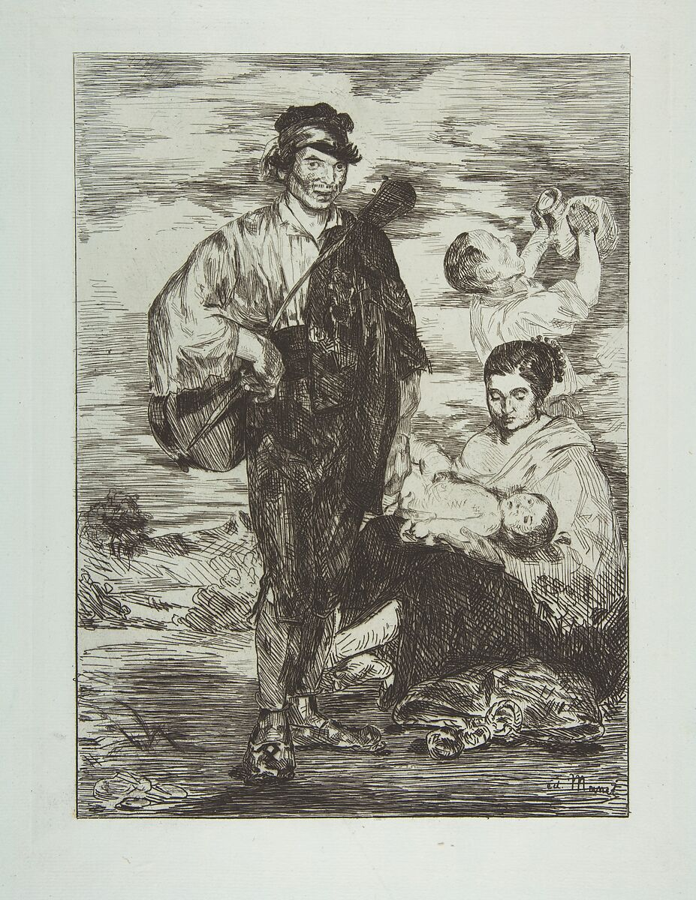
The ‘blackening’ of bohemia
“From its very inception, the Western [...] avantgarde has consistently found itself entangled in the cultural politics of colonialism. Examples of this entanglement are not difficult to find since they are often scantly masked beneath aesthetic categories like primitivism or negritude [...] or beneath a patronizing embrace of Asian performance traditions [...].” (James Harding, 2006:18)
Edouard Manet, The Gypsies, 1862, Metropolitan Museum New York

Slide 13
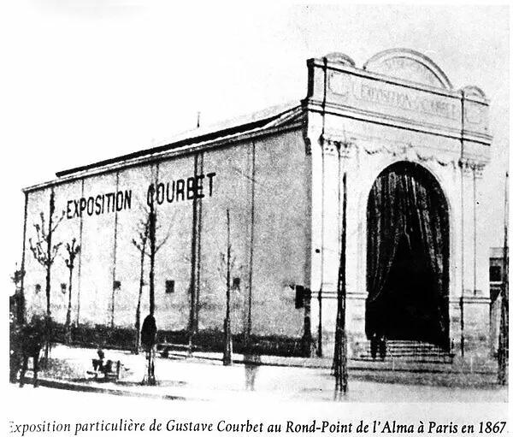
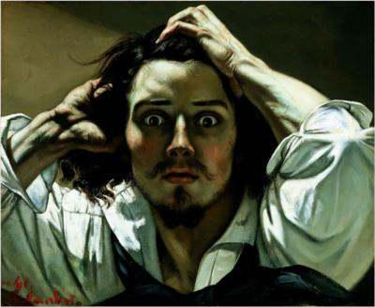
"In our oh-so-civilized society, it is necessary for me to lead the life of a savage [...] To that end, I have just set out on the great, independent, vagabond life of the gypsy”
Gustave Courbet, in Marilyn Brown, Gypsies and Other Bohemians: The Myth of the Artist in Nineteenth-Century France. Ann Arbor: UMI Research Press.1985, 4
Actual (artistic/social) distance as the key
Gustave Courbet, The Desperate Man, 1843-1845, private collection of the Conseil Investissement Art BNP Paribas
Courbet pavilion at the Universal Exhibition in Paris, 1855

Slide 14
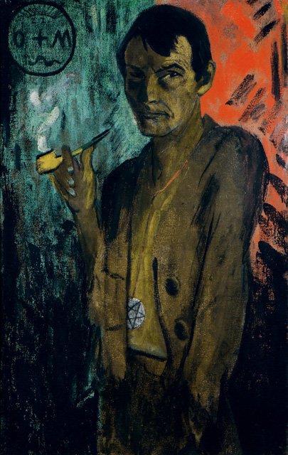
“The ubiquity of race and racialized thinking in the avantgarde is not just a consequence of the ubiquity of racial thought and racialized power in the modern world. The avantgarde has been an agent of that ubiquity, at times altering it in favour of the disempowered, at times working to strengthen the already empowered.”
Otto Müller, Self Portrait with Pentagram, around 1924. Von der Heydt-Museum Wuppertal. © Von der Heydt-Museum Wuppertal.

Slide 15
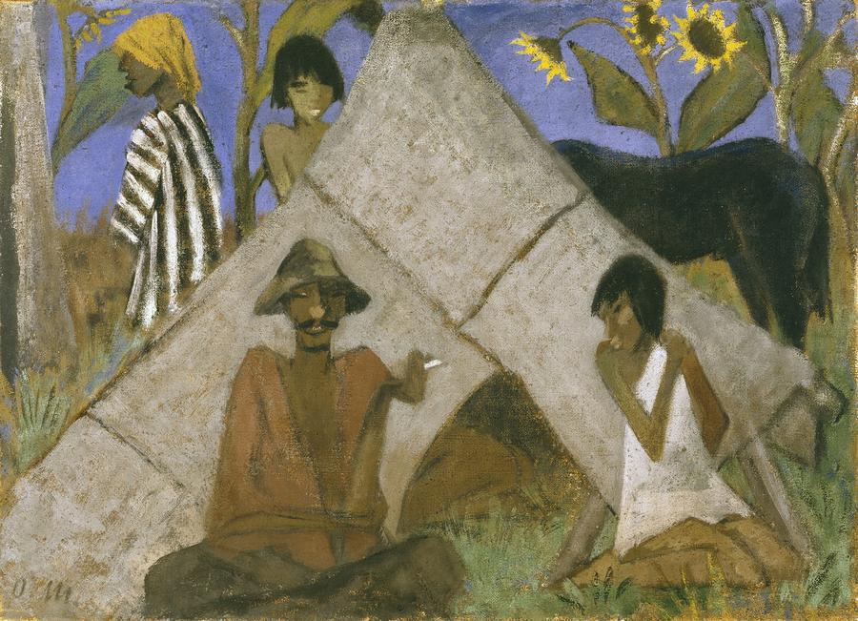
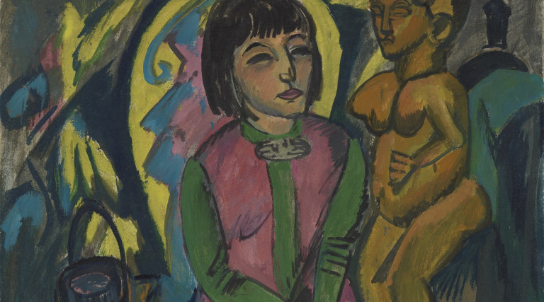
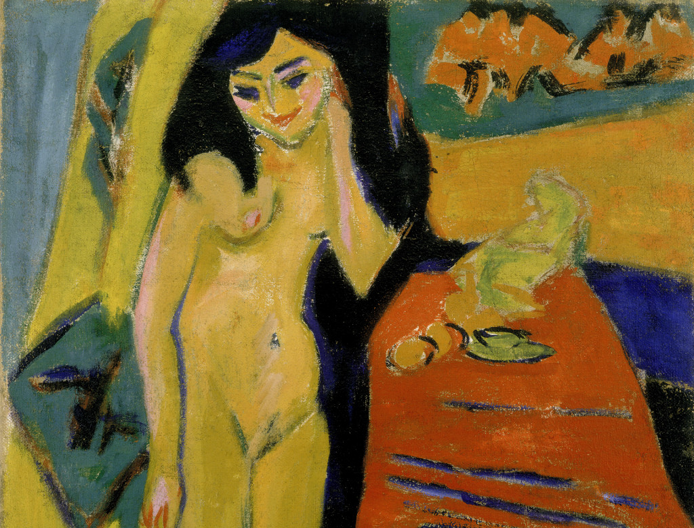
Ernst Ludwig Kirchner, Seated Woman with Wooden Sculpture (1912)
Ernst Ludwig Kirchner, Naked Girl behind the Curtain (Fränzi) (1910-1926)
Otto Müller Gypsy Encampment (1925)

