Slide 1
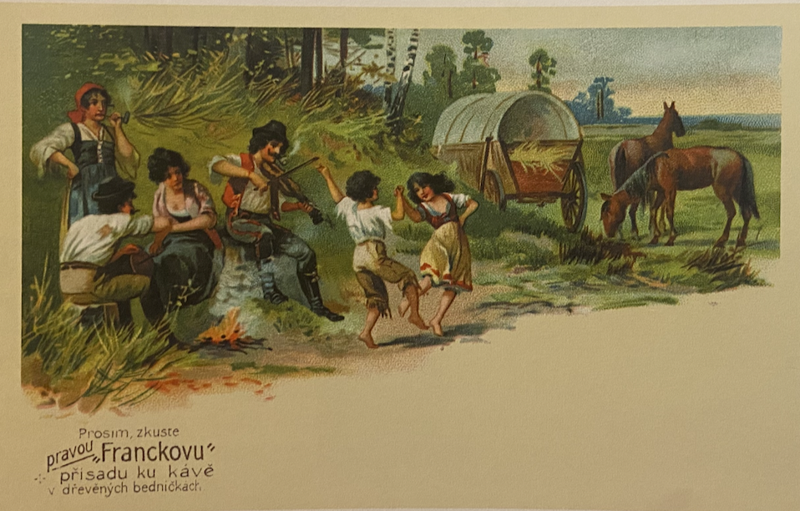
"Gypsies" everywhere
Photography, picture postcards and the commercialization of racialised images
16 March 2023

Slide 2
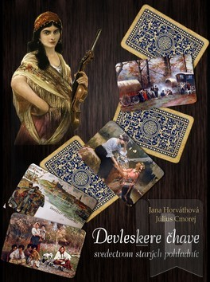
Jana Horváthová, Devleskere čhave - svedectvom starých pohľadníc, Region Poprad, 2006

Slide 3

Victoria Shmidt, Bernadette Nadya Jaworsky , Historicizing Roma in Central Europe. Between Critical Whiteness and Epistemic Injustice, Routledge 2021

Slide 4
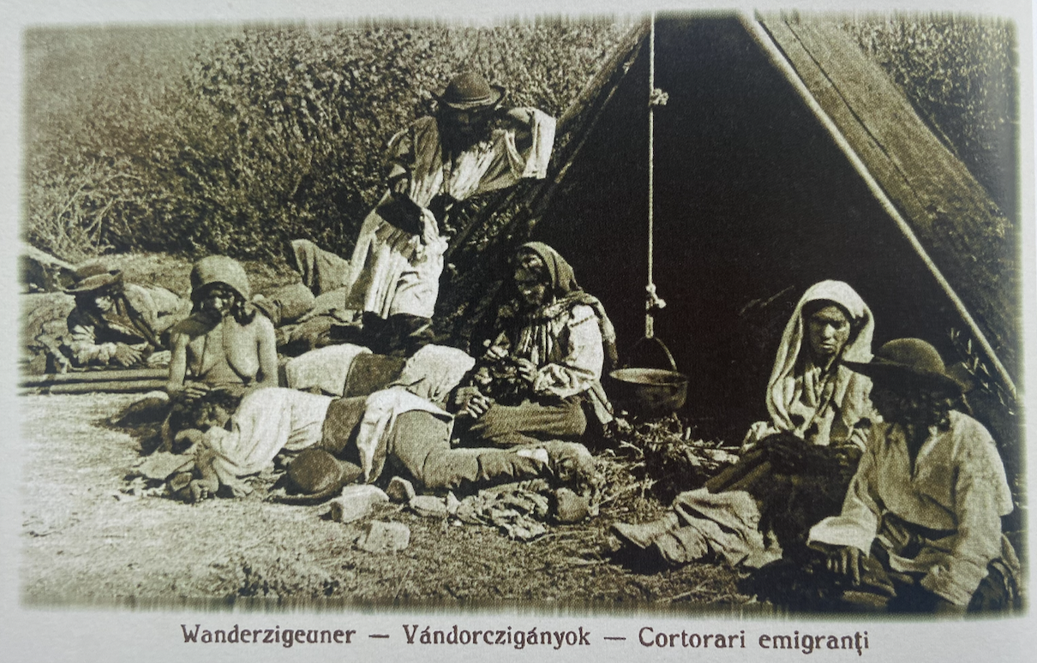
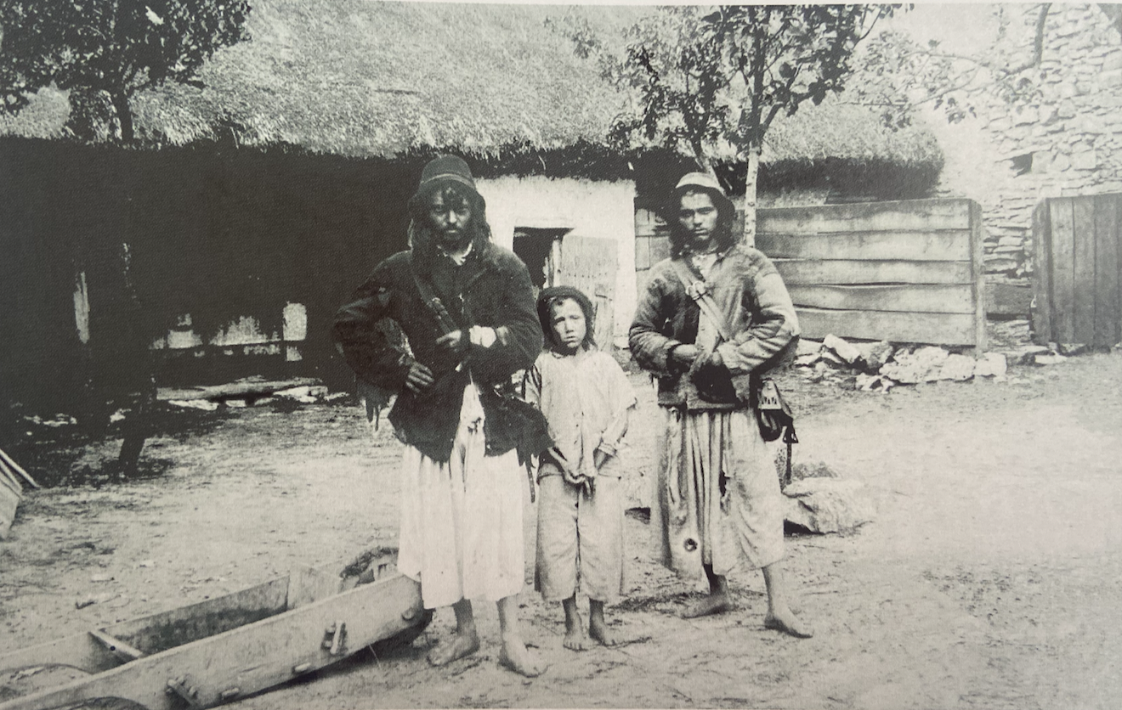
POSTCARDS, TRAVELLING, TOURISM
Picture postcard, 1916, Josef Drotleff Publishers, Sibiu
Picture postcard, ca. 1904, Croatia

Slide 5
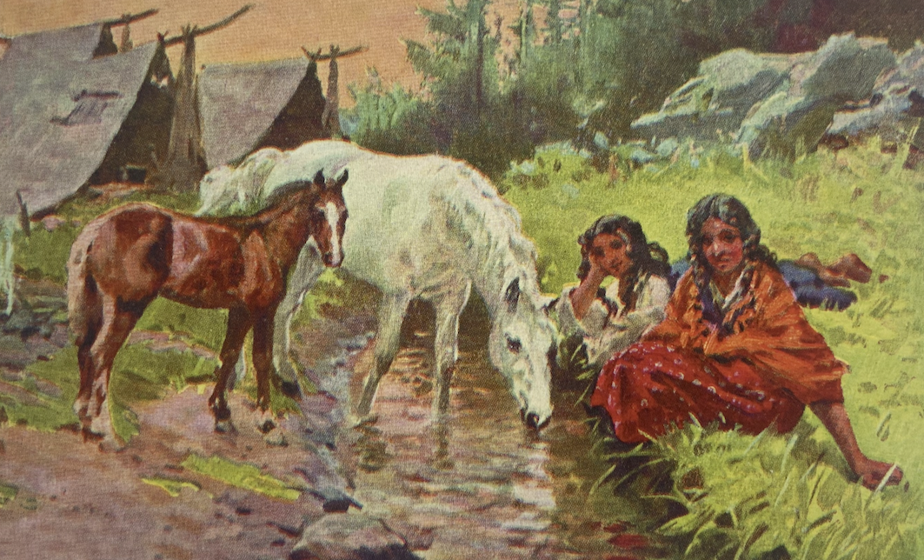
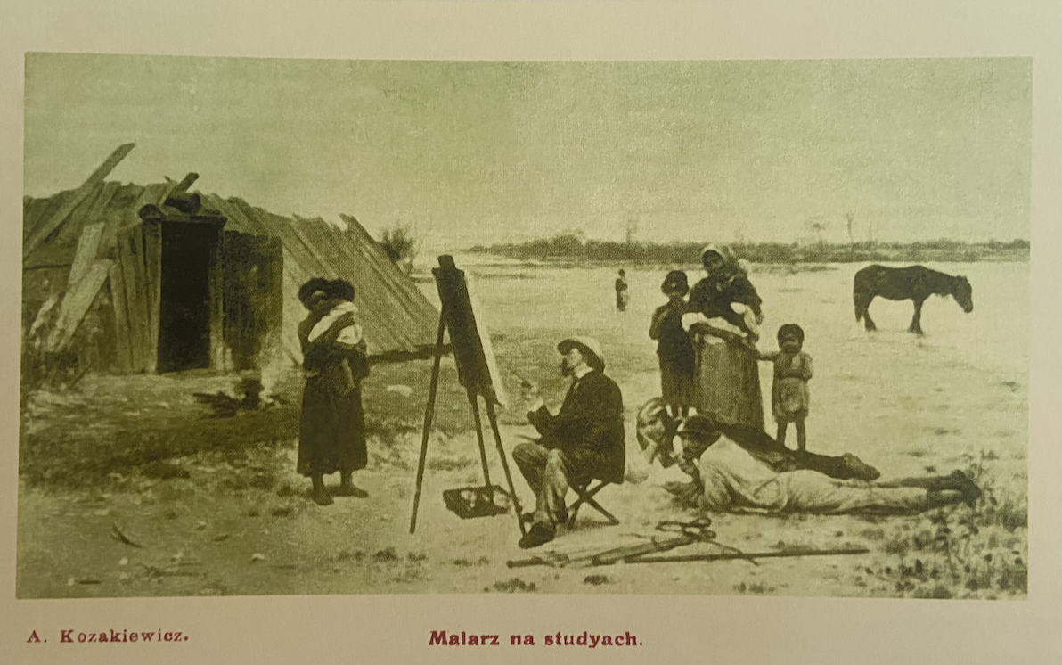
Picture postcard, Joso Bužan, Two girls with a horse (ca. 1925)
Antoni Kozakiewicz, The painter’s study, picture postcard

Slide 6
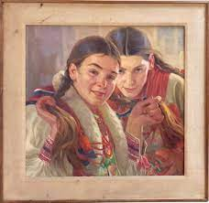
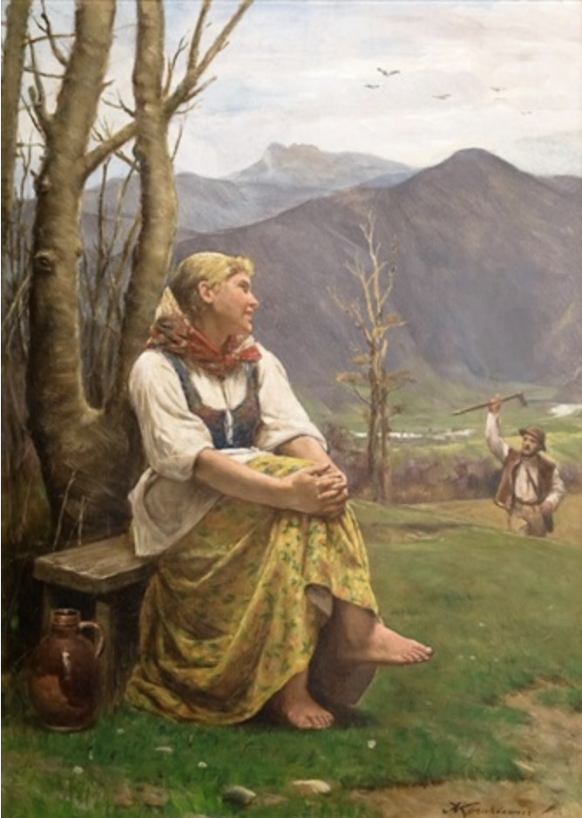
Joso Bužan (1873–1926)
Antoni Kozakiewicz (1841–1929)
Girls, 1912
Gorałka, 1920s

Slide 7
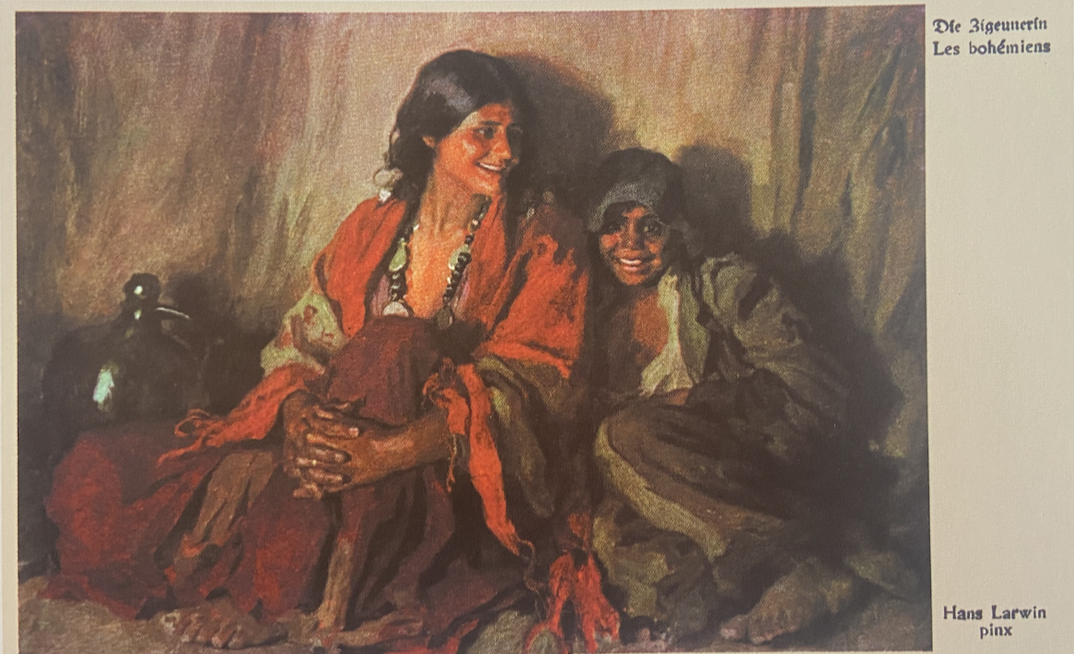
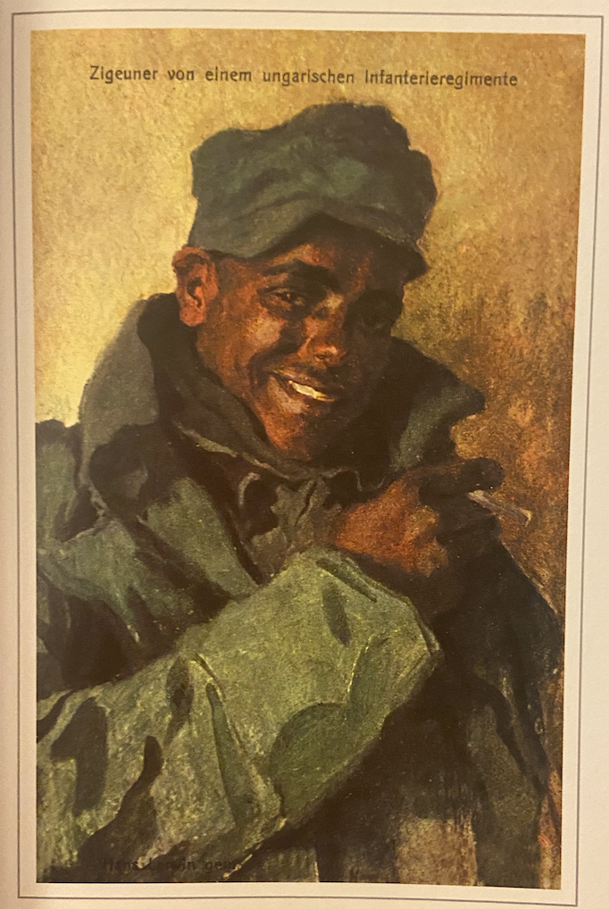
Hans Larwin, Gypsy women, 1915, picture postcard
Hans Larwin, Gypsy soldier, 1917, picture postcard for the international Red Cross

Slide 8
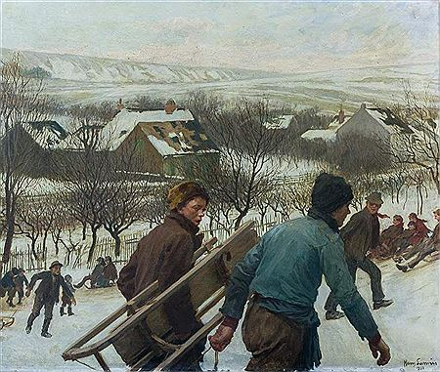
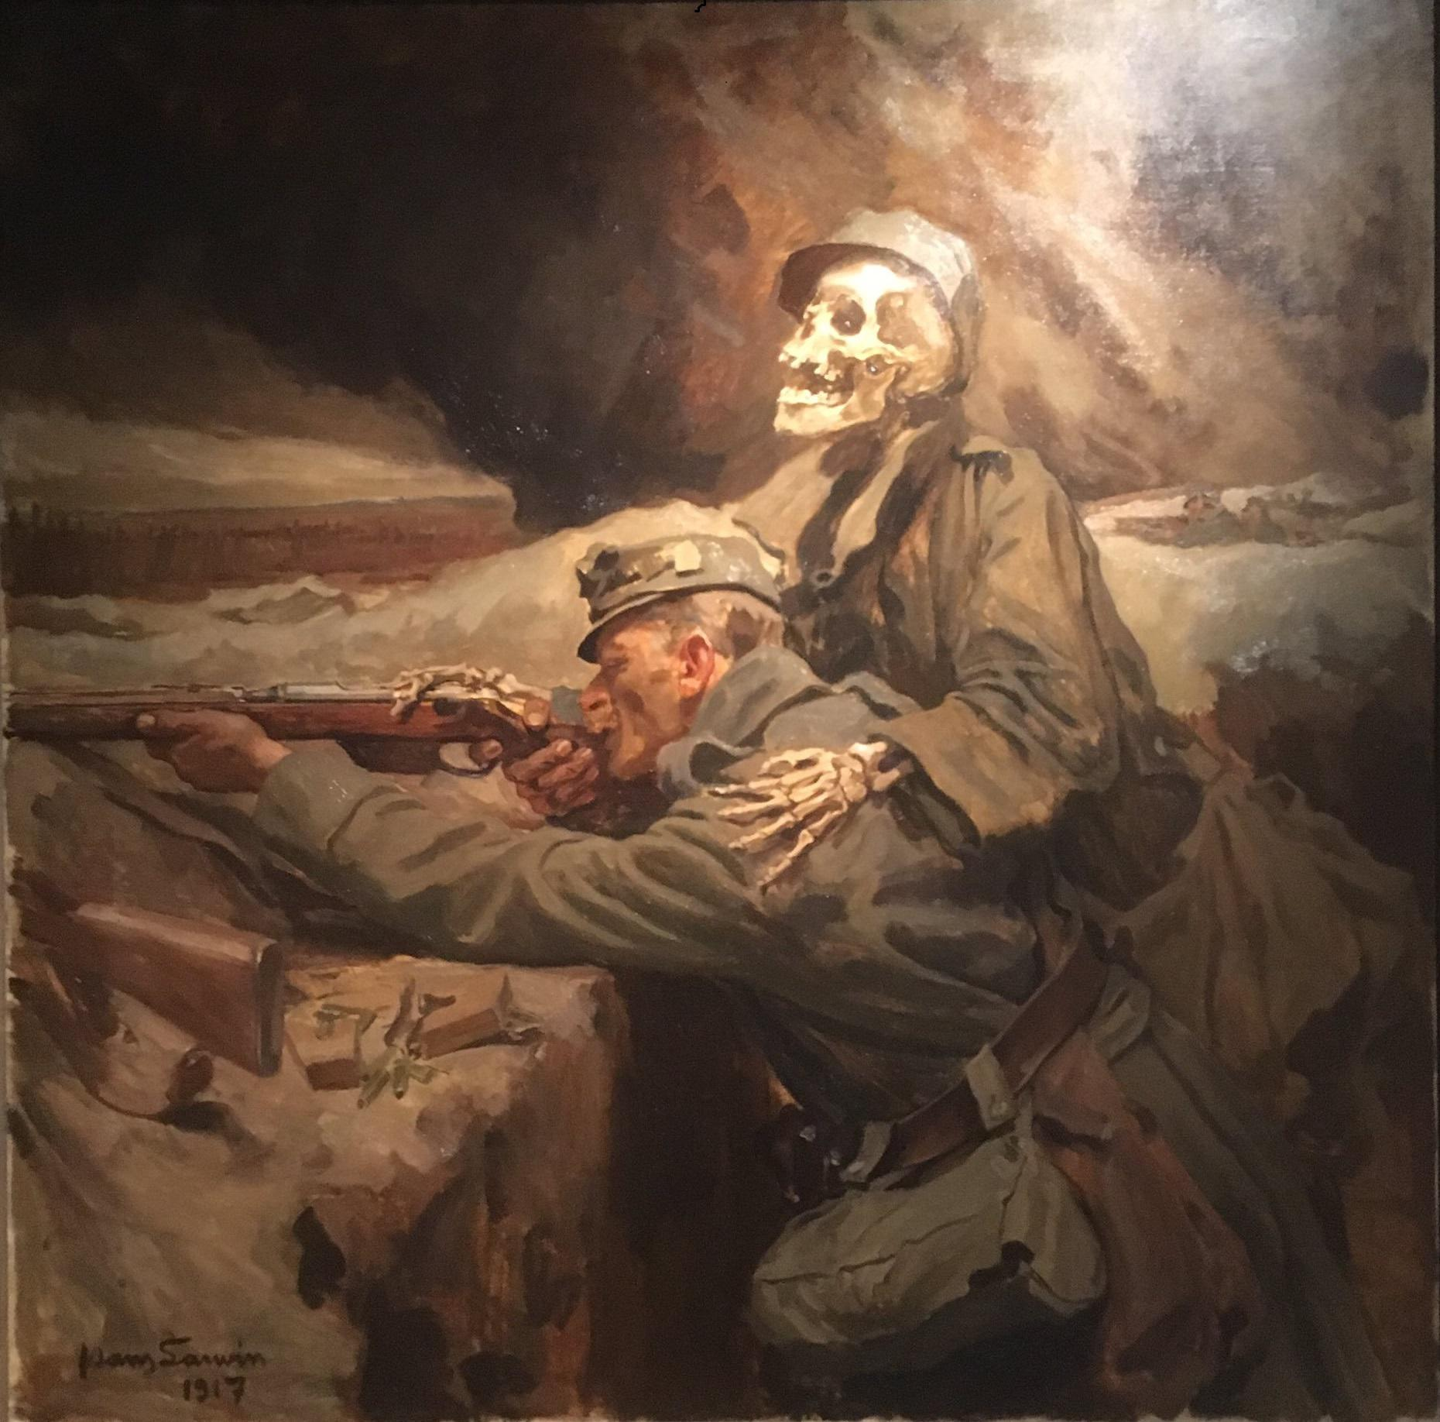
Hans Larwin (1873–1938)
Winter Joys, 1911
Soldier and death, Museum of Military History, Vienna, 1917

Slide 9
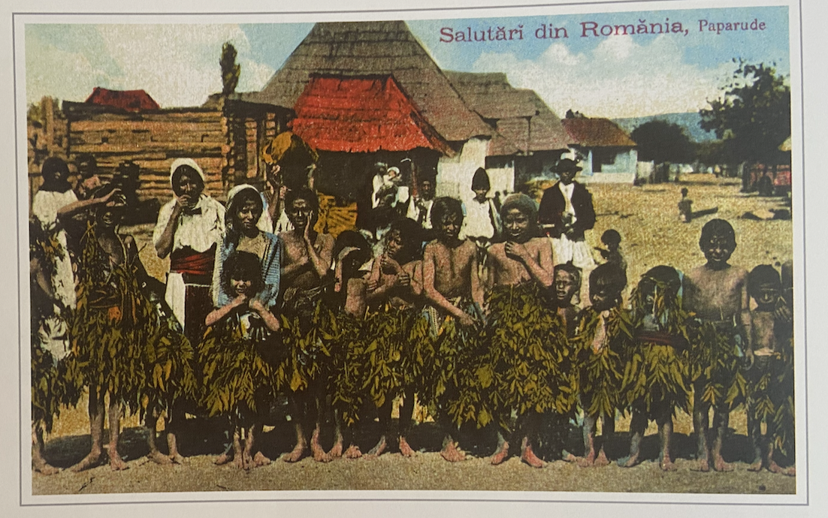
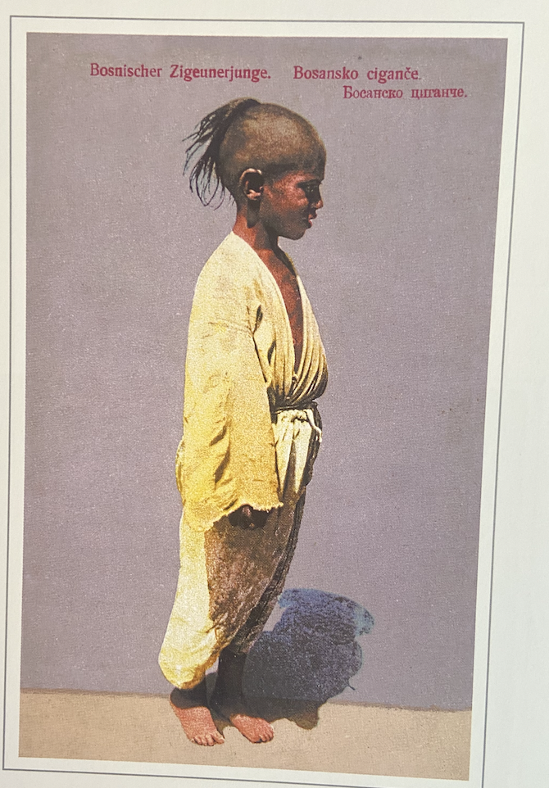
Paprude magic dance, Romania ca. 1920, coloured picture postcard
Bosnian gypsy boy, Studnička publishers, Sarajevo, ca. 1910.

Slide 10
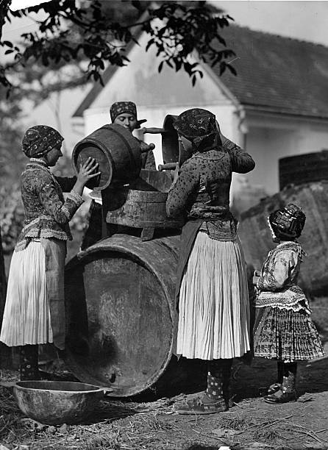
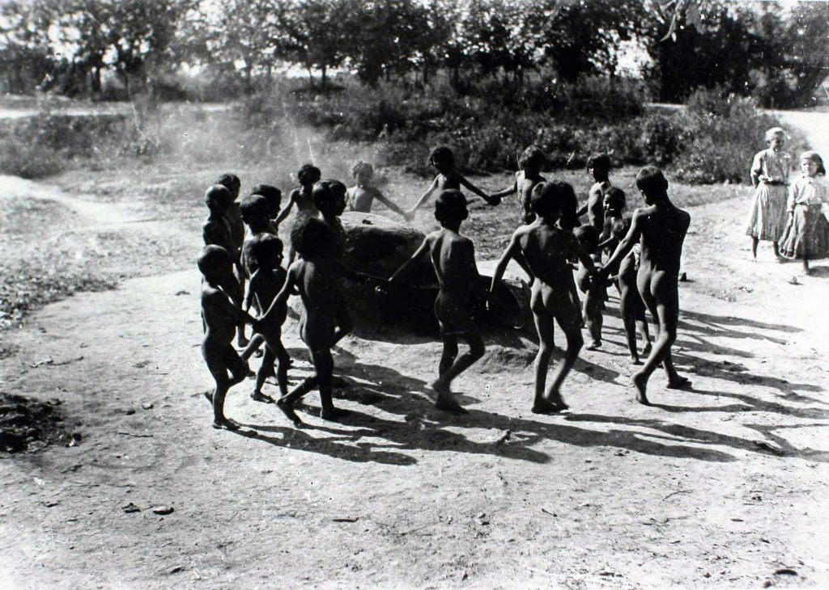
Rudolf Balogh, Women fill a barrel (c.1931)
Rudolf Balogh, untitled, 1920s-30s

Slide 11
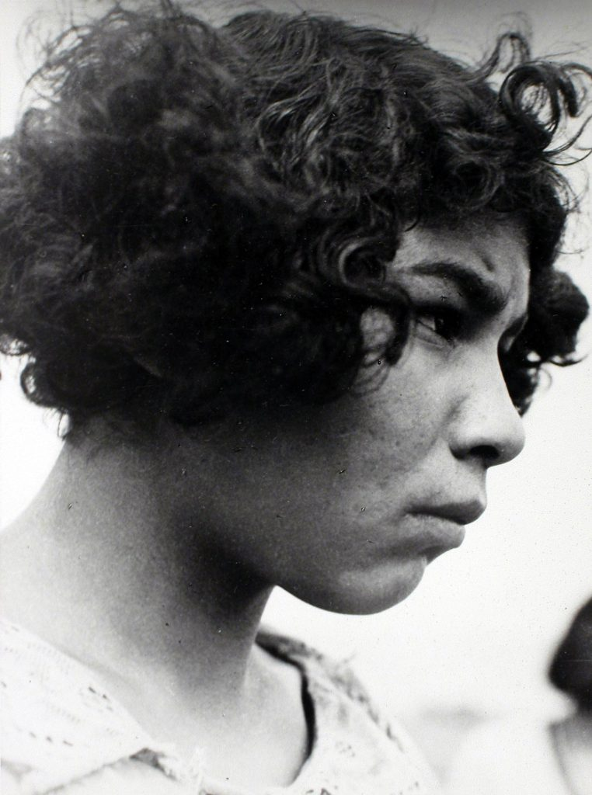
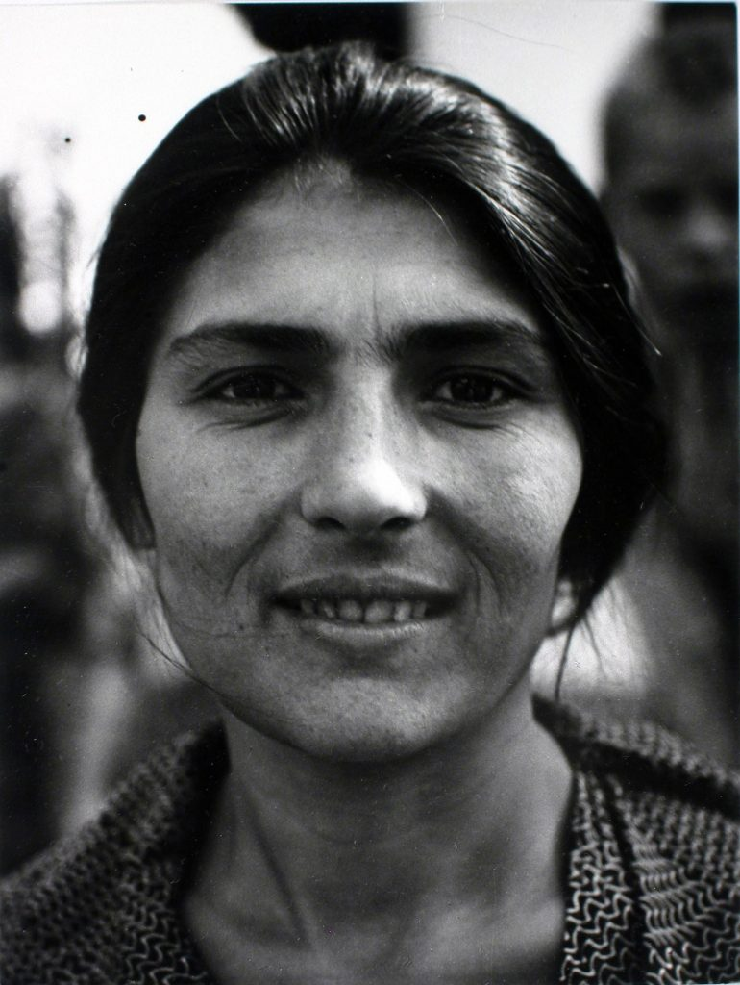
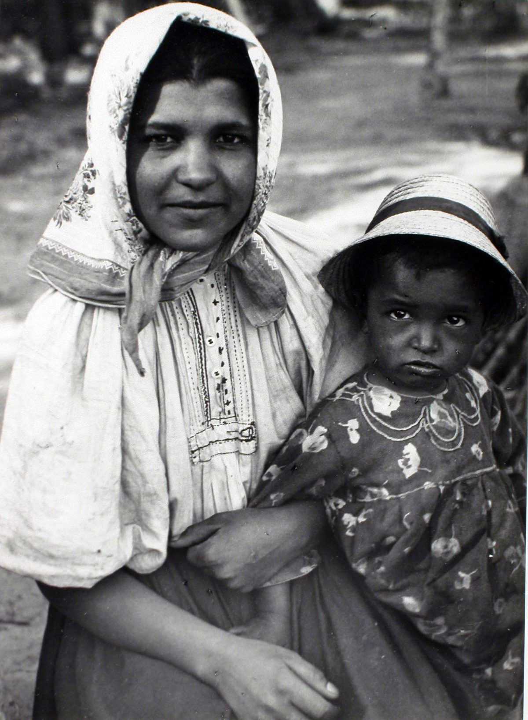
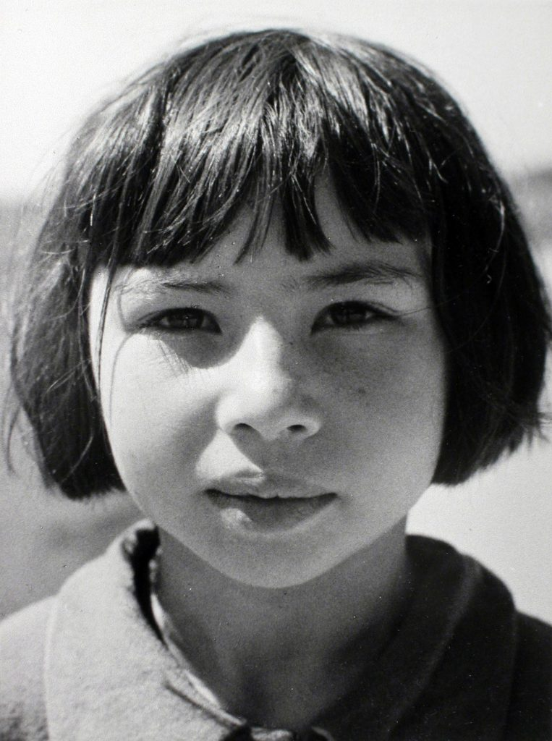
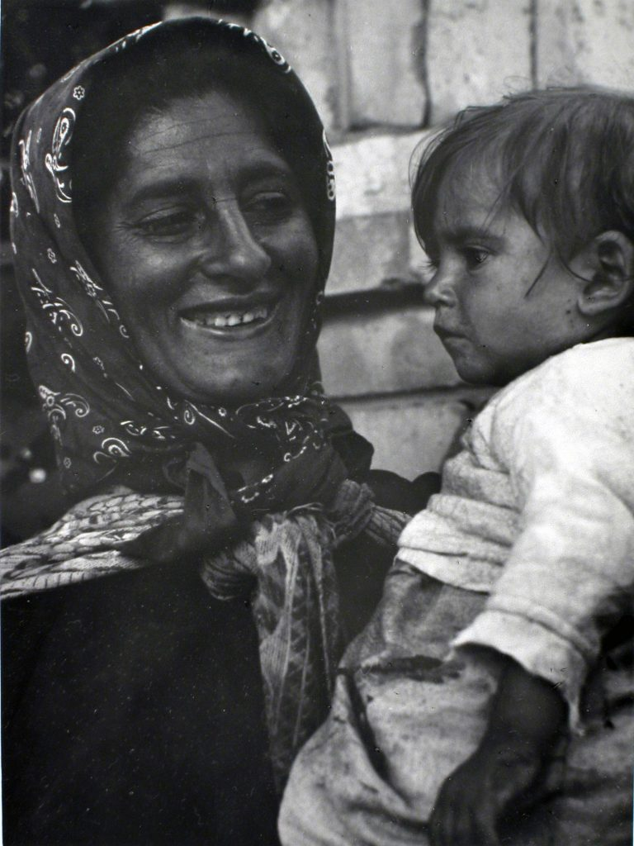
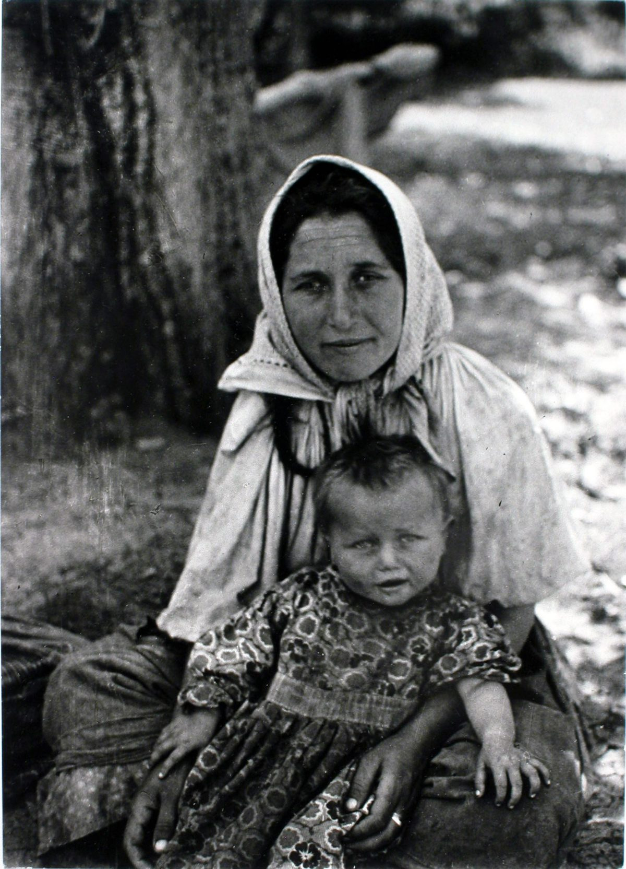
Kata Kálmán, Tiborc (1937) and The New Face of Tiborc (1955)

Slide 12
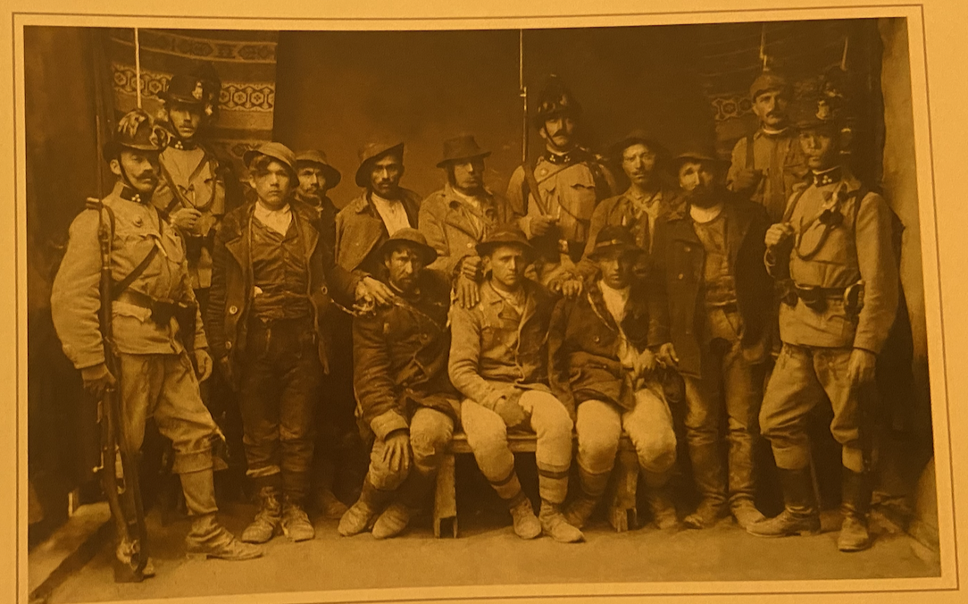
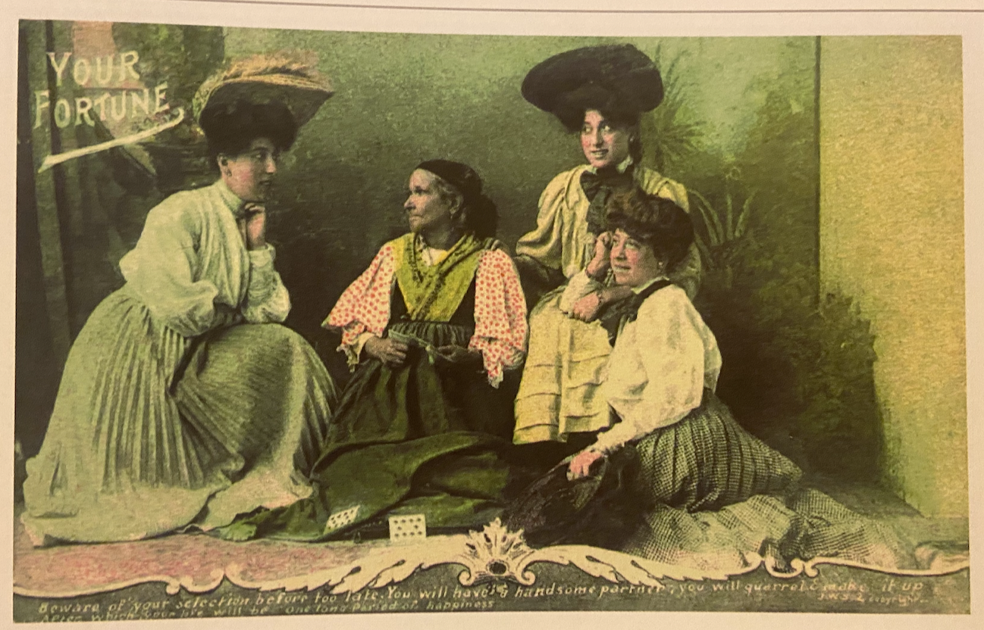
Group of Gypsies with Policement, picture postcard, ca. 1910
Fortune Teller, picture postcard, n.d.

Slide 13
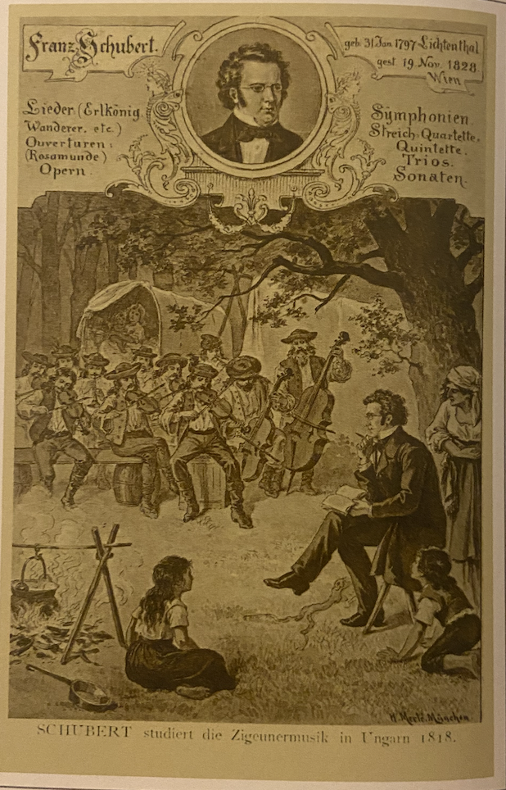
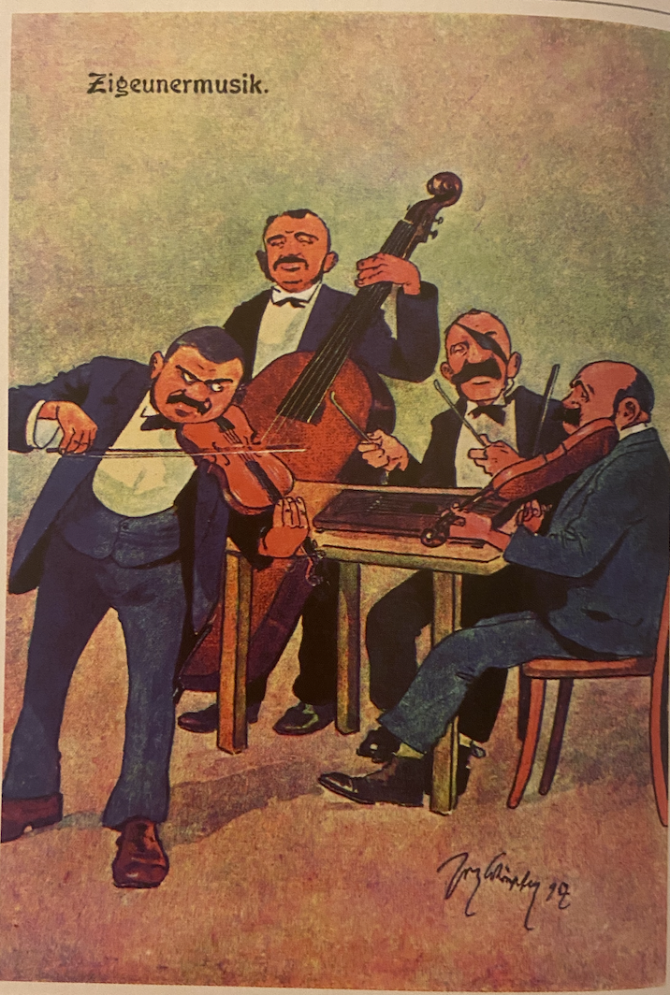
Franz Schubert studying gypsy music, n.d.
Moriz Jung (?), Gypsy Music, picture postcard, around 1910

Slide 14
ADVERTISING and COMMODITY CULTURE
Advertising postcard Franckova, n.d.

Slide 15
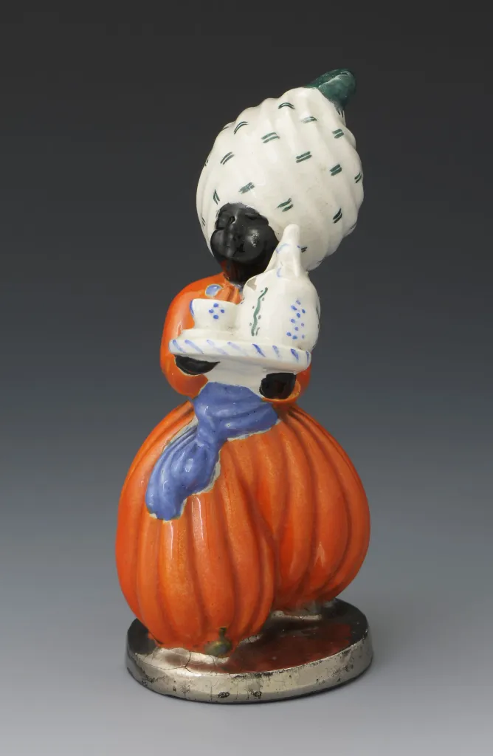
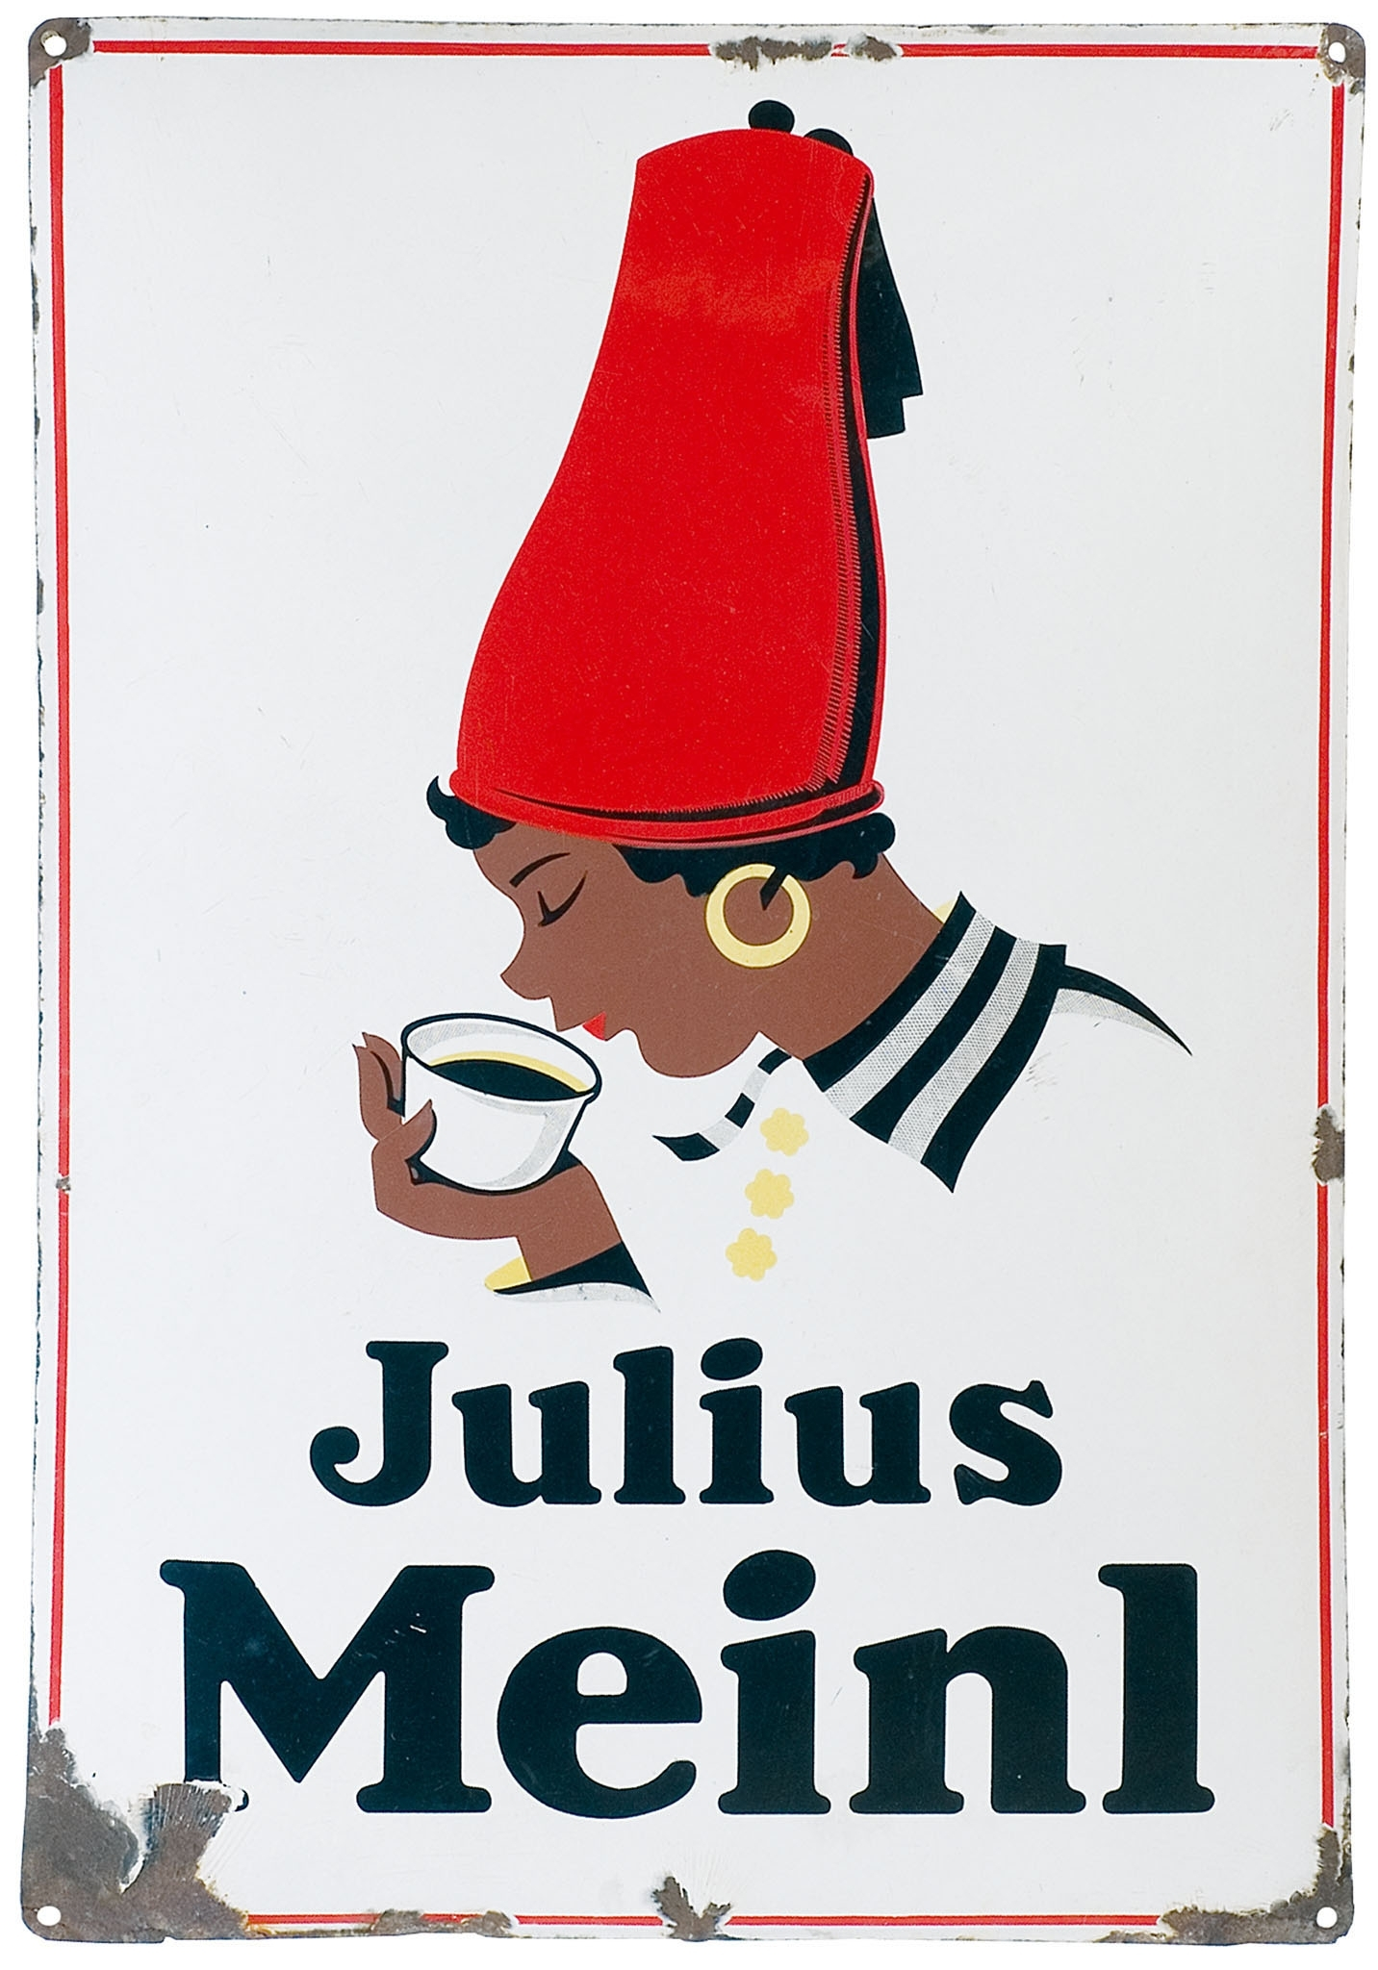
Josef Binder, Meinl Moor, 1924
Helena Johnová: The Black Boy, 1912, Moravian Gallery, Brno

Slide 16
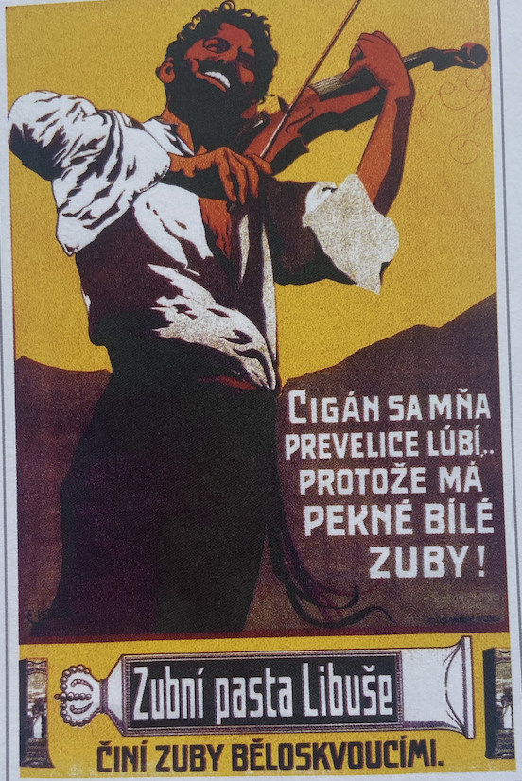
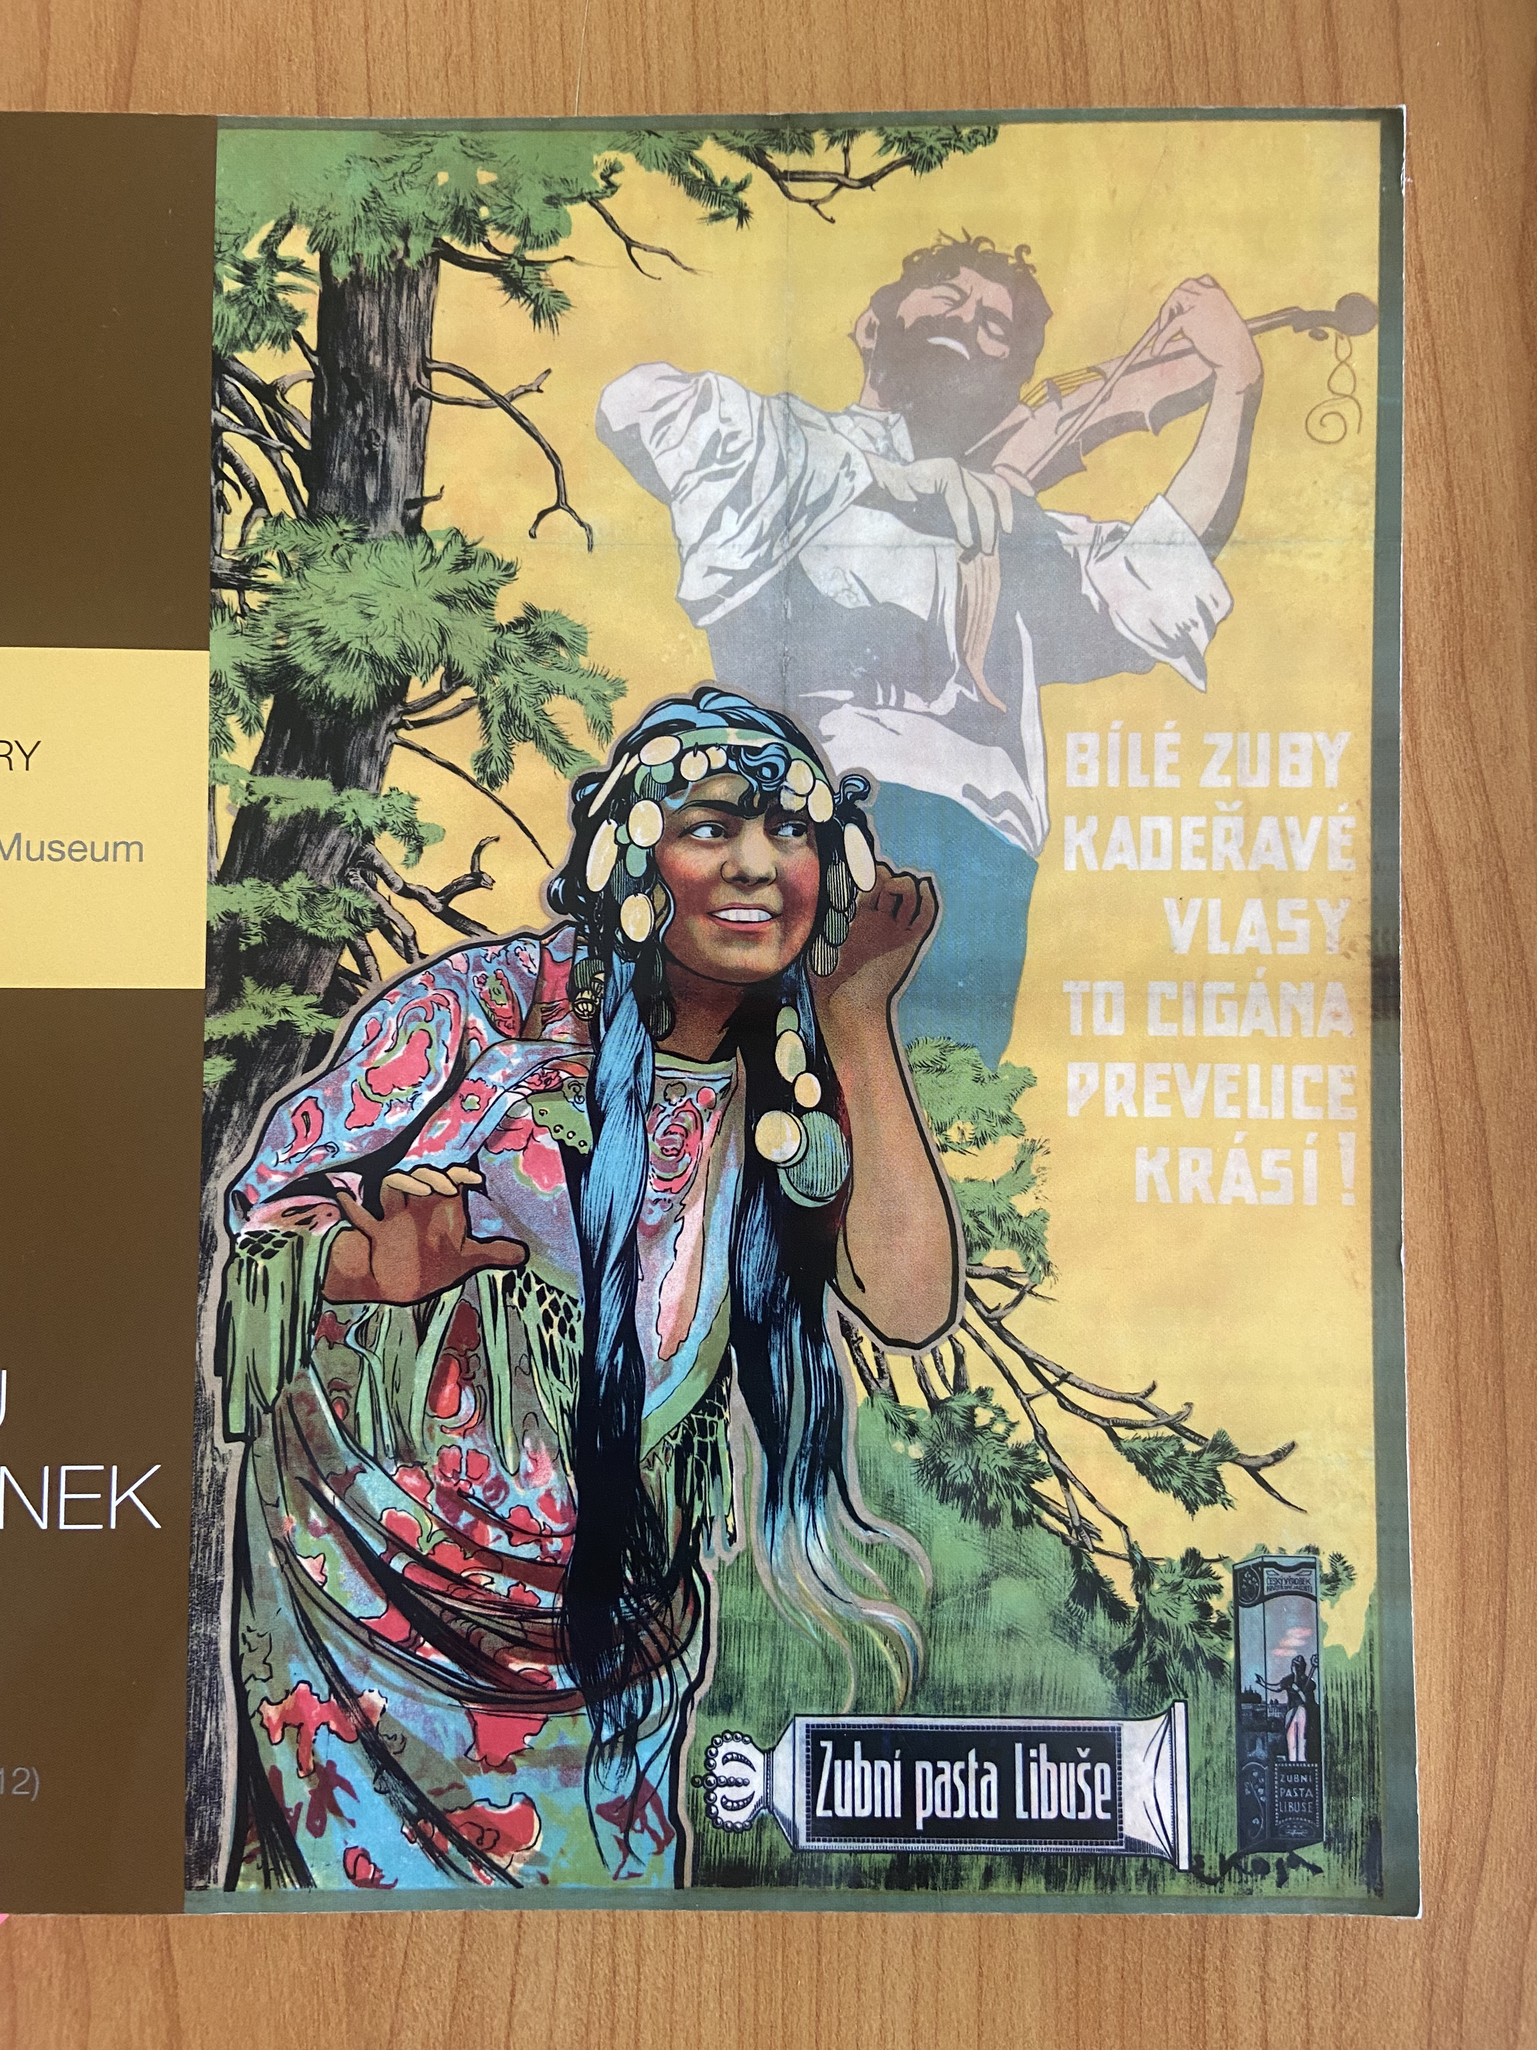
Emil Kosa, Advertising posters for Libuše tooth paste, 1910–1914

Slide 17

Pavla Vošahlíková, Zlaté časy české reklamy, Karolinum 1999

Slide 18
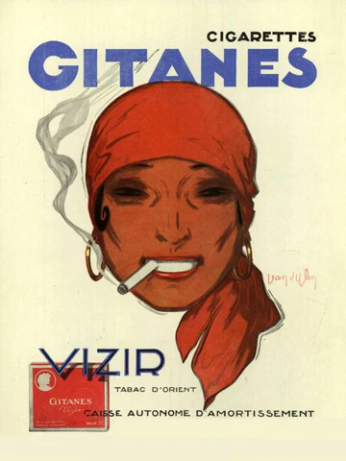

“Gitanes is a great example of a design that can be called 'quintessential'; it's quintessentially French, with a particular cool allure and style all of its own.
The design is a statement that says one likes life unfiltered, jazz-scored and a little bit Left Bank. No wonder Bowie was a fan, and Paul Weller posed for the cover of The Face slipping a pack into his jacket pocket. Like all really powerful brands, it is a signpost for values we ascribe to it and which it in turn inspires.”
Silas Amos (Brand Strategist), December 2012
https://www.campaignlive.co.uk/article/champions-design-gitanes/1162598
Molusson, design for Gitanes cigarettes, 1943

Slide 19
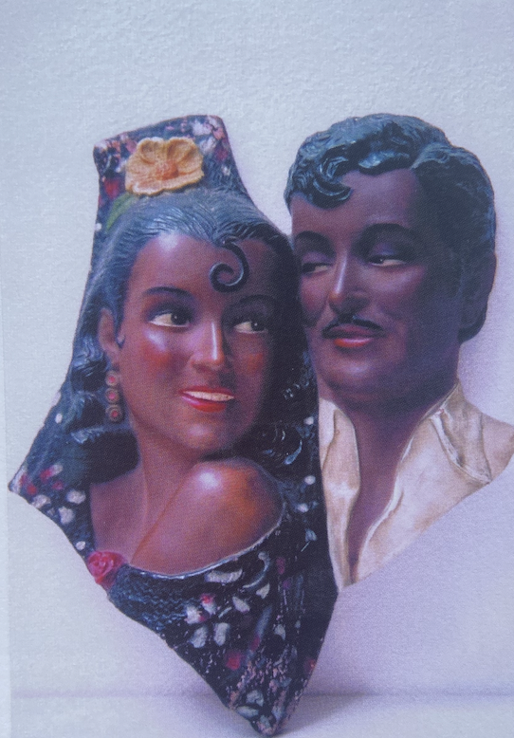
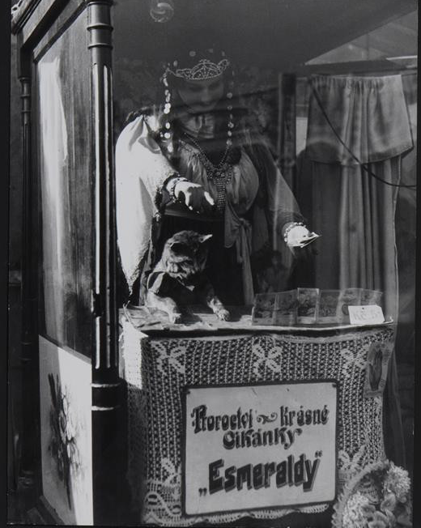
Tibor Honty (1907–1968)
Gypsy couple, wall decoration, turn of the 20th century
Museum of Romani Culture, Brno
Tibor Honty, Maringotky (Proroctví krásné cikánky), 1940, Moravian Gallery, Brno

Slide 20
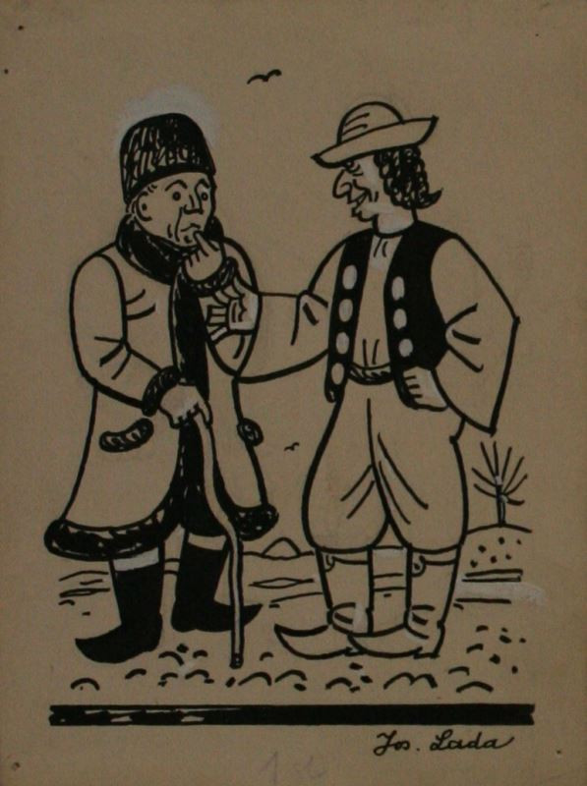
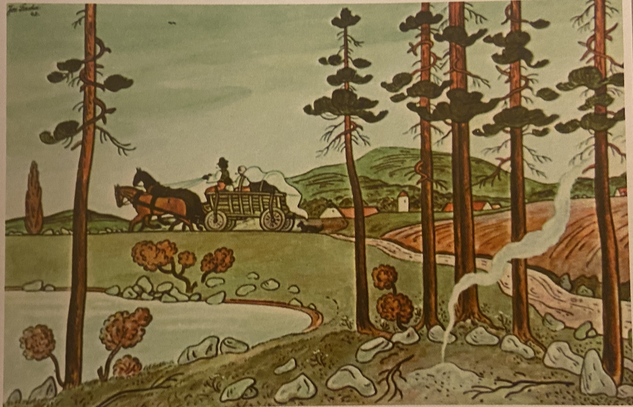
Josef Lada (1887–1957)
Josef Lada, Gypsy motif, picture postcard, 1942
Josef Lada, Sedlák a cikán, n.d., Moravian Gallery, Brno

Slide 21
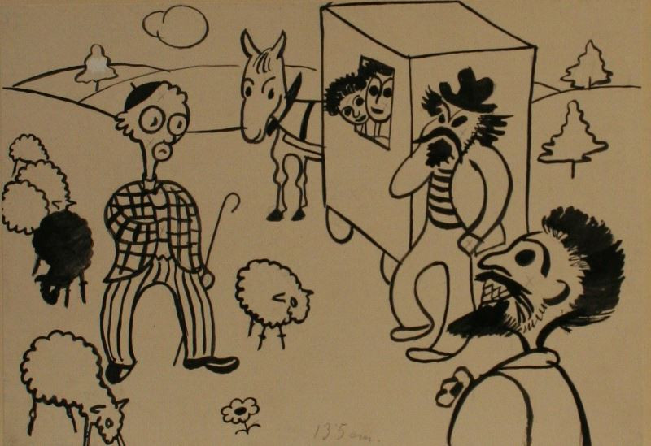
Eduar Milén (1891–1976)
Eduard Milén, Černošský pámbůh a páni Izraeiti, Cikáni, n.d., Moravian Gallery, Brno

Slide 22
