Slide 1
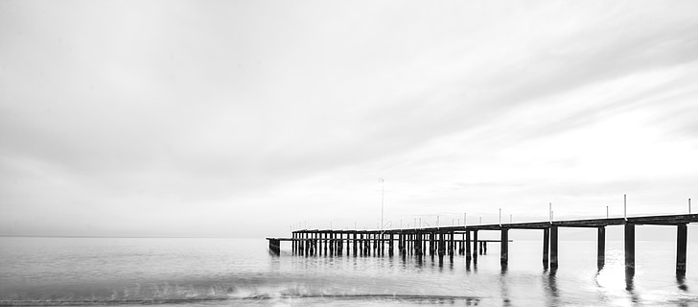
Everyday Aesthetics
Blended online course
Masaryk University
Spring 2023
Lee - Di Stefano - Ryynänen - Vrchlabský

Slide 2
What is Everyday Aesthetics?

Slide 3

Topics:
22nd Feb
"Everyday Aesthetics: Introduction"
(Lee)
1st March
a reading week
8th March
“Village contra City” (Lee)

Slide 4
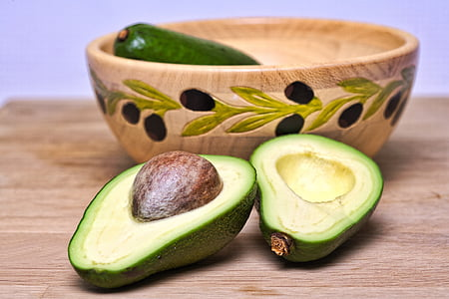
15th March - “In the Seclusion near the Forest:
Czech Cottagers in the in the Era of Communism” (Lee)
22nd March- Elisa di Stefano
29th March - Vrchlabský
5th April - Max Ryynänen
12th Apr - Vrchlabský
!!!The courses by Max and Elisa will be held in a hybrid form - online via MS Teams, also in a classroom (no recording).
Lenka's courses and student presentations will be held in a classroom (no recording).!!!

Slide 5
19th Apr - a reading week
“The Aesthetics of Windmills” (Lee)
May 3rd + 10th + 17th: Presentations (students)

Slide 6
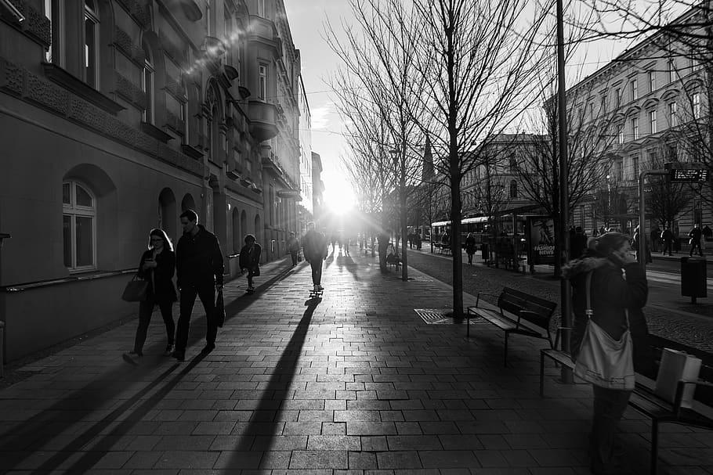
Requirements
Active participation: 10 times per semester (present and online courses - web camera on, questions on chat during online lectures), text analysis
Presentation

Slide 7

Presentations:
an article, a chapter from a book (15 - 25 pp.)
send me the bibliographic data + title by April 16th
(to IS -> Homework Vaults -> Presentation_Title + Bibliography)
15 minutes in a classroom
PP presentation
PP (Google Pres. etc.) presentation (submit a day before the presentation (Tuesday 20:00) to IS -> Homework Vaults -> Presentations_PP)
b) In advance: 600 - 900 words abstract (submit three days before the presentation (Sunday 23:59) to IS -> Homework Vaults -> Presentations_abstract)

Slide 8
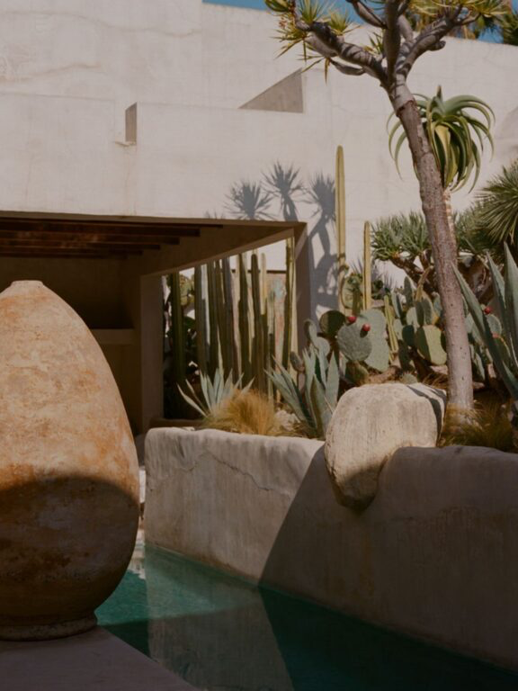
Bibliography:
See https://plato.stanford.edu/entries/aesthetics-of-everyday/#Bib

Slide 9
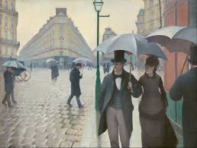
Presentation resources:
JSTOR
https://www-jstor-org.ezproxy.muni.cz
SAGE Journals Online - HSS
https://journals.sagepub.com
ESPES
https://espes.ff.unipo.sk/index.php/ESPES/issue/view/20
https://books.google.fi/books?id=BeVOEAAAQBAJ&newbks=0&printsec=frontcover&hl=cs&source=gbs_ge_summary_r&cad=0#v=onepage&q&f=false
… and others…:-)

