Slide 1


Aussie, Kiwi and South African Accents

Slide 2
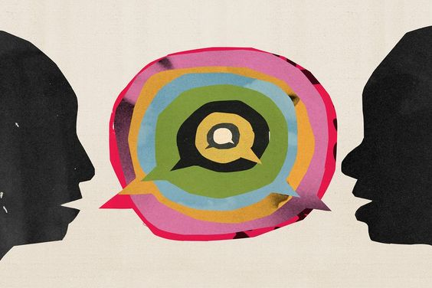
Accents
Accents signify not only where we come from but also our socio-economic background.
According to the sociolinguist definition, an accent is “a manner of pronunciation peculiar to a particular individual, location, or nation.”
Accents develop as individuals who speak the same language in a sepcific location adopt the same way of pronouncing their vowels and consonants for particular words and phrases.

Slide 3
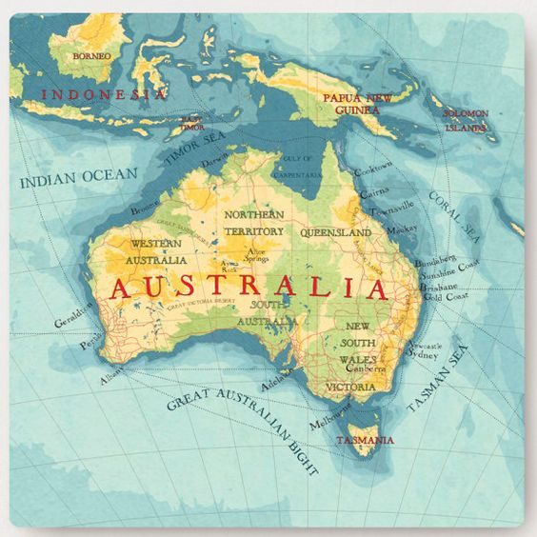
The Aussie Accent
How did it develop?
The Aussie accent is a blend of the accents and dialects of the first settlers who came ot Ausralia.
The dialects of South East England including the traditional cockney dialect of London were influencial in constructing the Australian accent (wide diphthongs).
There is also the influence of Irish English as well as the native accent of Australian Aboriginals.
It is noteworthy that the Auatralian accent is pretty consistent across the country.

Slide 4
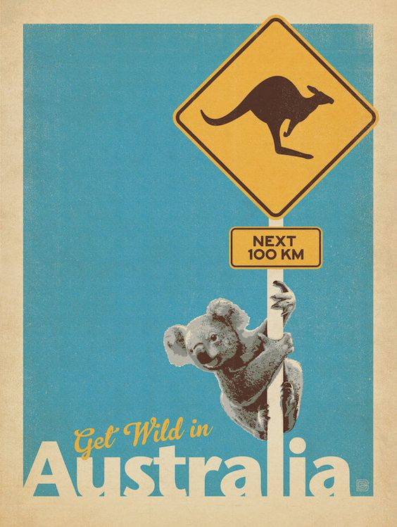
The Aussie Accent
There are 3 different versions of Aussie accent that should be discerned:
1. General: the most common one which most Australians speak.
2. Broad: spoken by people who live in more rural areas(the bush); isolated and less affected by RP influence.
3. Cultivated: the least Australian sounding; usually spoken by high societly.
These verisons are collectively referred to as “mainstream Australian English”.

Slide 5
Examples:
General australian accent: from a popular Aussie reality tv show:
https://www.youtube.com/watch?v=WSShYNDKwYI&t=13s&pp=ygUzZG9tZW5pY2EgY2FsYXJjbyAgdGhleSBoYXZlIGJlZW4gdGFsa2luZyBhYm91dXQgaGVy
2. Cate Blanchett (Cultivated Aussie Accent)
https://www.youtube.com/watch?v=Dti6XC15AWA

Slide 6

Main Features of Aussie Accent
Use of inflection, intonation at the end of the sentence: High Rising Terminal (HRT); a very common intonation pattern.
Finishing delcarative sentences using high intonation: as if the speaker is asking a question.
Heavily nasalized vowel sounds and flapping the medial /t/ : a soft /d/ sound.
Little : liddle
Australians like to shorten and abbreviate their words: brekkie, dins, avo,
Dropping the last letter of words like “running” or “crying” to : ‘runnin’, ‘cryin’.
It is a non-rhotic variety of spoken English.

Slide 7
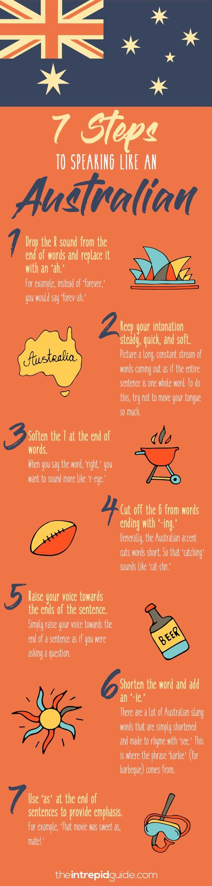
Tips to sound like an Aussie:

Slide 8
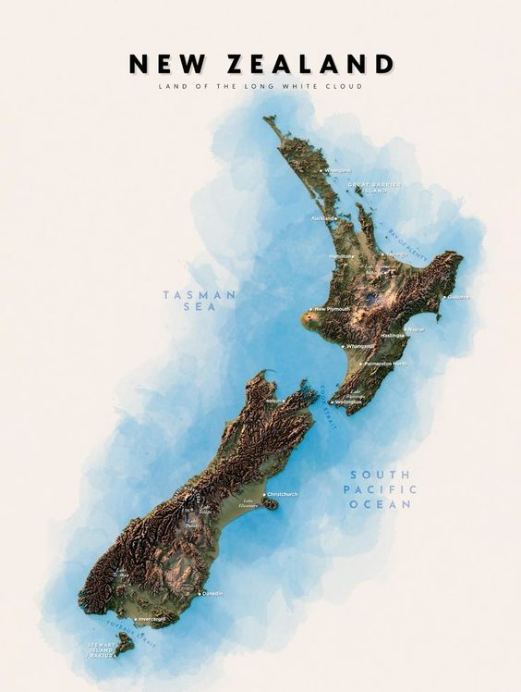
The kiwi accent:
Like the Australian accent, the kiwi accent is based onn different accents, mainly the South East England one with Scottish, Irish and Australian thrown into the mix.
It is a little softer sounding than the Australian accent.
Theare two versions of the Kiwi Accent:
1. The North Island version: non-rhotic variety: “car” is pronounced as ‘ca’.
2. The South Island version: Southlanders roll their ‘r’s due to the scottish influence.

Slide 9
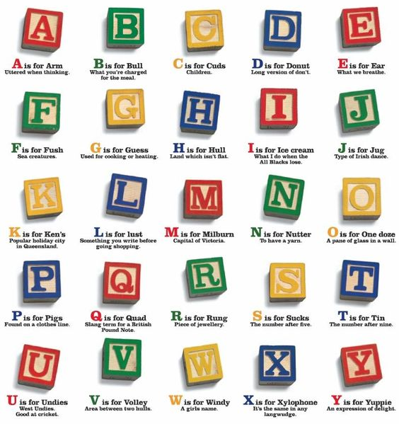
Key kiwi words :

Slide 10
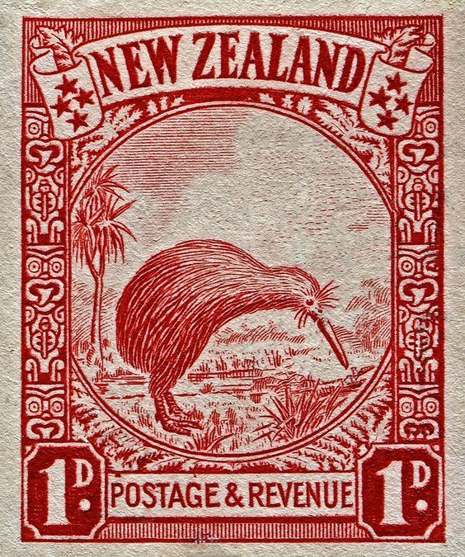
Characteristics of Kiwi accent:
Substituting the short [æ] with [a](following RP) or [e].
Eg: ask, answer, after
Vs apple, cash, hat, have
Substituting [e] with [I]
Eg: spend, led, epic, mess
Substituting [I] with unstressed schwa /ə/
Eg: witch, dig, ship, lip, vision
High Rising inflection or upspeak is also common in Kiwi accent.

Slide 11
Example :
Lorde interview:
https://www.youtube.com/watch?v=t0-isrENxyk

Slide 12
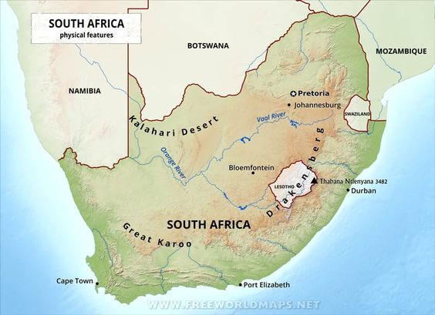
South African Accent:
Or the “South Efrican Eccent”
South Africa is the fifth largest native English-speaking country in the world.
To an untrained ear, South African English sounds similar to Australian and New Zealand English.
it was heavily influenced by Afrikaans and other Southern African Languages (Xhosa and Zulu in particular).

Slide 13
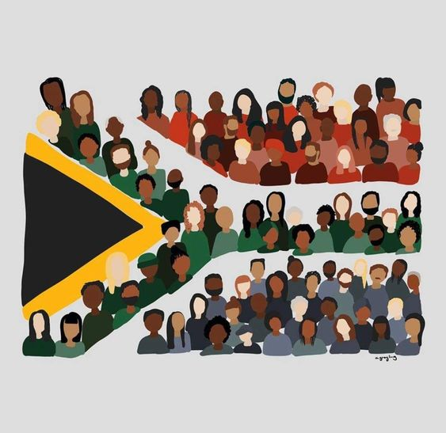
Characteristics:
It is a non-rhotic variety of English.
The prevocalic and intervocalic /r/ sound is more of a fricative than the approximant type found in most other kinds of English (audible friction).
RP /I/is normally realized as /ə/ in South African English.
Hitting the consonants very hard “What a fright I got”

Slide 14
Example :
Trevor Noah:
https://youtu.be/MhCEdIqFCck

Slide 15
Thanks for your attention

