Slide 1
Glasgow patter / Glaswegian
EE Varieties 2020/2021
Ema Bícová

Slide 2
Influences
> Influenced by Highlander (traditional Gaelic-speakers) and Irish migrants from 19-20th century
> Scots is replaced by standard and colloquial English vocabulary
  > Modern Scots = sister language of Modern English, recognized as a regional indigenous language of UNESCO
  > Both independently diverged and developed from Early Middle English
  > Considered a variety of English by some

Slide 3
Cockney influence?
Some studies suggest that working-class adolescents have started to adopt certain aspects of Cockney and SE England accents due to their prominence on TV:
  TH-fronting
  Reduced (typical Scottish) post-vocalic /r/
J.C. Wells notably disagrees with this:
  Journalists misrepresented TH-fronting prominence
  No evidence TH-fronting originated in London
  Dialects change over time

Slide 4
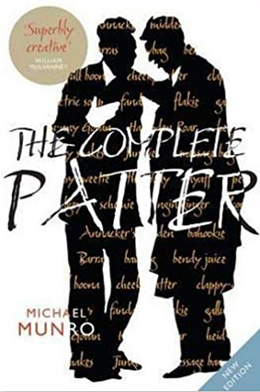
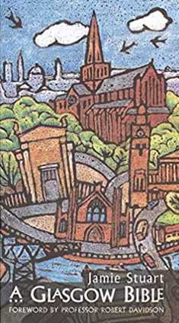
Books in glaswegian
The Complete Patter – Michael Munro
  A compound version of two guidebooks to Glaswegian
A Glasgow Bible – Jamie Stuart
Alice‘s Adventirs in Wunnerlaun
  Translation of Alice‘s Adventures in Wonderland into Glaswegian Scots by Thomas Clark
  Linguistically, the maist important immigrants bi faur wir the Irish an the Scottish Hielanmen, who settlt in Glesca in their droves. The vowel soonds ae Glaswegian, mebbe its maist significant distinguishing merks, owe much tae the pronunciation ae the city's Irish an Hielan incomers.

Slide 5
Varieties
Glasgow Standard English (GSE)
form of Scottish Standard English used by the middle class
Glasgow vernacular (GV)
working-class dialect with distinctive slang based on West-Central Scots and strongly influenced by Irish English

Slide 6
Features - consonants
T-glottalization – also occurs with K and P
T and D dentalisation
D omitted at the end of words (old, stand)
Th-fronting – to a degree, mostly younger speakers
x – loch; not as frequent amongst younger speakers
ʍ – used in wh-words (whine)
No H-dropping except in unstressed cases of him and her.
Yod-dropping only occurs after l or s.
Rhoticity – ɹ, ɻ or r.
L is dark in almost all positions.

Slide 7
Features - vowels
 | RP | GSE | GV
kit | ɪ | ɪ | ɪ̈ ~ i
head | ɛ | ɛ | I
lot | ɒ | ɔ | o
foot | ʊ | ʉ | ɪ̈ ~ ɪ
nurse | ɜː | ʌ̈ | ʌ̈ ~ ɪ
mouth | aʊ | ʌʉ | ʉ
cure | ʊə | jʉ | jʉ

Slide 8

Air Traffic Control – SNL
(with James McAvoy)

Slide 9

Examining The Glaswegian Accent BBC Scotland

Slide 10

Glasgow / Glaswegian Accent
English Like a Native

