Slide 1
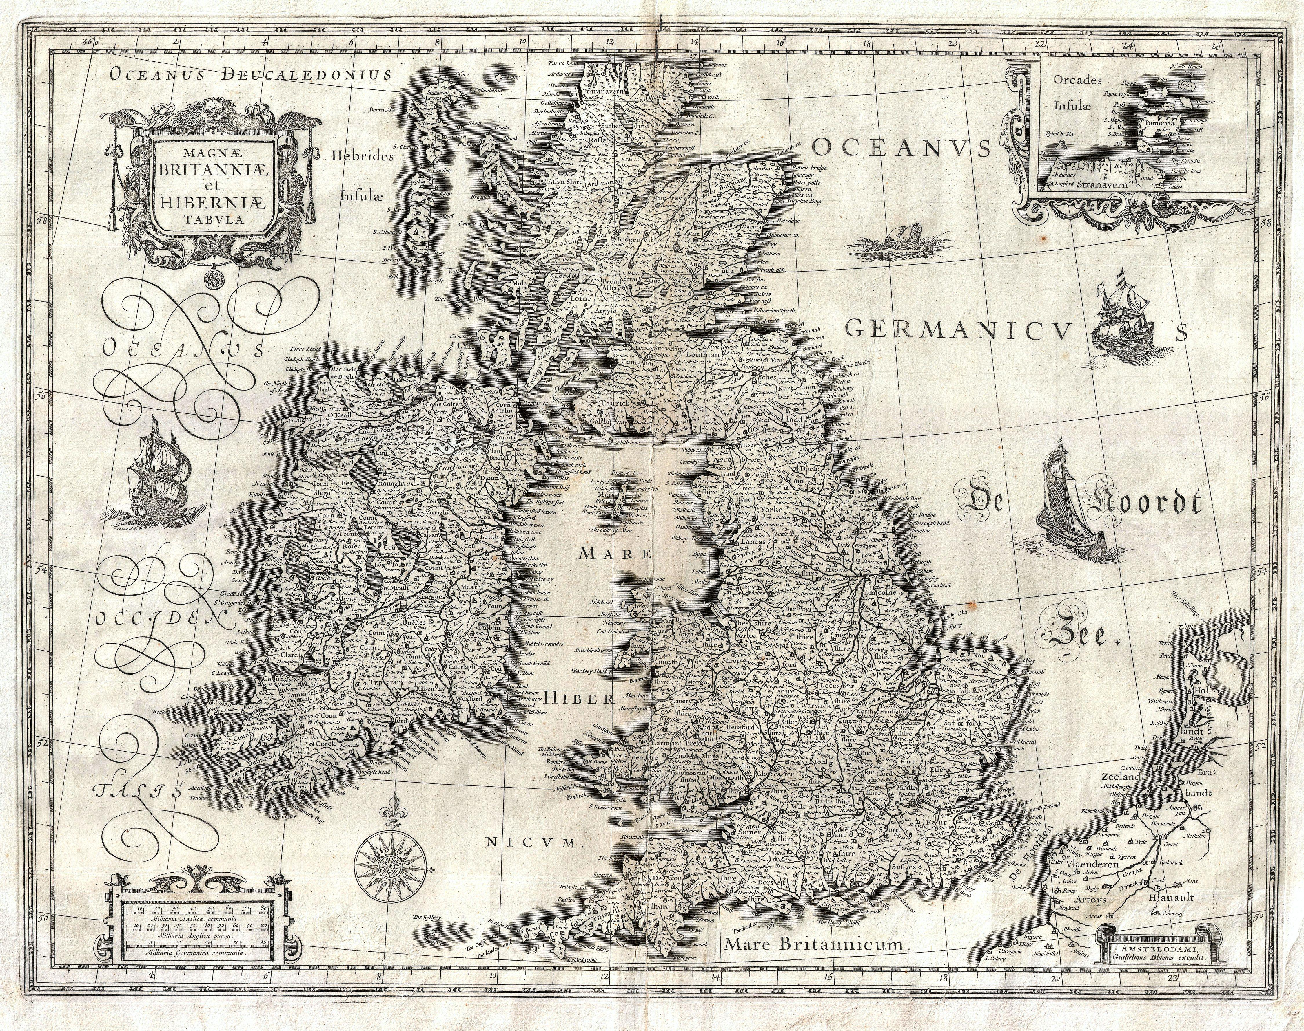
HISTORICAL DEVELOPMENT
OF ENGLISH
Kristína Macejová

Slide 2

POSITION OF ENGLISH IN THE WORLD
3rd most common native language
Global lingua franca
Official language of 60 states, EU, world organizations
Most popular second language

Slide 3
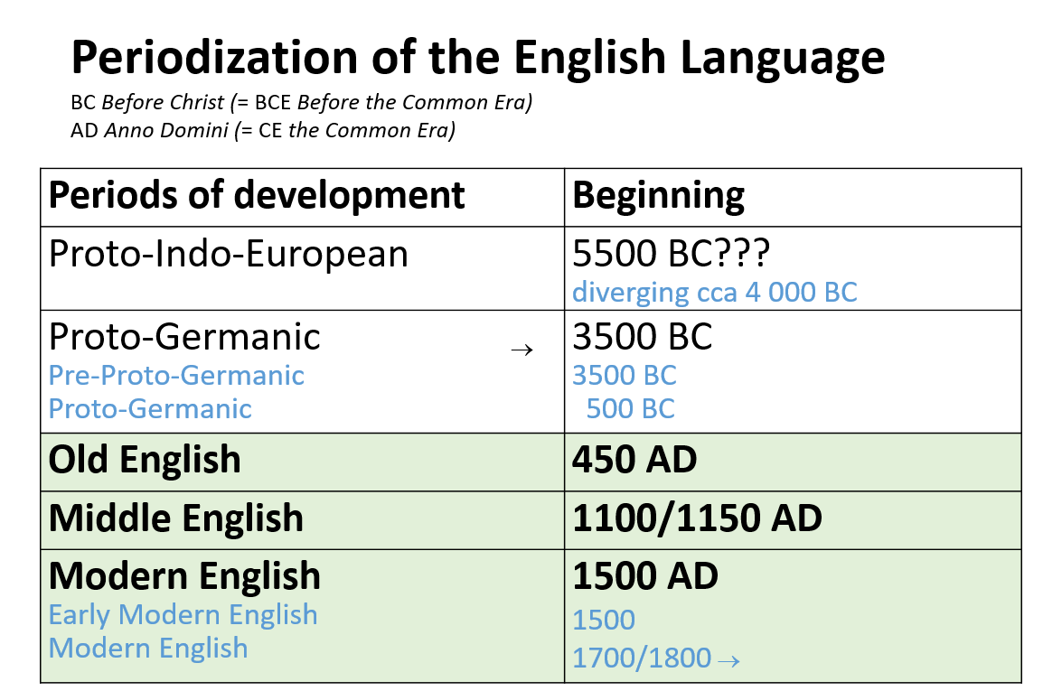

Slide 4
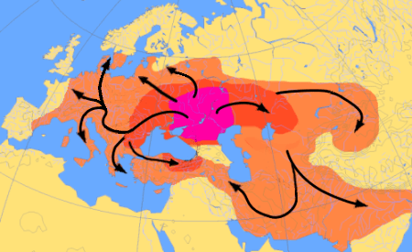
PROTO-INDO-EUROPEAN
around 5500 BC, speakers living in the Pontic-Caspian steppe of Eastern Europe – (Kurgan hypothesis)
Langauge split and evolved after their expansion

Slide 5
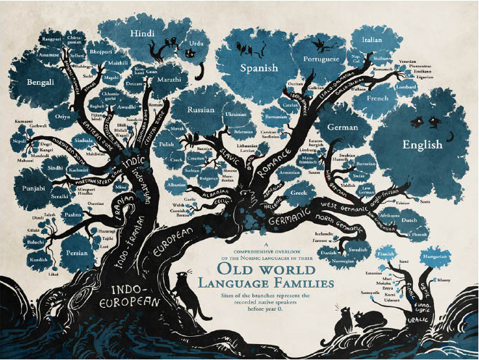
Now – 400 languages and dialects (over 3 billion native speakers)
  Genetically related
No written records – based on lingvistic reconstruction methods
Comparative linguists - August Shleicher, Karl Verner, Jacob Grimm, and others

Slide 6
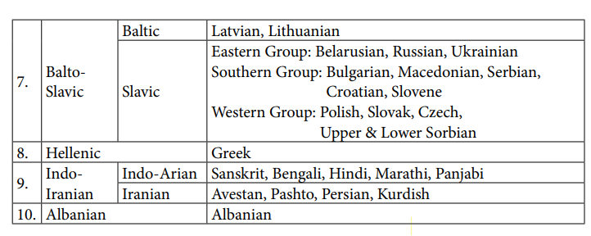
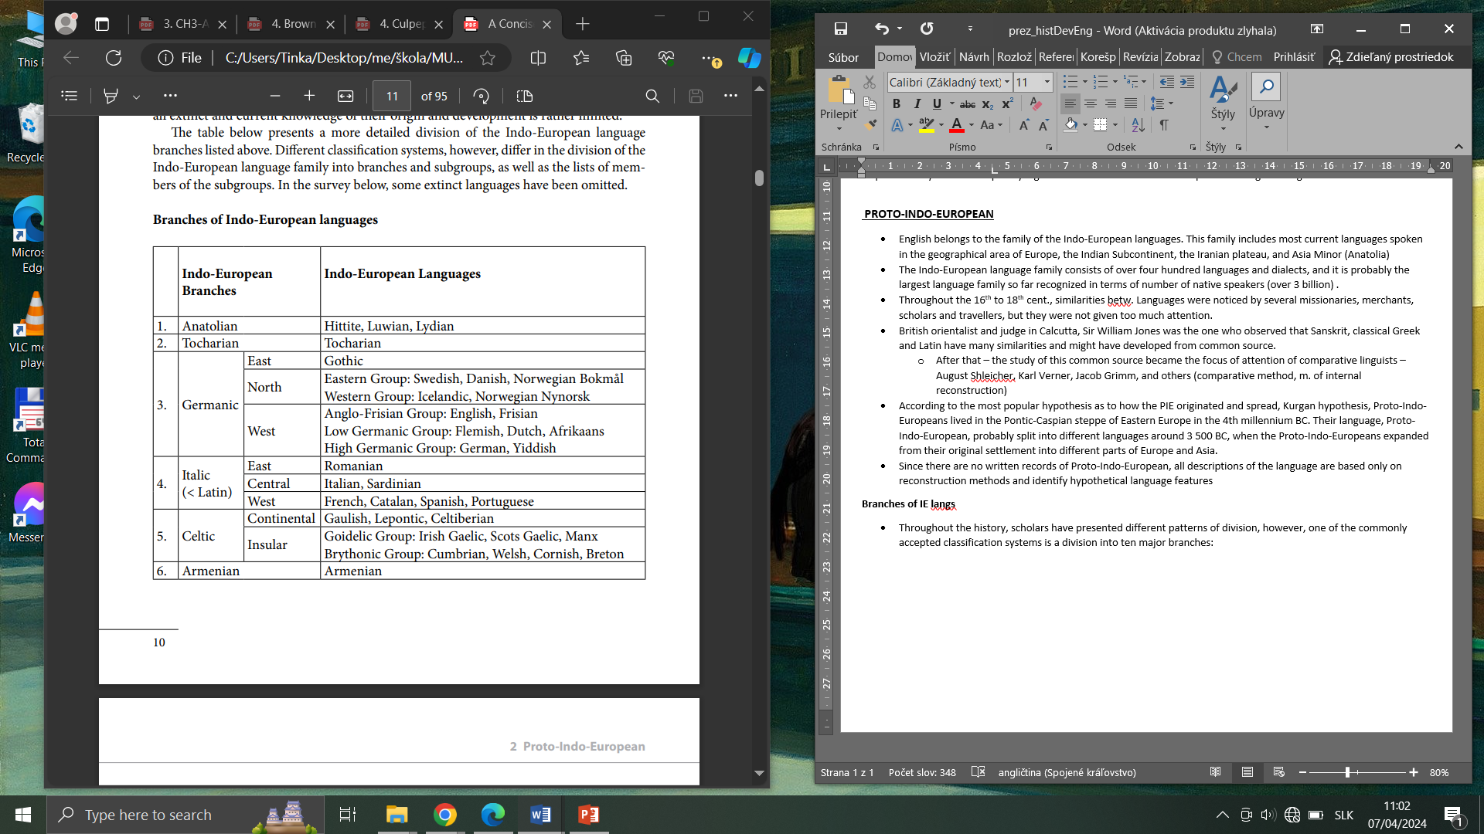
BRANCHES OF PIE
  The division into the:
  - branches – based on genetic relationship – a common ancestor
  - subdivision – shared innovations

Slide 7
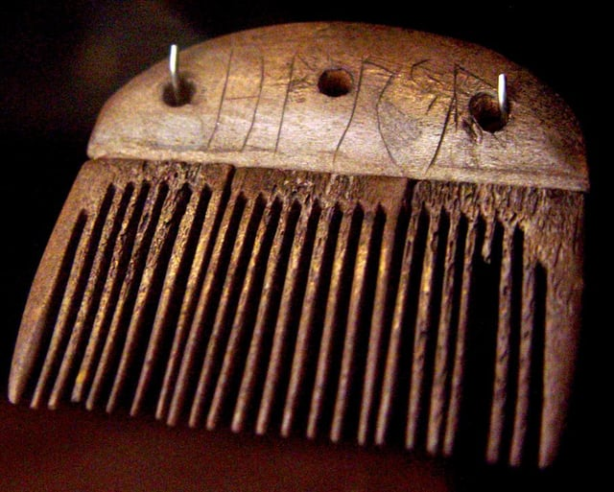
PROTO-GERMANIC (500 BC)
Common ancestor to all Germanic languages
Runic Vimose inscriptions from
200 AD (Denmark) – only written records available
Grammar:
  6 cases: (N,G,D,A,Vocative, and I)
  3 numbers – sg, pl, dual,
  3 genders – feminine, masculine, neuter
  Two voices
  Three moods

Slide 8
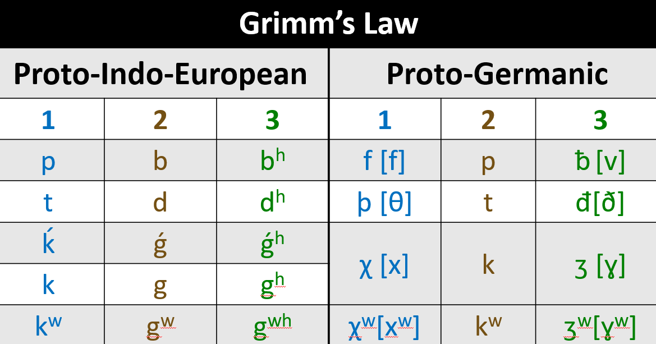
SOUND CHANGES FROM PIE TO PG AND OLD ENGLISH
  (1) PIE voiceless stops transformed into voiceless fricatives (spirants)
    p > f: lat. piscis > OE fisc (“fish”)
  (2) PIE unaspirated voiced stops transformed into unaspirated voiceless stops
    d > t: lat. duo > OE twā (“two”)
  (3) PIE aspirated voiced stops transformed into unaspirated voiced fricatives (spirants)
    b^{h} > ᵬ: sans. bhrātar > OE brōþor (“brother”)

Slide 9
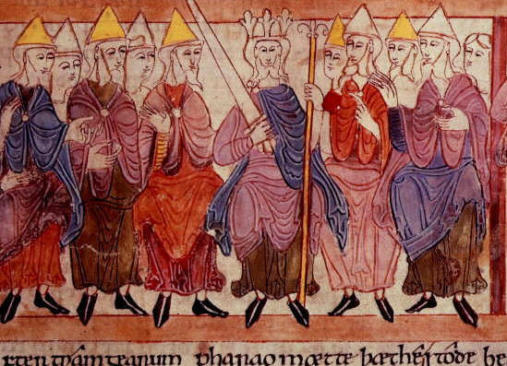
OLD ENGLISH (450 AD)
arrival the Germanic tribes in 449 AD from the north-west part of Europe
  Angles, Saxons, Jutes
Anglo-Saxons – most influential in the further development of the counry and language
  terms of kinship (brōðor, mōdor, sunu)
  names of natural phenomena (sunne, mōna, mere ‘sea’)
  sċīrġerēfa (sċīr ‘shire, county’ + ġerēfa ‘chief ’, ultimately shortened to sheriff)

Slide 10
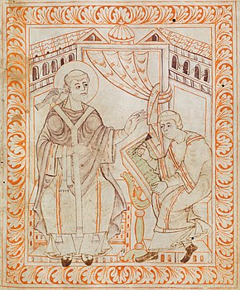
OTHER INFLUENCES
Romans (43 AD – 409 AD)
  towns, e.g. OE ċeaster ‘Roman fortified town’ from L castra,
    survives in place-names: Chester, Winchester, Leicester
Christianization in 7th-8th cent
  Religion and the Church: abbot, apostle, balsam, creed, disciple, font, martyr, mass
  Household and clothing: candle, cap, silk, sponge
Viking invasion
  introduction of non-palatalized pronunciations in words like skirt, kettle, give, or egg

Slide 11

LORD‘S PRAYER
IN OLD AND MIDDLE ENGLISH
https://www.youtube.com/watch?v=lol78Eh3UD8

Slide 12
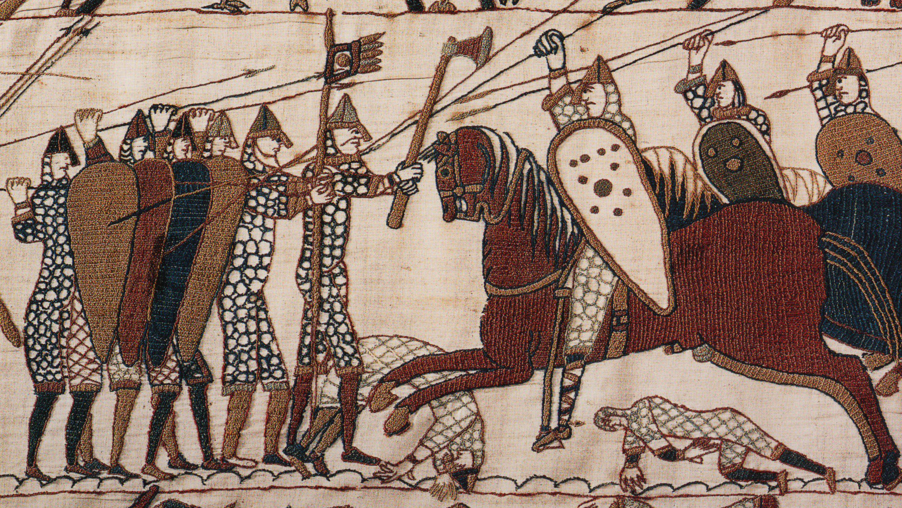
MIDDLE ENGLISH (1100/1150 AD)
Norman Conquest of 1066 – strong influence on languge and culture
Normans seized political, economic, military, and religious power
Population continued to speak Eng, as the Norman Lords spoke French
After loss of Normandy – forced to adapt to English

Slide 13
CHANCERY STANDARD
After 1400, London has become the new political and cultural centre, replacing Winchester → Chancery Standard
Reduction of unstressed syllables
  Inflectional system simplified
  Word order → less flexible

Slide 14
The Canterbury Tales (Prologue) in Middle English
https://www.youtube.com/watch?v=mVG77xTPH6E

Slide 15

EARLY MODERN ENGLISH
(1500 AD)
16th – 17th – centuries of reformation but also of learning and discovery
  New science, expansion of the colonial empire, colonization of North America → American English
Rapid expansion of printing industry

Slide 16
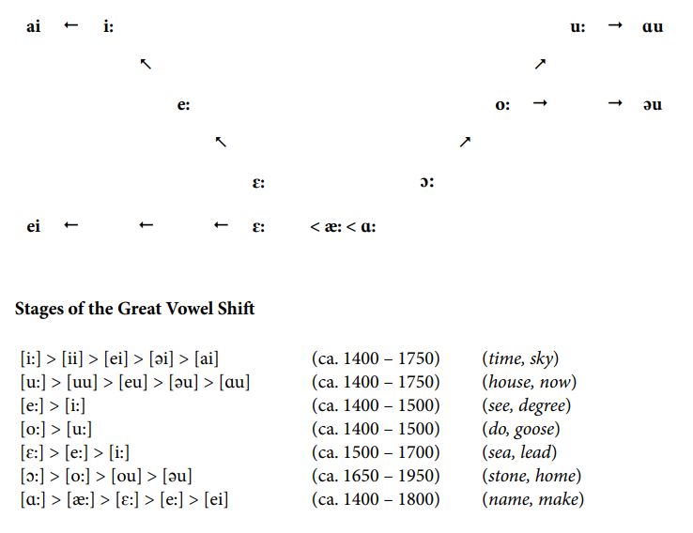
THE GREAT VOWEL SHIFT

Slide 17
SHAKESPEAREAN PLAYS AND SONNETS
https://www.youtube.com/watch?v=RDPT2e26SgY – Twelfth Night at The Globe
https://www.youtube.com/watch?v=nD6Of-pwKP4 – Sonnet 18, David Tennant

Slide 18
SOURCES
Chamonikolasová, J. (2014). A Concise History of English. Masaryk University.
Pictures from the book:
Periodization of English language: study materials from the course: Historical Development of English by Jana Chamonikolasová, ‘Origin, development and global spread of English‘ presentation, 2023
Grimm‘s Law table – study materials from the course: Historical Development of English by Jana Chamonikolasová, ‘Sound changes from Proto-Indo-European To Proto-Germanic and Old English‘ - Jiří Lukl, Jana Chamonikolasová, 2023

Slide 19
Thank you for your attention !
☺

