Slide 1
English Pron. Varieties: Practical Examples
Libor Blahut

Slide 2
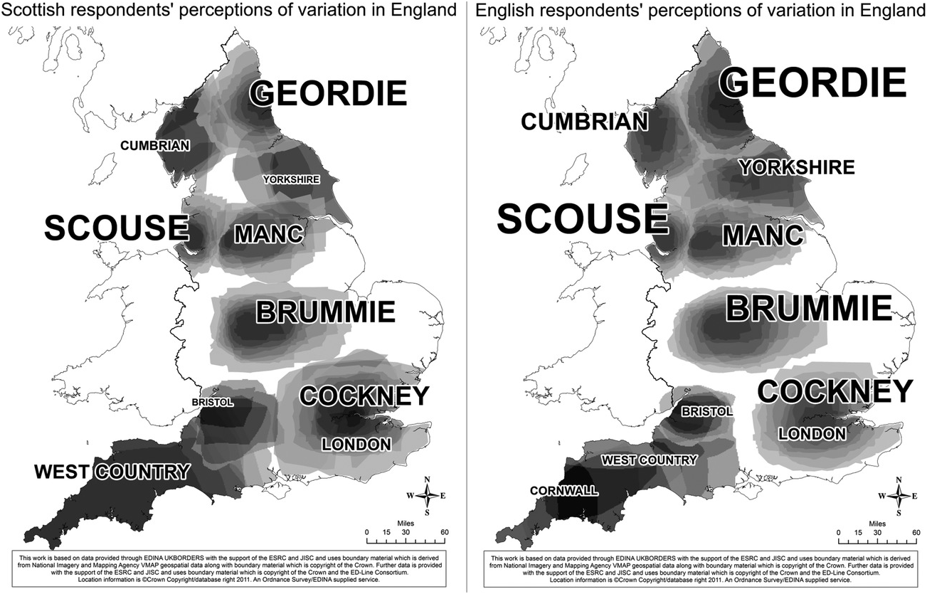

Slide 3
RP & GN in Vicious
https://www.youtube.com/watch?v=tWK0WyoGXBQ&list=PL3wXW4qdCvpi6ZpUactbVa5z7_Vc95W15&index=2
(00:19:01) - notice: the use of intonation in the imperative utterance, which goes as if in a question (high jump)
https://www.youtube.com/watch?v=OzSBbrDSY4w&list=PL3wXW4qdCvpi6ZpUactbVa5z7_Vc95W15&index=3
(00:08:39) - notice: Ash's monophthongisation of "away" /əwe:/ and "potatoes" /pote:tos/

Slide 4
Bolton Accent by Philomena Cunk
https://www.youtube.com/watch?v=yvzxAOTIIUY
(00:00:50) - notice: "old age" /'olde:dʒ/, generally monophthongised, intonation high jump/glide up -> almost as if interrogative
https://www.youtube.com/watch?v=3d_SZ08ro8o&t=131s
(00:02:13) - notice: "resonate today" /'rezone:,təde:/ - monophth. + omission of terminal consonants
(00:03:32) - "theory" /θi:ri/ front closed /i/ instead of /iə/

Slide 5
Scottish Accent in Court Video (authentic) vs. Bill Nighy's Scottish Accent
https://www.youtube.com/watch?v=LoEotny5_jI
- notice: monophthongisation, strong rhoticity, intonation goes up (take off) at the end of the utterance
https://youtu.be/5crxHhe5b7w
(00:01:55) - notice: "married" rhotic (less than in the previous video of genuine Scottish speakers; (00:03:37) "against" /əge:nst/

Slide 6
Cockney in Sweeney Todd
https://www.youtube.com/watch?v=ZukfGuYBGyQ
(00:00:05) - notice: "downright shame" /dawnra:t,ʃajm/
https://www.youtube.com/watch?v=VUngoASVsZs
(00:00:35) - notice: "something" /'samtin/ stopping th
omission of the terminal consonants, open vowel [a] pronounced as /a/

Slide 7
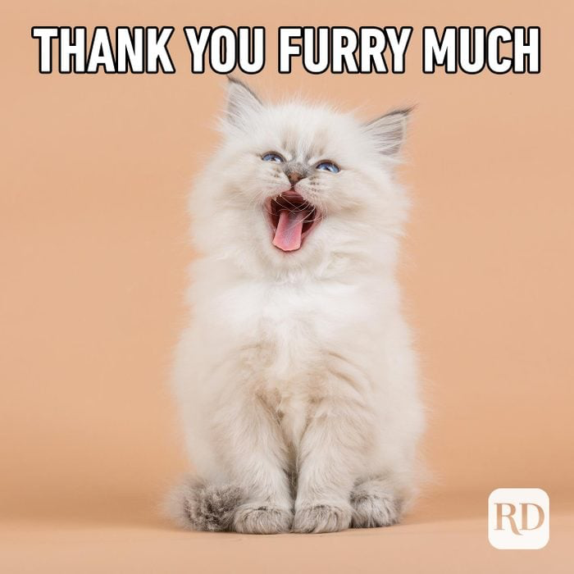
Thank you

