Slide 1
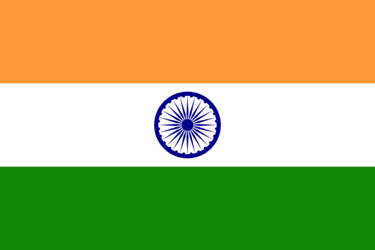

English in the
Jewel in the Crown
- Indian English -
Rochana Jayasinghe
rochjayasinghe@gmail.com

Slide 2
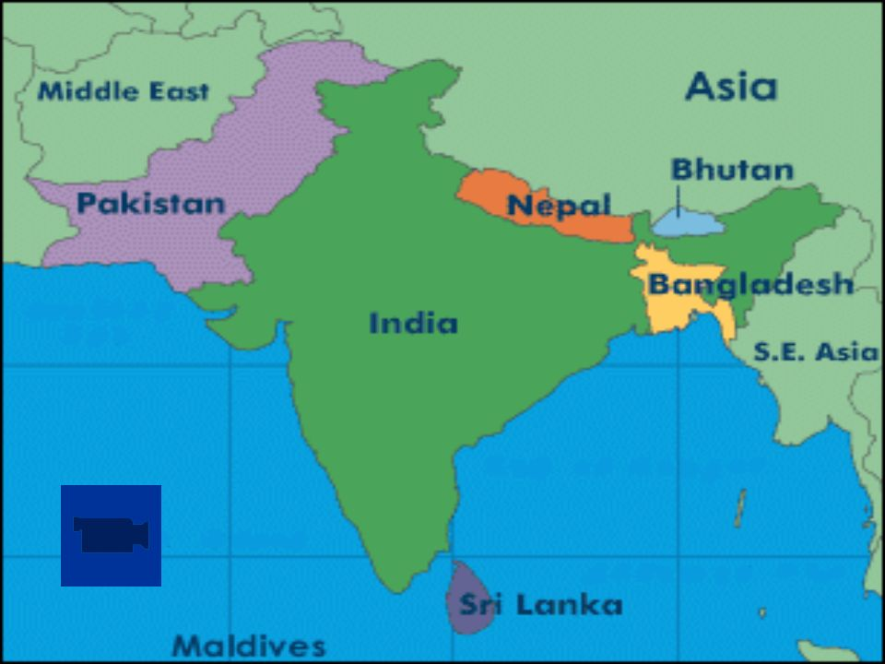

Slide 3
Number of English speakers in the Indian subcontinent – 200 million to 333 million
India is among the leading English-using nations in the world; 125 million
The third largest English book printing country in the world after the UK and the US
India publishes more books in English than in any other language

Slide 4

HOW? WHY?
BRITISH RAJ (1858-1947)
Jewel in the Crown

Slide 5
One of the 22 official languages
Widely used in administration, education, media, cross cultural communication
Plays the most prominent role in the prestigious domains of education, science and technology
The instrument that various poliical leaders utilized for national awakening and freedom struggles

Slide 6
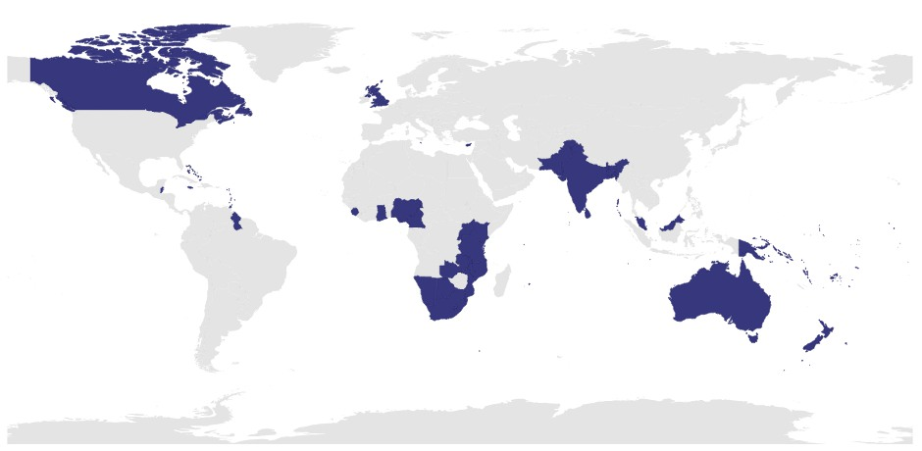

Slide 7
What is your good name?
Today morning, yesterday night
Cousin sister, cousin brother
Prepone
Do the needful

Slide 8
Auntie/uncle
Timepass
Don’t eat my head
To pass out

Slide 9
On/off the lights
‘Only’
Revert back
Do one thing
Himalayan Blunder

Slide 10
I have a doubt
Batch/batchmates
Cut the call
Current went/current came
‘No’

Slide 11
Sri Lankan English
Hi
How have you been lately?
What a shame
Dont be silly
No way!
I accept that
They're dating

Slide 12
This is my son's girlfriend
Everybody
Everybody will be there
Its crazy!
Everything is alright
Is that ok? Don't worry
Late night partying
This is ridiculous
Dont make me repeat myself
Unfortunately

Slide 13
Can you turn the air conditioner on?
Can you switch off the light?
My arm hurts
There you go
There was so much traffic on the road today
You must be so tired
That's what I told you!
Yes, that's right.
I didn't know at all
Bon Appetit!

Slide 14
Sounds ridiculous?
Is it wrong?

Slide 15
English is ‘nativized’
When a language is transported to new cultures as in South Asia, it undergoes striking changes
It is not a uniform variety

Slide 16


Slide 17
Speak English “Our” Way
English is now one of “our” languages
Has ceased to be the “property” of England
Small price to pay for colonial destruction?
What about what I speak?
Long time, no see
More the merrier
No can do

Slide 18
“Englishes”

