Slide 1
Scottish accent
EE Varieties 2021/2022
Ema Bícová

Slide 2
SSE (Standard Scottish English)
Distinctive vocabulary
Result of the contact of Scots with Standard English
Code-switching and style shifting is equally common in speakers

Slide 3
history
King James VI of Scotland became King James I of England in 1603
Court moves to London
Court poets adapt language and style to the English market
Scots is eclipsed as a literary language (only English translation of the Bible was available)
In 1707, Scottish and English parliaments amalgamated, but church and educational and legal structures remained separate
Terminology remains distinct and separate

Slide 4
Phonology
Mostly rhotic
  /r/ may be postalveolar approximant [ɹ], alveolar tap [ɾ], or alveoral trill [r]
  /o/ and /ɔ/ before /r/ are contrasted (different pron. of horse and hoarse)
  /or/ and /ur/ are contrasted (shore x sure, pour x poor)
  /r/ before /l/ is strong: occurrence of epenthetic vowel (girl, world = 2 syllables)
/ʍ/ is present (which)
/x/ is frequent in Scots and Gaelic borrowings (loch)
/l/ is velarized to [ɫ]
/p/, /t/ and /k/ may not be aspirated
ending –ed may be realized as /t/ (ended)
ending –g is dropped (endin‘)
glottal stop may be an allophone of /t/ after vowels

Slide 5
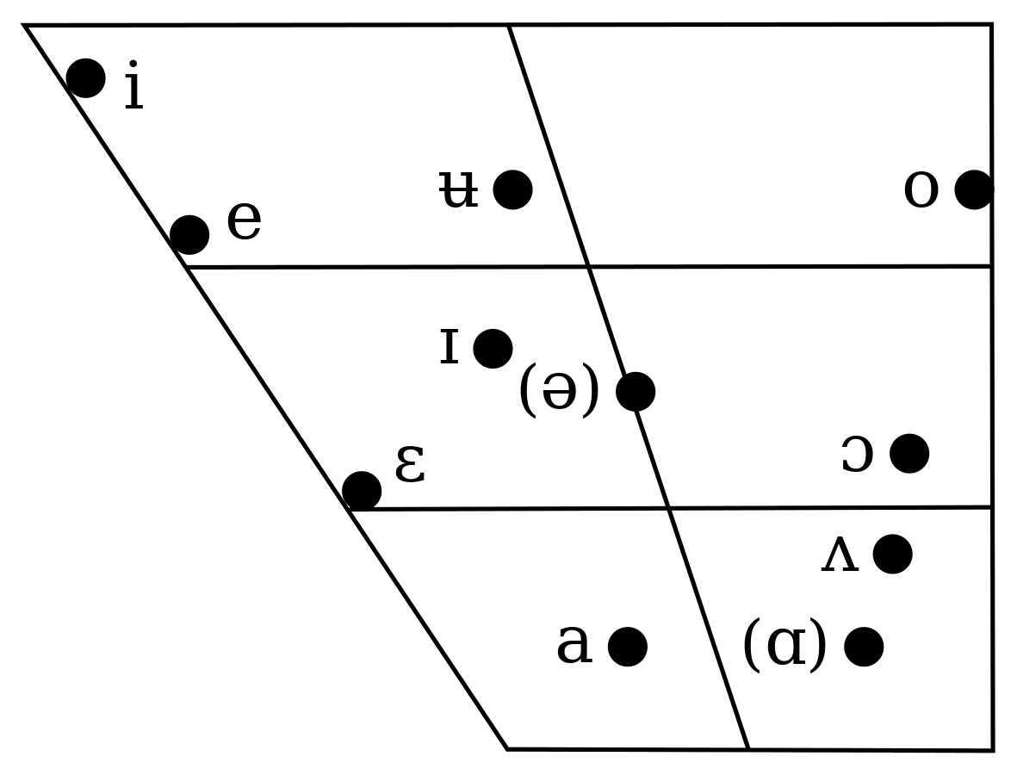
vowels
no /ʊ/, instead transferring Scots /u/ = [ʉ] or [ʏ] (pull & pool = homophones)
no /æ/-/ɑː/ distinction (bath, trap, laugh & palm = same vowel)

Slide 6
Aitken‘s Law
Scottish Vowel Length Law = Aitken‘s Law (A.J. Aitken)
Vowel length is conditioned by the target vowel‘s phonetic environment
Vowels and diphthongs are short, except in these environments, where they are long:
  Before /r/.
  Before a voiced fricative (/v, z, ð, ʒ/).
  Before a morpheme boundary.
  In a word-final open syllable, save for the HAPPY vowel /e/ (or, in Geordie, /i/).

Slide 7

How to do a scottish accent in under 2 minutes
Matt Pocock

Slide 8
scotticisms
What a dreich weather! – What a lousy weather!
You'd better just caw canny. – Don‘t overdo it.
Just play the daft laddie. – Play stupid.
Cheers. – Thanks.
Ach, away ye go! – I don‘t believe you.
I'll come round (at) the back of eight. – I‘ll come round just after 8.
Oan yer bike pal. – Go away.
Hello. – Awright ya?
Aye. – Yes.
Ah cannae dae tha. – I can‘t do that.

Slide 9
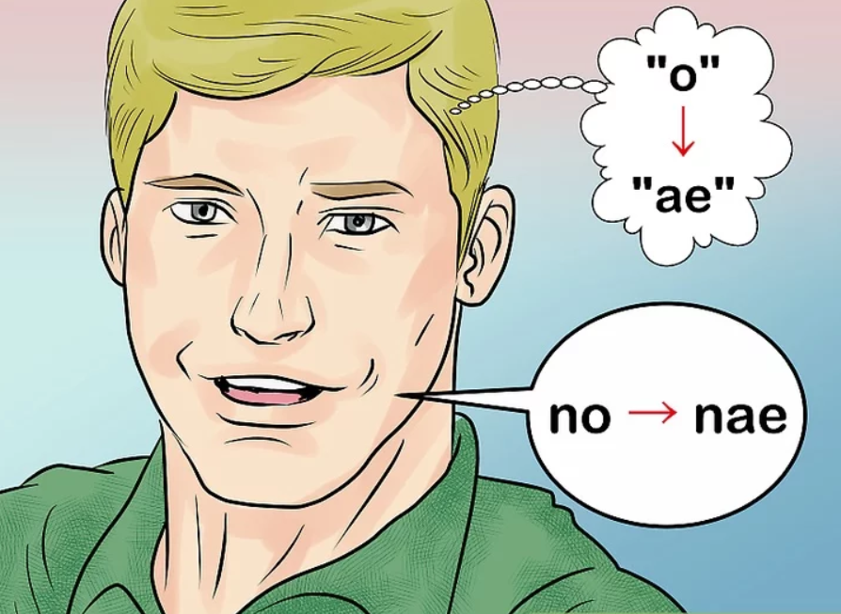
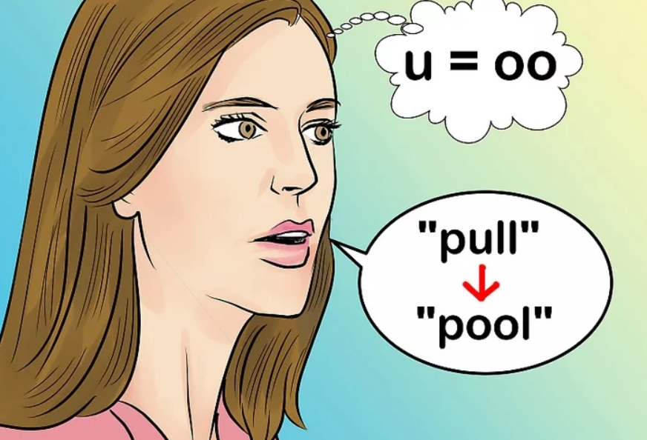
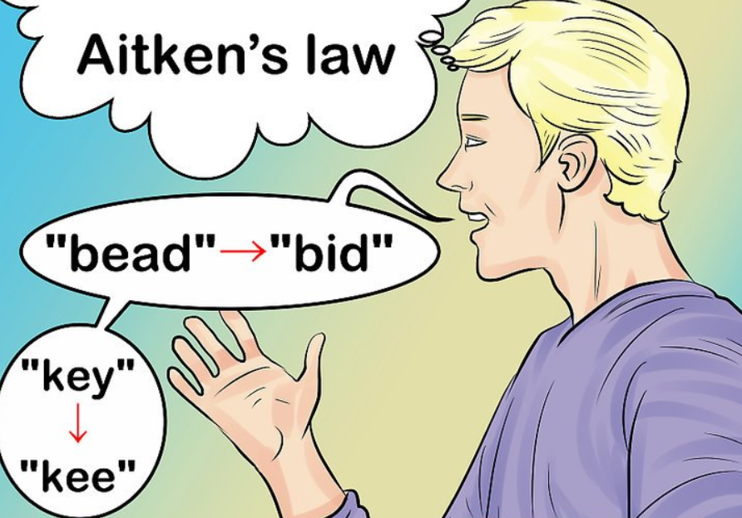
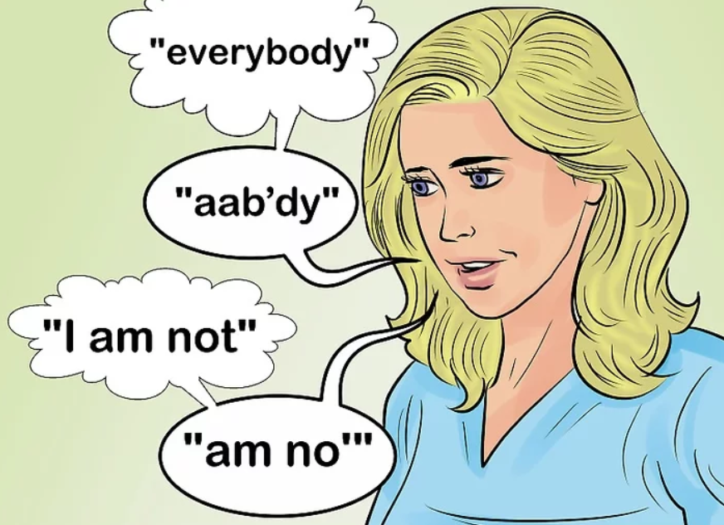
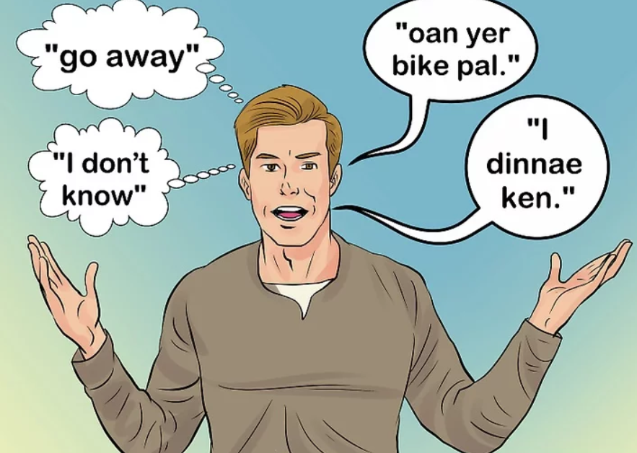
https://www.wikihow.com/Talk-With-a-Scottish-Accent

Slide 10

Famous Voices – billy boyd

Slide 11
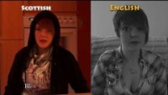
English Vz Scottish Translations
WeeScottishLass

Slide 12
English to Scottish translators
Scottie Translator
Welcome tae the Scottie Translator from Scotland. Write yer wee bit English phrase in the kistie on the left an we'll chynge it intae Scottie juist lik that! Nae havers nou!
http://www.whoohoo.co.uk/scottish-translator.asp
(The website includes translators to other notable British accents as well.)
ScoTranslate
http://www.scotranslate.com/
LingoJam
https://lingojam.com/EnglishtoScots

Slide 13
cheers fur yer attention.

