Slide 1
History of Central European Culture III
CMAa12
13. 5. 2024
Mgr. Šárka Jelínek Gmiterková, Ph. D.

Slide 2
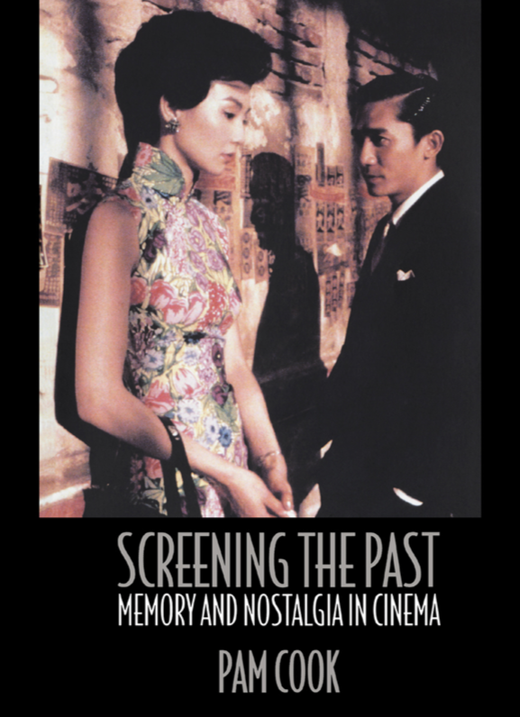
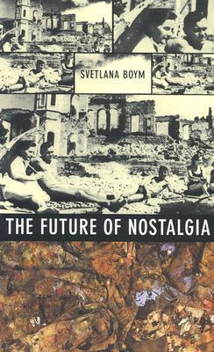
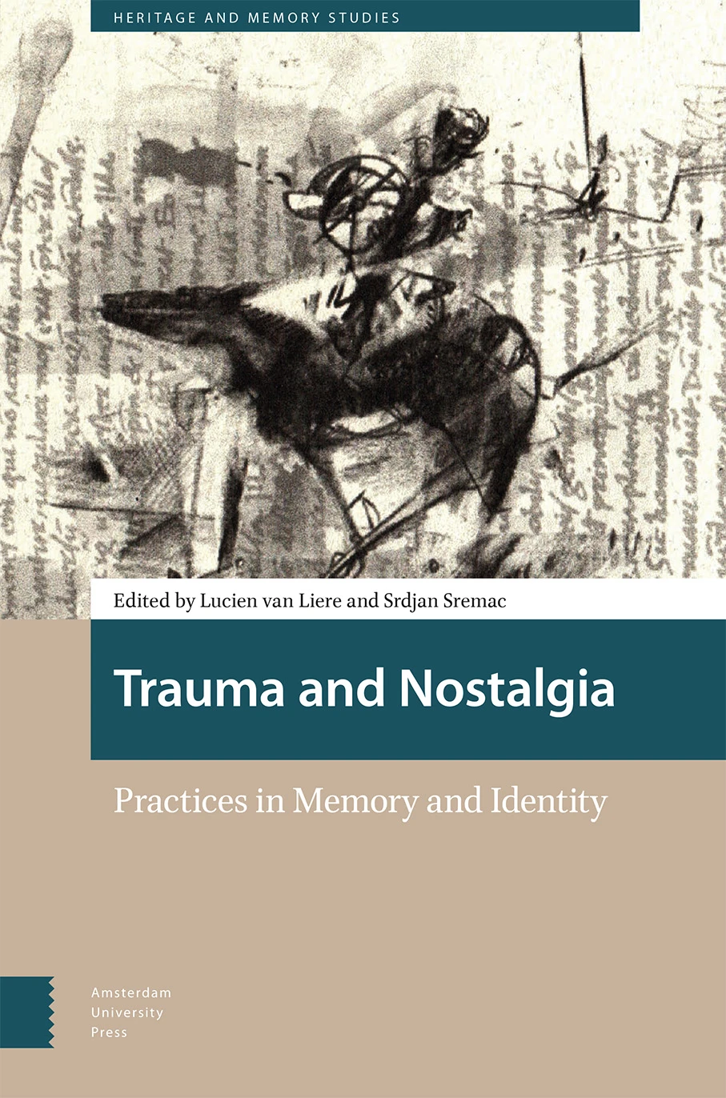
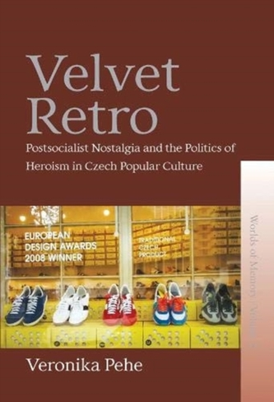

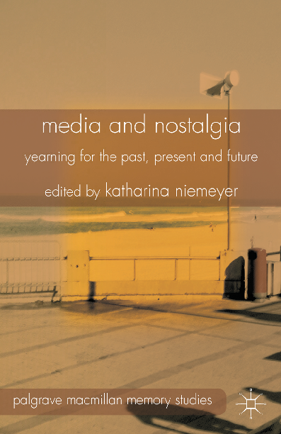
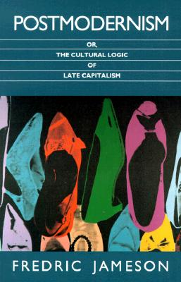
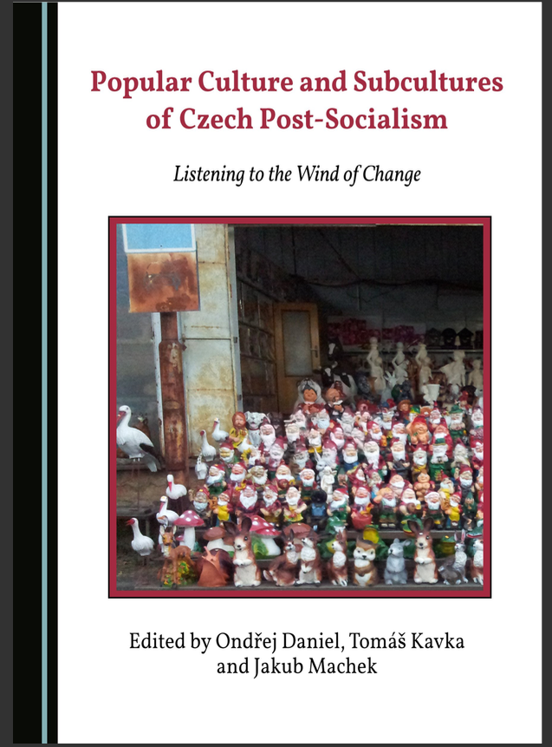

Slide 3
Cultural Memory
Memory shaped by education, which binds the individual to the nation or region >> the ability to understand historical and cultural development across generations
Carried by media that convey the lived experience of ancestors (artistic representations, monuments, museums, archives...)
The transition from lived experience to cultural memory is problematic and risky, with the risk of narrowing, distortion and instrumentalisation
X HISTORY?
History as a disinterested past (calm, stoic)
History as remembered past (saturated with emotions, "polluted" by the various intentions of those who remember)

Slide 4
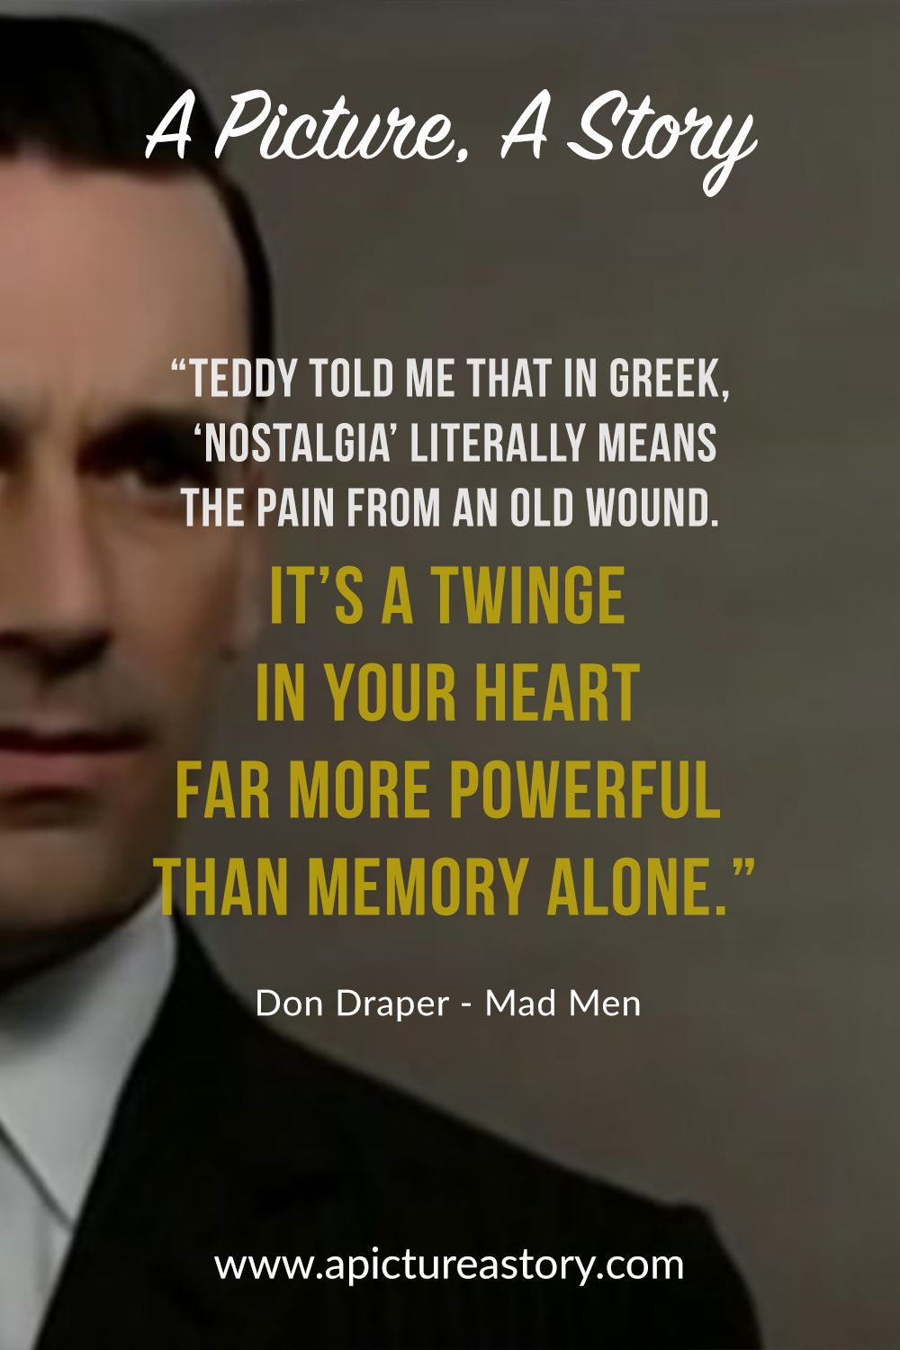
History/Memory/Nostalgia
If we perceive history as something objectively reliable and distanced,
then nostalgia is the
opposite extreme – a bittersweet
looking back to the past.

Slide 5
Nostalgia as a part of postmodernism
Postmodern cultures as sequences of images, surfaces and their subsequent quotations X absence of a solid core and a substance + absence of depth
Postmodern society is stripped of all historicity, everything is reduced to images
Nostalgic returns in the form of stereotypes and evocations of feelings; intertextuality
A lost ideal that will never return and will only be accessible through images, objects or performances of a bygone era
an escape into enclosed and transparent worlds of the past instead of facing chaotic and unsatisfying present >> as a form or resignation or a critical dialogue with the present?

Slide 6
What, if anything, makes post-socialist nostalgia specific and distinct vis-a-vis other incarnations of mediated longing for the past?

Slide 7
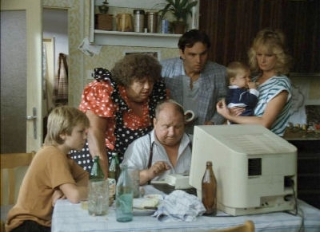
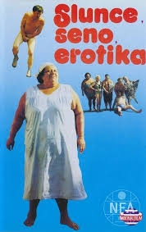
Post-socialist nostalgia
a sentimental relationship with the past in Central and Eastern Europe, accompanied by feelings of loss and longing X first half of the 1990s, when society was oriented towards the future (see the clip from the Sun, hay and erotica, 1991, dir. Zdeněk Troška)
a fascination with nostalgic mode of remembering, closely tied to the vernacular and everyday level
making sense of one’s identity and belonging in the post-socialist transformation
TV formats

Slide 8
What happened that citizens of the former eastern bloc have undergone such radical reversal with their relationship with time, suddenly dropping their future oriented revolutionary sense of future and transforming themselves into past-oriented beings with a sense of loss or even longing for the bygone era?

Slide 9
The emergence of post-socialist nostalgia
Politically motivated readings of recent history, which downplay the hardships of life under communism
Commercially repacked symbols and products of the bygone era
Grass-root reactions to the hasty rejections of all things socialist after 1989
Growing economic uncertainty and social disparities brought by economic liberalization
>> nostalgic practices are heterogenous, polysemic and can articulate a range of different attitude to the past
There are several types of post-socialist nostalgia:
Temporal orientations – restorative nostalgia X reflective nostalgia
Forms of expression
Political uses
Economic motivations

Slide 10





Ostalgia
Combination of nostalgia and German "Ost" - East (origin in Germany)
Its emergence is related to the economic and political crisis of the second half of the 1990s
Ostalgia = a positive relationship to some phenomenon in the field of consumerism or directly to consumer goods associated with the socialist era
Two types of continuity:
  consumer or mass entertainment from the socialist period (mainly television and the music industry)
  products

Slide 11

Ostalgie
socialist kitsch?
In the German context, it expresses the sense of social and physical dislocation of many former East Germans >> disillusionment with the reunification process
The new German unified identity as a process for negotiation
The attempt to show childhood and adolescence in East Germany as normal and shared by many is itself a political gesture

Slide 12

Good Bye, Lenin! (2003, r. Wolfgang Becker)
The peak of the ostalgic wave
The story of a young man, Alex, and his sister, Ariane, who také care of their mother, Christiane. She falls into a coma just days before the fall of the regime and wakes up eight months later.
For his mother, he creates his own nostalgic version of late socialism that has nothing to do with reality >> a self-reflexive gesture
Alex as an archaeologist searching for objects from the former regime.
Just a family drama?

Slide 13

Good Bye, Lenin! (2003, r. Wolfgang Becker) trailer

Slide 14
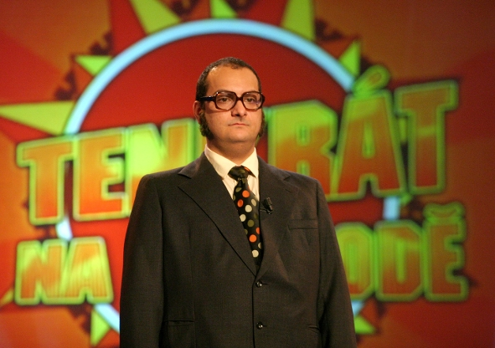
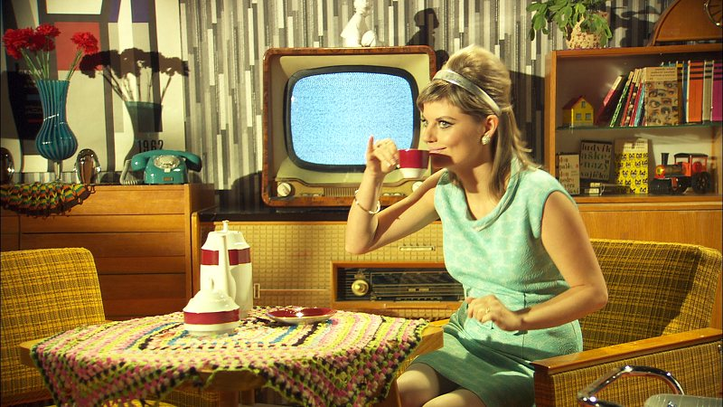
Ostalgic Television – new formats
Once upon a time in East (TV Nova)
Retro magazine
Wonderful years – a family saga spanning over four decades, combining personal memories with national history

Slide 15

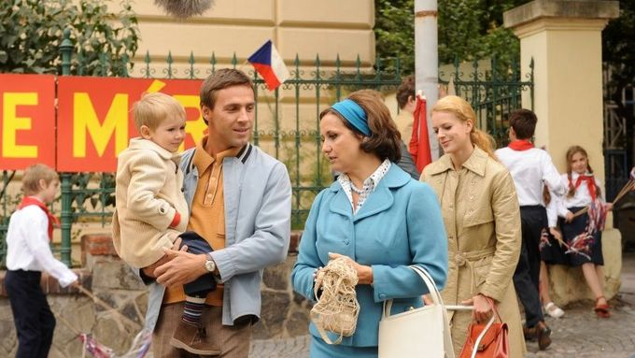
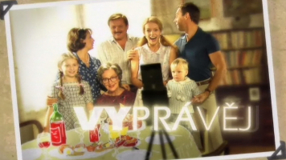

Slide 16
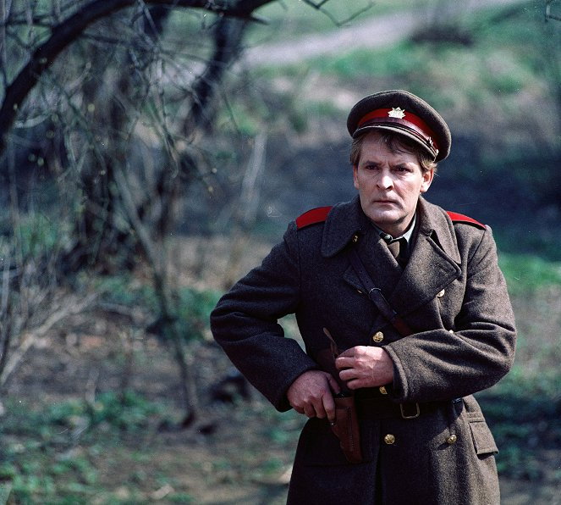
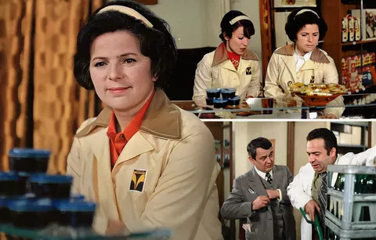

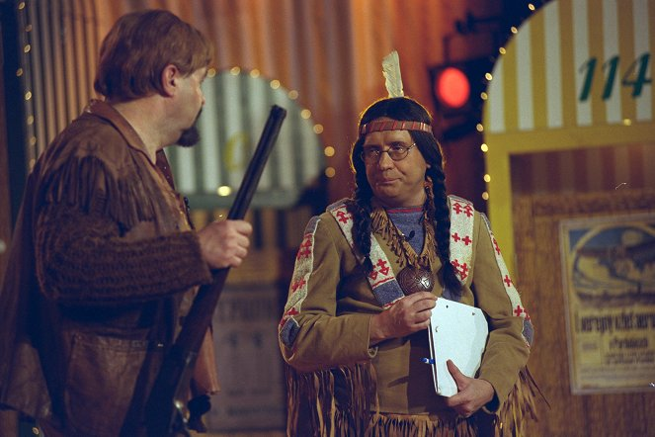

Slide 17
Ostalgia – characteristics
Everydayness
Greyness, uniformity and conformity X carefree period, family values and romance
Small-scale heroism = humorous anti-regime gestures of defiance, as an illusion of tiny dissent for everyone
Childhood/adolescence perspective
"us" and "them"
"we" as a family or neighborhood creating microcosms protected from outside influences
Positive heroes are not necessarily positive, but their actions are not a subject of ridicule
"they" are characters supporting and creating the regime, often a form of caricature

Slide 18
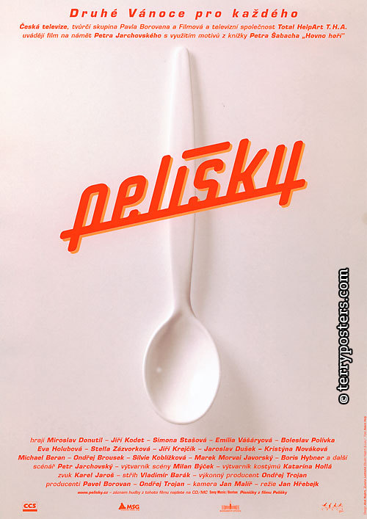
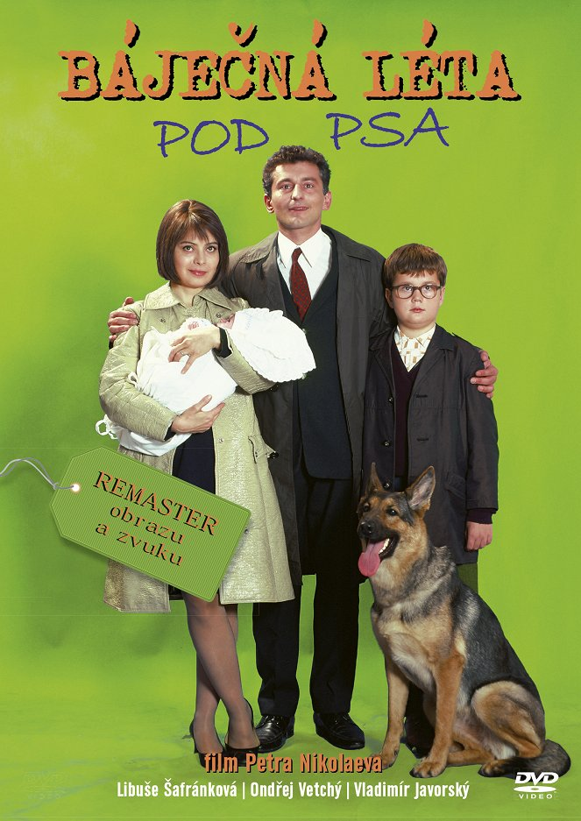
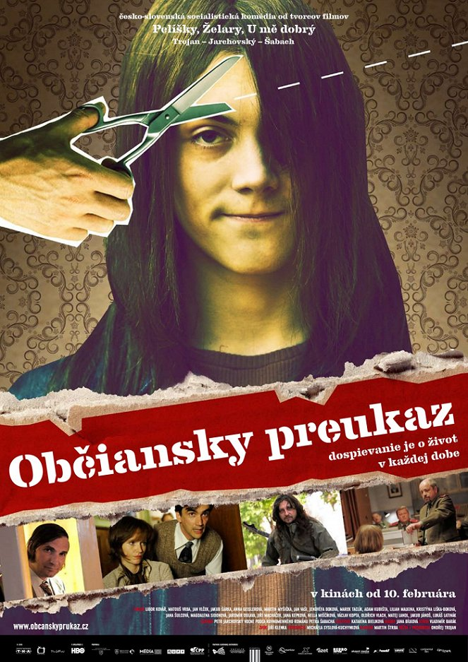
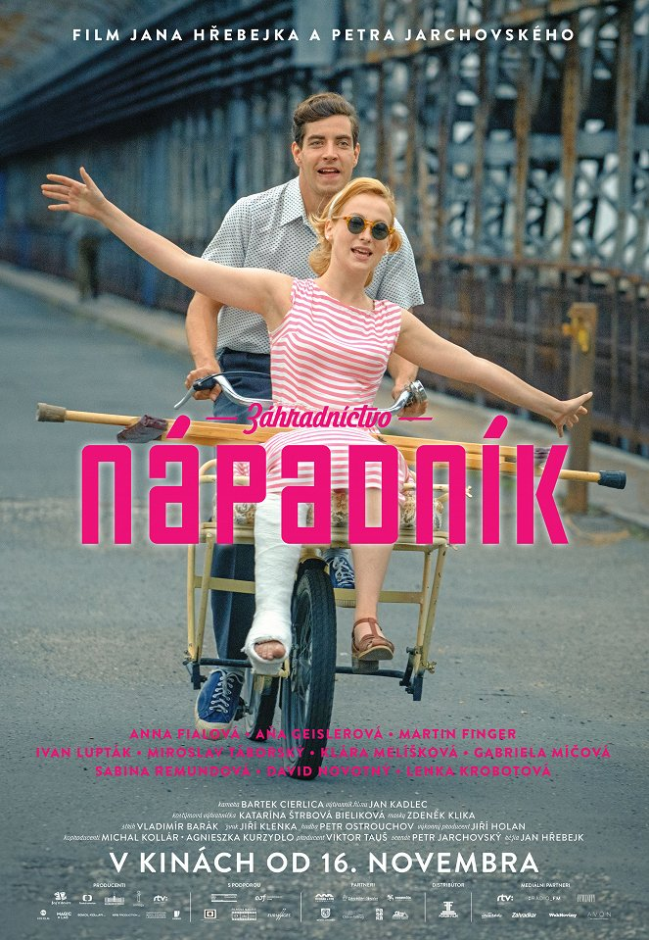




Slide 19
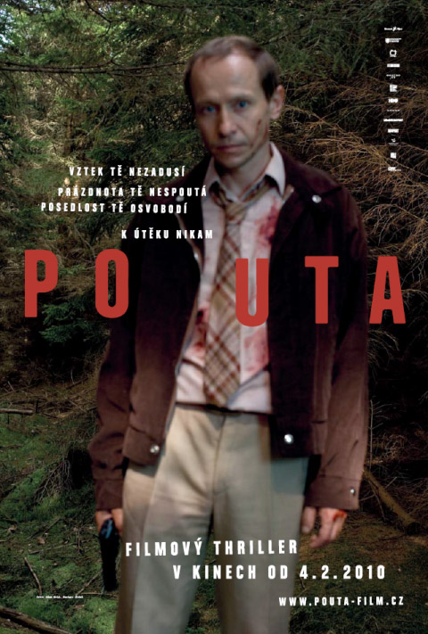

The end of ostalgia?
The lives of others
(2006, Germany, dir. Florian Henckel von Donnersmack)
Walking too fast
(2009, Czech Republic, dir. Radim Špaček)

Slide 20
Critical portrayals of recent past
… it‘s gonna get worse (2007, dir. Petr Nikolaev, about a hippie community situated in northern part of Czechoslovakia)
Walking too fast (2009, dir. Radim Špaček, a story of a secret service member Antonín Rusnák)
Kawasaki‘s Rose (2009, dir. Jan Hřebejk, a contemporary drama reflecting on past guilt)
Eighty letters (2011, dir. Václav Kadrnka, personal experience of growing up in socialist Czechoslovakia in a minimalist concept)
Burning bush (2012, dir. Agnieszka Holland, HBO miniseries about the growing desilusion after the sucide of Jan Palach) Fair Play (2013, dir. Andrea Sedláčková, drama about a competitive athlete and practices of socialist top level athletics)
The Teacher (2016, dir. Jan Hřebejk, about a teacher who exploits her pupils nad their parents for a network of various services)

Slide 21
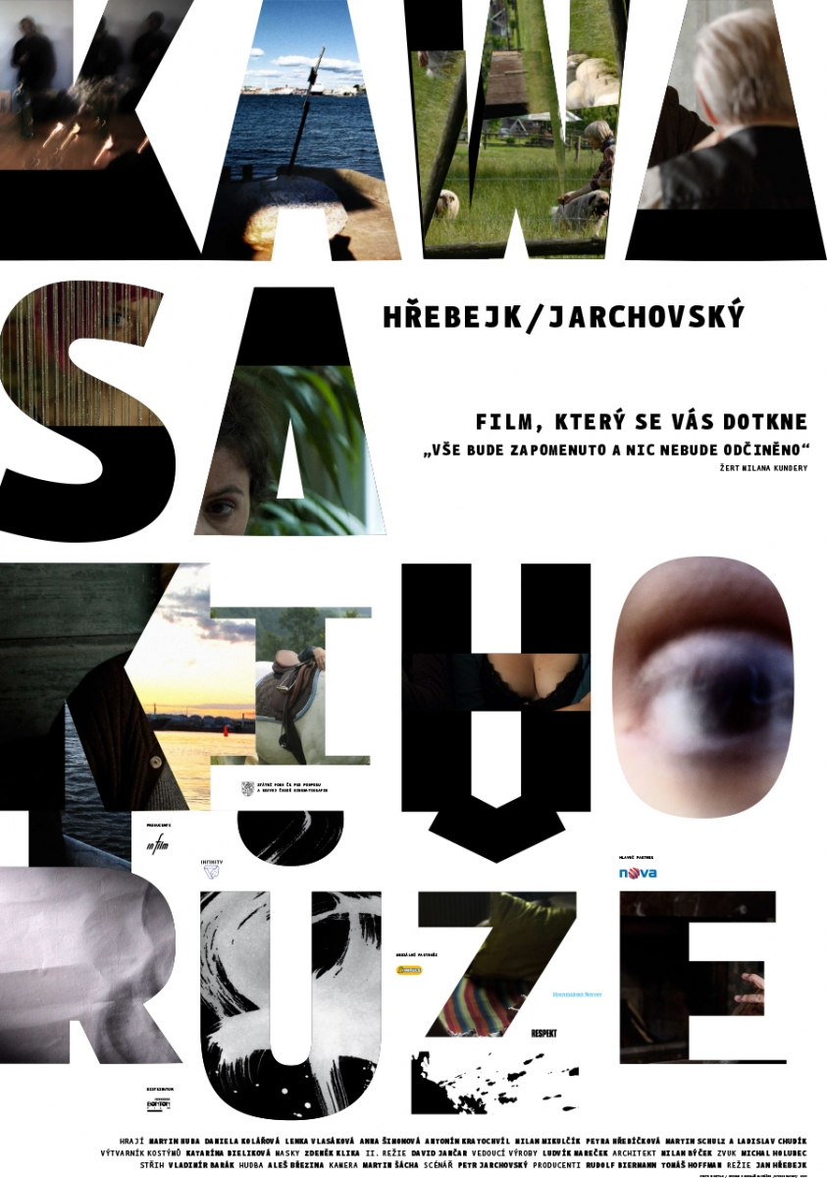
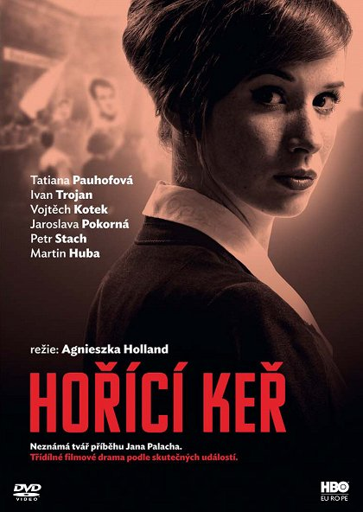
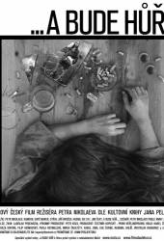
Critical portrayals of recent past
I, Olga Hepnarová (2014–15, dir. Tomáš Weinreb and Petr Kazda, a story of a murderer sentenced to death, based on real events)
The Sleepers (2019, dir. Ivan Zachariáš, espionage themed series set at the dawn of the 1980s)
Volha (2023, dir. Jan Pachl, series about a driver, who is able to navigate himself and benefit from the socialist system)

Slide 22
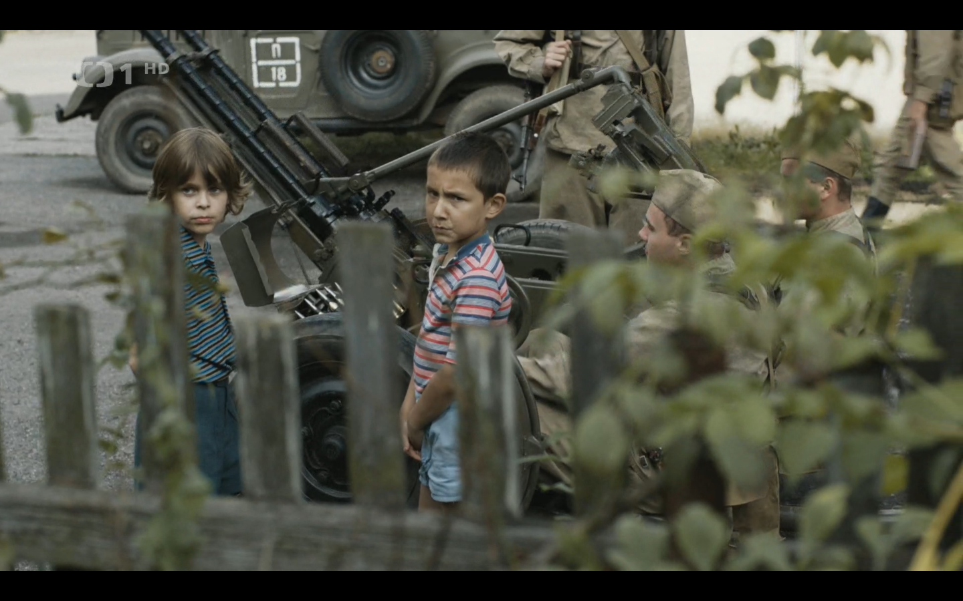
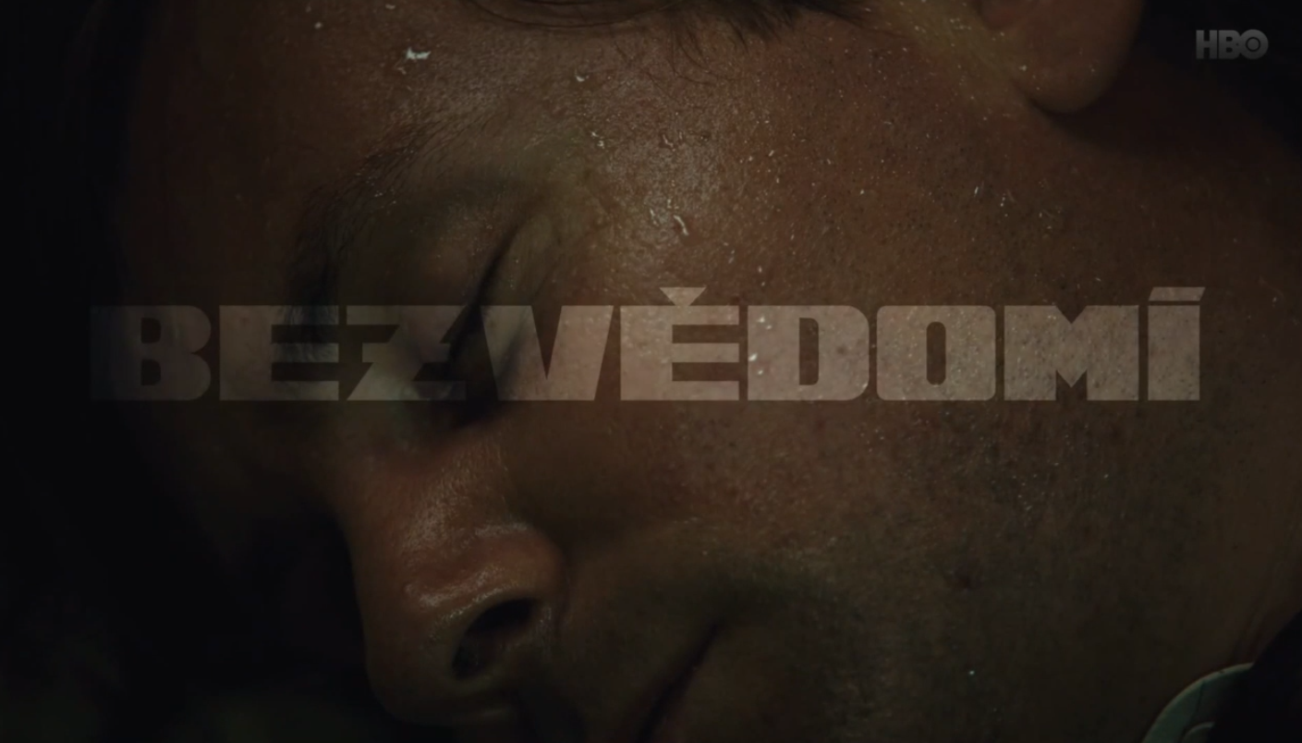

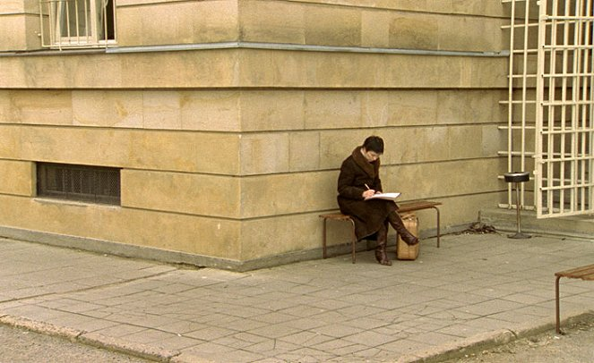


Slide 23
Possible conclusions?
Post-socialist nostalgia can be seen growing out of global nostalgic tendencies evident in the late 1990s and early aughts, however in central-eastern European countries it is an important aspect of making sense of one’s identity and belonging in the post-socialist transformation.
Various tv formats and recycled tv content (series, game shows, documentaries) are tarnished by the medium‘s history as an important tool of communist propaganda. Nevertheless, post-socialist viewership is able to enjoy these programes as forms and pleasures of entertainment (see Richard Dyer – Entertainment and utopia in Only entertainment)
Negative aspects of life under communist governements are more critically explored in films rather that in television broadcasting.

