Slide 1
What is not „Cultural transfer“ I.
comParison:
Dependent/independent variable
Explanatory approach
(critique: comparison does not take time into account)
Possible goals of comparion:
Identification of differences/similarities
Identification of uniqueness
Typologization
Hypothesis testing
Notes:
Postup při aplikaci komparativní metody podle Miroslava Hrocha:
Definice objektu – tedy určení, co bude srovnáváno. Rozlišit, zda srovnáváme procesy, nebo struktury.
Určení cíle srovnání:
a) určení shod a rozdílů b) určení jedinečnosti jevu nebo procesu – individualizace c) vytváření typologie d) vytváření syntézy e) výkladová komparace – vysvětlení shod a rozdílů, objasnění souvislostí – interpretující, ne popisná komparace f) ověření hypotéz g) hledání alternativ vývoje (kontrafaktická historie) h) analýza transferu
Kritéria komparace – volba porovnávaných prvků
pouhé paralelní vyprávění – které neslouží teoretickému vysvětlení podobností nebo rozdílů

Slide 2
Test questions – a sample
Social Network Analysis
Sample questions:
Theory
1/ Explain the basic parameters of Social Network Analysis methodology: in which fields it is used, and for what respective purposes; what kind of research questions can SNA effectively answer
2/ Explain the difference between whole-network and ego-network approaches
3/ Explain the following metrics of SNA – what they mean, how they can be used and interpreted: Degree (average degree; weighted degree); Centrality (Closeness C., Eigenvector Centrality, Betweenness Centrality)
Applications and case studies
1/ Crossley and Ozturk examined the network formed between artists and music festivals. How did they define ties between the nodes “artist” and “festival”? What was the main intention of the project?
2/ Crossley and Ozturk identified “core” and “periphery” in the network of artists and festivals. What do “core” and “periphery” mean in their research? How did they interpret the network structure?
3/ We discussed research on characters in books (Les Misérables, The Witcher) and films (Wes Anderson movies). What kind of ties between characters does SNA allow us to visualize? What research questions on fiction characters can SNA answer?
Obligatory reading: Nick Crossley – Tugba Aydin Ozturk, Music, social structure and connection: Exploring and explaining core-periphery structure in a two-mode network of music festivals and artists in Turkey. Miscellanea Anthropologica et Sociologica 2019, 20(2): 192–210
Recommended reading: Travis J. Grosser – Stephen P. Borgatti, Network Theory/Social Network Analysis. In: Theory in Social and Cultural Anthropology: An Encyclopedia. Sage, 2013

Slide 3
Method of agreement
Cases: 1, 2, 3, 4…
Causal conditions A, B, C, D
Result
(possibly) necessary condition: C
Notes:
Použijí se maximálně odlišné případy a spojuje je shodný výsledek – aby se snížil počet vyskytujících se shodných podmínek
Závislá proměnná
zachycuje intenzitu jevu, o jehož vysvětlení usilujeme.
Nezávislá proměnná
vyjadřuje faktor, který může uvedený jev ovlivňovat nebo způsobovat. Korelační pojetí zkoumá, zda hodnota
závislé proměnné kolísá v závislosti na hodnotě nezávislé proměnné, tj. zda spolu hodnoty
obou proměnných korelují.
Otázka obvykle je „Proč?“ – ptám se po příčině jevu; spíš než po důsledku určitých podmínek
Často slouží k testování hypotéz – ale lze použít i induktivně pro formulování nové teorie

Slide 4
Method of difference
B and C are not sufficient conditions
Notes:
prostřednictvím metody rozdílu ověřujeme, zda kauzální podmínka představuje postačující podmínku výsledku
Vždy, když je splněna podmínka, ale není dosažen výsledek, není to dostačující podmínka – podmínka B a C není postačující – sufficient; využíváme příklady, které jsou si co nejvíc podobné
(J.S.Mill, angl. Filozof 19.st.; aplikovatelnost na sociální vědy je sporná)

Slide 5
What is not „Cultural transfer“ II.
Histoire Croisée (Michael Werner – Bénédicte Zimmermann)
entangled history (Sebastian Conrad) – e.g., the mutual bound of colonizers and colonized societies
Notes:
HC - pokrok od transfer studies, kde jsou zdůrazněny vztahy a propojení, ale nepřihlíží se ke zpětnému vyjednávání ve vzájemných vztazích

Slide 6
transfer
Cultural Transfer Approach – defined in 1980s (Michel Espagne, Michael Werner)
„Transfer are processes through which the norms, images and representations of one cuture appear in another by the transmission through migration, meetings, reading of texts from another culture; integration of foreign cultural elements into a culture defined as native. Against the notion of „influence“
Michel Espagne, 1994
Transnational history concentrates on the relations between cultures, societies or groups of societies and intentionally transcends the boundaries of one culture or country.
Studying networks
Ther, Philipp: Comparisons, Cultural Transfers, and the Study of Networks: Toward a Transnational History of Europe. In: Haupt, Heinz-Gerhard — Kocka, Jürgen (eds.): Comparative and Transnational History, cit. dílo, s. 204–225.
“[Transfer studies should be] connected to identifiable actors and institutions. It should be possible to study intentions, interests, and functions related to the transfers. Social historians are also interested in the effects of such transfers, and they want to explain where and why a specific transfer occurred and for what reasons it assumed the form that it did.”
(Jürgen Osterhammel: A „Transnational“ History of Society. Continuity or New Departure? In: Haupt, Heinz-Gerhard – Kocka, Jürgen (eds.): Comparative and Transnational History. Central European Approaches and New Perspectives. New York – Oxford: Berghahn Books, 2009)

Slide 7
Cultural transfer
forms of intercultural processes: circulation and reception of texts, discourses, cultural practices and forms of knowledge between different cultural areas
Cultural Transfer Approach is based on the hypothesis that any cultural artifact transferred between different cultures (or cultural systems) undergoes a process of transformation, re-interpretation
Cultural transfer can productively use the category of “cultural mediators” - “cultural brokers”; or the concept of network, as articulated in network theory
Cultural Transfers should not be regarded purely as a simple act of transmission or communication from a transmitting to a receiving culture, but rather as multi-faceted processes transcending frontiers, sometimes thanks to individual agents and their linguistic-cultural specialisation (Jorgensen – Lüsebrink, eds., Cultural Transfer Reconsidered, 2021)
Appropriation, „productive misinterpretation“

Slide 9
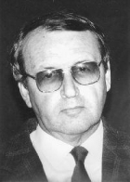
Appropriated appropriation
Pavel Hajný
Born 1939. In 1968, Hajný graduated at the Department of Dramaturgy at the FAMU film school in Prague
Up to 1975, Hajný had been credited as a scriptwriter on seven television films and two features
Hajný’s career at Barrandov was launched in 1968 in the position of a dramaturge in František Daniel-Bohumil Šmída creative group. After the post-1968 reorganization at Barrandov and Daniel’s emigration, Hajný became a dramaturge at the dramaturgical group of Vladimír Kalina.
Notes:
Apropriace českého vidění polské kultury + transfer dramaturgických a scenáristických tradic a schopností
Taky jako broker

Slide 10
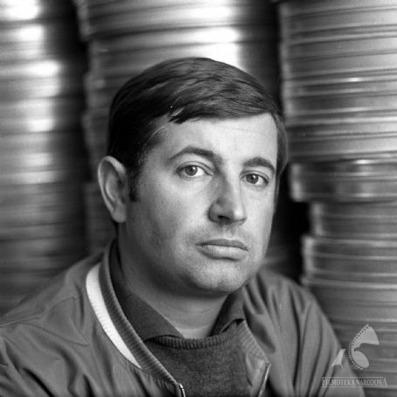
Janusz Majewski
Majewski finished his film education at the Film School in Lodz (Department of Direction) in 1960
Pavel Hajný authored scripts for three of Majewski’s movies.
Two of them, Dvojí svět hotelu Pacifik/Zaklęte rewiry/Hotel Pacific (Janusz Majewski, Poland–Czechoslovakia, 1975), based on the Polish writer Henryk Worcell’s book
and C.K. Dezerterzy/K. u. k. Szökevények/The Deserters (Janusz Majewski, Poland–Hungary, 1985), an adaptation of Kazimierz Sejda’s novel satirizing the Austro-Hungarian army during the First World War
achieved extraordinary success with Polish audiences (6.1 mil. viewers)
Slaná růže/Słona róża/Salty Rose (Janusz Majewski, Poland-Czechoslovakia, 1982) was second of Hajný’s cooperations with Majewski, based on the memoirs of Ryszard Frelek, who was a high-ranked party functionary in the 1970s

Slide 11
Hotel Pacific, 1975
In 1975 Hajný responded to a proposal of a co-production received from the Polish group Tor
Hajný wrote the script for Hotel Pacific
This project brought Hajný and the movie´s director Majewski together.
The early partnership was significantly enhanced by Hajný’s previous interest in Polish culture. He had been learning Polish in the Polish Cultural and Information Centre in Bratislava to be able to read Polish periodicals devoted to jazz and translate Polish novels and sketches for a student theatre. In effect, he was able to speak Polish and become a mediator between Różewicz’s, Zanussi’s and Zalewski’s group Tor, on one side, and Kalina’s dramaturgical group, on the other side.
Hajný: “To write a script for a Polish movie was a great lecture for me thanks to the encounter with a different dramaturgical tradition. It was the best education for me because it was necessary to adapt to attitudes of both cinema industries. … I would love to continue in cooperation with the Polish cinema and to participate in its evolution.” Hajný at the session of the approval commision for feature films (Komisja Kolaudacyjna Filmów Fabularnych), June 13, 1975.

Slide 12
The literary director of the Tor group Witold Zalewski said words of compliments on Hajný’s script:
“… the script written by Pavel Hajný for our group was already the second one based on the Henryk Worcell’s novel. The first one was authored by a Polish writer and it needs to be admitted that it was not a good script. Consequently, we decided to ask Pavel Hajný for a new version. It seemed to us that to offer a classical, local Polish story to someone from outside could bring good results. And it turned out that the script has been written with a great empathy for our matters, keeps all of the most important issues of the story, and the adaptation respects the novel’s spirit, character, atmosphere, and, additionally, it expresses what is typical for Cracow and its surroundings. At the same time, it is well constructed and excellently written script both dramatically and dramaturgically, and keeps dramatic tension. It is extremely interesting segment of the co-production project and we should keep a memory of the experience and its results for the case of any other cooperation with Czech filmmakers.”
Notes:
Although the movie was a nominal co-production, Hajný’s role was closer to the position of a “service man” than to an equal partner: he was invited to provide a substitute for a failed script by the Polish author Ireneusz Iredyński.
Majewski on the role of dramaturges in Czech cinema at a meeting of Board of film units

Slide 13
Wojciech Marczewski
Zmory/Nightmares (Poland, 1978)
Wojciech Marczewski’s historical drama Nightmares (1978), an adaption of Emil Zegadłowicz’s novel from 1935. The script written by Marczewski himself was rated very weak in the group Tor.
Marczewski: “Hajný was a fantastic professional, capable of conveying meaning through the structure. He was an engineer who knew how to build a house. I added a façade, shiny windows and balconies.” (interview, 2016)
Hajný: “Both the book and the author’s personality have been causing a controversy for many years. As a foreigner I had a distance to the case. When writing I was not accompanied by the burden that the Pole would experience” (interview, Ekran, 1983)

Slide 14
Scriptwriting „crisis“
Throughout Hajný’s most productive decades of the 1970s and 1980s, film professionals in both countries shared an intensified feeling of a “scriptwriting crisis”.
of the 418 indigenous movies made in the Czech studios during the relevant 15 years (1975-1989), almost a third (128) were based on literary sources. in Poland, adaptations amounted to 178 of 405 Polish movies produced in the same period. Nevertheless, in contrast to the situation in the Czech studios, the auteurist approach to scriptwriting and directing was flourishing in Poland, with Wojciech Marczewski, Agnieszka Holland, Janusz Kijowski, Krzysztof Kieślowski and Feliks Falk all penning scripts.
With almost exactly the same productivity from both Czech and Polish studios in the period 1975–1989, the difference in the number of “auteurist” projects, in which the director was the only scriptwriter of the movie, is very significant: 100 in Poland, in contrast to just 60 in the Czech studios.
In Poland, Hajný was perceived as a talent transferable into the milieu where people able (or willing) to work as professional scriptwriters were absent.
It was his “professional” attitude focused on the fluent transfer of compatible norms rather than on changing the schemas that helped him to establish the position of a sought-after craftsman.

Slide 15
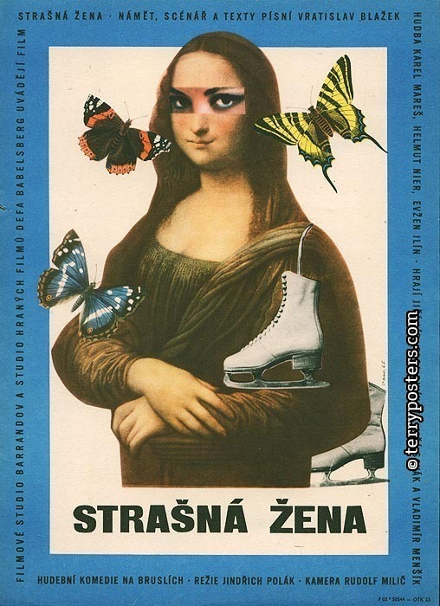
co-productions – „symbolic interventions“
The Figure Skater and Fidelity - Eine schreckliche Frau/Strašná žena, 1965, dir. Jindřich Polák
financial limit (4,2 mil. CZK) to the “creative group” Karel Feix – Miloš Brož
the German “artistic group” (Künstlerische Arbeitsgruppe - KAG) Roter Kreis (KAG – 1959-66; Dramaturgengruppen – 1966-1990)
intended for export, but of the capitalist countries only Italy bought the movie from the Czechoslovak export company Filmexport, and the attendance in the Czech cinemas reached 664 000 viewers till 1970
The director of Barrandov Studio Vlastimil Harnach demanded that DEFA has to ensure colour material as well as widescreen cameras.
1964 was the credit balance to Barrandov’s benefit 223.000,- DM
dramaturge Dieter Wolf
the Czech studio approached DEFA rather as a profitable negotiator with a West German producer, than as a viable partner
Olga Divínová, Karol Divín

Slide 16
Musicals
Besides Eine schreckliche Frau, Czechs were also hired to participate in another two music films. Nichts als Sünde was based on a successful theatrical adaptation of Shakespeare’s comedy Was ihr wollt – Hanuš Burger directed both the theatrical and the film version and the actress Helga Čočková was casted into one of the main roles. In 1964, the choreographer Josef Koníček worked on the highly successful and appraised Czech musical Starci na chmelu (Ladislav Rychman) – DEFA admired the movie and hired Josef Koníček as a choreographer for the musical Reise ins Ehebett (Joachim Hasler, 1966), despite the troubles the appointment caused to DEFA because of Koníček’s commitment to a Prague’s theatre
Three subsequent Johannisthal’s popular hits: Heißer Sommer from 1968 and Nicht schummeln, Liebling! from 1972, both directed by Hasler and casting Frank Schöbel (the role in Reise ins Ehebett was Schöbel’s debut), and Hochzeitsnacht im Regen (Horst Seemann, 1967)
Starci na chmelu - Den je krásný (youtube.com)
https://www.youtube.com/watch?v=Djf5uOkmhSc

Slide 17
„New wave“ appropriated
Der Fall Gleiwitz (Gerhard Klein, 1961; Jan Čuřík´s participation proposed by Klein and approved by DEFA director Albert Wilkening – to support „certain level of experimentation“. The movie was screened in GDR for a few weeks only
https://www.youtube.com/watch?v=b62jCtUJ8Fc

Slide 18
commercial travellers
One of the main incentives for using the Barrandov’s personnel was a shortage of indigenous practitioners who would be or willing, or able to help the studio to launch the entertainment genre movies demanded by Central Film Administration (Hauptverwaltung Film /HV Film/).
Of the movies which passed the Kahlschlag in GDR and were released in 1965 and 1966, very few had a stronger genre identity – and, above all, seven of them were shot by a foreign director. Five of the movies were shot by four Czech directors: Der Schwarze Panther (Josef Mach, 1966); Die Söhne der großen Bärin (Josef Mach, 1965); Ohne Pass in fremden Betten (Vladimír Brebera, 1965); Nichts als Sünde; Eine schreckliche Frau (Jindřich Polák, 1965).
HV Film report: “despite the fact that co-productions confirm that DEFA is an internationally recognized studio, co-productions can not serve as an excuse for never-ending postponement in training indigenous experts, especially in entertaining movies and musicals.”

Slide 19
The sons of great bear Synové Velké medvědice
https://www.youtube.com/watch?v=faBVXR8bazw&list=PLDy9nGXGdnMXkwodg9Eqiv1Gbaaq9GJ2X&index=2
The Czech director Josef Mach launched the series of Indianerfilme with Die Söhne der großen Bärin in 1965 and then gave the role of director in the series over to the indigenous filmmakers, despite started to work on a script for another Indianerfilm.
Mach also directed Der Schwarze Panther (1966), an adventure movie set in a circus ambience
Both of the movies were shot by the Czech cameraman Jaroslav Tuzar whom Mach proposed for this job. Mach was explicitly addressed as a director which is experienced in genre production and successful in attracting audiences: he was presented as an author of “lustspielen, satiren und grotesken”, an adventure movie (Akce B), or a tanzilm (Rodná zem), where he allegedly used “stilmittel des musicals”
Mach was proposed as the director for the comedy Ohne Pass in fremden Betten (1965) – but the group Roter Kreis obstructed this competitive engagement to the KAG Johannisthal’s project and the movie was made by another Czech director, Vladimír Brebera
and with music composed and performed by the Czech jazzman Karel Krautgartner and his orchestra.
Mach handled his role of an entertainment genre booster rather effectively and pragmatically, as prove both the enormous success of the first Indianerfilm with the audience and the complaints the author of the script and historian Liselotte Welskopf-Henrich raised against the director’s criterion of suspense (spannung).

