Slide 1
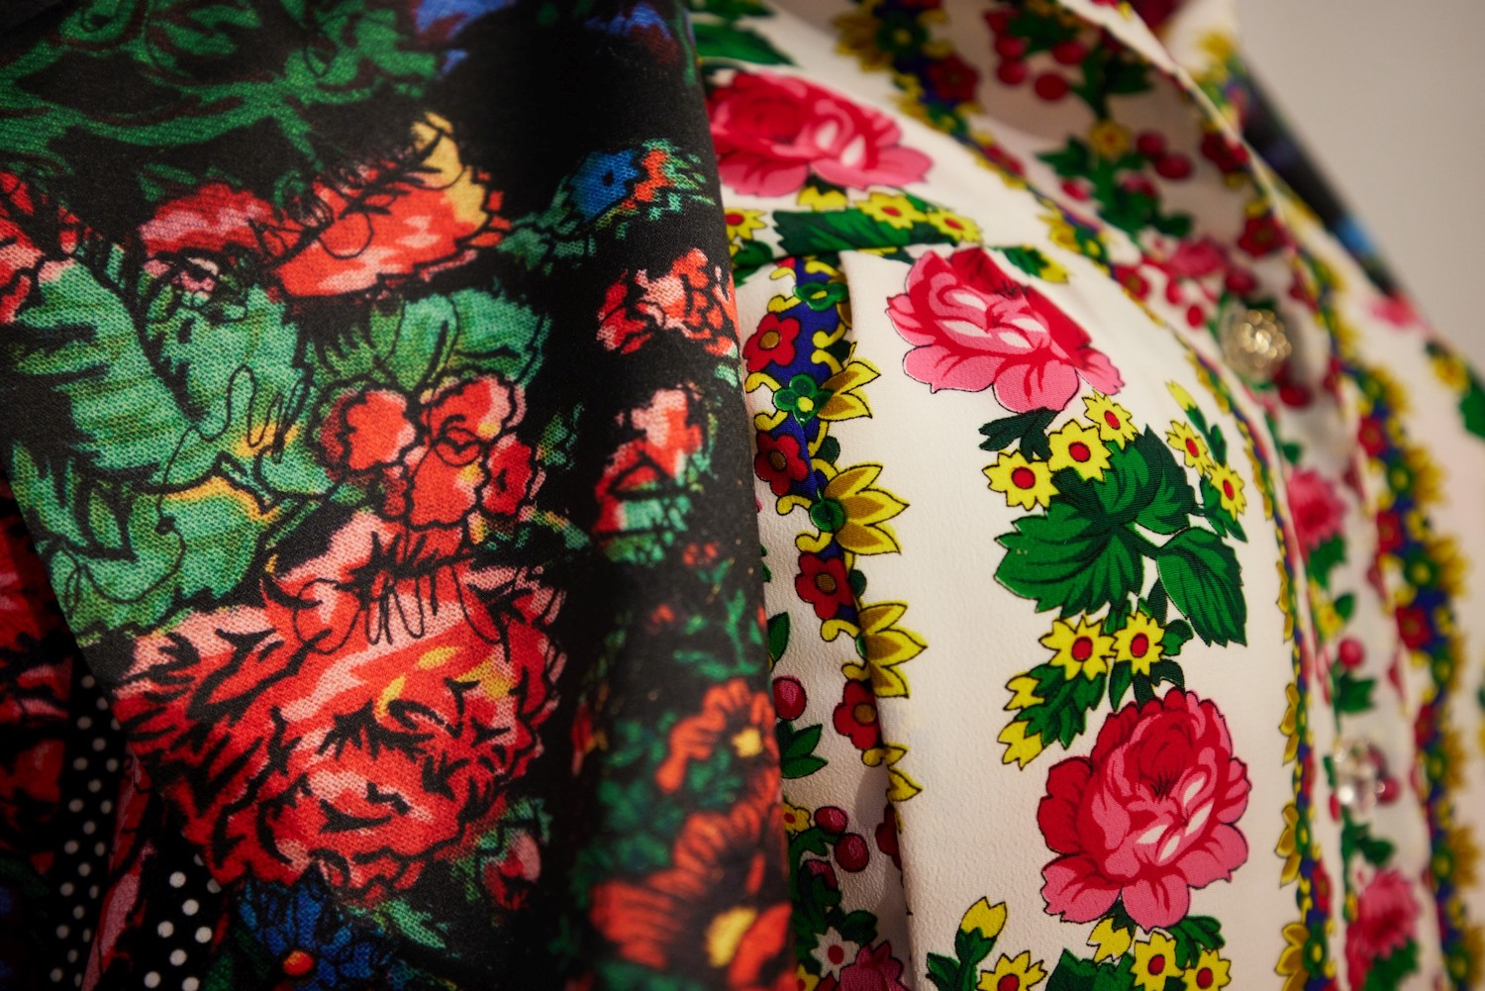
Design & Visual Culture
17 May 2024

Slide 2
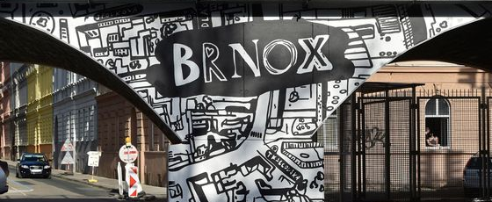
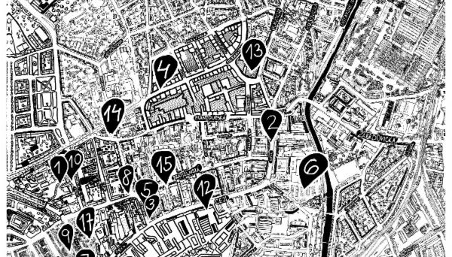
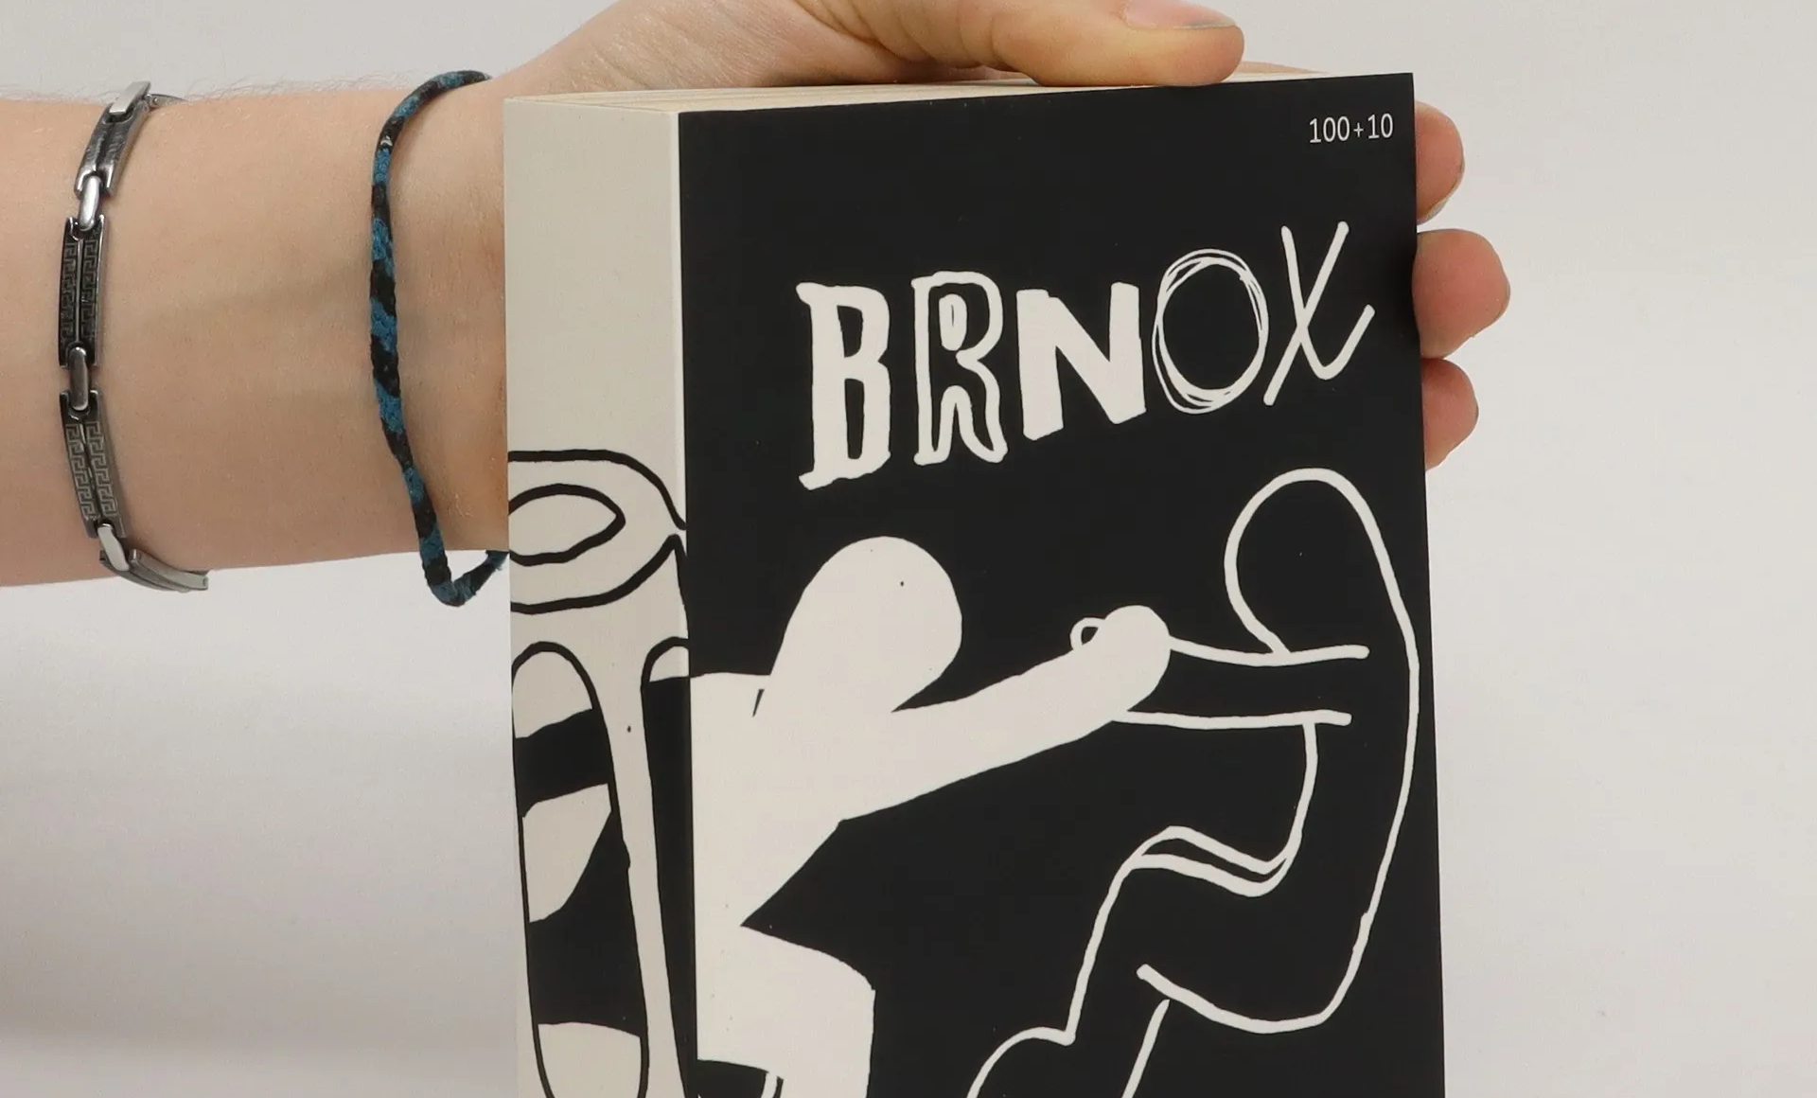
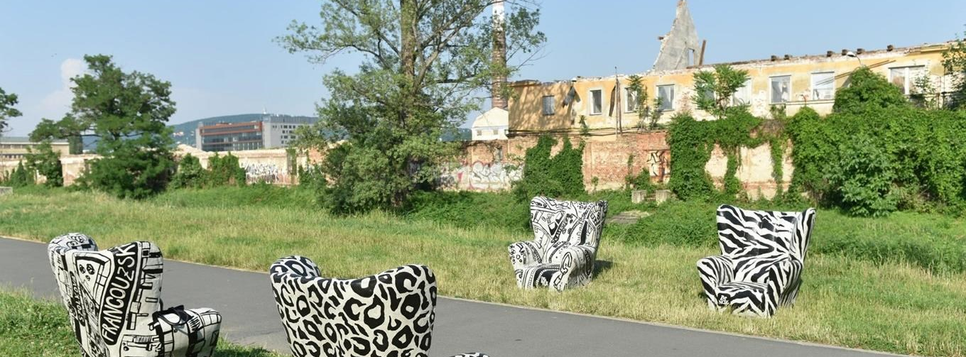

Slide 3
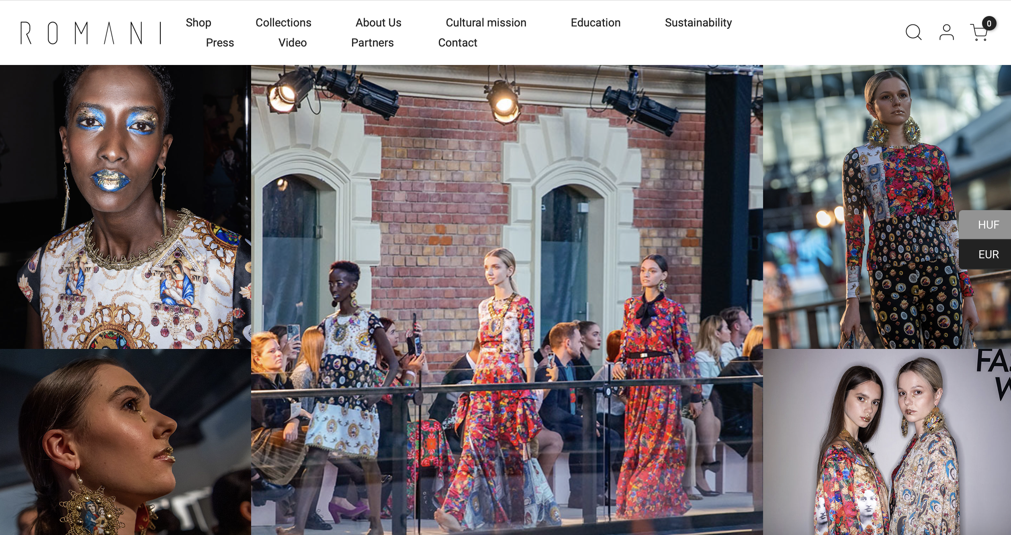
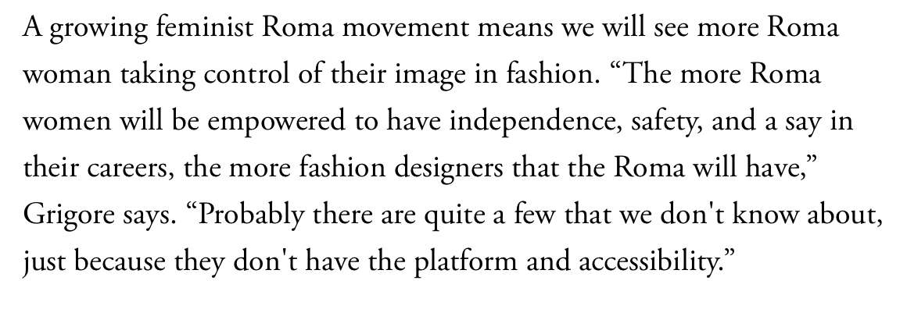
Kitsch and the decorative as an emanicpatory style
https://www.vogue.com/article/roma-activism-fashion
Helena & Erika Varga, https://romani.hu/en/

Slide 4


Emilia Rigová, Transgressing The Past, Shaping The Future, 2018.
https://romani.hu/en/

Slide 5


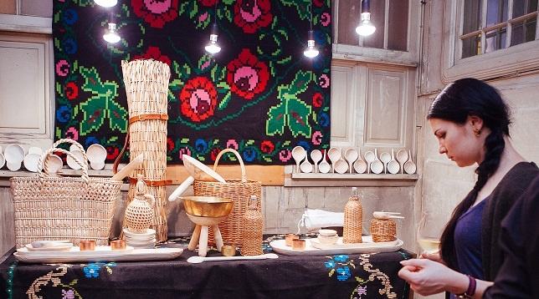
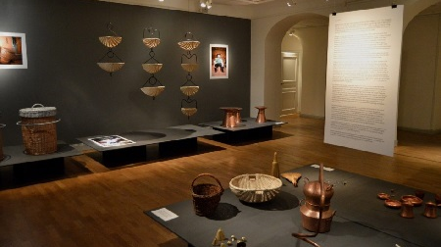

Slide 6
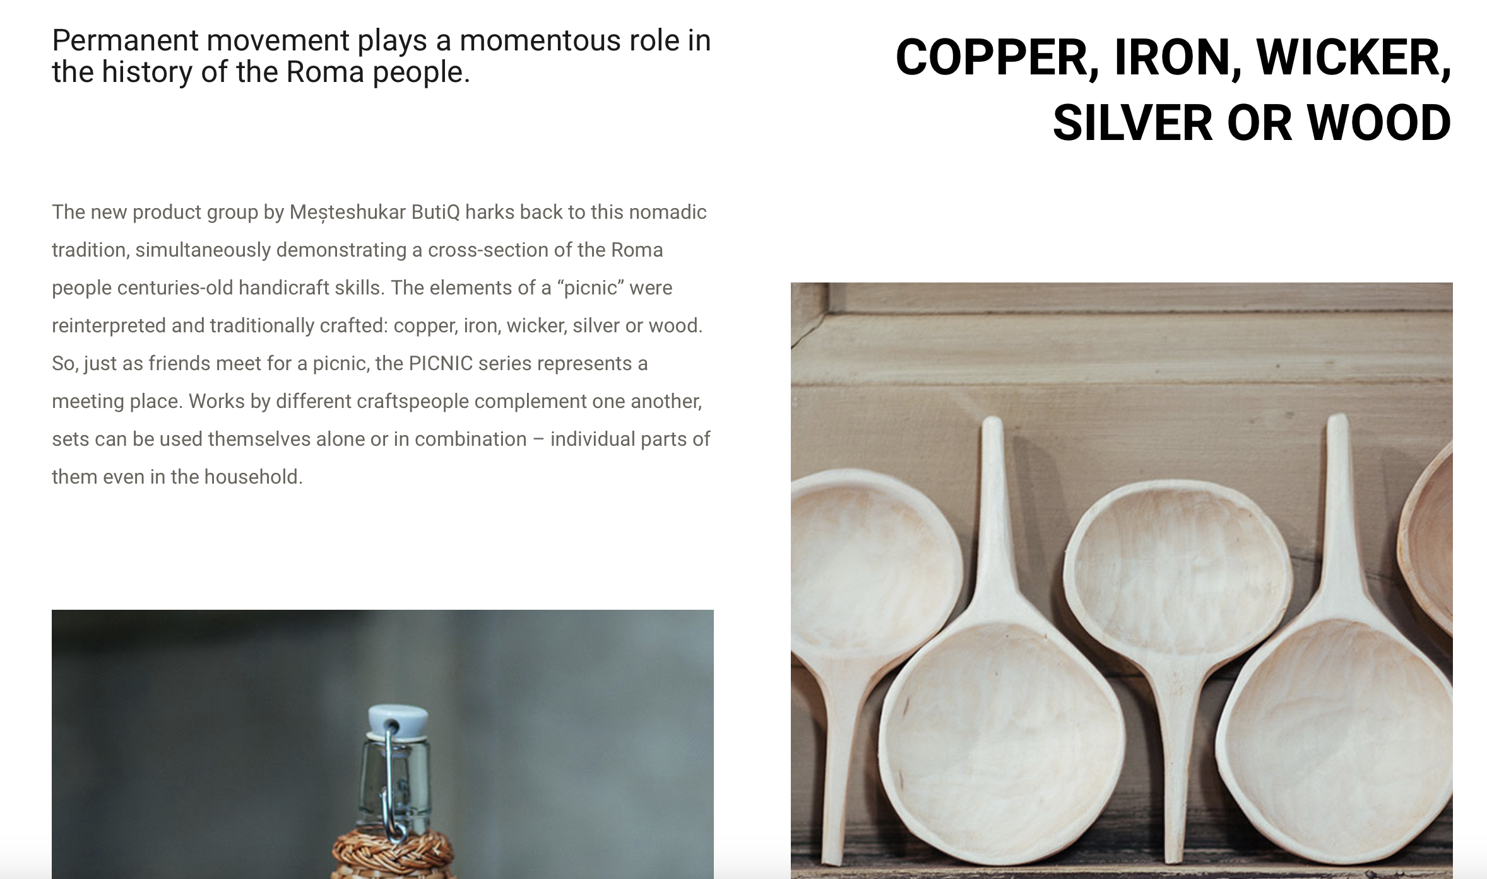
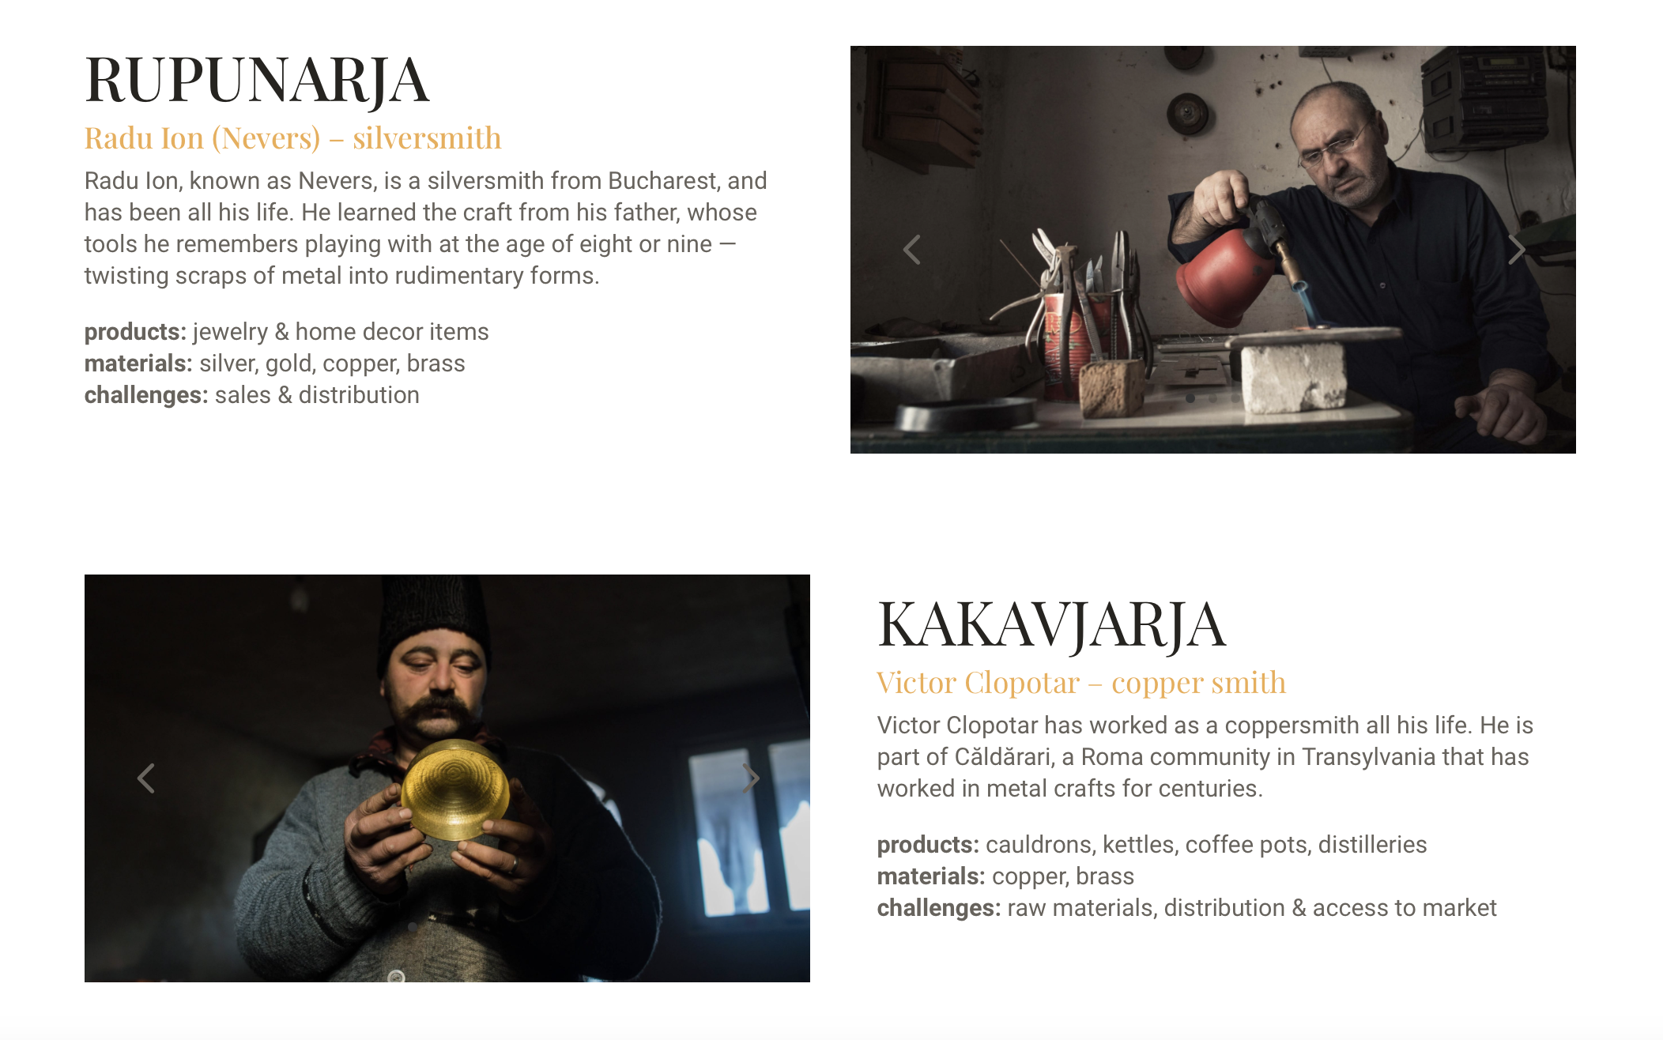

Slide 7
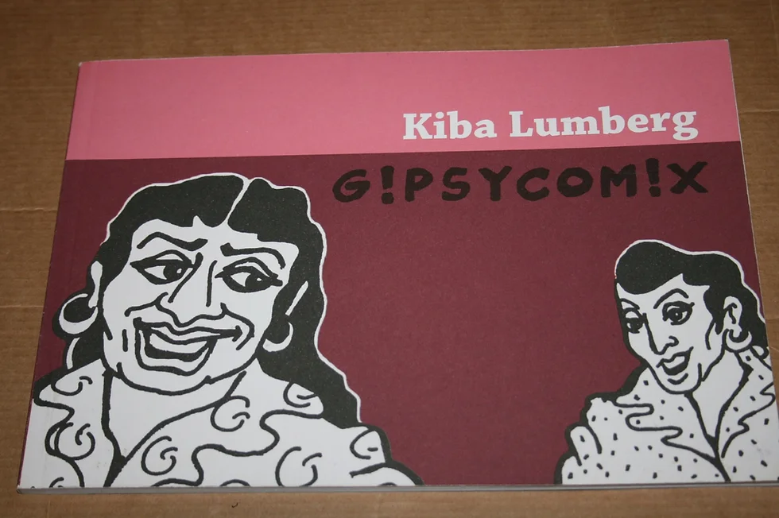

Kiba Lumberg, G!psy Com!x (2010)

Slide 8
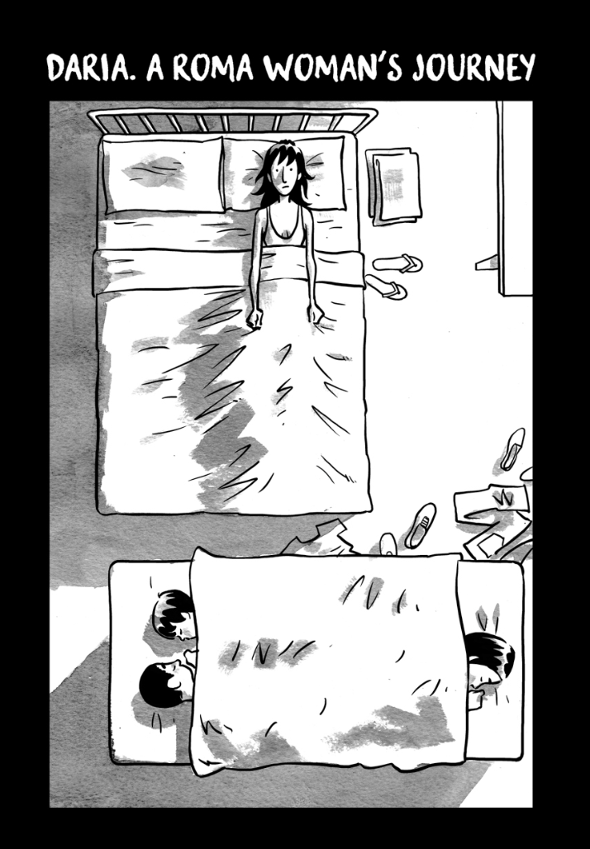

Krrist Mirror, Tsiganes series
https://positivenegatives.org/story/daria-a-roma-womans-journey/

Slide 9
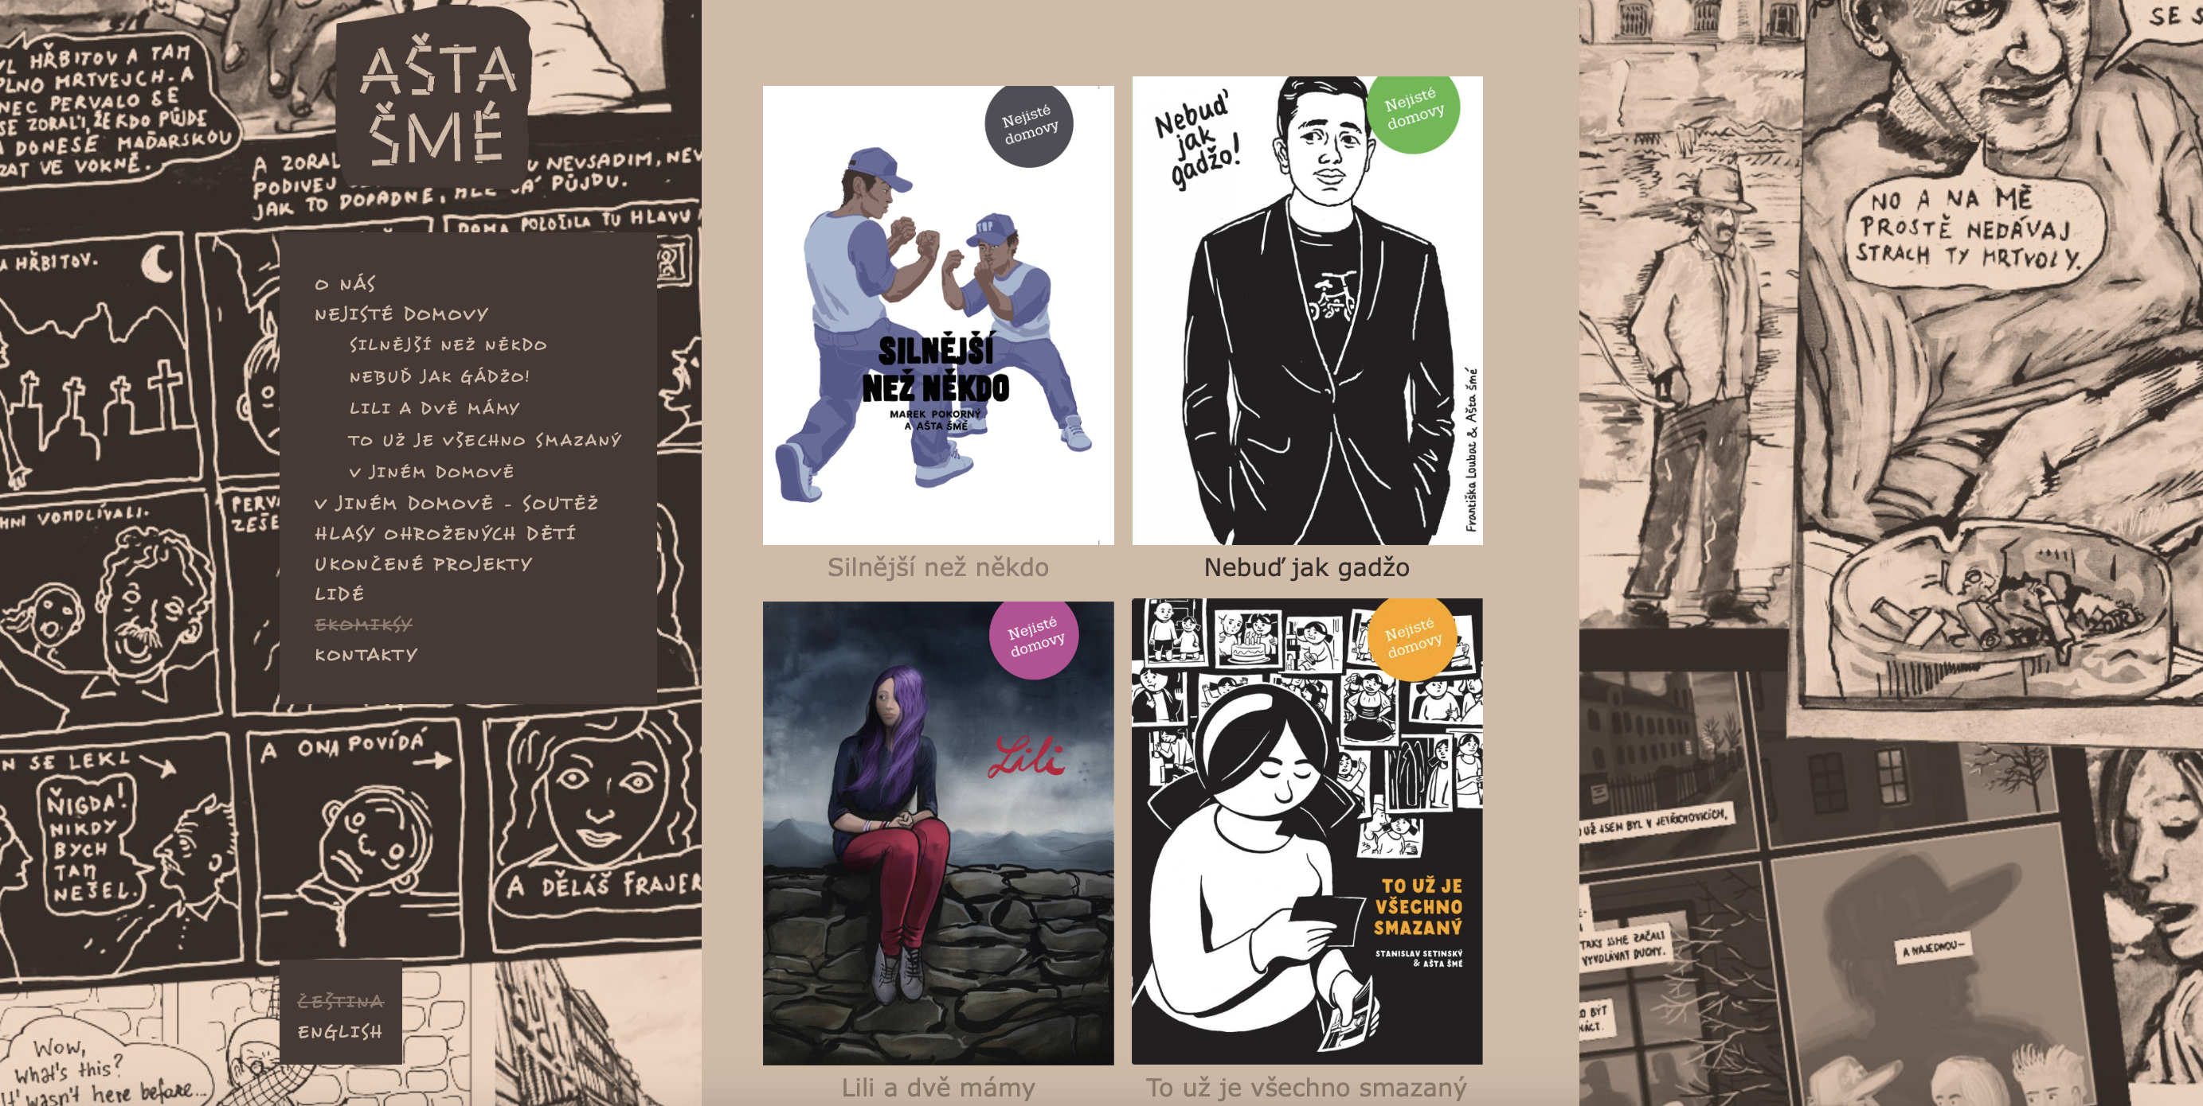
https://www.asta-sme.cz/cs/ekomiksy

Slide 10

