Slide 1
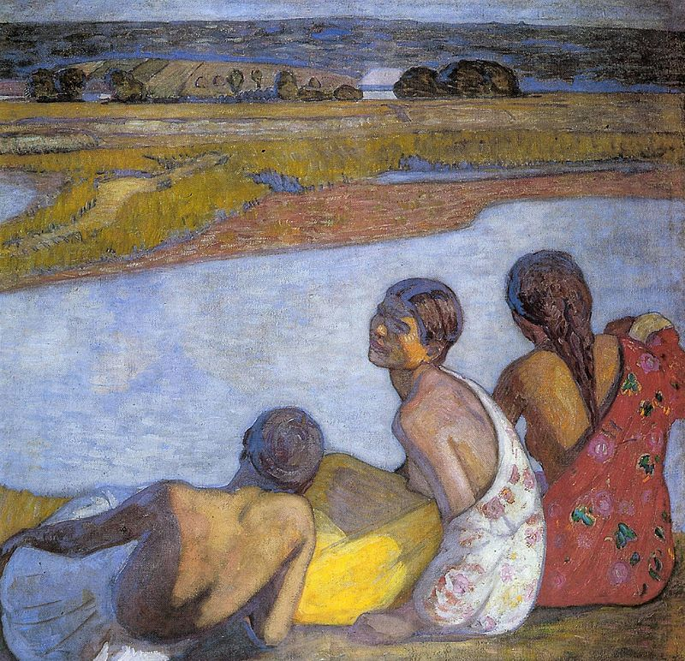
What does postcolonialism have to do with it? The "Gypsy" body and blackness
8 March 2024
(It’s Women’s Day!)

Slide 2
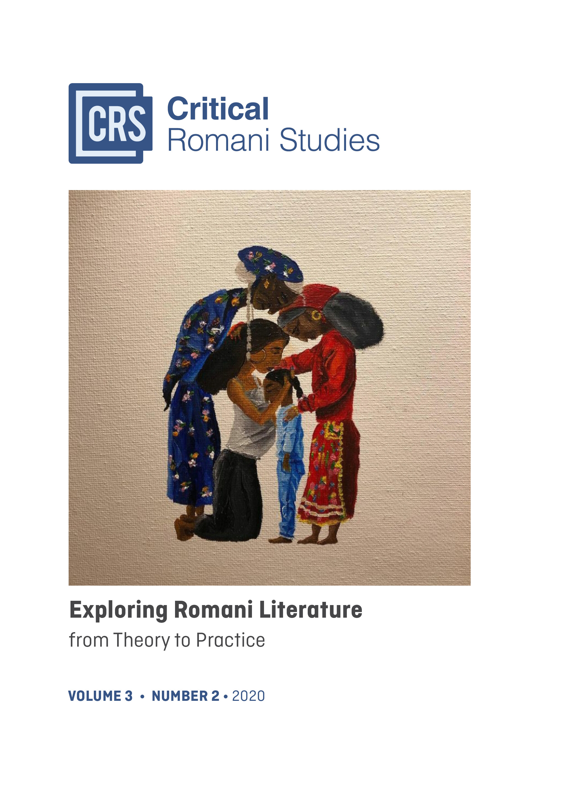
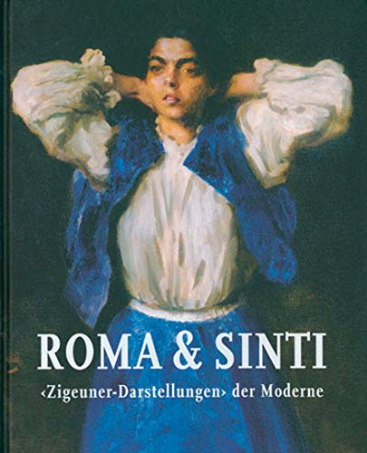
Kovács, Éva. (2021). Black Bodies, White Bodies – ‘Gypsy’ Images in Central Europe at the Turn of the Twentieth Century (1880–1920). Critical Romani Studies, 3(2), 72-93. https://doi.org/10.29098/crs.v3i2.75

Slide 3

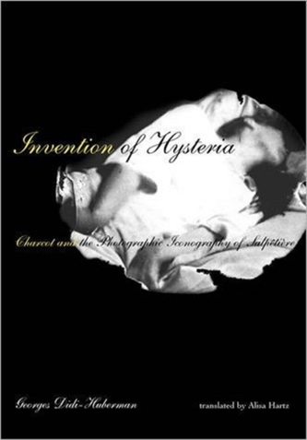
Georges-Didi Huberman, Invention of Hysteria, MIT Press, 2004
Sander Gilman, The Jew’s Body, Routledge, 1991

Slide 4
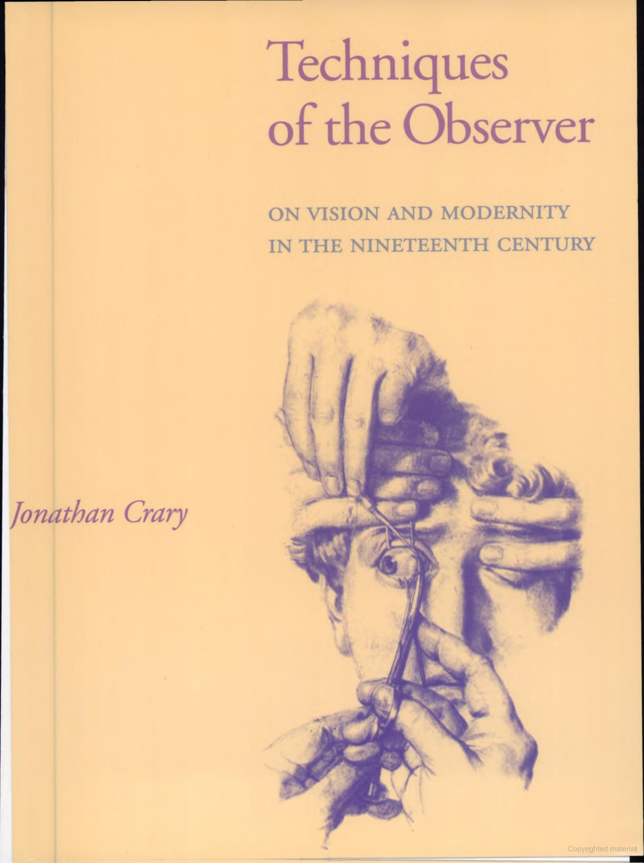
“We are used to thinking of gaze and image as separate, and therefore we speak of looking at an image. (...) however, images form in adapting the gaze. The complicity between body and gaze leads to the image”
Hans Belting, ‘Body and Image’. In Iconic Power. Cultural Sociology, 2012, 187.
“…the history of vision is not merely the history of representations; it also encompasses the history of the status of the observer at the intersection of relations between the body and forms of institutionalised discursive power.”
Jonathan Crary, Techniques of the Observer, 1990

Slide 5
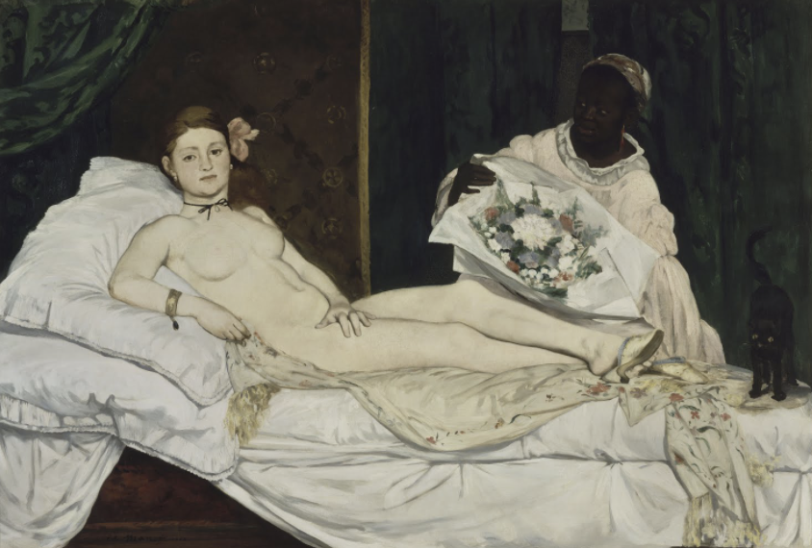
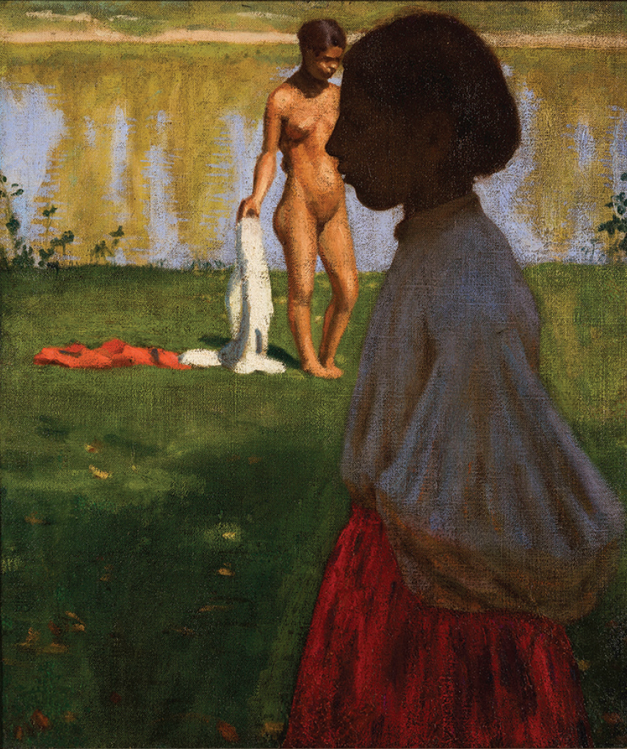
the panoptic regime of Modernity (Michel Foucault): internalised, visible yet unverifiable power
In the Panopticon of Central European Modernity, ‘Gypsies’ become pendants of the African and Asian ‘primitives’ of Western Europe.
Kovács, p.76,
the optical unconscious (Walter Benjamin): aspects of reality that register in our senses but are never quite processed consciously

Slide 6
Édouard Manet, Olympia, 1863–65, Muséé d’Orsay, Paris

Slide 7
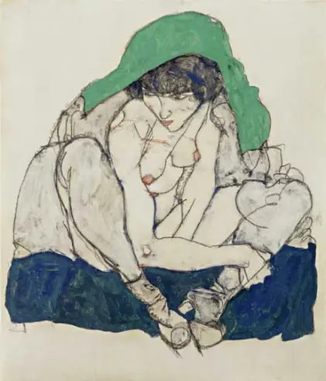
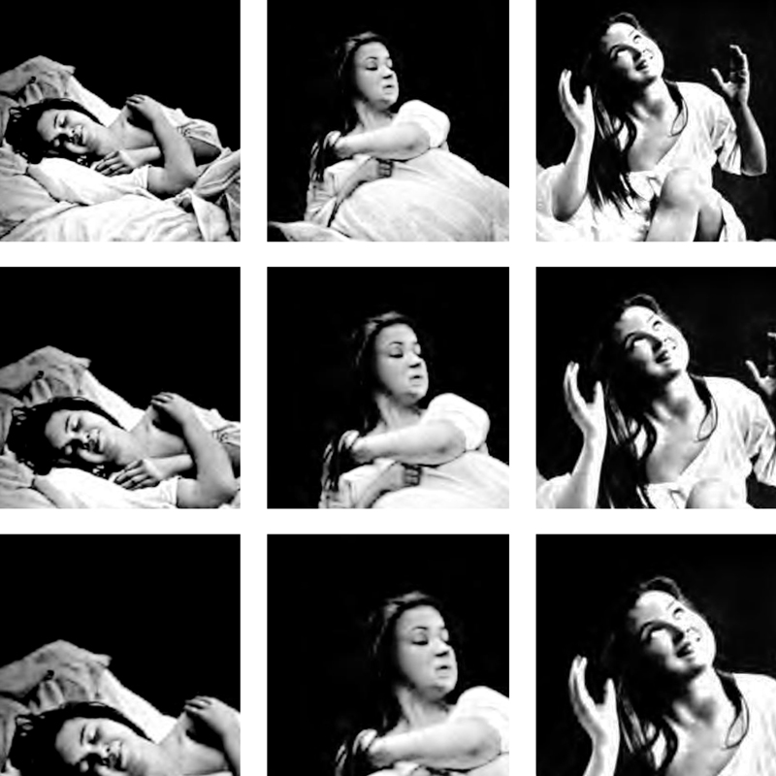
“Hysteria”
Salpêtrière Hospital, Jean Martin Charcot
Egon Schiele, Crouching Woman with Green Kerchief , 1914, Leopold Museum, Vienna
"Iconographie photographique de la Salpêtrière" (Jean Martin Charcot, 1878)

Slide 8
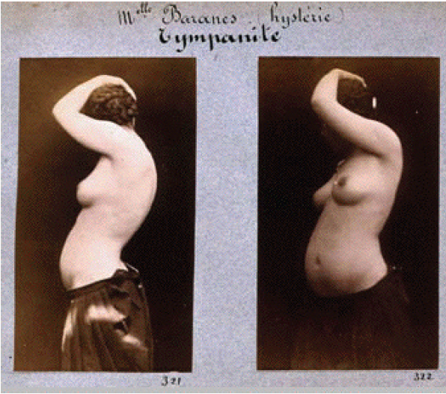
“Such positioning of the female body, detached from space and time and deprived of identity was perfectly apt to condense the various images of women, the ‘other’, and those with unstable moral identities (prostitute or criminal) in a single image, in which the nude does not look back anymore but deflects herself from her own body.”
Kovács, 78.
Albert Londe, Mlle Banares (hystérie), c. 1883, collection Texbraun

Slide 9
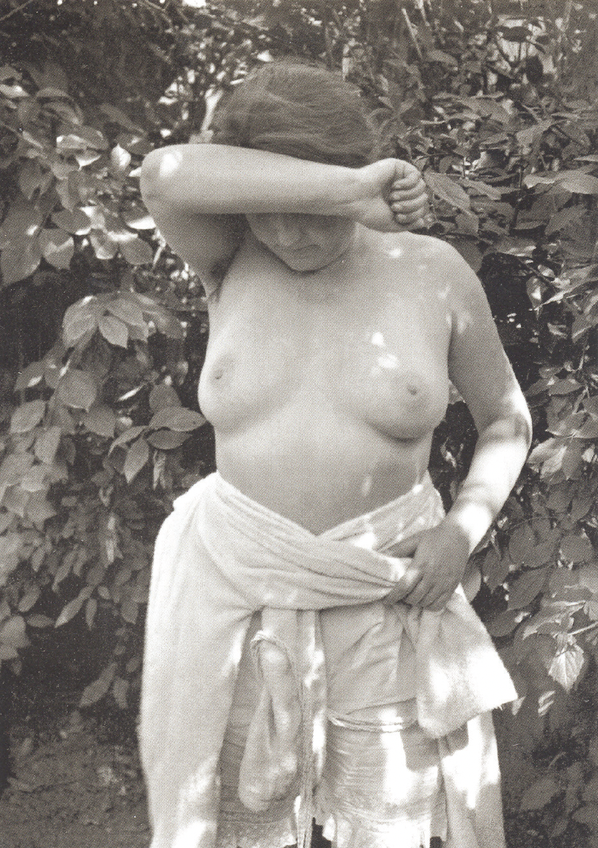
What happens if we combine image comparisons in new ways? The “hysterical” female body
Albert Londe, Mlle Banares (hystérie); Tympanite, c. 1883, collection Texbraun
André Kertész, Untitled, Abony, 1921, Ministére de la Culture (AFDPP), France.

Slide 10
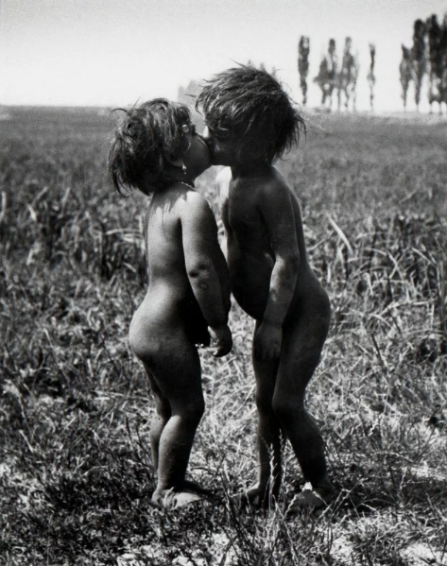
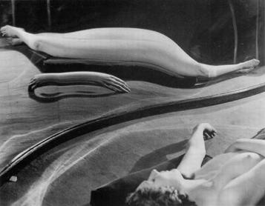
André Kertész (1894–1985)
Gypsy Children Kissing, 1917.
Holden Luntz Gallery, Palm Beach,
Distortion#49, one of the images in the Distortion series, 1933.
Untitled, Abony, 1921, Ministére de la Culture (AFDPP), France.

Slide 11

Horizontal Art History?
Piotr Piotrowski (1952–2015)
“The non-European ‘Other’ is a real ‘Other’, while the Central or Eastern European Other is a ‘not-quite-Other’ or a ‘close Other’. “
Piotr Piotrowski (2009), “Toward a Horizontal History of the European Avant-Garde”, 52.
“While it seems obvious that the modern art of the margins developed under the influence of the West, it appears much less obvious to ask how the developments in non-Western art affected the history of Western art or, more precisely, the perception of Western art.
Here, then, a question arises: how does marginal art change the perception of the art of the center? How is the center perceived, not from the center itself – the place usually occupied by the historian of modern art – but from a marginal position?”
Piotr Piotrowski (2009), “Toward a Horizontal History of the European Avant-Garde”, 54.
Horizontal Art History and Beyond Revising Peripheral Critical Practices. Edited By Agata Jakubowska, Magdalena Radomska, Routledge, 2022

Slide 12
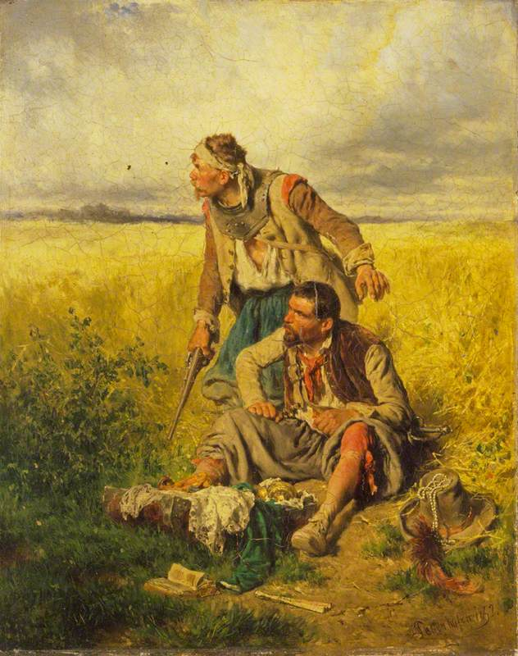
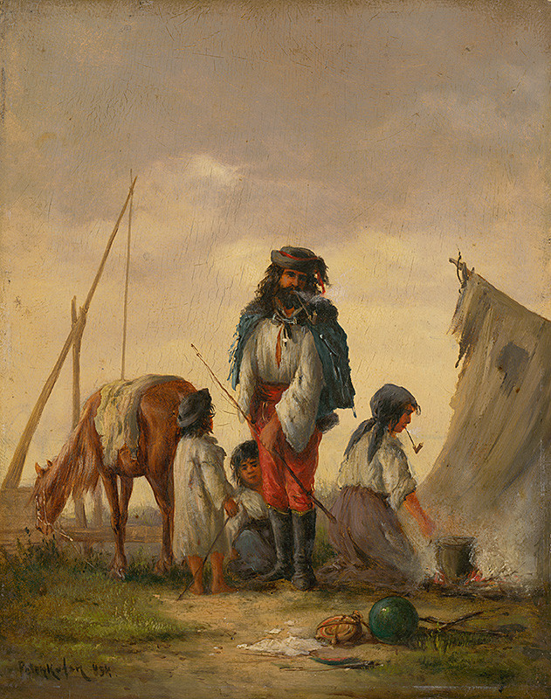
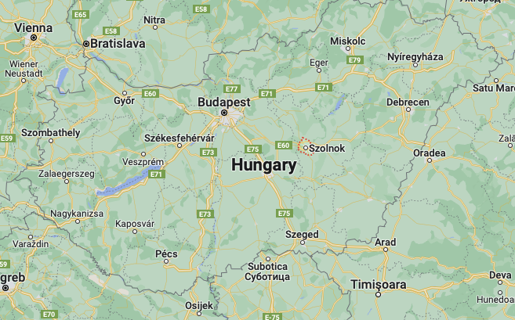
August von Pettenkofen (1822–1889) & the Szolnok artist colony
Genre painting in the Biedermeier era: idyllic scenes of “ordinary life”
August von Pettenkofen, Gypsy Family, 1868, Slovak National Gallery
August von Pettenkofen, Robbers in a Cornfield 1852, The Wallace Collection

Slide 13
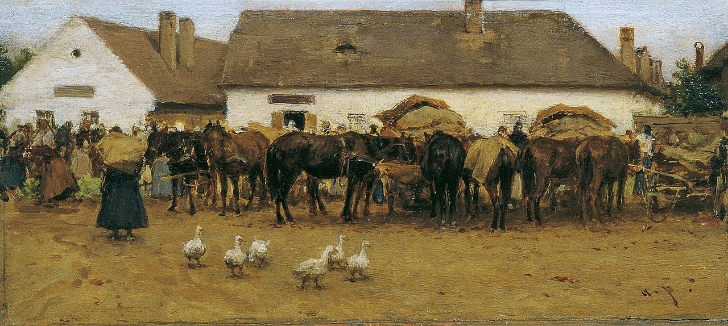
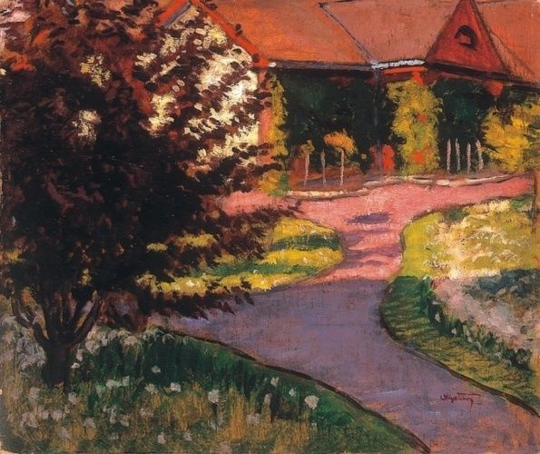
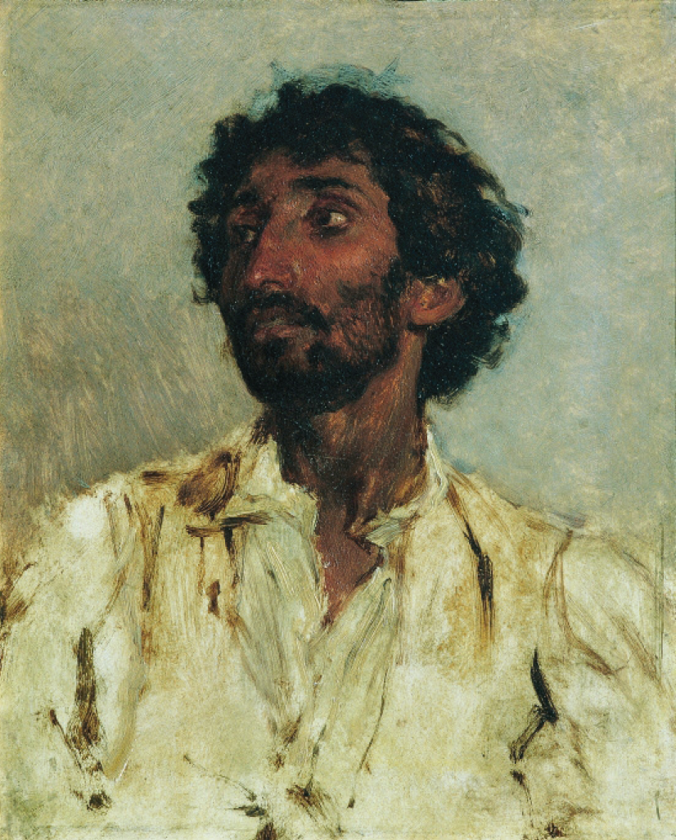
August von Pettenkofen, Market in Szolnok, ca. 1870 – 1880. Kunsthistorisches Museum Vienna
August von Pettenkofen, Portrait of a Gypsy, c.1860, Belvedere, Vienna.
Tibor Pólya, The artist colony in Szolnok, 1925

Slide 14
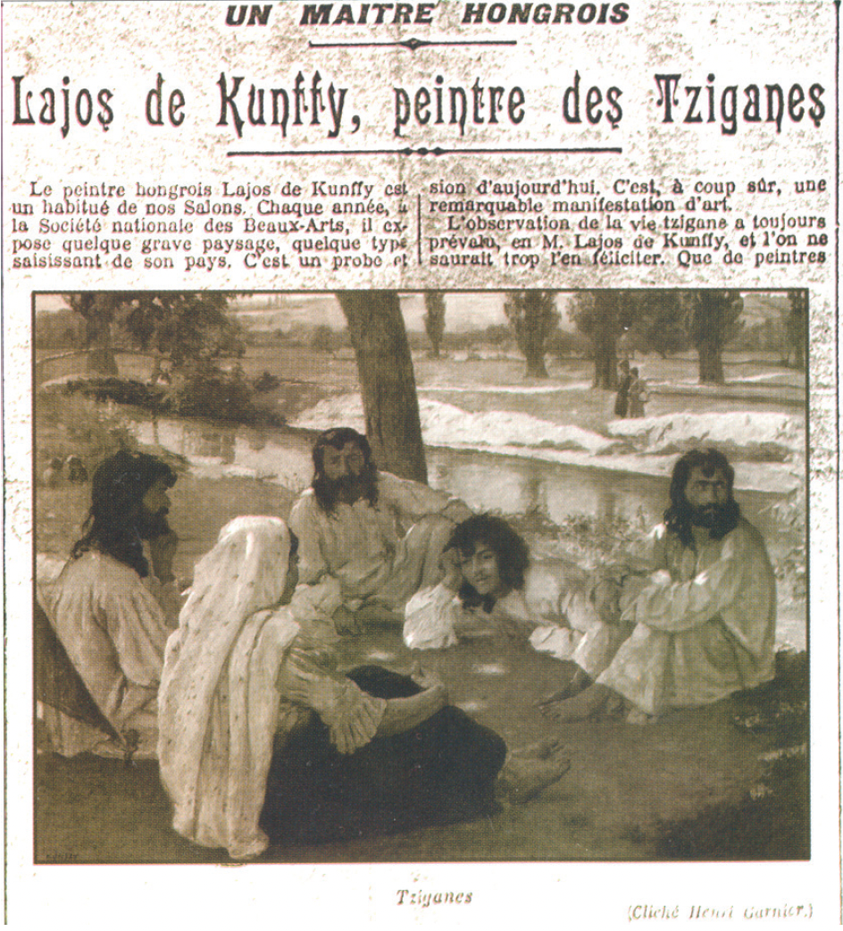
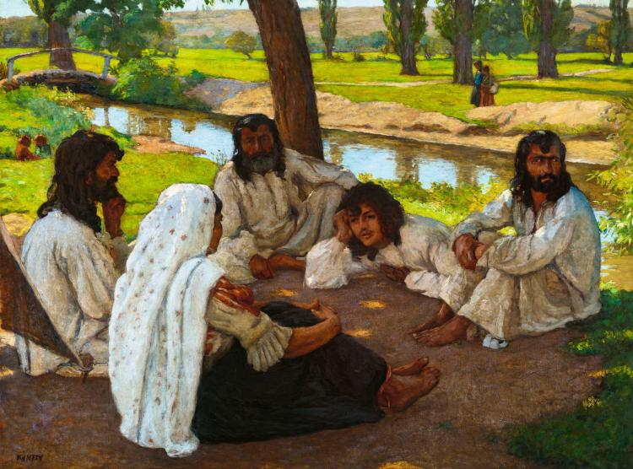
“When Albert Besnard returned to France from his voyage in India and I saw his work, I told him there was no need to travel great distances as you can paint figures like that in Hungary, too. (...) Most of my Gypsy paintings have been sold since; I hardly have any left in my ownership. In a collective exhibition in Paris in 1913, where I still had many works with Gypsy themes on show, the daily Paris-Midi that reproduced some of these paintings called me ‘le peintre des zigán’. But what had befallen these Gypsies? They were no longer wearing long hair. As a matter of fact, those drafted into the army in 1914 had their hair cut short…”
Kunffy, Visszaemlékezéseim [My memoirs], edited by János Horváth, 2006, 108–109 – translated by Róza Vajda
Tabarant, ‘Un maître Hongrois. Lajos de Kunffy, peintre des Tziganes’. Paris Midi, 29 January 1913.

Slide 15
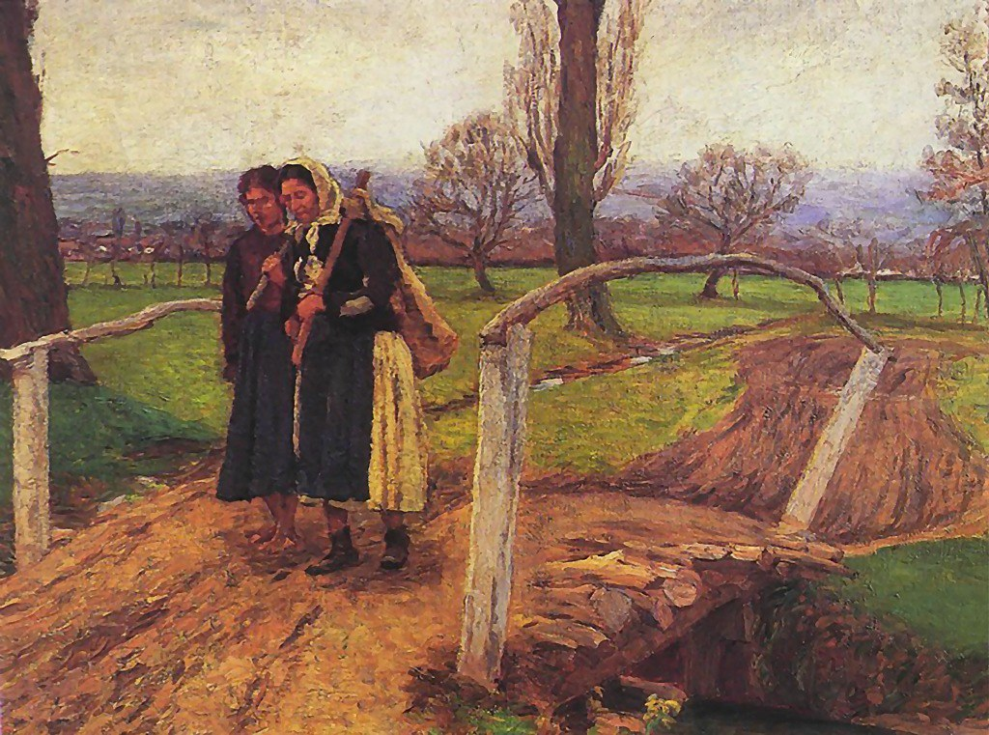
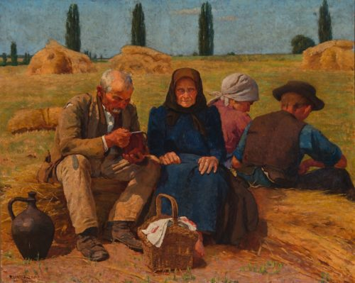
Lajos Kunffy (1869–1962)
Somogytúr artist “colony”: Béla Iványi Grünwald, Lajos Szilányi, Aladár Edvi-Illés, and József Rippl-Rónai
Gypsy Women On The Bridge (on The Way Home), 1911, location unknown.
Harvesters having lunch, 1921, Hungarian National Gallery

Slide 16
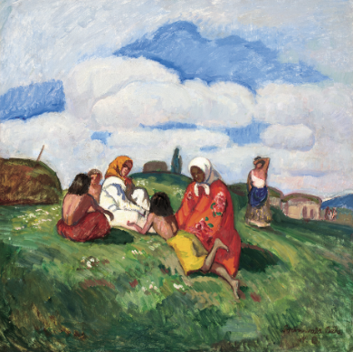
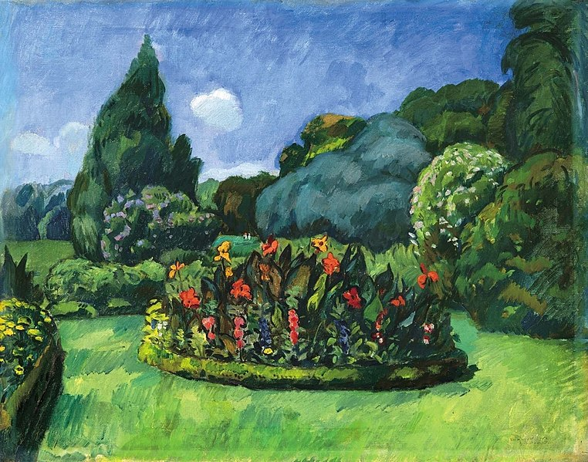
Béla Iványi-Grünwald (1867 –1940)
Nagybánya artists' colony and Kecskemét artists' colony
Rest at Noon, nd., Virág Judit Gallery
Gypsy Girls by the Banks of the Lápos, 1909
Kecskeméti park, n.d.

Slide 17
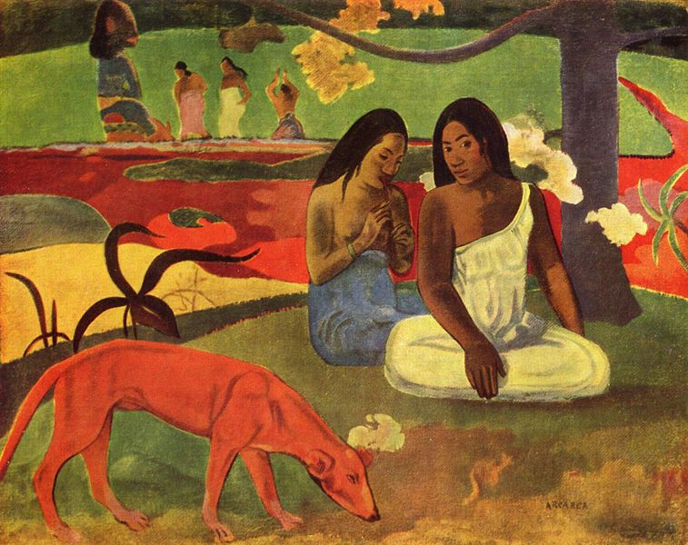
Paul Gaugin, Ararea, 1892, Musée d’Orsay
Béla Iványi-Grünwald, Gypsy Girls by the Banks of the Lápos, 1909

Slide 18
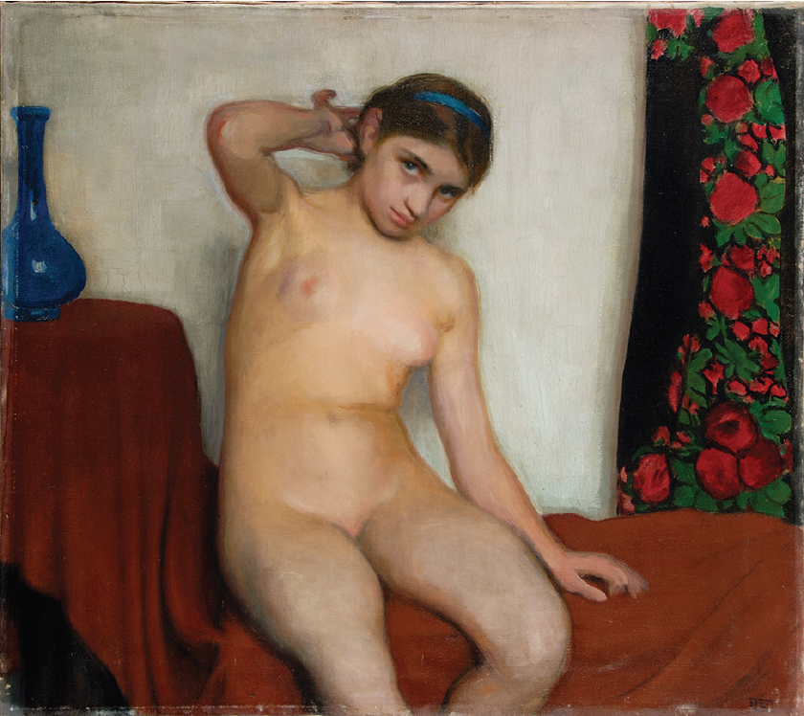
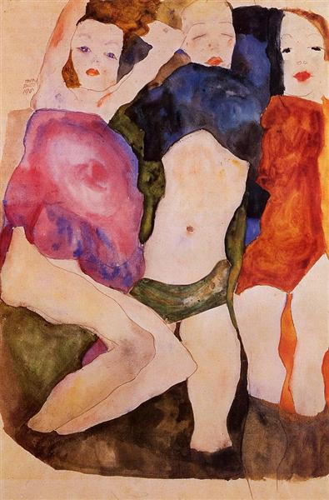
“Black” bodies, “white” bodies?
“The eyes of the adolescent girl reflect the dominant – so to speak, paedophile – male gaze: instead of eroticism, they suggest embarrassment, fear, and sexual vulnerability. Such an explicit infringement of social norms was possible only when oppressed ethnic or social groups were concerned – hard as I tried, I have not found a single similar composition by any contemporary Hungarian artist of a ‘white’ adolescent girl.”
Kovács, 86.
István Réti, Gypsy Girl, 1912, oil on canvas, 80.5 x 91 cm, Hungarian National Gallery, Budapest.
Egon Schiele, Three Girls, 1911, private collection

Slide 19
the panoptic regime of Modernity (Michel Foucault): internalised, visible yet unverifiable power
the optical unconscious (Walter Benjamin): aspects of reality that register in our senses but are never quite processed consciously
János Göröncsér Gundel, Gypsy Girl and Nude Model, c. 1907, Hungarian National Gallery, Budapest.

Slide 20
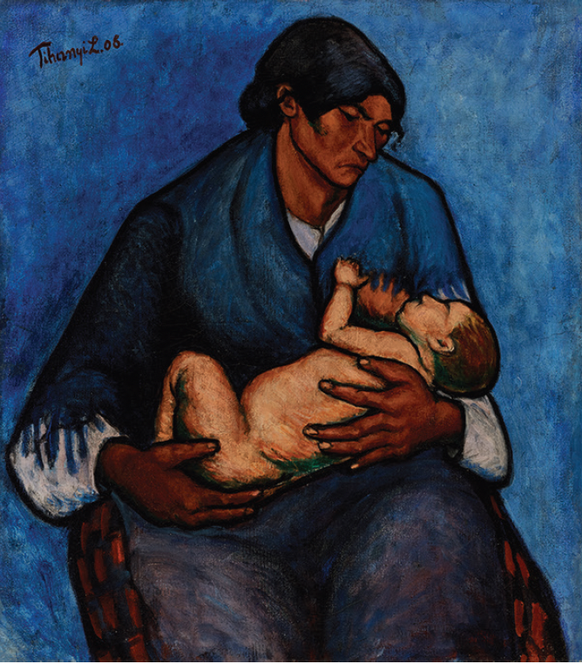
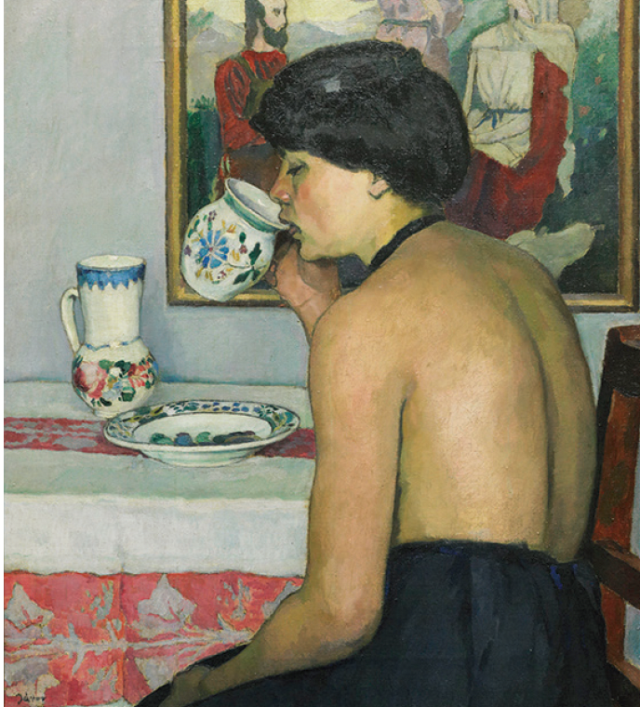
Lajos Tihanyi, Gypsy Woman with Child, 1908, oil on canvas, 84 × 75 cm, Janus Pannonius Museum, Pécs.
Pál Jávor, Gypsy Girl, c. 1915, oil on canvas, 80 × 71 cm, Damjanich János Museum, Szolnok.

