Slide 1
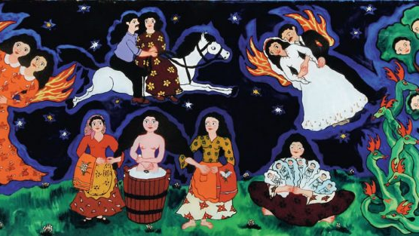
Roma Art now
The “public” and the “popular”
3 May 2024
Gyöngyi Kalányos Rácz: Little Snake with Seven Twin Horns/ Hét ikerszarvas kigyócska, 1980, oil on fibreboard.

Slide 2
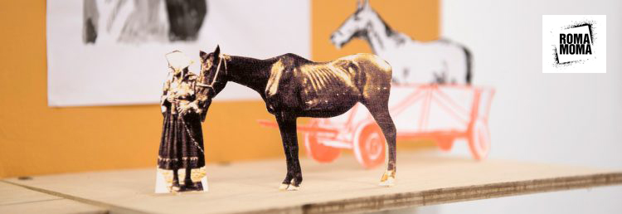

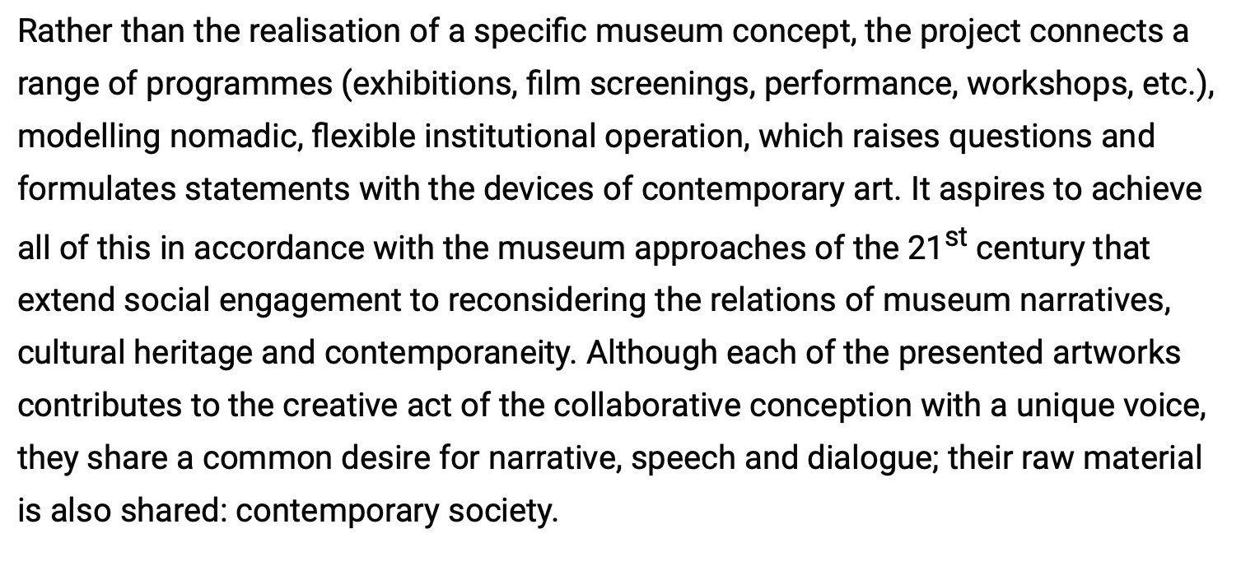
https://eriac.org/category/romamoma/

Slide 3
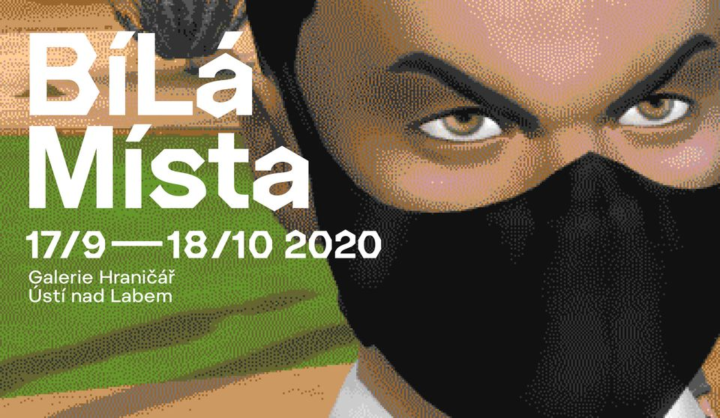
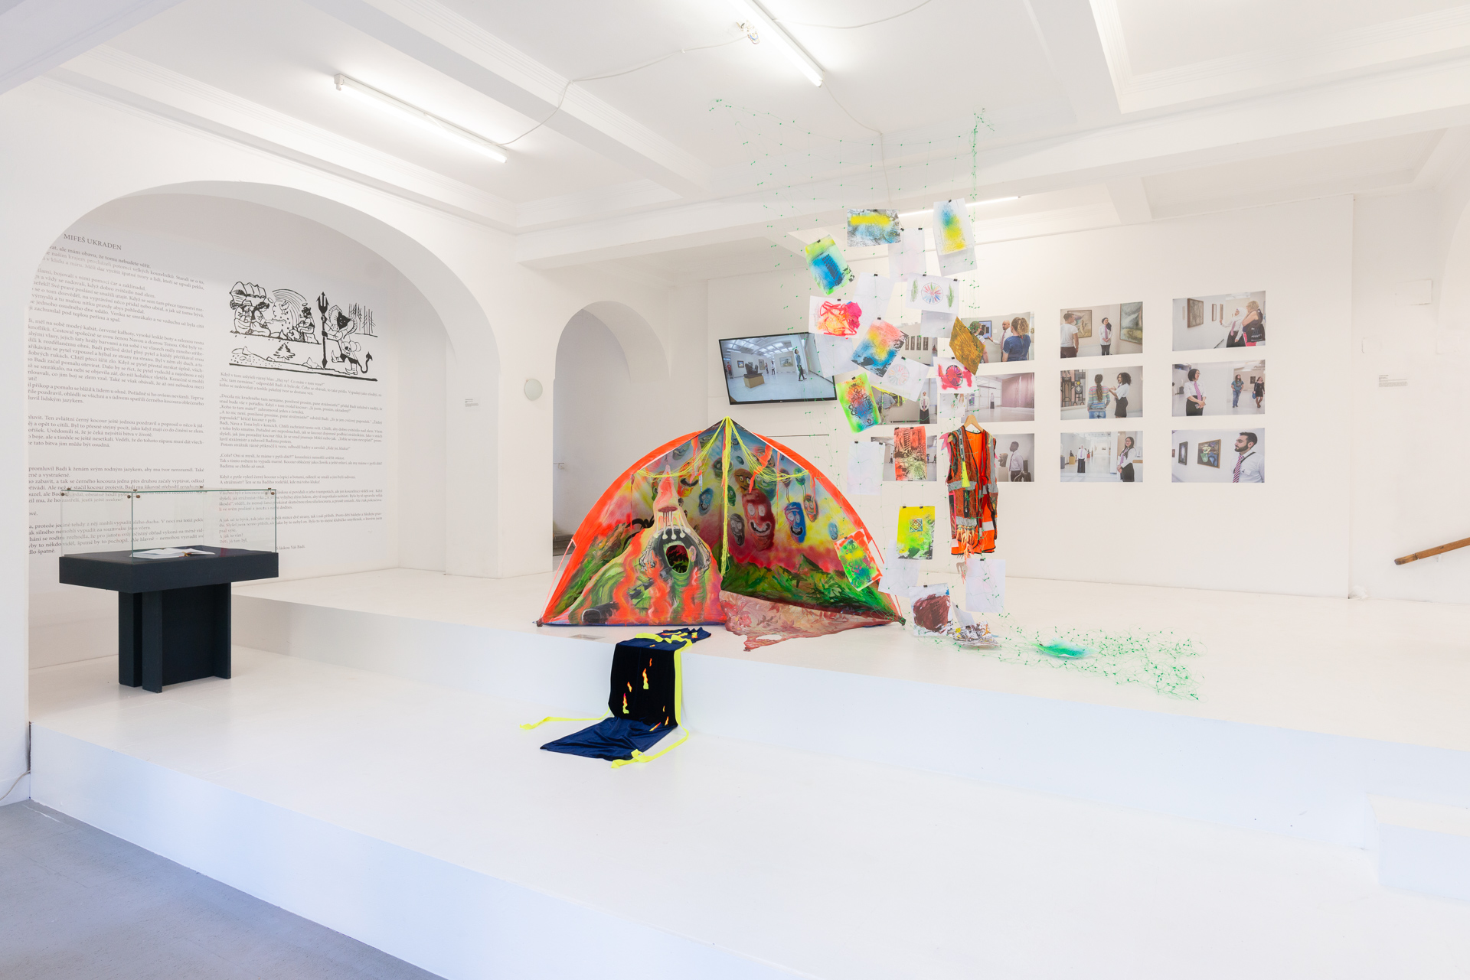
BíLá Místa, Hranicář Gallery, Ustí nad Labem (2020)
https://artalk.cz/2020/10/05/roma-lives-matter-v-hranicari/?fbclid=IwAR2zbG0yCtwDxh874ZrCspWpNciDXDcyPXIozFszM1hilHljIcTH42TT3Dw

Slide 4
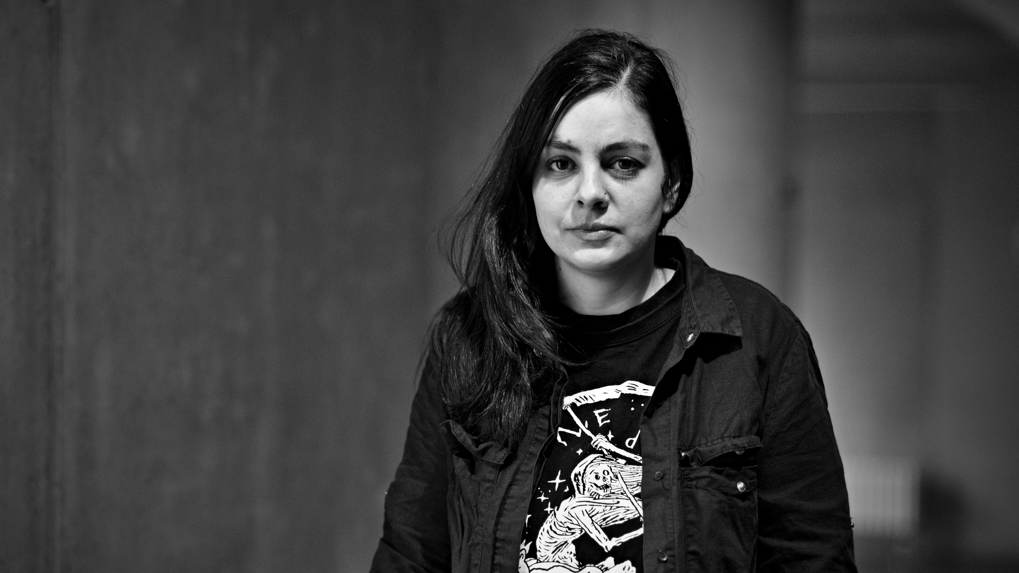
LACKA – Ladislava Gažiová
https://www.artlist.cz/en/lacka-ladislava-gaziova-618-video/

Slide 5
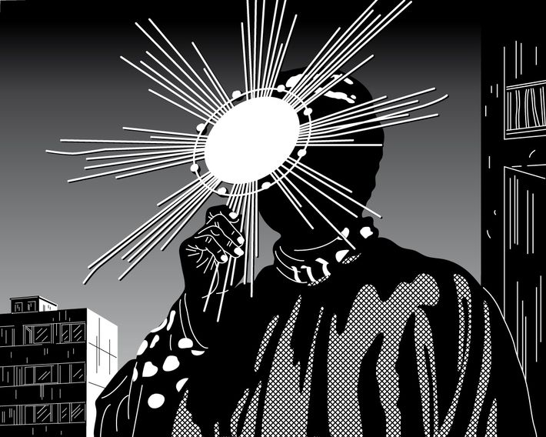
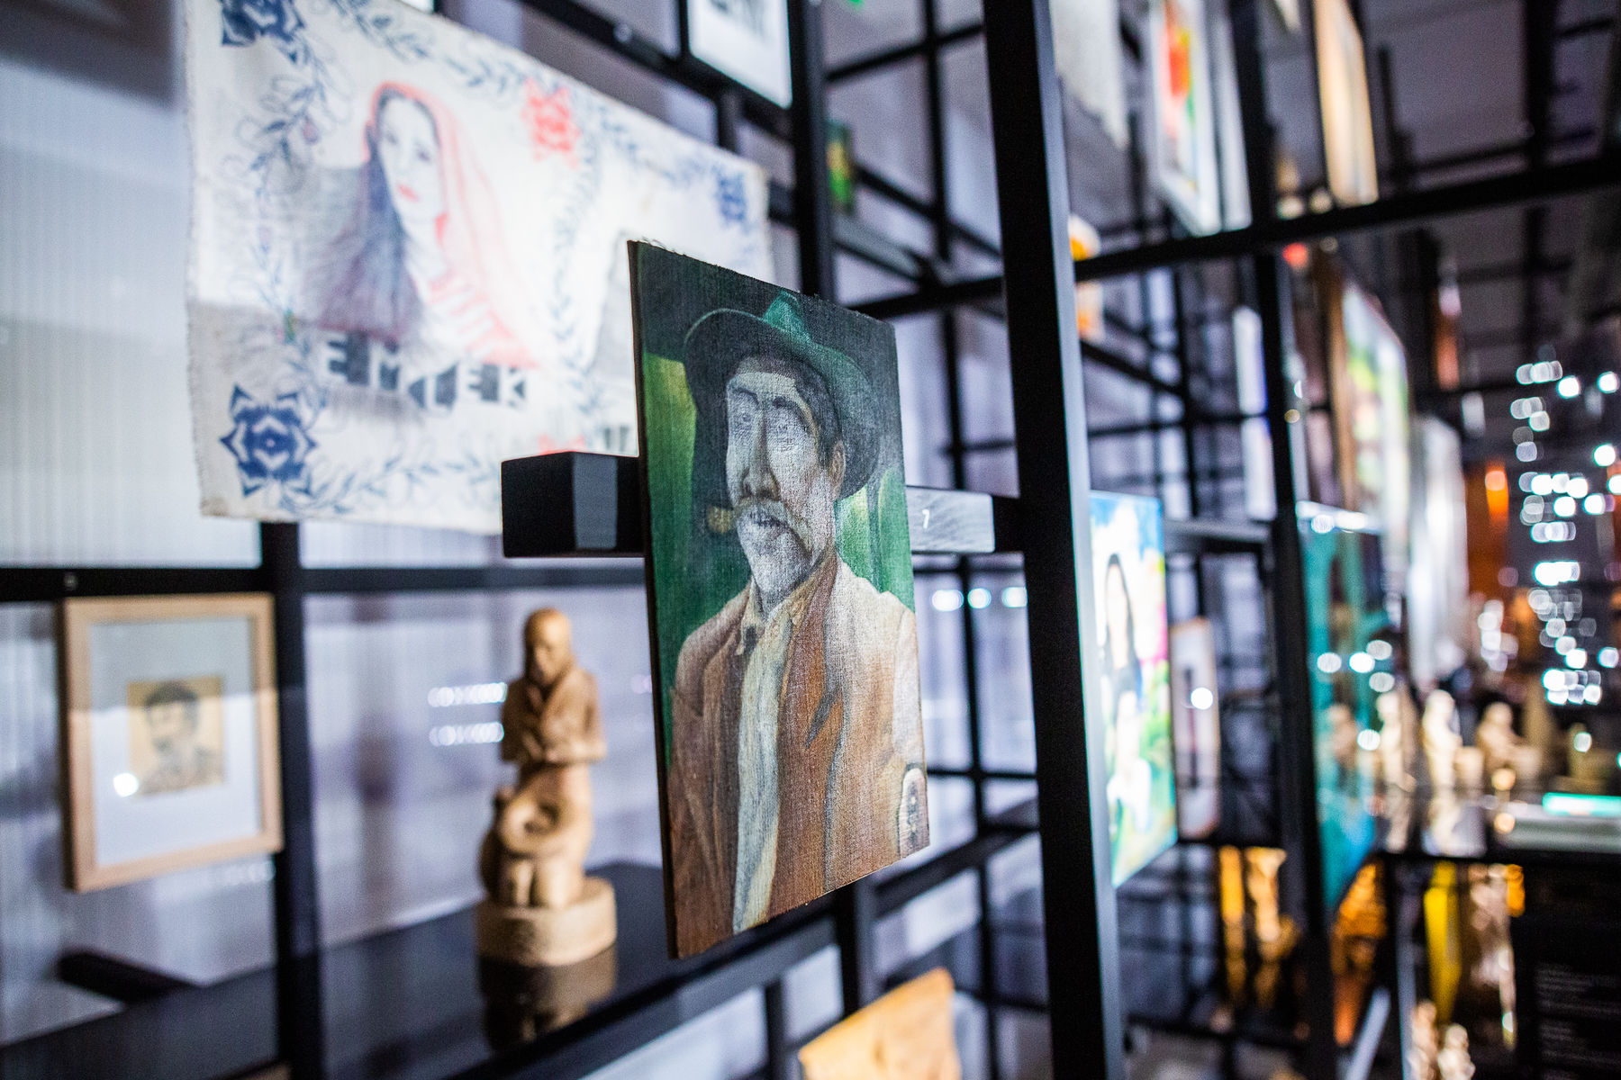
O kosmos hino kalo/The Universe is Black, 2017, Moravian Gallery in Brno,
Phundrado drom / The Open Road, Ethnographic Museum, Prague, 3. 6. 2022 – 31. 5. 2024
Ladislava Gažiová,
https://www.artmap.cz/artist/ladislava-gaziova/
https://www.nm.cz/en/program/exhibitions/phundrado-drom-the-open-road#gallery-9

Slide 6
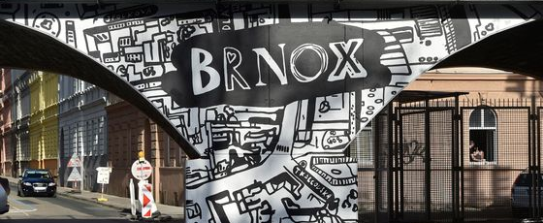
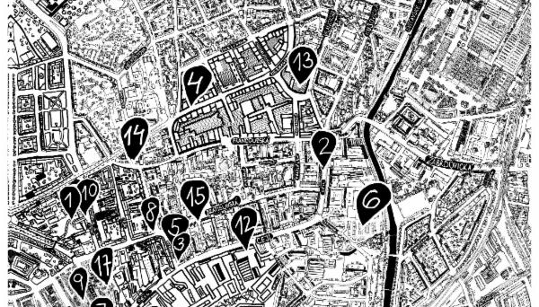
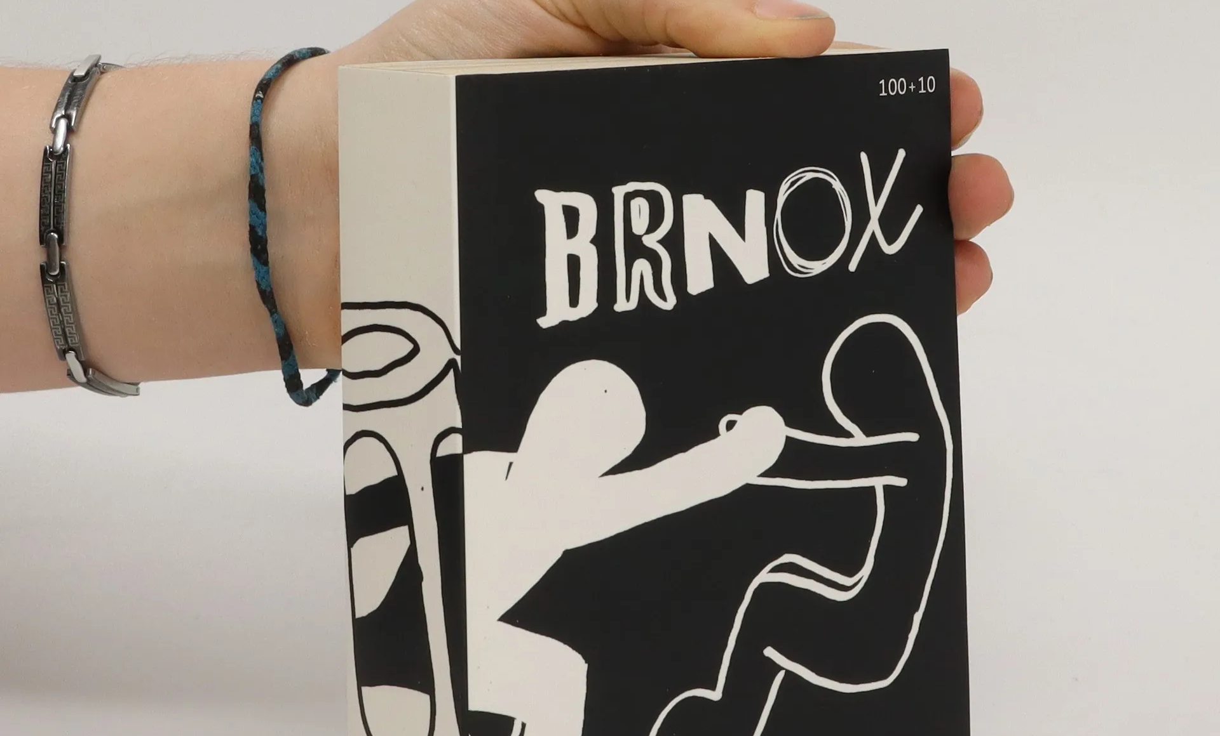
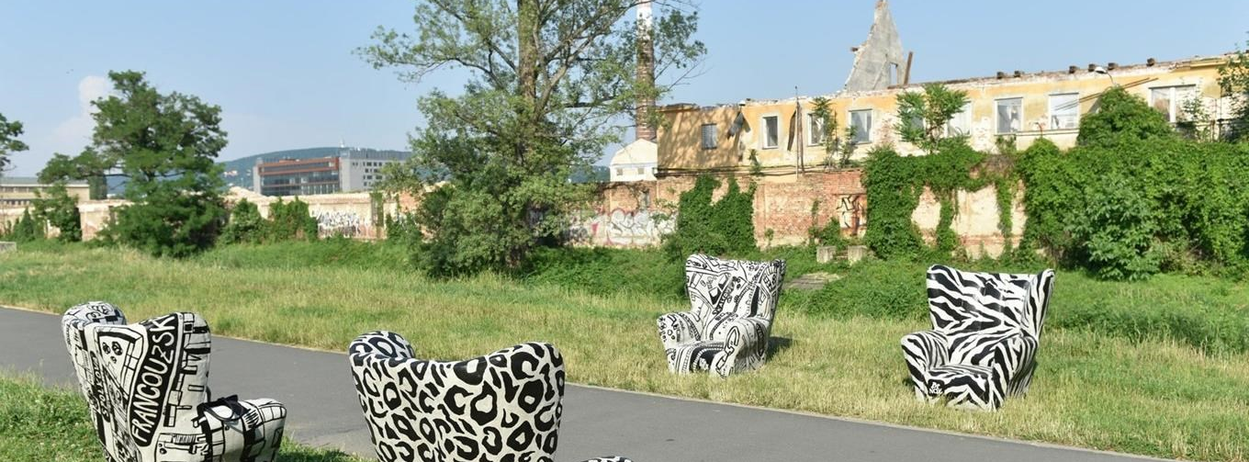

Slide 7
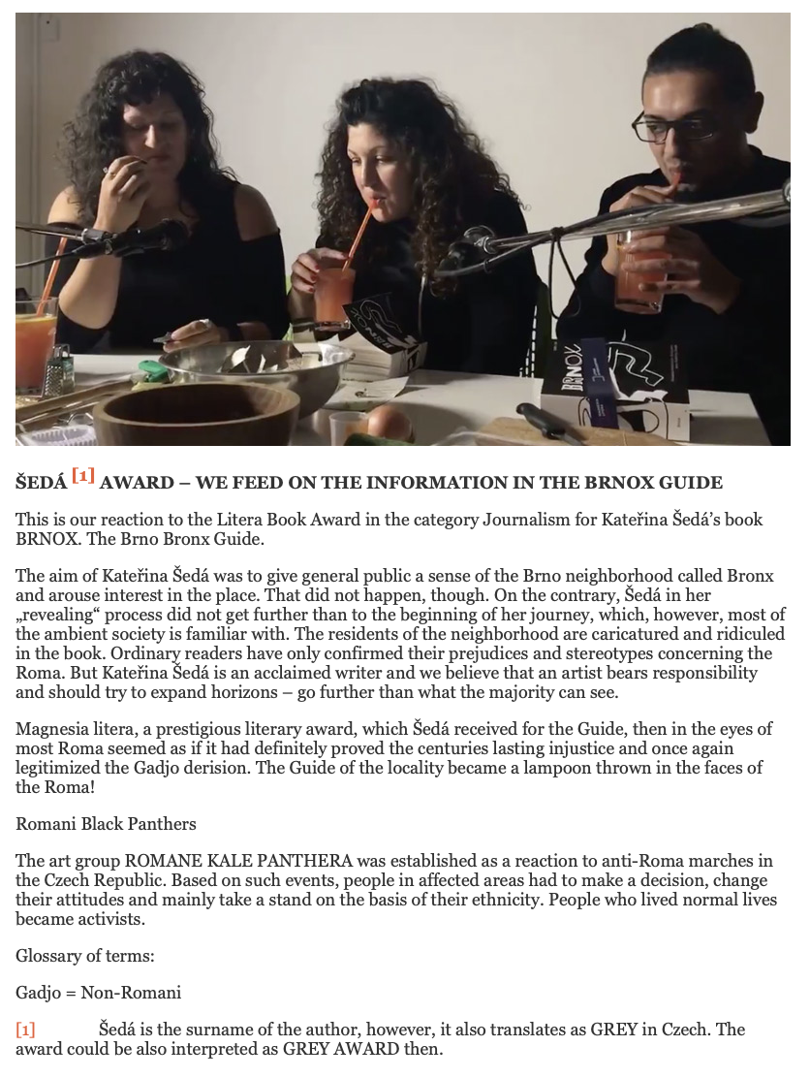
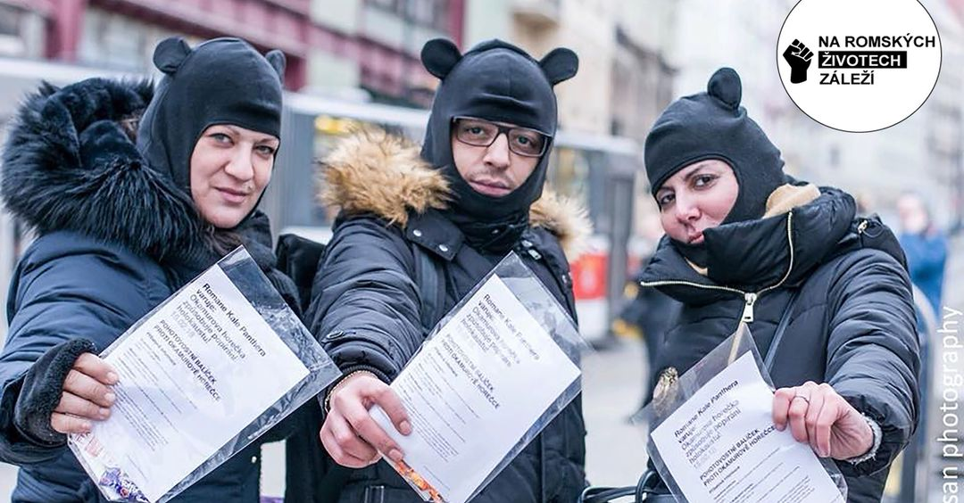
Romane Kale Panthera / Roma Black Panthers
http://www.tamaramoyzes.info/?p=1420

Slide 9
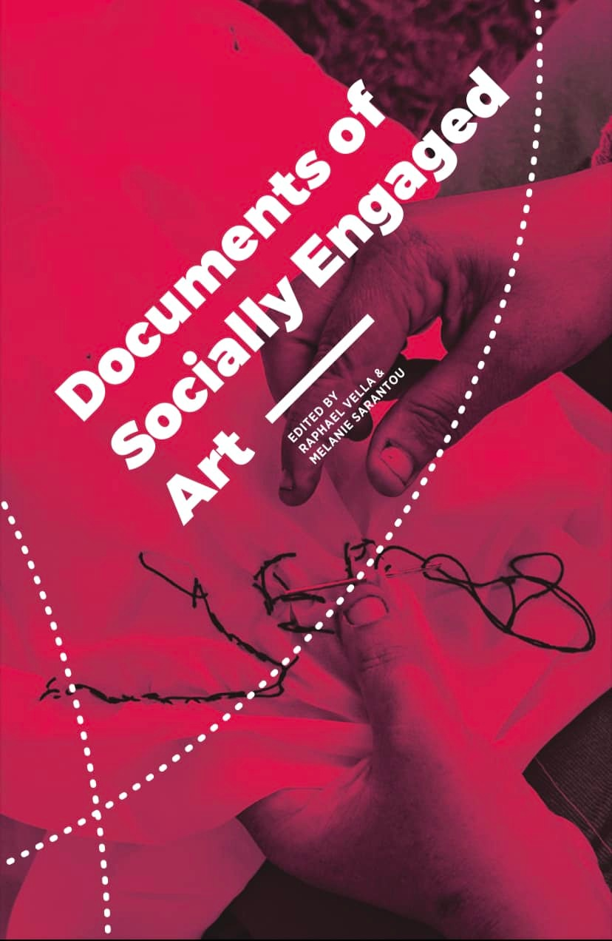
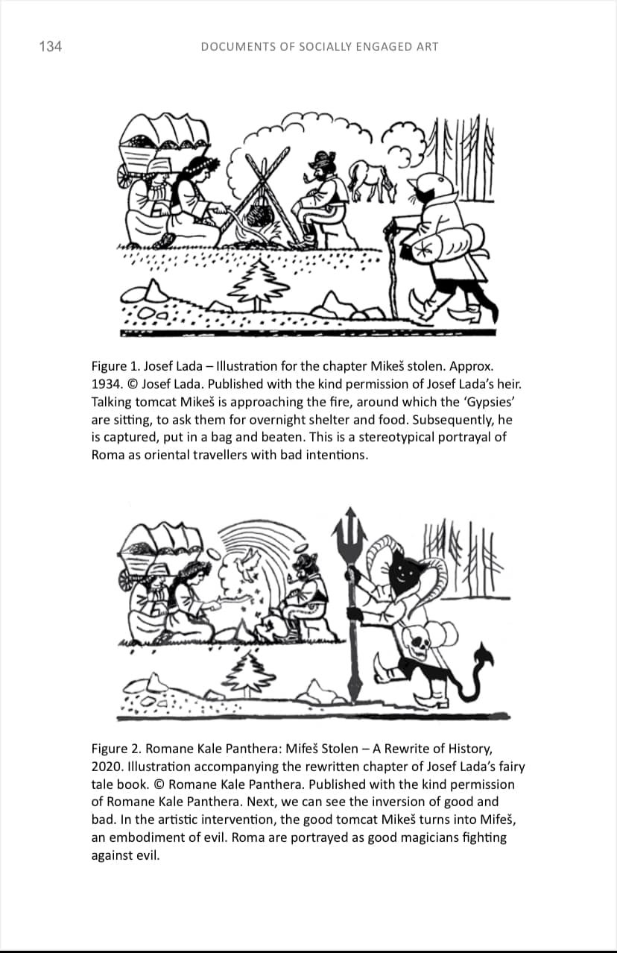
Raphael Vella & Melanie Sarantou, Documents of Socially Engaged Art, InSEA (2021)

Slide 10
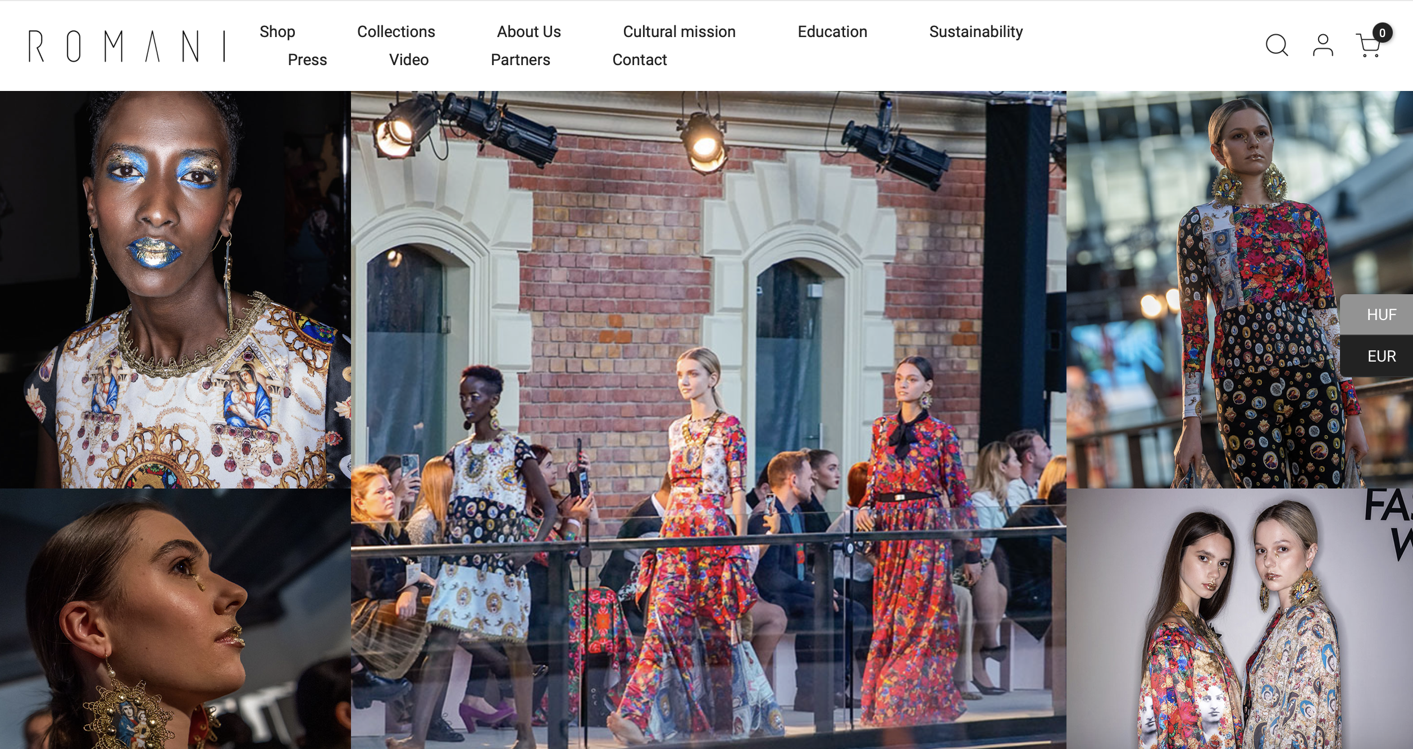
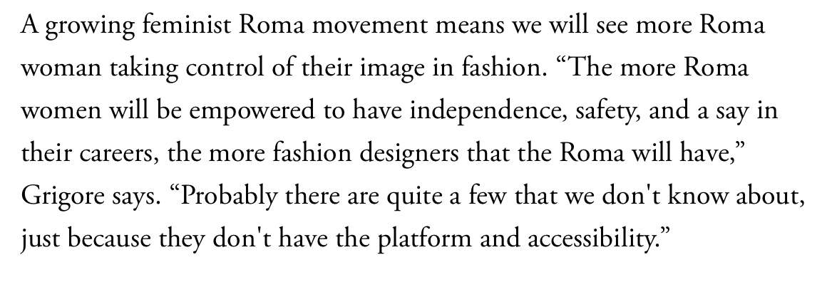
Kitsch and the decorative as a style
https://www.vogue.com/article/roma-activism-fashion
Helena & Erika Varga, https://romani.hu/en/

Slide 11
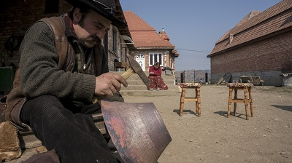

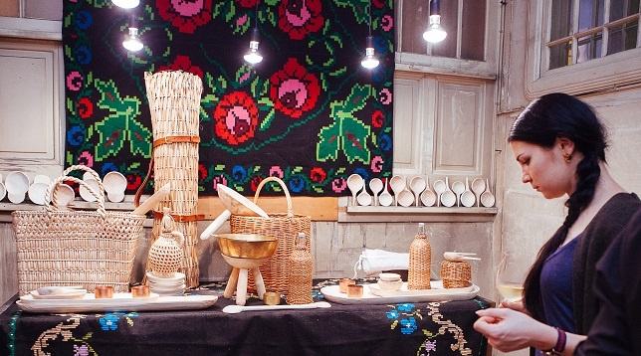
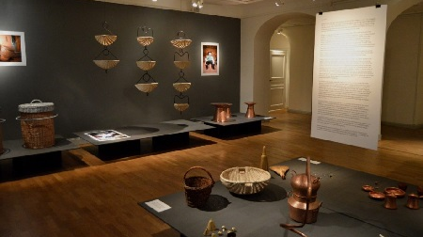

Slide 12

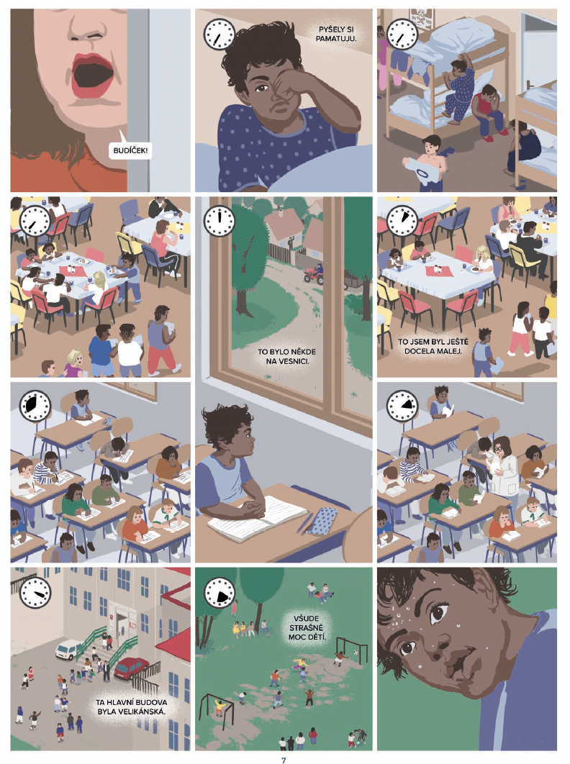

Slide 13
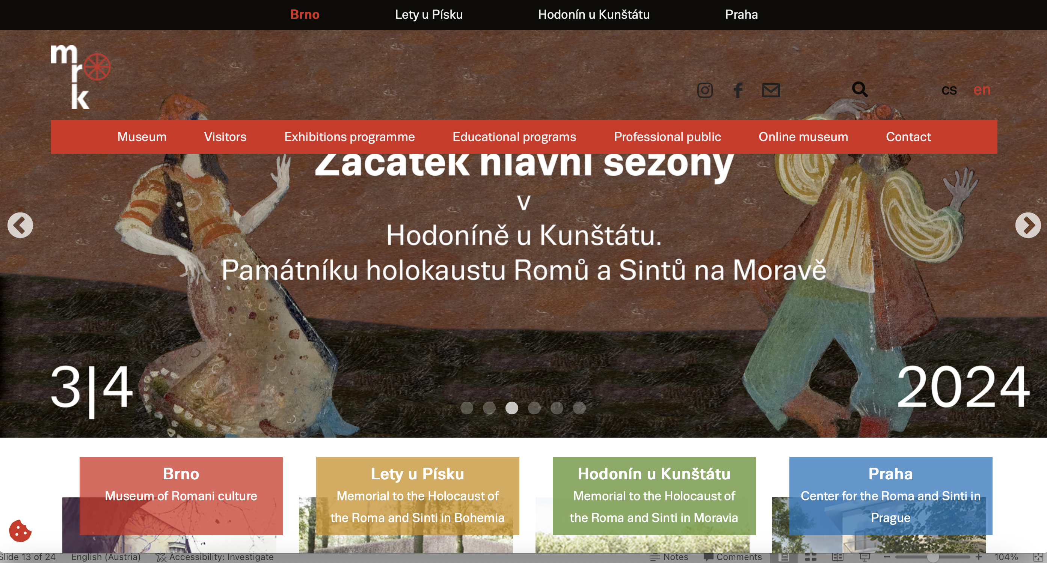
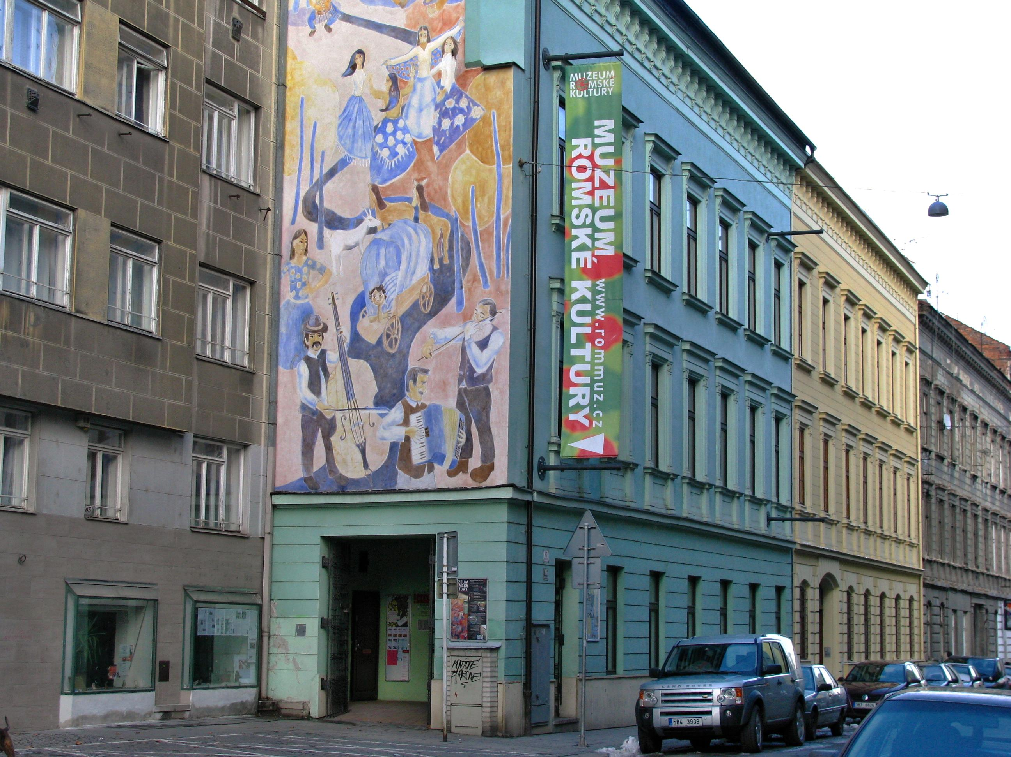


Slide 14
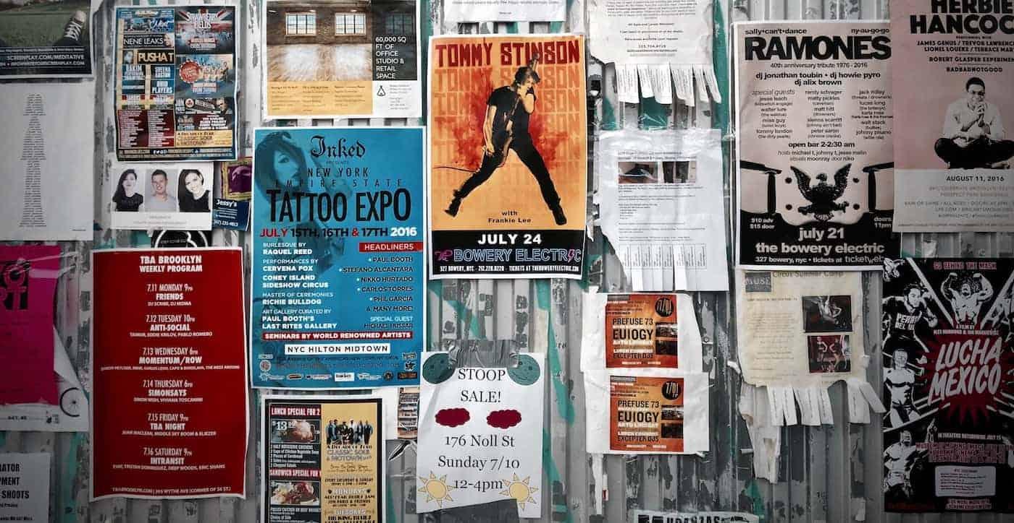
POSTERs

Slide 15
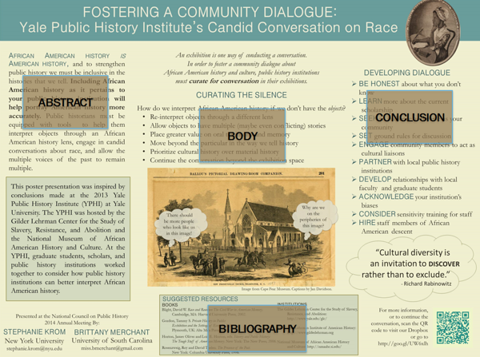
What is a poster?
A large-format poster is a big piece of paper or image featuring
a short title
an introduction to your topic
an overview of your approach (body)
your results in graphical form (conclusion)
a list of references (bibliography)
if all text is kept to a minimum (500-1000 words), a person could fully read your poster in 5-10 minutes.
INTRODUCTION

Slide 16
Learning outcomes
Translate what you learnt in lectures and discussions into own research
Find an original topic and conduct independent research on it
Turn your findings into a brief visual and oral presentation
Think about most important information to include in a poster
Be able to present your poster

Slide 17
Questions to ask
What is the key message from the research that you want to highlight to your audience?
Not just the work of art/artist, but the message
Along with the main image, what other material (texts, graphs, other images) do you need to support the poster theme?
Keep it simple. Choose a lead image and supporting material.
Who is the audience?
Us
What medium?
Handmade collage or software (PowerPoint, Adobe inDesign, Illustrator, Canva…).

Slide 18
Practicalities
What size should your poster be?
A2 ideally, landscape or portrait
How many words?
1000 words max. Think of the font and size.
What colours will you use?
Plan it.
You have the idea; how will you present it visually and in an interesting way?
Keep it simple. Limit text, focus on images but explain.
Sketch it out.

Slide 19
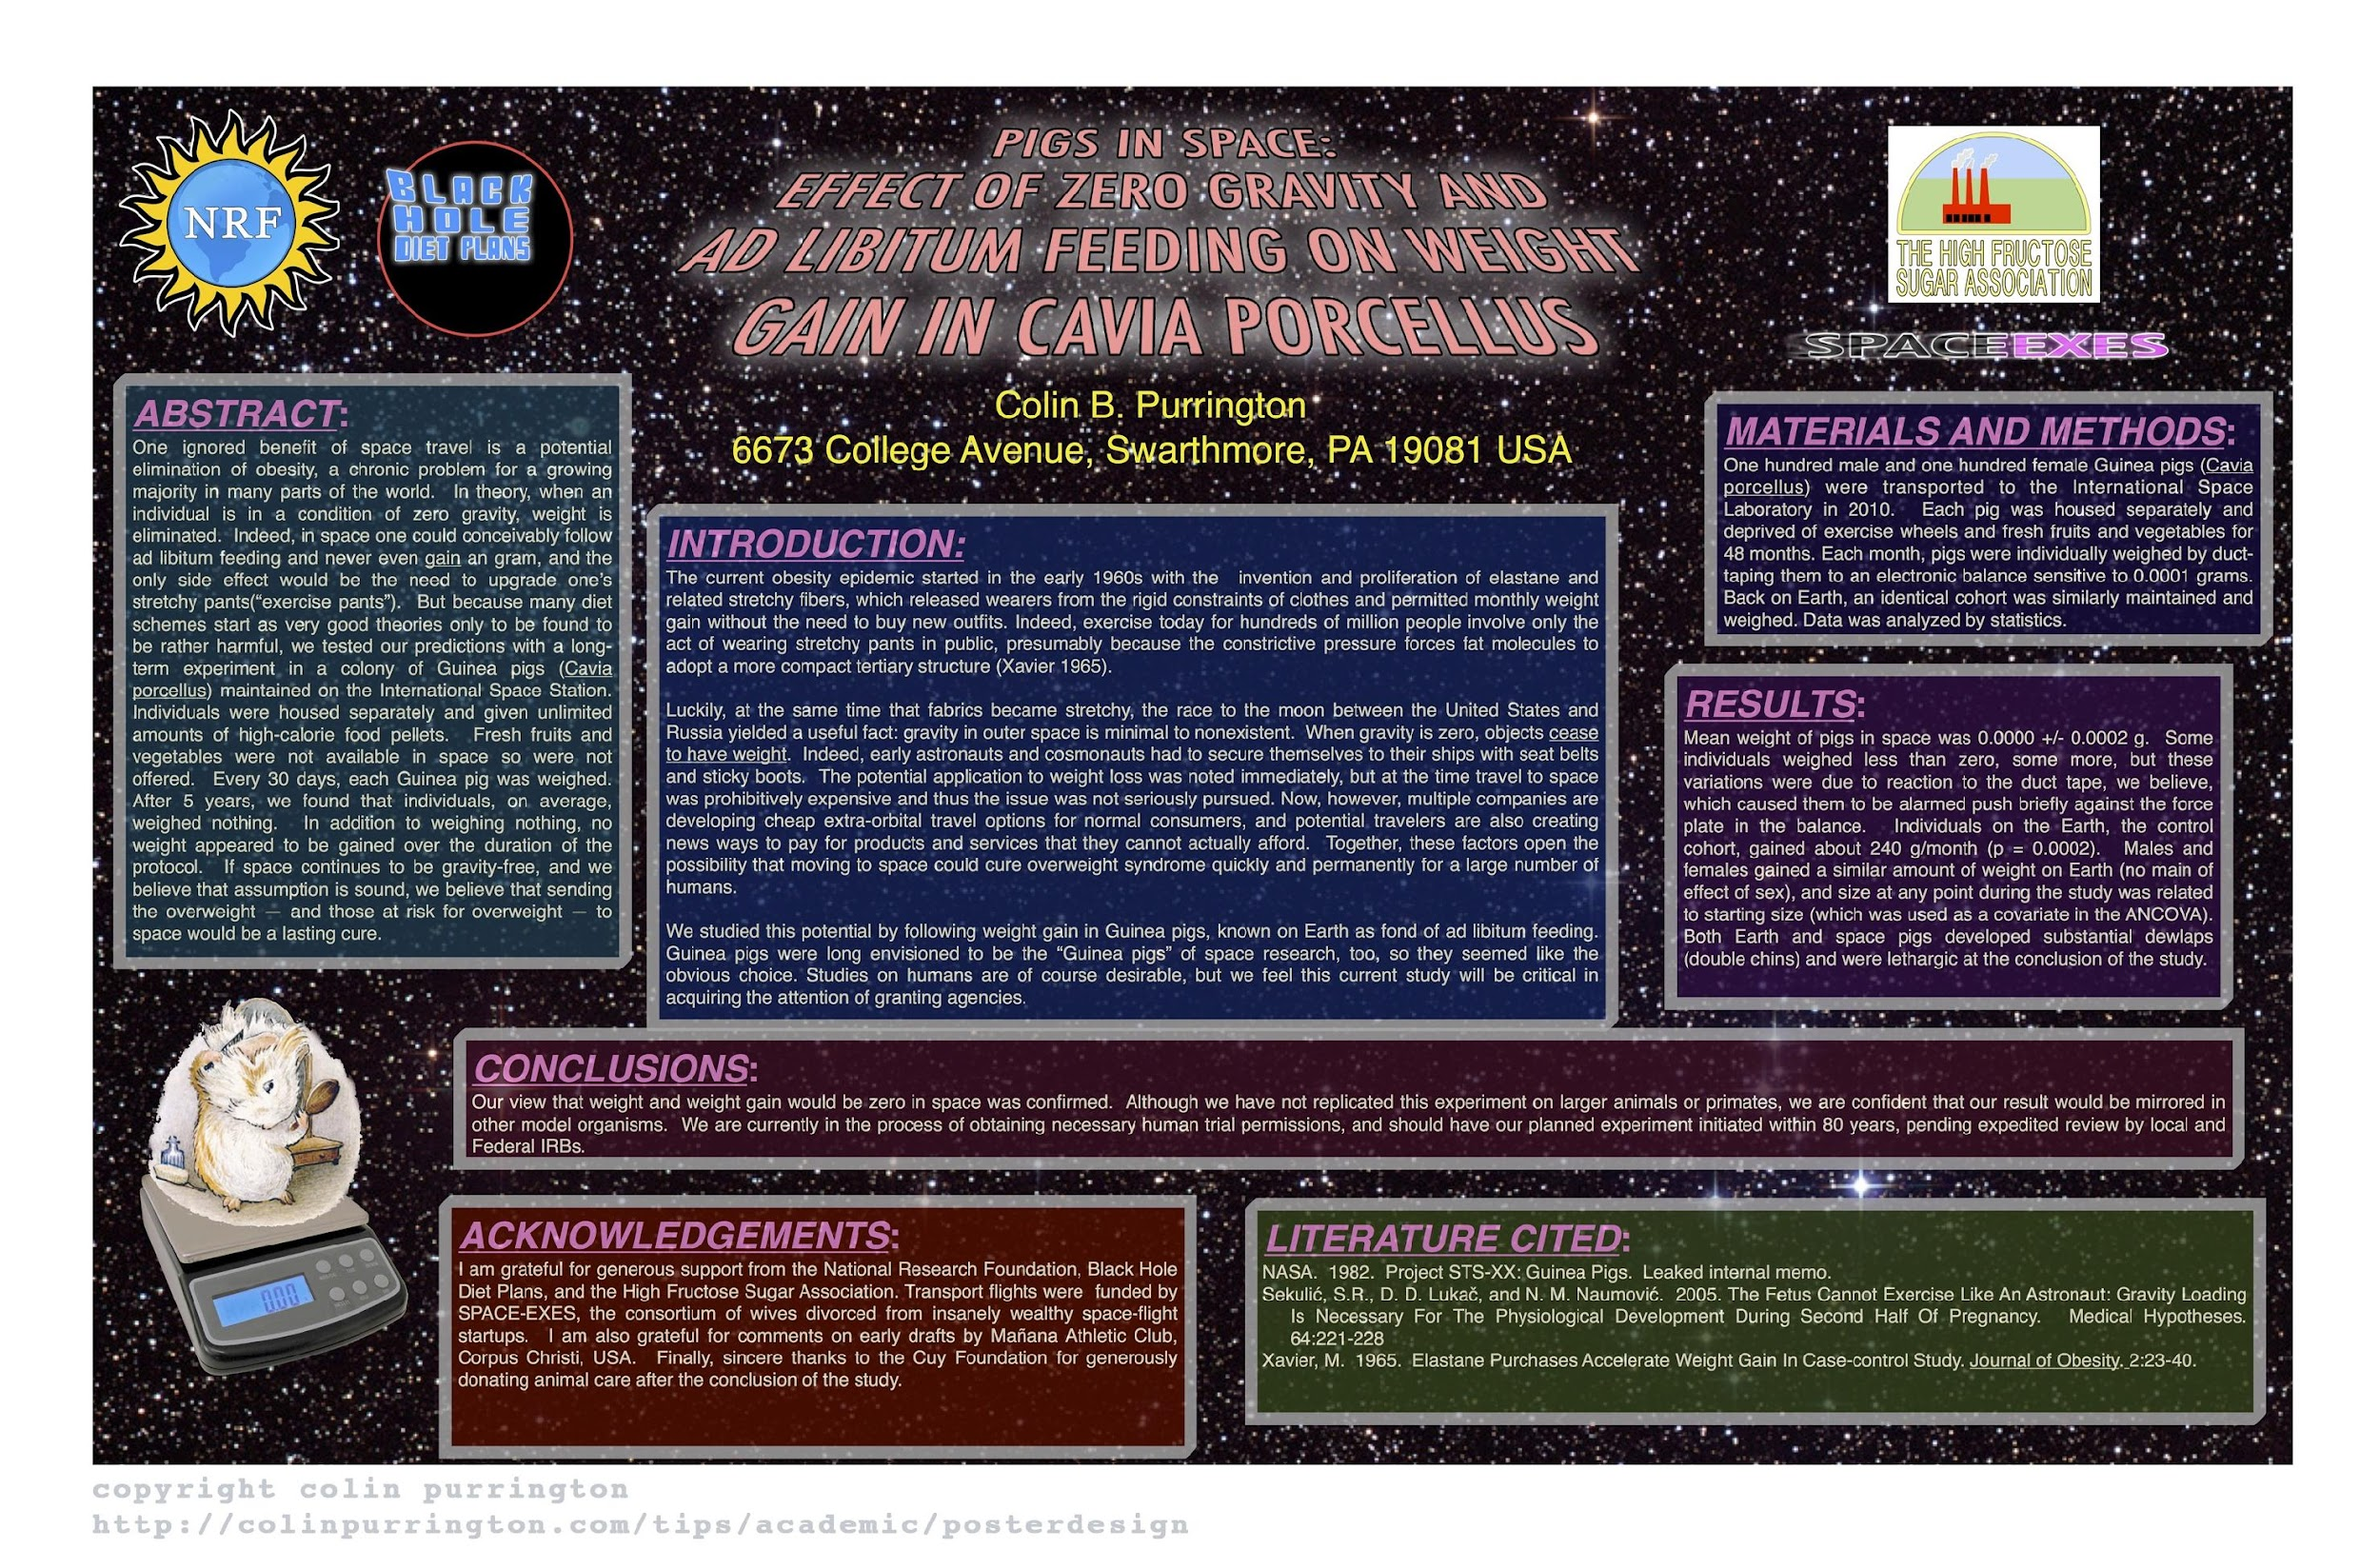

Slide 20
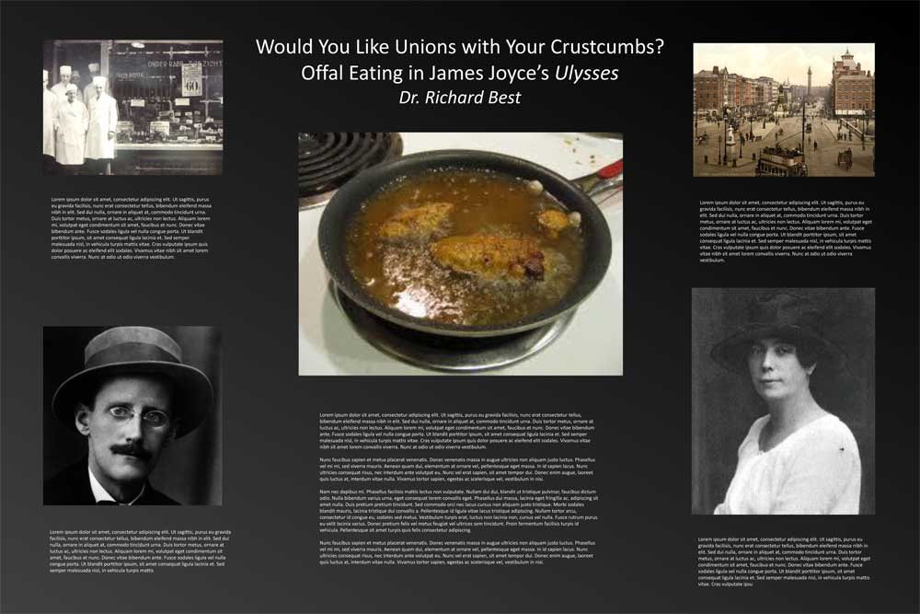

Slide 21
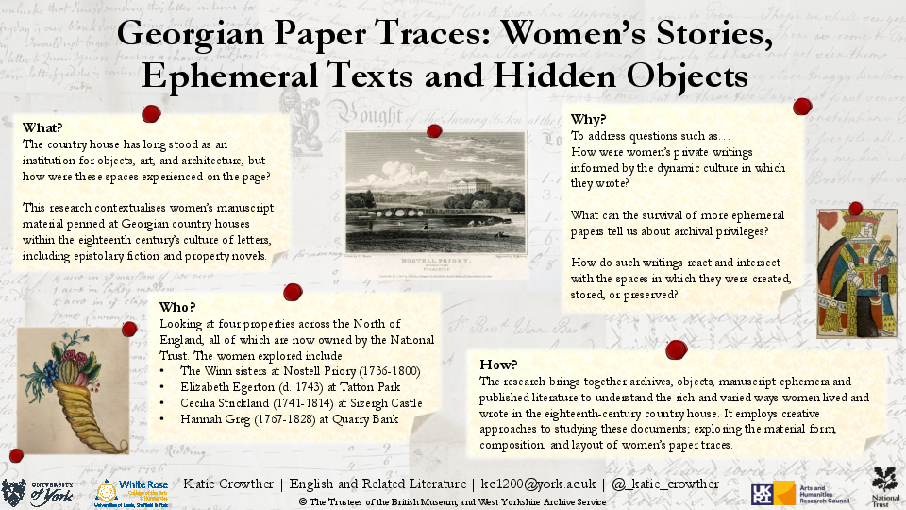

Slide 22
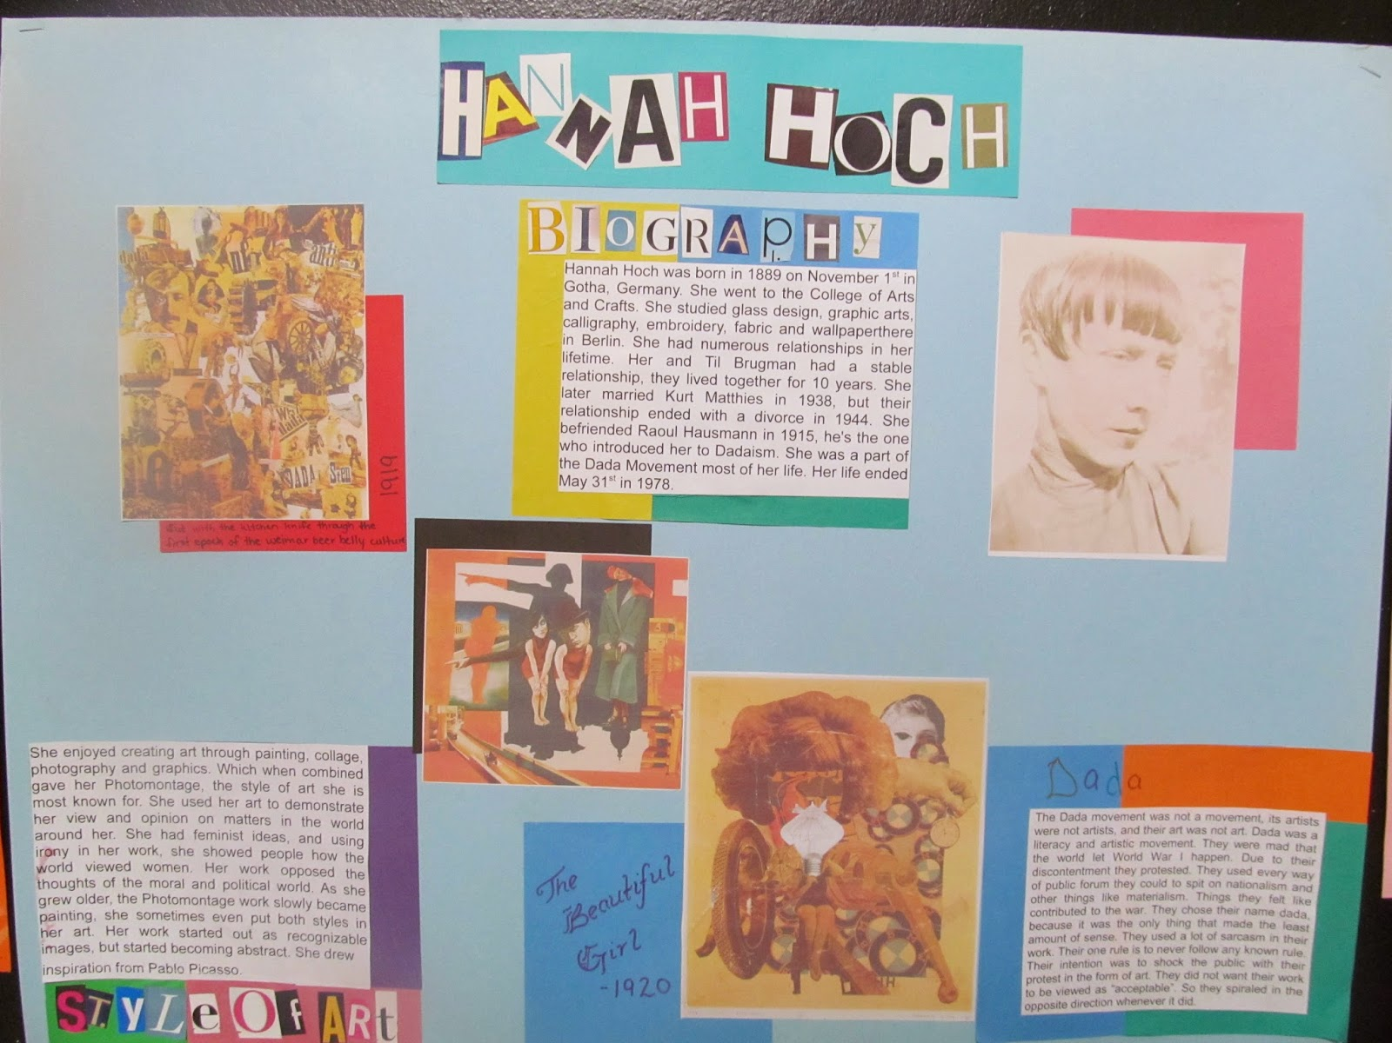

Slide 23
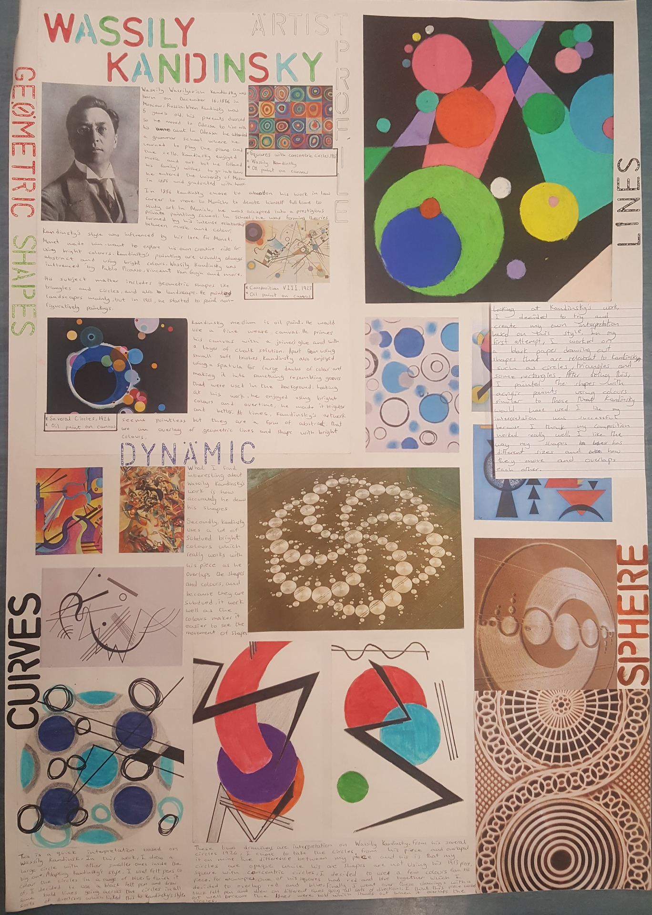
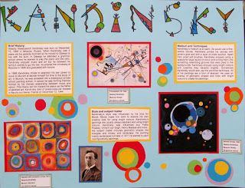

Slide 24
Some resources
Tips for poster creation
Art and Humanities posters
Examples
Software suggestions

