Slide 1
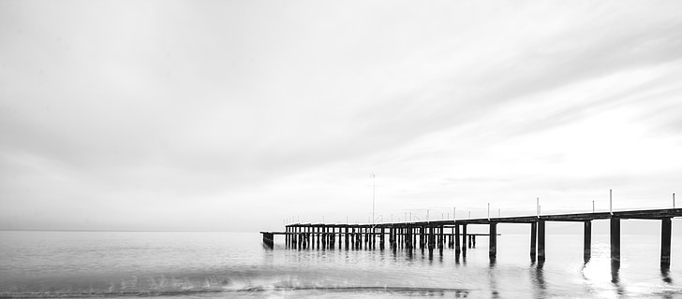
Everyday Aesthetics
Masaryk University
Spring 2024
Lee - Di Stefano - Ryynänen - Vrchlabský

Slide 2
What is Everyday Aesthetics?

Slide 3

Topics:
“Everyday Aesthetics: Introduction”
(Lee)
“Village contra City” (Lee)
“In the Seclusion near the Forest:
Czech Cottagers in the in the Era of Communism” (Lee)

Slide 4
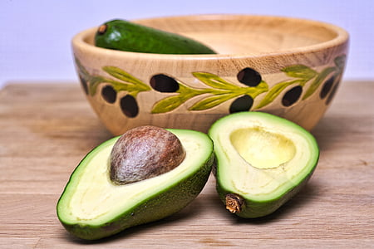
Elisa di Stefano
Adam Vrchlabský
Max Ryynänen
!!!The courses by Max and Elisa will be held in a hybrid form - online via MS Teams, also in a classroom (no recording).
Lenka's courses and student presentations will be held in a classroom (no recording).!!!

Slide 5
April 24th + May 15th: Presentations (students)

Slide 6
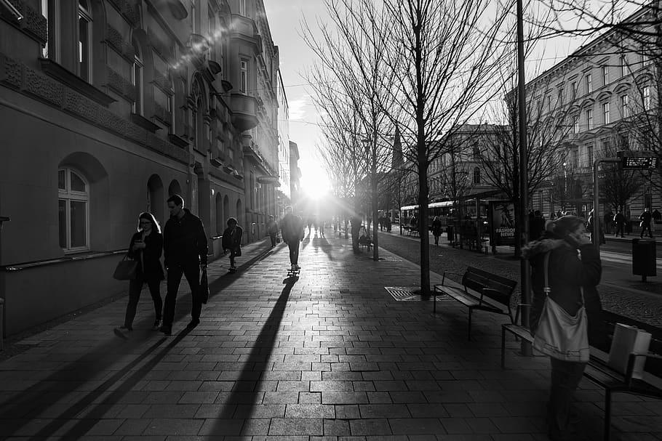
Requirements
Active participation: 8 times per semester
Presentation

Slide 7
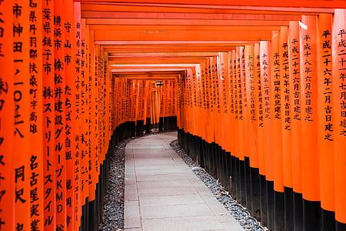
Presentations:
an article, a chapter from a book (15 - 25 pp.)
send me the bibliographic data + title by April 3th
(to IS -> Homework Vaults -> Presentation_Title + Bibliography)
10 minutes in a classroom
PP presentation
PP (Google Pres. etc.) presentation (submit a day before the presentation (Tuesday 20:00) to IS -> Homework Vaults -> Presentations_PP)
b) In advance: 600 - 900 words abstract (submit three days before the presentation (Sunday 23:59) to IS -> Homework Vaults -> Presentations_abstract)

Slide 8
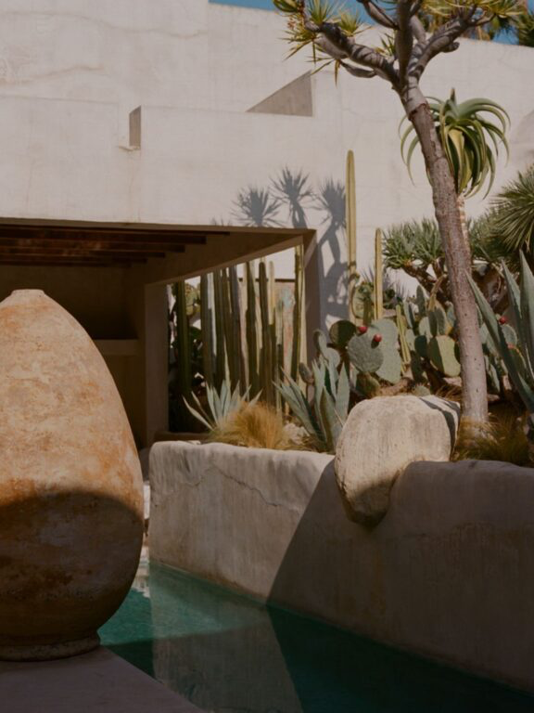
Bibliography:
See https://plato.stanford.edu/entries/aesthetics-of-everyday/#Bib

Slide 9
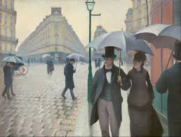
Presentation resources:
JSTOR
https://www-jstor-org.ezproxy.muni.cz
SAGE Journals Online - HSS
https://journals.sagepub.com
ESPES
https://espes.ff.unipo.sk/index.php/ESPES/issue/view/20
https://books.google.fi/books?id=BeVOEAAAQBAJ&newbks=0&printsec=frontcover&hl=cs&source=gbs_ge_summary_r&cad=0#v=onepage&q&f=false
… and others…:-)

Slide 10
Somavision and the Everyday - from Films to Robot Cars
Both film - which is more often used by us as a sort of everyday practice than an art
practice - and our currently developing relationship to robots are more about the
body-mind than what we have realized. This lecture takes the initiative to theorize that
through some leaps into brain research and theories of bodily engagement. (Max Ryynänen)
"Aesthetic categories and ordinary objects"
The lecture focuses on some aesthetic categories and in particular highlights the transformation of the notion of beauty, once considered a high value and now become only appearance (aestheticization of life). Finally, I will talk on decorum as a category more suited to everyday aesthetics. (Elisabetta di Stefano)

Slide 11
“Alternative Everydays”
There are many texts about the everyday, but (although this is slowly changing) nearly all of them end up talking about it being 'homey', taking up examples of design objects on the table, and it looks like the everyday, in philosophical discourse as much as the sociological, is a thing of the middle class of the West and/or the Global North. How did the discussion end up being like this? And how can we start studying other everydays? Most scholars have not collected trash for living nor been flying private jets. This lecture still proposes, that a careful, multicultural and class-wise open-minded selection of examples is very important for the discussion, and proposes some ideas on work that could be used for expanding it. (Max Ryynänen)
Everyday Aesthetics: ordinary objects and daily practices"
It is an introduction to Everyday Aesthetics. The lecture focuses on daily activities (and some daily
objects) that acquires value in our life and give us aesthetic pleasure.

