Slide 1
Švédská literatura a kultura počátkem 20. stol.
SE

Slide 2
Ellen Key
1849 - 1926
Kultivace kultury jako životní potřeba člověka
O vlastnickém právu ženy a emancipaci její z moci manželovy
Svoboda osobnosti
Žena budoucnosti
Století dítěte – Barnets århundrade
Výchova zcela přirozená, neinstitucionální, v blízkosti k anarchismu

Slide 3
Ellen Key, in full Ellen Karolina Sofia Key, (born December 11, 1849, Sundsholm, Sweden—died April 25, 1926, Strand), Swedish feminist and writer whose advanced ideas on sex, love and marriage, and moral conduct had wide influence; she was called the “Pallas of Sweden.”
Key was born the daughter of the landowner and politician Emil Key (1822–92). Family misfortune obliged her to take up teaching in Stockholm in the late 1870s, and for the next 20 years she also lectured at the workers’ institute there. Barnets århundrade (1900; The Century of the Child, 1909) made her world famous. This book and numerous other publications concerning the issues of marriage, motherhood, and family life were translated into many languages. In 1903 she started lecture tours abroad, particularly in Germany. She also propagated her ideas through an enormous correspondence, and many young authors were influenced by her. Her liberal and radical opinions in most fields of cultural life, and especially on love and marriage, led to controversy.
https://www.britannica.com/biography/Ellen-Key

Slide 4
Hjalmar Bergman
1883 Örebro (Wadköping) – 1931 Berlin

Slide 5
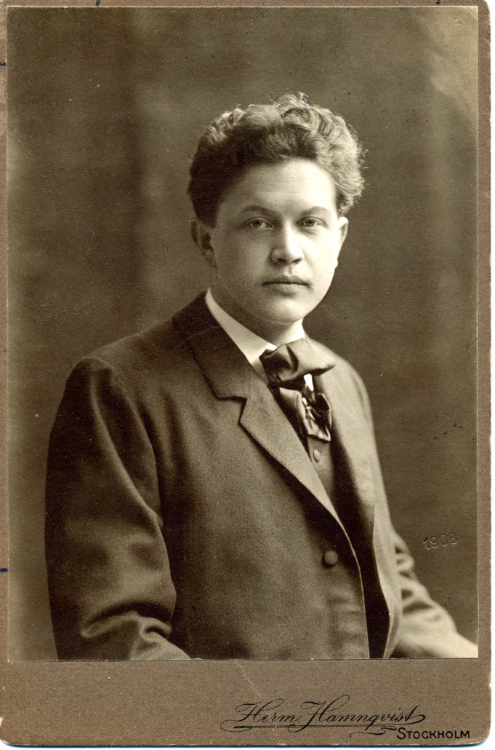
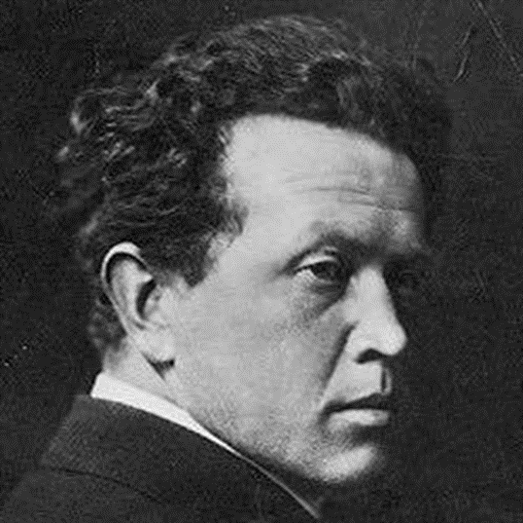

Slide 6
Romaner
En döds memoarer (1918)
Markurells i Wadköping (1919)
Chefen fru Ingeborg (1924)
Clownen Jac (1930)
https://www.themodernnovel.org/europe/w-europe/sweden/bergman/

