Slide 1
Preserving the Past, Embracing the Future
Curating the Vasulka Live Archive on the Remnants of Video Art

Slide 2
Media Art Live Archive
An Intelligent Interface for Interactive Mediation
of Cultural Herritage
(2019–2022)
Technology Agency of the Czech Republic

Slide 3
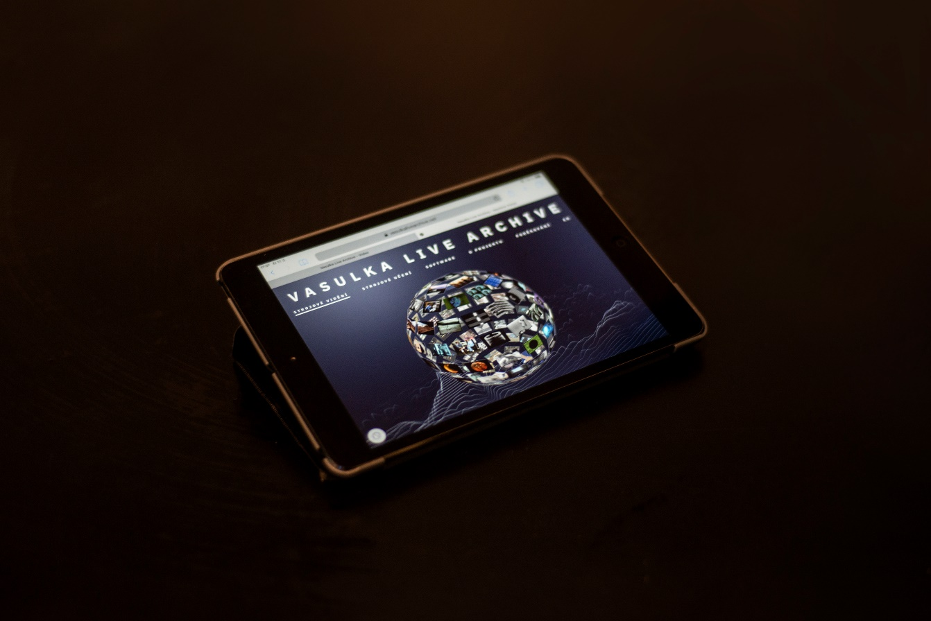
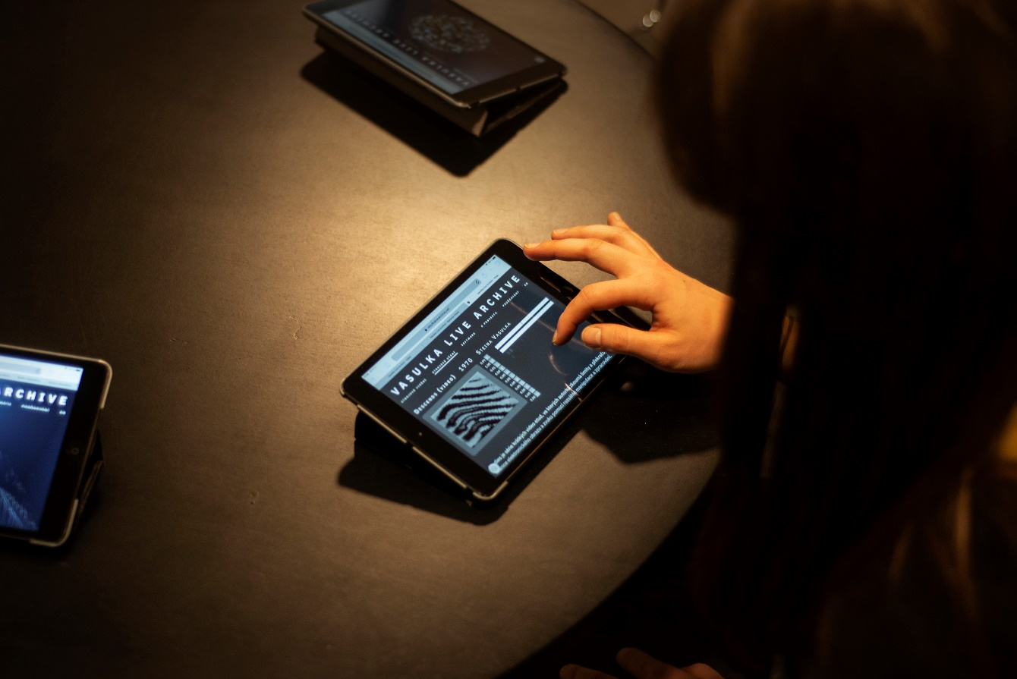
Curating the Vasulka Live Archive on the Remnants of Video Art
VasulkaLiveArchive.net

Slide 4
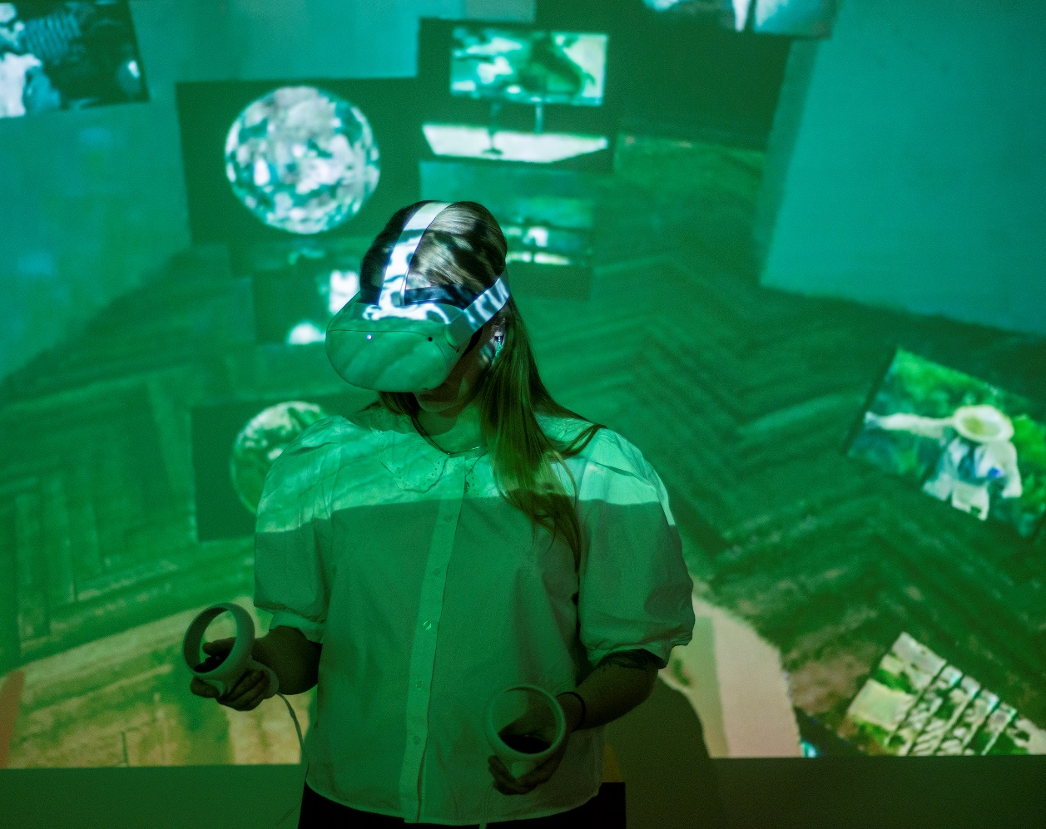
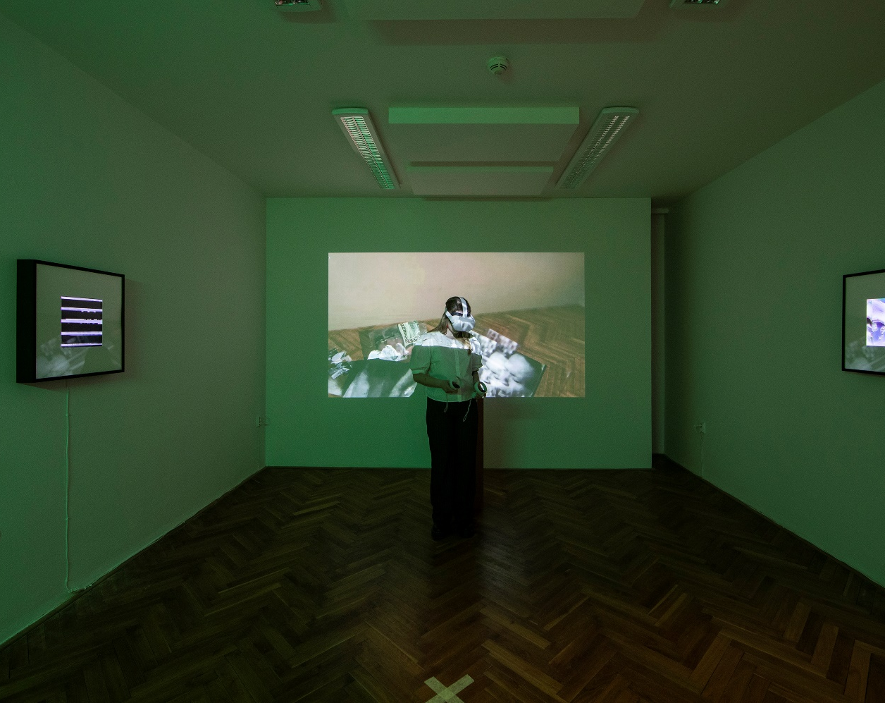
Curating the Vasulka Live Archive on the Remnants of Video Art
Exhibition Vasulka Live Archive / Interfaces

Slide 5
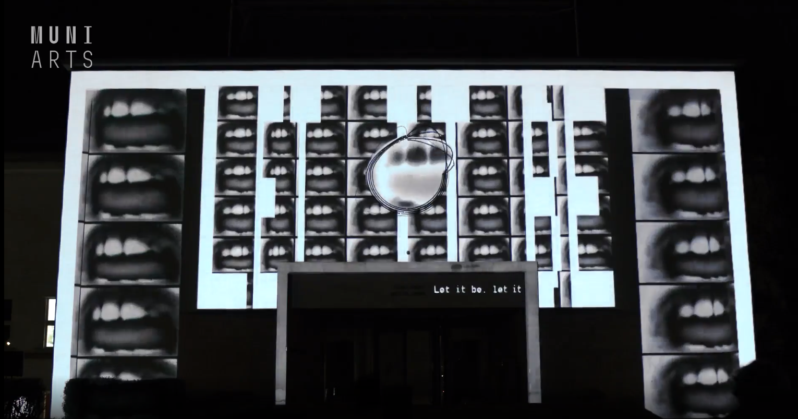
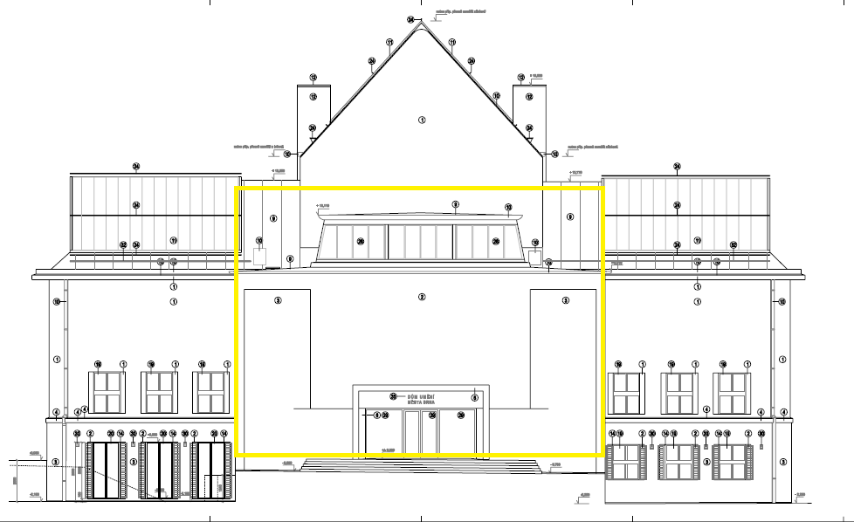
Curating the Vasulka Live Archive on the Remnants of Video Art
Videomapping

Slide 6

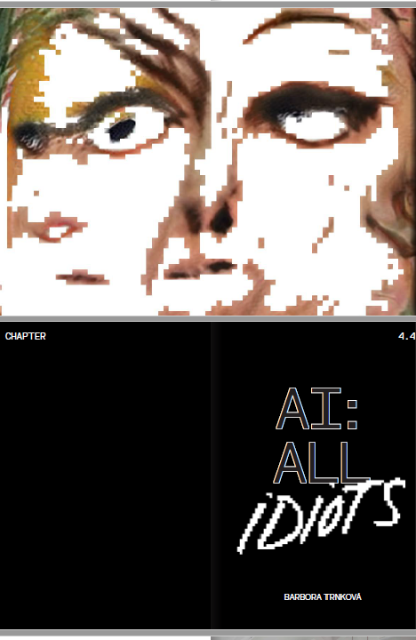
Curating the Vasulka Live Archive on the Remnants of Video Art
The Black Box Book

Slide 7
Curating the Vasulka Live Archive
on the Remnants of Video Art

Slide 8
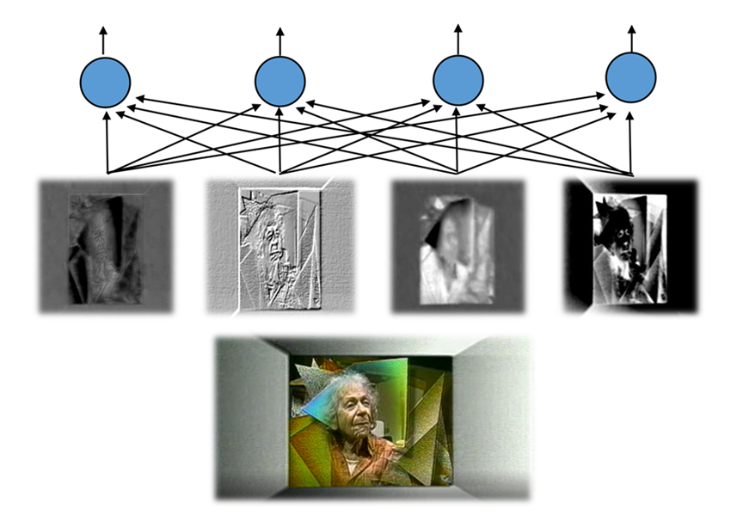
Curating the Vasulka Live Archive on the Remnants of Video Art
Key words of the presentation
Live Archive
Curating
The remnants

Slide 9
Vasulka Live Archive
Design of the project
Digital humanities
Design thinking
Artificial intelligence /
Distant reading
Live archive

Slide 10
Design of the project
Digital humanities
Design thinking
Artificial intelligence /
Distant reading
Live archive
„… Digital Humanities both shapes and interprets [technological imaginary] …, its engagement with design as a method of thinking-through-practice is indisputable. Digital Humanities is a production-based endeavor in which theoretical issues get tested in the design of implementations, and implementations are loci of theoretical reflection and elaboration. “
(Burdick, A. et al., 2012, p. 13)

Slide 11
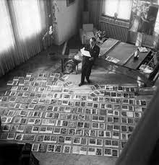
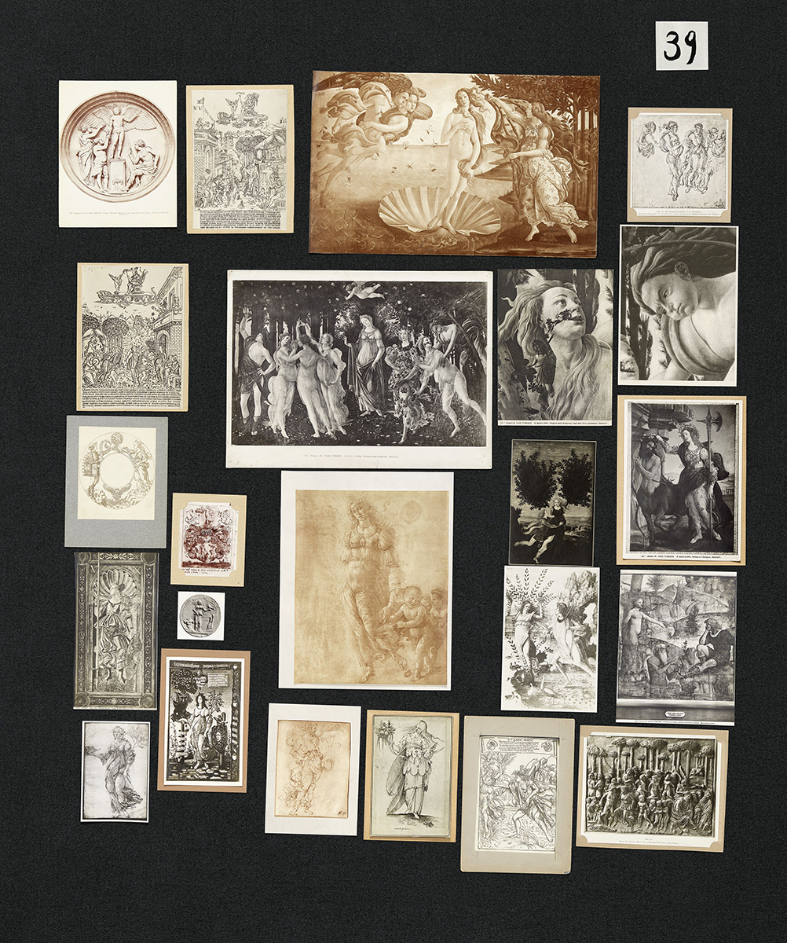
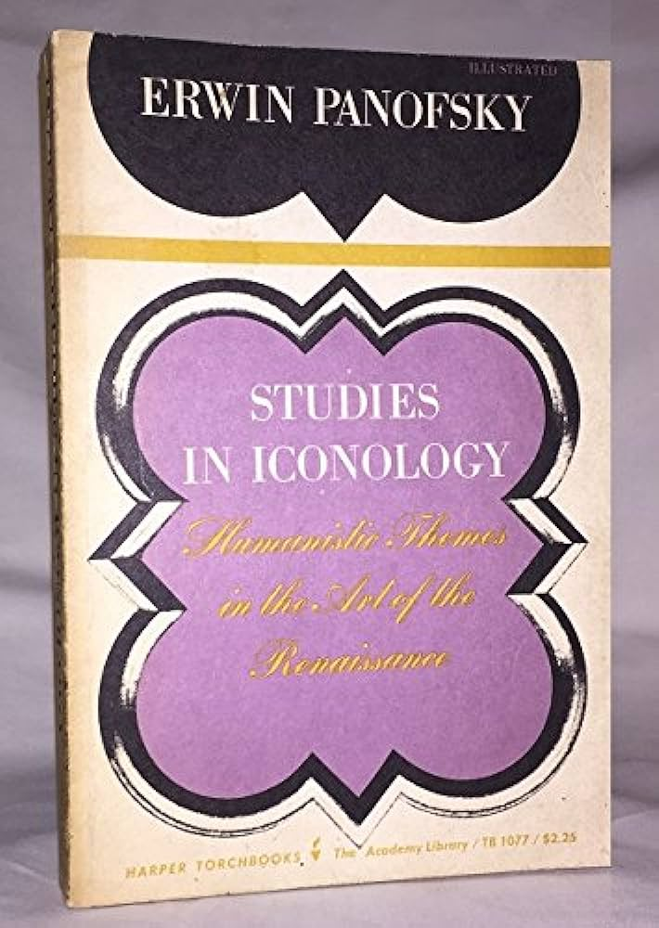
Digital archive and Artificial Intelligence / inspirations and influences

Slide 12
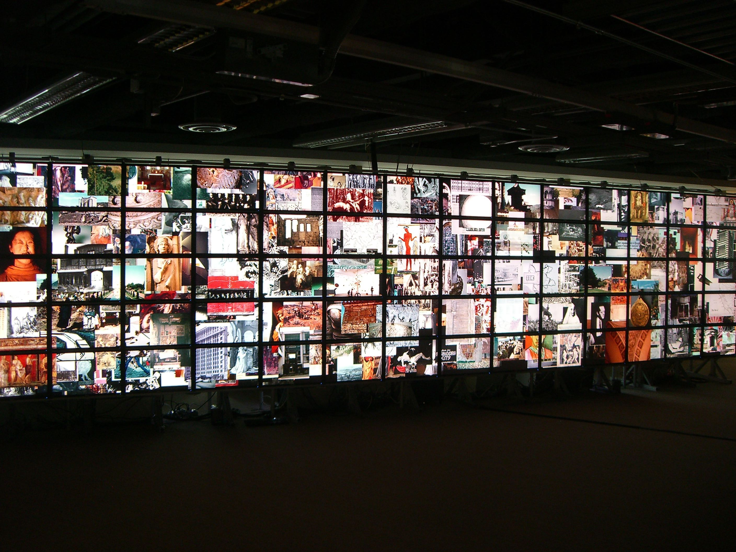
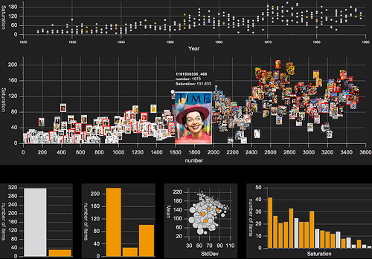
Digital archive and Artificial Intelligence / inspirations and influences
http://lab.culturalanalytics.info/2016/04/exploratory-visualizations-of-thomas.html

Slide 13
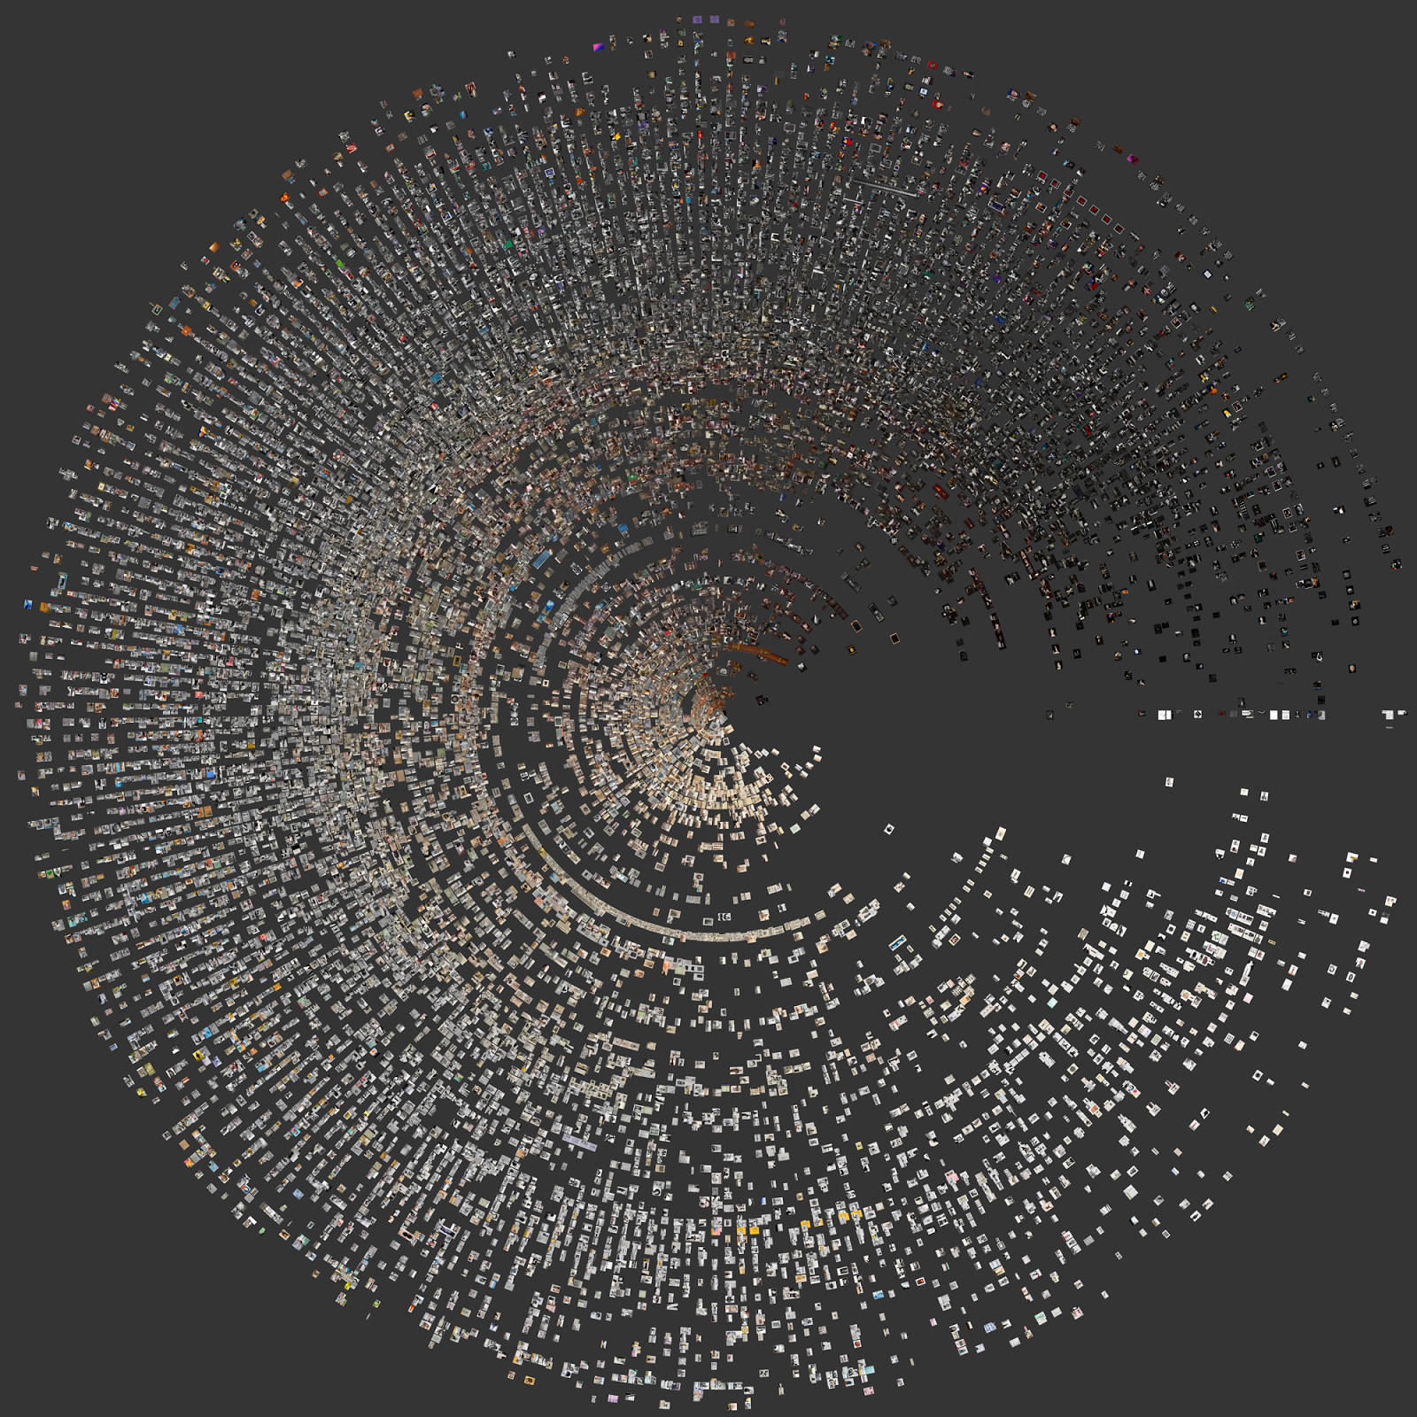
Digital archive and Artificial Intelligence / inspirations and influences
http://lab.culturalanalytics.info/2016/04/exploratory-visualizations-of-thomas.html

Slide 14
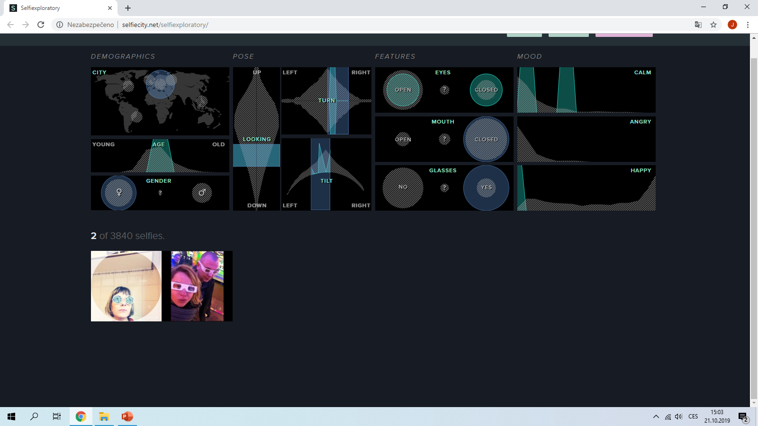
Digital archive and Artificial Intelligence / inspirations and influences

Slide 15
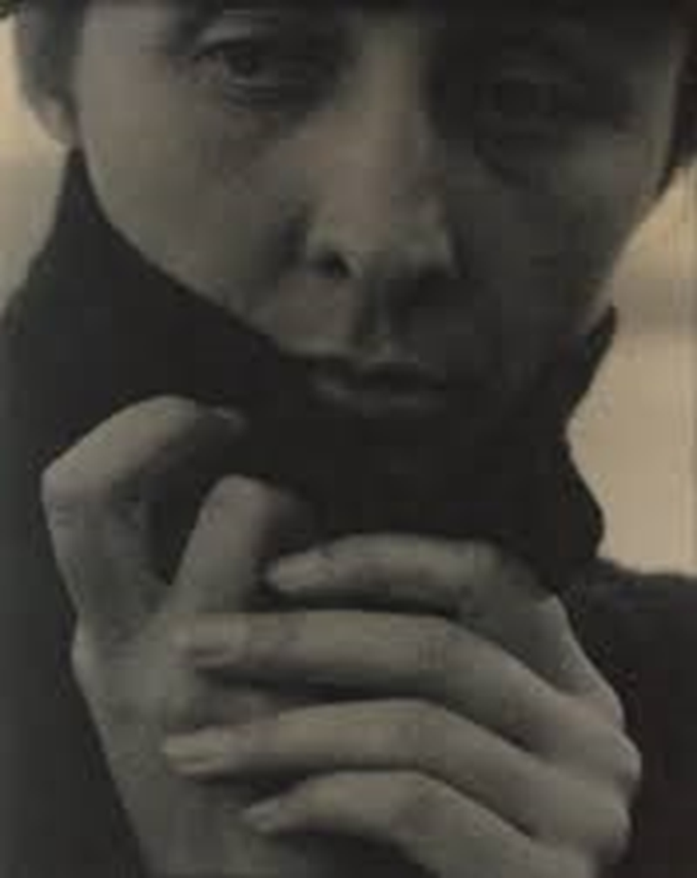

Digital archive and Artificial Intelligence / inspirations and influences

Slide 16
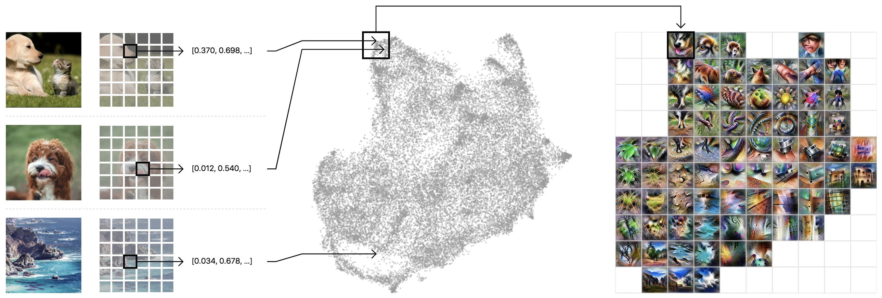
Digital archives and Artificial Intelligence / inspiration and influences
https://distill.pub/2019/activation-atlas/

Slide 17
Design of the project
Graphic representation of the three pillars (research areas) that are integrated into the web-epistemological tool VasulkaLiveArchive.net.
Vasulkalivearchive.net
An interactive epistemological tool for an "augmented iconology" of artistic videos.
The work of the Vasulkas | Theory of video art | Artificial intelligence (machine learning)
Digital archive of the Vasulkas videos. | Concepts introduced by Peter Weibel and Rosalind Krauss. A study of the Vasulkas videos with a focus on recurring visual and sound motifs. | Two CNNs for content analysis of the Vasulkas videos, one for audio and the other for visual signs analysis.

Slide 18
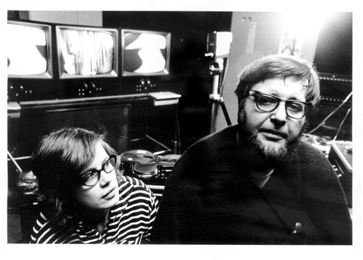
Curating the Vasulka Live Archive on the Remnants of Video Art
Key words of the presentation
The Vasulkas

Slide 19
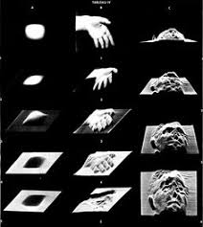
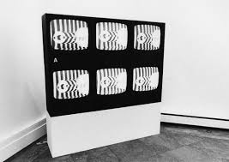
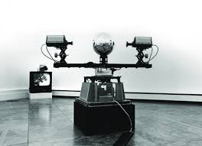
Curating the Vasulka Live Archive on the Remnants of Video Art
Key words of the presentation
Video art

Slide 20
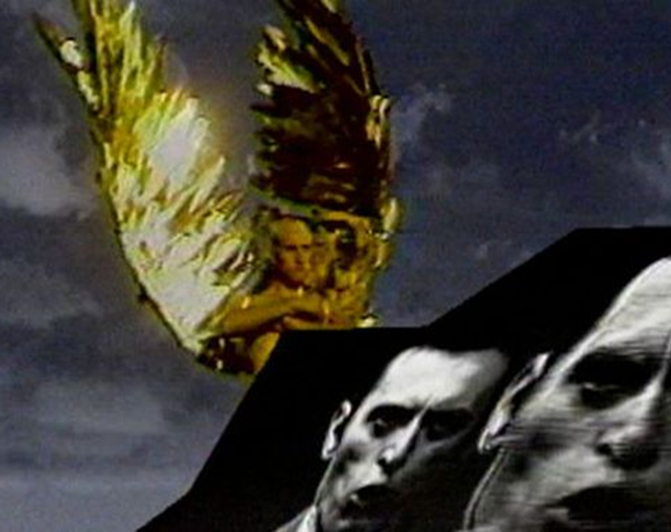
Curating the Vasulka Live Archive on the Remnants of Video Art
Key words of the presentation
Video art
Video art is a form of artistic expression that utilizes video or moving images as its primary medium.
It encompasses various techniques such as recording, editing, and manipulating video footage to convey artistic concepts and ideas.

Slide 21
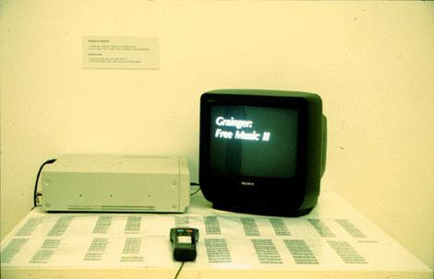
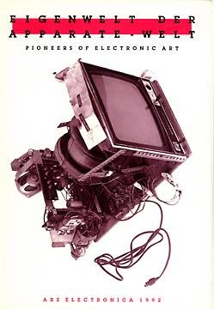
Digital archive and Artificial Intelligence / inspirations and influences

Slide 22
Artificial Intelligence at the Service of Video Art analysis
Four different applications of machine learning and AI in aesthetics (Manovich – Arielli, 2021, p. 12)
 | Pattern recognition | Pattern generation
 | (Analysis and description) | (Production and prediction)
Objects | Studying objects | Generating objects
Subjects | Studying subjects | Generating subjects
Basic processes the AI is doing (Hageback – Hedblom, 2022, p. 50)
Analyse and summarise
Generate
Imitate
Translate
Pasquinelli – Joler, 2020
„[AI as] an instrument of knowledge magnification that helps to perceive features, patterns, and correlations through vast spaces of data beyond human reach.“
(Moretti, 2000)
„Distant reading: where distance, …, is a condition of knowledge: it allows you to focus on units that are much smaller or much larger than the text: devices, themes, tropes—or genres and systems.”

Slide 23
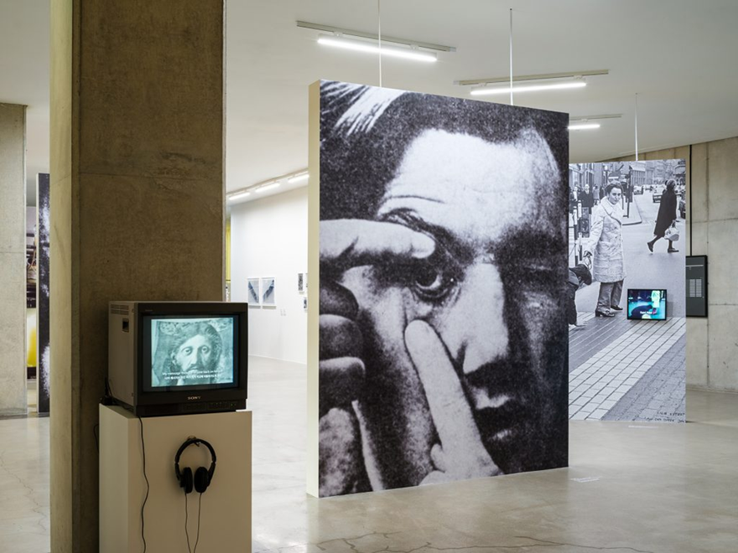
Curating the Vasulka Live Archive on the Remnants of Video Art
Video art poetics
Peter Weibel
1. Synthetics
2. Transformation
3. Self-reference
4. Instant time
5. Box
Video is an epistemological tool.
Video Art as an act of cognition.

Slide 24
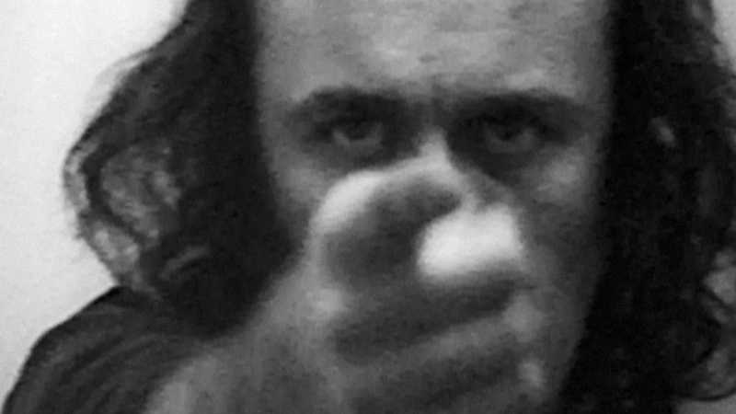
Curating the Vasulka Live Archive on the Remnants of Video Art
Video art poetics
Rosalind Krauss
Video: The Aesthetics of Narcissism
“As we look at the artist sighting along his outstretched arm and forefinger towards the center of the screen we are watching, what we see is a sustained tautology: a line of sight that begins at Acconci's plane of vision and ends at the eyes of his projected double.”
"The medium of video art is the psychological condition of the self split and doubled by the mirror-reflection of synchronous feedback..."

Slide 25
VasulkaLiveArchive.net
How we proceeded?

Slide 26
Vasulka Live Archive: how we proceeded
Dataset
  Data set volume in general: 536 GB / 1,800 audio-visual works.
  880 videos successfully converted to mp4 format.
  Final data set: 137 GB data corpus / 6 days, 20 hours and 27:30 min. watch time.
  List of the Vasulkas videos: 108 in total (21 by Woody Vasulka, 49 by Steina Vasulka, 38 by the Vasulkas).
  VasulkaLiveArchive.net: 124 items represents 105 artistic works of the Vasulkas.
  The archive contains video tapes, video documentation of art installations, documentary videos reporting on the Vasulkas work. Most of the video tapes are represented in a complete version, some are available only in fragments.

Slide 27
Vasulka Live Archive: how we proceeded
Metadata
Thematic cluster | Visual objects | Sound objects
Human | Body, Face, Hand, Steina, Woody | Speech, Singing
Interior / Exterior | Interior, Landscape | x
Natural elements | Air, Earth, Fire, Water | Air (Noise), Fire (Noise), Water (Noise)
Special Effects / Electrical Signal Manipulation | Rutt/Etra processor, Keying, Machine vision (fisheye effect), Effect | Noise
Machine and tool | Car, TV, Violin | Electronic music, Acoustic music, Playing the violin, Car (noise)
Symbols | Numbers, Letters, Lines | x

Slide 28
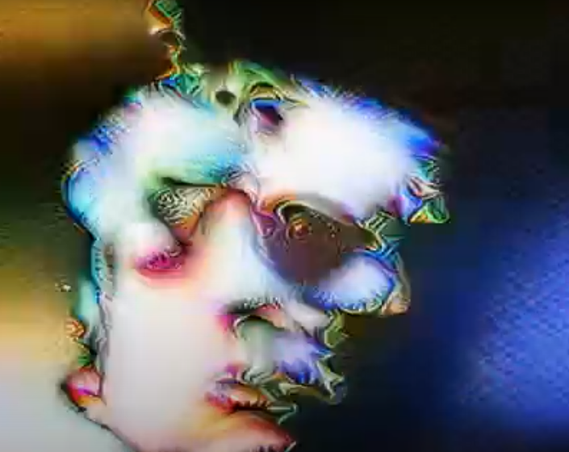
Vasulka Live Archive: how we proceeded
2 x Intelligent software
    Convolutional Neural Networks (CNNs) for content-oriented analysis of sound and visual data.
    Sikora, P. (2022). MediaArtLiveArchive – Video Tagging [Software].
    Miklanek, S. (2022). MediaArtLiveArchive – Audio Tagging [Software].
    github.com/vasulkalivearchive/audio
    github.com/vasulkalivearchive/video

Slide 29
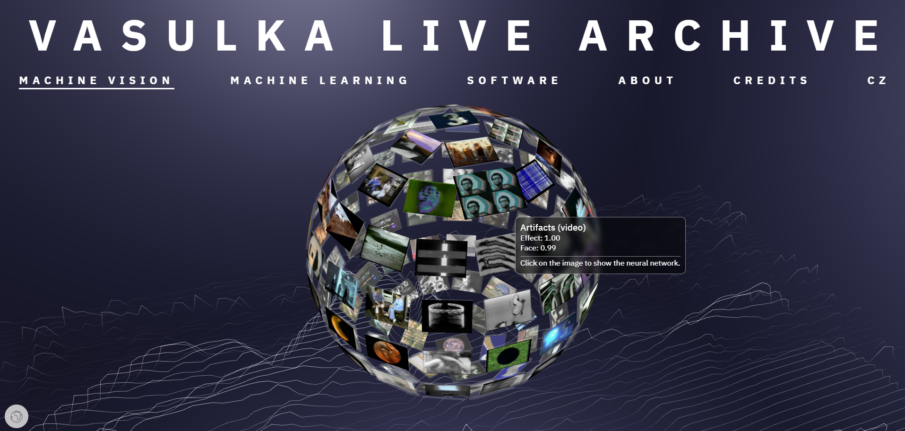
Vasulka Live Archive: how we proceeded
Web / Machine Vision (level 1) : https://vasulkalivearchive.net (Inspired by the Activation Atlas)

Slide 30
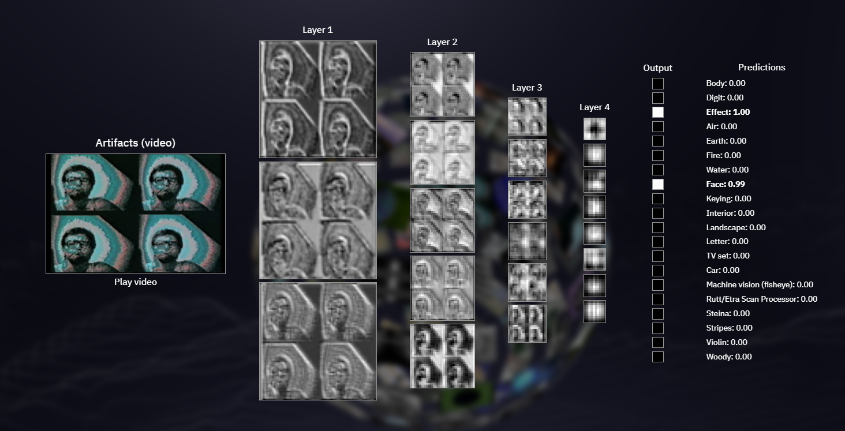
Vasulka Live Archive: how we proceeded
Web / Machine Vision (level 2) : https://vasulkalivearchive.net (Inspired by the Activation Atlas)

Slide 31
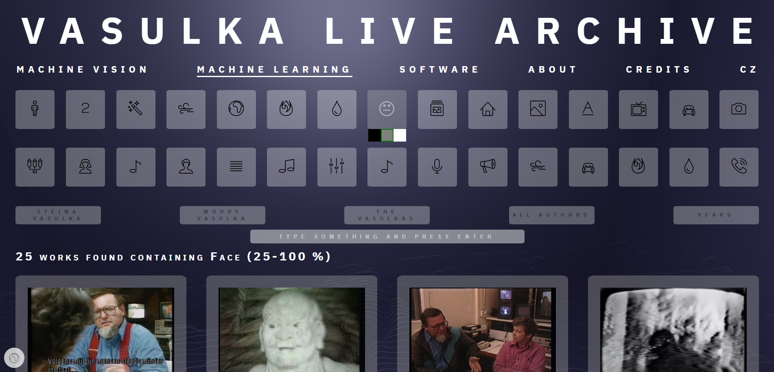
Vasulka Live Archive: how we proceeded
Web / Machine Learning (level 1) : https://vasulkalivearchive.net/Video

Slide 32
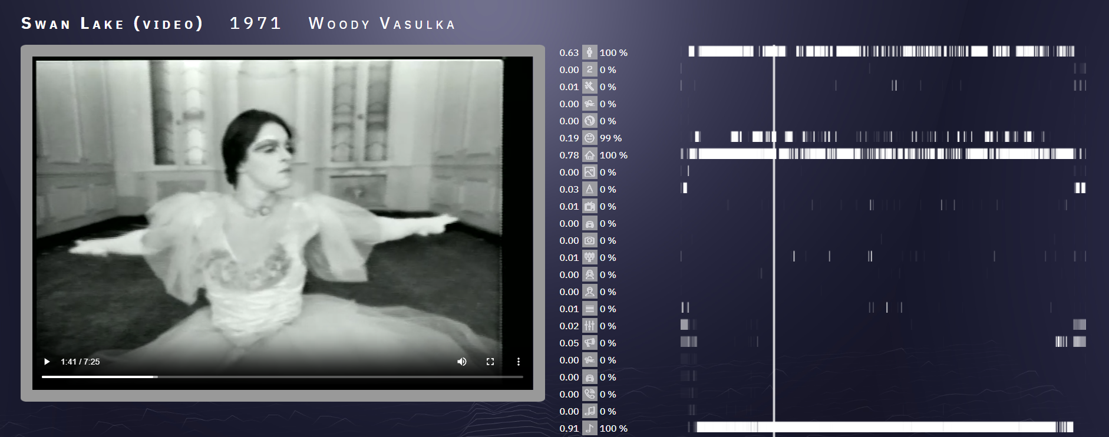
Vasulka Live Archive: how we proceeded
Web / Machine Learning (level 2): https://vasulkalivearchive.net/Video/Play/Swan%20Lake%20(video)?searchText=swan%20lake

Slide 33
What can we learn about Vasulkas videos by using this intelligent epistemological tool?

Slide 34
What new can we learn about Vasulkas videos by using an intelligent epistemological tool?
Test 1: Abstraction scaling (inspired by Peter Weibel)
Visual signs
Acoustic signs
Results:
The results of this test confirmed that it is necessary to teach the intelligent software for analysis of video art to quantify the degree of transformation (or the level of abstraction) of the image and/or sound (see P. Weibel, 5 attributes of video art). Moreover, it has proven that the study of the artistic videos cannot be reduced to the visual components, but their characteristic features must be searched for within acoustic components of the videos too.
 | 1-100 | 25-100 | 50-100
Effect | 108 | 40 | 22
Effect + Rutt/Etra | 34 | 9 | 7
 | 1-100 | 25-100 | 50-100
Noise | 112 | 61 | 38
Noise + Effect | 99 | 54 | 33

Slide 35
What new can we learn about Vasulkas videos by using an intelligent epistemological tool?
Test 2: Measuring narcissism (inspired by Rosalind Krauss)
Visual signs
Acoustic signs
Results:
The test showed that people (Bodies, Faces) are often represented in the Vasulkas videos, but not necessarily the authors themselves. Thus, it did not confirm that video serves as a mirror (narcissistic feedback loop) to artists, rather it showed that it is used as a tool for creating video portraits in general. In addition, the results raised the question of whether the concept of "narcissism" of videos should also extend to the audio aspects of these audiovisual works, as the acoustic representation of artists in videos occurs to a large extent.
 | 1-100 | 25-100 | 50-100
Body | 60 | 26 | 6
Body (Woody) | 17 | 10 | 2
Body (Steina) | 21 | 13 | 2
Face | 50 | 25 | 11
Face (Woody) | 16 | 4 | 1
Face (Steina) | 21 | 11 | 4
 | 1-100 | 25-100 | 50-100
Speech | 50 | 22 | 16
Speech (Woody) | 14 | 10 | 8
Speech (Steina) | 19 | 3 | 1

Slide 36
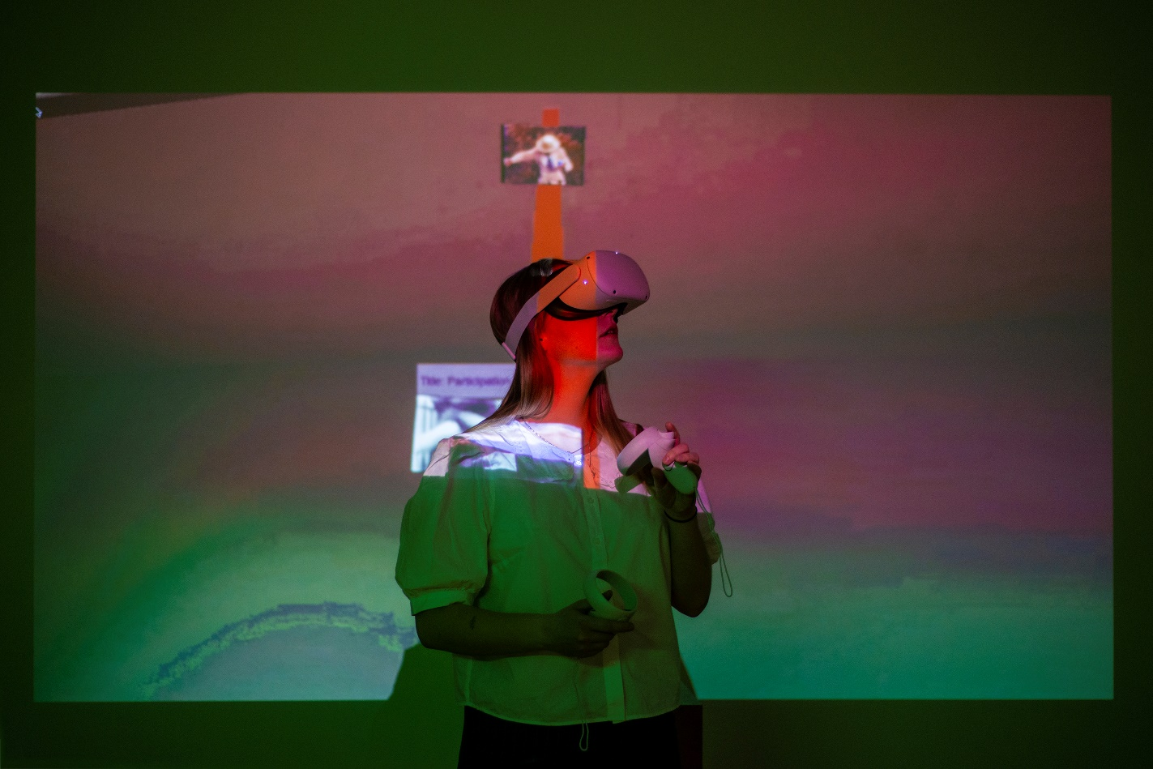
Conclusion: VasulkaLiveArchive.net the intelligent epistemological tool
The Vasulka Live Archive is an intelligent epistemological tool, which enables an exact examination of the intertextual structural and motivic relationships in the work of the Vasulkas.
The results of applying machine learning to Vasulkas' videos showed that artificial intelligence (CNN), when properly trained for specific tasks, is not only useful for automated search and sorting of data set / archive, but it can also provide new data-driven insights into an aesthetics of video art.
Emily L. Spratt named the method „augmented iconology“.

Slide 37
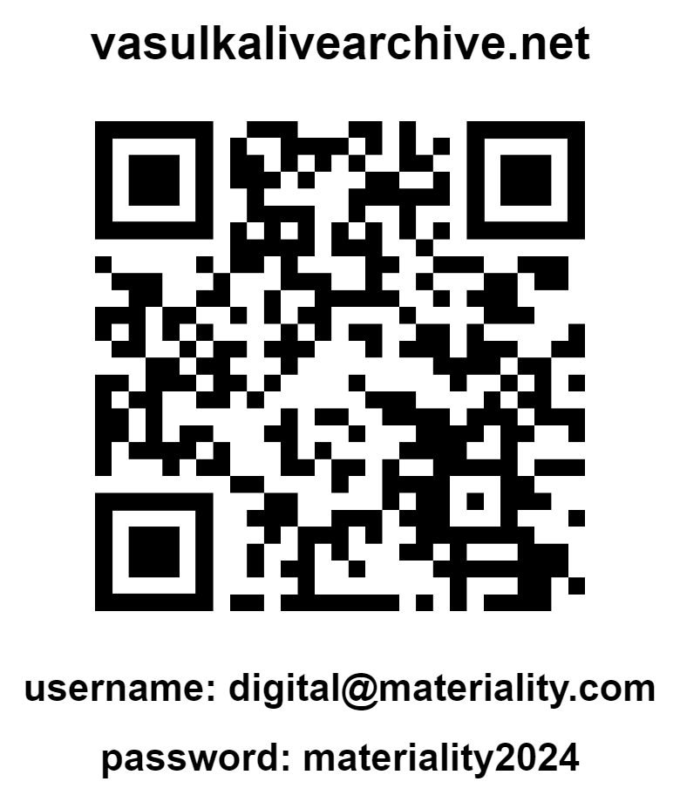
Thank you for your attention.
VasulkaLiveArchive.net
How to cite:
HORÁKOVÁ, Jana, Jiří SCHIMMEL, Pavel SIKORA, Štěpán MIKLÁNEK, and Dušan BAROK. (2021) Vasulka Live Archive [online]. Brno: Masaryk University [cit. year-month-day]. Available from: vasulkalivearchive.net
E-mail:
horakova@phil.muni.cz
stepan.miklanek@vut.cz

Slide 38
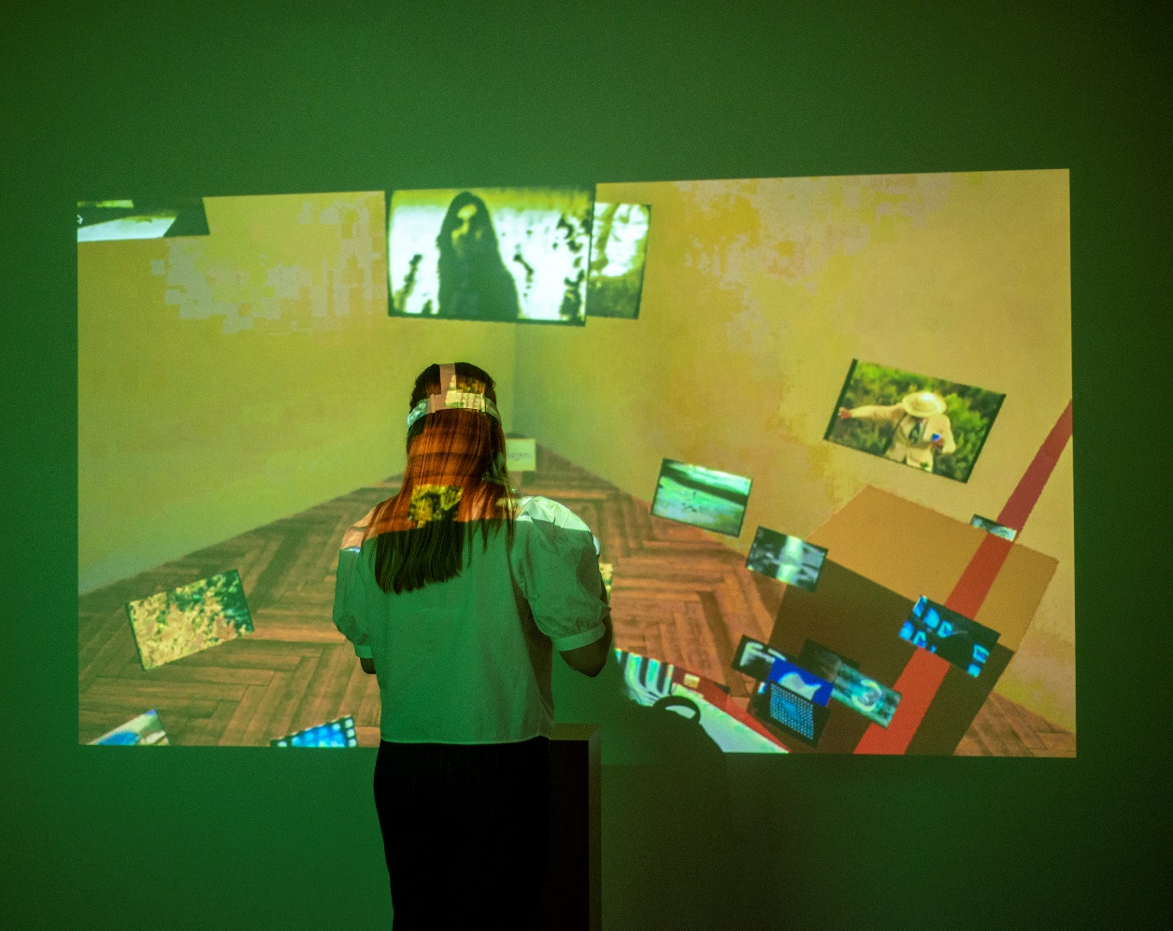
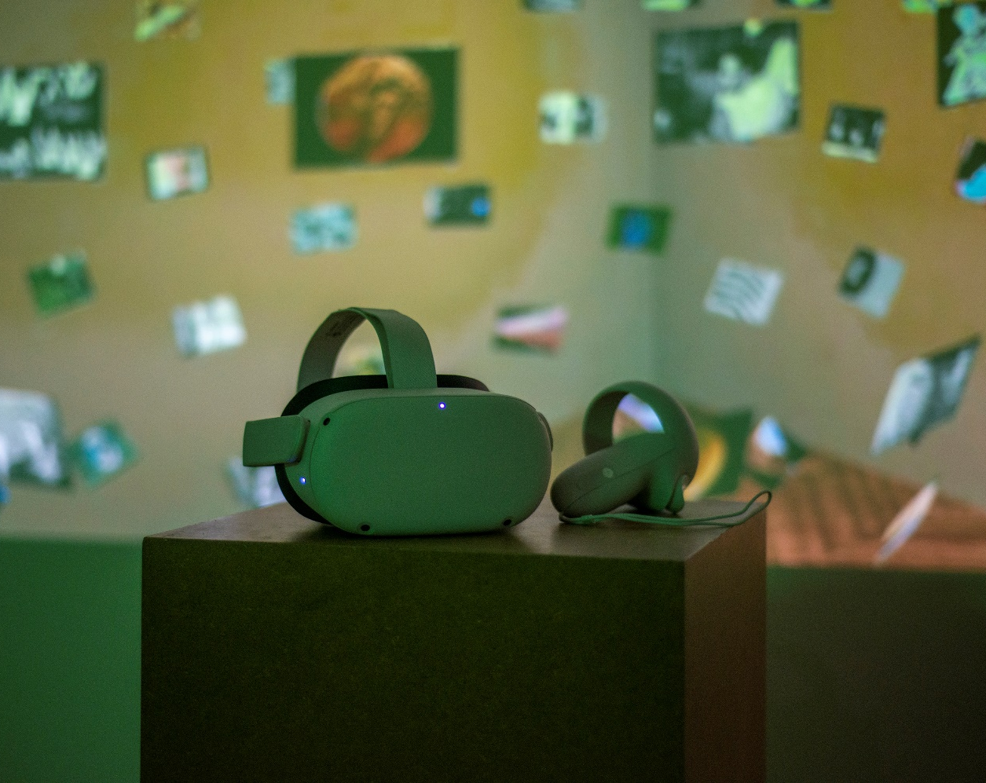
VR Vasulka Live Archive

