Slide 1
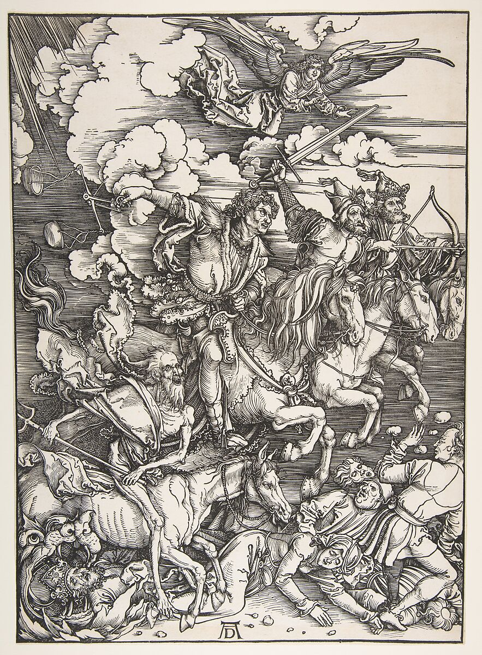
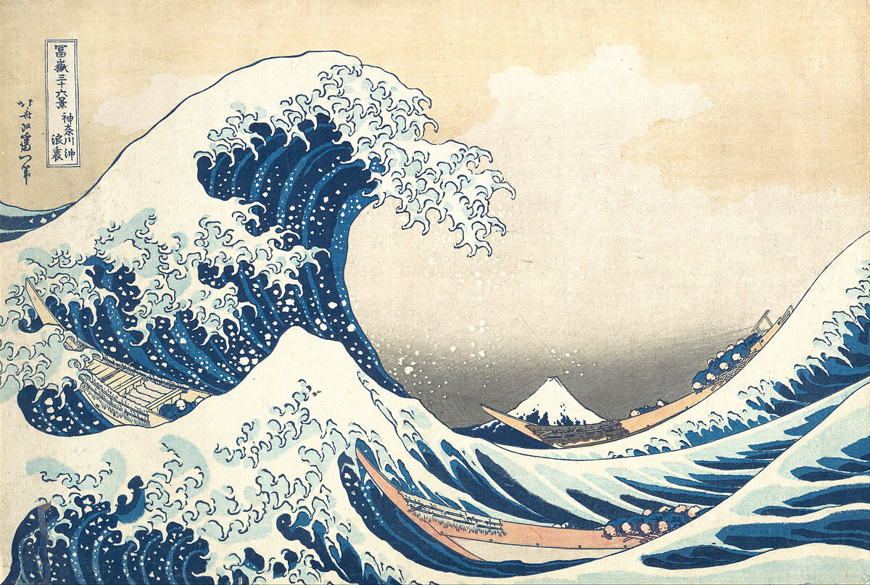
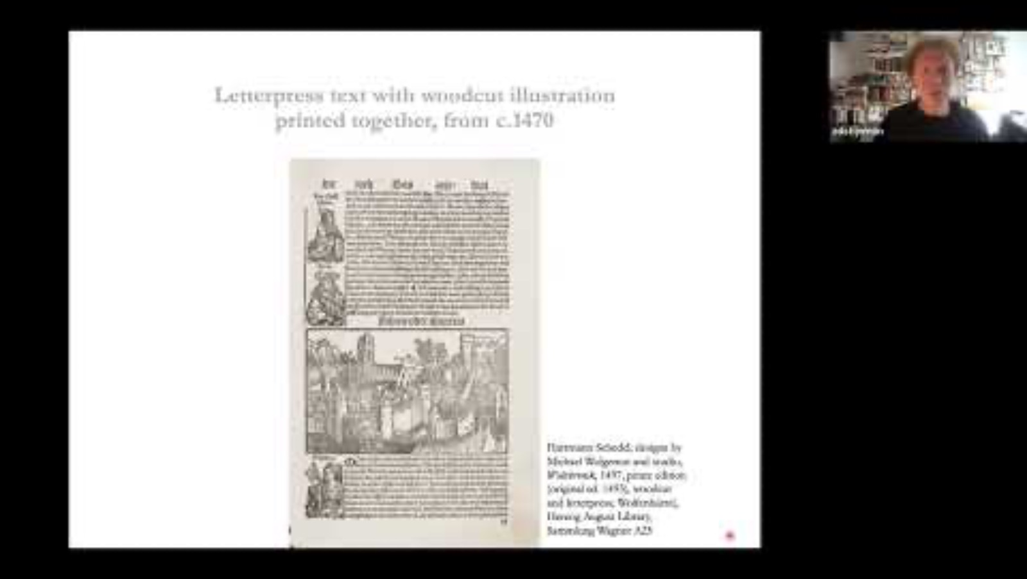
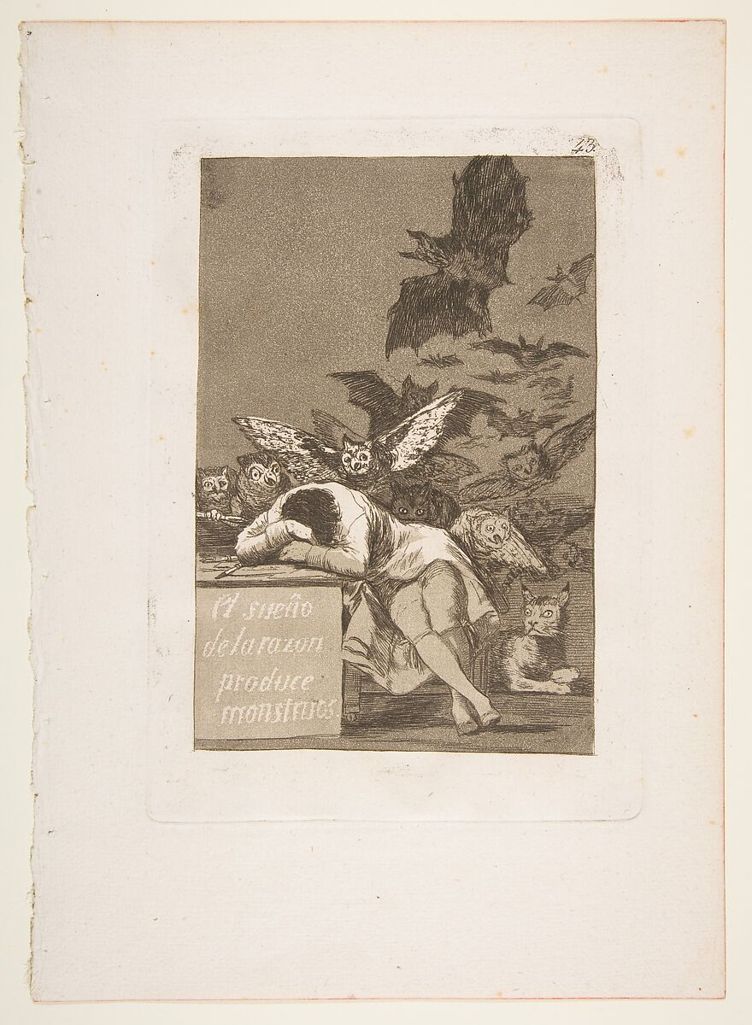
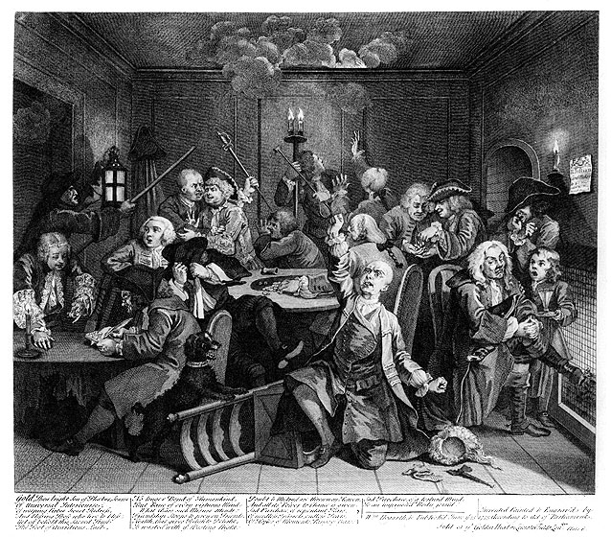
A Concise History of Prints & Printmaking Techniques up to 1800
techniques & what they represent matters!
Notes:
Use of print for a new public sphere – one that is embedded in processes of modernisation, but seems to be working outside it
Forging its own public – the ‘popular as a shifting concept’

Slide 2
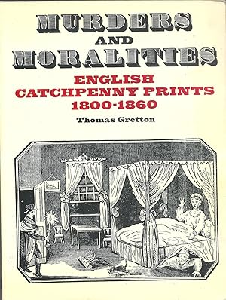
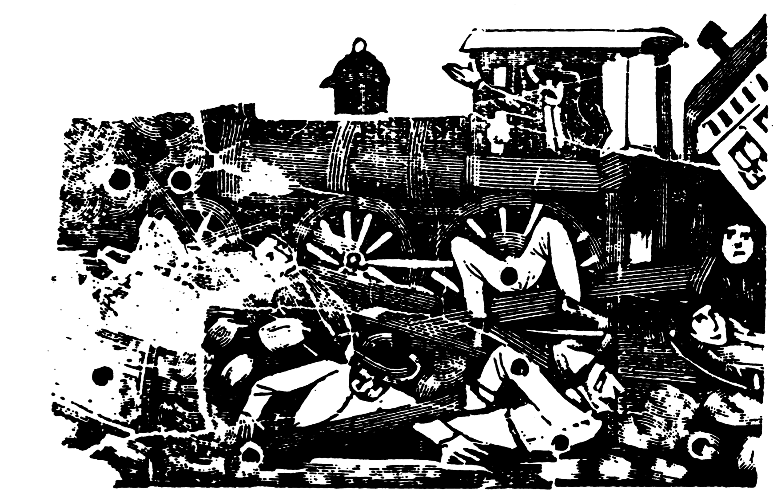
The Catchpenny Print
Gretton, Thomas. “Posada and the ‘Popular’: Commodities and Social Constructs in Mexico before the Revolution.” Oxford Art Journal 17, no. 2 (1994): 32–47. http://www.jstor.org/stable/1360573.
Corrido del descarrilamiento de Temamatla (Ballad of the Temamatla Derailment). Undated – printing blocks are probably all from the 1890s.
Murders and moralities : English catchpenny prints, 1800-1860. Compiled by Thomas Gretton, 1980.
Notes:
Use of print for a new public sphere – one that is embedded in processes of modernisation, but seems to be working outside it
Forging its own public – the ‘popular as a shifting concept’

Slide 3
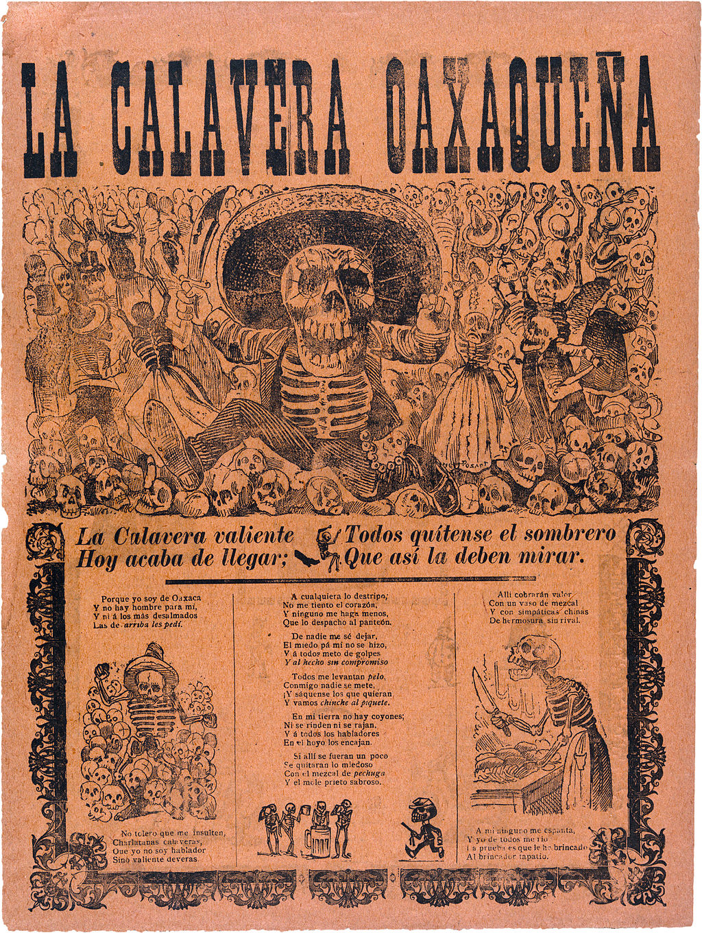
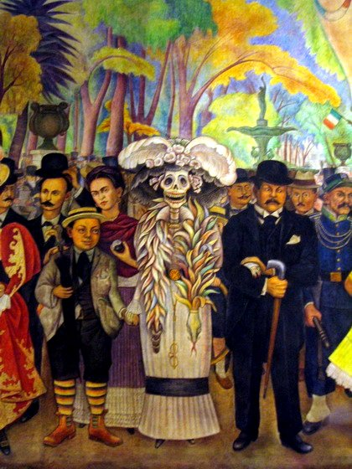
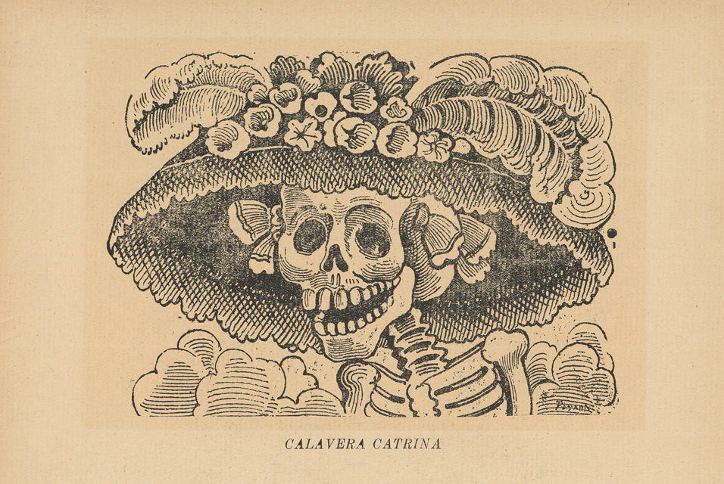
Calavera de la Catrina (Skull of the Female Dandy), from the portfolio 36 Grabados: José Guadalupe Posada, published by Arsacio Vanegas, Mexico City, c. 1910
Diego Rivera, Sunday Afternoon in Alameda Park (mural) (1946–1947)
José Guadalupe Posada, Calavera oaxaqueña, 1903
Notes:
Mythmaking & superstitions in modern culture
Its adaptations and broader significance

Slide 4
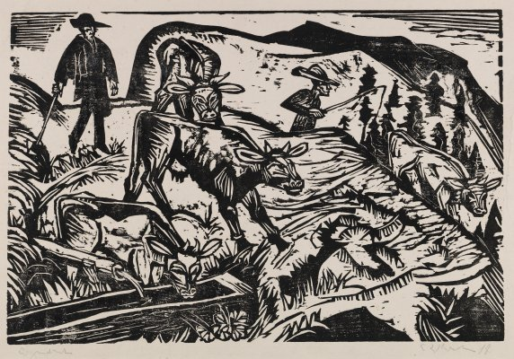
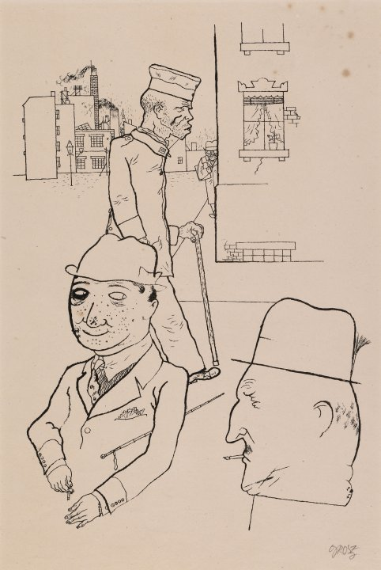
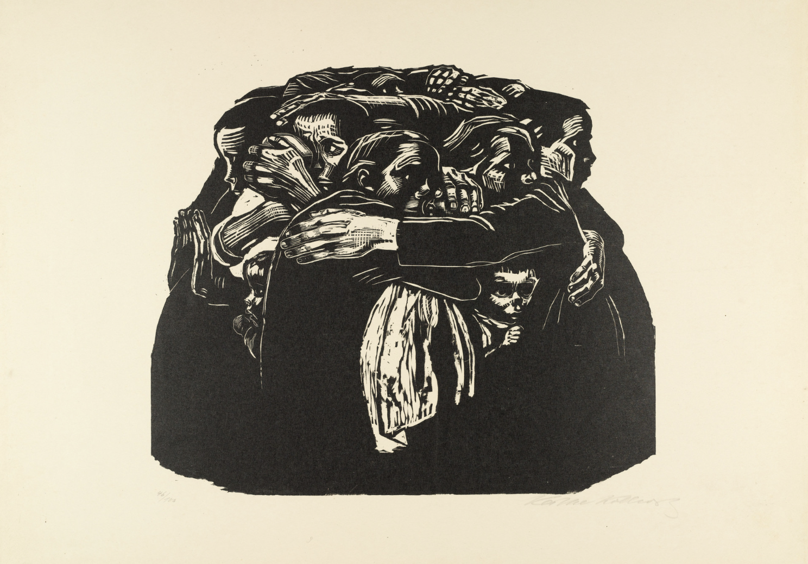
PRINT & MODERNISM
George Grosz, Bright Eyes, 1922–1924
Ernst Ludwig Kirchner (German, 1880-1938).Cows Descending, 1917. Woodcut.
Käthe Kollwitz. The Mothers (Die Mütter) from War (Krieg). 1921–22, published 1923.
Notes:
- Similar application can be found across modernist movements – woodcut revival, but also lithographs, drawings and etchings

Slide 5
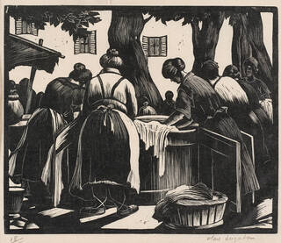
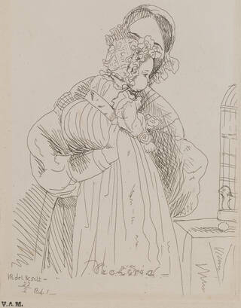
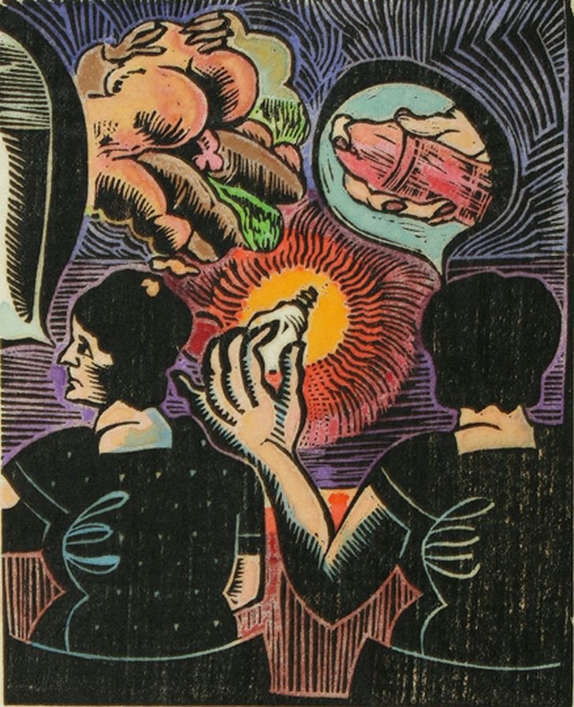
WOMEN & PRINT
Toulon Washerwomen, wood engraving, by Clare Leighton, about 1920s, Britain. © Victoria and Albert Museum, London
Print depicting Princess Victoria, by Victoria, Queen of Great Britain, 1841, England. © Victoria and Albert Museum, London
Auguste Kronheim, Series – Bright as bright day (series), 1970s.

