Slide 1
Aboriginal tools and skills
Josef Eliáš
383147

Slide 2
1 Hunter-gatherer
2 Tools and technology implements
3 Woomera/a spear thrower
4 Spears
5 Boomerangs
6 Tracking
7 Other skills

Slide 3
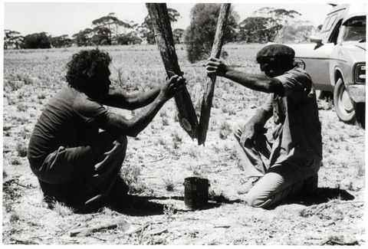
Hunter-gatherer
Tribes along the coast and rivers expert fishermen, inlanders (bush, desert) hunting/fire hunting, skilled in seeking out water
Fire hunting - burning the undergrowth to encourage the growth of plants favoured by the game they hunted
Men hunt large animals (kangaroos, emus), flying animals (bats, birds)
women the smaller ones (snakes, goannas, insects,see next. page),
also collect food

Slide 4
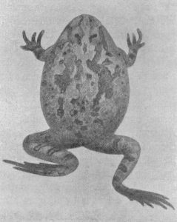
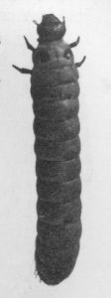
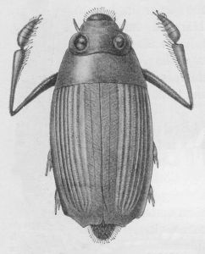
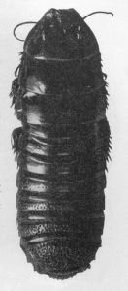
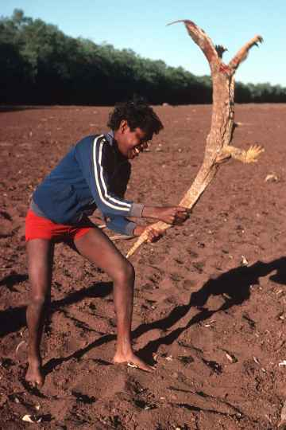
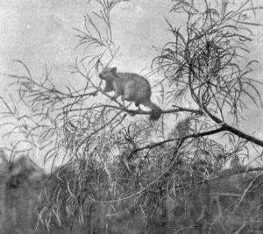
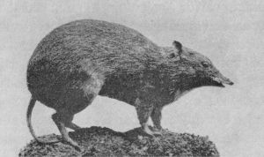

Slide 5
Tools and technology implements
Aboriginal people the first with stone technology
- also the first with ground edges on cutting tools and grinding seeds
Tools and implements – geographical locations – materials: coastal tribes use fishbone tips, desert tribes use stone
The most common weapons – spears, clubs and boomerangs
The tips tied on with animal sinews or glued on with resin
After the English colonization adopted metal, glass and ceramics

Slide 6
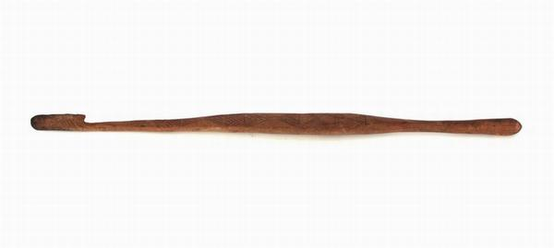
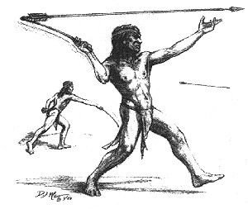
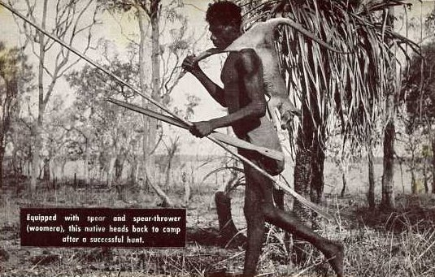
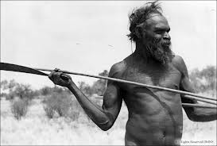
Woomera / a spear thrower
an extension of the thrower's arm
A woomera and spear were the fastest weapons in the world before the invention of the self-loading rifle (Eric Willmot).
multipurpose tools - + stone cutting tool / axe-like attachment = hunt, chop firewood, cut down branches to make a shelter or chop up meat; making fire

Slide 7
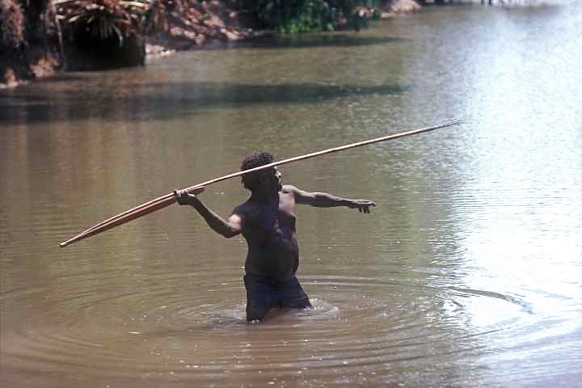
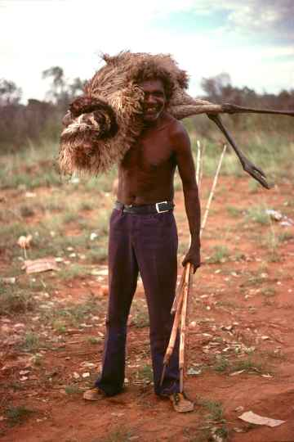
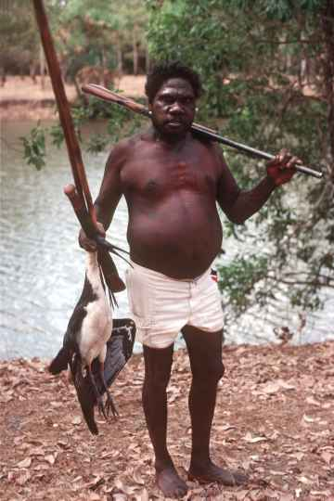
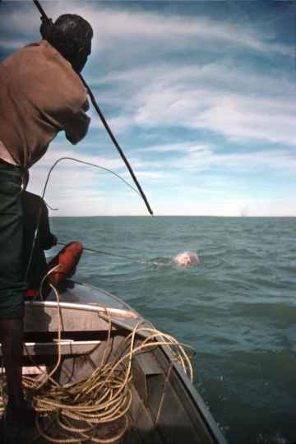
hunting a crocodile
…an emu
…an ibis
and a dugong.

Slide 8
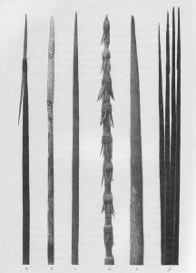
Spears
Large animals - strong hardwood
Fishing spears from lighter materials, often barbed
Spears for hunting birds of light wood, also boomerangs
Fighting spears – hard wood, barbed
Spears and boomerangs used almost exclusively by men

Slide 9
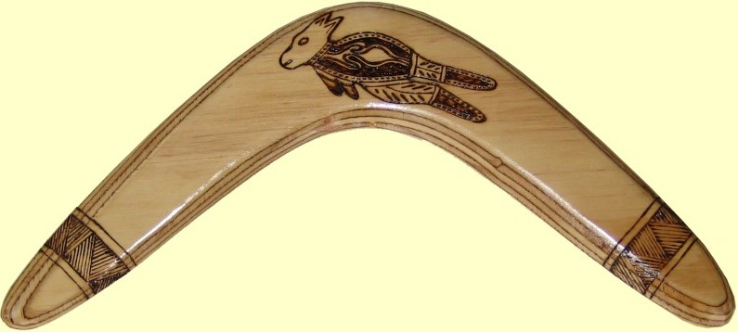
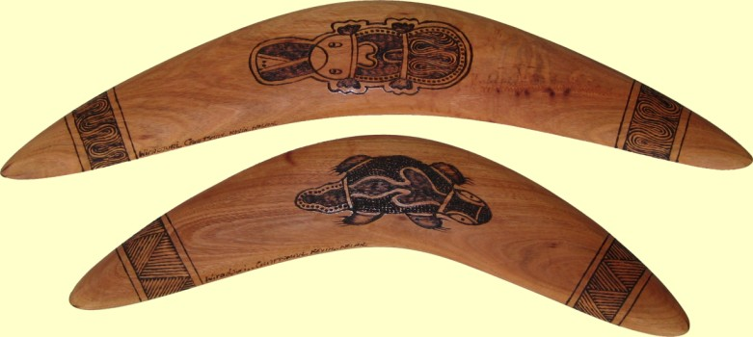
Boomerangs
Use – hunting and fighting, digging and as a music instrument
Non/returning boomerangs (non-returning larger, heavier, deadlier)
boomerang in action

Slide 10
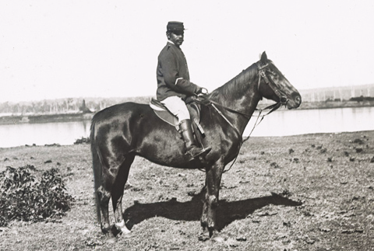
Tracking
GW Wilson 'Aboriginal tracker', an Aboriginal policeman of the late nineteenth century. National Library of Australia.
a knowledge passed down through generations, taught from early age
primarily men-hunters, but also women-hunters/gatherers
identifying the tracked – worth following? (if animal is dying, carrying a baby, skilled trackers can tell if a snake is poisonous
Aboriginal trackers – ‘exploration guides’, trackers of runaway convicts

Slide 11
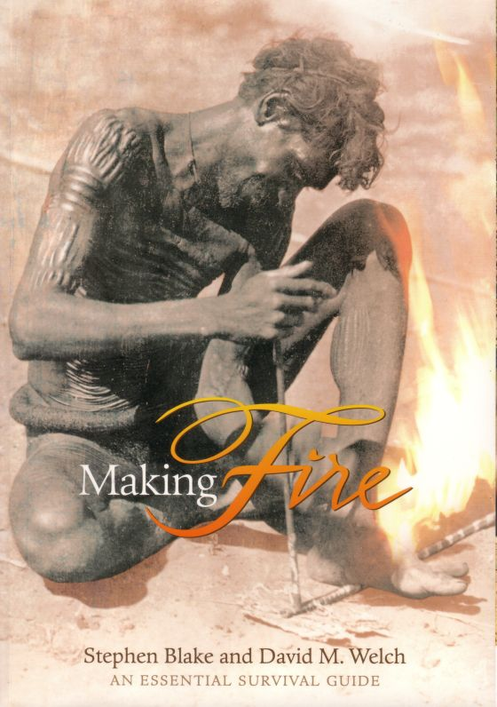
Other skills
starting fire with sticks and tinder
Traditional people also use fire to bend or straighten timber, or to make it harder.
Fire hunting

Slide 12
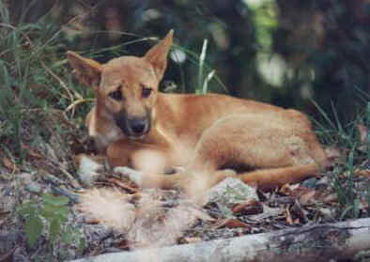
Thank you for your attention

Slide 13
Sources:
http://www.survivalinternational.org/tribes/aboriginals
http://www.ozoutback.com.au/Australia/hunting/index.html
http://www.aboriginalculture.com.au/toolsandweapons.shtml
http://australia.gov.au/about-australia/australian-story/austn-indigenous-tools-and-technology

