Slide 1
The Problem of History
Can we study past religions experimentally?
It is sometimes said that, because the past is gone for good, CSR is of no help: experiments can only be done in the present and therefore only illuminate us about present human thought and behavior
There is some wisdom in this claim, but the problems are not insurmountable
I hope to show why this is the case

Slide 2
Experimental protocols
All experiments start with a problem to be solved: why and how
A hypothesis to test
A protocol (or procedure) to test the hypothesis
And a knowledge of statistics to test the results (This is one place where friends with knowledge of stats can be a great help!)

Slide 3
Four disciplines study the past
History (the study of information from the past, primarily texts, but also relevant artifacts)
Archaeology (the study of human artifacts from previous eras)
Paleontology and Geology (the study of the history of the earth and its many inhabitants from its very early beginnings)
Cosmology (the study of the very distant past e.g. the origins and development of the universe)

Slide 4
Interpretation and Explanation
All of these disciplines employ scientific methods to a greater or lesser extent
All of these disciplines involve both interpretation and explanation (See RR chapter 1)
“Interpretation” in the sense that every inquirer chooses what kind of information to take into consideration, i.e. what will be of value for the study
“Explanation” in the sense that causal factors need to be identified by the methods employed in order to make sense of the information

Slide 5
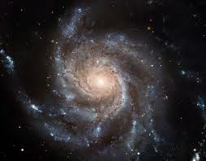
Cosmology

Slide 6


Slide 7
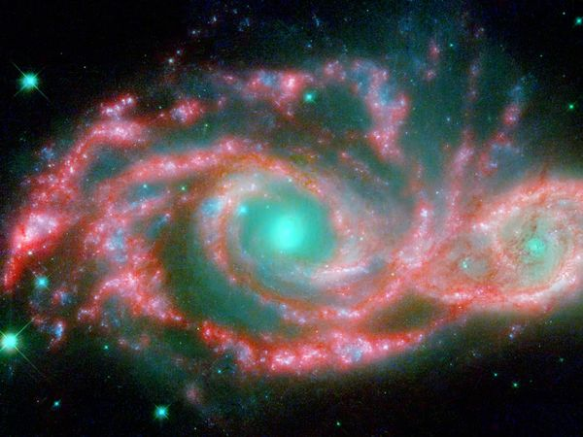

Slide 8
The science of cosmology
Astrophysicists have done many clever things: They first had to measure the speed of light
Then on the basis of the “red shift factor” they were able to determine how far away stars and galaxies were and whether they were moving towards us or way from us
Colliders continue to make discoveries about the origin, structure and development of the universe
Some of their ideas are still highly theoretical (such as string theory”, others, such as the Higgs boson have been confirmed by experiments using the LHC

Slide 9
The point is that they are successfully studying and explaining events that happened billions of years ago!

Slide 10
Paleontology and Geology
Plate tectonics is just one example of a successful explanation of why we have mountains and why plants and animals are dispersed in the way that they are
Paleontologists and geologists are able to explain, by examining the various geological strata, both what earlier plant and animal forms were like and what their relationship to present forms and the period in which they existed

Slide 11
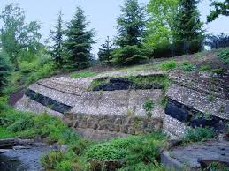
Geological Strata

Slide 12
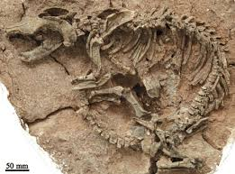
Dinosaur

Slide 13
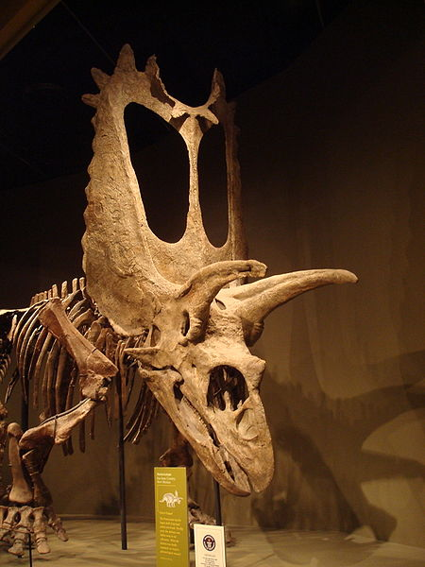
Pentaceratops

Slide 14
Archaeology
Archaeology focuses primarily on artifacts from the past and, therefore, is able to explain some of the features of particular kinds of human behavior (See Steven Mithen’s The Prehistory of the Mind)
Archaeologists interested in ritual behavior are discovering more and more ritual sites and make judgments about what went on in them

Slide 15
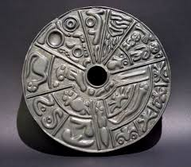
A treasure from the past

Slide 16
Cognition, Religious Ritual and Archaeology
McCauley and I have already shown how cognitive science in general and the cognitive science of religion in particular can contribute to an interpretation and explanation of artifacts from the past and can make a contribution to archaeology (See “Cognition, religious ritual and archaeology”) so I will not repeat those arguments here except to make the following point

Slide 17
Types of ritual
Although such studies are at a very early stage, archaeologists may be able to compare ritual sites in order to determine whether they were the locale for performing special agent, special instrument or special patient rituals.

Slide 18
Types of ritual (continued)
Special agent rituals are those rituals in which the gods are thought to act typically through intermediaries such as priests or other kinds of ritual officials
Special instrument rituals are those rituals in which the work for the gods is done, for example sacrifices and offerings
Special patient rituals are those rituals in which the gods are the recipients of the actions rather than the agents

Slide 19
Types (continued)
Special agent rituals are only performed once in the life of an individual and are infrequently performed
Special instrument and special patient rituals are performed many times in the life of an individual and are, therefore, frequently performed
Religions which have a balance between these kinds of rituals have longer survival rates than those that don’t (which is an historical question)

Slide 20
Archaeological methods
Archaeologists also employ rigorous methods such as carbon dating in order to determine the various times in which the artifacts were made thus opening up the relationship between various times.
They can even explain not only the transportation of artifacts from one place to another but also why they were transported

Slide 21
History
History is the study of human behavior in the past
The primary source of information is texts, but artifacts such as statues, grave markers, burial sites, monuments and so on provide further information
Some historians think that because the makers of these texts are dead it is hopeless to theorize about their minds, their cognitive processes

Slide 22
Incurable Optimism
Perhaps they are right and we are doomed to hermeneutics, the speculative interpretation of texts with the only possibility being the correlation of one texts with another
Cognitive historians have a different opinion
I will temporarily adopt the mantle of a cognitive historian and try to show how cognitive historiography in general and the cognitive science of religion in particular can make progress in reading past minds and explaining their behavior

Slide 23
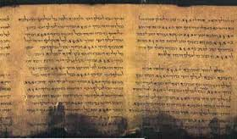
Dead Sea Scrolls

Slide 24
Retrodiction and undiscovered texts
Why did the discovery of the dead sea scrolls cause so much excitement among historians?
Because historians who were interested in explanations had expected that stories about the Messiah were more widespread than the extant texts showed and they retrodicted (predicted about the past) that new texts, if discovered, would show this.

Slide 25
Deja vu
So, you have a theory, a hypothesis (a retrodiction), a discovery which can either confirm or disconfirm the hypothesis, all of which can be analyzed statistically.
The next slide will look familiar!

Slide 26
Experimental protocols
All experiments involve dealing with a problem to be solved: why and how
A hypothesis to test
A protocol (or procedure) to test the hypothesis
And a knowledge of statistics to test the results (This is one place where friends with knowledge of stats can be a great help!)

Slide 27
Building a toolbox
So we now have the first tool in our toolbox: retrodiction
But that is only the beginning
Let us look at those texts which historians want to interpret but resist explaining in cognitive and evolutionary terms

Slide 28
More tools
Let us look at those texts (the historians data)
What kinds of information do they contain
Do they have moral injunctions?
Do have rules for behavior?
Do they give us information about who is or is not part of the group?
Do they have descriptions of rituals?
Do they talk about the gods, ancestors, demons etc.?

Slide 29
Relevant Themes
Do they talk about an after-life?
Do they talk about birth, death, love, initiation, mate choice, threats, danger?
If they talk about any, some, or all of these things then we already have a large amount of information about their cognitive capacities, environmental and socio-cultural triggers, which are the very features that provide data for cognitive scientists and cognitive historians and suggest hypotheses about ancient minds

Slide 30
A basic assumption
Given the theory of evolution and the processes of natural selection, while the socio-cultural conditions under which we now live are quite different the mind, biologically and cognitively we are still in the Paleolithic period. There has not been enough evolutionary time for any significant changes in either our bodies or our basic capacities
However see the notion of “the extended mind”

Slide 31
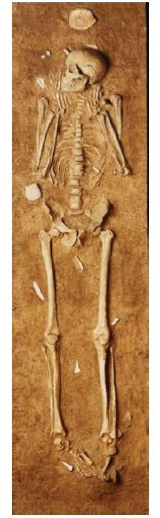
A dead man from the Paleolithic period

Slide 32
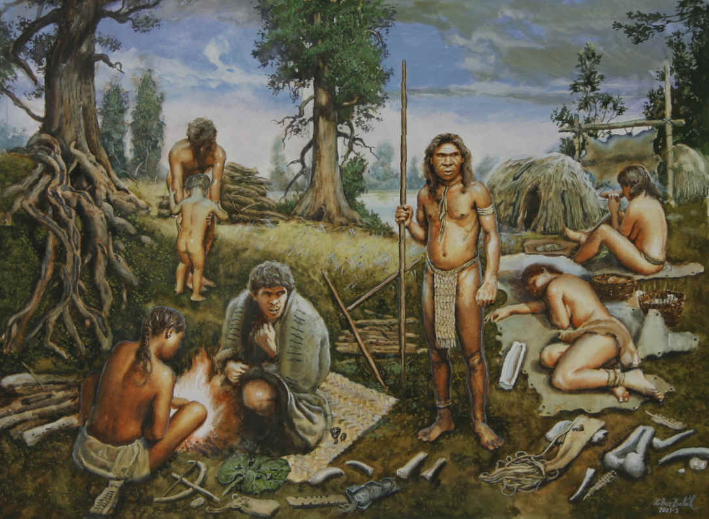
Rock and Roll!

Slide 33
Ritual theory
Now, if we have the information that we asked questions about, from much later than the Paleolithic era, and on the assumption that our capacities have not changed, then we already know much about these figures from the past
We know that they thought in either hierarchical or non-hierarchical terms, that they made esthetic and moral distinctions, that they had rules for ritual behavior, that they had ceremonies marking birth, copulation and death

Slide 34
In fact they behaved in much the same way as we do, and when our behavior differs from theirs it is because the contextual situations which evoke our cultural behavior can be dysfunctional rather than serving the earlier functions for which evolution designed them
  (See Dan Sperber’s discussion of proper and actual domains in “ Explaining Culture”)

Slide 35
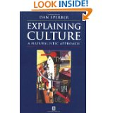
Worth Reading!

Slide 36
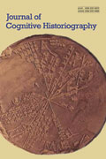
New Journal

Slide 37
A New Journal
The Journal of Cognitive Historiography puts into practice the ideas about which I have been talking
That is a mark of scientific progress in the study of history

Slide 38
And this is where you enter the picture
Those of who wish to apply the insights of the cognitive science of religion to the past will need to begin to do case studies
There is lot of work to do!

Slide 39
This is not the end, it is not even the beginning of the end
Happy studies!

