Slide 1
SPANISH ENGLISH
TEREZA NOŽIČKOVÁ

Slide 2
Adding /ə/ or “epenthetic” vowel
SCHWA SOUND BEFORE WORDS BEGINNING WITH /S/ + ANOTHER CONSONANT -> DEFORMATION OF RHYTHM AND INTONATION
STOP; SPEAK; SNEAK

Slide 3
Substitution
SPANISH LETTERS ARE WRITTEN AS PRONOUNCED
BAD INTELLIGIBILITY
The schwa sound /ə/
Responsib(ə)le; Personality; Vegetab(ə)les; stationary etc.
The vowel /æ/ for /a/ or /ɑː/ or /e/
substitute vowel /æ/ for /a/ or /ɑː/
Have; Cat; Fat; Rat; plaid; apple; advertising

Slide 4
Confusion of /i/ and /ɪ/
when they see the letter [i]
/i/: Need; read; treat; believe; meat; wheel
/ɪ/: Knit; rid; tit; live; mitt; will
/ɑː/
Tendency to shorten vowels
/ɑː/ replaced with /ɔ/ or /ʌ/
Robot; caught; call; mall
/u:/ and /ʊ/
/u:/: Room; tooth; food
/ʊ/: Book; put; foot; hood;

Slide 5
/oʊ/
Learners have to pronounce a vowel /ɔ/ and a consonant /w/ -> Spanish learners leave the vowel out
Wrote; old; boat; coat
/eɪ/ and /aɪ/
omitting the /j/ altogether at times or mispronounce the vowel preceding it whether it happens to be /e/ or /a/
/eɪ/: Name; date; wait; train
/aɪ/:right; fight; side; light; tried
/θ/ & /ð/
Palatalization to /t/ and /dú

Slide 6
/m/
no problem pronouncing this consonant when it’s in the beginning of the word as in [miss] or [mister] but when it occurs in the end of the word -> /n/
Dream; rhyme; fame; William
/n/ & /ŋ/
Problems with /n/ in the beginning or middle of the word -> tendency to use /ŋ/ instead
While with – ing -> tendency to use /n/
/n/ (beginning and middle): name; knight; north; listener
/n/ (end): corn; thin; pen; can; listen

Slide 7
/r/
Spanish /r/ with sound vibration
Voiced Vs. Voiceless
/z/ + vowel as in [zero] which is pronounced as /si:roʊ/
/s/ + consosnant as in [sleep], which is sometimes pronounced as /zli:p/
the final [s] in the word as in [please] – big problem
not only /s/, it also affects /f/ and /v/, /k/ and /g/, /t/ and /d/, /tʃ/ and /ʤ/, /∫/ and /ʒ/, /p/ and /p/ and finally /θ/ and /ð/

Slide 8
Voiced and Voiceless
/z/: zero; please; is; rise; hazard; hazel;he’s ill etc./f/ and /v/: five and “fife”/k/ and
/g/: log and lock/t/ and /d/: kid and kit
/tʃ/ and /ʤ/ (especially at word endings): bridge and breach
/∫/ and /ʒ/: usually and “ushully”
/p/ and /p/: Bob and bop
/θ/ and /ð/: with and width

Slide 9
/j/ & /ʤ/
Word starting with /j/ becomes /ʤ/ and sometimes /dj/
Words starting with /ʤ/ becomes /j/
/j/: yes; yell; yet; you; University
/ʤ/: John; germs; job;gel; jewelry
/w/
when it precedes vowel /ʊ/ as in [would] -> tendency to insert /g/ before /w/ which makes [would] sound like [good]
/w/: would; wood; wool; wolf; womb
/v/
when producing /v/, the result is /b/
/v/: over; oval; rove; novel; hover; drove
but alsoProve; move

Slide 10
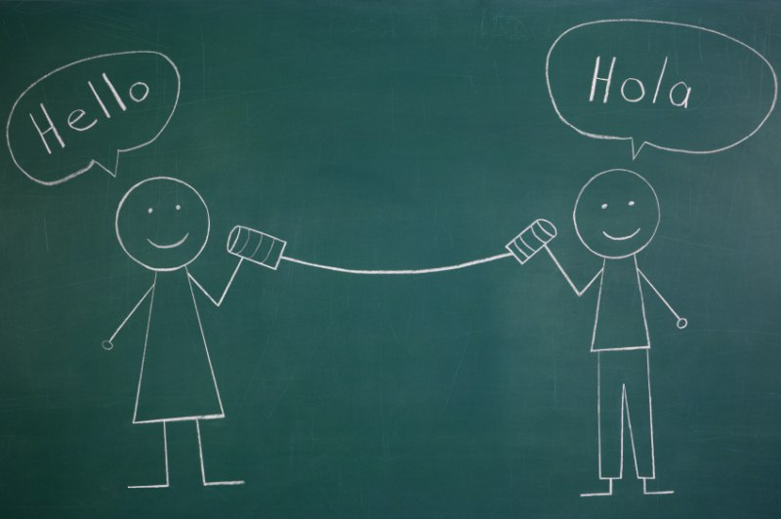
https://www.youtube.com/watch?v=zCgDSNkzjEg

Slide 11
SOURCES
http://englishspeaklikenative.com/resources/common-pronunciation-problems/spanish-pronunciation-problems/
http://edition.tefl.net/articles/teacher-technique/spanish-speaker-pronunciation-problems/
https://www.youtube.com/watch?v=zCgDSNkzjEg

