Slide 1
Learning Phonetics and Phonology with smart apps
Roman Kálecký
UČO: 426554

Slide 2
Segmental features
Sounds
Speach Trainer 3D
Suprasegmental features and accents
Speak English
SpeakAP
Accentuate!
The Real Accent: USA
All information, data and pictures are retrieved from the official
iTunes/Google Play descriptions.

Slide 3
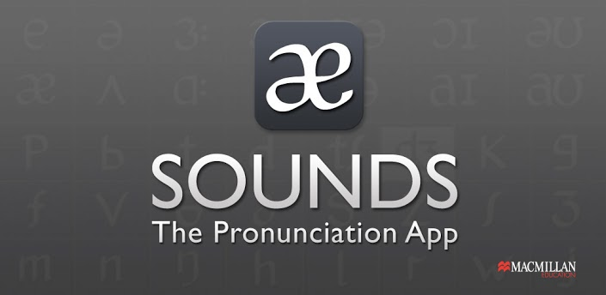



Sounds

Slide 4
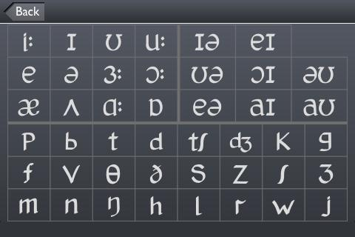
The ultimate mobile English pronunciation aid, for both students and teachers. Sounds: The Pronunciation App helps you study, practise and play with pronunciation wherever you are. This free version includes Interactive Phonemic Charts for British English and American English. Tap to hear a sound, or tap and hold to hear the sound and an example word.

Slide 5
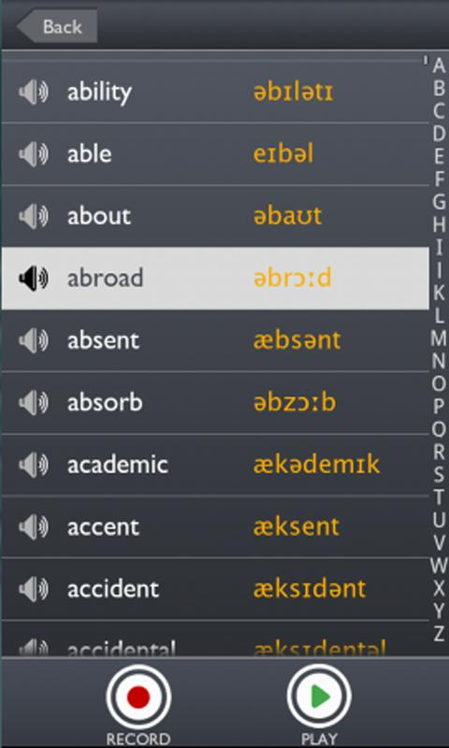
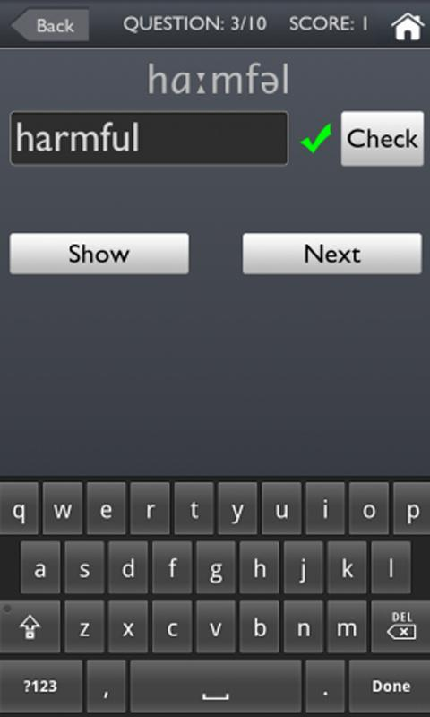
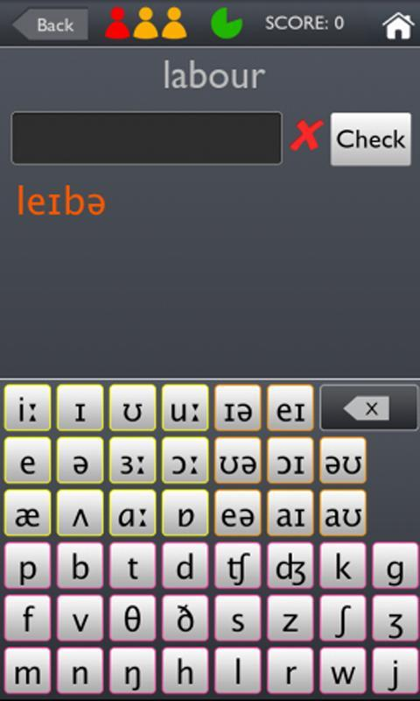
In the Premium version you can look up, listen to and record words in the wordlist, practise your pronunciation skills, test yourself with the pronunciation quizzes and learn with Top Tips, videos and more.

Slide 6
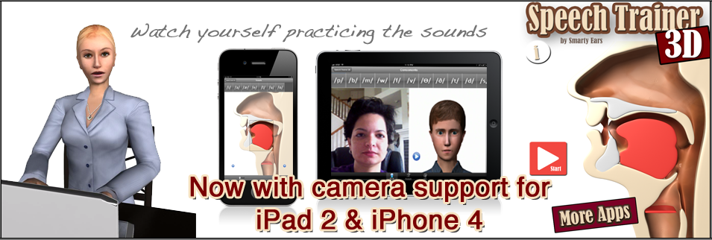

Speech Trainer 3D

Slide 7
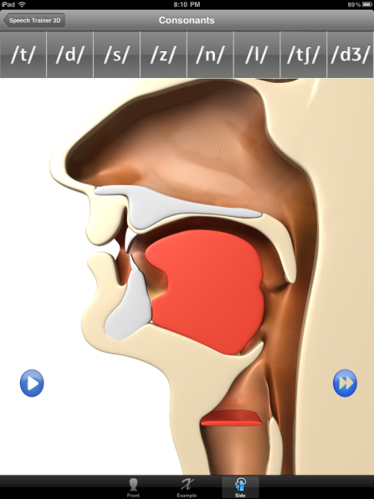
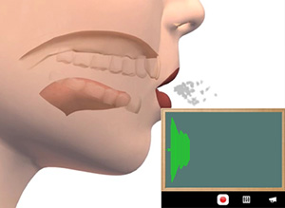
Speech Trainer 3-D is a unique application created specifically to help individuals with speech-sound disorders and English language learners. It provides an animated video model, with both side and front view, of 32 English language sounds: 23 consonants and 8 vowels.

Slide 8
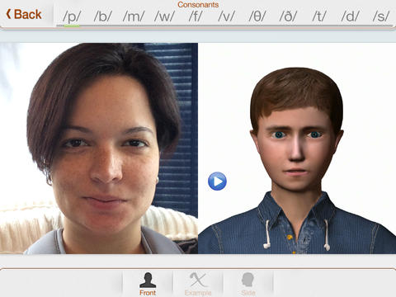
In addition to the animated video model, Speech Trainer 3-D uses the camera function built into the iPad 2 and higher to allow the learner to see a side-by-side picture of the model and his or her own face making the sound.

Slide 9

Speak english

Slide 10
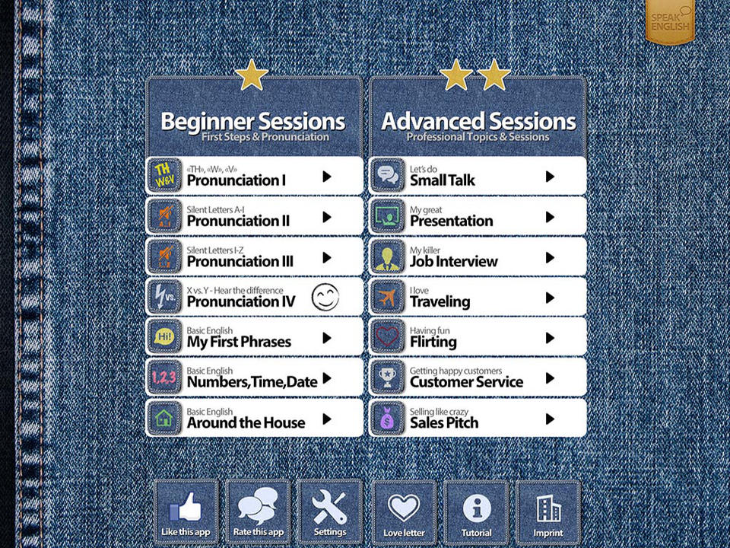
Speak English is an app which helps you to improve your English speaking skills naturally and easily. You can train your pronunciation, fluency and learn some great phrases and vocabulary.

Slide 11
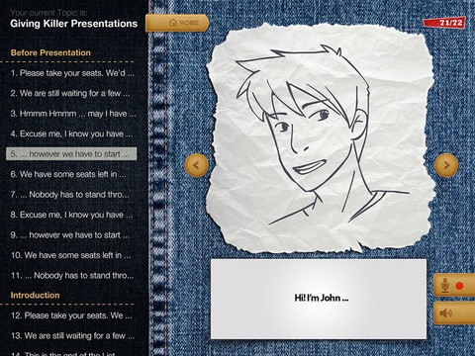
1. It reads a phrase to you. (Listen to it as often as you like)
2. Repeat the sentence and record yourself
3. Play your recording back and compare your pronunciation

Slide 12
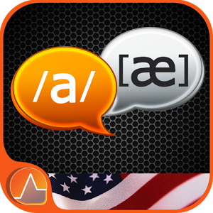
SpeakAP-Analyze Pronunciation

Slide 13
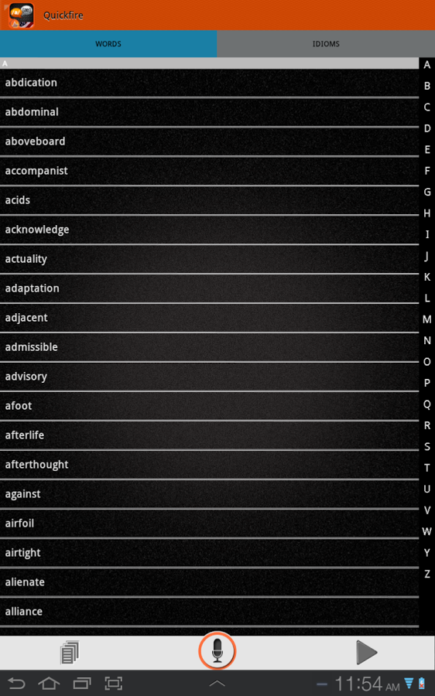
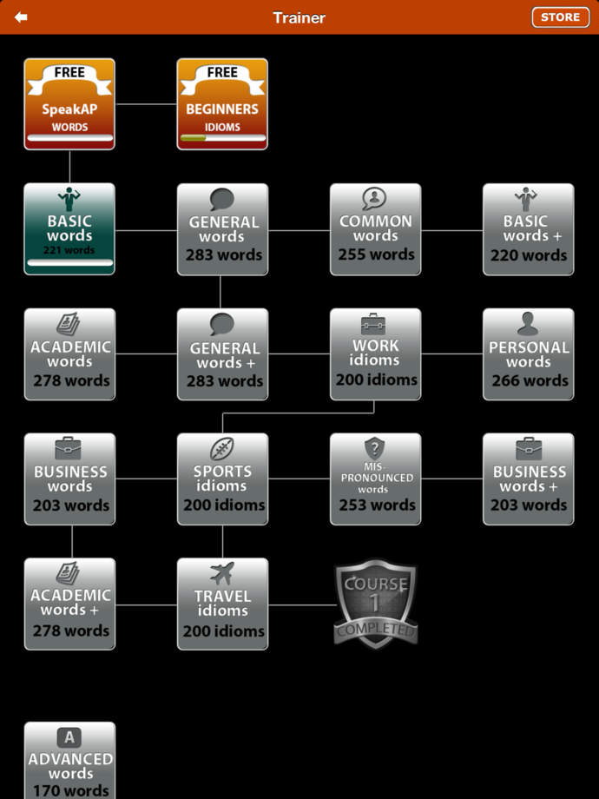
SpeakAP is a great American English pronunciation, accent and articulation learning application. It also includes over 6,800 unique words and over 2,200 idioms with reference pronunciation, description and usage.

Slide 14
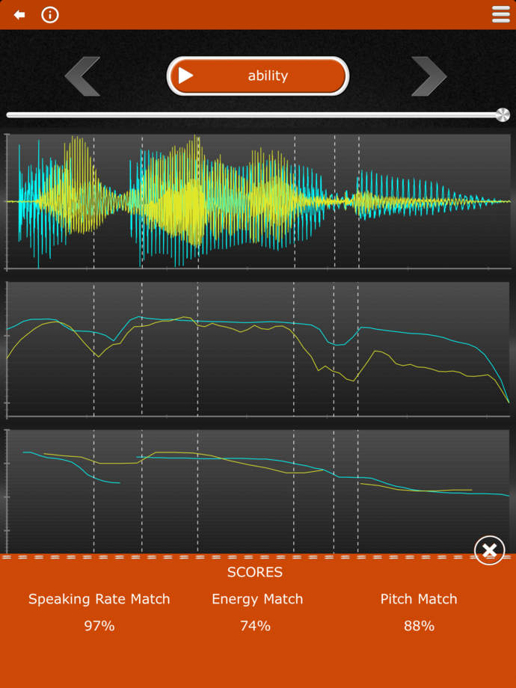
SpeakAP algorithms provide a similarity score for pitch, energy and speaking rate with visual depiction of the phonetic transitions marked on the waveform for easy learning. BioFeedback provides automated real-time feedback.

Slide 15

Accentuate!

Slide 16
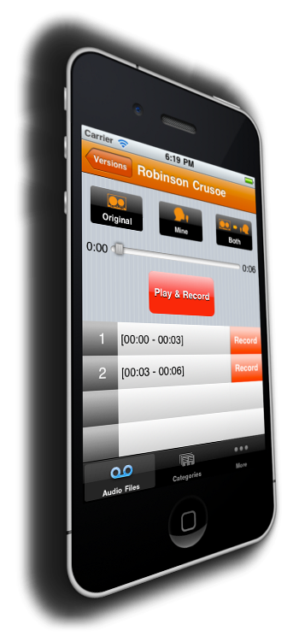
Accentuate is an app for aspiring actors, foreigners wishing to learn or correct an accent, people with speech impediments, or anyone who wants to learn an accent.
Learn by listening and repeating. Create different versions so that you can compare yourself to how you sounded in the past.

Slide 17
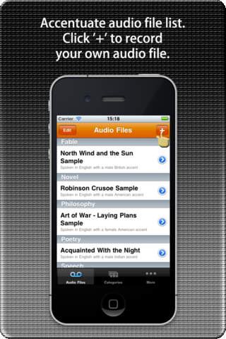
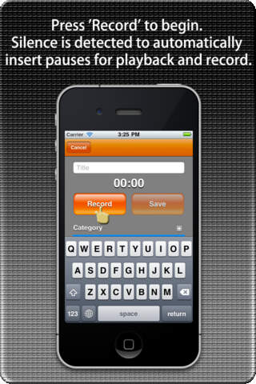

Slide 18
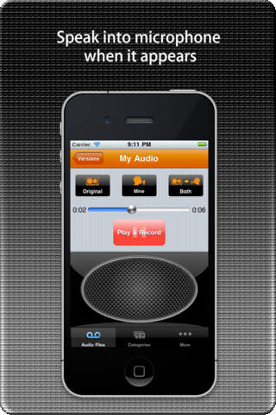
Repetition is one of the most effective methods of learning. Accentuate! helps you learn by giving you small segments of speech to listen to and then allowing you to repeat it. It records your response so you can review it later.

Slide 19

The Real Accent: USA

Slide 20
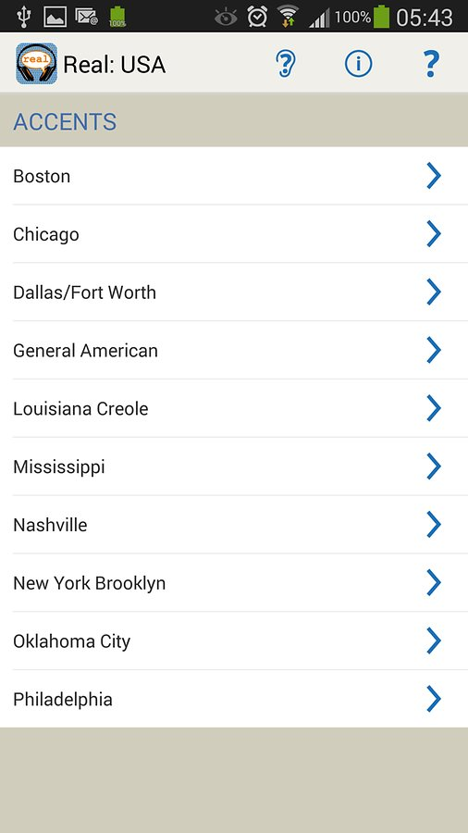
The Real Accent App: USA is ideal for actors and those who want to pick up USA accents from authentic native speakers from each region. There are 26 people, with incredible stories to tell, recorded across 10 accents.

Slide 21
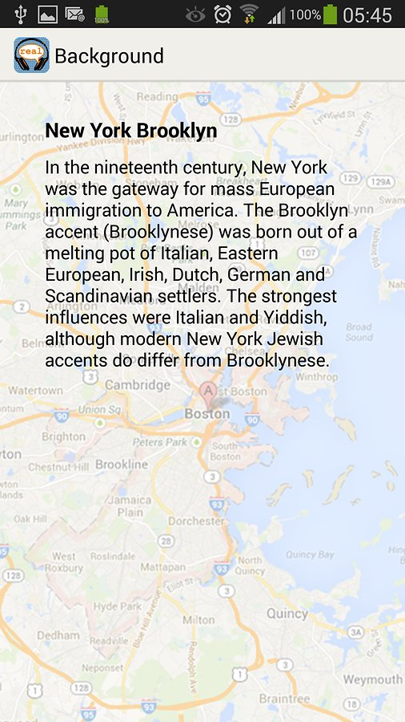
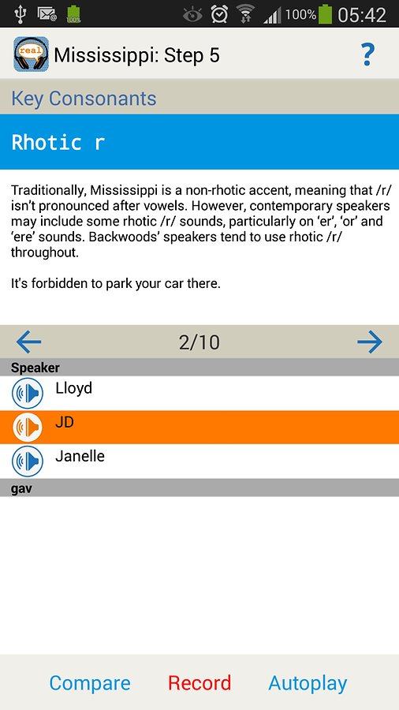

Slide 22

What is your experience with using smart apps?
Have you tried any of these?
What are the pros and cons?

Slide 23
Thank you!

