Slide 1
New Technology in Education
29. 9. 2014
Alžběta Karolyiová
karolyiova@phil.muni.cz
Department of Library and Information Studies

Slide 2
Requirements
Lectures every Monday (+ 20 and 27 October 2014 – Mr. Pharo and Ms. Weber, 15:50, D22)
2 absences possible
Essay or 2 position paper
Essay: 1200 – 1700 words, topic optional
Position paper: resume and critique of chosen text related to one of lectures topics; 3 questions

Slide 3
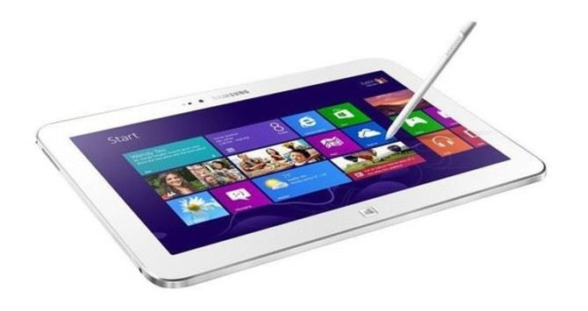
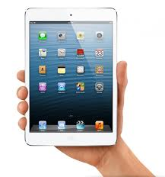
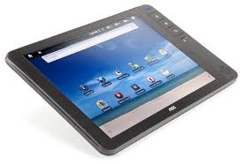
Tablets
INTERES
1 September 2014
34 partner schools
Apps for education
presentation apps
languages
lesson plans
books

Slide 4
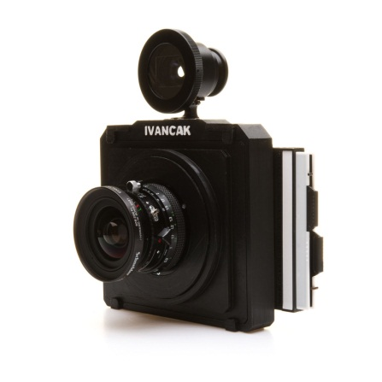
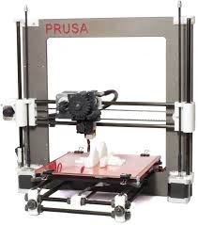
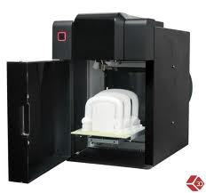
3D printer
= additive manufacturing
developped in 1980s; stereolithography
materials: ABS
3D Bioprinting (valves; kidneys…)

Slide 5
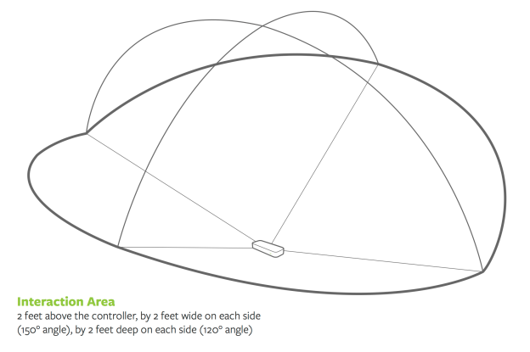
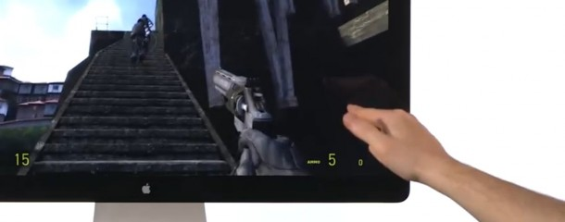
Leap motion
analogous to a mouse
no hand contact or touching
developped in 2008
80 USD
http://bit.ly/1opw7Db

Slide 6
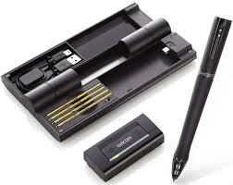
Inkling
Tool for designers
Ink sketches turned into digital vector drawings
60 USD
http://bit.ly/1dcNEPc

Slide 7
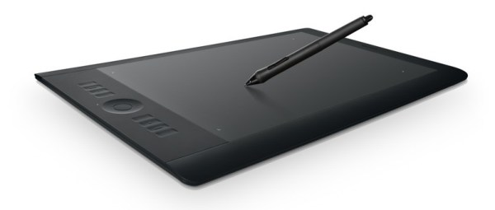
Graphic tablet
photoshop, illustrator…
illustrations, photo editing…
http://bit.ly/1vqsn9J
http://bit.ly/1vqstxV

Slide 8
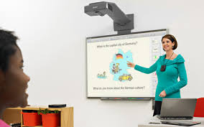
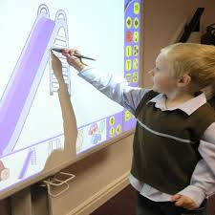
Interactive whiteboard
large interactive display
projector projects computer display to IW
controlled by finger, pen, stylus
USB, Bluetooth
2000 – 6500 USD
Smart board, Active board
Ultrasound IW
Electromagnetic IW
Laser IW
Křižovatka Library

Slide 9
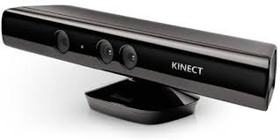
Kinect
Enables to control and interact with console and PC
No need of controller; using gestures and spoken commands
Microsoft
Other similar technologies: Wii, Playstation…
110 USD
http://bit.ly/1AVfzbS

Slide 10
Robotic technology

Slide 11
Next lecture
Hana Habermannová: Self-directed Learning
6 September 2014

