Slide 1
Videoconferencing in English
November 13, 2015

Slide 2
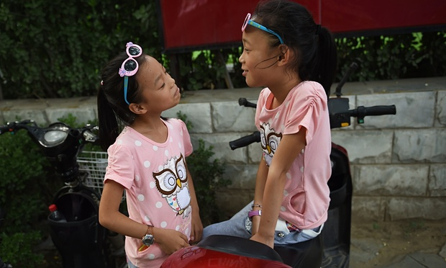
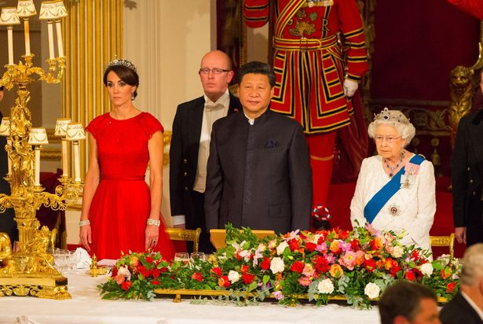
What has happened in China recently?
https://www.youtube.com/watch?v=LhLrHCKMqyM

Slide 3
China ends one-child policy after ___ years
China has scrapped its one-child policy, allowing all couples to have two children for the first time since draconian family planning rules were introduced more than ________ ago.
The announcement followed a ________Communist party summit in Beijing where China’s top leaders debated financial reforms and how to maintain growth at a time of heightened concerns about the economy.
China will “fully implement a policy of allowing each couple to have two children as an active response to an ageing population”, the party said in a statement published by ________, the official news agency. “The change of policy is intended to balance population development and address the challenge of an ageing population,”
Some celebrated the move as a positive step towards greater personal freedom in China. But human rights activists and critics said the loosening – which means the Communist party continues to control the size of Chinese families – did not go far enough.
“The state has no business regulating how many children people have,” said William Nee, a _______________ activist for Amnesty International.

Slide 4
China ends one-child policy after 35 years
China has scrapped its one-child policy, allowing all couples to have two children for the first time since draconian family planning rules were introduced more than three decades ago.
The announcement followed a four-day Communist party summit in Beijing where China’s top leaders debated financial reforms and how to maintain growth at a time of heightened concerns about the economy.
China will “fully implement a policy of allowing each couple to have two children as an active response to an ageing population”, the party said in a statement published by Xinhua, the official news agency. “The change of policy is intended to balance population development and address the challenge of an ageing population,”
Some celebrated the move as a positive step towards greater personal freedom in China. But human rights activists and critics said the loosening – which means the Communist party continues to control the size of Chinese families – did not go far enough.
“The state has no business regulating how many children people have,” said William Nee, a Hong Kong-based activist for Amnesty International.

Slide 5
Language focus
One-child policy
Four-day summit
Dvoutýdenní dovolená
Pětihvězdičkový hotel
Šestiminutové video

Slide 6
http://www.theguardian.com/world/2015/oct/29/china-abandons-one-child-policy

Slide 7
Missing facts 2
Demographers in and outside China have long warned that its low fertility rate – which experts say lies somewhere between ______and ____ children a woman – was driving the country towards a demographic crisis.
Since 2013, there has been a gradual relaxation of China’s family planning laws that already allowed ____________ families and rural couples whose firstborn was a ________ to have more than one child.

Slide 8
Language focus: major, large, dramatic, huge, aggressive, shocking, immense
The Communist party credits the policy with preventing 400m births, thus contributing to China’s _________ economic takeoff since the 1980s.
But the human toll has been ________, with forced sterilisations, infanticide and sex-selective abortions that have caused a ________ gender imbalance that means millions of men will never find female partners.
“The gender imbalance is going to be a very ________ problem,” warned Steve Tsang, a professor of contemporary Chinese studies at the University of Nottingham. “We are talking about between 20 million and 30 million young men who are not going to be able to find a wife. That creates social problems and that creates a ________ number of people who are frustrated.”
History showed that countries with a very ______ number of unmarried men of military age were more likely to pursue __________, militarist foreign policy initiatives, Tsang said.
In one of the most ________ recent cases of human rights abuses related to the once-child policy, a woman who was seven months pregnant was abducted by family planning officials in Shaanxi province in 2012 and forced to have an abortion.

Slide 9
Key:
The Communist party credits the policy with preventing 400m births, thus contributing to China’s dramatic economic takeoff since the 1980s.
But the human toll has been immense, with forced sterilisations, infanticide and sex-selective abortions that have caused a dramatic gender imbalance that means millions of men will never find female partners.
“The gender imbalance is going to be a very major problem,” warned Steve Tsang, a professor of contemporary Chinese studies at the University of Nottingham. “We are talking about between 20 million and 30 million young men who are not going to be able to find a wife. That creates social problems and that creates a huge number of people who are frustrated.”
History showed that countries with a very large number of unmarried men of military age were more likely to pursue aggressive, militarist foreign policy initiatives, Tsang said.
In one of the most shocking recent cases of human rights abuses related to the once-child policy, a woman who was seven months pregnant was abducted by family planning officials in Shaanxi province in 2012 and forced to have an abortion.

Slide 10
Sketch Engine
Very major

Slide 11
Visual representation
Opponents say the policy has created a demographic “timebomb”, with China’s 1.3 billion-strong population ageing rapidly, and the country’s labour pool shrinking. The UN estimates that by 2050 China will have about 440 million people over 60. The working-age population – those between 15 and 59 – fell by 3.71 million last year, a trend that is expected to continue.

Slide 12
Reactions
Experts said the relaxation of family planning rules is unlikely to have a lasting demographic impact, particularly in urban areas where ………………………………………………
Gietel-Basten said: “In the short term, probably there will be a little baby boom particularly in ……………………
Others expressed concern that the announcement of the new two-child policy, which referred to Chinese couples, suggested children born outside of wedlock would ……………………………………………..

Slide 13
Reactions
Experts said the relaxation of family planning rules is unlikely to have a lasting demographic impact, particularly in urban areas where couples were now reluctant to have two children because of the high cost.
Gietel-Basten said: “In the short term, probably there will be a little baby boom particularly in some of the poorer provinces where the rules have been very strict, like in Sichuan or in parts of the south. But in the long term I don’t think it’s going to make an enormous amount of difference.”
Others expressed concern that the announcement of the new two-child policy, which referred to Chinese couples, suggested children born outside of wedlock would continue to be penalised by the government.

Slide 14
Indirect speech
Gietel-Basten said: “In the short term, probably there will be a little baby boom particularly in some of the poorer provinces where the rules have been very strict, like in Sichuan or in parts of the south. But in the long term I don’t think it’s going to make an enormous amount of difference.”
“From a political, pragmatic perspective, loosening the policy is good for the party but also it is a good thing for individual couples who want to have that second child. It is a kind of win-win for everybody,” he said.

Slide 15
SOURCE?
“We reward families with two children and fine those with only one,” read one ________________________________.
“Those who decide not to have children or who are infertile should be thrown in jail.”

Slide 16
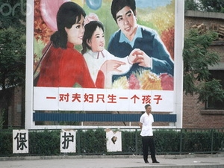
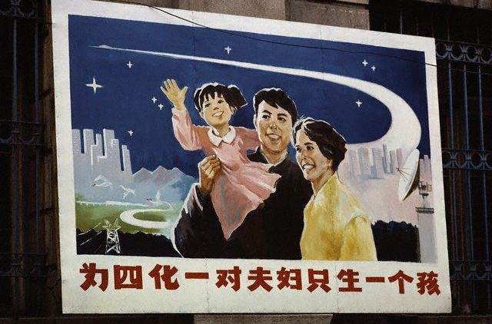
“We reward families with two children and fine those with only one,” read one spoof poster mocking Beijing’s change of heart. “Those who decide not to have children or who are infertile should be thrown in jail.”

Slide 17
Topics?
Travelling?

