Slide 1
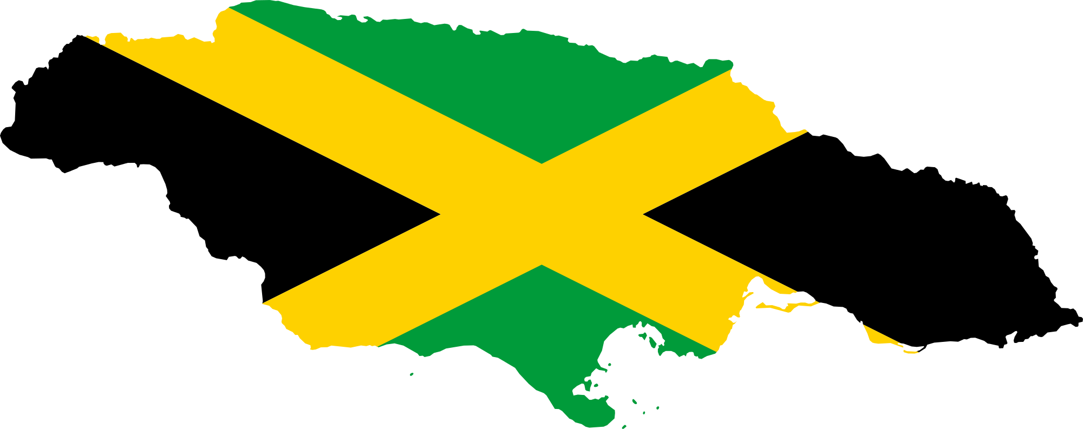
Jamaican patois
[ˈdʒʌmɪekʌn pʌtʊʌ]

Slide 2
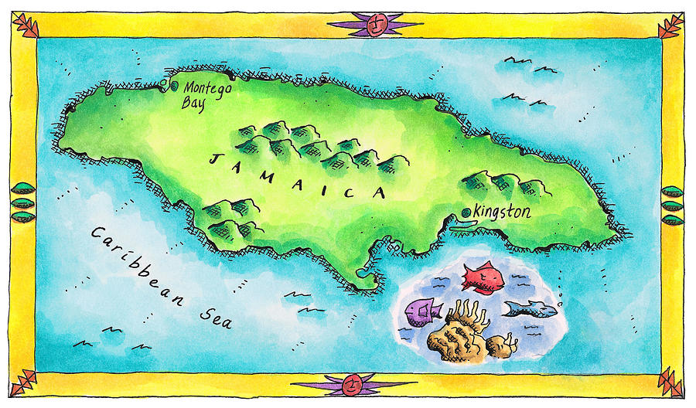

Slide 3
Pidgins, Creoles
Collision of different languages- a clear need for „lingua franca“
Language undergoes process of pidginization only in a multilingual situation.
Pidginization- process of simplification, mixture and reduction+ loss of redundancy.
Pidgin which acquires native speakers and takes on a full range of social functions is called creole.
Reduction that took place during pidginization has to be repaired by a process of expansion-creolization.

Slide 4
J.Creole (Patois/Patwa), Standard JE
Socially dialectal continuum, some variables are stigmatized and percieved as the means for distinction. P. and SJE are grammatically and syntactically different.
Jamaican Creole (Patwa)- mesolectal and basilectal form of the continuum, the grammar shows creole-like features, resulting from the process of simplification (part of the pidginization). Written form-phonetic
https://www.youtube.com/watch?v=9nKMDGyRBFY Dr. Seuss‘ ABC read in Patwa
Standard JE- acrolectal form, „well educated urban professional, the phonology resembles RP, /h/ occurs, as well as vowel distinction: bud- bird, pat-pot, etc.

Slide 5
J.Creole (Patois/Patwa), Standard JE
„The ability to use JC is considered a necessary element in the complex of sociocultural characteristics that define a Jamaican identity“ (Irvine 2).
Monoglot speaker is viewed as either socially inferior, if they only use JC, or foreign and pretentious if they only use JE.
„The monolingual JC speaker is associated with little or no education, low income and traditionally rural provenance- has low status in a social context that sees an inability to speak English as moral failure“ ( Irvine 1).
https://www.youtube.com/watch?v=icy6iKN7jDM Ian Salmon on how to use Patois as a stress reliever
https://www.youtube.com/watch?v=F6syBXasM-8 Jamaican English used in a context of Patois teaching

Slide 6
Rastafarian English
„The Rastafarian language is actually much easier to learn than Jamaican Patois because it’s mostly a play on English words“( such as „overstand [ˈɔːvʌˌstʌnd]“ for „understand“, because you do not have to go under to understand something. „Downpression [dʌʊnˈpreʃʌn]“ for „oppression“ to indicate that it is pushing you down).“
I and I [ɑɪˈʌnɑɪ]- the unity of J. people- I am in conciousness of the others of my kind- therefore it is not only me, its I and I
Give tanks -Thank you
Jah [ˈdʒʌ]- Jehova, God and also (Etiopian) emperor Haile Sellasie I
Yaman- substitute for simply saying „yes“
Bredrin- brothers, derived from „brethren“
https://www.youtube.com/watch?v=feGUNTQhG04 All of the phrases above used in an interview with Julian Marley (yes, he is Bob‘s son)

Slide 7
Phonological and morphophonemic features of Patois
Missing copula-resembling African American vernacular
Palatal glides- can‘t [ˈkyʌnt] baby [ˈbɪebɪ] care [kyʌ] don‘t[dʊɒn]
Some word of different (african) origin: pikni- child, nyam- eat
Plural- plural form „unu“ for you, form „dem“ used as a substitute for –s suffix, or as a general plural form: buk dem- books, pikni dem- children
Overcorrection- initial glottal fricative /h/, around Kingston- owning [hɔnɪŋ], out [hʌʊt], egg [heg]- opossite situation can be found throughout Jamaica, where /h/ is lacking- hous [ˈʌʊs], hill [ˈɪl]
Gerundium: mi a go- I am going, mi ben/bin waak- I was working
fi- for/ to – in basilect widely used: ebribadi en glad fi si wi ‘everybody was glad to see us’
Interdental fricatives- thick [tɪk], think [ˈtɪnk], that [dʌt]
Absence of 3rd person- she like dat

Slide 8
Phrases
Wha gwaan mi bredren! Hello, how are you?
Im a gwaan bad, iing? He is behaving badly, isn’t he?
Wen mi kom, mi wi gi yu som. When I come, I will give you some.
Jan a haid fram di poliisman. John is hiding from the policeman’
Di buk de pan di tiebl ina ruum. the book is on the table in (my) room’
Dem kyari di sik biebi a dakta. they took the sick baby to the doctor’
Peculiar expressions: http://jamaicanpatwah.com/dictionary/category/jamaican-expressions

Slide 9
Quiz
Jan yu si de, im no kya bout moni.
Im beri di siem die wen Plomi go-we.
Mi a go bak a di plies go si ef di yai-dem a luk.
Fieba se mi no fi se so.
Mi no hafi go luk fi mi pikni-dem fi si we Mievis a du wid dem!
Dem lik im.

Slide 10
Quiz
Jan yu si de, im no kya bout moni. John (whom) you see there, he doesn’t care about money
Im beri di siem die wen Plomi go-we. He was buried the same day on which Plumie left.
Mi a go bak a di plies go si ef di yai-dem a luk. I am going back to the place to see if the eyes are looking.
Fieba se mi no fi se so. It seems that I should not say so.
Mi no hafi go luk fi mi pikni-dem fi si we Mievis a du wid dem! I have to go to see about my children, (to see) what Mavis is doing with them!
Dem lik im. They beat him.

Slide 11
Bibliography and interesting web pages
Alison Irvine, Contrast and Convergence in Standard Jamaican English: the Phonological Architecture of the Satndard in an Ideologically Bidialectal Community. Italy, 2008. Print.
Bell, Allan. The Guidebook to Sociolinguistics. Chichester, UK: Wiley, 2013. Print.
https://debate.uvm.edu/dreadlibrary/herbold.html
http://jamaicanpatwah.com/

