Slide 1
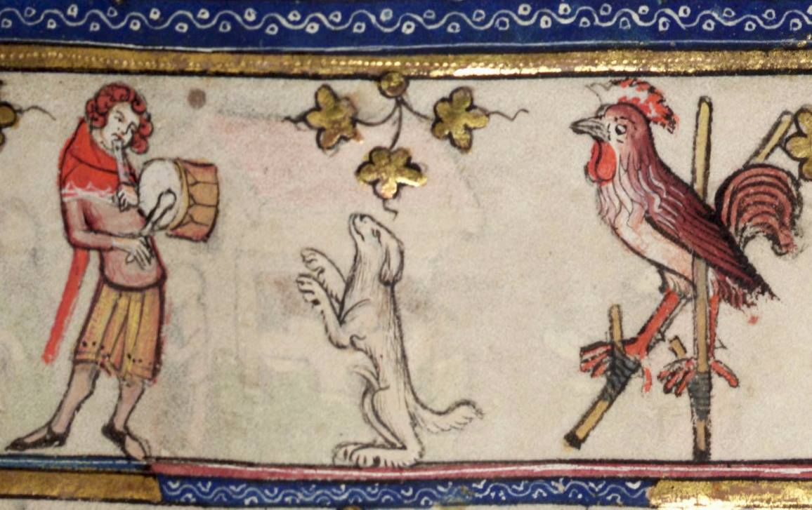
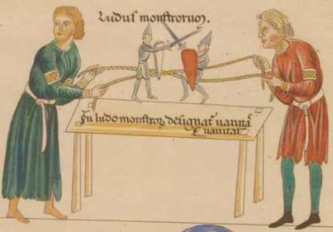
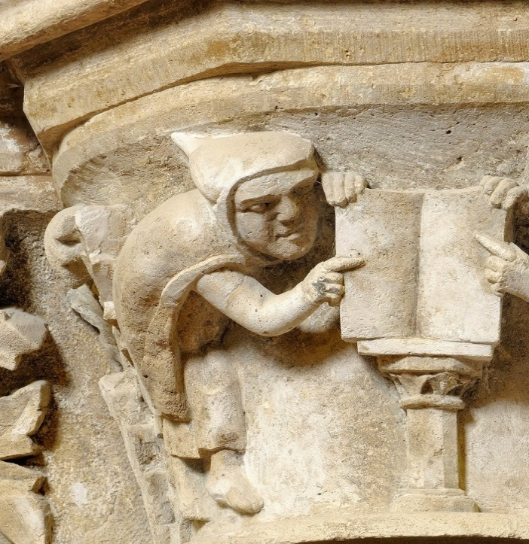
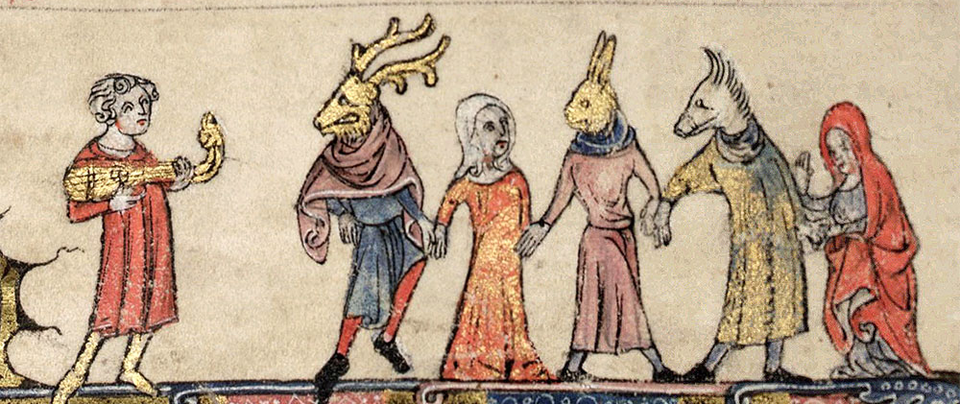
Středověké divadlo mimo církev
Notes:
Martyre de sainte Appoline, par Jean Fouquet, Heures d'Etienne Chevalier

Slide 2
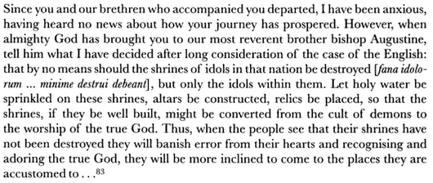
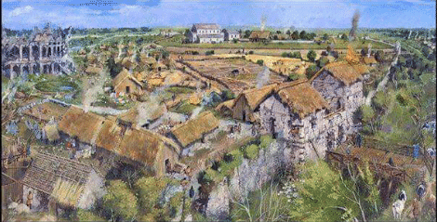
Řehoř Veliký, Ep. XI.56 (18. 6. 601)

Slide 3
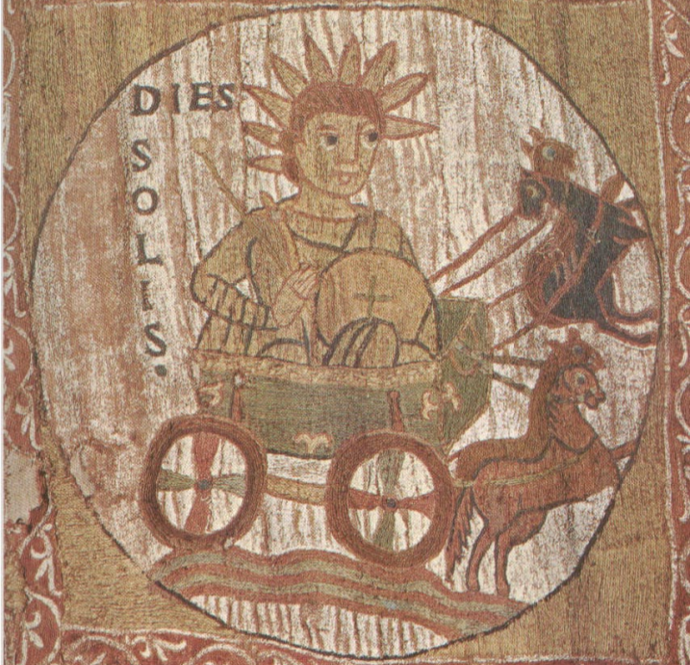
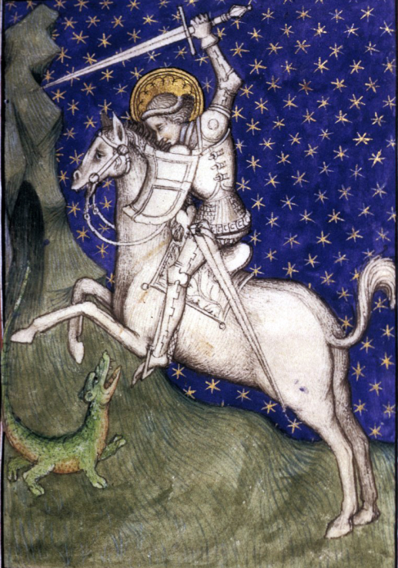
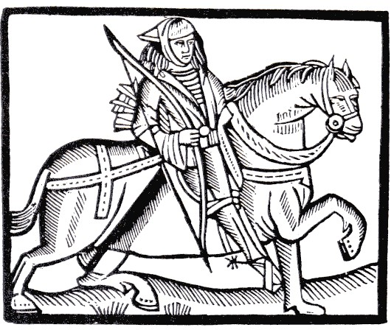
Room, room, brave gallants all
Pray give us room to rhyme!
We come to show you activity
At this special Spring/Easter/Whitsun/Summer/Autumn time
Activity of youth, activity of age
I will show you such activity
That never was acted upon a common stage
And if you don't believe what I say
Step in St. John – and clear the way!
Notes:
Kristus jako Slunce, tapisérie, 11. stol., Itálie (+ Rpbin Hood a sv. Jiří)

Slide 4
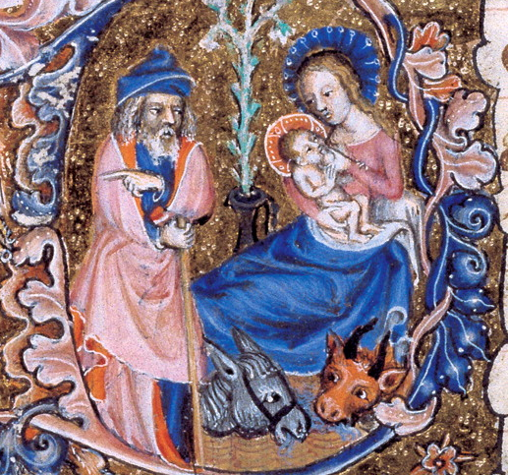
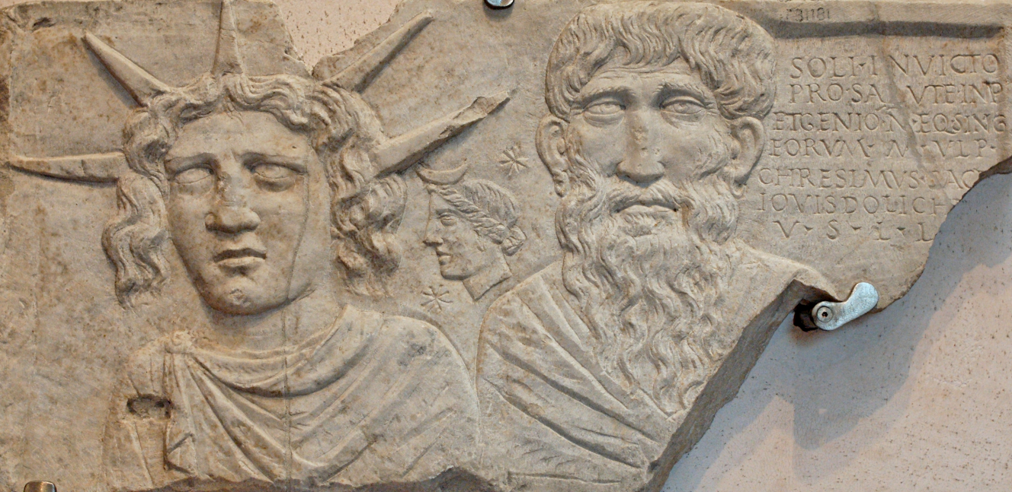
Pohanské vs. křesťanské svátky
Vánoce (25. 12.)
Sol invictus (25. 12.)
Notes:
Dedication slab representing the Sun god crowned by solar rays, the Moon goddess bearing a crescent on her hair, and an old man, perhaps Jupiter Dolichenus. [Soli Invicto pro salute Imp(eratorum) et Genio n(umeri) eq(uitum) sing(ularium) eorum M. Ulp(ius) Chresimus sace[rd(os)] Iovis Dolich[eni] [dedicavit]] [Dedicated to Sol Invictus and to the Genius of the Imperial Batavian horseguards (equites singulares) for the emperors' health, by M. Ulpius Chresimus, priest of Jupiter Dolichenus]

Slide 5
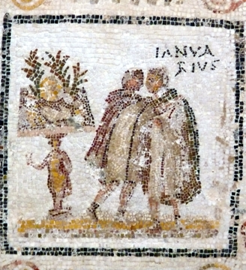
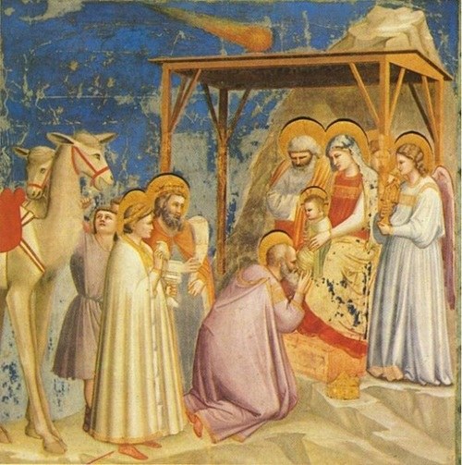
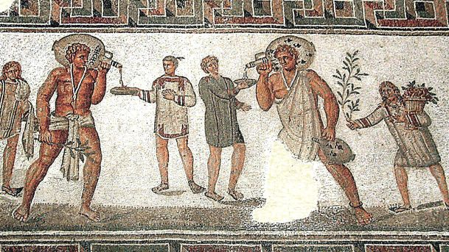
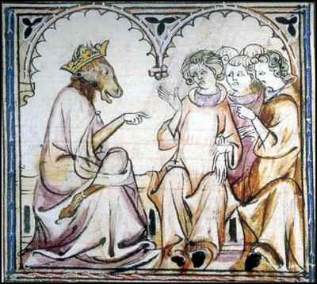
Lednové kalendy
(1.–3. 1.)
Epifanie
(6. 1.)
Saturnálie
(17. 12.)
Svátky bláznů
(26. 12.–6. 1.)

Slide 6
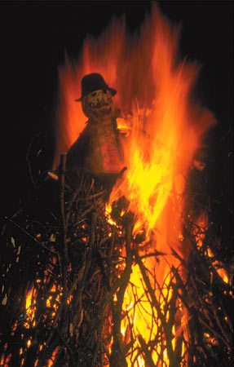
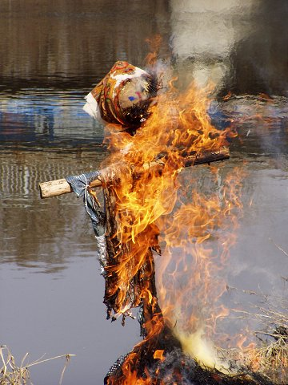
Rex autumnalis
Morana

Slide 7
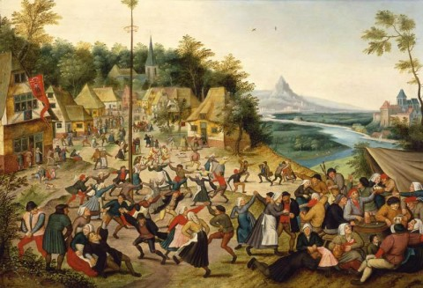
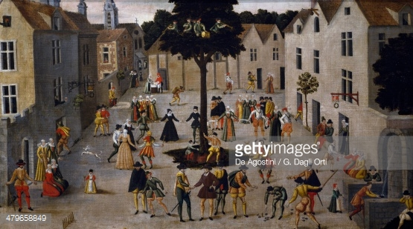
The morris rings, while hobby-horse
Doth foot it feateously;
The lords and ladies now abroad,
For their disport and play,
Do kiss sometimes upon the grass,
And sometimes in the hay.
Francis Beaumont (1584–1616)
Ralph, the May-lord

Slide 8
Májové slavnosti
Tempus est iocundum, o virgines,
modo congaudete vos iuvenes.
Oh, oh, totus floreo,
iam amore virginali totus ardeo,
novus, novus amor
est, quo pereo.
Mea me confortat promissio,
mea me deportat negatio.
Oh, oh, totus floreo,
Tempore brumali vir patiens,
animo vernali lasciviens.
Oh, oh, totus floreo,
Mea mecum ludit virginitas,
mea me detrudit simplicitas.
Oh, oh, totus floreo,
Veni, domicella, cum gaudio,
veni, veni, pulchra, iam pereo.
Oh, oh, totus floreo,
iam amore virginali totus ardeo,
novus, novus amor est,
quo pereo.
Carmina burana 22
Notes:
https://www.youtube.com/watch?v=6FqeX888P18

Slide 9
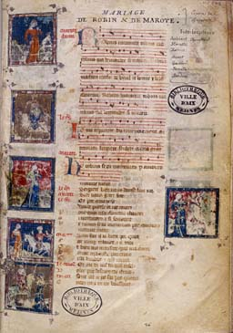
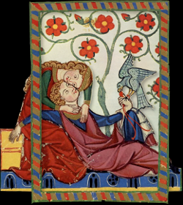
Adam de la Halle: Jeu de Robin et Marion
Notes:
https://www.youtube.com/watch?v=UCIx07t14jw

Slide 10
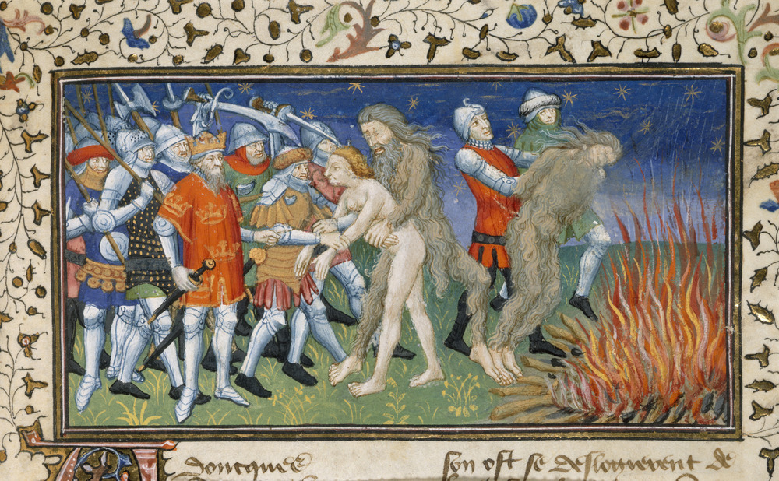
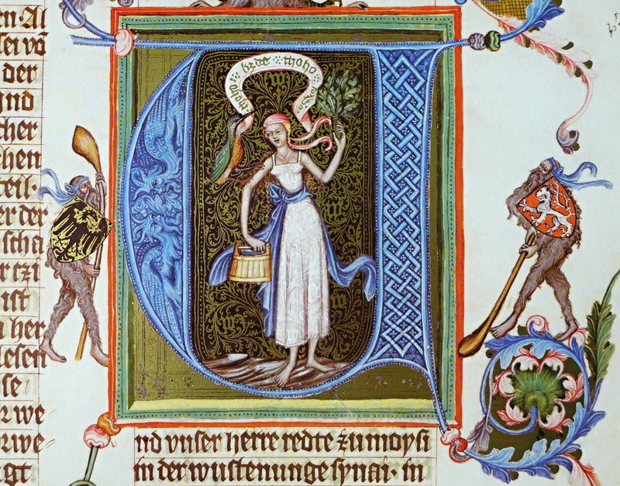
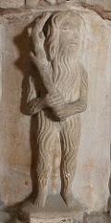
Notes:
Bible Václava IV., konec 14. stol.

Slide 11
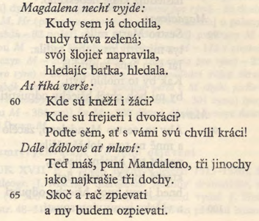
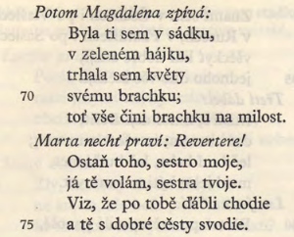
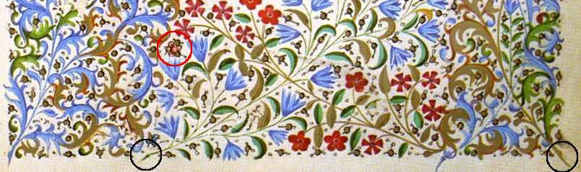
Hra veselé Magdaleny (14. stol.)

