Slide 1
Chinese in Popular Culture for MA. program
2016A @MU YPY

Slide 2
About me
叶姵妤 yè pèiyú
pei95209@gmail.com
454978@mail.muni.cz
Office hour: Mon.11:00~12:00 AM

Slide 3
Grading
Attendance
Homework
Final report

Slide 4
Teaching Materials
Google Drive
Account: twcnpopculture@gmail.com
Password: QwAsZx123

Slide 5
Topics
中国的节日
中国的变化
旅游
健康与生活
男女平等
环境保护与节约能源
理财与投资
中国历史
面试
外国人在中国

Slide 6
上课以前
1.在家看一次那一课的影片
2.查完那一课的生字
Notes:
在這門課，我們會依照每一週的主題上课。雖然課程名稱是流行文化，但是文化很難切割，所以不只會介紹流行文化，同樣也會介紹相關的文化思想、行為，甚至是傳統文化。

Slide 7
你觉得
什么是流行文化？

Slide 8
流行文化
流行文化 ( Popular Culture )，又称为通俗文化及大众文化，指在现代社会中盛行的地区上文化，包括想法、观点、态度图像及其他现象等。
流行文化的内容主要由散播文化製品的工业（传媒）来塑造并传播，例如摄影电影、电视、出版社等媒体。实际上，流行文化是由大众与传媒间互动所产生的，即：大众影响传媒，传媒又反过来影响大众。因此流行文化本身是双向的、不断更新成长的。
Notes:
簡單來說，很多人都會做的某件事，慢慢地成為一種習慣，再加上特有的意義，就成為了流行文化。

Slide 9
举例來说，台湾的流行文化有…
1.集点
https://youtu.be/o7Jw0TiuLv0
2.喜欢一窩蜂做某件事
https://youtu.be/nLY_2s7HJxU
3.热爱用facebook、instagram等軟体
https://youtu.be/nLY_2s7HJxU

Slide 10
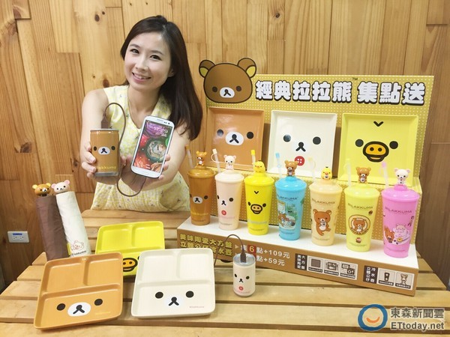
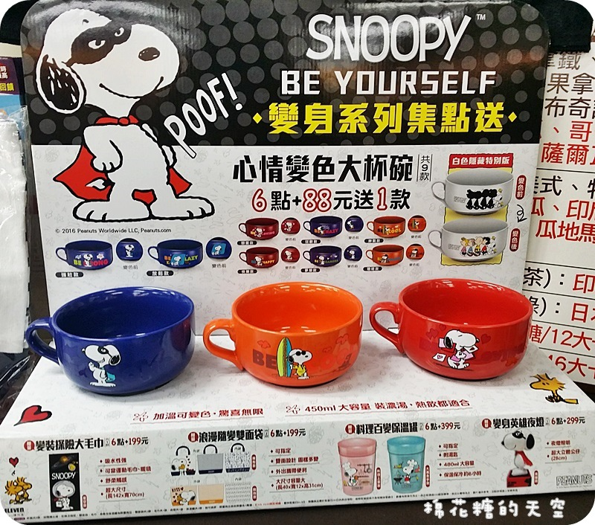
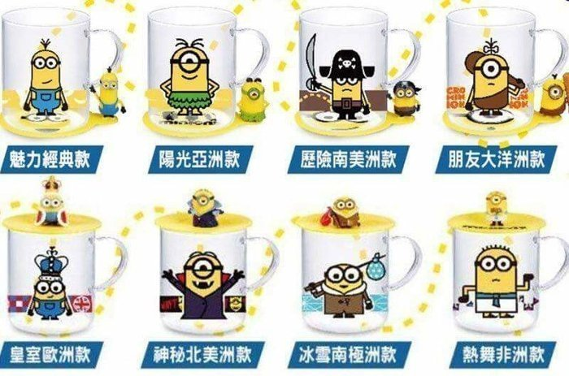
集点

Slide 11
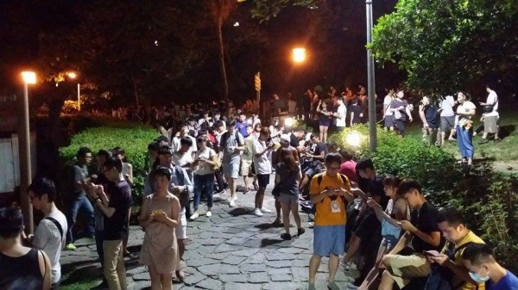
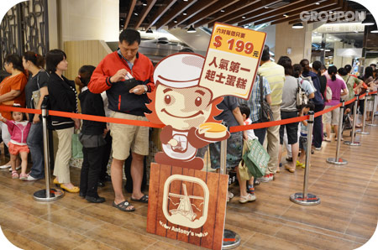
喜欢一窩蜂做某件事

Slide 12
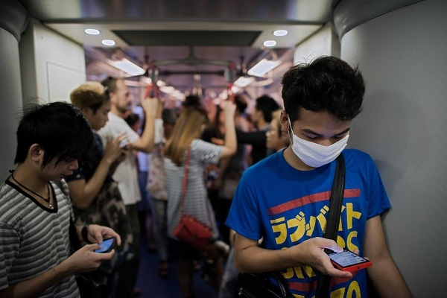
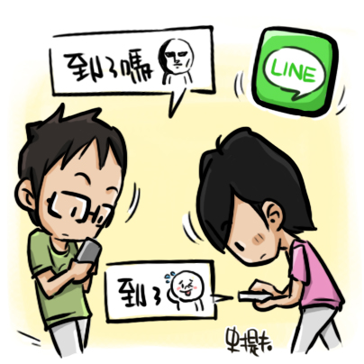
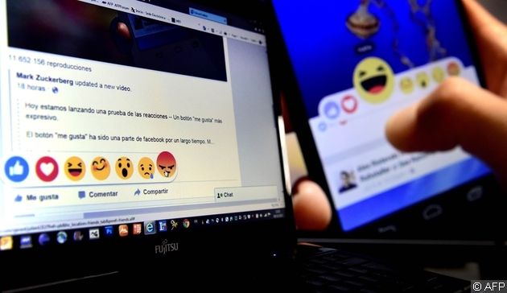
低头族

Slide 13
捷克有什么流行文化？

Slide 14
在这个影片中，有哪些文化点？
https://youtu.be/3wO_M6XY7IQ

Slide 15
文化点
1.下象棋
2.寺庙、拜拜、求籤
3.夜市

Slide 16
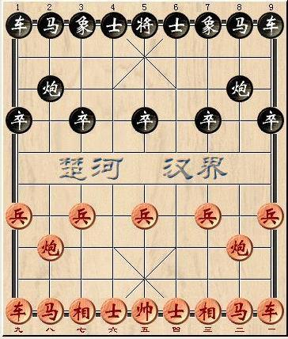
下象棋
帅(将)
仕(士)
相(象)
俥(车)
傌(马)
炮(砲)
兵(卒)

Slide 17
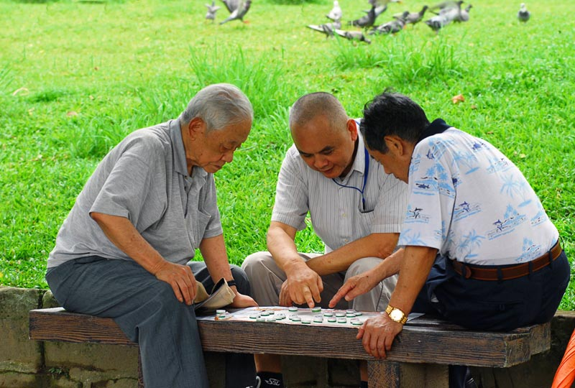
下象棋
俗语：观棋不语真君子，起手无回大丈夫

Slide 18
寺庙
Façade 正面
The Layout of Temples 布置
Gate/Door 门
Pillars 柱子
Roof 屋顶
Floor 地板
Wall 墙壁
Statues of Gods 神明的雕像

Slide 19

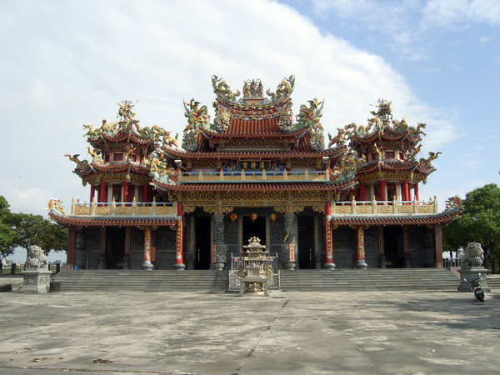
Façade
Temples always show the perfect symmetry in order to have a balanced visual effect.

Slide 20
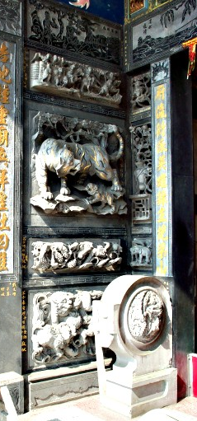
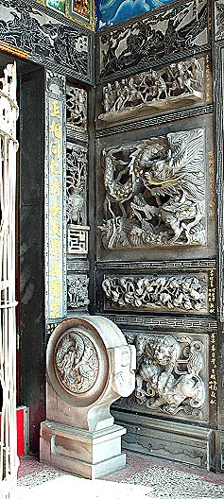
Right door→
(with dragon)
Out
In
← Left door
(with tiger)

Slide 21
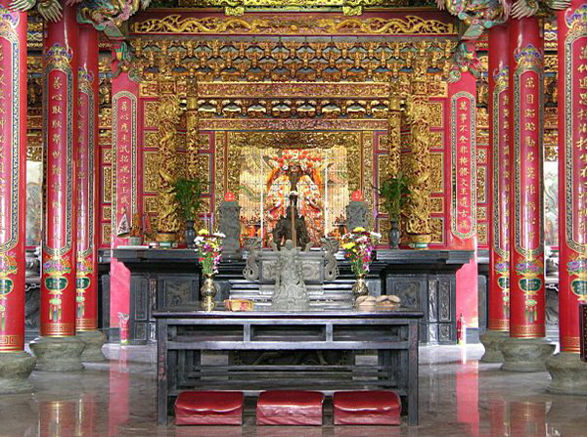
The Layout of Temples： Hòudiàn(後殿)
Hòudiàn(後殿) is also called Dàdiàn(大殿). The modern architecture of temple nowadays has been regarded Hòudiàn(後殿) as the main hall of the temple. It has many historical and cultural relics and the statue of gods/goddess are placed in it.

Slide 22
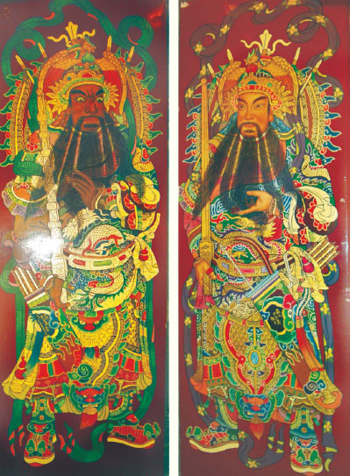
Gate/Door
The front gate of temple is painted with two figures who are said to protect the temple.
They are two generals born in Táng (唐) dynasty (A.D.618-907). One (left) is named Yùchígōng(尉遲恭), the other(right) is called Qínshūbǎo(秦叔寶). It is believed that both of them were strong and brave enough to guard sacred temples.
尉迟恭
秦叔宝

Slide 23
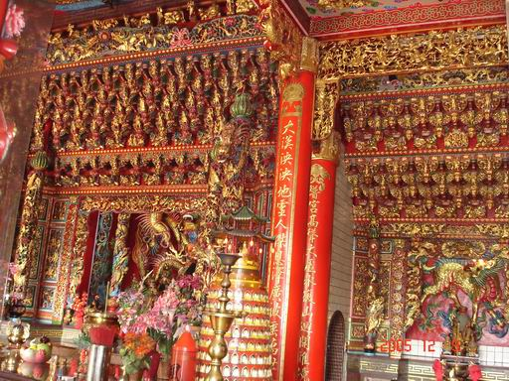
Pillar
Pillars in temples are red instead of other colors, and there are lots of carving or painting on pillars to decorate it.
There are couplets on some of pillars. The words on the pillars express blessing and show a great amount of gratitude and respect towards gods.

Slide 24
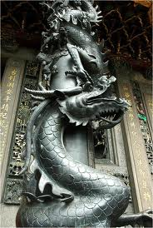
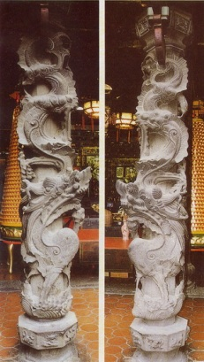
Pillar：Lóngzhù (龍柱)
In front of the gate stands two Lóngzhù, which carved with dragons. Lóngzhù take a lots of time to finish due to countless stone carving.

Slide 25
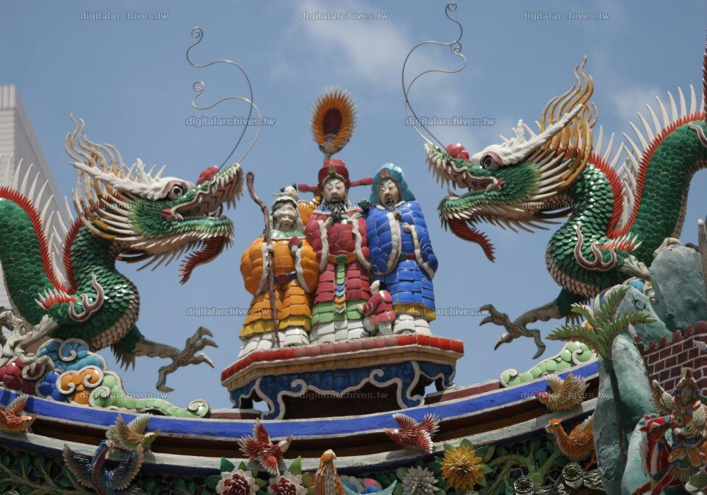
The three Gods of
Fu (Happiness),
Lu(Prosperity),
Shou(Longevity)
(There are two mythological dragons protecting them.)

Slide 26
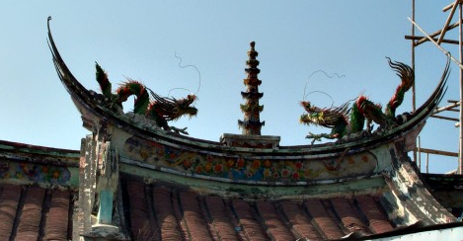
Tower
(There are also two mythological dragons protecting it.)

Slide 27
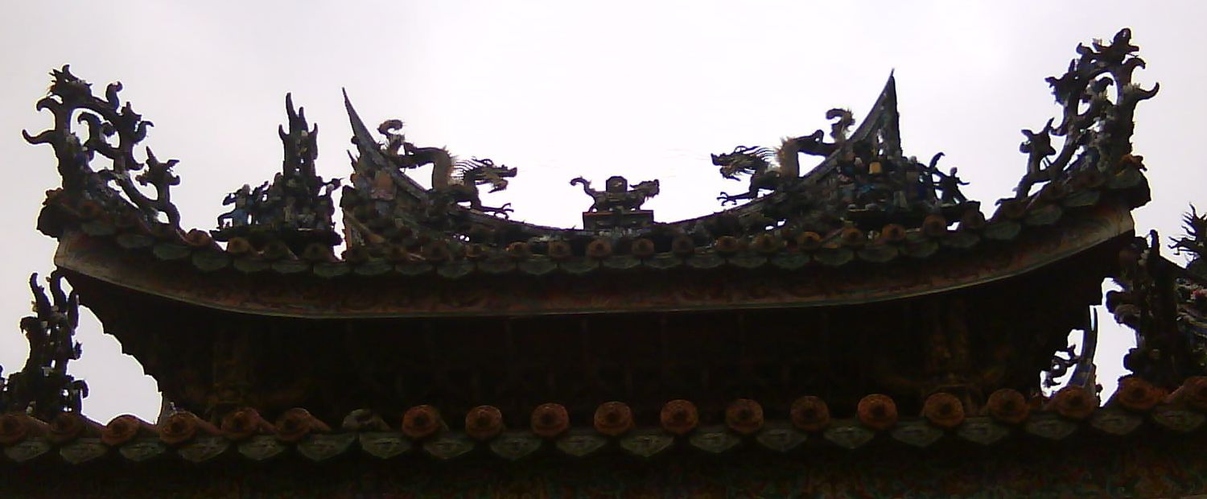
Eight Trigrams
(There are also two mythological dragons protecting it.)

Slide 28
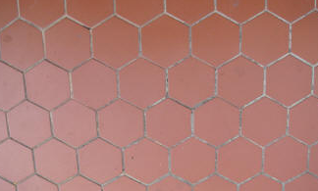
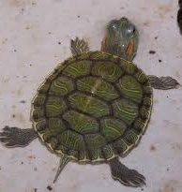
Floor
The floor surface is often covered with red hexagon tiles, like the shape of turtle’s shell, which symbolizes longevity.

Slide 29
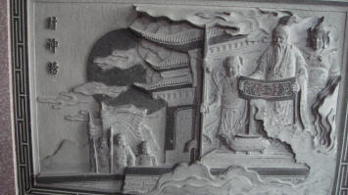
Wall
Walls in Chinese temples are decorated with murals, and stone carvings, whose subjects are various.There is……

Slide 30
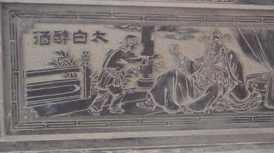
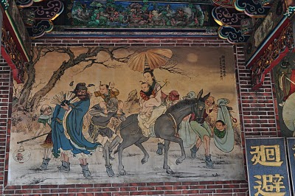
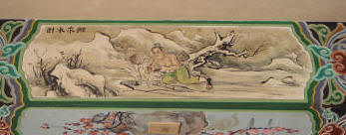
Stories from folklore and history

Slide 31
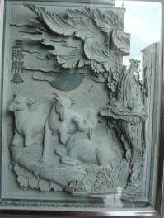
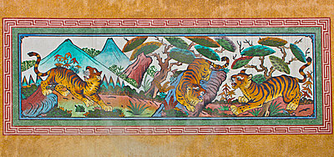
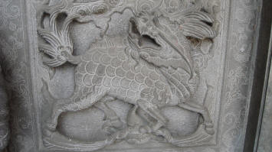
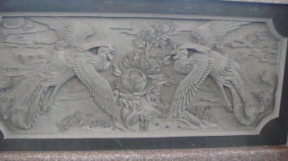
Animals

Slide 32
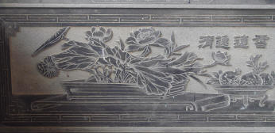
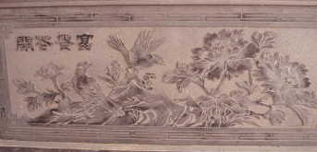
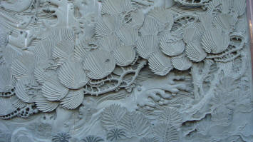
Plants

Slide 33
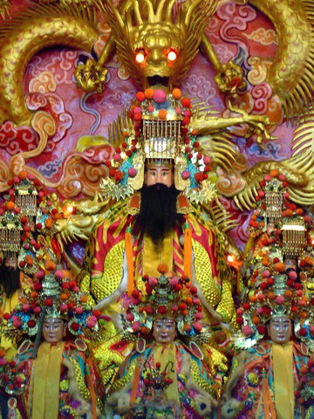
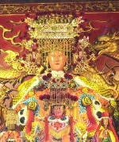
Statues of Gods
There’re a variety of Gods in Chinese folk culture such as Mazu(the sea goddess), and Jade Emperor.(the ruler of Heaven and all realms of existence)
Jade Emperor
Mazu

Slide 34
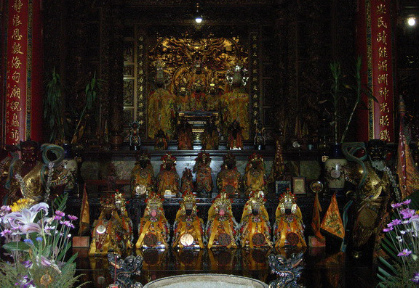
Statues of Gods
The exquisite statues of Gods in temple, which are made out of wood, are placed on the highest altar in three main shrines. Sometimes the statues are placed in glass-fronted cabinets, and wooden tables are placed in front of them to hold the required paraphernalia.

Slide 35
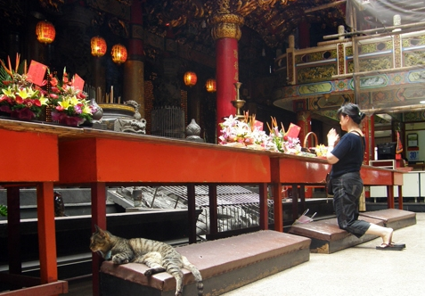
Statues of Gods
Padded cushions are usually placed in front of the altar so that worshiper can kneel, pray and show respect toward Gods in front.

Slide 36
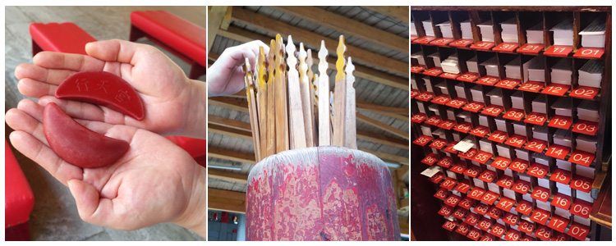
求籤

Slide 37
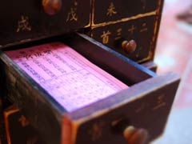
求籤

Slide 38
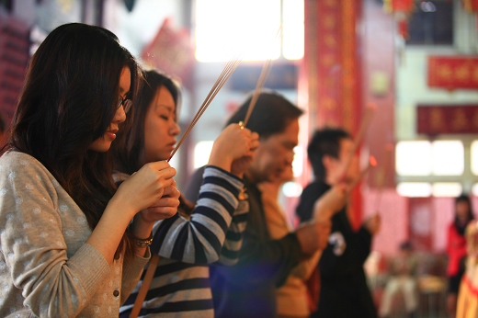
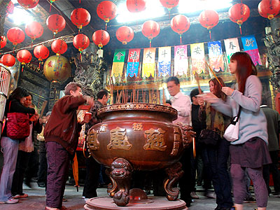
拜拜

Slide 39
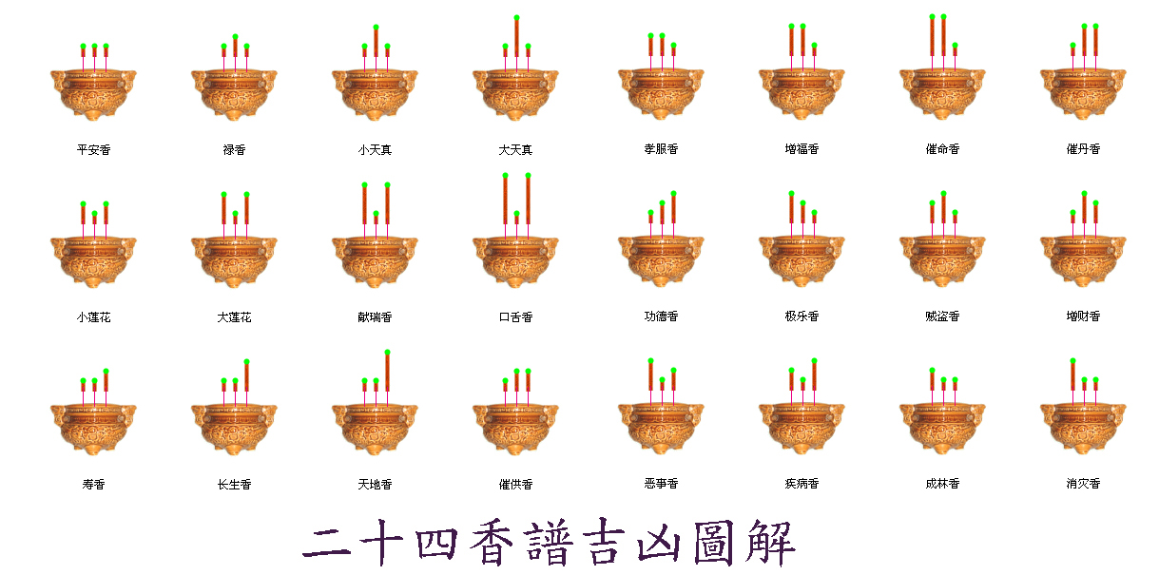
香的意义
神明想透过告诉我们的

Slide 40
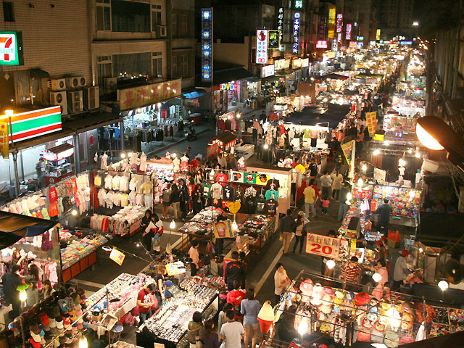
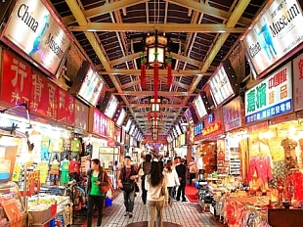
夜市

Slide 41
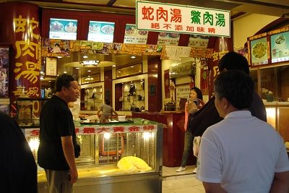
夜市

