Slide 1

Borderline Personality Disorder
BPD
Autumn 2016
PSX_003 Counselling Psychology
PhDr. Pavel Humpolíček, Ph.D
Aline Lampertz 464475
Yurena Febles Arteaga 464375

Slide 2
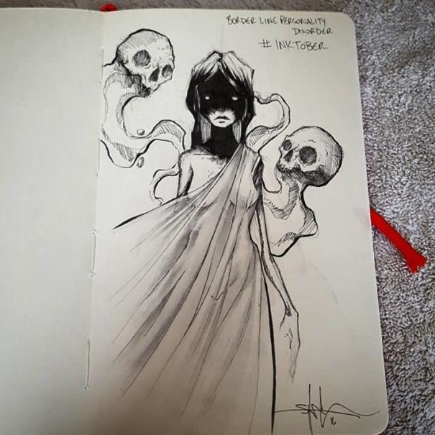
What is Borderline Personality Disorder?
− By illustrator Shawn Coss −

Slide 3


Definition
Serious mental disorder
Moods
Instability in
Behaviour
Impulsive actions
Self-image
Unstable relationships
Functioning
Episodes of anger, depression, and anxiety (from a few hours to days)
(National Institute of Mental Health, 2016)

Slide 4

Criteria
Borderline Personality Disorder (BPD) (301.83)
DSM-5 (American Psychiatric Association, 2013)
Associated features
Indicated by five (or more) of the following:
Avoid real or imagined abandonment
Unstable and intense relationships
Identity disturbance
Impulsivity in at two areas that are self-damaging
Suicidal behaviour, gestures, or threats, or self-mutilating behavior
Affective instability
Chronic feelings of emptiness.
Anger
Paranoid ideation
Give up goals
More secure with transitional objects
Psychotic
Symptoms
Job losses, interrumpted education, separation/divorce
Beginning by early adulthood

Slide 5
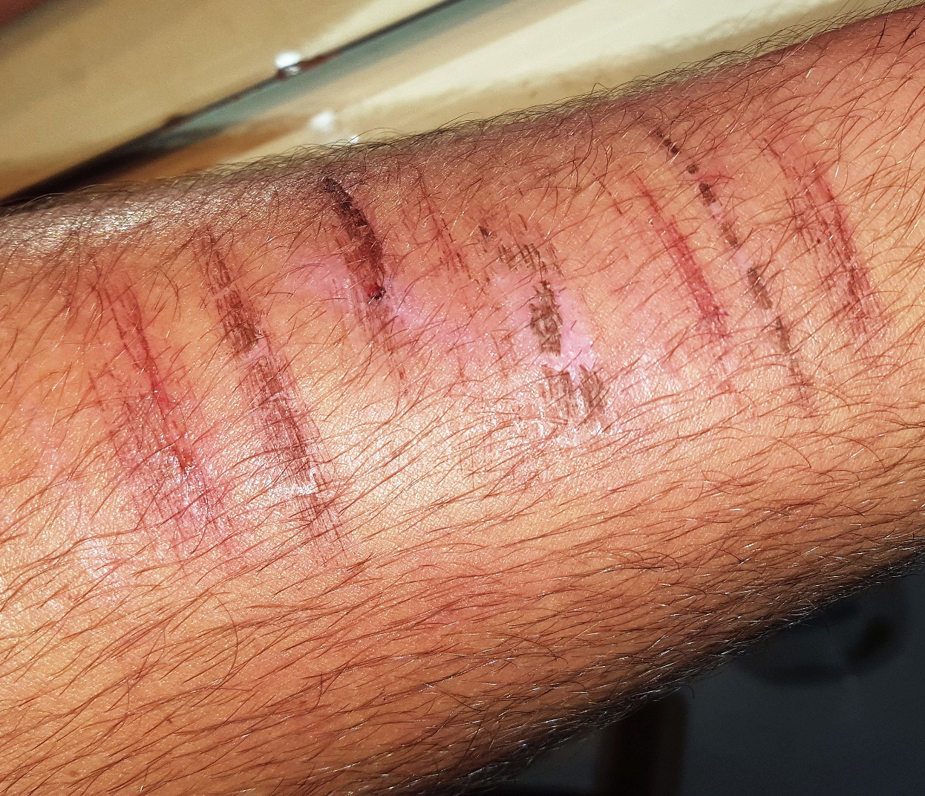
Different states of wound healing
Self-damaging

Slide 6
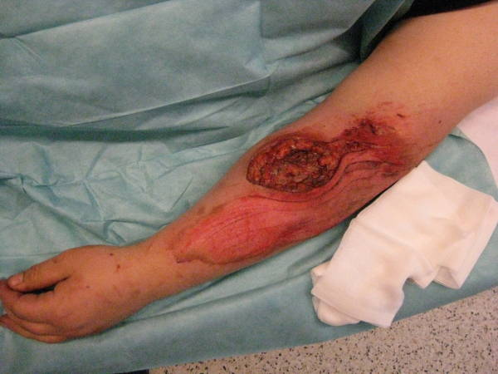
Secondary wound healing in a psychiatric BPD patient after self-mutilation
Self-damaging

Slide 7
Criteria
Emotionally unstable personality disorder (F60.3)
ICD-10 (World Health Organization, 1992)
A. F60.30 Impulsive type (3 of them must be present, including “2”)
B. F60.31 Borderline type (≥ 3 of Impulsive type must be present and two of the following):
Act unexpectedly and without consideration of the consequences.
Engage in quarrelsome behaviour and to have conflicts with others.
Outbursts of anger or violence.
Difficulty in maintaining any course of action that offers no immediate reward.
Unstable and capricious mood.
Disturbances in and uncertainty about self-image, aims, and internal preferences.
Liability to become involved in intense and unstable relationships.
Excessive efforts to avoid abandonment.
Recurrent threats or acts of self-harm.
Chronic feelings of emptiness.
Demonstrates impulsive behaviour.

Slide 8

Development and Course
Severe affective and impulsive dyscontrol
Instability in early adulthood
High levels of use of health and mental health resources
Considerably variable course
More impairment for the disorder and risk of suicide in young-adult years
Decreases with age
30s-40s
Greater stability in their relationships and vocational functioning

Slide 9

Development and Course
Less stable over time than expected
(Skodol et al., 2005; Lenzenweger et al., 2007; Gunderson et al., 2003)
Lifelong tendency toward intense emotions, impulsivity, and intensity in relationships but
Improvement in the first year of therapeutic intervention

Slide 10
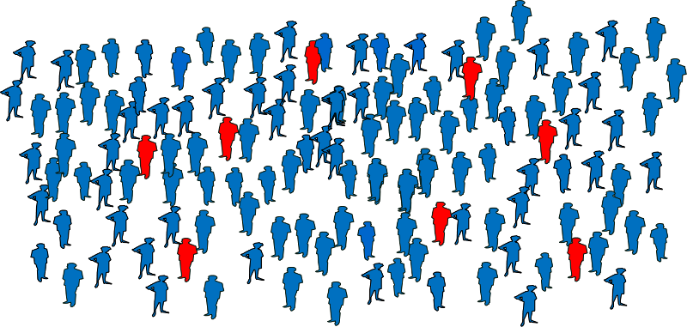

Prevalence
DSM-5 (American Psychiatric Association, 2013)
Average population
Between 1.6% and 5.9%
Predominantly in females
about 75%
Primary care settings
about 6%
Outpatient mental health clinics
about 10%
Psychiatric inpatients
about 20%

Slide 11


Etiology
GENETIC AND BRAIN FACTORS
ENVIRONMENTAL FACTORS
GxE

Slide 12
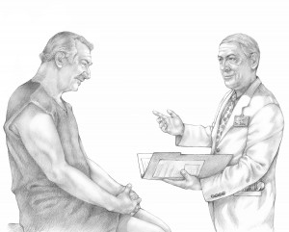
Diagnosis
Underdiagnosed or misdiagnosed
Symptoms that overlap with BPD difficult to distinguish BPD
  I.e.: a person may describe feelings of depression but may not bring other symptoms to the mental health professional's attention (National Institute of Mental Health, 2016).
Relief when people with BPD realize that others understand their experience and treatment options exist

Slide 13

Differential Diagnosis
BPD
Depressive and bipolar disorders
Substance use disorders
Eating disorders
Attention-deficit/hyperactivity disorder
Posttraumatic stress disorder
DSM-5 (American Psychiatric Association, 2013)

Slide 14



Differential Diagnosis
BPD
Personality change
BPD
Symptoms in association with persistent substance use
BPD
Identity problem

Slide 15


Impact on functioning
FAMILY
ROMANTIC RELATIONSHIP
BPD can feel angry at members of their family
Family members feel angry and helpless
Parents of BPD patient can have a bad behavior → overinvolvement (i.e.incest) or underinvolvement
High levels of chronic stress and conflict
Decrease satisfaction of romantic partners
Abuse
Unwanted pregnancy

Slide 16

Impact on functioning
Major defense mechanism of BPD patients
‘All-good’ or ‘All-bad’- Middle ground
Idealization splite white
Devaltuation splite black
Splitting - Idealization and Devaluation
“Dichotomous thinking”
(Beck and Freeman)
“All or none thinking” (Linehan)
Psychotherapy
Shades of grey

Slide 17


Impact of functionning
Goldman, D’Angelo & De Maso (1993)
Greater rates of depression
Zanarini (2004)
The families of BPD probands were more likely to have BPD psychopathology compared with the non BPD probands
Davidson and Siever (1991)
Substance abuse
Antisocial characteristics
. Higher risks for affective and impulse disorders
Impact on functioning
Psychopathology in the extended families of BPD

Slide 18

Impact of functioning
Studies with both parents | Studies with mother | Studies with father
Uncaring and overcontrolling Zweig-Frank , Paris J., 1997; Weaver, Clum, 1993; Parker, Roy, Wilhelm et al. (1999) | Insecure attachment The perception of a lack of caring Nickell et al. (2002) | Not too many studies about fathers Negative image Baker et al. (1992)
Unempathetic Guttman, Laporte, 2000 | Egocentric Golomb, Ludolph & Westen (1994)
Conflictual Allen, Abramson, Whitson et al., 2005 | Overinvolved Liotti & Pasquini, 2000 | Age Perpetrators of sexual abuse
Less affectionate Johnson, Cohen, Chen, et al., 2006
Over-involved / under involved Allen & Farmer, 1996
More unfavorable in all aspects Bandelow et al. (2005)
Psychopathology in the parents of BPD patients
Unflattering light

Slide 19

Children of mothers with BPD
Weiss et al. (1996)
Newman et al. (2007)
Barnow and colleagues (2006)
Hobson and colleagues (2005)
Less available for positive engagement
Disorganized
Insensitive
Lower self-esteem
Exhibited more emotional and behavioral problems
More harm avoidant
More impulsive
More psychiatric diagnoses
Higher prevalence
Less sensitive with offspring
Children had less desire to interact, less satisfied, less competent and more distressed

Slide 20


Treatment and Therapies
It is important for people with BPD and their relatives, couple, friends and others to be patient and to receive appropriate support during treatment (National Institute of Mental Health, 2016).

Slide 21
Psychotherapy is the primary treatment
Medication is useful for treating comorbid disorders
Short-term hospitalization is not more effective than community care for improving outcomes or long-term prevention of suicidal behavior (Paris, 2004)

Slide 22

Medication
RESULTS
A systematic review and meta-analysis of randomised controlled trials
Haloperidol → anger
Flupenthixol → likelihood of suicidal behaviour
Aripiprazole → interpersonal problems and impulsivity.
Olanzapine → affective instability, anger, psychotic paranoid symptoms, and anxiety
Ziprasidone → not significant.
Placebo had a greater ameliorative impact on suicidal ideation than olanzapine did
Valproate semisodium → depression, interpersonal problems, and anger
Lamotrigine → impulsivity and anger;
Topiramate → interpersonal problems, impulsivity, anxiety, anger, and general psychiatric pathology
Carbamazepine → not significant.
Amitriptyline → depression
Mianserin, fluoxetine, fluvoxamine, and phenelzine sulfate → no effect.
Omega-3 fatty acid → less suicidality and improve depression
From 2010, trials with these medications have not been replicated and the effect of long-term use have not been assessed.
(RCT)
Antipsychotics
Impact isolated symptoms of BPD or the symptoms of comorbid conditions
Mood stabilizers
Antidepressants
Cochrane collaboration (Stoffers et al., 2010)

Slide 23

Medication should not be used specifically for BPD and its individual symptoms or associated behaviou0r
(UK National Institute for Health and Clinical Excellence, 2009)
Serious side effects from some of these medications
Considered in the general treatment of comorbid conditions

Slide 24
Medication
Ingenhoven, Lafay, Rinne et al. (2010)

Slide 25
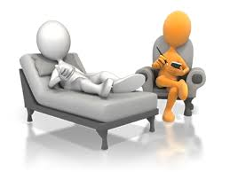

Psychotherapy
Main treatment for people with BPD (Leichsenring et al., 2011)
Psychotherapy may alleviate some symptoms but more studies are needed (National Institute of Mental Health, 2016)
Individual or group format
Trust the therapist

Slide 26
    Cognitive Behavioural Therapy
(CBT)
Identify and change beliefs and/or behaviours that cause inaccurate perceptions of themselves & others
Observable behaviours
Psychic schemata or “inner scripts”
Dichotomous thinking
(Beck & Freeman, 1990)
Fear of abandonment
Conviction of unlovability
Exaggerated guilt
BPD: Maladaptative shemata and behaviours

Slide 27
    Cognitive Behavioural Therapy
(CBT)
Therapy focuses on
Decreasing “dichotomous thinking”
Better control over emotions & impulses
Strengthen the patient’s sense of identity
National Institute of Mental Health (2006)
Reduces a range of mood & anxiety symptoms
Reduces suicidal or self-harming behaviours

Slide 28

Dialectical Behaviour Therapy
Minimizes suicide or attempts of self-harm behaviours
Combines standard CBT techniques (emotion regulation) with Mindfulness, Distress tolerance, Acceptance & Interpersonal effectiveness
One individual session per week with a therapist & Weekly group session
Phone calls to the therapist are allowed
(DBT)
Marsha Linehan (1993)
Term ‘dialectical’
Synthesis of opposites
Polarized opposite feelings
Attitudes of the patient
Need for acceptance and for change
Condition:
Conversation lead to the abstention (suicide or self-cut)
Cut short the call if the patient calls after having self-damaging

Slide 29

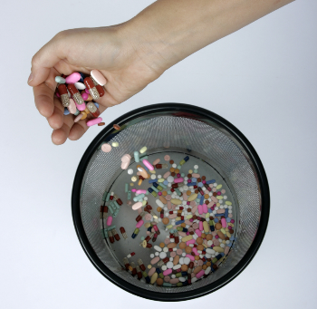

First randomized clinical trial of DBT
(Dimeff & Linehan, 2001)
Meta-analysis
(Kliem, Kröger & Kosfelder, 2010)
Systematic review
(Binks et al., 2006)
Reduced rates of suicidal gestures
Reduces psychiatric hospitalizations
Reduces treatment drop-outs
Moderate effects in individuals with BPD
Showed no differences between DBT and treatment as usual
Dialectical Behaviour Therapy
(DBT)
Marsha Linehan (1993)

Slide 30


Dialectical Behavioural Therapy
New York-Presbyterian Hospital
https://www.youtube.com/watch?v=KJA53l91LSk
DBT

Slide 31
    Psychodynamic Psychotherapy
Polarized attitudes and oscillating behaviours
(PDP)
Unconscious forces and conflicts are buffeting the patient
Promotes psychic integration
Client-therapist relationship must be strong
1 to 3 times a week face-to-face with the patient
(American Psychiatric Association, 2001)

Slide 32

Transference-Focused Psychotherapy
Splitting or dichotomous thinking as defense mechanisms
Patient’s confused and contradictory sense of identity
(TFP)
Disturbed relationships
Psychodynamic treatment
Focus of treatment:
Distorted perceptions of self & others
Mechanism of change: interpretation of distorted perceptions
Learn to reflect feelings
Intense changes in emotions
Reassignation of extreme + or – images from one person to another
transference

Slide 33

Transference-Focused Psychotherapy
(TFP)
Clarkin, Foelsch & Levy (2001)
Suicide attempts reduced
Physical condition improved
Clarkin, Levy & Schiavi (2005)
Decreases in psychiatric visits and hospitalizations
Increases in global functioning
Decrease in psychiatric hospitalizations
The dropout rate: 19.1%

Slide 34

Group therapy
Not harmful and helpful (American Psychiatric Association, 2001)
Homogeneous group of BPD is recommended
Dependent, schizoid and narcissistic personality disorders or chronic depression
Antisocial personality disorder, untreated substance abuse, or psychosis
Combined with individual Dynamic Therapy and group therapy:
The greatest therapeutic power (McGlashan, 1986)

Slide 35

Therapeutic communities
Structured environments where people with a range of complex psychological conditions and needs come together to interact and take part in therapy
Most TCs are residential, such as in large houses, where people can stay for around one to four days a week
Aim → help people with emotional and self-harming problems by teaching them social interaction skills
TCs
Taking part in individual & group therapy + doing other activities to improve social skills and self-confidence, i.e.:
  Household chores
  Meal preparation
  Games, sports & other recreational activities
  Regular community meetings – people discuss issues that have arisen in the community
National Health Service (NHS), 2016

Slide 36
Therapeutic communities
Guidelines on what is considered acceptable behaviour within the community: not drinking alcohol, no violence & no attempts at self-harming.
Guidelines broken → leave the TC
TCs
While some people with BPD have reported that the time spent in a TC helped their symptoms, there's not yet enough evidence to tell whether TCs would help everyone with BPD
National Health Service (NHS), 2016

Slide 37

Online spaces
Some organizations now offer online support groups, discussion boards, blogs & online communities as additional ways to connect with others in similar situations.
It can be an additional support for in-person groups and may be especially helpful if there are no groups in the area where the patient lives.
Support groups
- Fellow members of online spaces offer validation
- Members give tips and techniques that have worked for others.
Mental Health America has its own support community through Inspire which enables individuals to connect on a variety of issues and topics related to mental health.

Slide 38

Other types of psychotherapy
Supportive Psychotherapy
Dynamic Deconstructive Therapy
Schema-Focused Therapy
Mentalization-Based Therapy
(DDT)
Supportive Psychotherapy Dynamic Deconstructive Therapy (DDT), Schema-Focused Therapy (SFT) or Mentalization-Based Therapy (MBT)
(SFT)
(MBT)
Combination of psychotherapies
Research is needed to improve other core features of this disorder (Skodol et al., 2005)

Slide 39

  Pharmacotherapy with psychotherapy
Unclear
No benefits (Simpson and colleagues, 2004)
Fluoxetine (antidepressant)
Dialectical Behaviour Therapy
An additional benefit (Soler et al. 2005)
Olanzapine (antipsychotic)
Dialectical Behaviour Therapy
No Benefit in other study
(Linehan, McDavid, Brown, Sayrs & Gallop, 2008)
Fluoxetine and interpersonal therapy was superior to fluoxetine plus clinical management

Slide 40


Family therapy
Family members may aggravate their relative's symptoms
Some therapies include family members
Help them understand and support BPD individuals (National Institute of Mental Health, 2016)
Few in number
Most authors seem to recommend psychoeducation (Sansone & Sansone, 2009).

Slide 41

Family therapy
Systems Training for Emotional Predictability and Problem Solving
Blum et colleagues (2008)
Group treatment
Educate family members
Psychoeducation
Only one published study of family therapy for patients with BPD Psychoeducational approach (Gunderson, 2009)
Improve communication and diminish conflict
20 weeks
Supplement other treatments
includes cognitive behavioral elements
Published clinical reports differ about their family treatment recommendations
Skills training
Encourages the participation of family members
(STEPPS)
Family support
Greater knowledge about BPD was associated with greater family member distress, burden, depression, and hostility Hoffman et al. (2003)
Common reason to stop the treatment

Slide 42

Only clinical experience
Useful
Not recommended as only form of treatment
Not recommended when partner is unable to listen to the other’s criticisms (Seeman, & Edwardes-Evans, 1979).
Settle and strengthen the relationship
Clarify the nonviability of the relationship
Educate and clarify for the partner of the BPD patient the process that is taking place
May struggle to accommodate the patient’s alternating patterns of idealization and depreciation
- dysphoric and self-doubting,
- too attentive and exhibit reaction formation .
Explore and change maladaptive reactions and problematic interactions
Couples therapy
APA Practice Guideline (American Psychiatric Association, 2001)
SPOUSE

Slide 43
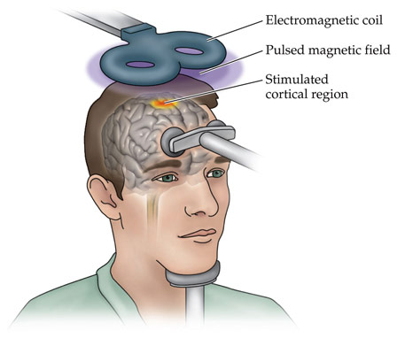
  Transcranial magnetic stimulation
(TMS)
Impulsivity
Improvements in
Suicidality
Agression
McKenzie & Nasrallah (2003)

