Slide 1
Geordie Dialect
Rami Ibrahim

Slide 2
Historical Background

Slide 3
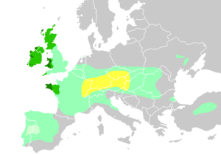
Expansion and Decline of the Celtic Culture

Slide 4
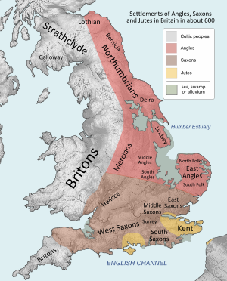
Anglo-Saxons and their language
The Geordie dialect started to develop after the Romans left Britain in the 5th century and the Anglo-Saxons started invading Britain. Anglo-Saxons introduced their language which is known today as old English. Over the years the Anglo-Saxon language changed greatly due to the influence of Latin, Greek and Norman- French. As a result of its relative remoteness and isolation, the North- East was not influenced so heavily and Old English has not changed to such an extent as it was in other parts of England.

Slide 5
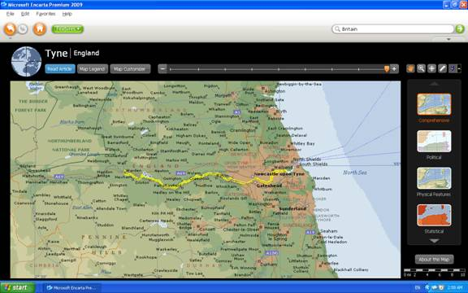
Old English: Remnants and Survival
The modern-day dialects which bear the closest resemblance to Old English are the dialects of Northumberland, Durham and Tyneside. 80 % of distinctively Geordie words are of an Anglo-Saxon origin.

Slide 6
Term
The term Geordie generally refers to a native of Newcastle-upon-Tyne, also called Tyneside. However, the term is used sometimes in connection with the whole of North East England.
Several theories about how the term Geordie came into existence.

Slide 7
Standard English Versus Geordie

Slide 8
Grammatical Differences:
Pronominal System: the most notable one is the use of different possessive pronouns.

Slide 9
Possessive “me”
Geordie: Me mum and me dad are very proud.
ST: My mum and my dad are very proud.

Slide 10
Singular and plural “Us”
Geordie: Tell us the truth.
We love us country.
ST: Tell me the truth.
We love our country.

Slide 11
“Wor” Geordie transcription of “our” but it refers to the standard “my”.
Geordie: Wor lass
ST: My wife

Slide 12
“we” instead of “us”
Geordie: They did not give us any hope.
They did not give we any hope.
ST: They did not give us any hope.

Slide 13
Second person plural “youse”
Geordie: “Youse”
ST: “You all” or “you guys”

Slide 14
Reflexive and emphatic pronouns:
Geordie: mysell,…, themsells.
ST: my self,…., themselves.

Slide 15
Anticipatory pronoun:
Geordie: I read a book, me.
She has been always clever, her.
ST: No equivalent!

Slide 16
“them”
Geordie: Are them chairs free?
ST: Are these chairs free?

Slide 17
“what” instead of “that”:
Geordie: There is something on the table what your brother brought yesterday.
ST: There is something on the table that your brother brought yesterday.

Slide 18
Verbs
One of the most obvious differences is the use of “is” for third person plural.
Geordie: There is /was four lasses in the house.
ST: There are/were four girls in the house.

Slide 19
Negation
Double negation
“divn’t” instead of “don’t”
Geordie: I divn’t like bairns.
ST: I don’t like children.

Slide 20
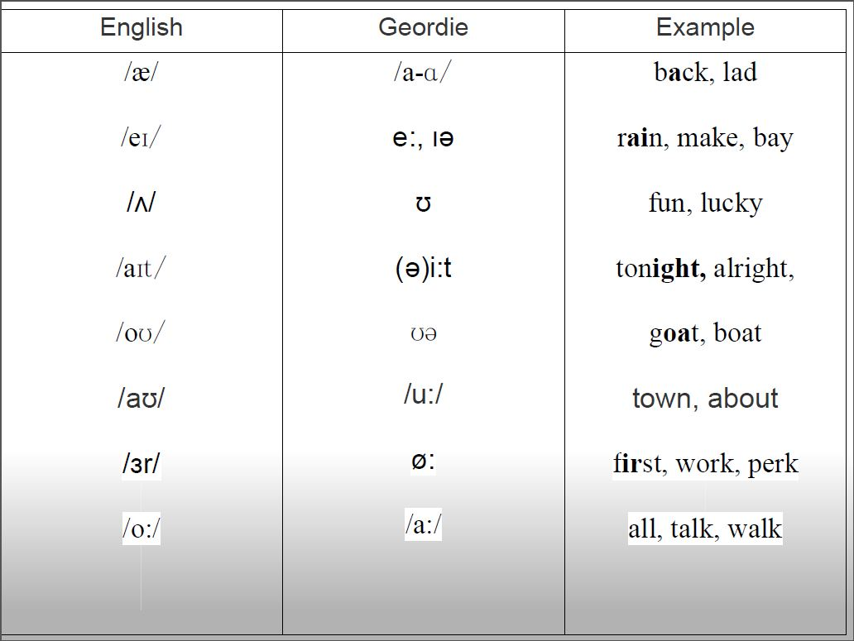
Sound System:

Slide 21
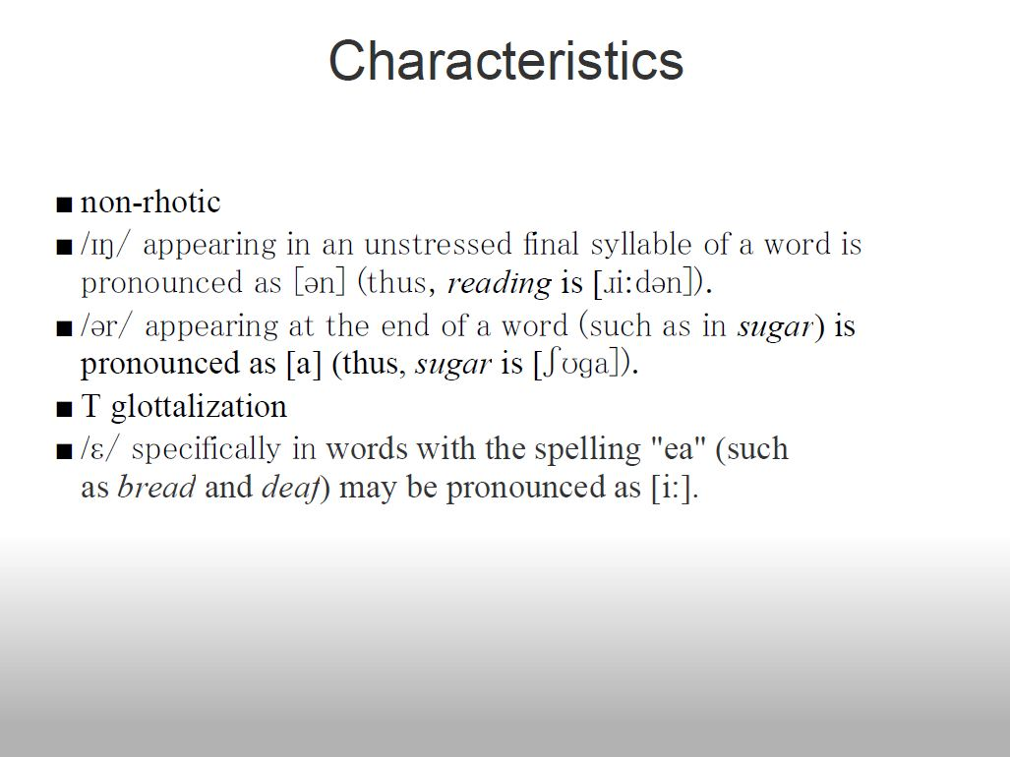

Slide 22
Vocabulary
Hadaway, let us larn youse Geordie

Slide 23
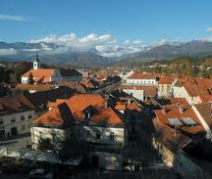
Toon

Slide 24
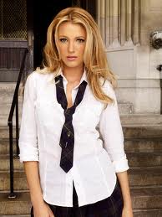

Lad/Laddie
Lass/Lassie

Slide 25
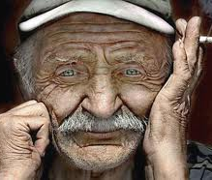
Gadgie

Slide 26
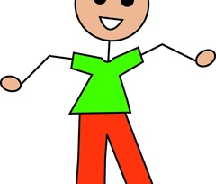
Bairn

Slide 27
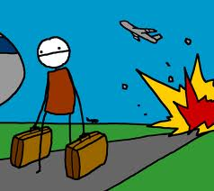
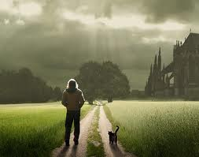
Damn, they divn’t leave us no hope! I gan hyem, me.
Let we gan yem!

Slide 28
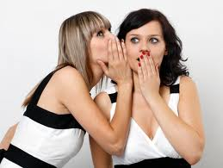

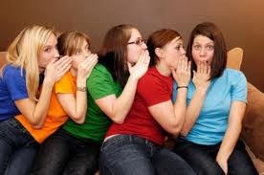
Crack
Crack

Slide 29
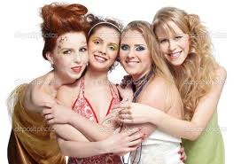
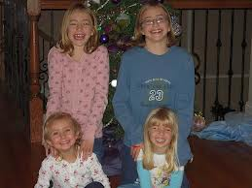
Them lasses is canny beautiful.
Them lasses is canny.

Slide 30
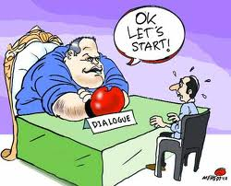
Do you agree?
Whey aye! Whyaye!

Slide 31
ST | Geordie
Teach | larn
Come on | Hadaway
Go home | Gan hyem
Of course | Whey aye
Very, pleasant | canny
ST | Geordie
town | toon
girl | lass/lassie
boy | lad/laddie
child | bairn
Old man | gadgie
gossip | crack

Slide 32
Thank “youse” for your attention!

