Slide 1
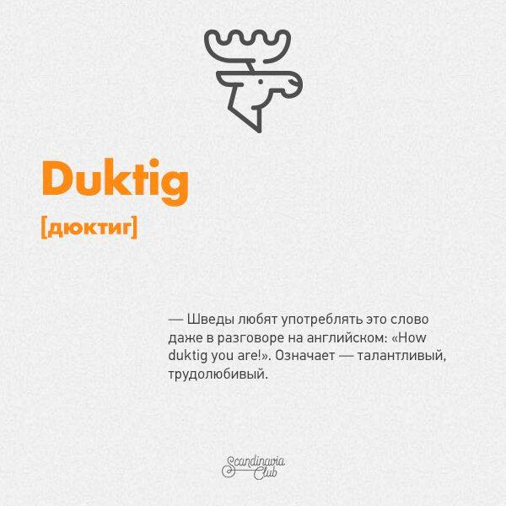
Swedish enjoy using this word even in conversations in English How duktig you are!. The meaning is – talented/hardworking.

Slide 2
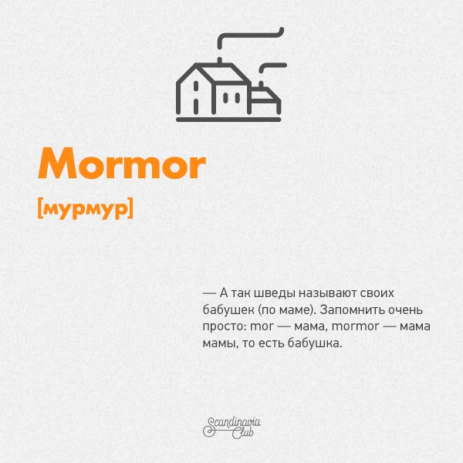
This way Swedish call their grandmothers. It’s an easy word to remember – mother (Mor )of your mother (Mor) is Mormor.

Slide 3
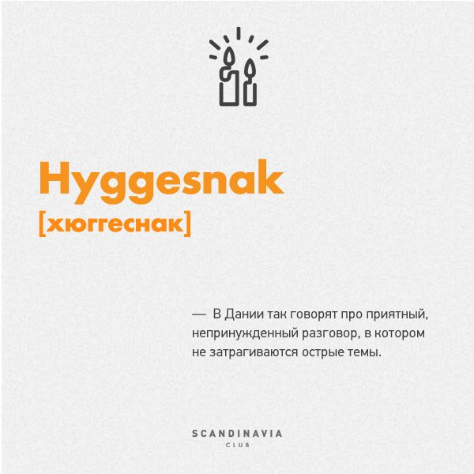
In Denmark they say Hyggesnak talking about a nice conversation in which the hot controversial topics are not mentioned.

Slide 4

According to the Swedish language, it means an active muffin. An active, energetic person is called so.

Slide 5
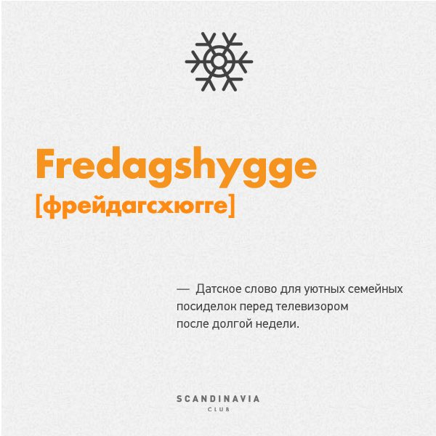
This is a Dutch word for cozy families spending their evenings in front of TV after the long workdays.

Slide 6
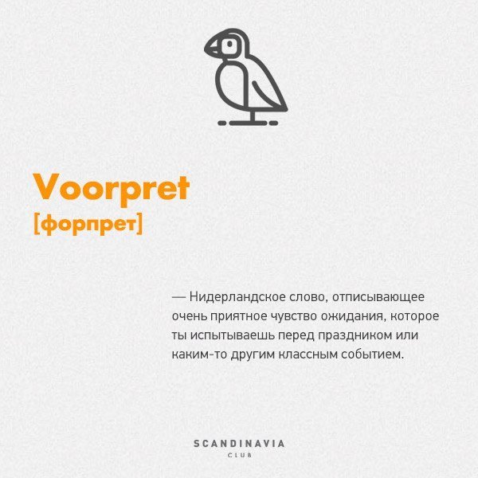
This word means an excitement, curiosity which you experience before a big holiday (as your b-day or Christmas) or other exciting events.

Slide 7
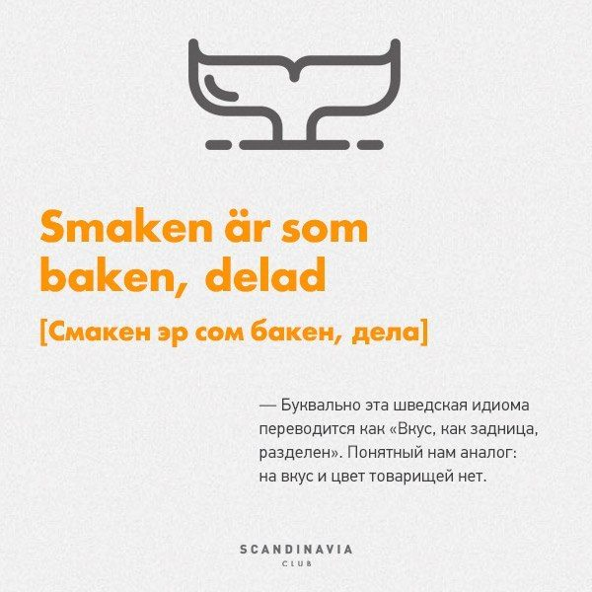
In common words, this Swedish proverb is translated as “The taste is divided like an ass.” The English translation might be – “There is no accounting for tastes”.

