Slide 1
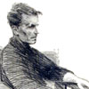


Wittgenstein’s On Certainty
Brno, 11 October 2017
Rune J. Falch
WAB/Dep.Phil. Bergen, Norway
rune.falch@uib.no
© Blackwell

Slide 2

On Certainty [OC] §467
«I am sitting with a philosopher in the garden; he says again and again «I know that that’s a tree», pointing to a tree that is near us. Someone else arrives and hears this, and I tell him: «This fellow isn’t insane. We are only doing philosophy.»»

Slide 3
Overview
The main theme of On Certainty: epistemology and scepticism
Some highlights from the scepticist tradition
Moore’s response to scepticism
Wittgenstein’s response to Moore

Slide 4
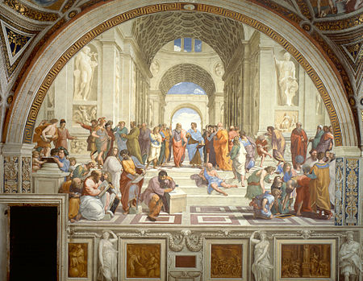
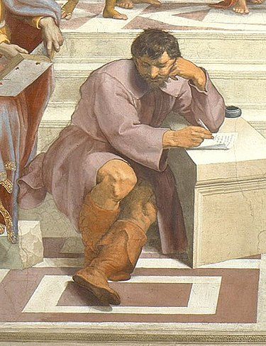
Heraclitus
«Panta rhei» = «Everything flows.»
«No man ever steps into the same river twice.»
«Everything changes and nothing remains still ... and ... you cannot step twice into the same stream»
(cf. e.g. William Harris: Heraclitus – The Complete Philosophical Fragments)

Slide 5
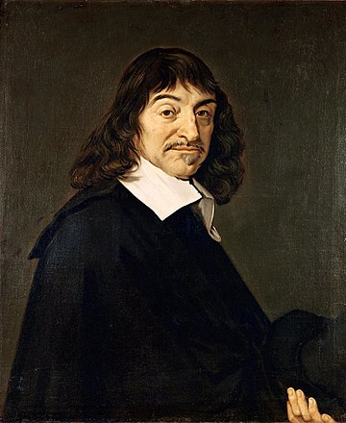
Descartes’ sceptical method
All knowledge must stem from the mind (rationalism).
To systematically doubt anything which can be doubted...
...so as to arrive at something indubitable, a basis for knowledge
What can be doubted? Tradition, sensory knowledge, dream/awake, mathematics…
But I cannot doubt that I am doubting! Therefore I am thinking. Therefore I exist. “Cogito ergo sum.”
And God guarantees that I can also attain more knowledge.

Slide 6
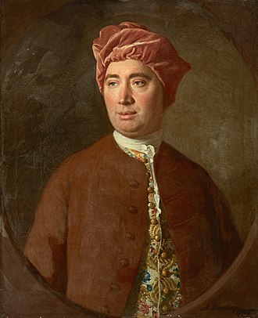
Hume’s problem of induction
All knowledge must stem from the senses (empiricism).
Impressions and ideas
Hume’s example of billiards: we can sense contact between A and B; and we can sense succession of events (x happens before y); but we cannot sense necessity – therefore we cannot really know cause and effect.

Slide 7
On Certainty [OC] §467
«I am sitting with a philosopher in the garden; he says again and again «I know that that’s a tree», pointing to a tree that is near us. Someone else arrives and hears this, and I tell him: «This fellow isn’t insane. We are only doing philosophy.»»

Slide 8
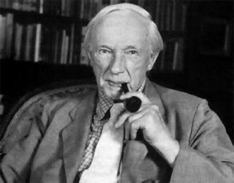
George Edward Moore
‘Common sense’ philosophy
“Proof of an external world.” (1939)
Examples of ‘obviously true propositions’:
‘I know that this is a tree.’
‘Here is one hand. And here is another.’
‘The earth has existed longer than five minutes.’
Wittgenstein’s question: What does it mean to say “I know I have two hands”? (The “peculiar role played by certain empirical propositions in our discourse.”)

Slide 9
The peculiarity of Moore’s props
“The propositions, however, which Moore retails as examples of such known truths are indeed interesting. Not because anyone knows their truth, or believes he knows them, but because they all have a similar role in the system of our empirical judgements.
We don’t, for example, arrive at any of them as a result of investigation.
There are, e.g., historical investigations and investigations into the shape and also the age of the Earth, but not into whether the Earth has existed during the last hundred years.” (OC§138)

Slide 10
“This situation is thus not the same for a proposition like ‘At this distance from the sun there is a planet’ and ‘Here is a hand’ (namely my own hand). The second can’t be called a hypothesis. But there isn’t a sharp boundary line between them.” (OC§52)
“For it is not true that a mistake merely gets more and more improbable as we pass from the planet to my own hand. No: at some point it has ceased to be conceivable.” (OC§54)
“Or are we to say that certainty is merely a constructed point which some things approximate more, some less closely? No. Doubt gradually loses its sense.” (OC§56)

Slide 11
“[W]e are interested in the fact that about certain empirical propositions no doubt can exist if making judgments is to be possible at all. Or again: I am inclined to believe that not everything that has the form of an empirical proposition is one.”

Slide 12
Learning language
“As children we learn facts; e.g. that every human being has a brain, and we take them on trust. I believe that there is an island, Australia, of such-and-such a shape, and so on and so on; I believe that I had great-grandparents, that the people who gave themselves out as my parents really were my parents, etc. This belief may never have been expressed; even the thought that it was so, never thought.” (OC§159)
“The child learns by believing the adult. Doubt comes after belief.” (OC§160)

Slide 13
Learning (cont.)
“When a child learns language it learns at the same time what is to be investigated and what not. When it learns that there is a cupboard in the room, it isn’t thought to doubt whether what it sees later on is still a cupboard or only a kind of stage set.” (OC§472)
“Children do not learn that books exist, that armchairs exist, etc. etc.,--they learn to fetch books, sit in armchairs, etc. etc.” (OC§476)
“Does a child believe that milk exists? Or does it know that milk exists? Does a cat know that a mouse exists?” (OC§478)

Slide 14
Wittgenstein’s riverbed analogy
Wittgenstein calls propositions like these a description of a ‘world-picture’, which in a sense make up a ‘mythology’ for us. [logos/mythos]
These propositions play this role for us; but their status could change and become different. (Does this mean Wittgenstein is a relativist…?)
OC§97: “The mythology may change back into a state of flux, the river-bed of thoughts may shift. But I distinguish between the movement of the waters on the river-bed and the shift of the bed itself; though there is not a sharp division of the one from the other.”
OC§99: “And the bank of that river consists partly of hard rock, subject to no alteration or only to an imperceptible one, partly of sand, which now in one place now in another gets washed away, or deposited.”

Slide 15
Heading
Text

Slide 16
Heading

Slide 17
Heading

Slide 19
Scepticism
https://en.wikipedia.org/wiki/Heraclitus
Heraclitus: «Panta rhei» = «Everything flows.»
"We both step and do not step in the same rivers. We are and are not.“
"You will not find anything, in which the river remains constant. ... Just the fact, that there is a particular river bed, that there is a source and a estuary etc. is something, that stays identical. And this is ... the concept of a river“ (Karl-Martin Dietz)

