Slide 1
Vernaculer media of conflict
Guest lecture Masaryk University Brno, November 2018
Prof. dr. Kevin Smets (Vrije Universiteit Brussel, Belgium)

Slide 2
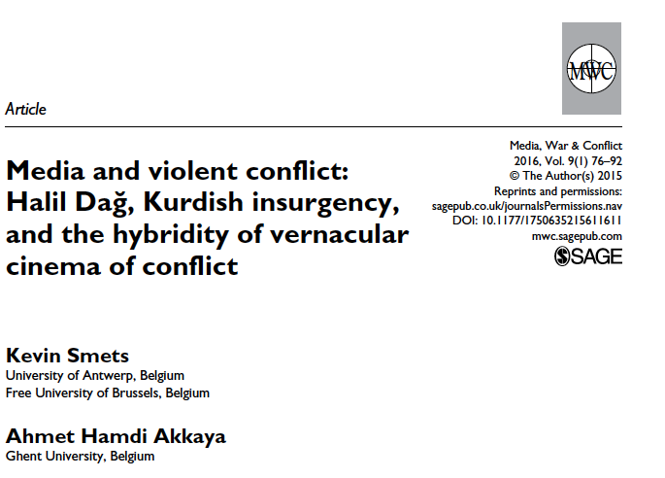
Smets & Akkaya (2016)

Slide 3
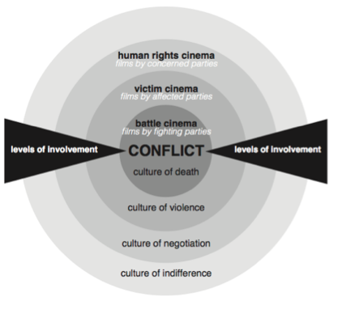

Slide 4
Vernacular media of conflict: context
Main themes in research
  Framing, agenda setting, war photography
  Media production ??
Visual turn in conflict research
  Visual aspects of hard and soft conflicts are increasingly important (Mirzoeff; Parry)

Slide 5
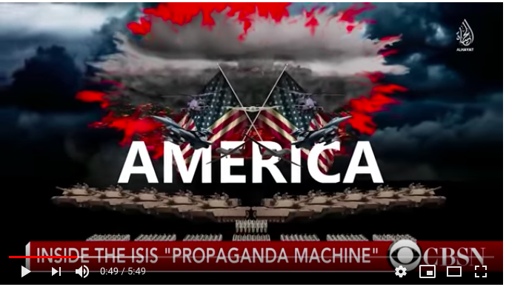
Vernacular media of conflict: context
Increased attention for non-elite media producers (in conflict)
Increasing volume of “vernacular media production in conflicts”
  Blogs and vlogs by active duty soldiers
  Citizen photo journalism during attacks
=> ”raw” and “autonomous” media
(Authenticity?)

Slide 6
Why cinema? (1)
Exaggerated focus on social media blogs, vlogs etc?
Connecting with a (little known) history of filmmakers involved in conflicts
  Eg. East German director Konrad Wolf
  Eg. Australian soldiers / amateur film makers during Vietnam War
  Eg. Revolutionary movements that have employed cinema, for instance Nicaragua

Slide 7
Why cinema? (2)
Film (still) very important propaganda tool during or “after” conflicts
  Soviet cinema
  Military-industrial complex Hollywood
  Flames of War ISIS film

Slide 8
Conceptualizing “vernacular cinema of conflict”
Going beyond dichotomy of elite versus amateurs
Approaching these media not only as “conflict-supporting narratives” but also look at their production and cultural meanings
Kurdish insurgent movement as a case study
  Elaborate media landscape
“The vernacular”
  Counter-hegemonic, “specific”, “local”
  Media studies: “vernacular creativity” on social media

Slide 9
Previous/recent research on conflict and vernacular media
War on Terror and soldier-produced media: changing nature of media reporting in conflicts
Vernacular productions by citizens in conflict zones: witnesses
E.g. ‘milblogs’

Slide 10
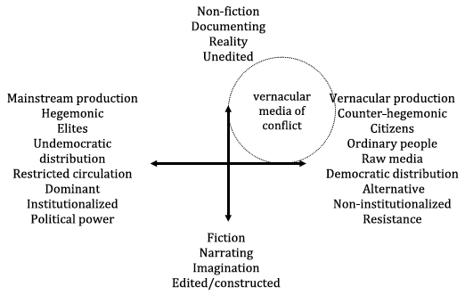

Slide 11
Problematizing the alternative – mainstream divide
  Alternative in terms of: Modes of production? Message? Audience?
  Often Euro-centric bias for terms such as ‘citizen’, ‘journalism’, ‘participation’

Slide 12
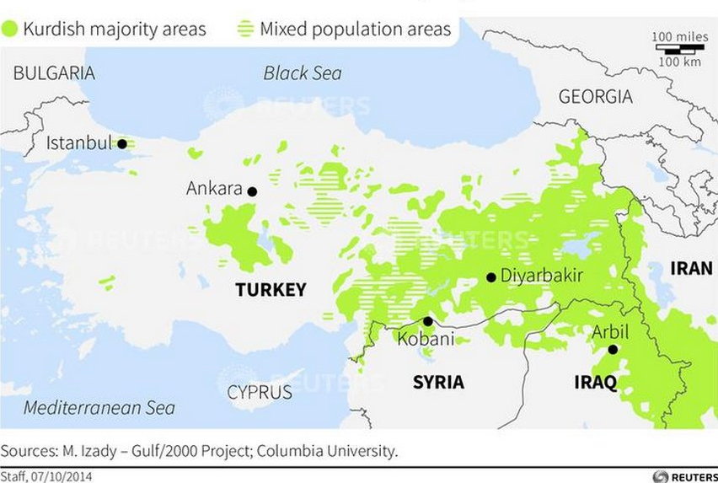
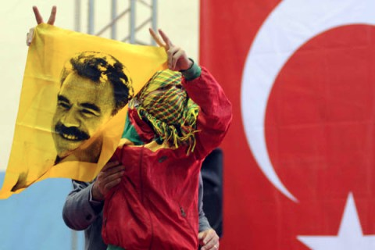
Kurdish conflict in Turkey

Slide 13
The case of Halil Dağ: methods
Interviews
Participant observations
Auto-ethnography!
Dağ’s memoir
Qualitative content analysis: narrative structure, symbolism, visual

Slide 14
Introducing Halil Dağ

Slide 15
“I decided to stay there and to go further after our interview with Abdullah Öcalan, which was a very meaningful work for me. I now remember very well that I had then decided to go further into the depths of the Middle East, not to return again. I was feeling that what I had been in search of until then was there, waiting for me. So I jumped into a geography about which I knew nothing, mingled freely with a people who I do not know at all, and I went to a country in which a language I do not understand any word is spoken.”

Slide 16
Inspired by film theory

Slide 17
Film making as a duty / personal struggle
“I was timid for a long time since I was afraid of not working sufficiently on my stories […]. However, I believed that I should start from somewhere and, in time, I would make the best of it. In this sense I had to give up my first stories. I still suffer from this. Therefore, I want to revive my [debut] film, Tîrej”

Slide 18
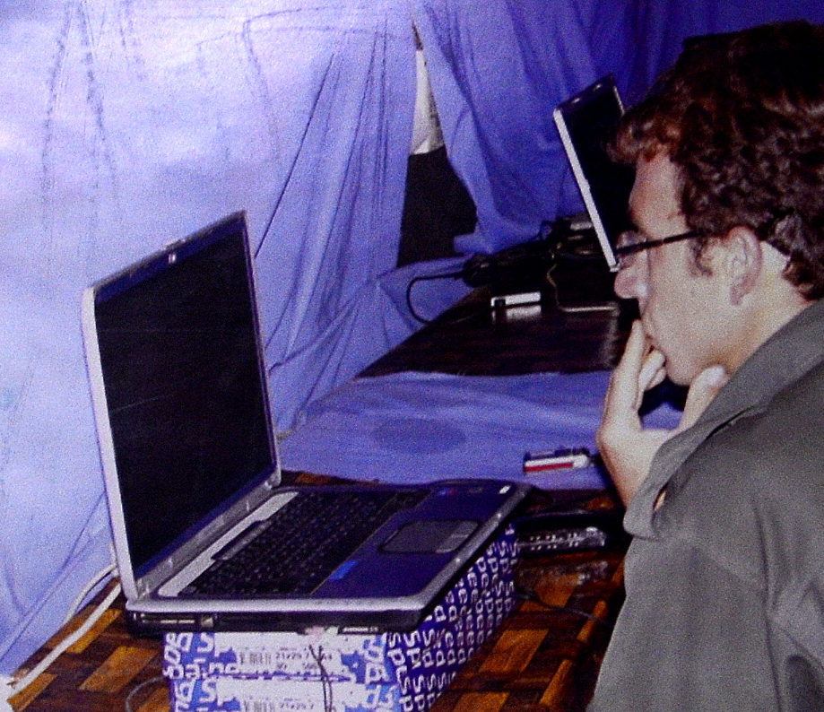
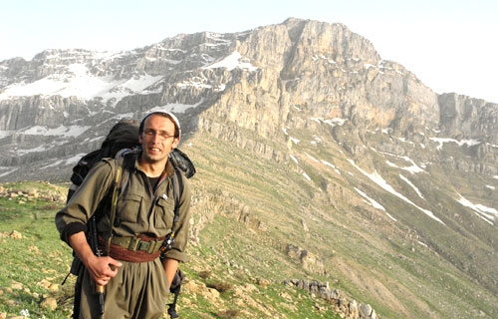
Mode of producing: “mountain cinema”

Slide 19
Film oeuvre
Central theme: conflict, resistance, daily life of guerrilla fighters, women
6 films, between 29 and 162 minutes
Hybrid between documentary and fiction
Cinematic language
  Symbols and allegories
  Natural environment

Slide 20
A closer look
Tirej
Firmeskên Ava Zê
Berîtan

Slide 21
Significance
Historical documents
Diversifying forms within the Kurdish mediascape
Propaganda
Inspiration

Slide 22
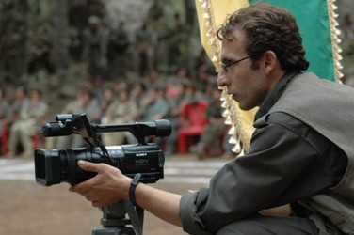
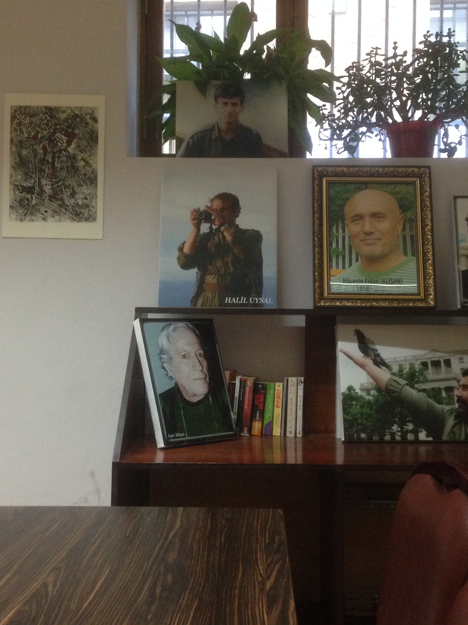
Excerpt from Tirej (2002) by Halil Dag

Slide 23
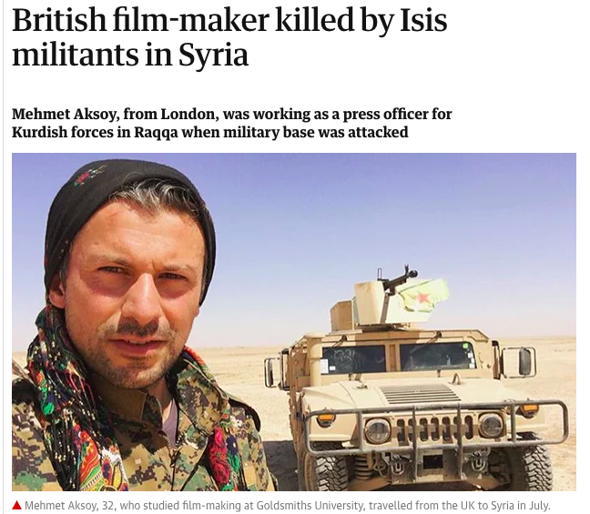
The Guardian, 27 September 2017

Slide 24
