Slide 1
Refugees and visual culture
Guest lecture Masaryk University Brno, November 2018
Prof. dr. Kevin Smets (Vrije Universiteit Brussel, Belgium)

Slide 2
Refugees and visual culture
Do iconic images make a difference?
  Case: Alan Kurdi
Representation and voice
  Case: reacting to images
Visual culture and daily life
  Case: refugee camp
(Discussion: refugee camp and technologies)

Slide 3
”Iconic images”, children and conflict

Slide 4
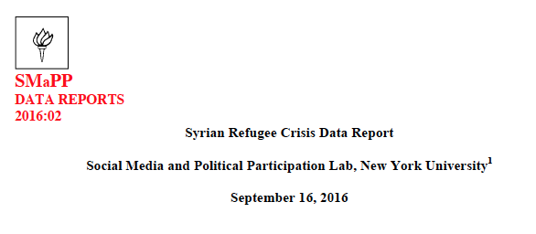
Alexandra Siegel & Joshua Tucker (SMaPP Lab, NYU)
Farida Vis, Simon Faulkner, Francesco D’Orazio & Lin Prøtiz
(Visual Social Media Lab)

Slide 5
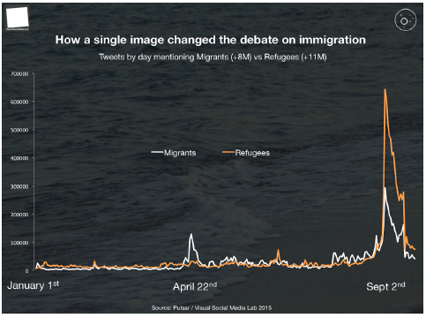
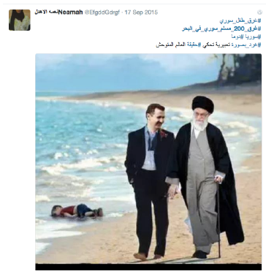

Slide 6
Central questions
How are refugees (as individuals/group) portrayed, visually and discursively?
How is the refugee issue (as a demographic/political phenomenon) framed, understood, explained or solved?
  Do the Alan images and “momentum” alter the discourses on refugees of Twitter users?
  Do different actors in the debate about refugees, such as NGO’s or politicians make use of the image? And in what ways does it connect to their discourses on refugees?
  How do these findings play out in specific national or local contexts?

Slide 7
Research focus
A qualitative analysis of tweets about refugees posted by key actors (NGOs, politicians, citizens) between June 2015 and July 2016 in Turkey and Flanders (Belgium)
Maximiliaanpark, Brussels
(September 2015)
Refugee camp in South-Eastern Turkey

Slide 8
Methodology: procedure
Defining key actors: NGOs, politicians, citizens (exploratory observations, literature)
Coding: inductive and deductive
Advantages of qualitative analysis: tone, context, relations, multi-modality, conversations (meso-level)
Selecting users in each actor category (Twitter advanced search options, multiple keywords)
Selecting tweets per user: purposive sampling
(Twitter advanced search options, scraping, TextWrangler, Excel)

Slide 9
Methodology: data
BELGIUM |  |  |  | TOTAL
Actor group | Citizens: 23 | Politicians: 11 | NGOs: 8 | 42
Tweets | 202 | 115 | 117 | 434
TURKEY |  |  |  | TOTAL
Actor group | Citizens: 15 | Politicians: 6 | NGOs: 9 | 30
Tweets | 285 | 15 | 227 | 527

Slide 10
Methodology: analysis
Category | Description
Descriptive information | Date, user name, follower numbers, etc.
Used links and visuals | Content of the link and pictures
Description of Refugees | Threat, Victim, Opportunity, Agents
Perspective of Representation | Individual vs. Collective perspective
Reasons of the ‘Refugee Crisis’ | How is refugee ‘crisis’ explained: reasons, explanations, people to blame
Solutions to the ‘Refugee Crisis’ | Solutions offered to the current situation
References to Aylan Kurdi | References to Aylan in September 2015 and afterwards

Slide 11
Citizens: representations of refugees
Refugees as victims
  Turkey: Anti-government tweeters blame the government, pro-government tweeters blame the opposition, Asad, the west, or the humanity
  Belgium: Refugees mostly seen as the victims of a lack of political action, or as the victims of instrumentalization (by politicians, media and NGOs)
Refugees as a threat
  Turkey: mostly during particular events and discussions (e.g. citizenship discussion); Aylan as a threat because of Kurdish ethnicity
  Belgium: most present during particular events (e.g. attacks in Brussels); connected to pre-existing tropes of migrant as exploiter and cultural Other

Slide 12
Citizens: framing the refugee ‘crisis’
The reasons for the refugee ‘crisis’
  Users who are against migration: economic pull factors, particular politicians
  Users who are positive about migration: vague reasons (e.g. ‘humanity’)
The solutions for it
  Those employing a victim representation: call for action and solidarity
  Those employing a threat representation: closing borders, restricting migration, cutting benefits (mostly in Belgian case)

Slide 13
Discussion (all actors)
Change over time and the ’Aylan moment’
  Consistency and coherence at user-level
  Aylan image incorporated into pre-existing discourses
  Exception: 1-time tweeters with strong affective responses
Comparing Turkey and Belgium
  More intra-actor discussions in Belgium
  Different roles of Islam
  More political polarization in Turkey: AKP, Gülen, Kurdish issue
  Both see the Gulf countries as the bad ‘Others’ who do not take any refugees
  Islamic State rather absent

Slide 14
Discussion
Users who oppose to immigration employ the clearest vocabulary and framework
Significance of the comparison
  ‘Global’ icon and awareness ←→ Local and national contexts and discussions
The limited power of the iconic image (on social media)
  Continuity of discourses rather than disruptions
  Similarities and convergence with ’traditional’ media

Slide 15
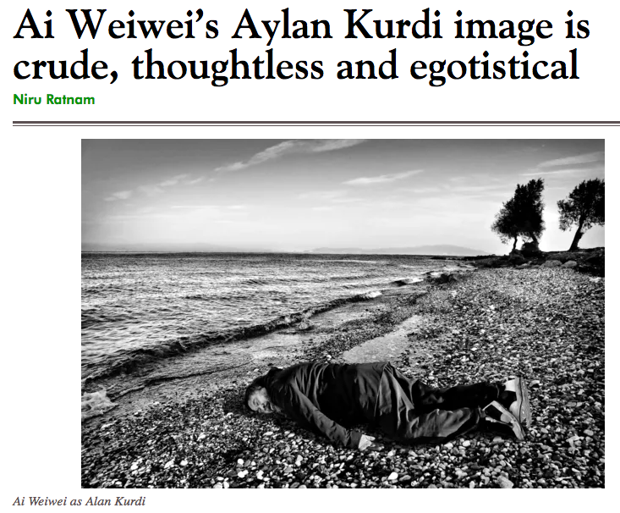

Slide 16
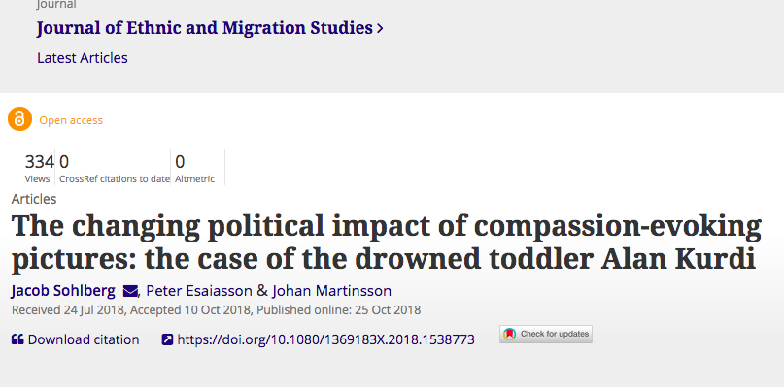

Slide 17
Representation and voice

Slide 18
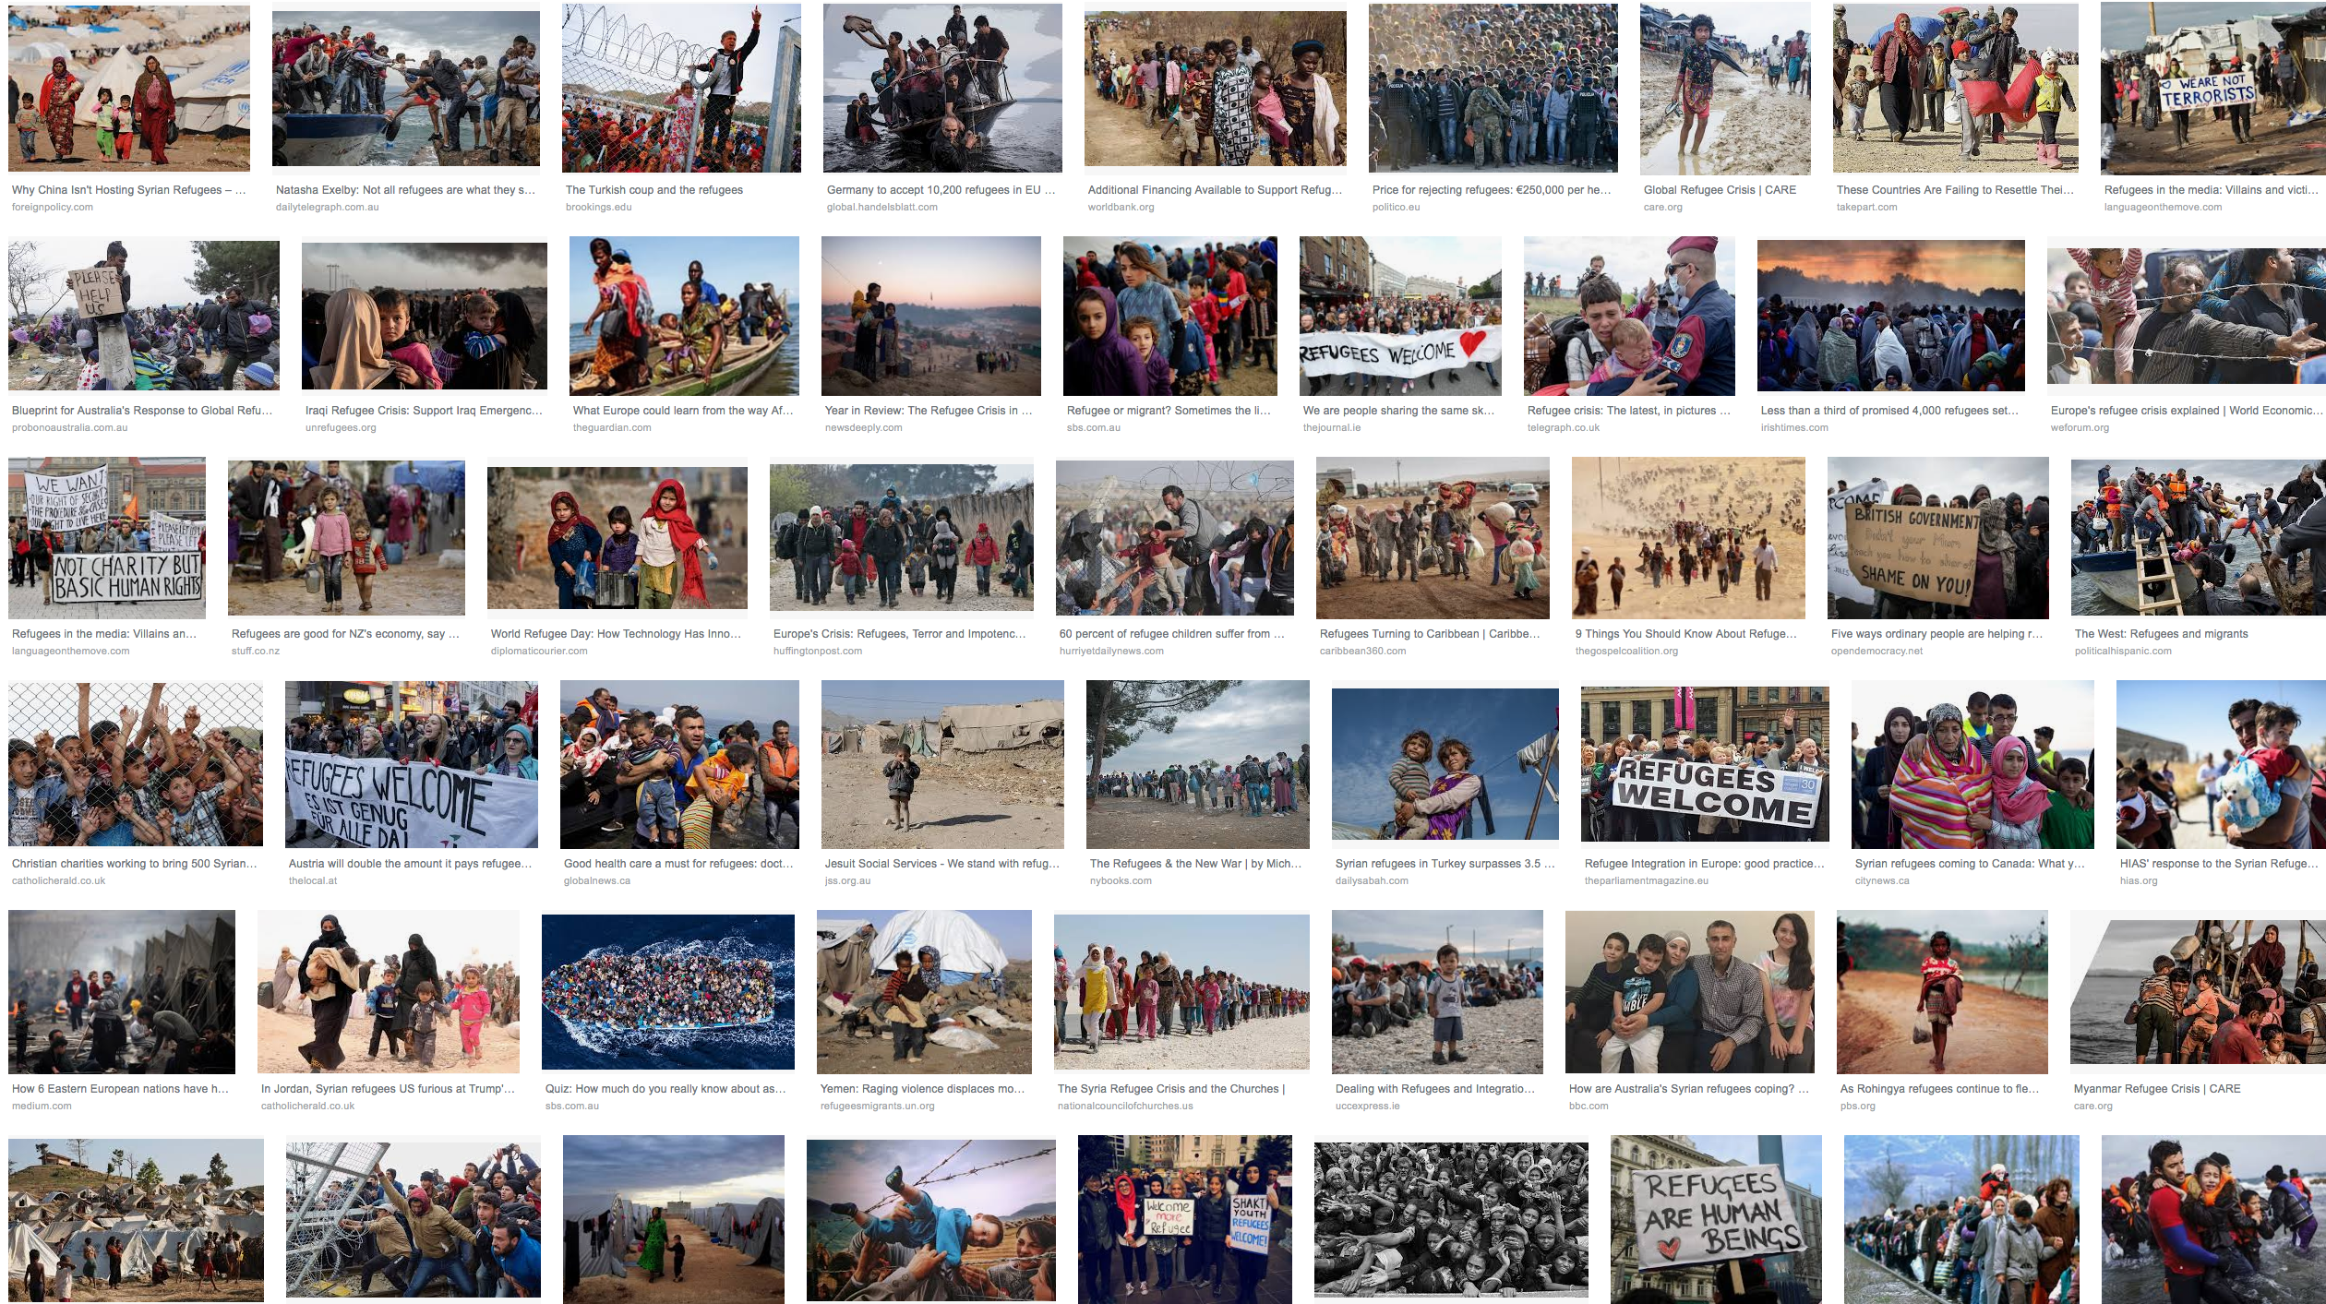
(Visual) representations of forced migration
Migrants do not have “voice”
Emphasis of “Otherness”
Social, economic or security threats
Victimization, “Regime of pity”
(Chouliaraki, 2006; Chouliaraki & Stolic, 2017; Georgiou & Zaborowski, 2017; Ongenaert & Joye, in press; Wright, 2002)

Slide 19
Misrepresentations can be harmful to groups
Include the perspectives of those being represented
Co-analyzing media texts
(Horsti, forthcoming; Georgiou, 2018; Nikunen, forthcoming; Perez Portilla, 2018; Rajaram, 2002)

Slide 20
Methods
Interdisciplinary team
Interviews, focus groups and visual workshops with 44 asylum seekers and refugees from Syria (24), Afghanistan (11) and Iraq (9)
31 men, 13 women, between ages 17 and 60 ; many had post-secundary education
Inspired by photo voice and photo elicitation methods
Core of discussions about representation: a database of 29 photos (Reuters, AP, Magnum, ...) that represent key themes in coverage on refugees

Slide 21
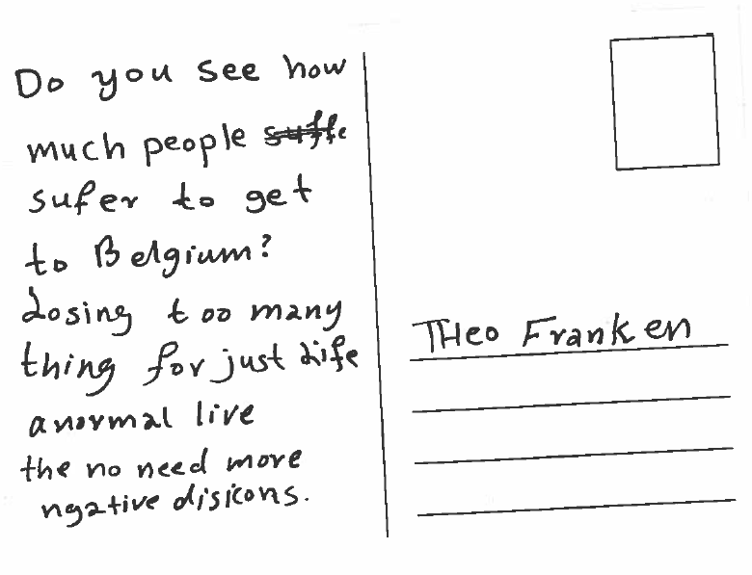
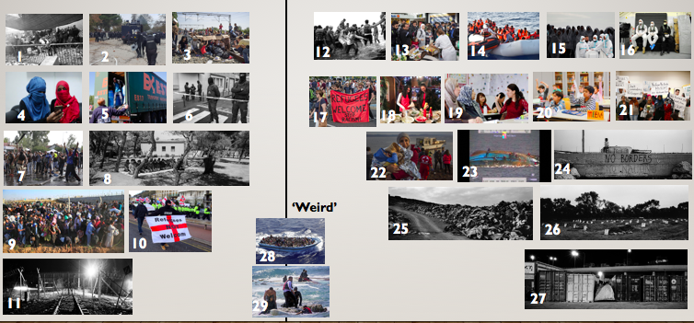
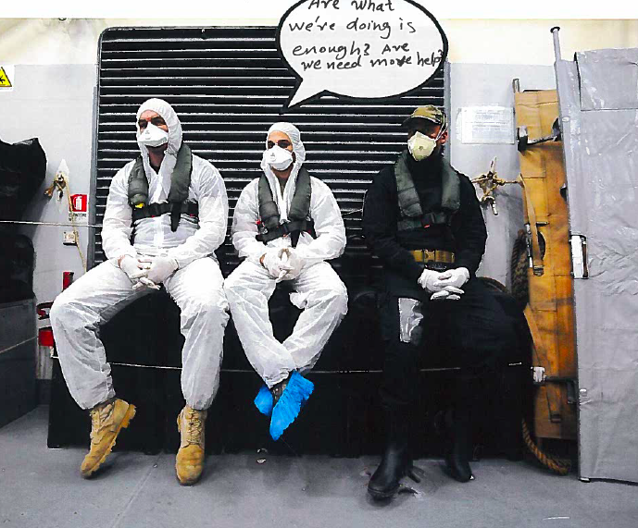

Slide 22
The triple violence
Experiences of the country fled, the risk-taking journey, and the unstable new lives (Kobelinsky, 2012)
Ensuing trauma
How to re-humanize oneself? How to regain a dignified life?

Slide 23
The climate of suspicion
“Deserving” versus “undeserving” migrants (Lacroix, 2016)
“Crimmigration” (Stumpf, 2006)
The individual responsibility and “the right to have rights” (Mazzocchetti, 2017)
How to prove one merits asylum?

Slide 24
A paradigmatic shift
(counter-representations)
From pity to empathy
Showing suffering in all its shapes – including deception in Belgium
Criticizing victimhood as a pan-identity

Slide 25
Visual culture and dialy life

Slide 26
What are refugees doing when they are not suffering?
How do refugees react to these portrayals?

Slide 27
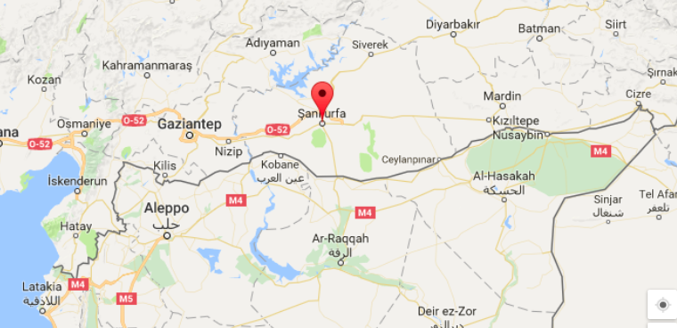
media and home-making in a refugee camp

Slide 28
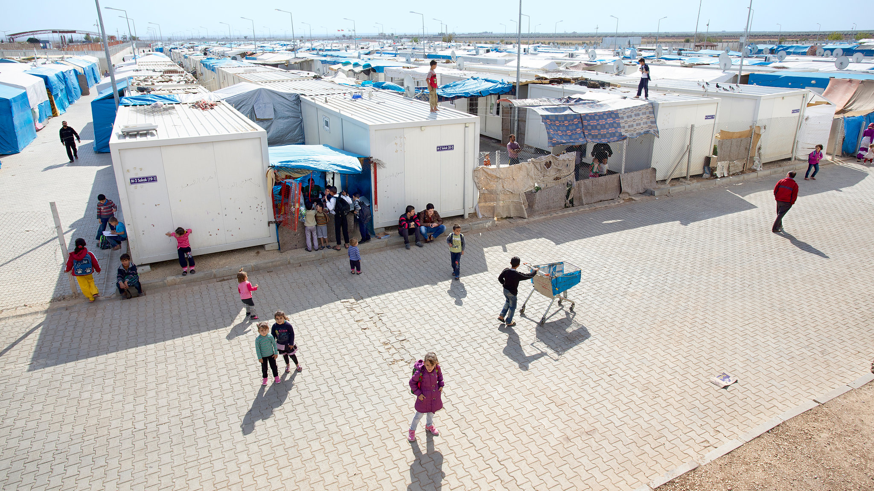
Kilis, © Tobias Hutzler

Slide 29
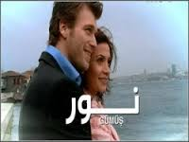
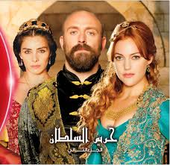
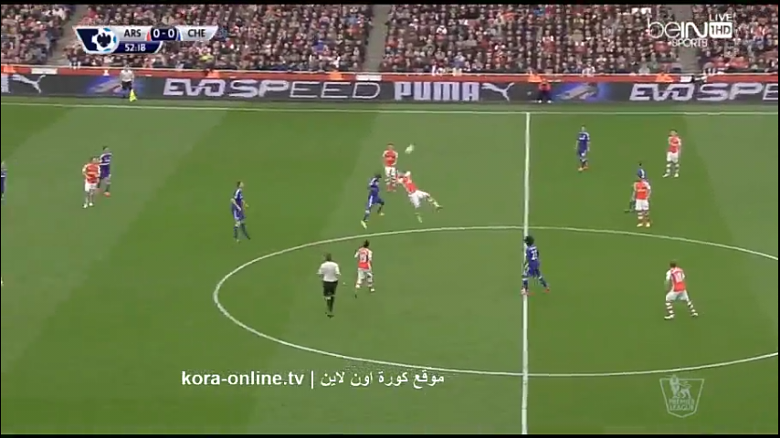
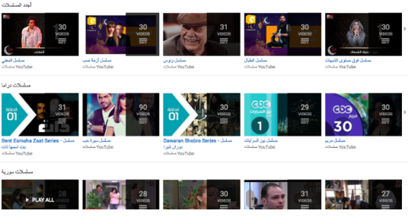
1. Entertainment and popular culture play a central role in maintaining “ontological security”

Slide 30
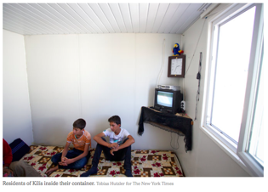
2. Media devices are important “currency” in the camp’s informal economy
© Tobias Hutzler
© Anita Fabos & Cathrine Brun

Slide 31
District Zero (2015, Jorge Fernandez, Pablo Iraburu, Pablo Tosco)

Slide 32
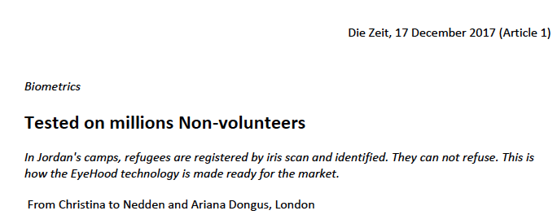
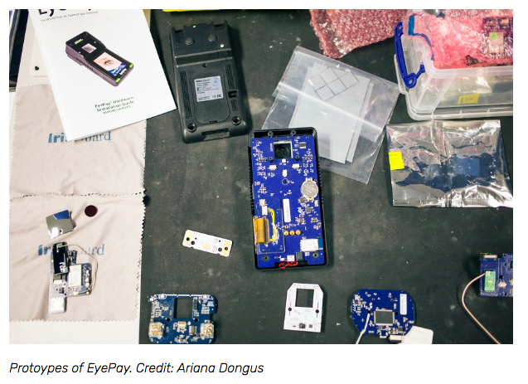
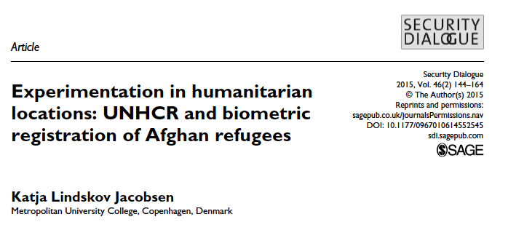
Discussion: technology in refugee camps?

