Slide 1
Kánon umění nových médií. The best of new media art I IMK47 BLOK 2
Mgr. Martina Ivičič
Teorie interaktivních médií
180916@mail.muni.cz
Podzim 2018

Slide 2
Umelecká avantgarda : Hnutie fluxus
FLUXUS FILMS (FLUX FILM ANTHOLOGY)
Nam June Paik, Dick Higgins, George Maciunas, Chieko Shiomi, John Cavanaugh, George Brecht, Wolf Vostell, George Landow, Paul Sharits, Ben Vautier
Chris Burden: SHOOT 1971
https://www.youtube.com/watch?v=q9Dd5Ze10tQ
YOKO ONO: CUT PIECE 1964 https://www.youtube.com/watch?v=lYJ3dPwa2tI&t=11s
http://www.ubu.com/film/fluxfilm.html

Slide 3
Umelecká avantgarda : JoHN CAGE
John Cage: I have nothing to say and I´m sayin it. ---- HOMEWATCH !!!!
https://www.youtube.com/watch?v=EfP5OMCfiZs
John Cage: 4:33 for piano (1952) John Cage: 4.33 http://www.youtube.com/watch?v=gN2zcLBr_VM
Imaginary Landscape No. 1 (1939)
http://www.medienkunstnetz.de/works/imaginary-landscape-1/audio/1/
Imaginary Landscape No. 3 for 6 percussionists http://www.youtube.com/watch?v=HWGnN_W0EkE
Imaginary Landscape No. 4 ,12 radios (1951) http://www.youtube.com/watch?v=51zT2qX10FA
WATER WALK: https://www.youtube.com/watch?v=SSulycqZH-U
John Cage: HPSCHD : Computer-generated sound tapes
http://www.youtube.com/watch?v=t_hTxJpWITw

Slide 4
Dick Higgins: partitúry

Slide 5
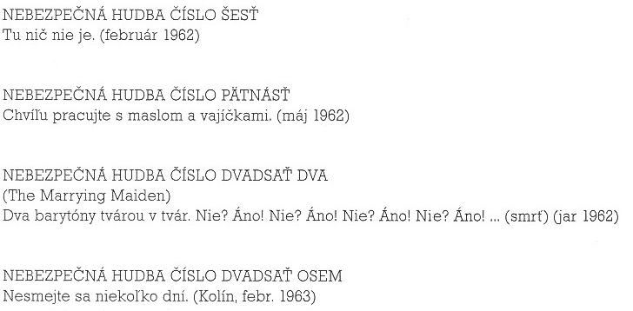

Slide 7
Partitúra pre dvoch interpretov a klavír
Sadnite si ku klavíru.
Interpret č. 1 sa doširoka usmeje
Interpret č.2 pozoruje spoluhráčov úsmev
Nech sa zuby interpreta č. 1 stanú notovým zápisom
Interpret č. 2 zahrá na klavíri skladbu na základe tohto notového zápisu

Slide 8
COMPUTER ART
Cybernetic Serendipity (1968)
https://www.youtube.com/watch?v=n8TJx8n9UsA then
https://www.youtube.com/watch?v=oSwovB28B34 now
Charles Csuri: Hummingbird 1967 https://www.youtube.com/watch?v=tpCMOgpx70M
John Whitney: Permutations 1968 https://www.youtube.com/watch?v=kdYxJ85RSds

Slide 9
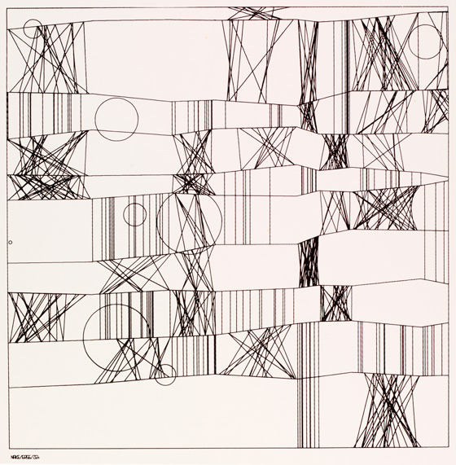
Michael Noll: Computer Generated Ballet 1965
https://www.youtube.com/watch?v=-dXQIUEwEGQ
Frieder Nake : 'Hommage à Paul Klee
13/9/65 Nr.2', 1965
GEORG NEES

Slide 10
POČIATKY VideoartU
Nam June Paik : Lessons from the VideoMaster, http://ubu.com/film/paik_master.html
Nam June Paik : NYC 2009 retrospektívna výstava
TV SCULPTURES: http://www.youtube.com/watch?v=Ra-OU33n434&feature=related
NJP: PIANO: http://www.youtube.com/watch?v=8XcoJEBXm90
NJP: Electronic Superhighway: http://www.youtube.com/watch?v=3rPZYGuCFdw&feature=related
VIDEO FLAG: http://www.artelectronicmedia.com/artwork/video-flag-y
NJP: VENUS
https://www.youtube.com/watch?v=hP03QNPvs80
Nam June Paik - Videofilm Concert (1965
https://www.youtube.com/watch?v=VEAUjFLSqXY

Slide 11
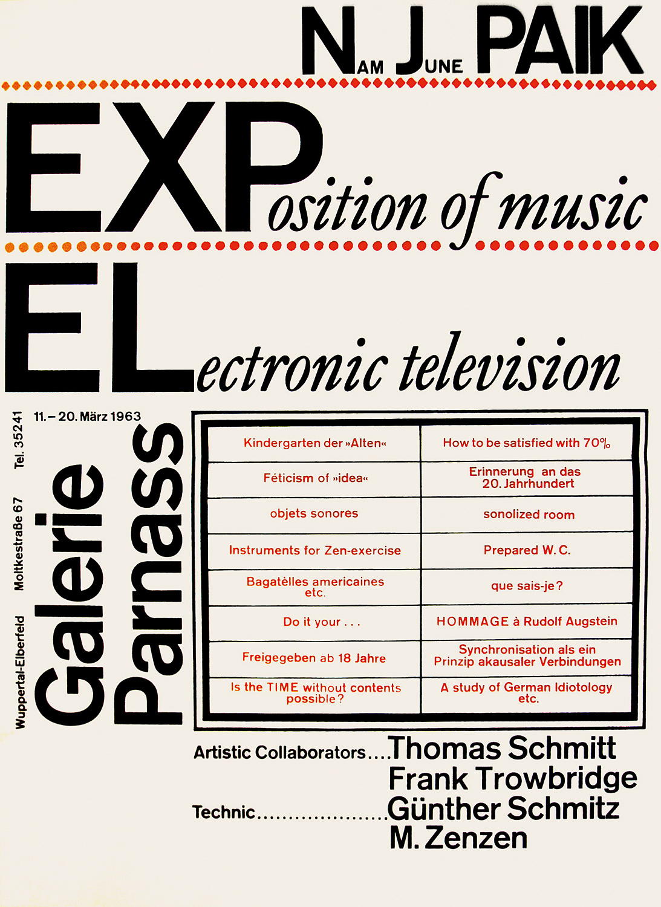

Slide 12
Wolf Vostell
Sun in your head
https://www.youtube.com/watch?v=IJcOQ5FAlGw
'9 No – Dé-coll/ages) - 14 September 1963 in nine different locations in Wuppertal, and was organized by the Galerie Parnass
Wolf Vostell Elektronischer dé-coll/age Happening Raum 1968
https://www.youtube.com/watch?v=XzGsVbSdD3k

Slide 13
WOODY & STEINA VASULKA
Intro: https://www.youtube.com/watch?v=Ylow_1ytoiE
Woody Vasulka: Virtuální houbaření. Iluminace, 2006 DVD
Lenka Dolanová, Dialog s démony nástrojů - Steina a Woody Vasulkovi, Prague: Nakladatelství Akademie múzických umění / Mezinárodní festival dokumentárních filmů Jihlava, 2011. 208 pages.
Steina Vasulka ubu.com: http://www.ubu.com/film/vasulka_calligrams.html
http://www.vasulka.org/Videomasters/MA_index.html VIDEOARCHÍV

