Slide 1
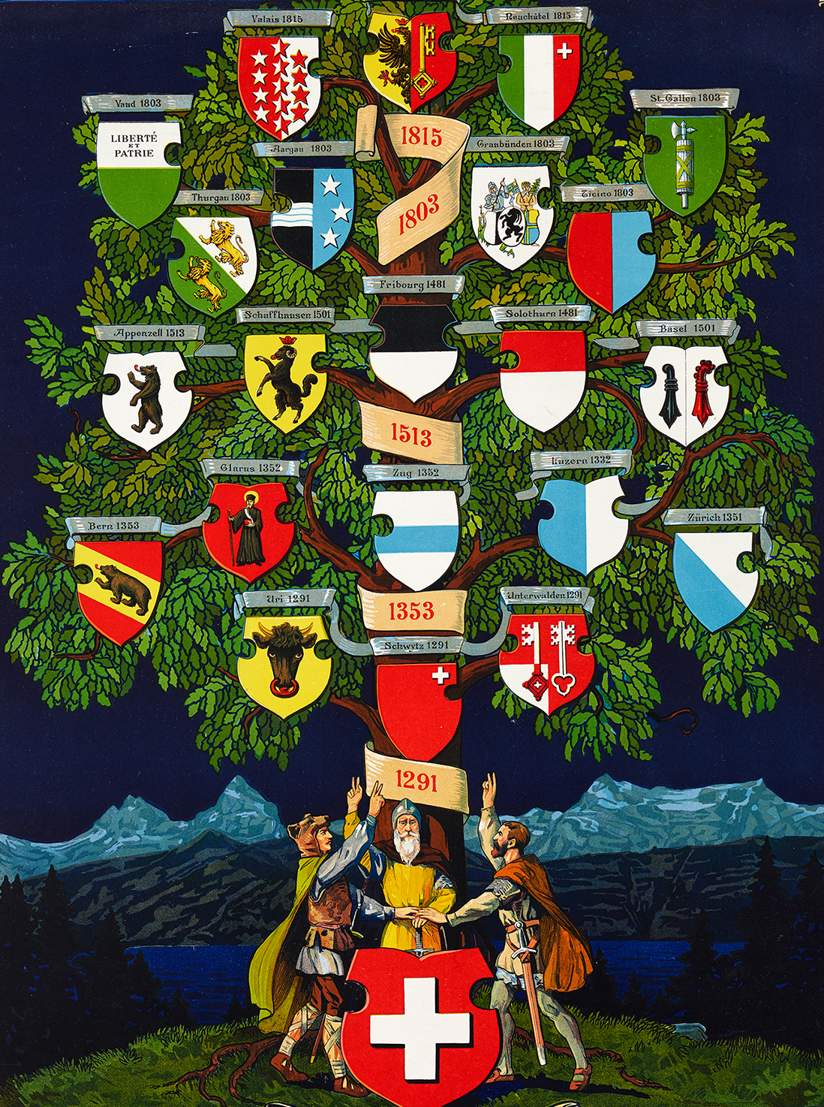
Swiss Medieval History IV
The Rural Communities

Slide 2
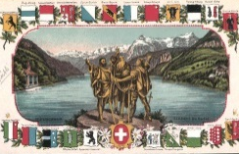
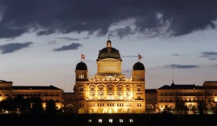

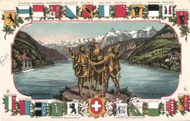
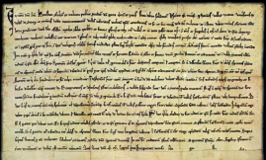
General Survey
Introduction 5’
«National Symbols» 10’
Important Facts and Dates 5’
Towns vs. Rural Communities 25’
Source-Reading (Federal Charter) 45’

Slide 3

Learning Outcomes 24.10.2018
Introduction
Students can enumerate towns, rural communities and other members of the late medieval Swiss Confederation
Students can identify the main characteristics of the members of the late medieval Swiss Confederation
Students can describe the political structures, procedures and functions of late medieval rural communities
Students are able to recognize intentional writing of towns or rural communities in sources and historiographical texts

Slide 4
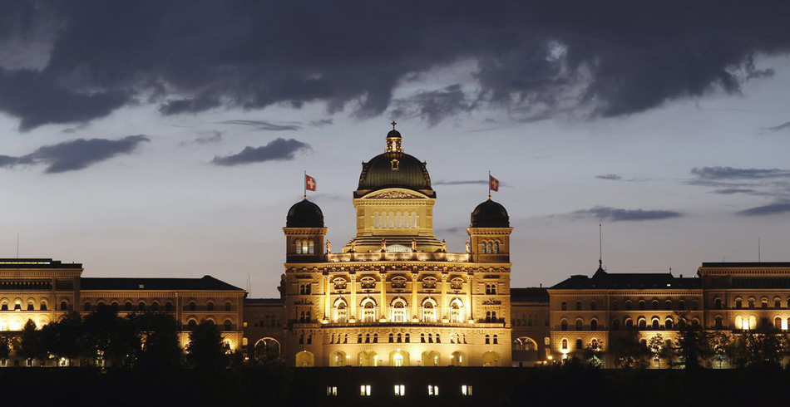

Slide 5

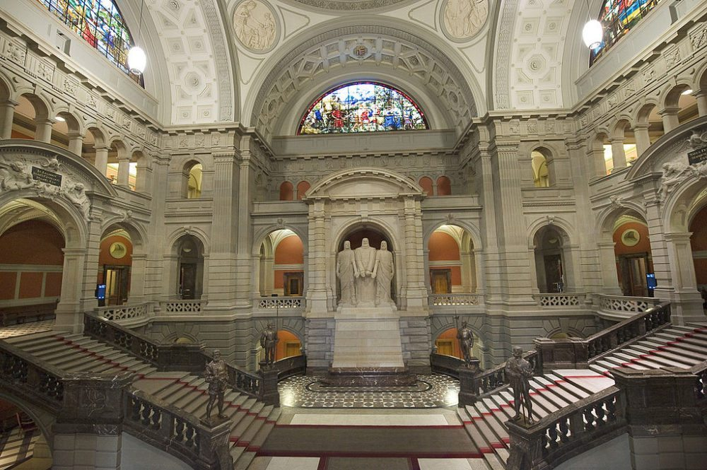

Slide 6


Slide 7
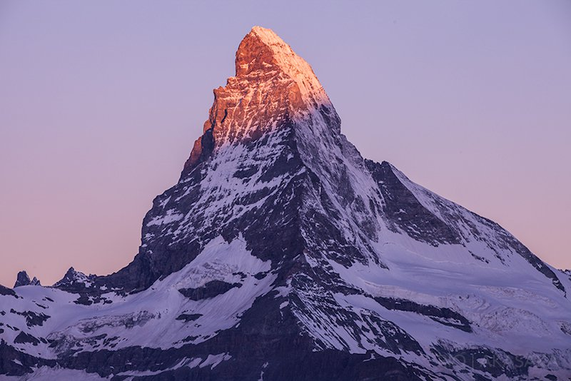
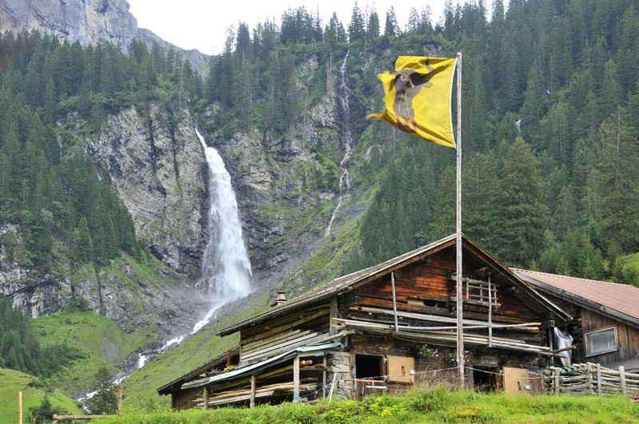
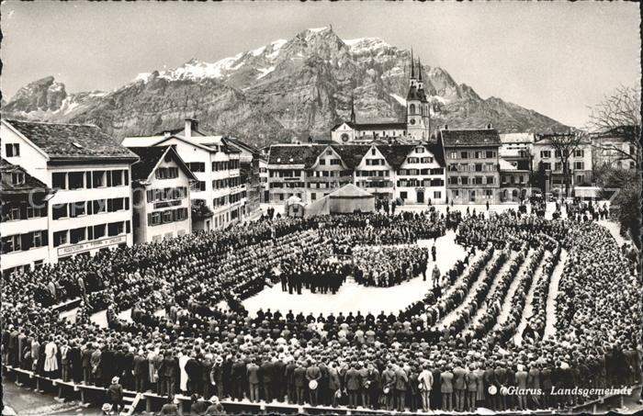

Helvetia and her neighbours, anonymous , Zürich around 1612

Slide 8
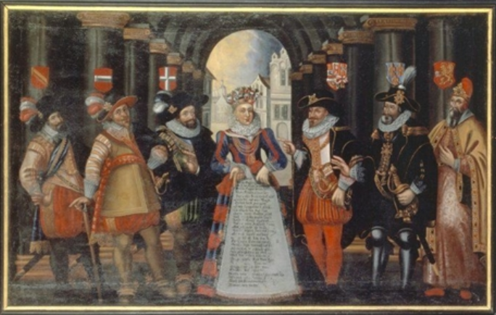
«League of the discordant members»
Helvetia and her neighbours, anonymous , Zürich around 1612

Slide 9
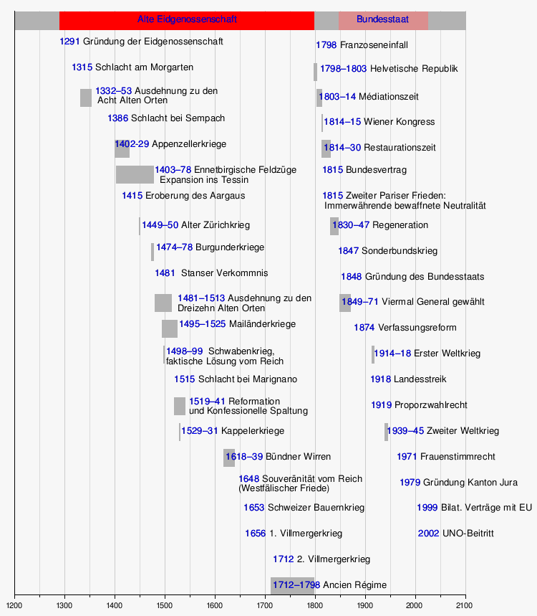
Important Facts
Red: Direct implications with the Rural Cantons

Slide 10
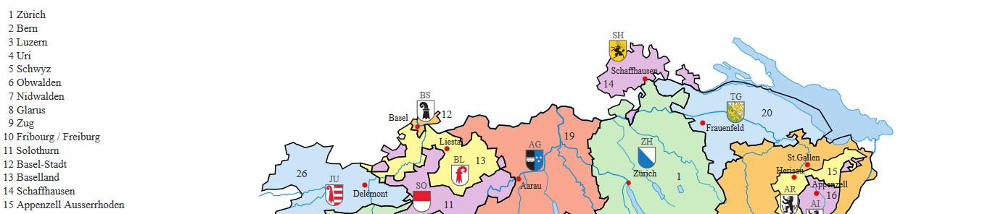
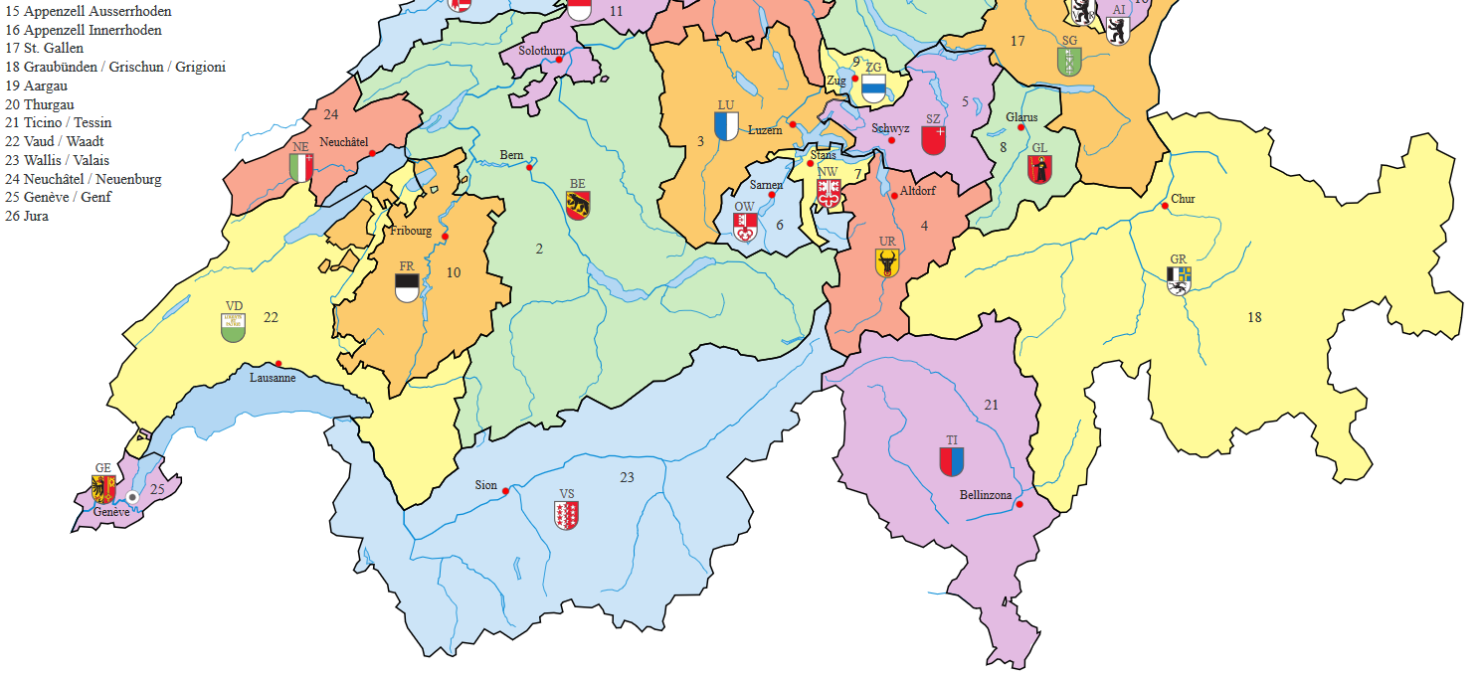
Cantons
Remember the
Coats of Arms!

Slide 11
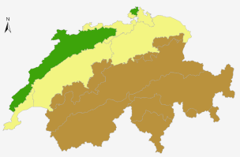
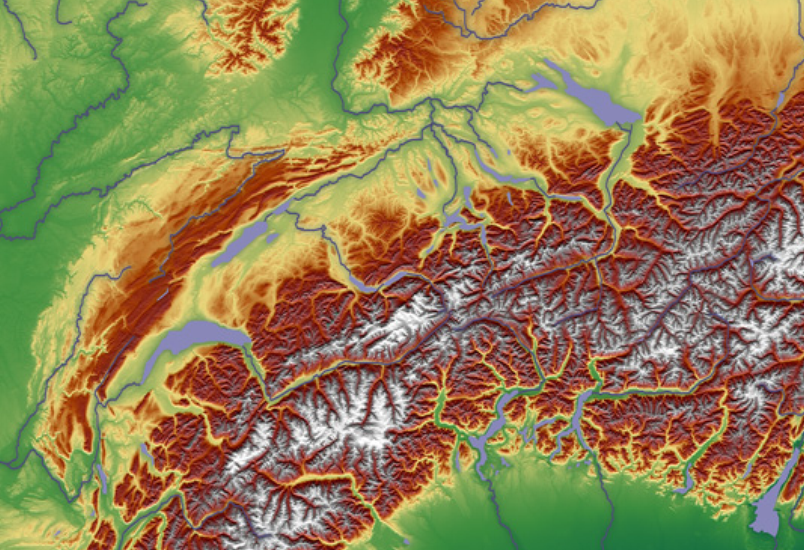
Rural Communities

Slide 12
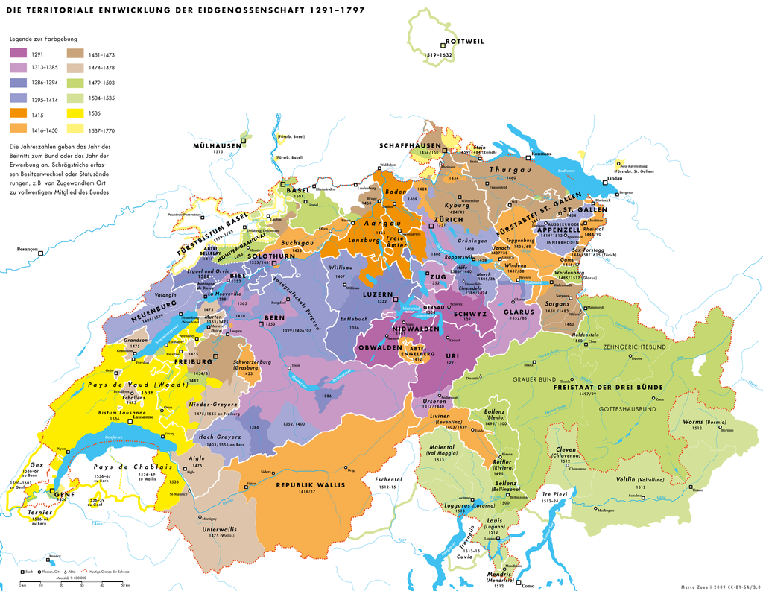

Slide 13
Rural Communities

Slide 14
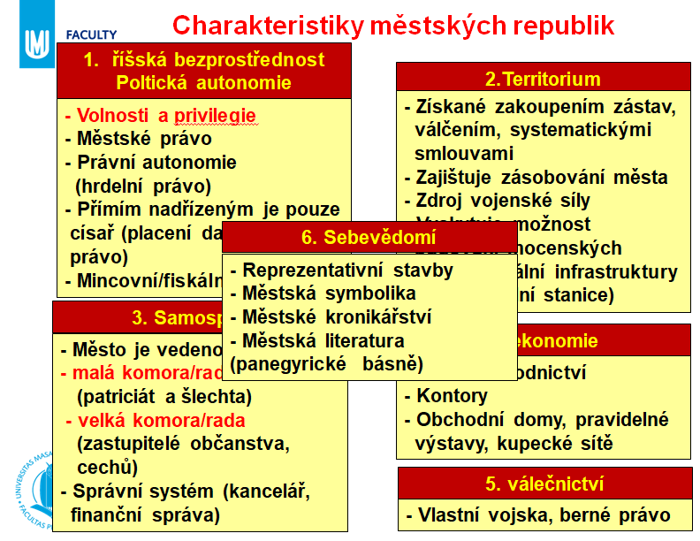
Characteristics of Rural Communities
Comparison
with towns:

Slide 15
Characteristics of Rural Communities
1. Formal independence
2. Territory
3. Self government
4. Economy
5. Warfare
6. Image

Slide 16











I: Central Switzerland

Slide 17
II Western Switzerland
Erguel
Kandertal
Saanen
Hasli
Simmental

Slide 18
1) Formal Independece (town)
říšská bezprostřednost
Poltická autonomie
Justice and Law
- Volnosti a privilegie
- Městské právo
- Právní autonomie
(hrdelní právo)
- Přímím nadřízeným je pouze
císař (placení daní, berné
právo)
- Mincovní/fiskální právo
Posession
Regime

Slide 19






1) Formal Independece
1. Contract with CH
Formal independence
1291: UR 14.c. √
SZ 14.c. √
UW (hw) X
1332: LU (A) X
1351: ZH 13.c. √
1352: GL (A) X
ZG (A) X
1353: BE 14.c. √
UW=Unterwalden=is composed of
Obwalden (OW) and Nidwalden (NW)
Hw=Hunwil, local gentry
A=Austria

Slide 20
1) Formal Independece (RC)
lower iurisdiction
higher iurisdiction
Lawgiving
Ownership/Property
Use/usufruct/interests
Lordship
Overlordship
Privigelies
Representation
Justice and Law
Posession
Regime
Image

Slide 21
1) Formal Independece
BERN
RC (central)
říšská bezprostřednost
Poltická autonomie
√
√
Justice and Law
- Volnosti a privilegie
- Městské právo
- Právní autonomie
(hrdelní právo)
- Přímím nadřízeným je pouze
císař (placení daní, berné
právo)
- Mincovní/fiskální právo
√
Posession
Regime
√
Image

Slide 22
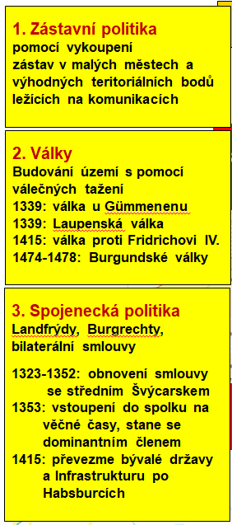
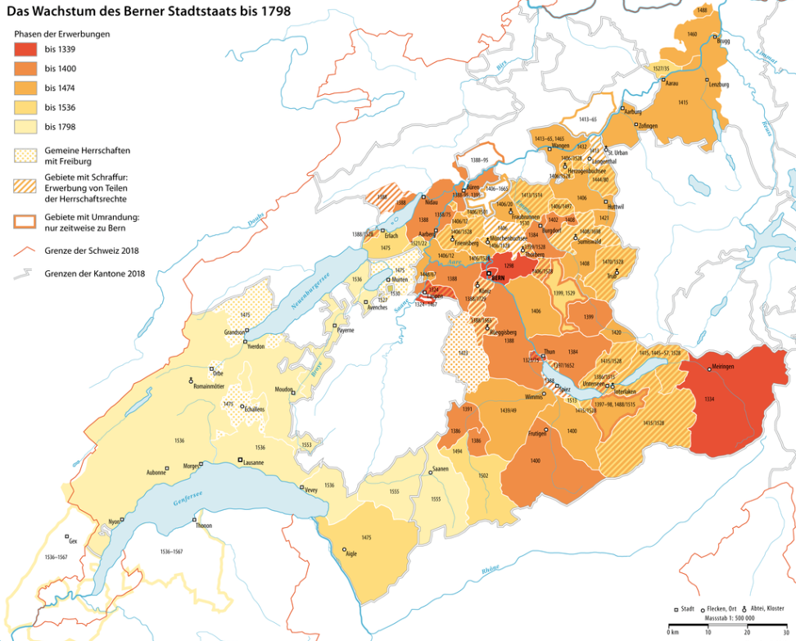
II: Western Switzerland
Erguel
Biel
Burgdorf
Laupen
BERN
Thun
Saanen
Hasli
Kandertal
Simmental

Slide 23
1) Formal Independece
BERN
RC (Saanen)
říšská bezprostřednost
Poltická autonomie
√
Justice and Law
- Volnosti a privilegie
- Městské právo
- Právní autonomie
(hrdelní právo)
- Přímím nadřízeným je pouze
císař (placení daní, berné
právo)
- Mincovní/fiskální právo
√
Posession
Regime
√
Image

Slide 24
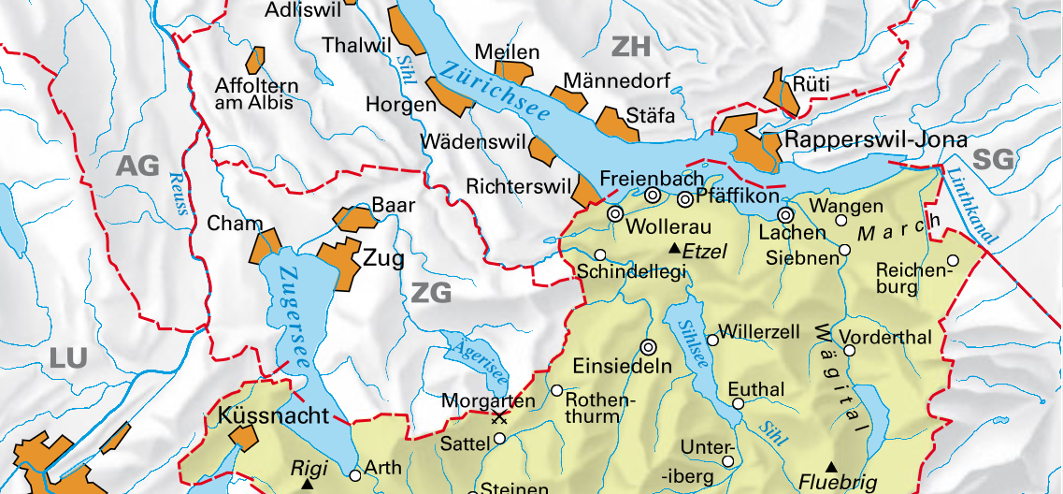
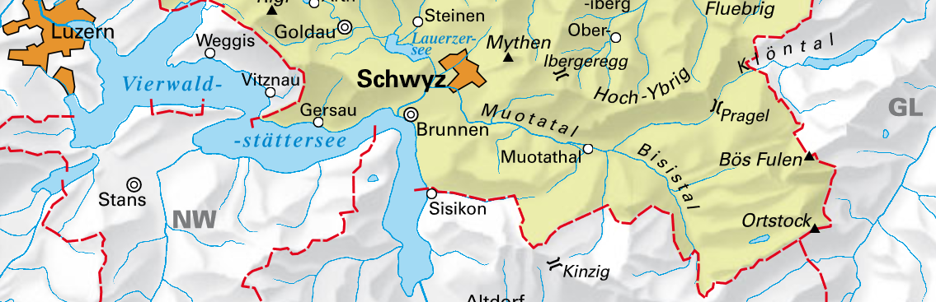
2) Territory
BERN
Schwyz
2.Territorium
- Získané zakoupením zástav,
válčením, systematickými
smlouvami
- Zajištuje zásobování města
- Zdroj vojenské síly
- Vyskytuje možnost
budování mocenských
pozicí, fiskální infrastruktury
(silnice, celní stanice)
(√)
√

Slide 25
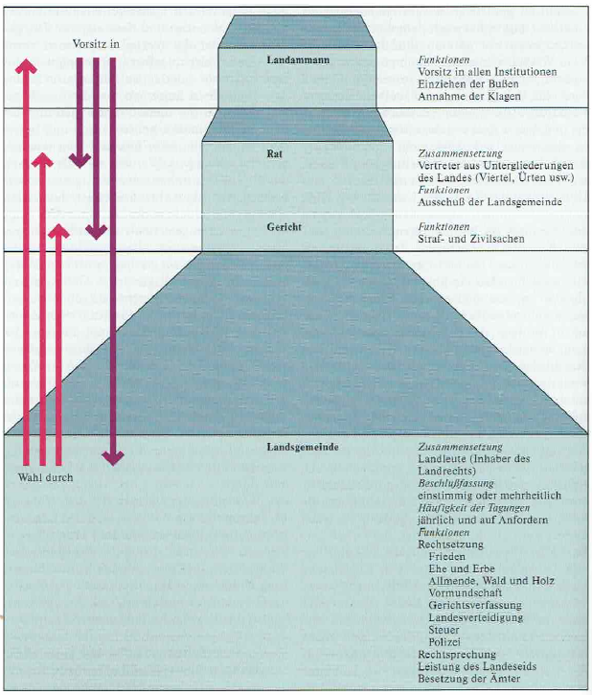
3) Self government
Schwyz
BERN
mayor
3. Samospráva
- Město je vedenou radou
- malá komora/rada/senát
(patriciát a šlechta)
- velká komora/rada
(zastupitelé občanstva,
cechů)
- Správní systém (kancelář,
finanční správa)
counsil
court
cantonal
assembly
√
√

Slide 26
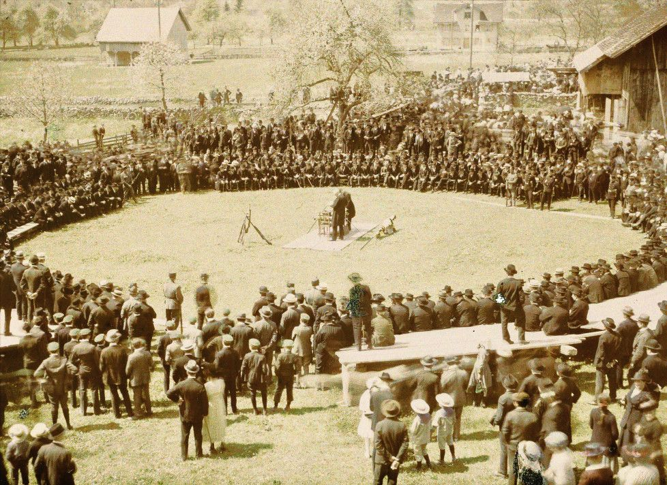
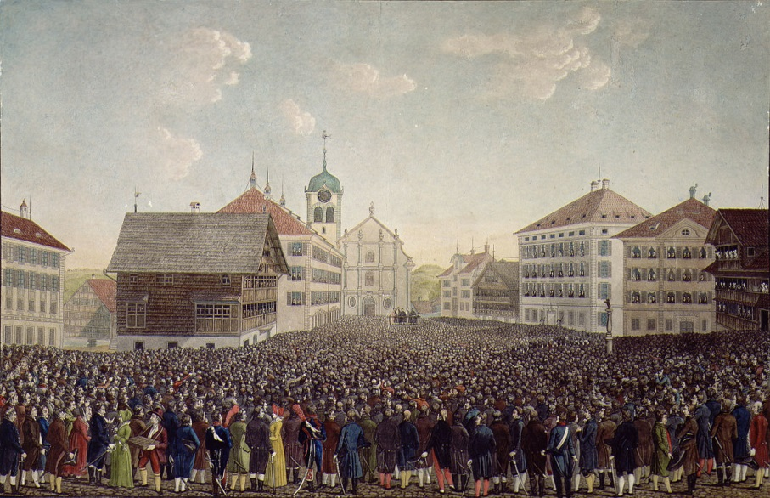
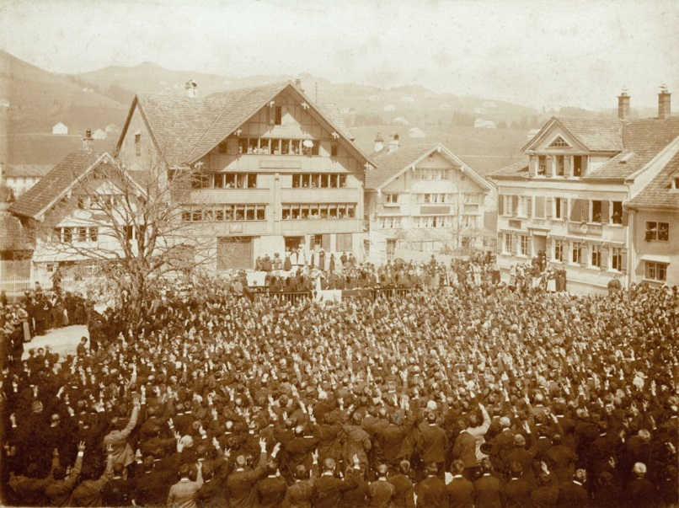
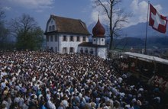
3) Cantonal Assembly
Heiden (AR) 18th c.
Uri 1920s
Appenzell (AI) 1900
Obwalden 1970s

Slide 27
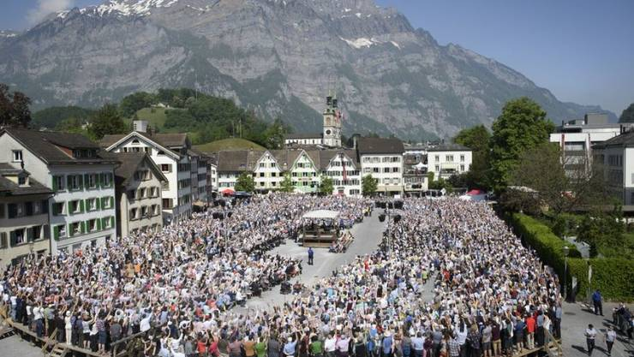
3) Cantonal Assembly
Glarus (GL) 2018

Slide 28
4) Economy
?
4. ekonomie
- Silné obchodnictví
- Kontory
- Obchodní domy, pravidelné
výstavy, kupecké sítě
Cattle in the Glaronese Alps

Slide 29
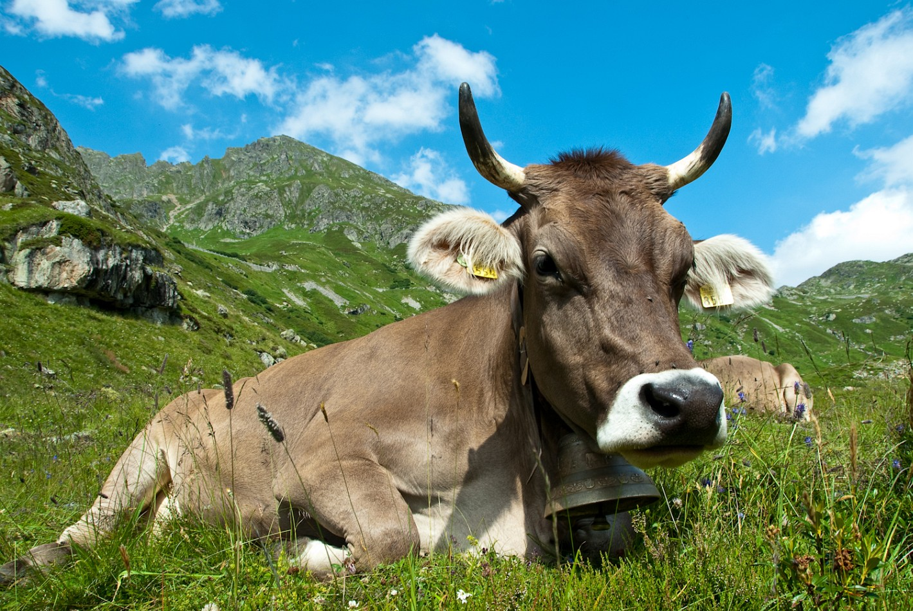
4) Economy
Cattle in the Glaronese Alps

Slide 30
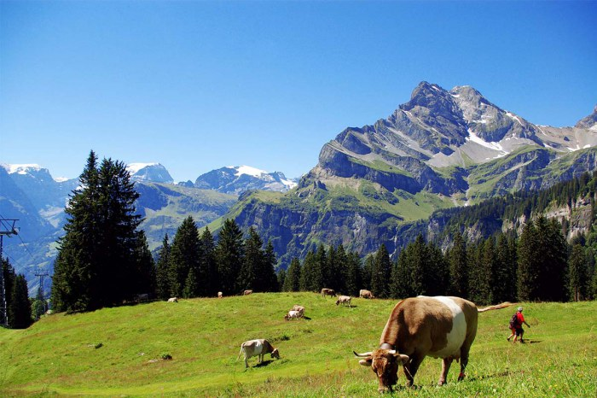
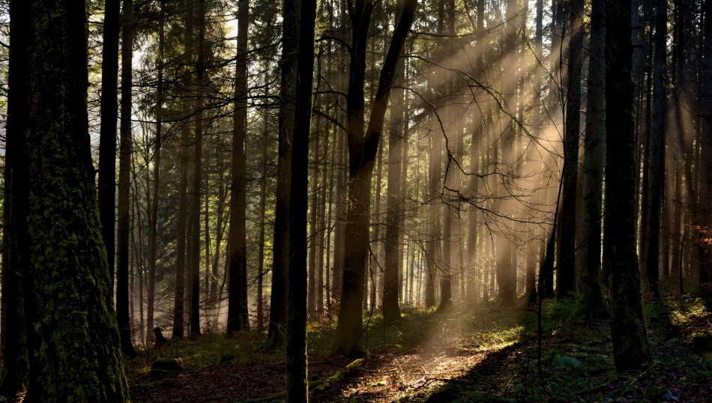
4) Economy
Cattle in the Glaronese Alps

Slide 31
break

Slide 32
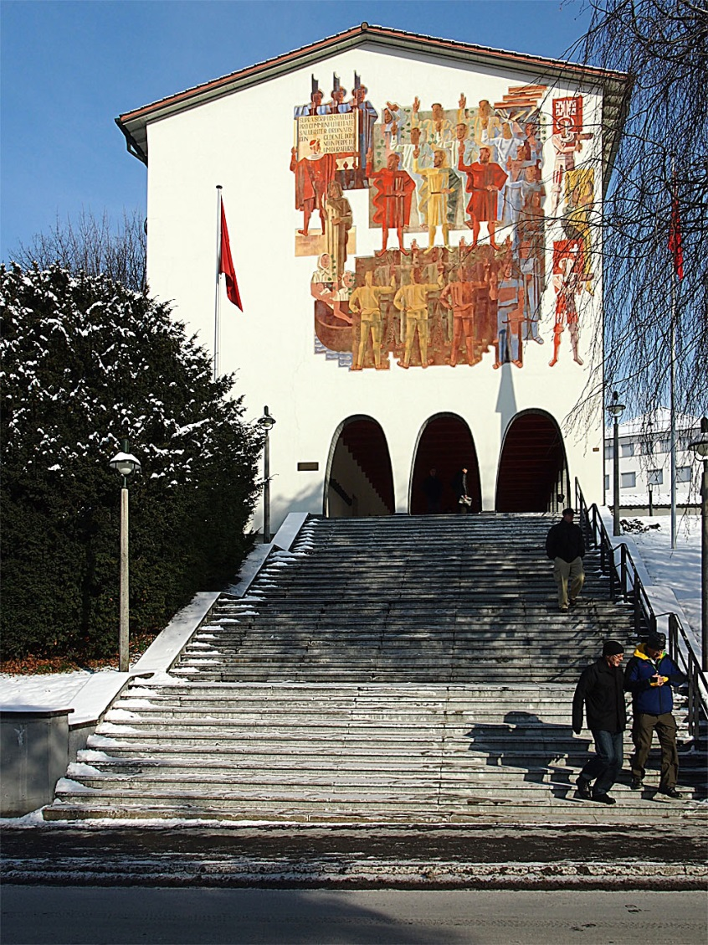
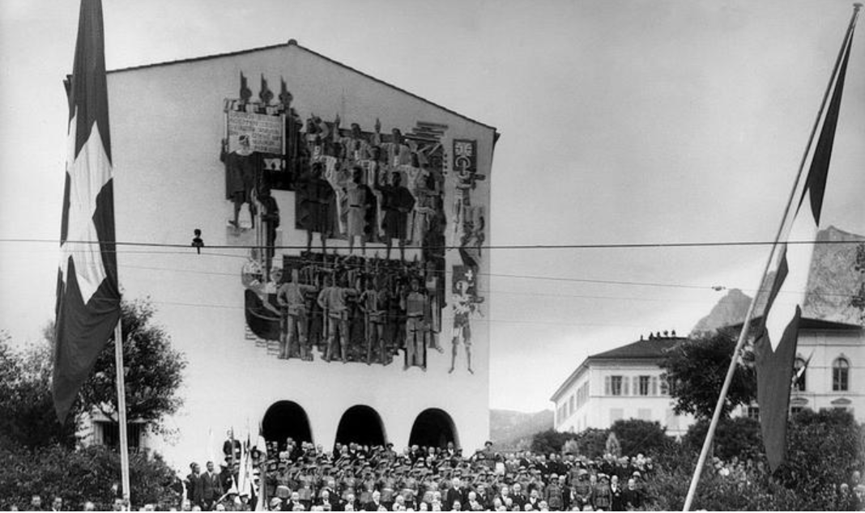
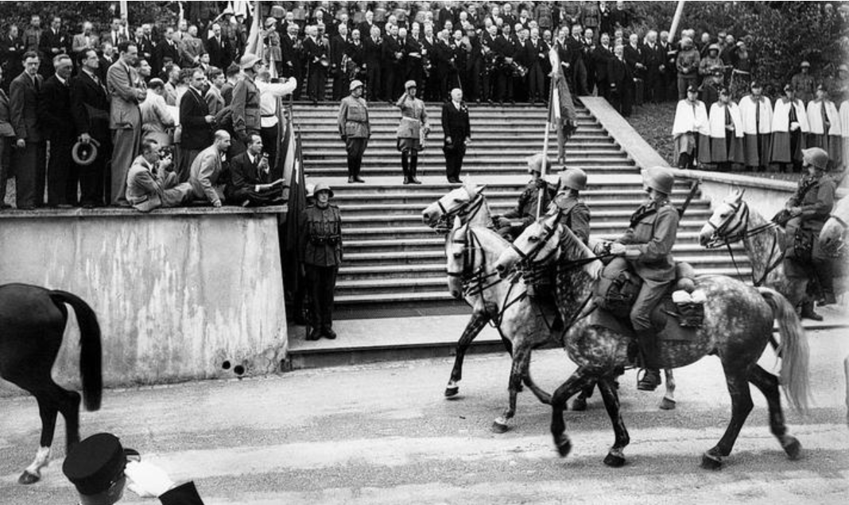

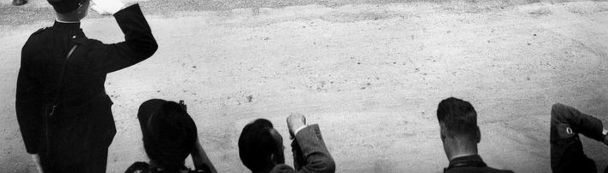
Federal Charter 1291

Slide 33
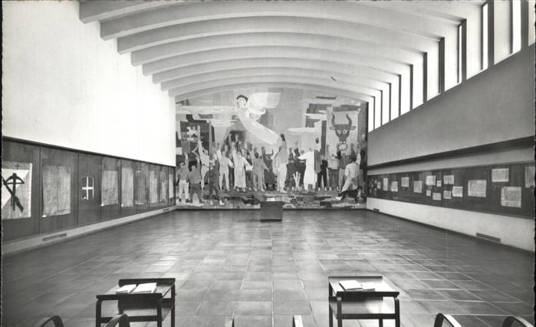
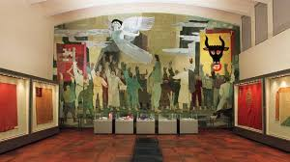
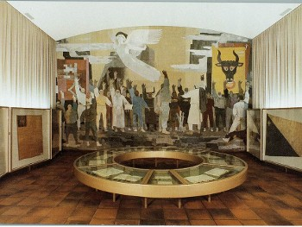
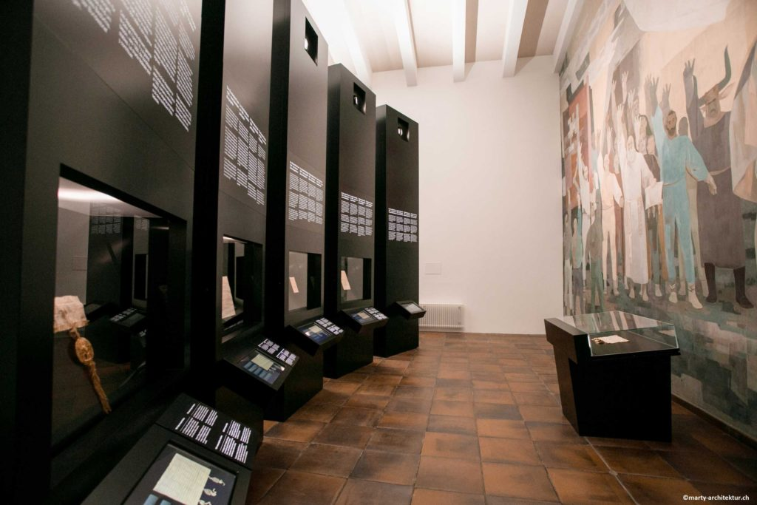
Federal Charter 1291

Slide 34

Source-reading:
Federal Charter 1291

Slide 35
Federal Charter 1291
In nomine domini amen. Honestati consulitur et utilitate publice providetur ,
dum pacta quietis et pacis statu debito solidantur. Noverint igitur universi,
quod homines vallis Uranie, universitatisque vallis de Switz, ac communitas
hominum intramontanorum vallis inferioris maliciam temporis attendentes, (…).

Slide 36
Federal Charter 1291 (1)
In nomine domini amen. Honestati consulitur et utilitati publice providetur, dum pacta quietis et pacis statu debito solidantur.
Noverint igitur universi, quod homines vallis Uranie universitasque vallis de Switz ac communitas hominum Intramontanorum Vallis Inferioris maliciam temporis attendentes,
For the common good and proper establishment of peace, the following rules are agreed :
It is to be known that, view of the troubled circumstances of this time, the people and communities of Uri, Schwyz and Nidwalden (…)

Slide 37
Federal Charter 1291 (2)
…ut se et sua magis defendere valeant et in statu debito melius conservare,
fide bona promiserunt invicem sibi assistere auxilio, consilio quolibet ac favore, personis et rebus, infra valles et extra, toto posse, toto nisu contra omnes ac singulos,…
…promise to assist each other by every means possible against one and all who may inflict on them violence or injustice within their valleys and without.

Slide 38
Federal Charter 1291 (3)
…qui eis vel alicui de ipsis aliquam intulerint violenciam, molestiam aut iniuriam in personis et rebus malum quodlibet machinando, ac in omnem eventum quelibet universitas promisit alteri accurrere, cum necesse fuerit, ad succurrendum et in expensis propriis, prout opus fuerit, contra impetus malignorum resistere, iniurias vindicare, …
Each community shall help the other with every counsel and favour and at its own expense in the event of any assault on persons or goods within and without the valleys…

Slide 39
Federal Charter 1291 (4)
…prestito super hiis corporaliter iuramento absque dolo servandis antiquam confederationis formam iuramento vallatam presentibus innovando,
ita tamen, quod quilibet homo iuxta sui nominis conditionem domino suo convenienter subesse teneatur et servire.
… and to this end have sworn a solemn oath to uphold this agreement in confirmation and renewal of a more ancient accord.
Every man shall continue to serve his overlord to the best of his abilities.

Slide 40
Federal Charter 1291 (5)
Communi etiam consilio et favore unanimi promisimus, statuimus ac ordinavimus, ut in vallibus prenotatis nullum iudicem, qui ipsum officium aliquo precio vel peccunia aliqualiter comparaverit vel qui noster incola vel conprovincialis non fuerit, aliquatenus accipiamus vel acceptamus.
The office of judge may not be obtained for any price and may only be exercised by those who are natives or resident with us.

Slide 41
Federal Charter 1291 (6)
Si vero dissensio suborta fuerit inter aliquos conspiratos, prudenciores de conspiratis accedere debent ad sopiendam discordiam inter partes, prout ipsis videbitur expedire, et que pars illam respueret ordinationem, alii contrarii deberent fore conspirati.
Any dispute amongst the Confederates shall be settled by the most prudent amongst us, whose decision shall be defended by all.

Slide 42
Federal Charter 1291 (7)
Super omnia autem inter ipsos extitit statutum, ut, qui alium fraudulenter et sine culpa trucidaverit, si deprehensus fuerit, vitam ammittat, nisi suam de dicto maleficio valeat ostendere innocenciam, suis nefandis culpis exigentibus, et si forsan discesserit, numquam remeare debet.
Receptatores et defensores prefati malefactoris a vallibus segregandi sunt, donec a coniuratis provide revocentur.
Those who commit murder shall themselves be put to death. A murderer who flees may never return.
Those who protect him shall themselves be banished from the valley until they are recalled by the Confederates.

Slide 43
Federal Charter 1291 (8)
Si quis vero quemquam de conspiratis die seu nocte silentio fraudulenter per incendium vastaverit, is numquam haberi debet pro conprovinciali. Et si quis dictum malefactorem fovet et defendit infra valles, satisfactionem prestare debet dampnificato.
Those who maliciously injure others by fire shall lose their rights as fellow countrymen, and anyone who protects and defends such an evil-doer shall be held liable for the damage done.

Slide 44
Federal Charter 1291 (9)
Ad hec si quis de coniuratis alium rebus spoliaverit vel dampnificaverit qualitercumque, si res nocentis infra valles possunt reperiri, servari debent ad procurandam secundum iusticiam lesis satisfactionem.
Any man who robs a Confederate or injures him in any way shall be held liable to the extent of his property in the valleys.

Slide 45
Federal Charter 1291 (10)
Insuper nullus capere debet pignus alterius, nisi sit manifeste debitor vel fideiussor, et hoc tantum fieri debet de licencia sui iudicis speciali.
Preter hec quilibet obedire debet suo iudici et ipsum, si necesse fuerit, iudicem ostendere infra <valles>, sub quo parere potius debeat iuri.
The property of debtors or sureties may only be seized with the permission of a judge
Every man shall obey his judge and must if need be indicate the judge in the valley before whom he must appear.

Slide 46
Federal Charter 1291 (11)
Et si quis iudicio rebellis exstiterit ac de ipsius pertinatia quis de conspiratis dampnificatus fuerit, predictum contumacem ad prestandam satisfactionem iurati conpellere tenentur universi.
Any man who rebels against a verdict and thereby injures a Confederate shall be compelled by all other Confederates to make good the damage done.

Slide 47
Federal Charter 1291 (12)
Si vero guerra vel discordia inter aliquos de conspiratis suborta fuerit, si pars una litigantium iusticie vel satisfactionis non curat recipere complementum, reliquam defendere tenentur coniurati.
War or discord amongst the Confederates shall be settled by an arbiter and if any party fails to accept the decision or fails to make good the damage, the Confederates are bound to defend the other party.

Slide 48
Federal Charter 1291 (13)
Suprascriptis statutis pro communi utilitate salubriter ordinatis concedente domino in perpetuum duraturis.
In cuius facti evidentiam presens instrumentum ad peti<ci>onem predictorum confectum sigillorum prefatarum trium universitatum et vallium est munimine roboratum.
Actum anno domini M CC Lxxxx primo incipiente mense Augusto.
These rules for the common good shall endure forever.
Done with the seals of the three aforementioned communities and valleys at the beginning of August 1291.

