Slide 1

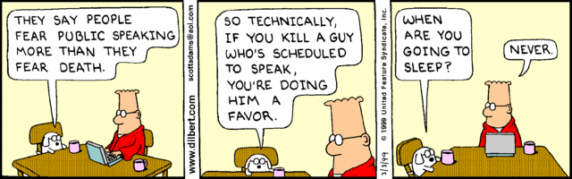
SESSION 4 FRIDAY, FEBRUARY 6 3:00-4:30pm
Spoken English: From Film to Oracy

Slide 2
SZENTGYÖRGYI, SZILÁRD
University of Pannonia, Hungary
szentsz@almos.uni-pannon.hu
How do Movie Characters’ Accents Reflect
Linguistic Stereotypes and Prejudices?
TOMKOVÁ, KATEŘINA
Masaryk University, Faculty of Arts, Brno, Czech Republic
2060@mail.muni.cz, tomkat@phil.muni.cz
A Chapter from Academic Oracy: Oral Presentations in English

Slide 3
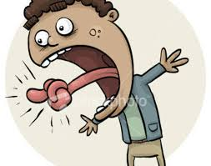
Academic Oracy:
Oral Presentations in English

Slide 4
Academic Oracy:
Oral Presentations in English
THE CONTENT AND PURPOSE OF ACADEMIC ORACY
PREREQUISITES TO ACADEMIC ORACY
SITUATIONS PRACTISED IN ACADEMIC ORACY
PITFALLS AT VARIOUS STAGES OF MAKING
A PRESENTATION
OBSERVATIONS MADE AT THIS CONFERENCE
THE DEEPEST TRAP OF ALL
QUESTIONS – YOURS AND MINE

Slide 5
THE CONTENT AND PURPOSE
OF ACADEMIC ORACY
to increase awareness of the diverse forms of spoken English
to present academic papers in class on topics such as Interlingual word tabboos, Academic Slang, Academic Hierarchy and Argumentative Fallacies
to practice speech behavior in typical academic situations & deal with the immediacy (Vachek) of spoken discourse
to create, rehearse and perform a comic skit in English at Creativity Night
to select 2 of the most admired speakers at this department and engage in a fan session

Slide 6
PREREQUISITES TO ACADEMIC ORACY
Phonetics & Phonology - suprasegmentals,
social and regional accents
Spoken Fluency - synthesis of skills = confidence
knowledge # skill
Pronunciation Varieties of English
best recordings: The English Language in 24 Accents, A Tour of the British Isles in Accents, Amy Walker‘s tutorials for American English, Lisa Mojsin‘s Accent Reduction videos, Rachel’s English (can x can’t)
Students‘ own role models and observations
Q1
Students benefit greatly from all the above but this may just be my impression.

Slide 7
SITUATIONS PRACTISED
IN ACADEMIC ORACY
an oral examination
a diploma thesis defense
(see Recurrent errors)
a presentation in class, at conferences
a debate – academic, impromptu

Slide 8
PITFALLS
AT VARIOUS STAGES OF MAKING A PRESENTATION
selection of topic, amount of information conveyed, lexical and other means Q2
preparation, rehearsing, timing
delivery: - technicalities & anxiety
- rapport with audience, confidence,
posture & body language Q3
- correspondence between screen and
speech
- voice & pronunciation (see Form.pdf),
loudness & tempo

Slide 9
OBSERVATIONS
MADE AT THIS CONFERENCE: technicalities
Jan´s distance from the microphone
missing mic at last night´s reception
uncooperative master computer at this morning´s culture studies session
Stoicism and flexibility helps.

Slide 10
OBSERVATIONS
MADE AT THIS CONFERENCE: choice of lexical means
Q2
J. Vanderziel: arduous journey; I´d like to echo
O. Jelinek: as fate would have it
M. Kaylor: The words Erasure and Vanishment will mark my own departure.
A. Van Herk: Dr. Kaylor, you´re incorrigible.
D. Sparling: Such – excuse the pun – such military overkill…
T. Sherman: to be media-savvy

Slide 11
OBSERVATIONS MADE AT THIS CONFERENCE: choice of lexical means by non-native speakers
Non-native speakers I have heard so far lack the audacity to use expresions such as the above, maybe with the exception of Prof. Ventola saying Excuse my French which could be understood as quoting John Major. However, they dispose of expert vocabularies is their fields of research such as were heard in an earlier British Studies session:
to frame
Scroungers
fecklessness

Slide 12
OBSERVATIONS
MADE AT THIS CONFERENCE: voice & pronunciation
Q2
+ A. Van Herk´s use of tempo!
- stresses and reductions in analysis, component, event, hypothesis-ses, participants, success
- devoicing in studies of English have always been x bees (beast, beasts)
- a combination of mistakes in a short word such as the tenth being perceived as the dense
- /æ/>/e/: massive, passive, lacking… x laxical
- mispronunciations: cradle, occurrence, their

Slide 13
THE DEEPEST TRAP OF ALL
Losing oneself: fretting over the details so much that one loses a detached view of one´s topic and enjoyment of one´s own presentation.
Improvements are to be expected with age.

Slide 14
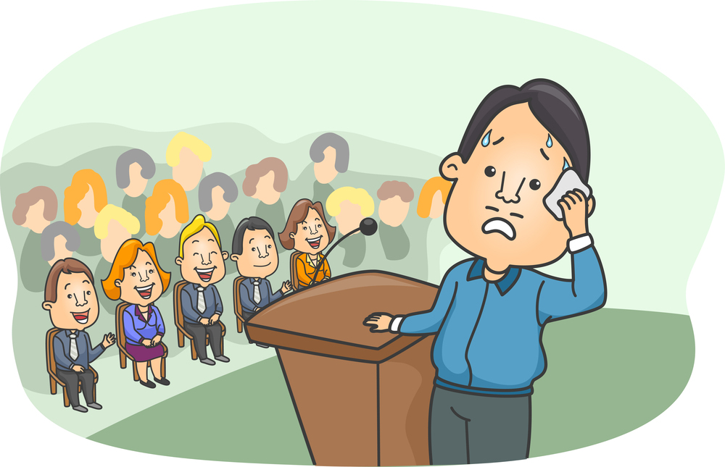
THANK YOU FOR YOUR KIND ATTENTION <3

Slide 15
QUESTION TIME…
If you don´t ask, I will!

Slide 16
QUESTIONS
Q1: Why doesn´t a student´s speaking performance always reflect their extensive listening experience?
Q2: Is it always an advantage to present in your mother tongue? What are the perks (if any) of being a non-native speaker of E presenting in E?
Q3: Does posture and obvious breaking of rules really matter?

