Slide 1
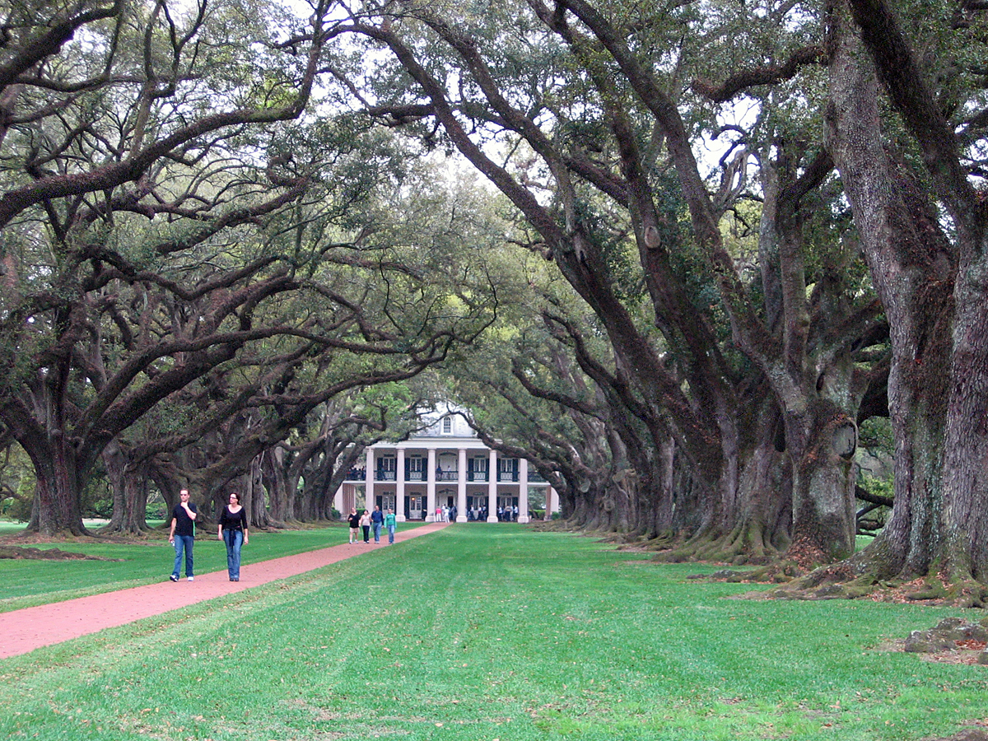
Southern American English
(Deep South)

Slide 2
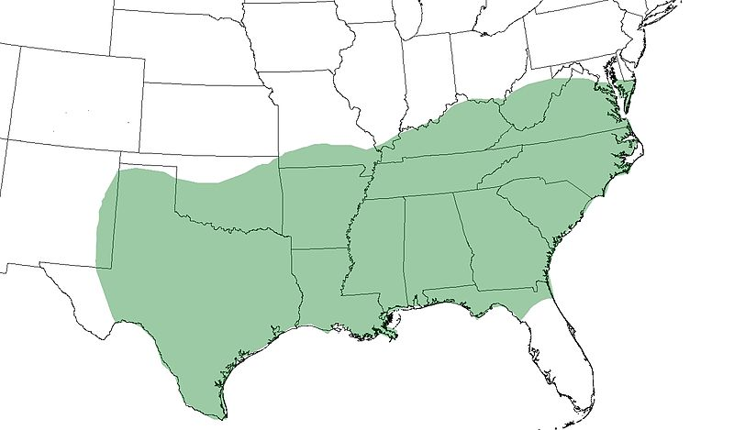
Approximate extent of Southern American English

Slide 3
South does not have one monolithic dialect, there are vast differences between regions in the area.
It is a GROUP of dialects.
African American Vernacular English has a lot in common with Southern dialects because of strong historical ties.
Southern dialects originated in large part from British immigrants who moved to the area in 17. and 18. centuries.

Slide 4
Only few generalizations can be made about Southern American English because of the great variation between the regions.
Pronunciation also differs very much between older and younger generations as well as between numerous ethnical groups.
Older SAE: distinction between [ær], [er] and [ɛr] in marry, merry, and Mary is preserved.
Newer SAE: Merging of [ɛ] and [ɪ] before nasal consonants = pen and pin are pronounced the same.

Slide 5
Lax and tense vowel neutralization before L. Pairs like feel/fill become homophones.
Dialects
Atlantic: Virginia Piedmont (most famous, strong influence on the rest of dialects ), Coastal Southern.
Midland and Highland: South Midland or Highland Southern, Southern Appalachian.
Gulf of Mexico: Gulf Southern and Mississippi Delta, Florida Cracker.
Louisiana: Cajun, Creole, French.

Slide 6
Signature sounds
Merging of [ɛ] and [ɪ] before nasal consonants = pen and pin are pronounced the same. (Occasional diphtongization – end, men)
Words such as yellow, window: Final vowel pronounced as r.less schwa instead of [oʊ] or [o].
Monophtongization: Words such as boy, boil, choice: diphtong reduced to monophtong [ɔ] . Also (right, time, like)
Every is reduced to ɛvə.
-Ing is pronounced as [in] instead of [iŋ] in present participles.

Slide 7
Many nouns are stressed on the first syllable instead on the second: 'police, 'cement, 'Detroit, 'behind.
Contractions: voiced alveolar fricative [z] becomes voiced alveolar stop [d]. Isn´t [iznt] = [idnt], wasn´t [wʌznt] = [wʌdnt].
The Southern vowel shift: the nuclei of [ɛ] and [ɪ] move to become higher and fronter, of [ɛjə], [ɛ] becomes a tenser [ejə].
Vowel lowering: [i] is realised as [ɛ] or [aə] before velar nasal. Sing [siŋ] = [saəŋ].
Post coronal glides: words with coronal stops /t/d/n/ have a glide /j/ inserted between the stop and vowel. Tune, duke, news become [tju:n], [djuk], [nju:z]

Slide 8
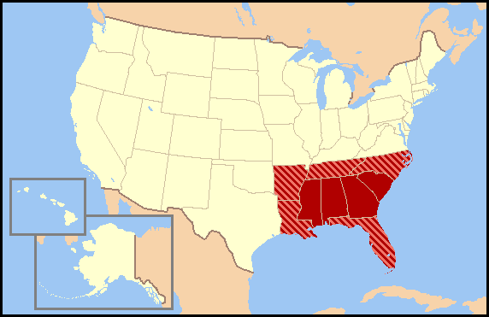
The Deep South

Slide 9
Alabama, Georgia, Mississippi and South Carolina.
Famous for: The Southern drawl.
Vowels are longer, monophtongs become diphtongs and diphtongs become triphtongs.
Kit [kit] = [ki:ət], milk [milk] = [mij(ə)k]
Lingering on important words while shortening the less important words.

Slide 10
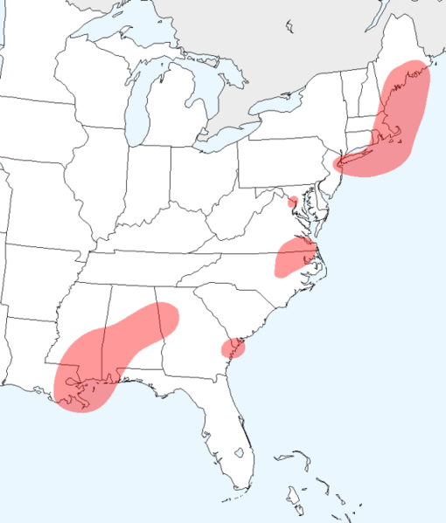
Rhotic vs. Non-Rhotic

