Slide 1

Introduction to Linguistics, Autumn 2019
Week 13, Session 12 Thursday, December 12
Prague school of linguistics; structuralism, functionalism

Slide 2

AGENA GAGENDA TODAY:
                Inquiry about Christmas
                Structuralist approach to language
                Functionalism
                The P&P Song
                Revision of today’s agenda
                The 12 Days of Christmas

Slide 3

Remind me when you‘re too tired – we‘ll sing

Slide 4
Predecessors of structuralism:
Comparative and historical grammars of the 19th century
Turn of the 19th and 20th centuries:
natural sciences, geography, dialectology, psychology, sociology, aesthetic
idealism, the schools of Kazan and Moscow, “the lonely American“
W.D. Whitney

Slide 5
Structural Linguistics
Parallel beginnings at Geneva, Prague, later Copenhagen.
Other structural approaches: Kurylowicz (Poland), Guillaume and Martinet (France), the U.S.S.R., Halliday and the British School, American Structuralism (=Descriptivism)

Slide 6
GROUNDWORKS
Cours de linguistique générale (F. de Saussure 1916)
language=structure=an underlying formal system of mutually related
forms=langue x realization of this system in the actual act of
speech=parole
new discipline of semiotics
On the potentiality of the phenomena of language (V. Mathesius, 1911)
synchronic oscillation; functional approach (speaker‘s intention and
listener‘s understanding

Slide 7
The Prague School of Linguistics
Classical period: 1926-1939
Members: Vilém Mathesius, Roman Jacobson, Bohuslav Havránek, Jan Mukařovský, Vladimír Skalička, Bohumil Trnka, Nikolai Trubetskoy, Josef Vachek (mention prof. Garvin)

Slide 8
Followers
Jan Firbas
Josef Hladký
Libuše Dušková
Ludmila Urbanová
Jana Chamonikolasová

Slide 9
Key concepts
Analytical comparison
Automatisation (habitualisation) versus foregrounding
Communicative dynamism, theme, rheme
Distinctive features of phonemes
FSP
Markedness
Binary oppositions

Slide 10
Key theses
Language like any other activity is goal-oriented. Whether we analyse language as expression or communication, the speaker‘s intention is the most evident and most natural explanation. In liguistic analysis, therefore, one should adopt the functional perspective. From the functional point of view, language is a system of goal-oriented means of expression. No linguistic phenomenon can be understood without regard to the system to which it belongs.
An important factor in the stratification of language is the relationship among the interlocutors: the degree of their social cohesion, their professional, territorial, and familial connections, and also their membership in multiple collectivities, as expressed in the mixture of linguistic systems in the language of cities.
Preceded Pragmatics, Sociolinguistics, Semantics, Dialectology…
and will never be outdated.

Slide 11
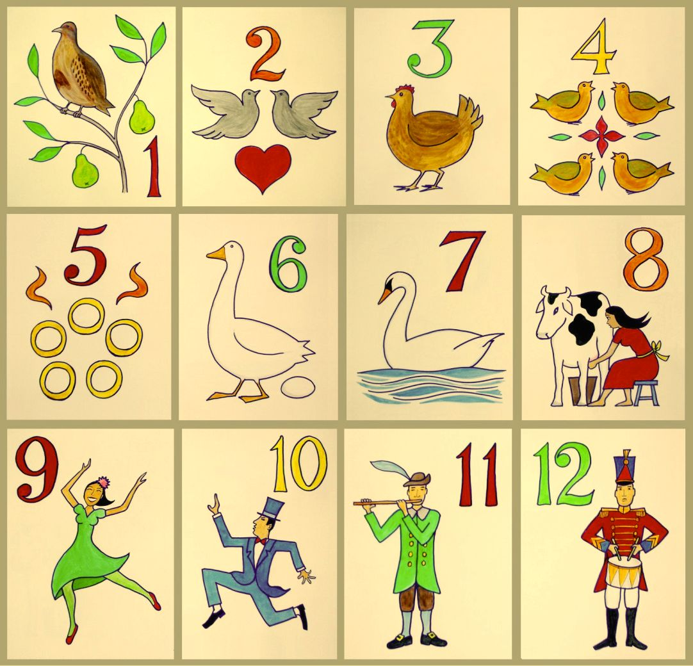
THE 12 DAYS OF CHRISTMAS

Slide 12

THANK YOU FOR YOUR KIND ATTENTION, Merry Christmas <3

Slide 13
QUESTION TIME…
If you don´t ask, I will!

Slide 14
QUESTIONS
Q1: Why doesn´t a student´s speaking performance always reflect their extensive listening experience?
Q2: Is it always an advantage to present in your mother tongue? What are the perks (if any) of being a non-native speaker of E presenting in E?
Q3: Does posture and obvious breaking of rules really matter?

