Slide 1



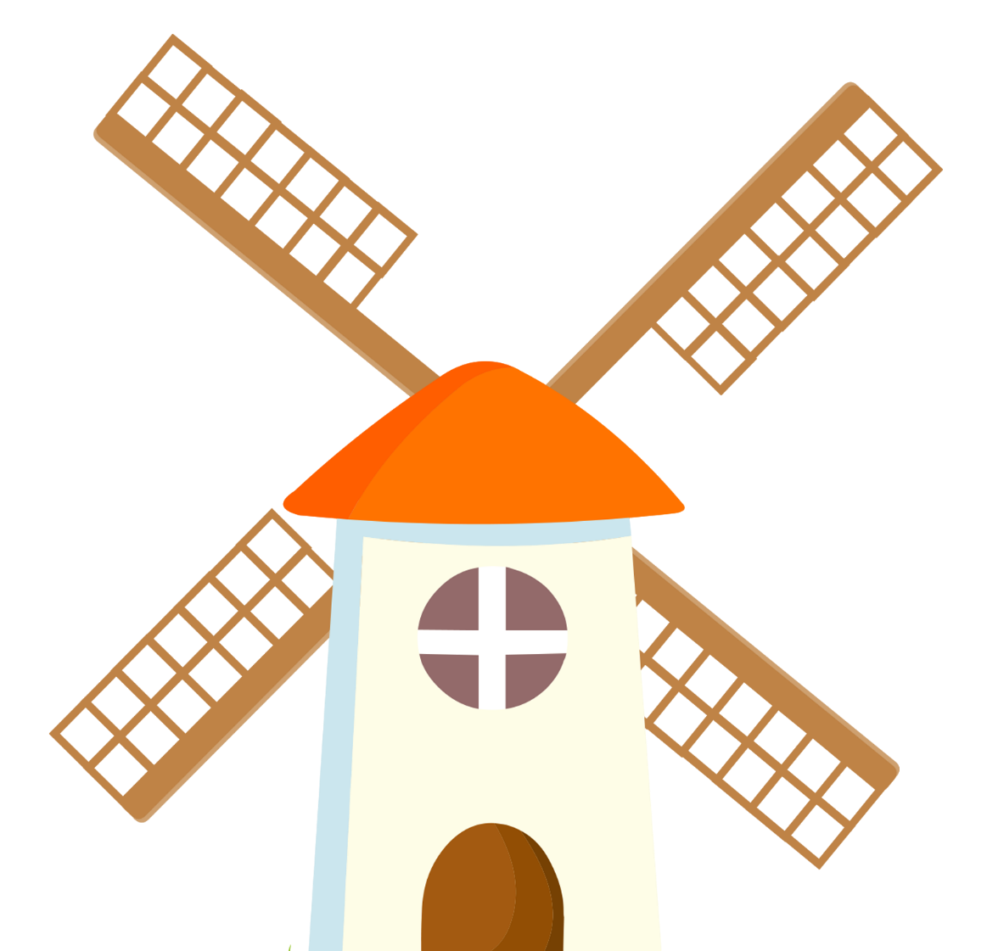

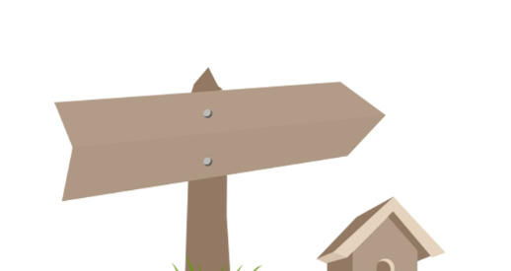
Family
家庭
jiā tíng
LI Xin Yu

Slide 2
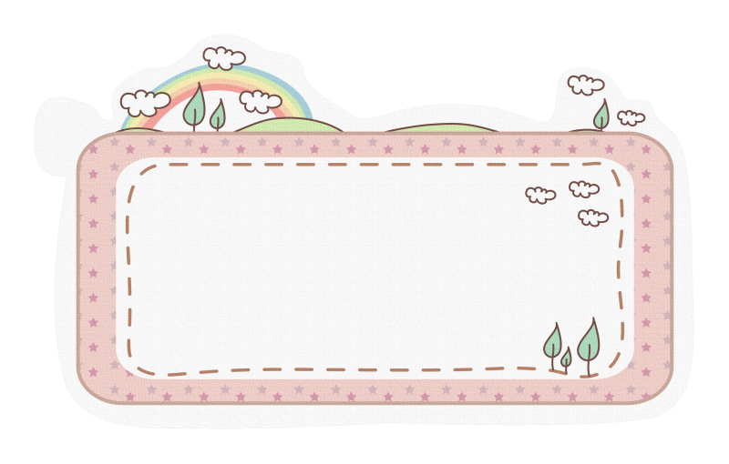
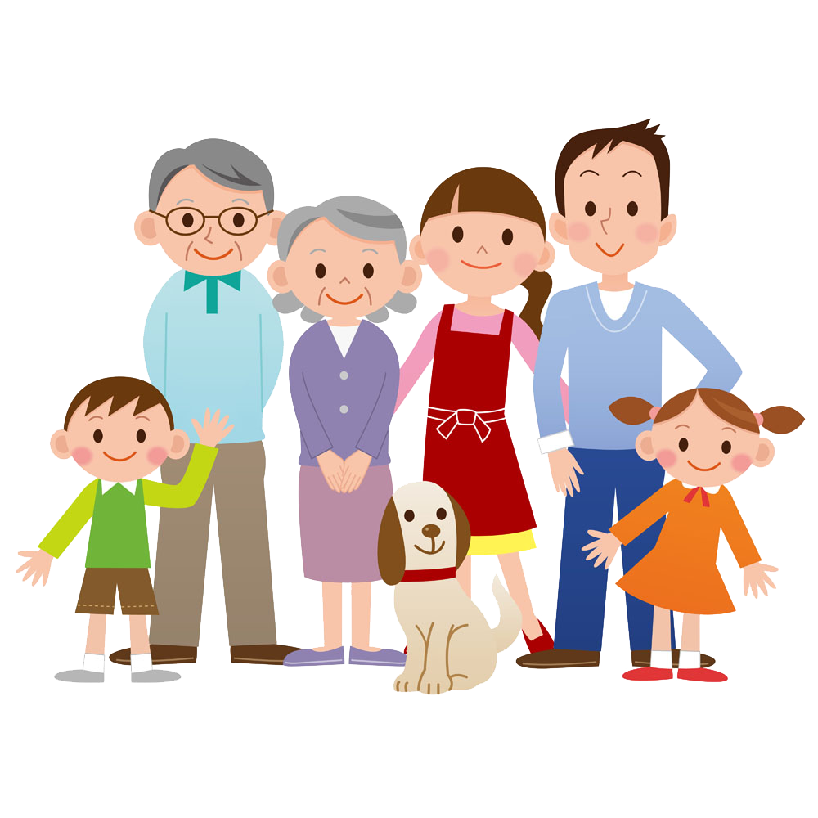
Vocabulary

Slide 3


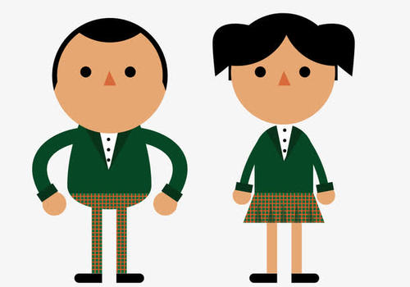

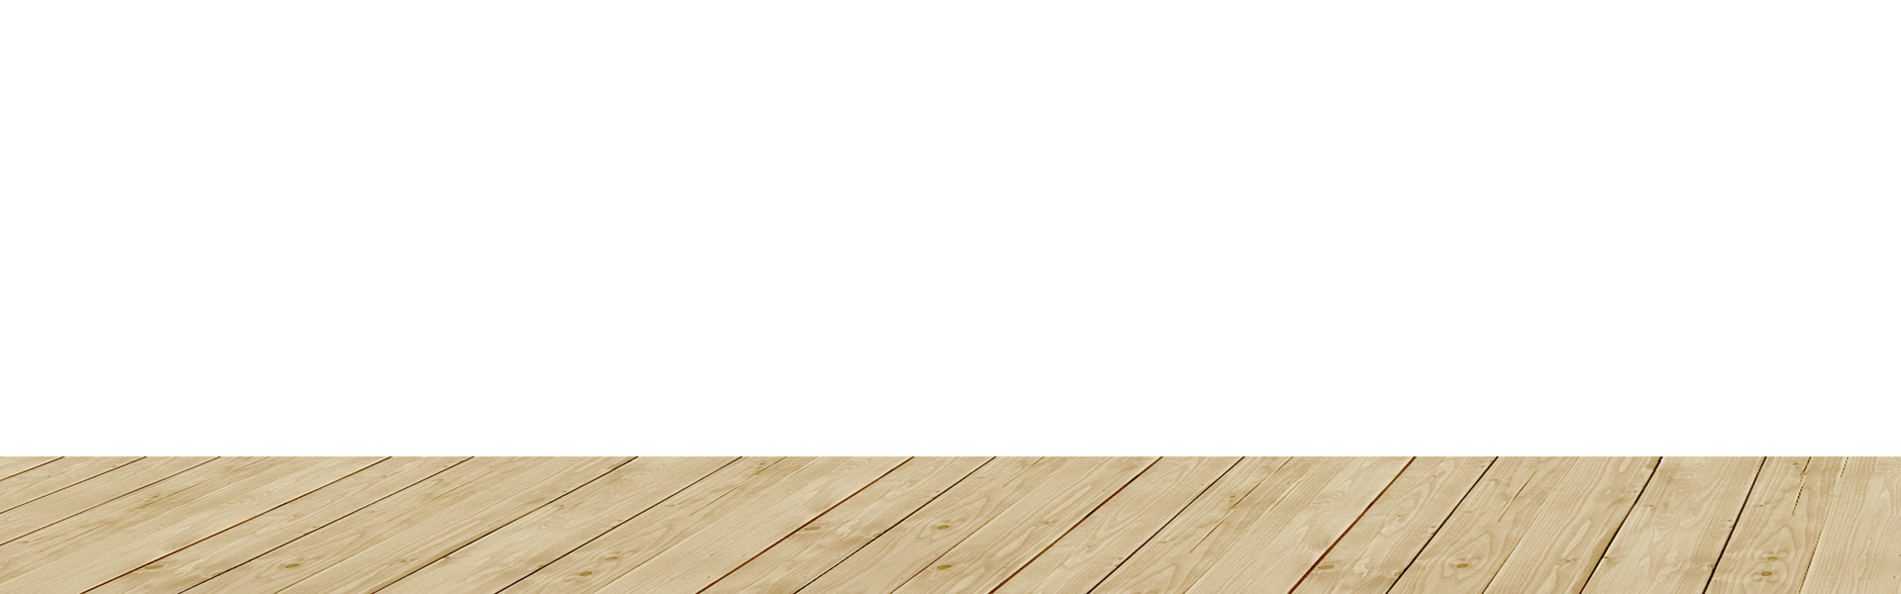
nán
tā
男
他
male
he;him
nǚ
tā
女
她
female
she;her

Slide 4
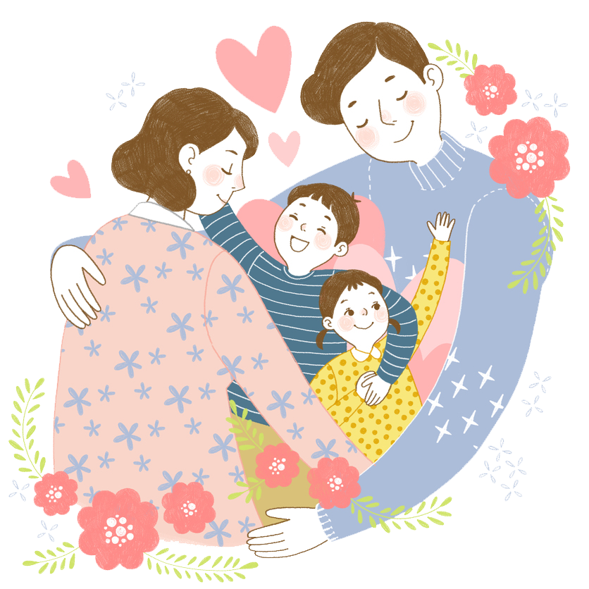
爸爸
bà ba
father，dad
父亲
fù qīn
父亲 is most used in writing
爸爸 is most used in speaking.

Slide 5
妈妈
mā ma
mother,mom
母亲
mǔ qīn
母亲 is most used in writing
妈妈 is most used in speaking.

Slide 6

hái zi
孩子
child

Slide 7
儿子 cannot be replaced by 男孩子
女儿 cannot be replaced by 女孩子
ér zi
nán hái zi
儿子
男孩子
son
boy
nǚ ér
nǚ hái zi
女儿
女孩子
girl
daughter

Slide 8
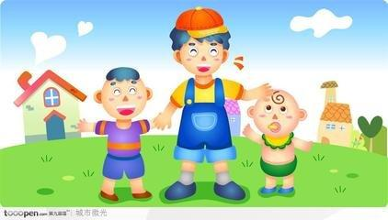
gē ge
哥哥
older brother
dì di
弟弟
younger brother

Slide 9
dà gē
大哥
eldest brother

Slide 10
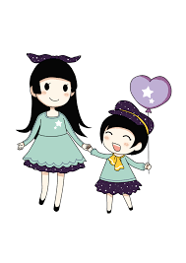
jiě jie
姐姐
older sister
mèi mei
妹妹
younger sister

Slide 11
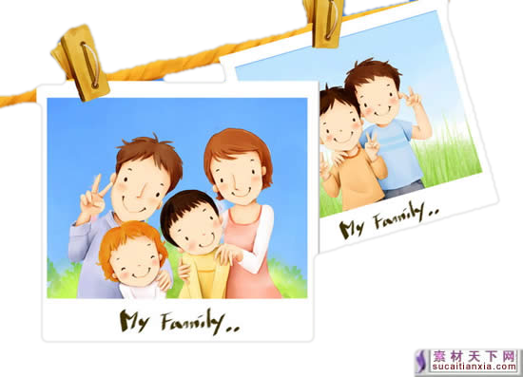
zhào piàn
照片
picture；photo

Slide 12


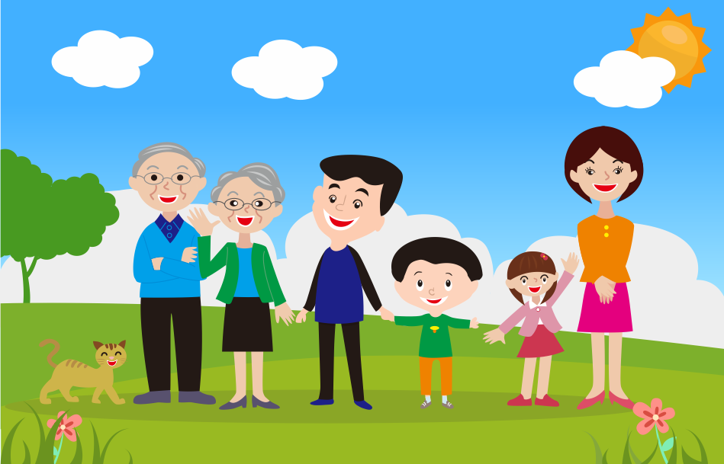
Please draw your family tree in Chinese
爸爸
妈妈
我

Slide 13
Grammer 个（gè /ge)
measure word
In Chinese a numeral is usually not followed immediately by a noun.
(1)number + measure word + a noun.
(2)demonstrative pronoun + measure word + a noun.
个（gè /ge) is the single most common measure word in Chinese. It is also sometimes used as a substitute for other measure words.

Slide 14
Grammer 个(gè /ge)
(1)number + measure word + a noun.
1、一个人（yí ge rén）
a person
2、一个学生（yí ge xué shēng）
a student
3、一个老师（yí ge lǎo shī）
a teacher

Slide 15
Grammer 个（gè /ge)
(2)demonstrative pronoun + measure word + a noun.
1、这个孩子（zhè ge hái zi ）
this child
2、那个男学生（nà ge nán xué sheng ）
that male student

Slide 16
In colloquial Chinese, 这 can also be pronounced as zhèi and 那 as nèi if followed by a measure word or a numeral and a measure word.
zhè
nà
这
那
this
this
这个人叫李生。
zhè ge rén jiào Lǐ Shēng
This person is called Li Sheng.
那个人是李先生的女儿。
nà ge rén shì lǐ xiān sheng de nǚ ér 。
That person is the daughter of Mr. Li.

Slide 17
méi
没
not

Slide 18
Grammer 有(yǒu)
有(yǒu) in the Sense of “to Have” or “to Possess”
有(yǒu) is always negated with 没(méi ) instead of 不(bù)
A:王先生有弟弟吗？
wáng xiān sheng yǒu dì di ma ？
Does Mr.Wang have a younger brother?
B:王先生没有弟弟。
wáng xiān sheng méi yǒu dì di 。
Mr.Wang doesn`t have any younger brothers.

Slide 19
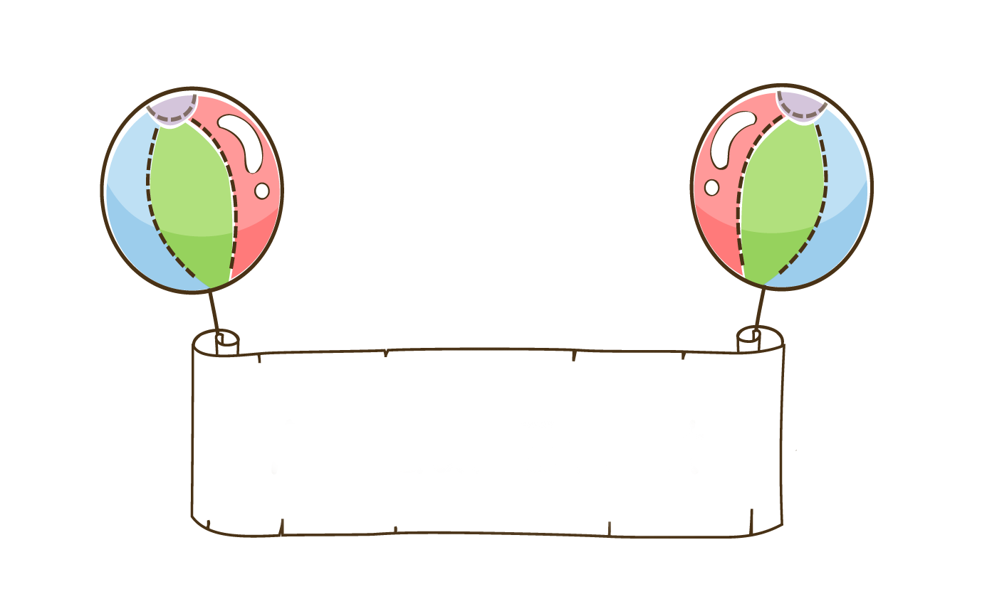
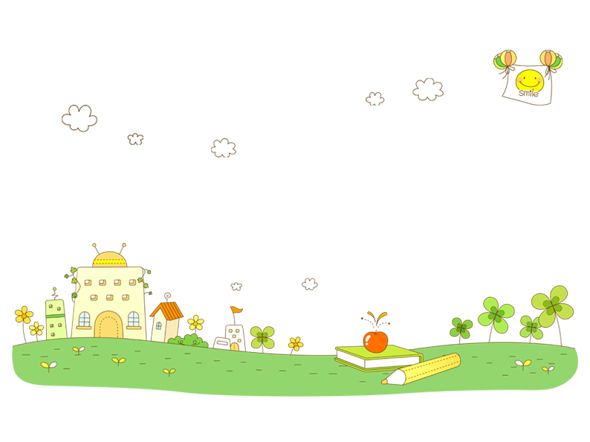
practice
In groups of three practice this conversation

Slide 20
Grammer 有(yǒu)
Please use 哥哥（gē ge)、弟弟(dì di)、姐姐(jiě jie )、妹妹(mèi mei)、大哥(dà gē ) to practice the conversations
A:你有弟弟吗？
nǐ yǒu dì di ma ？
Do you have a younger brother?
B:我没有弟弟。
wáng xiān sheng méi yǒu dì di。
Mr.Wang doesn`t have any younger brothers.

Slide 21
The Usage of 二 (èr)and 两(liǎng)
二(èr)and两(liǎng) both mean“ two,” but they differ in usage. 两(liǎng) is used in front of common measure words to express a quantity, e,g.,两个人(liǎng gè rén).In counting, one uses 二(èr):“一，二，三，四...”(yī ，èr ，sān ，sì ...;one,two,three,four...). In compound numersals, 二(èr) is always used for the 2 on the last two digits,e.g.,二十二(èr shí èr;22);一百二十五(yì bǎi èr shí wǔ;125) .But 二百二十二(èr bǎi èr shí èr;222 ) can also be said as 两百二十二(liǎng bǎi èr shí èr;222).

Slide 22
Grammer 有(yǒu)
有(yǒu) in the Sense of “to Have” or “to Possess”
有(yǒu) is always negated with 没(méi ) instead of 不(bù)
A:我有三个姐姐，你呢？
wǒ yǒu sān ge jiě jie ，nǐ ne ？
I have three older sisters, How about you?
B:我没有姐姐。
wǒ méi yǒu jiě jie.
I don`t have any older sisters.

Slide 23
practice
In groups of three practice this conversation

Slide 24
Grammer 有(yǒu)
Please use 哥哥（gē ge)、弟弟(dì di)、姐姐(jiě jie )、妹妹(mèi mei)、大哥(dà gē ) to practice the conversations
A:我没有姐姐，你呢？
wǒ méi yǒu jiě jie,nǐ ne ？
I don`t have any older sisters,How about you?
B: 我有三个姐姐。
wǒ yǒu sān ge jiě jie.
I have three older sisters.

Slide 25
Grammer The Particle 的(de)
的(de) appears between the "possessor" and the "possessed."
It is equivalent to the "`s" structure in English. For example: 老师的名字（lǎo shī de míng zi ）=teacher`s name. 的 is often omitted in colloquial speech after a personal pronoun and before a kinship term. Therefore, we say “王朋的妈妈”(wáng péng de mā ma ) Wang Peng`s mother, but “我妈妈”(wǒ mā ma) my mother.
王朋：noun 我：personal pronoun

Slide 26
Grammer3 Question Pronouns 谁(shéi)
In a question with a question pronoun, the word order is exactly the same as that in a declarative sentence.
A:那个女孩子是李友。
nà gè nǚ hái zǐ shì lǐ yǒu 。
That girl is Li You.
谁是李友？
shéi shì Lǐ Yǒu ？
Who is Li You?
One can replace 那个女孩子 with 谁 to form a question if he or she wishes to find out who Li You

Slide 27
Grammer3 Question Pronouns 谁(shéi)
A:谁是李友？
shéi shì Lǐ Yǒu ？
Who is Li You?
B:那个女孩子是李友。
nà gè nǚ hái zǐ shì lǐ yǒu 。
That girl is Li You.

Slide 28
practice
In groups of three practice this conversation

Slide 29
Grammer3 Question Pronouns 谁(shéi)
A:那个女孩子是李友。
nà gè nǚ hái zi shì lǐ yǒu 。
That girl is Li You.
那个女孩子是谁？
nà ge nǚ hái zi shì shéi ？
Who is that girl?
One can also replace 李友 with 谁 to form a question if he or she wishes to find out who that girl is

Slide 30
Grammer3 Question Pronouns 谁(shéi)
A:那个女孩子是谁？
nà ge nǚ hái zi shì shéi ？
Who is that girl?
B:那个女孩子是李友。
nà gè nǚ hái zǐ shì lǐ yǒu 。
That girl is Li You.

Slide 31
practice
In groups of three practice this conversation

Slide 32
Grammer3 Question Pronouns 谁(shéi)
A：谁是老师？
shéi shì lǎo shī ？
Who is a teacher?
B：李先生是老师。
Lǐ xiān sheng shì lǎo shī.
Mr.Li is a teacher.

Slide 33
practice
In groups of three practice this conversation

Slide 34
Grammer3 Question Pronouns 谁(shéi)
A：那个女孩子姓什么？
nà ge nǚ hái zi xìng shén me ？
What`s that girl`s family name?
B：那个女孩子姓王。
nà ge nǚ hái zi xìng wáng .
That girl`s family name is Wang.

Slide 35
practice
In groups of three practice this conversation

Slide 36
Grammer3 Question Pronouns 谁(shéi)
A：谁有姐姐？
shéi yǒu jiě jie?
Who has older sisters?
B：高文中有姐姐。
gāo wén zhōng yǒu jiě jie.
Gao Wen Zhong has an older sister.

Slide 37
practice
In groups of three practice this conversation

Slide 38
Text
王朋：高文中，那是你的照片吗？
高文中：是。这是我爸爸，这是我妈妈。
王朋：这个女孩子是谁？
高文中：她是我姐姐。
王朋：这个男孩子是你弟弟吗？
高文中：不是，他是我大哥的儿子。
王朋：你大哥有女儿吗？
高文中：他没有女儿。

Slide 39

Question
Please read the text to answer the following questions
  1.Whose photo is on the wall?
  2.Who is the young lady in the picture?
  3.Who is the boy in the picture?

Slide 40
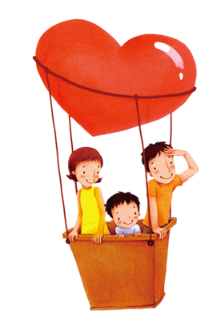
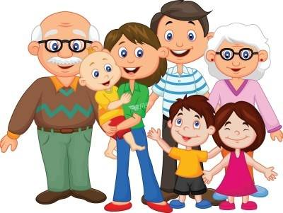
Language Practice
Please draw your family on paper.

