Slide 1






Family
家庭
jiā tíng
LI Xin Yu

Slide 2




Dialogue2:Asking about Someone`s Family
jiā
家
family;home
In Chinese,家 can refer to one`s family as well as one`s home. So one can point to his or her family picture and say “我家有四口人（wǒ jiā yǒu sì kǒu rén ；There are four people in my family”,and one can also point to his or her house and say “这是我家（zhè shì wǒ jiā；This is my home.）”

Slide 3

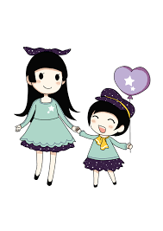
dà jiě
大姐
elder sister
èr jiě
二姐
second oldest sister

Slide 4
Dialogue2:Asking about Someone`s Family
jǐ
几
how many;some;a few
我家有三口人。
wǒ jiā yǒu sān kǒu rén.
There are three people in my family.

Slide 5
Dialogue2:Asking about Someone`s Family
kǒu
口
family;home
口 is the idiomatic measure word in northern China for the number of family members. In the south, people say 个 instead.

Slide 6
Dialogue2: 一 (yī ，one)
The numeral 一(yī ;one) is pronounced in the first tone(yī) when it stands alone or comes at the end of a phrase or sentence.ex.第一
(dì yī ;the first)
Otherwise, its pronunciation changes according to the following rules:
(a)Before a fourth-tone syllable, it becomes second tone:一个(yí gè)
(b)Before a first-,second-or third-tone syllable, it is pronounced in the fourth tone,e.g,一张(yì zhāng;a sheet),一盘(yì pán;one plate),
一本(yì běn;one volume).

Slide 7
Dialogue2:Asking about Someone`s Family
hé
和
and
Unlike and, 和(hé) cannot link two clauses or two sentences:我爸爸是老师，和我妈妈是医生(X)

Slide 8
Dialogue2:Asking about Someone`s Family
zuò
做
to do

Slide 9

Dialogue2:Asking about Someone`s Family
gōng zuò
工作
job;to work

Slide 10
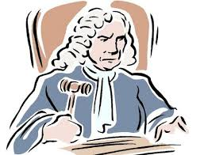
Dialogue2:Asking about Someone`s Family
lǜ shī
律师
lawyer

Slide 11
Dialogue2:Asking about Someone`s Family
yī shēng
医生
doctor;physician

Slide 12

Dialogue2:Asking about Someone`s Family
yīng wén
英文
English(language)
英文老师
yīng wén lǎo shī
English teacher

Slide 13
practice
If you feel this question involves personal privacy and does not want to answer, you can use 医生（yī shēng）、律师（lǜ shī）、老师（lǎo shī ） to practice this conversation.
A:你爸爸妈妈做什么工作？
nǐ bà ba mā ma zuò shén me gōng zuò ？
What do your dad and mom do?
B:我爸爸是__律师__，我妈妈是__医生__。
wǒ bà ba shì __lǜ shī __，wǒ mā ma shì __yī shēng __。
My dad is a lawyer. My mom is a docter.

Slide 14

Dialogue2:Asking about Someone`s Family
dà xué shēng
大学生
college student

Slide 15
Dialogue2:Asking about Someone`s Family
dà xué
大学
university;college
马萨里克大学(Masaryk University )
mǎ sà lǐ kè dà xué

Slide 16
有（yǒu ）in the Sense of “to Exist”
A:你家有几个人？
nǐ jiā yǒu jǐ gè rén ？
How many people are there in your family?
B:我家有五个人。
wǒ jiā yǒu wǔ gè rén 。
There are five people in my family.

Slide 17
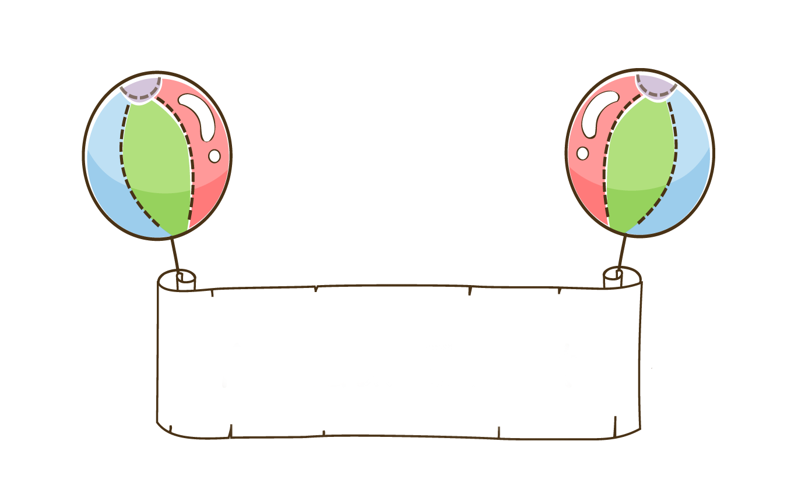

practice
In groups of three practice this conversation

Slide 18
有（yǒu ）in the Sense of “to Exist”
A:小高家有几个大学生？
xiǎo gāo jiā yǒu jǐ gè dà xué shēng ？
How many college students are there in Little Gao`s family?
B:小高家有两个大学生。
xiǎo gāo jiā yǒu liǎng gè dà xué shēng 。
There are two collage students in Little Gao`s family.

Slide 19
The Adverb 都（dōu,both;all）
The word 都(dōu) always occurs in front of a verb, It is classified as an adverb. However, because it refers to something that has been mentioned earlier in the sentence, or in a preceding sentence, it also has a pronoun-like flavor and it must be used at the end of an enumeration.

Slide 20
The Adverb 都（dōu,both;all）
王朋是学生。
Wáng Péng shì xué sheng .
Wang Peng is a student.
李友是学生。
Lǐ Yǒu shì xué sheng .
Li You is a student
高文中是学生。
Gāo Wén zhōng shì xué sheng. Gao Wen zhōng is a student.
王朋、李友和高文中都是学生。
Wáng Péng 、Lǐ Yǒu hé Gāo Wén zhōng dōu shì xué sheng .
Wang Peng 、Li You hé Gao Wen zhōng all are students.

Slide 21
The Adverb 都（dōu,both;all）
都(dōu)refers back to Wang Peng, Li You and Gao Wenzhong and therefore appears after they are mentioned.
1、王朋和李友都不是律师。
wáng péng hé lǐ yǒu dōu bú shì lǜ shī 。
Neither Wang Peng nor Li You is a lawyer.

Slide 22
The Adverb 都（dōu,both;all）
都(dōu)refers back to Wang Peng, Li You and Gao Wenzhong and therefore appears after they are mentioned.
2、王朋和白英爱都有妹妹。
wáng péng hé bái yīng ài dōu yǒu mèi mei.
Both Wang Peng and Bai Ying ai have younger sister.
3、高文中和李友都没有弟弟。
Gāo Wén zhōng hé Lǐ Yǒu dōu méi yǒu dì di.
Neither Gao Wen zhong nor Li You has any younger brothers.

Slide 23
The Adverb 都（dōu,both;all）
沒(méi) is always used to negate 有(yǒu). However, to say “not all of...have,” we say 不都有(bù dōu yǒu) rather than 沒都有(méi dōu yǒu) (X). Whether the negative precedes or follows the word 都(dōu)makes the difference between partial negation and complete negation.

Slide 24
The Adverb 都（dōu,both;all）
1、他们不都是中国人。
tā men bú dōu shì zhōng guó rén 。
Not all of them are Chinese.
2、他们都不是中国人。
tā men dōu bú shì zhōng guó rén 。
None of them are Chinese.

Slide 25
The Adverb 都（dōu,both;all）
3、他们不都有弟弟。
tā men bù dōu yǒu dì di 。
Not all of them have younger brothers.
4、他们都没有弟弟。
tā men dōu méi yǒu dì di 。
None of them have any younger brothers.

Slide 26
Text
李友：白英爱，你家有几口人？
白英爱：我家有六口人。我爸爸、我妈妈、一个哥哥、两个妹妹和我。李友，你家有几口人？
李友：我家有五口人。爸爸、妈妈、大姐、二姐和我。你爸爸妈妈做什么工作？
白英爱：我爸爸是律师，妈妈是英文老师，哥哥、妹妹都是大学生。
李友：我妈妈也是老师，我爸爸是医生。

Slide 27

Question
Please read the text to answer the following questions
  1.How many people are there in Bai Ying`ai`s family?
  2.What is Li You`s father`s occupations?
  3.How many people are there in Li You`s family?

Slide 28

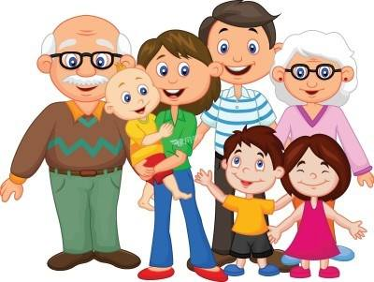
Language Practice

Slide 29
practice
In groups of three practice this conversation

