Slide 1
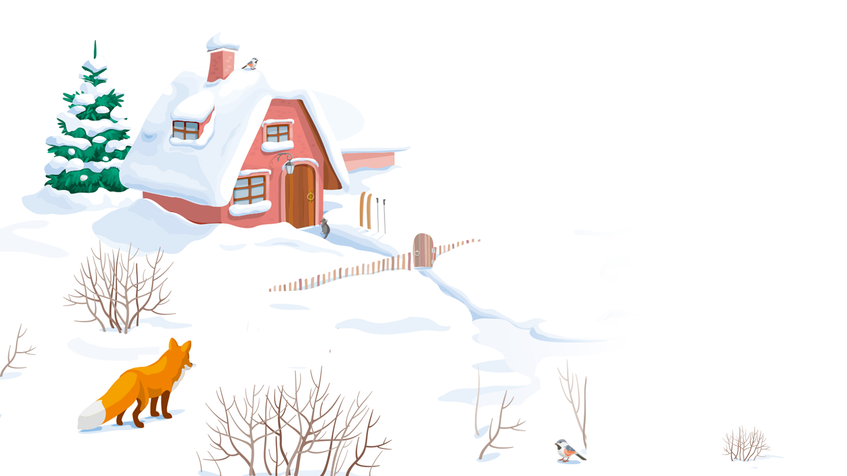
Review lessons 6-10
LI XINYU

Slide 2
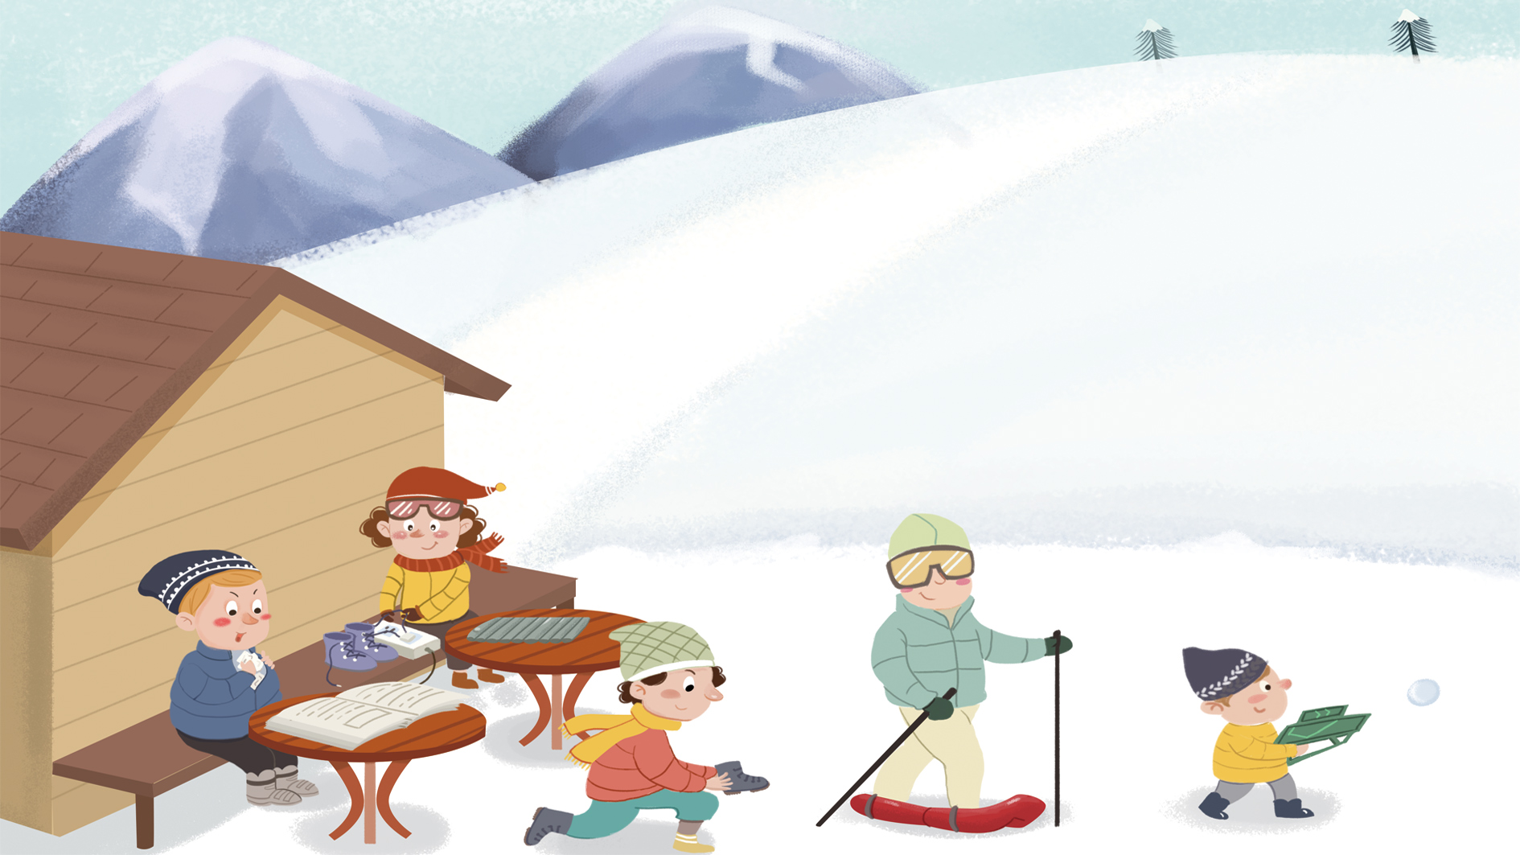
打电话

Slide 3
您

Slide 4
The personal pronoun 您(nín) is often used to address an older person or someone of a higher social rank. It is common for strangers to address each other with 您 and then switch to 你 as they become more familiar with each other.

Slide 5
给

Slide 6
The Preposition 给
给 can be a verb or a preposition. In Chinese, prepositions are generally combined with nouns or pronouns to form prepositional phrases, which appear before verbs as adverbials.
1.他给我打了一个电话。
2.他是谁？请你给我们介绍一下。
3.你有你姐姐的照片吗？给我看一下，行吗？

Slide 7
上 午

Slide 8
下 午

Slide 9
哪

Slide 10
以 后

Slide 11
In English, we say “after four o`clock” The word “after” appears before the time expression “four o`clock.” The Chinese equivalent is 四点以后(sì diǎn yǐ hòu). Note the difference in word order. Likewise, we say “before Monday.” but 星期一以前(xīng qī yī yǐ qián) in Chinese.

Slide 12
在

Slide 13
位

Slide 14

A:您是哪位？
B:我是李友。

Slide 15
时 间

Slide 16
就

Slide 17
就
A：喂，请问，常老师在吗？
B：我就是。您是哪位？

Slide 18
考 试

Slide 19
空(儿)

Slide 20
“To have free time” is 有时间(yǒu shí jiān) or 有空儿(yǒu kōngr),never 有时候(yǒu shí hou, sometimes).

Slide 21
几点(jǐ diǎn) is to ask for a specific time, as in “what time is it?” The general question word for “when” is 什么时候(shén me shí hou), not 什么时间(shén me shí jiān)

Slide 22
A:您什么时候有空儿？
B:明天四点以后有空儿。

Slide 23
年 级

Slide 24
喂

Slide 25
课

Slide 26
The measure word for academic courses is 门(mén).
Compare:三门课(sān mén kè,three courses),三节课(sān jié kè,three class periods) and 三课(sān kè,three lessons)

Slide 27
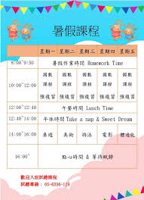
A:你一周有几节课？
B:我一周有九节课。

Slide 28
A:这学期你有几门课？
B:这学期我有三门课。

Slide 29
方 便

Slide 30
问 题

Slide 31
Both 问(wèn) and 请(qǐng) could be “to ask” in English. The verb 问(wèn) means “to inquire” e.g.,我问她一个问题(wǒ wèn tā yí gè wèn tí, I ask her a question). To mean “to invite” or “to request”, say 请(qǐng),e.g.,我请她跳舞(wǒ qǐng tā tiào wǔ, I invite her to dance)

Slide 32
节

Slide 33
到

Slide 34
开 会

Slide 35
等

Slide 36
要

Slide 37
The Modal Verb要(yào,will;be going to)
The modal verb 要(yào) has several meanings. In this lesson, 要(yào) indicates a future action, particularly a scheduled event or an activity that one is committed to. The negative form is expressed by adding 不 and deleting 要(yào)
1.下午我们要考试。
2.今天晚上妹妹要去看电影。

Slide 38
The Modal Verb要(yào,will;be going to)
3.A:明天我要去小白家玩儿。你呢？
B:明天我不去小白家玩儿，我要开会。

Slide 39
电 话

Slide 40
别

Slide 41
客 气

Slide 42
The Adverb 别(bié,don`t)
别(bié,don`t) is used to advise someone to refrain or stop someone from doing something. Depending on the context, it can be used to form a polite formula, a gentle reminder, or a serious admonition
1.别客气。
2.你别说。
3.别进来！
4.那个电影没有意思，你别看。

Slide 43
办公室

Slide 44
行

Slide 45
要 是

Slide 46
要是(yào shi,if) is a conjunction to introduce a contingent or hypothetical action or situation. It`s not the “whether if” in English.
A:要是您方便，四点半我到您的办公室去，行吗？
B:四点半，没问题。

Slide 47
没问题(méi wèn tí) here means “no problem.” It is used to assure someone that a promise will be fulfilled or a favor will be done. But when people thank you and say 谢谢(xiè xiè), you cannot respond with 没问题

Slide 48
Practice 6-1
A.Rearrange the following words into a complete sentence.Use the English in parentheses as a clue.
1、四点/我/办公室/电话/在/明天/等/以后/下午/你的
（I will be waiting for your phone call in the office after 4:00
p.m. tomorrow)
2、朋友/才/吃饭/昨天晚上/我/回来/晚上九点/请我
（My friend took me out for dinner last night. I didn`t come
back until 9:00 p.m.)
3、您/回来/给我/方便/以后/打/要是/电话
（If it is convenient for you, please give me a call after you
come back.)

Slide 49
练 习

Slide 50
帮

Slide 51
中 文

Slide 52
啊

Slide 53
见 面

Slide 54
回 来

Slide 55
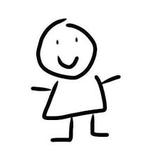
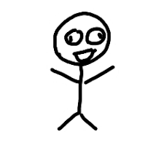
Directional Complements (I)
来/去(lái/qù, to come/go) can serve as a directional complement after such verbs as 进(jìn, to enter) and 回(huí, to return). 来(lái, to come) signifies movement toward the speaker, while 去(qù, to go) signifies movement away from the speaker.
1
来

Slide 56
Directional Complements (I)
来/去(lái/qù, to come/go) can serve as a directional complement after such verbs as 进(jìn, to enter) and 回(huí, to return). 来(lái, to come) signifies movement toward the speaker, while 去(qù, to go) signifies movement away from the speaker.
1
去

Slide 57
Directional Complements (I)
1、[A is at home, speaking on the phone to B, who is away from home]
A:你什么时候回来？
B:我六点回去。
1

Slide 58
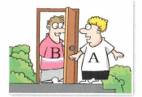
Directional Complements (I)
2、[A is outside, and B is inside. A knocks on the door, and B tells A to come in.]
B:进来。
jìn lai.
Come in
1

Slide 59
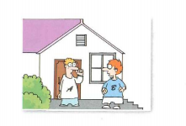
Directional Complements (I)
2、[Both A and B are outside. A tells B to go inside.]
A:进去。
jìn qu.
Go in
1

Slide 60
吧vs吗？
Compare the two particles 吧(ba) and 吗(ma):
1、你是李友吧?
You are Li You, aren`t you?
(I think you`re Li You. Am I right?)
2、你是李友吗？
Are you Li You？
(I am not quite sure.)
1

Slide 61
准 备

Slide 62
下 个

Slide 63
Time Expressions
下个星期(xià ge xīng qī) literally means “the week below.” By the same token, 上个星期(shàng ge xīng qī ) literally means “the week above.” The measure word 个 can be omitted: 下个星期=下星期；上个星期=上星期. “Last/next month” is 上个月/下个月(shàng ge yuè/xià ge yuè).However, we don`t say “上月/下月”
To help you remember, envision a calendar. Next week/month is below(下,xià) this week/month; last week/month is above (上,shàng)
this week/month.

Slide 64
Time Expressions Involving Month and Week
上上个月 | shàng shàng ge yuè the month before last | 上上(个)星期 | shàng shàng(ge) xīng qī the week before last
上个月 | shàng ge yuè last month | 上(个)星期 | shàng (ge)xīng qī last week
这个月 | zhè ge yuè this month | 这(个)星期 | zhè (ge) xīng qī this week
下个月 | xià ge yuè next month | 下(个)星期 | xià (ge) xīng qī next week
下下个月 | xià xià ge yuè the month after next | 下下(个)星期 | xià xià (ge) xīng qī the week after next
1

Slide 65
一月 yī yuè January | 二月 èr yuè February | 三月 sān yuè March
四月 sì yuè April | 五月 wǔ yuè May | 六月 liù yuè June
七月 qī yuè July | 八月 bā yuè August | 九月 jiǔ yuè September
十月 shí yuè October | 十一月 shí yī yuè November | 十二月 shí èr yuè December
1

Slide 66
Time Expressions
The above expressions with 月(yuè) and 星期(xīng qī) form two parallel serics. “one weeks” is 一个星期(yí ge xīng qī), therefore “one week later” is 一个星期以后(yí ge xīng qī yǐ hòu ). “One month” is 一个月(yí ge yuè), not 一月(yī yuè). “One month later” is 一个月以后(yí ge yuè yǐ hòu)
1

Slide 67
Additional Time Expressions Involving Year and Day
大前天 | dà qián tiān three days ago | 大前年 | dà qián nián three years ago
前天 | qián tiān the day before yesterday | 前年 | qián nián the year before last
昨天 | zuó tiān yesterday | 去年 | qù nián last year
今天 | jīn tiān today | 今年 | jīn nián this year
1

Slide 68
Additional Time Expressions Involving Year and Day
明天 | míng tiān tomorrow | 明年 | míng nián next year
后天 | hòu tiān the day after tomorrow | 后年 | hòu nián the year after next
大后天 | dà hòu tiān three days from today | 大后年 | dà hòu nián three years from now
1
The above expressions with 天(tiān) and 年(nián) form two parallel series except for 昨天(zuó tiān) and 去年(qù nián)

Slide 69
跟

Slide 70
但 是

Slide 71
说

Slide 72
得
must

Slide 73
The Modal Verb得(děi,must)
The Modal Verb得(děi) means “need to “ or “must”.
1.我现在得去开会，没空儿跟你聊天儿。
2.我有事儿，得去学校。
1

Slide 74
The Modal Verb得(děi,must)
The negative form of 得(děi,must) is 不用(bú yòng,need not) or 不必(bú bì, need not). not 不得(bú děi). Therefore, the correct way to say “ You don`t have to go to the library” in Chinese is A, not B:
1
A:你不用去图书馆。 or 你不必去图书馆。
B:你不得去图书馆。(X)

Slide 75
面

Slide 76
Practice 6-2
Following the example,make sentence using the given words, 得 and 别.
EXAMPLE: A：我想去找同学聊天儿。(准备考试)
B：别去找同学聊天，你得准备考试。
1. A：我想看电视。(看书)
B：___________________________________。

Slide 77
Following the example,make sentence using the given words, 得 and 别.
EXAMPLE: A：我想去找同学聊天儿。(准备考试)
B：别去找同学聊天，你得准备考试。
2. A：我想喝咖啡。(睡觉)
B：___________________________________。

Slide 78
Following the example,make sentence using the given words, 得 and 别.
EXAMPLE: A：我想去找同学聊天儿。(准备考试)
B：别去找同学聊天，你得准备考试。
3. A：我想跟朋友玩儿。(工作)
B：___________________________________。

Slide 79
说 话

Slide 80
复 习

Slide 81
懂

Slide 82
真

Slide 83
The Adverb 太(tài,too) and 真(zhēn,really)
When adverb太(tài,too) and 真(zhēn,really) are used in exclamatory sentence, they convey in most cases not new factual information. but the speaker`s approval,disapproval, etc.If the speaker wants to make a more “objective” statement or description, other intensifiers such as 很(hěn,very), or 特别(tè bié,especially) are often used in place of 太(tài,too) or 真(zhēn,really)

Slide 84
The Adverb 太(tài,too) and 真(zhēn,really)
1.A:他写字写得怎么样？
One would normally answer:
B:他写字写得很好。
rather than:
B1:他写字写得真好。

Slide 85
The Adverb 太(tài,too) and 真(zhēn,really)
Compare B1 with C below
B1:他写字写得真好。
C:小李，你写字写得真好！你可以教我吗？

Slide 86
The Adverb 太(tài,too) and 真(zhēn,really)
When 太(tài,too) is used in an exclamatory sentence, 了(le) usually appears at the end of the sentence:
1、这个电影太有意思了！
2、我的语法太不好了！我得多练习。
3、你跳舞跳得太好了。

Slide 87
上 个

Slide 88
学

Slide 89
慢

Slide 90
哪 里

Slide 91
哪里(nǎ li)
哪里(nǎ li),which literally means “where,” is a polite reply to a compliment. In recent times, however, 哪里(nǎ li) has become somewhat old-fashioned. Many people will respond to a compliment by saying 是吗(shì ma, is that so). Some young people in urban areas will also acknowledge a compliment by saying 谢谢(xiè xiè, thanks) instead.

Slide 92
写 字

Slide 93
语 法

Slide 94
预 习

Slide 95
一枝笔

Slide 96
一张纸

Slide 97
得
particle

Slide 98
Descriptive Complements
The particle 得(de) can be used after a verb or an adjective. This lesson mainly deals with 得(de) as it appears after a verb. What follows 得(de) in the construction introduced in this lesson is called a descriptive complement, which can be an adjective, an adverb, or a verb phrase. In this lesson, the words that function as descriptive complements are all adjectives. These complements serve as comments on the actions expressed by the verbs that precede 得(de).

Slide 99
Descriptive Complements
1、他写字写得很好。
很好(hěn hǎo,very well) is a comment on the action 写(xiě, to write)
2、他昨天睡觉睡得很晚。
很晚(hěn wǎn,very late) is a comment on the action 睡觉(shuì jiào, to sleep).

Slide 100
Descriptive Complements
3、妹妹歌唱得很好。
很好(hěn hǎo,very well) is a comment on the action 唱(chàng, to sing).

Slide 101
Descriptive Complements
If the complement is an adjective, it is usually preceded by 很(hěn, very). If the verb is followed by an object, the verb has to be repeated before it can be followed by the “得(de)+Complement” structure, e.g.,写字写得(xiě zì xiě de) in (1). By repeating the verb, the “verb+object” combination preceding it becomes a “topic” and the complement that follows serves as a comment on it. The first verb can be omitted if the meaning is clear from the context, as in (3)

Slide 102
容 易

Slide 103
多

Slide 104
第

Slide 105
Ordinal Numbers
Ordinal numbers in Chinese are formed by placing 第(dì) before cardinal numbers,e.g., 第一(dì yī,the first),第二杯茶(dì èr bēi chá,the second cup of tea), 第三个月(dì sān ge yuè,the third month). However, 第(dì) is not used in names of months: 一月(yī yuè,January)，二月(èr yuè,February)，三月(sān yuè,March). Neither is it used to indicate the birth order of siblings: 大哥(dà gē,oldest brother)，二哥(èr gē,second oldest brother)，三哥(sān gē,third oldest brother)

Slide 106
汉 字

Slide 107
难

Slide 108
生 词

Slide 109
好不好(hǎo bu hǎo)
Like 行吗(xíng ma) and 好吗(hǎo ma) ,the expression 好不好(hǎo bu hǎo, is it ok?) can also be used to seek someone`s approval of a proposal.

Slide 110
The Adverb 就(jiù)
The adverb 就(jiù) is used before a verb to suggest the earliness,briefness,or quickness of the action.
1、他明天七点就得上课。
2、我们八点看电影，他七点半就来了。

Slide 111
就(jiù) and 才(cái) compared
The adverb 就(jiù) suggest the earliness or promptness of an action in the speaker`s judgment.
The adverb 才(cái) is the opposite. It suggests the tardiness or lateness of an action as perceived by the speaker.
When commenting on a past action,就(jiù) is always used with了(le) to indicate promptness but 才(cái) is never used with 了.

Slide 112
就(jiù) and 才(cái) compared
1.A:八点上课，小白七点就来了。
B:八点上课，小张八点半才来。

Slide 113
就(jiù) and 才(cái) compared
2.A:我昨天五点就回家了。
B:我昨天五点才回家。

Slide 114
Double Objects
Some verbs can take two object. The object representing a person, persons,or an animate entity precedes the one representing an inanimate thing.
1、老师教我们生词和语法。

Slide 115
Double Objects
2、大哥给了我一瓶水。
3、你教我汉字，可以吗？
4、我想问你一个问题。

Slide 116
有(一)点儿(yǒu[yì]diǎnr, somewhat, rather; a little bit)
The phrase 有一点儿(yǒu yì diǎnr) precedes adjectives or verbs. It often carries a negative tone. The 一(yī) in the phrase is optional.
1、我觉得中文有(一)点儿难。
我觉得中文有(一)点儿容易。(X)
2、我觉得这一课生词有点儿多。

Slide 117
有(一)点儿(yǒu[yì]diǎnr, somewhat, rather; a little bit)
However, when the sentence suggests a change of the situation, the phrase 有一点儿(yǒu yì diǎnr) can carry a positive tone, e.g.
3、我以前不喜欢他，现在有(一)点儿喜欢他了。
以前yǐ qián =previously or before.

Slide 118
有(一)点儿(yǒu[yì]diǎnr, somewhat, rather; a little bit)
Take care not to confuse 有一点儿(yǒu yì diǎnr,a little), which is an adverbial used to modify adjectives, with 一点儿(yì diǎnr, a little), which usually modifies nouns. In the above sentences, 有一点儿(yǒu yì diǎnr) cannot be replaced by 一点儿(yì diǎnr).

Slide 119
有(一)点儿(yǒu[yì]diǎnr, somewhat, rather; a little bit)
4、给我一点儿咖啡。
5、给我一点儿时间。

Slide 120
有(一)点儿(yǒu[yì]diǎnr, somewhat, rather; a little bit)
6、我有一点儿忙。 我一点儿忙。(X)
7、她有一点儿不高兴。 她一点儿不高兴。(X)

Slide 121
practice7-1
When people praise or complain, they often use 真 or 太. Fill in the blanks with the appropriate word.
1、老师说话说得____慢了，学生都不想听。
2、你哥哥___帅，很多女孩子都想认识他。
3、早上七点变就得去学校上课，____早了。
4、小王写汉字写得____漂亮，我想请他教我怎么写。
5、你念课文念得_____不错，常常听录音吧。

Slide 122
Last week Little Li was either late or early.Complete the following sentence with either 才 or 就.
Example:学校下午三点开会 2:00 p.m
学校下午三点开会，小李两点_就_来了.
1、我们昨天上午九点考试 8:45 a.m
2、我们昨天晚上十点回家 11:30 p.m

Slide 123
功 课

Slide 124
怎 么

Slide 125
怎么(zěn me,how; how come) in Questions
怎么(zěn me,how; how come) is an interrogative pronoun. It is often used to ask about the manner of an action as in(1), and sometimes the reason or the cause of an action, as in (2) and (3) below.
1、请你教我怎么写“懂”这个字。
2、你怎么才来？
3、你怎么没去看电影？

Slide 126
怎么(zěn me,how; how come) in Questions
Both 怎么(zěn me,how; how come) and 为什么(wèi shén me,why) are used to ask about the cause of or reason for something. However, 怎么(zěn me,how; how come) conveys the speaker`s bewilderment or surprise whereas 为什么(wèi shén me,why) does not.

Slide 127
这 么

Slide 128
录 音

Slide 129
课 文

Slide 130
开 始

Slide 131
念

Slide 132
早

Slide 133
早(zǎo, Good morning!)
早(zǎo, Good morning!) is heard quite often in Chinese cities. Other morning greetings, such as 早上好(zǎo shang hǎo) and 早安(zǎo ān) , still sound rather formal to many Chinese people.

Slide 134
酷

Slide 135
晚

Slide 136
学 习

Slide 137
早 上

Slide 138
早上(zǎo shang,morning)
Both 早上(zǎo shang) and 上午(shàng wǔ) are usually translated as “morning” but the two Chinese words are not interchangeable. 早上(zǎo shang) refers to early morning; and 上午(shàng wǔ) to the latter part of the morning or to the first half of the day (until noon).

Slide 139
上 课

Slide 140
帅

Slide 141
帅(shuài)
帅(shuài) is used to describe a handsome——usually young——man.
To describe an attractive woman one uses the word 漂亮(piào liang,pretty). The term 好看(hǎo kàn,good-looking) is gender-neutral, and can be used for people of either sex and in any age group.

Slide 142
The 的(de) Structure
We have a 的(de) structure when an adjective is followed by the structural particle 的(de). Grammatically, a 的(de) structure is equivalent to a noun. When Bai Ying`ai says, “他是一个男的(tā shì yí ge nán de),” it is clear from the context that she means a male(one).
我写了十个字，五个难的，五个容易的。

Slide 143
The Use of Noun and Pronouns in Continuous Discourse
If a noun serves as the unchanged subject in a continuous discourse, its later appearances in the ensuing clauses or sentences generally should be substituted by an appropriate pronoun or simply omitted. The pronoun, in turn, can also be omitted after its first appearance.
1、小白很喜欢学中文。(她)晚上预习课文、复习语法、练习写汉字，常常很晚才睡觉。

Slide 144
The Use of Noun and Pronouns in Continuous Discourse
If we keep repeating the subject as seen in (2) or the pronoun as in (3), we will end up with a bunch of choppy, seemingly unrelated sentences:
2、小白很喜欢学中文。小白晚上预习课文，小白复习语法、小白练习写汉字。小白常常很晚才睡觉。
3、小白很喜欢学中文。她晚上预习课文，她复习语法、她练习写汉字。她常常很晚才睡觉。

Slide 145
This is a note that Little Bai left for Little Wang. Read it and answer the question（True/False）
小王：
你好！我上个星期有个中文考试，我考得不太好。我写汉字写得不错，可是太慢。中文语法也有一点儿难，我不太懂。这个周末你有时间吗？我想请你帮我复习中文。好吗？
小白
Question
1、Little Bai did a good job on the exam.
2、Little Bai wrote the characters pretty well, althought she did
not write quickly.
3、Little Bai didn`t understand the grammer at all.

Slide 146
早 饭

Slide 147
脑

Slide 148
餐 厅

Slide 149
累

Slide 150
告 诉

Slide 151
一 边

Slide 152

一边...一边...(yì biān ...yì biān ...)
This structure denotes the simultaneity of two ongoing actions. In general, the word or phrase for the action that started earlier follows the first 一边(yì biān), while that for the action that started later follows the second 一边(yì biān).
1、我们一边吃饭，一边练习说中文。
2、他常常一边吃饭一边看电视。

Slide 153
一边...一边...(yì biān ...yì biān ...)
Generally, the verb that follows the first 一边(yì biān) indicates the principal action for the moment, while the one that follows the second
一边(yì biān) denotes an accompanying action.
3、我一边洗澡一边唱歌。
4、我妹妹喜欢一边看书一边听音乐。

Slide 154
已 经

Slide 155
以 前

Slide 156
午 饭

Slide 157
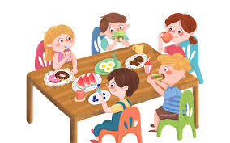
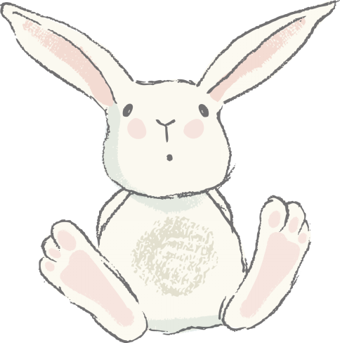
同学们在餐厅吃午饭。

Slide 158
一篇日记

Slide 159
新

Slide 160
教 室

Slide 161
以 后

Slide 162
起 床

Slide 163
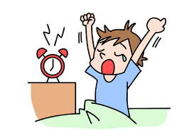
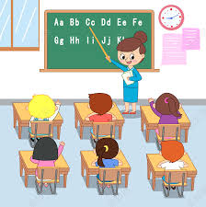
学生已经起床去上课了。

Slide 164
Series of Verbs/Verb Phrases
A number of verbs or verb phrases can be used in succession to represent a series of actions. The sequential order of these verbs or verb phrases usually coincides with the temporal order of the actions.
1、他常常去高小音家吃饭。
2、下午我要到图书馆去看书。
3、我明天想找同学去打球。
4、你明天来我家吃晚饭吧。

Slide 165
那 儿

Slide 166
中 午

Slide 167
大 家

Slide 168
洗 澡

Slide 169
电 脑

Slide 170
电脑(diàn nǎo, computer)
The usual colloquial term for a computer is 电脑(diàn nǎo), literally, “electric brain.” A more formal term, especially in mainland China, is 电子计算机(diàn zǐ jì suàn jī) or “electronic computing machine,” or simply 计算机(jì suàn jī). But in Taiwan 计算机(jì suàn jī) means a calculator. In mainland China, a calculator is called 计算器(jì suàn qì).

Slide 171
知 道

Slide 172
上 网

Slide 173
发 音

Slide 174
正 在

Slide 175
The Adverb 正在(zhèng zài, be doing...)
The adverb 正在(zhèng zài) denotes an ongoing or progressive action at a
certain point of time. It is more emphatic than 在(zài) when it serves the same function.
1.A:李友，你在做什么？
B:我在练习写汉字。

Slide 176
The Adverb 正在(zhèng zài, be doing...)
The adverb 正在(zhèng zài) denotes an ongoing or progressive action at a
certain point of time. It is more emphatic than 在(zài) when it serves the same function.
2.我们现在正在上课，你别打电话。
3.我昨天到他宿舍的时候，他正在练习发音。

Slide 177
The Adverb 正在(zhèng zài, be doing...)
The adverb 正在(zhèng zài) denotes an ongoing or progressive action at a
certain point of time. It is more emphatic than 在(zài) when it serves the same function.
4.A:你知道不知道王老师在哪儿？
B:他正在办公室开会。

Slide 178
宿 舍

Slide 179
The Position of Time-When Expressions
Time-when expressions come before the verb. They often appear after the subject. However, they sometimes precede the subject under certain discourse conditions. In this lesson, we focus on practicing the ones positioned after the subject.
1、我们十点上课。
2、我们几点去？
3、你什么时候睡觉？
4、他明天上午八点来。

Slide 180
The Adverb 就(jiù)
The adverb 就(jiù) connecting two verbs or verb phrases indicates that the second action happens as soon as the first one is completed.
1、他今天早上起床以后就听中文录音了。
2、王朋写了信以后就去睡觉了。
3、我做了功课以后就去朋友家玩儿。

Slide 181
The Particle 的(de)
When a disyllabic or polysyllabic adjective modifies a noun, the particle 的(de) is usually inserted between the adjective and the noun, e.g.漂亮的学校 ,容易的汉字, 有意思的电影. However, with monosyllabic adjectives, 的(de) is often omitted, e.g., 新课文, 新电脑, 大教室; 好老师. If the adjective is preceded by 很(hěn), however, 的(de) cannot be dropped,e.g.,很新的电脑; 很大的教室; 很好的老师

Slide 182
Read the following schedule for Little Wang and answer the questions.(True/False)
8:00 复习第七课生词、语法
9:00 上电脑课
10:00 去常老师的办公室练习发音
14:30 去图书馆看书
16:00 去打球
18:00 去宿舍餐厅吃晚饭
20:15 给小李打电话，跟他一起练习中文
22:30 给爸爸妈妈打电话
24:00 睡觉

Slide 183
Read the following schedule for Little Wang and answer the questions.(True/False)
1、小王今天只有一节课。 （）
2、小王跟小白一起吃午饭。 （）
3、小王上午去找常老师。 （）
4、小王去小李家练习中文 （）
5、小王吃晚饭以前去打球 （）
6、小王去图书馆以后去找常老师 （）
7、小王睡觉以前给爸爸妈妈打电话。（）
8、小王跟小李练习中文以后才吃饭。（）

Slide 184
专 业

Slide 185
希 望

Slide 186
会

Slide 187
能

Slide 188
能(néng) and 会(huì) Compared
Both 能(néng) and 会(huì) have several meanings. The basic meaning of 能(néng) is “to be capable of (the action named by the following verb).” It can also be an indication of whether one`s own abilities or circumstances allow the execution of an action. Additional meanings will be introduced in later lessons.

Slide 189
能(néng) and 会(huì) Compared
1、我能喝十杯咖啡。
2、今天下午我要开会，不能去听音乐会。
3、我们不能在图书馆聊天儿。

Slide 190
能(néng) and 会(huì) Compared
会(huì), as used in this lesson, means having the skill to do something through learning or instruction.
4、李友会说中文。
5、小白会唱很多美国歌。
6、我不会上网，请你教我。

Slide 191
一封信

Slide 192
用

Slide 193
近

Slide 194
后 来

Slide 195
后来(hòu lái)
后来(hòu lái) is usually translated as “later,” but it pertains only to an action or situation in the past.

Slide 196
祝

Slide 197
笑

Slide 198
最 近

Slide 199
哭

Slide 200
音乐会

Slide 201
学 期

Slide 202
最

Slide 203
除了...以外，还...（chú le ...yǐ wài ，hái ...in addition to...,also...)
1.我除了学中文以外，还学专业课。
2.上个周末我们除了看电影以外，还听音乐了。
3.他除了喜欢听音乐以外，还喜欢打球。

Slide 204
除了...以外，还...（chú le ...yǐ wài ，hái ...in addition to...,also...)
The activities in each of the three sentences above are performed by the same subject. But if activities are done by different subjects, the adverb 也 has to be used.
4.除了小王以外，小李也喜欢唱歌、跳舞。

Slide 205
The Adverb 就(jiù)
The adverb 就(jiù) can heighten the close relationship between two actions or situations. In this usage, the action or situation indicated by the verb or adjective that follows 就(jiù) is usually contingent upon the action or situation denoted by the verb or adjective in a preceding clause. The ralationship is often causal, as seen in (1) and (2), or conditional, as(3) and(４)
1.（因为）小高喜欢吃中国菜，（所以）我们就吃中国菜。
2.（因为)，小王的专业是电脑，（所以）我就请他教我怎么上网。

Slide 206
The Adverb 就(jiù)
3.要是同学帮我复习，我考试就考得很好。
4.要是你不能来，我就去你那儿。
5.写汉字，开始觉得难，常常练习，就觉得容易。

Slide 207
了(le)
开始我觉得很难，后来，王朋常常帮我练习中文，就觉得不难了。
This sentence-final particle 了 usually indicates a change of status or the realization of a new situation.

Slide 208
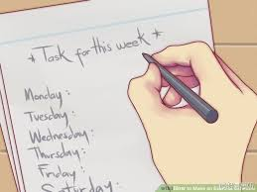

Bai Ying ai is such a capable person. She has many skills, and there is only one thing she is not able to handle.List some of the things that she can do and the only thing she cannot do based on the information given.
Example:
她会写英文

Slide 209
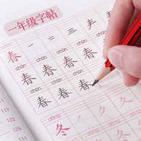
Bai Ying ai is such a capable person. She has many skills, and there is only one thing she is not able to handle.List some of the things that she can do and the only thing she cannot do based on the information given.
1、
______________

Slide 210
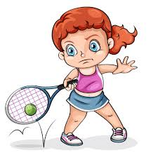
Bai Ying ai is such a capable person. She has many skills, and there is only one thing she is not able to handle.List some of the things that she can do and the only thing she cannot do based on the information given.
2、
______________

Slide 211

Bai Ying ai is such a capable person. She has many skills, and there is only one thing she is not able to handle.List some of the things that she can do and the only thing she cannot do based on the information given.
3、
______________

Slide 212


Bai Ying ai is such a capable person. She has many skills, and there is only one thing she is not able to handle.List some of the things that she can do and the only thing she cannot do based on the information given.
4、
______________

Slide 213
衬 衫

Slide 214
眼 镜

Slide 215
帽 子

Slide 216
手 表

Slide 217
穿

Slide 218
穿(chuān)VS戴(dài)
Note that the verb 穿(chuān) can mean both “to wear” and “to put on.” However, for most accessories, especially those for the upper part of the body, 戴(dài) is used instead of 穿(chuān)

Slide 219
商 店

Slide 220
衣 服

Slide 221
售货员

Slide 222
买东西

Slide 223
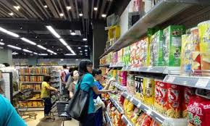
大家去商店买东西。
dà jiā qù shāng diàn mǎi dōng xi.
Everyone goes to the store to buy things.

Slide 224
双

Slide 225
裙 子

Slide 226
裤 子

Slide 227
In Chinese, a pair of pants is just one single piece of clothing. Hence 一条裤子(yì tiáo kù zi, literally, a trouser) instead of 一双裤子(yì shuāng kù zi, a pair of trousers)(X)

Slide 228
钱

Slide 229
块

Slide 230
百

Slide 231
毛

Slide 232
分

Slide 233
Amounts of Money
1.$8.55 八块五毛五(分)(钱）
2.$15.30 十五块三(毛)(钱)
3.$103 一百零三块(钱)

Slide 234
Amounts of Money
4.$100.30 一百块零三毛(钱)
5.$100.03 一百块零三分(钱)
To avoid ambiguity,毛（máo）and 分（fēn）cannot be omitted in (4) or (5)

Slide 235
A:这些东西一共多少钱？
B:一共九十二块三毛七分。

Slide 236
件

Slide 237
袜 子

Slide 238
找(钱)

Slide 239
黑

Slide 240
多 少

Slide 241
便 宜

Slide 242
The character 便 in 便宜(pián yi, inexpensive) is pronounced “pián” But in 方便(fāng biàn, convenient) the same character is pronounced “” It is not uncommon in Chinese for the same character to be pronounced differently and carry different meanings. Other examples include:乐(yuè/lè)in 音乐(yīn yuè,music),可乐(kě lè ,cola); and 觉(jué/jiào) in 觉得(juéde,to feel) and 睡觉(shuì jiào,to sleep)

Slide 243
条

Slide 244
一 共

Slide 245
鞋

Slide 246
咖啡色

Slide 247
如果...的话

Slide 248
1、如果长短合适的话，我就买。
2、如果我有很多钱的话，我要买很多衣服。
3、如果我是你的话，我不会买那条裤子。

Slide 249
紫

Slide 250
颜 色

Slide 251
绿

Slide 252
黄

Slide 253
红

Slide 254
蓝

Slide 255
橙

Slide 256
不 用

Slide 257
试

Slide 258
号

Slide 259
长 短

Slide 260
合 适

Slide 261
中

Slide 262
短

Slide 263
长

Slide 264
The Modal Verb 要(yào)
One of the meanings of 要(yào) is “to desire to do something.”
1.明天是周末，你要做什么？
2.我要去图书馆看书，你去不去？
3.我要喝可乐，他要喝茶。

Slide 265
The Modal Verb 要(yào)
To negate it, use 不想(bù xiǎng)
4.我不想去图书馆。
For(4), however, some Chinese speakers, particularly in the South, would say:
我不要去图书馆。

Slide 266
The Modal Verb 要(yào)
To negate it, use 不想(bù xiǎng)
5.今天我不想做功课。
Both modal verbs 想(xiǎng) and 要(yào) can express a desire or an intention, but 要(yào) carries a stronger tone.

Slide 267
多(duō) Used interrogatively
The adverb 多(duō) is often used in a question asking about degree or extent,e.g,
1.你今年多大？
2.你穿多大的衣服？
3.你弟弟多高？

Slide 268
多(duō) Used interrogatively
The adjectives that follow 多(duō) are typically those suggesting large extents such as 大(dà，big), 高(gāo,tall;high) and 远(yuǎn,far), rather than those denoting small degrees such as 小(xiǎo, small;little),矮(ǎi, short), and 近(jìn, near).

Slide 269
换

Slide 270
样 子

Slide 271
刷

Slide 272
收

Slide 273
一 样

Slide 274
跟/和...（不）一样(gēn /hé ...(bù)yí yàng,[not] the same as... )
To express similarity or dissimilarity between objects, persons, or actions, we use the structure 跟/和...(不)一样(gēn /hé ...(bù)yī yàng)
1.你的衬衫跟我的一样。
2.贵的衣服和便宜的衣服不一样。
3.弟弟跟哥哥一样高。
4.这个电脑跟那个电脑一样新。

Slide 275
跟/和...（不）一样(gēn /hé ...(bù)yí yàng,[not] the same as... )
Following 一样(yí yàng), an adjective can be used:
5.常老师写汉字写得跟王老师(写汉字写得）一样漂亮。

Slide 276
信用卡

Slide 277
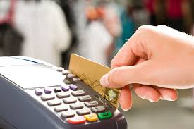
A：你们这儿可以刷卡吗？
B： 对不起，我们不收信用卡。

Slide 278
付 钱

Slide 279
种

Slide 280
它

Slide 281
就是它吧(jiù shì tā ba ) is an expression one often uses when making a decision at the end of a process of selection. It roughly means “This is it” or “I`ll take it”

Slide 282
刷 卡

Slide 283
虽 然

Slide 284
虽然...，可是/但是...（suī rán ...，kě shì /dàn shì ...
although...yet...）
This pair of conjunctions links the two clauses in a complex sentence. Note, however, that 虽然(suī rán) is often optional.
1.虽然这双鞋很便宜，可是大小不合适。
2.这本书很有意思，可是太贵了。
3.中文不容易，但是很有意思。

Slide 285
虽然...，可是/但是...（suī rán ...，kě shì /dàn shì ...
although...yet...）
Whether or not 虽然(suī rán) is used in the first clause, 可是/但是(kě shì /dàn shì) cannot be omitted in the second. The following sentence is, therefore, incorrect:
2a.虽然这本书很有意思，太贵了。

Slide 286
付

Slide 287
不 过

Slide 288
卡

Slide 289
挺

Slide 290
挺+adj+的(tǐng+adj+de) means “it`s rather adj.” The 的(de) is optional.
挺好的(tǐng hǎo de）it`s rather good

Slide 291
再

Slide 292
大 小

Slide 293
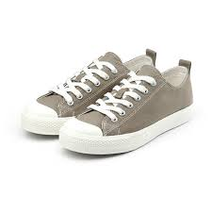
这双鞋虽然大小合适，可是颜色不好。

Slide 294
票

Slide 295
火 车

Slide 296
机

Slide 297
寒 假

Slide 298
电 车

Slide 299
飞

Slide 300
先

Slide 301
先...再...(xiān ...zài ...,first...,then...)
Sometimes 再(zài)indicates a sequence of actions rather than a repetition.先看电影再吃饭(xiān kàn diàn yǐng zài chī fàn,first go to the movie,then eat) means 先看电影以后吃饭(xiān kàn diàn yǐng yǐ hòu chī fàn,eat after seeing the movie).
1.A:你什么时候给妈妈打电话？
B:下课以后再打。
2.我想先打球再去图书馆。
3.弟弟常常先做功课再上网聊天儿。

Slide 302
先...再...(xiān ...zài ...,first...,then...)
As adverbs,先(xiān)and 再(zài) must come immediately before a verb.They cannot be placed in front of the subject.
4.小王先买东西再吃晚饭。
4a 先小王买东西再吃晚饭。(X)

Slide 303
公共汽车

Slide 304
走

Slide 305
站

Slide 306
飞 机

Slide 307
然 后

Slide 308
上 车

Slide 309
出租汽车

Slide 310
Taxicabs are called 计程车(jì chéng chē, metered cars) in Taiwan but 出租(汽)车(chū zū[qì]chē) in mainland China. To take a taxi is 打车(dǎ chē)

Slide 311
地 铁

Slide 312
坐

Slide 313
线

Slide 314
打 车

Slide 315
下 车

Slide 316
(飞)机票

Slide 317
最 后

Slide 318
开 车

Slide 319
或 者

Slide 320
或者(huò zhě,or)and 还是(hái shì,or)
While both 或者(huò zhě,or)and 还是(hái shì,or)link up two words or phrases that indicate different alternatives, the former usually appears in statements, the latter in questions
1.A:你今天晚上做什么？
B:听音乐或者看电影。
2.A:你周末想看电影还是跳舞？
B:看电影或者跳舞都行。

Slide 321
或者(huò zhě,or)and 还是(hái shì,or)
3.A:你喜欢什么颜色的鞋？黑色的还是咖啡色的？
B:黑色的或者咖啡色的我都不喜欢，我喜欢白的。
4.明天你去开会或者他去开会都可以。

Slide 322
汽 车

Slide 323
公 共

Slide 324
麻 烦

Slide 325
送

Slide 326
(飞)机场

Slide 327
开

Slide 328
出 租

Slide 329
租

Slide 330
Topic-Comment Sentences
When a noun or noun phrase has become established as a known element in a conversation, it can occur at the beginning of the sentence as the “topic,” with the rest of the sentence functioning as a “comment” on it. This forms what is known as a “topic-comment sentence.” In such a sentence the object of the verb can be brought forward to serve as the topic of the sentence.

Slide 331
Topic-Comment Sentences
1.A:我昨天买了一枝笔。
B:那枝笔你用了吗？
2.A:你知道我的衬衫在哪儿吗？
B:你的衬衫我给你妈妈了。
3.A:你有朋友吗？
B:朋友我有很多，可是都不在这儿。、
4.她不想去纽约，可是飞机票她妈妈已经帮她买了。

Slide 332
还是...(吧）(hái shì ...ba,had better)
The structure 还是...(吧）(hái shì ...[ba],had better) can be used to signify making a selection after considering two or more options. Sometimes in making such a decision one is forced to give up one`s preference.
1.A:你说，明天看电影还是看球？
B:还是看电影吧。
2.A:我的车有问题。怎么办？
B:那别去听音乐会了。我们还是在家看电视吧。

Slide 333
怎么去(zěn me qù)asks the means of transportation and 怎么走(zěn me zǒu)asks the detailed route or directions

Slide 334
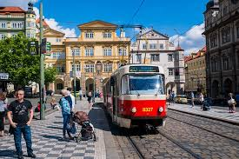
A:你怎么去学校？
B:我坐电车去学校。

Slide 335
Let`s practice how to make suggestions by using “还是...吧”.
EXAMPLE A:今天晚上没事儿,我们看电视,好吗?
(没意思,去跳舞)
B:看电视没意思,我们还是去跳舞吧！
1.A:这条白色的裤子很便宜。我想买。(样子不好，别买)
B:________________________________________。

Slide 336
Let`s practice how to make suggestions by using “还是...吧”.
EXAMPLE A:今天晚上没事儿,我们看电视,好吗?
(没意思,去跳舞)
B:看电视没意思,我们还是去跳舞吧！
2.A:我想坐地铁去机场。(太麻烦，打车)
B:________________________________________。

Slide 337
Let`s practice how to make suggestions by using “还是...吧”.
EXAMPLE A:今天晚上没事儿,我们看电视,好吗?
(没意思,去跳舞)
B:看电视没意思,我们还是去跳舞吧！
3.A:我们今天晚上去听音乐会,怎么样？(没空,后天晚上)
B:________________________________________。

Slide 338
让

Slide 339
城 市

Slide 340
特 别

Slide 341
不好意思

Slide 342
电子邮件

Slide 343
The Chinese word for email, 电子邮件(diàn zǐ yóu jiàn), literally means electronic mail. It is sometimes abbreviated as 电邮(diàn yóu).

Slide 344
公 路

Slide 345
紧 张

Slide 346
电 子

Slide 347
花

Slide 348
高 速

Slide 349
每

Slide 350
每...都...(měi...dōu...,every)
In a sentence that contains the term 每(měi,every), usually 都(dōu,all)has to be inserted further along in the sentence, immediately in front of the verb.
1.他每天晚上都预习课文。
2.我每节课都来。
3.这儿每个人我都认识。
4.常老师的字每个都好看。

Slide 351
自 己

Slide 352
路

Slide 353
快 乐

Slide 354
发短信

Slide 355
手 机

Slide 356
高速公路

Slide 357
新 年

Slide 358
要...了(yào...le,soon)
The 要...了(yào...le)structure indicates the imminence of an anticipated action or situation. It also appears in the form of 快要...了(kuài yào...le).
1.新年快要到了，我们给爸爸妈妈写一封信吧。
2.寒假要到了，你要做什么?
3.电影快要开始了，你买票了吗?
4.快要考试了，我们大家得准备一下。

Slide 359
Answer the following questions with 每...都...
EXAMPLE A:他晚上看电视吗？
B:他每天晚上都看电视。
1.A:她早上走高速公路吗？
B:_________________
2.A:考试的时候哪一个学生很紧张？
B:_______________________

Slide 360
Answer the following questions with 每...都...
EXAMPLE A:他晚上看电视吗？
B:他每天晚上都看电视。
3.A:常老师哪个周末回家？
B:_________________
4.A:那个商店的什么衣服很贵？
B:_______________________

