Slide 1



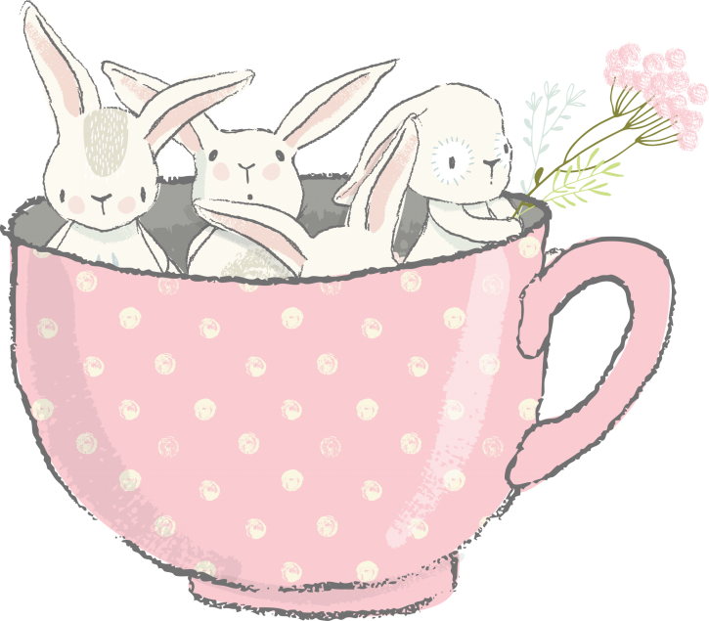

xué
xiào
学
校
huó
shēng
活
生
School Life
LI XIN YU

Slide 2
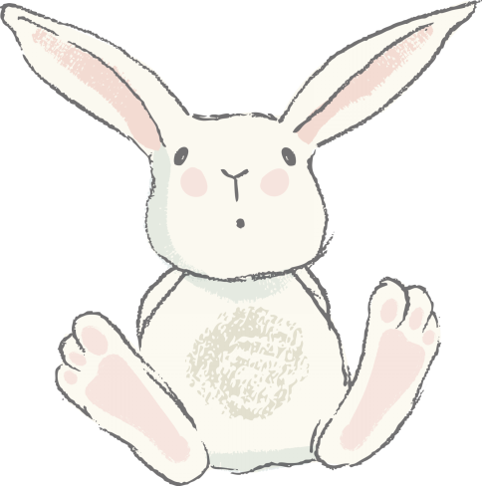
piān
篇
(measure word for essays, articles, etc.)

Slide 3
rì jì
日 记
diary

Slide 4
yì piān rì jì
一篇日记
a diary

Slide 5
lèi
累
tired

Slide 6
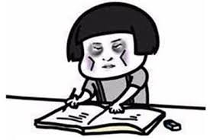
A:你今天累吗？
nǐ jīn tiān lèi ma?
Are you tired today?
B:我今天很累。
wǒ jīn tiān hěn lèi.
I am very tired today.

Slide 7
yǐ jīng
已 经
already

Slide 8
qǐ chuáng
起 床
to get up

Slide 9
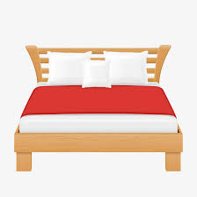
chuáng
床
bed

Slide 10
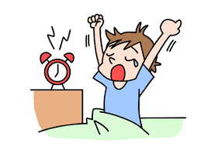
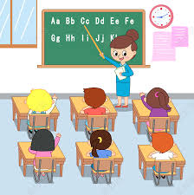
学生已经起床去上课了。
xué sheng yǐ jīng qǐ chuáng qù shàng kè le.
The student has already got up to go to class.

Slide 11
Series of Verbs/Verb Phrases
A number of verbs or verb phrases can be used in succession to represent a series of actions. The sequential order of these verbs or verb phrases usually coincides with the temporal order of the actions.
1、他常常去高小音家吃饭。
tā cháng cháng qù gāo xiǎo yīn jiā chī fàn 。
He often goes to eat at Gao Xiaoyin`s place.
2、下午我要到图书馆去看书。
xià wǔ wǒ yào dào tú shū guǎn qù kàn shū 。
This afternoon I will go to the library to read.

Slide 12
Series of Verbs/Verb Phrases
A number of verbs or verb phrases can be used in succession to represent a series of actions. The sequential order of these verbs or verb phrases usually coincides with the temporal order of the actions.
3、我明天想找同学去打球。
wǒ míng tiān xiǎng zhǎo tóng xué qù dǎ qiú.
I`d like to find some classmates to play ball with me tomorrow.
4、你明天来我家吃晚饭吧。
nǐ míng tiān lái wǒ jiā chī wǎn fàn ba.
Come and have dinner at my house tomorrow.

Slide 13
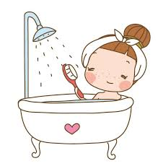
xǐ zǎo
洗 澡
to take a bath/shower

Slide 14
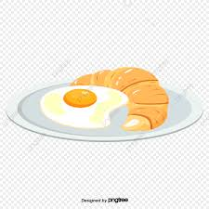
zǎo fàn
早 饭
breakfast

Slide 15
yì biān
一 边
simultaneously;at the same time

Slide 16
一边...一边...(yì biān ...yì biān ...)
This structure denotes the simultaneity of two ongoing actions. In general, the word or phrase for the action that started earlier follows the first 一边(yì biān), while that for the action that started later follows the second 一边(yì biān).
1、我们一边吃饭，一边练习说中文。
wǒ men yì biān chī fàn ，yì biān liàn xí shuō zhōng wén.
We practiced speaking Chinese while having dinner.
2、他常常一边吃饭一边看电视。
tā cháng cháng yì biān chī fàn yì biān kàn diàn shì.
He often eats and watches TV at the same time.

Slide 17
一边...一边...(yì biān ...yì biān ...)
Generally, the verb that follows the first 一边(yì biān) indicates the principal action for the moment, while the one that follows the second
一边(yì biān) denotes an accompanying action.
3、我一边洗澡一边唱歌。
wǒ yì biān xǐ zǎo，yì biān chàng gē.
I sang while taking a shower.
4、我妹妹喜欢一边看书一边听音乐。
wǒ mèi mei xǐ huan yì biān kàn shū yì biān tīng yīn yuè.
My younger sister loves listening to music while she reads.

Slide 18
一边...一边...(yì biān ...yì biān ...)
Generally, the verb that follows the first 一边(yì biān) indicates the principal action for the moment, while the one that follows the second
一边(yì biān) denotes an accompanying action.
1.我一边_______一边________。
wǒ yì biān ______yì biān ______.
2.我喜欢一边______一边_________。
wǒ xǐ huan yì biān ______yì biān ______.
3.我常常一边______一边_________。
wǒ cháng cháng yì biān ______yì biān _________.

Slide 19

jiāo shì
教 室
classroom

Slide 20
fā yīn
发 音
pronunciation

Slide 21
xīn
jiù
新
旧
new
worn

Slide 22
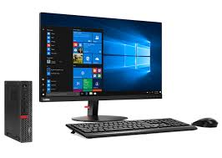
diàn nǎo
电 脑
computer

Slide 23
电脑(diàn nǎo, computer)
The usual colloquial term for a computer is 电脑(diàn nǎo), literally, “electric brain.” A more formal term, especially in mainland China, is 电子计算机(diàn zǐ jì suàn jī) or “electronic computing machine,” or simply 计算机(jì suàn jī). But in Taiwan 计算机(jì suàn jī) means a calculator. In mainland China, a calculator is called 计算器(jì suàn qì).

Slide 24
nǎo
脑
brain

Slide 25
zhōng wǔ
中 午
noon

Slide 26
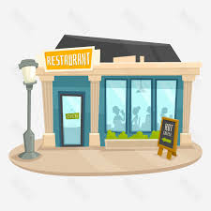
cān tīng
餐 厅
dining room, cafeteria

Slide 27
wǔ fàn
午 饭
lunch, midday meal

Slide 28
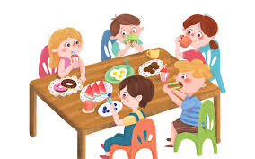
同学们在餐厅吃午饭。
tóng xué men zài cān tīng chī wǔ fàn.
Students have lunch in the dining room.

Slide 29
shàng wǎng
上 网
to go online; to surf the internet

Slide 30
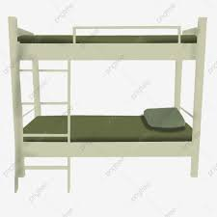
sù shè
宿 舍
dormitory

Slide 31
nàr
那 儿
there

Slide 32
zhèng zài
正 在
in the middle of (doing something)

Slide 33
The Adverb 正在(zhèng zài, be doing...)
The adverb 正在(zhèng zài) denotes an ongoing or progressive action at a
certain point of time. It is more emphatic than 在(zài) when it serves the same function.
1.A:李友，你在做什么？
lǐ yǒu, nǐ zài zuò shén me?
Li You, what are you doing?
B:我在练习写汉字。
wǒ zài liàn xí xiě hàn zì.
I`m practicing writing Chinese characters

Slide 34
The Adverb 正在(zhèng zài, be doing...)
The adverb 正在(zhèng zài) denotes an ongoing or progressive action at a
certain point of time. It is more emphatic than 在(zài) when it serves the same function.
2.我们现在正在上课，你别打电话。
wǒ men xiàn zài zhèng zài shàng kè ，nǐ bié dǎ diàn huà.
We are having a class right now. Don`t make phone calls.
3.我昨天到他宿舍的时候，他正在练习发音。
wǒ zuó tiān dào tā sù shè de shí hou ，tā zhèng zài liàn xí fā yīn.
When I got to his dorm yesterday, he was in the middle of practicing pronunciation.

Slide 35
The Adverb 正在(zhèng zài, be doing...)
The adverb 正在(zhèng zài) denotes an ongoing or progressive action at a
certain point of time. It is more emphatic than 在(zài) when it serves the same function.
4.A:你知道不知道王老师在哪儿？
nǐ zhī dao bù zhī dào wáng lǎo shī zài nǎr ？
Do you know where Teacher Wang is?
B:他正在办公室开会。
tā zhèng zài bàn gōng shì kāi huì.
He is having a meeting in his office.

Slide 36
yǐ qián
以 前
before

Slide 37
yǐ hòu
以 后
after

Slide 38
gào su
告 诉
to tell

Slide 39
zhī dào
知 道
to know

Slide 40
The Position of Time-When Expressions
Time-when expressions come before the verb. They often appear after the subject. However, they sometimes precede the subject under certain discourse conditions. In this lesson, we focus on practicing the ones positioned after the subject.
1、我们十点上课。
wǒ men shí diǎn shàng kè.
We start the class at ten.
2、我们几点去？
wǒ men jǐ diǎn qù ？
What time are we going?

Slide 41
The Position of Time-When Expressions
Time-when expressions come before the verb. They often appear after the subject. However, they sometimes precede the subject under certain discourse conditions. In this lesson, we focus on practicing the ones positioned after the subject.
3、你什么时候睡觉？
nǐ shén me shí hou shuì jiào ？
What time do you go to bed ?
4、他明天上午八点来。
tā míng tiān shàng wǔ bā diǎn lái
He will come at eight tomorrow morning.

Slide 42
The Position of Time-When Expressions
1、你什么时候吃早饭？
nǐ shén me shí hou chī zǎo fàn?
What time do you have breakfast？
2、你什么时候吃午饭？
nǐ shén me shí hou chī wǔ fàn ？
What time do you have lunch?
3、你什么时候吃晚饭？
nǐ shén me shí hou chī wǎn fàn ？
What time do you have dinner?

Slide 43
The Adverb 就(jiù)
The adverb 就(jiù) connecting two verbs or verb phrases indicates that the second action happens as soon as the first one is completed.
1、他今天早上起床以后就听中文录音了。
tā jīn tiān zǎo shang qǐ chuáng yǐ hòu jiù tīng zhōng wén lù yīn le.
He listened to the Chinese recordings right after he got up this morning.
2、王朋写了信以后就去睡觉了。
wáng péng xiě le xìn yǐ hòu jiù qù shuì jiào le.
Wang Peng went to bed right after he had finished writing the letter.

Slide 44
The Adverb 就(jiù)
The adverb 就(jiù) connecting two verbs or verb phrases indicates that the second action happens as soon as the first one is completed.
3、我做了功课以后就去朋友家玩儿。
wǒ zuò le gōng kè yǐ hòu jiù qù péng you jiā wánr.
I will go to my friend`s for a visit right after I finish my homework.

Slide 45
The Particle 的(de)
When a disyllabic or polysyllabic adjective modifies a noun, the particle 的(de) is usually inserted between the adjective and the noun, e.g.漂亮的学校(piào liang de xué xiào, beautiful schools) ,容易的汉字(róng yì de hàn zì, easy characters), 有意思的电影(yǒu yì si de diàn yǐng,interesting movies). However, with monosyllabic adjectives, 的(de) is often omitted, e.g., 新课文(xīn kè wén, new lesson texts), 新电脑(xīn diàn nǎo, new computers), 大教室(dà jiào shì, big classrooms); 好老师(hǎo lǎo shī, good teachers). If the adjective is preceded by 很(hěn), however, 的(de) cannot be dropped,e.g.,很新的电脑(hěn xīn de diàn nǎo, very new computers); 很大的教室(hěn dà de jiào shì, very big classrooms); 很好的老师(hěn hǎo de lǎo shī )

Slide 46
An Entry from Li You`s Diary
李友的一篇日记
十一月三日 星期二
今天我很忙，很累。早上七点半起床，洗了澡以后就吃早饭。我一边吃饭，一边听录音。九点到教室去上课。
第一节课是中文课，老师教我们发音、生词和语法，也教我们写字，还给了我们一篇新课文，这篇课文很有意思。第二节是电脑课，很难。
中午我和同学们一起到餐厅去吃午饭。我们一边吃，一边练习说中文。下午我到图书馆去上网。四点王朋来找我打球。五点三刻吃晚饭。七点半我去白英爱的宿舍跟她聊天(儿)。到那儿的时候，她正在做功课。我八点半回家。睡觉以前，高文中给我打了一个电话，告诉我明天要考试，我说我已经知道了。

Slide 47

How many classes did Li You have?
What did Li You do in the library?
What did Li You do after dinner?

Slide 48
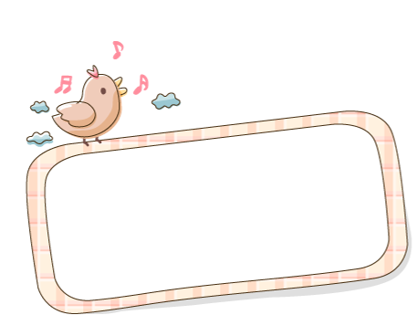

Language Practice

