Slide 1
xué
xiào
学
校
huó
shēng
活
生
School Life
LI XIN YU

Slide 2
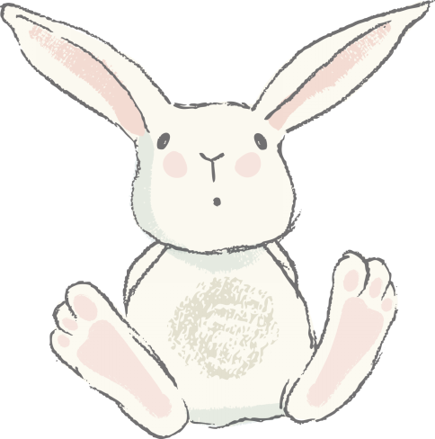
fēng
封
(measure word for letters)

Slide 3
xìn
信
letter (correspondence)

Slide 4
yì fēng xìn
一封信
a letter

Slide 5
zuì jìn
最 近
recently

Slide 6
zuì
最
(of superlative degree; most, -est)

Slide 7
jìn
yuǎn
近
远
close; near
far

Slide 8
xué qī
学 期
school term; semester/quarter

Slide 9
zhuān yè
专 业
major(in college); specialty

Slide 10
hòu lái
后 来
later

Slide 11
后来(hòu lái)
后来(hòu lái) is usually translated as “later,” but it pertains only to an action or situation in the past.

Slide 12
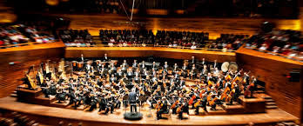
yīn yuè huì
音乐会
concert

Slide 13
xī wàng
希 望
to hope; hope

Slide 14
huì
会
can; know how to

Slide 15
néng
能
can; to be able to

Slide 16
能(néng) and 会(huì) Compared
Both 能(néng) and 会(huì) have several meanings. The basic meaning of 能(néng) is “to be capable of (the action named by the following verb).” It can also be an indication of whether one`s own abilities or circumstances allow the execution of an action. Additional meanings will be introduced in later lessons.
1、我能喝十杯咖啡。
wǒ néng hē shí bēi kā fēi.
I can drink ten cups of coffee.

Slide 17
能(néng) and 会(huì) Compared
2、今天下午我要开会，不能去听音乐会。
jīn tiān xià wǔ wǒ yào kāi huì ，bù néng qù tīng yīn yuè huì.
I have a meeting this afternoon. I cannot go to the concert.
3、我们不能在图书馆聊天儿。
wǒ men bù néng zài tú shū guǎn liáo tiānr.
We cannot chat in the library.

Slide 18
能(néng) and 会(huì) Compared
会(huì), as used in this lesson, means having the skill to do something through learning or instruction.
4、李友会说中文。
lǐ yǒu huì shuō zhōng wén.
Li You can speak Chinese.
5、小白会唱很多美国歌。
xiǎo bái huì chàng hěn duō měi guó gē.
Little Bai can sing many American songs.

Slide 19
能(néng) and 会(huì) Compared
会(huì), as used in this lesson, means having the skill to do something through learning or instruction.
6、我不会上网，请你教我。
wǒ bù huì shàng wǎng ，qǐng nǐ jiāo wǒ.
I don`t know how to use the Internet. Please teach me how.

Slide 20
yòng
用
to use

Slide 21
xiào
笑
to laugh at; to laugh; to smile

Slide 22
kū
哭
to cry

Slide 23
zhù
祝
to wish(well)

Slide 24
除了...以外，还...（chú le ...yǐ wài ，hái ...in addition to...,also...)
1.我除了学中文以外，还学专业课。
wǒ chú le xué zhōng wén yǐ wài ，hái xué zhuān yè kè.
Besides Chinese, I also take courses in my major.
2.上个周末我们除了看电影以外，还听音乐了。
shàng ge zhōu mò wǒ men chú le kàn diàn yǐng yǐ wài，hái tīng yīn yuè le.
Last weekend, besides seeing a movie, we also listened to music.
3.他除了喜欢听音乐以外，还喜欢打球。
tā chú le xǐ huan tīng yīn yuè yǐ wài ，hái xǐ huan dǎ qiú.
In addition to listening to music, he also likes to play ball.

Slide 25
除了...以外，还...（chú le ...yǐ wài ，hái ...in addition to...,also...)
The activities in each of the three sentences above are performed by the same subject. But if activities are done by different subjects, the adverb 也 has to be used.
4.除了小王以外，小李也喜欢唱歌、跳舞。
chú le xiǎo wáng yǐ wài ，xiǎo lǐ yě xǐ huan chàng gē,tiào wǔ.
In addition to Little Wang, Little Li also likes singing and dancing.

Slide 26
The Adverb 就(jiù)
The adverb 就(jiù) can heighten the close relationship between two actions or situations. In this usage, the action or situation indicated by the verb or adjective that follows 就(jiù) is usually contingent upon the action or situation denoted by the verb or adjective in a preceding clause. The ralationship is often causal, as seen in (1) and (2), or conditional, as(3) and(４)
１.（因为）小高喜欢吃中国菜，（所以）我们就吃中国菜。
（yīn wèi）xiǎo gāo xǐ huan chī zhōng guó cài ，（suǒ yǐ ）wǒ men jiù
chī zhōng guó cài．
Little Gao preferred Chinese food, so we went for Chinese food.

Slide 27
The Adverb 就(jiù)
2.（因为)，小王的专业是电脑，（所以）我就请他教我怎么上网。
(yīn wèi) xiǎo wáng de zhuān yè shì diàn nǎo,（suǒ yǐ ）wǒ jiù qǐng tā jiāo wǒ zěn me shàng wǎng.
Little Wang`s major is computer science, so I asked him to teach me how to use the Internet.

Slide 28
The Adverb 就(jiù)
3.要是同学帮我复习，我考试就考得很好。
yào shi tóng xué bāng wǒ fù xí ，wǒ kǎo shì jiù kǎo de hěn hǎo.
If my classmates help me review, I will do well on my test.
4.要是你不能来，我就去你那儿。
yào shi nǐ bù néng lái ，wǒ jiù qù nǐ nàr.
If you can`t come over, I will go to your place.

Slide 29
The Adverb 就(jiù)
5.写汉字，开始觉得难，常常练习，就觉得容易。
xiě hàn zì, kāi shǐ jué de nán, cháng cháng liàn xí, jiù jué de róng yì.
When [you] first learn to write Chinese characters, [you] would find it difficult. If [you] practice often, [you] would find it easy.

Slide 30
了(le)
This sentence-final particle 了 usually indicates a change of status or the realization of a new situation.

Slide 31
A Letter
一封信
小音：
你好！好久不见，最近怎么样？
这个学期我很忙，除了专业课以外，还得学中文。我们的中文课很有意思。因为我们的中文老师只会说中文，不会说英文，所以上课的时候我们只说中文，不说英文。开始我觉得很难，后来，王朋常常帮我练习中文，就觉得不难了。
你喜欢听音乐吗？下个星期六，我们学校有一个音乐会，希望你能来。我用中文写信写得很不好，请别笑我。祝
好
你的朋友
李友
十一月十八日

Slide 32
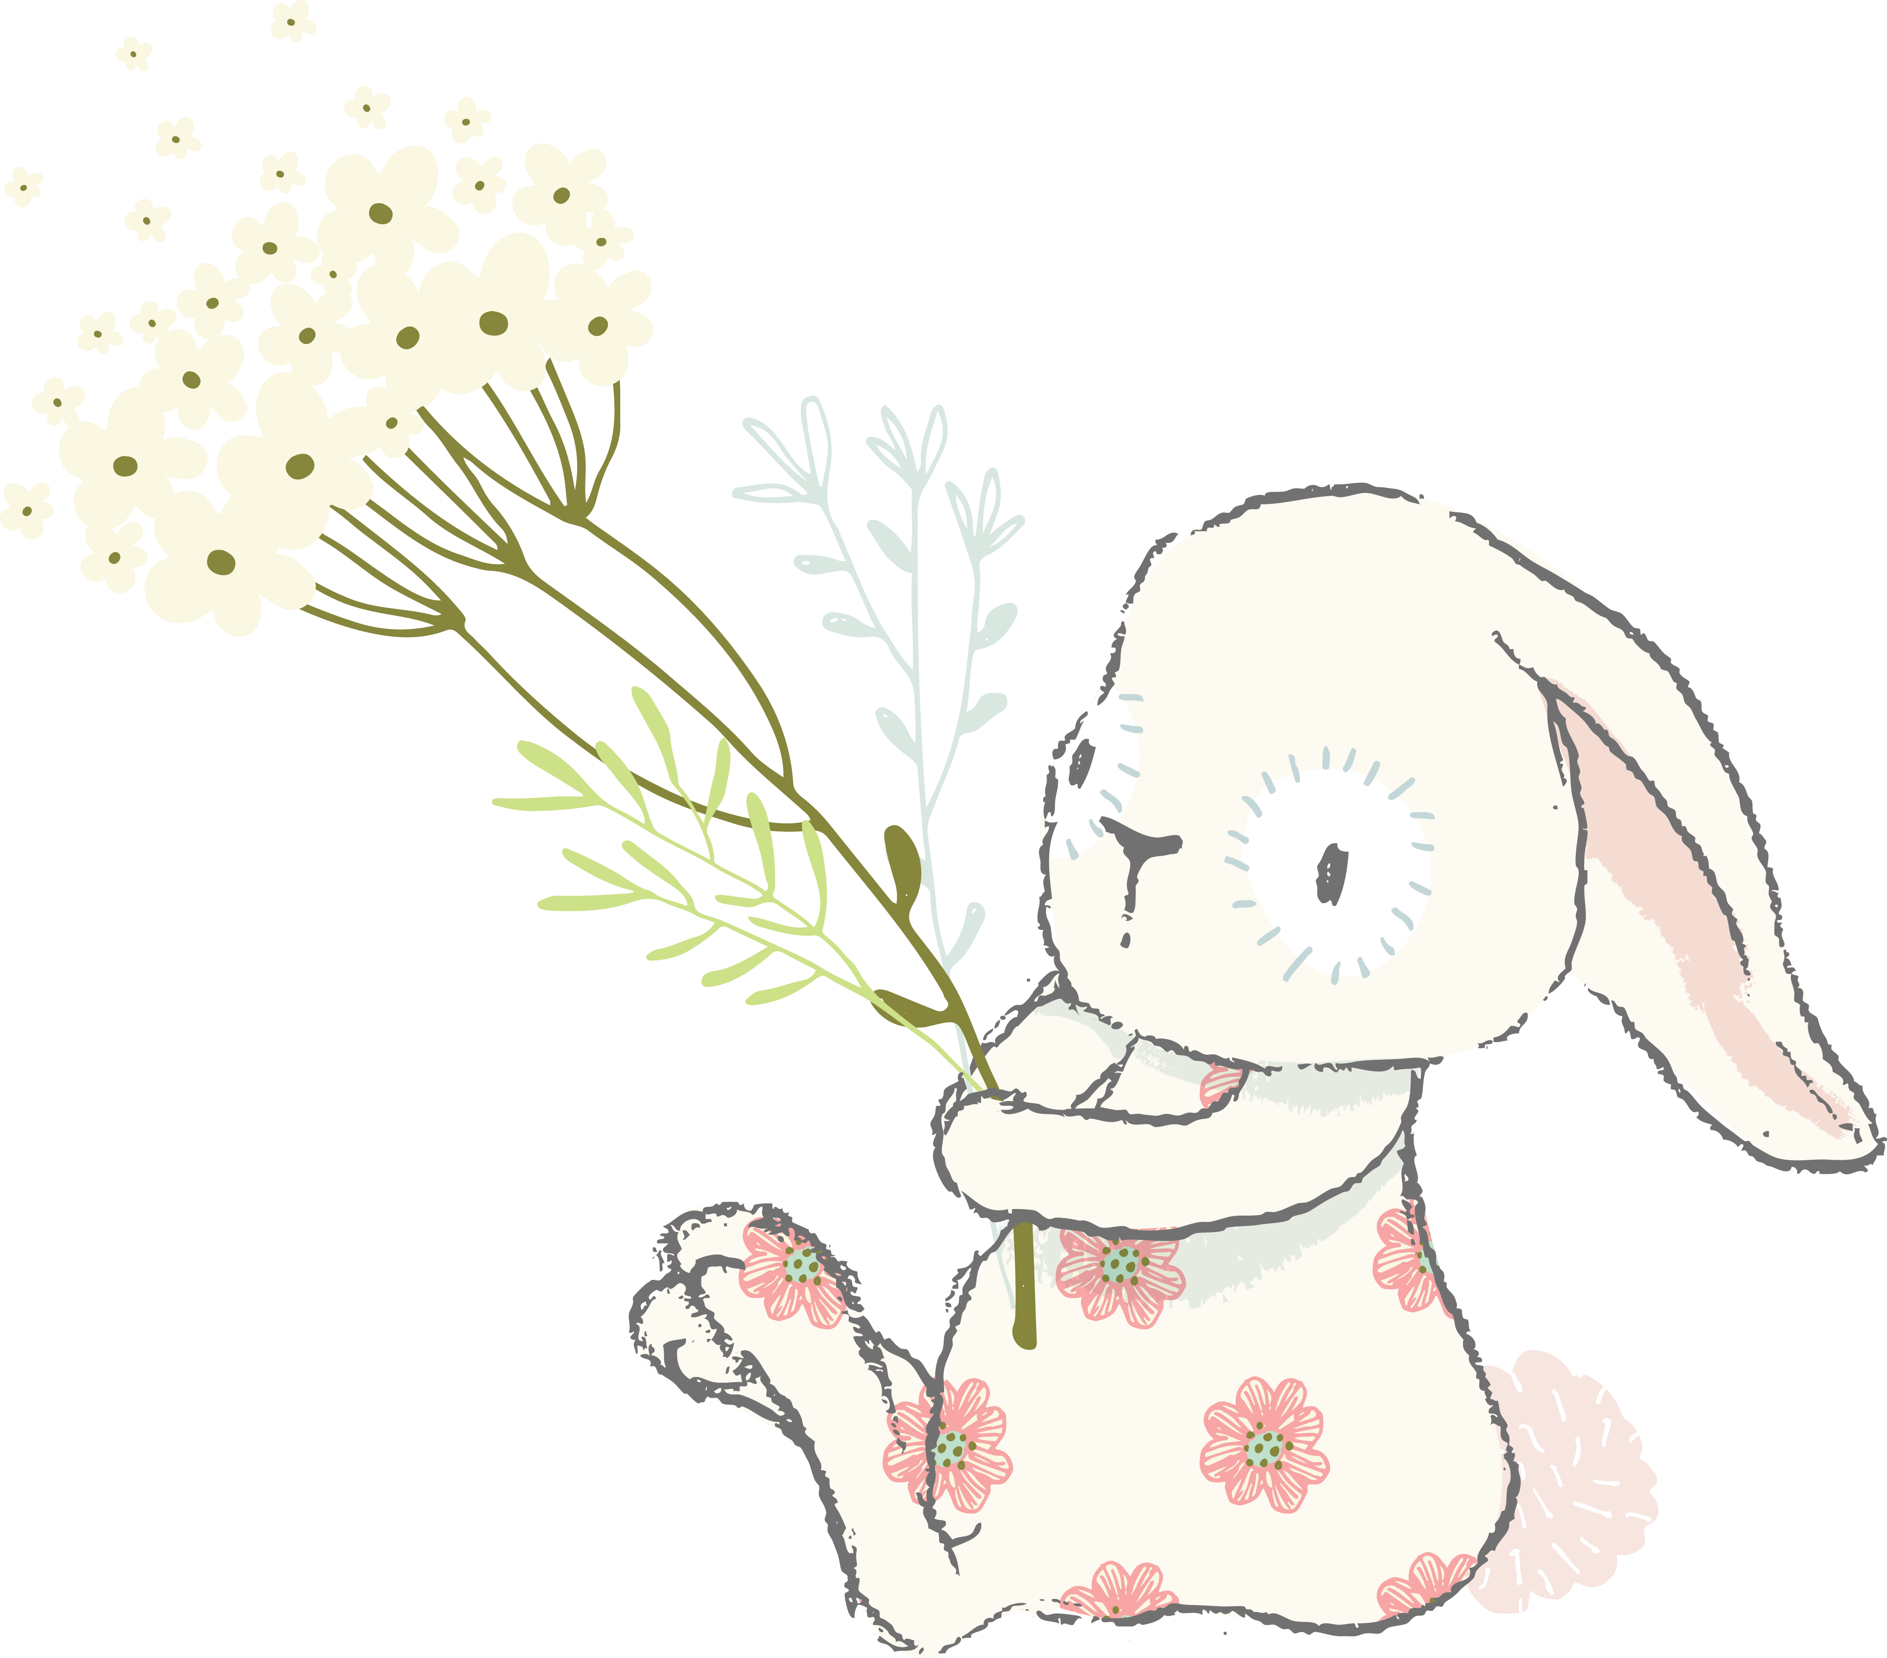
Why did Li You ask Xiao yin if she liked music?
How did Li You feel about her Chinese class?
Why is Li You so busy this semester?

Slide 33
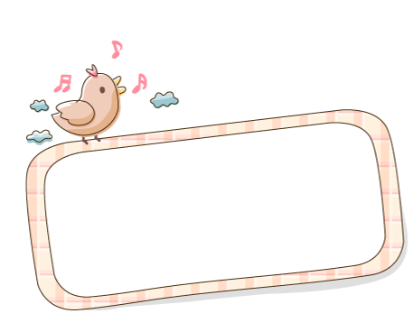
Language Practice

