Slide 1


Dates and Time
时间(shí jiān)
Li Xinyu
10月7日

Slide 2
PART ONE
Vocabulary

Slide 3
number |  |  |  |  |  |  |  |  | 0 零 / líng
1 一 yī | 2 二 èr | 3 三 sān | 4 四 sì | 5 五 wǔ | 6 六 liù | 7 七 qī | 8 八 bā | 9 九 jiǔ | 10 十 shí
11 十一 shí yī | 12 十二 shí èr | 13 十三 shí sān | 14 十四 shí sì | 15 十五 shí wǔ | 16 十六 shí liù | 17 十七 shí qī | 18 十八 shí bā | 19 十九 shí jiǔ | 20 二十 èr shí
30 三十 sān shí | 40 四十 sì shí | 50 五十 wǔ shí | 60 六十 liù shí | 70 七十 qī shí | 80 八十 bā shí | 90 九十 jiǔ shí | 100 一百 yì bǎi | 1000 一千 yì qiān | 10000 一万 yí wàn

Slide 4
Practice
Can you say the number in chinese?
报警电话（bào jǐng diàn huà ）：110
PoliceTel:110
火警电话（huǒ jǐng diàn huà ）：119
Fire Call:119

Slide 5
Practice
Can you say the number in chinese?
三十八 | 七十六 | 四十五 | 二十九 | 六十一
九十五 | 二十四 | 一百六十八 | 六十六 | 十二
三千二百五十五 | 九十九 | 五十三 | 八十二 | 四十六
六十 | 三百 | 七千五百 | 零/O | 一万两千八百七十五

Slide 6
Vocabulary
tiān
昨天 zuó tiān yesterday
今天 jīn tiān today
明天 míng tiān tomorrow
天
day

Slide 7
Vocabulary
xīng qī
星期
week

Slide 8
Monday | Tuesday | Wednesday | Thursday | Friday | Saturday | Sunday
星期一 xīng qī yī | 星期二 xīng qī èr | 星期三 xīng qī sān | 星期四 xīng qī sì | 星期五 xīng qī wǔ | 星期六 xīng qī liù | 星期日 xīng qī rì or 星期天 xīng qī tiān
礼拜一 lǐ bài yī | 礼拜二 lǐ bài èr | 礼拜三 lǐ bài sān | 礼拜四 lǐ bài sì | 礼拜五 lǐ bài wǔ | 礼拜六 lǐ bài liù | 礼拜日 lǐ bài rì or 礼拜天 lǐ bài tiān
周一 zhōu yī | 周二 zhōu èr | 周三 zhōu sān | 周四 zhōu sì | 周五 zhōu wǔ | 周六 zhōu liù | 周日 zhōu rì

Slide 9
Week
In China the week starts on Monday.
星期/礼拜 is used in spoken Chinese.
In spoken Chinese 礼拜(lǐ bài ) is more colloquial than 星期(xīng qī )
周 (zhōu )is used in written Chinese.
周末(zhōu mò):weekend,In China 周末=周六(zhōu liù)+周日(zhōu rì)
A:今天是星期几/礼拜几/周几？(What day is today?)
jīn tiān shì xīng qī jǐ /lǐ bài jǐ /zhōu jǐ ？
B:今天是星期一/礼拜一/周一。(Today is Monday.)
jīn tiān shì xīng qī yī /lǐ bài yī /zhōu yī

Slide 10
Vocabulary
yuè
月
month

Slide 11
月(yuè) Months
一月 yī yuè January | 二月 èr yuè February | 三月 sān yuè March
四月 sì yuè April | 五月 wǔ yuè May | 六月 liù yuè June
七月 qī yuè July | 八月 bā yuè August | 九月 jiǔ yuè September
十月 shí yuè October | 十一月 shí yī yuè November | 十二月 shí èr yuè December

Slide 12
Vocabulary
hào
号
day of the month

Slide 13

Vocabulary
rì
日
day;sun

Slide 14
Days of the month
In spoken Chinese 号(hào) is used to refer to the days of the month. However, in written Chinese 日(rì) is always used.
Example:二月五号 èr yuè wǔ hào February 5 (Spoken)
二月五日 èr yuè wǔ rì February 5 (Written)

Slide 15
Vocabulary
nián
去年qù nián last year
今年jīn nián this year
明年míng nián next year
年
year

Slide 16
年(nián)year
Unlike in English, where the two years given above are read "seventeen eight-six" and "twenty-fifteen" respectively, years in Chinese are pronounced one digit at a time.
Example:一七八六年 yī qī bā liù nián 1786
二〇一五年 èr líng yī wǔ nián 2015

Slide 17
Word order for dates
year | month | day | day of the week
X年 | X月 | X号/日 | 星期X
Chinese time expressions proceed from the largest to the smallest unit
Example:二〇一五年七月二十六号/日星期三。
èr líng yī wǔ nián qī yuè èr shí liù hào /rì xīng qī sān 。
Wednesday,July 26, 2015

Slide 18
Vocabulary
shēng
生
to give birth to;
to be born

Slide 19
Vocabulary
shēng rì
生日
birthday

Slide 20
Practice
A:你的生日是几月几号？
nǐ de shēng rì shì jǐ yuè jǐ hào ？
B:我的生日是一月二十四号
wǒ de shēng rì shì yī yuè èr shí sì hào

Slide 21
Vocabulary
duō
多
how many/much;
to what extent;
many

Slide 22
Vocabulary
dà
大
big;old

Slide 23
Age
To find out someone`s age, we ask, 你今年多大？(nǐ jīn nián duō dà ？)
If the person is a child who appears to be under ten, ask instead, 你今年几岁？(nǐ jīn nián jǐ suì ？)

Slide 24
Vocabulary
suì
岁
year(of age)

Slide 25
Age
ive
To give one`s age, it is correct to say 我十八岁(wǒ shí bā suì ), and the verb 是 is usually not needed. The word 岁(suì) can often be dropped. However, if the age is ten or under, the word 岁 cannot be omitted.我十(X) or 我八(X)

Slide 26
Age
ive
A：你今年多大？
nǐ jīn nián duō dà ？
How old are you this year?
B：我18岁。
wǒ shí bā suì .
I am eighteen years old.

Slide 27
Vocabulary
chī
吃
to eat

Slide 28
Vocabulary
fàn
饭
meal;(cooked) rice

Slide 29
Vocabulary
chī fàn
吃饭
eat
我请你吃饭。
wǒ qǐng nǐ chī fàn.
I invite you to dinner.

Slide 30
Vocabulary
zěn me yàng
怎么样
Is it O.K.? How is that? How does that sound?

Slide 31
Vocabulary
xiè xie
谢谢
to thank

Slide 32
Vocabulary
A:我星期一请你吃饭，怎么样？
wǒ xīng qī yī qǐng nǐ chī fàn,zěn me yàng ？
I`ll treat you to a meal on Monday. How`s that?
B:太好了。谢谢，谢谢。
tài hǎo le .xiè xie,xiè xie.
That would be great. Thank you very much!

Slide 33
Vocabulary
tài ... le
太...了
too;extremely
太酸了 tài suān le too sour
太甜了 tài tián le too sweet
太累了 tài lèi le too tired

Slide 34
Vocabulary
cài
菜
dishes,cuisine

Slide 35
Vocabulary
xǐ huān
喜欢
to like

Slide 36
Vocabulary
A:你喜欢吃捷克菜还是美国菜？
nǐ xǐ huān chī jié kè cài hái shì měi guó cài ？
Do you like Czech food or American food?
B:我喜欢吃捷克菜。
wǒ xǐ huān chī jié kè cài .
I like Czech food.

Slide 37
Vocabulary
kě shì
可是
but

Slide 38
Vocabulary
wǒ men
我们
we

Slide 39
Vocabulary
zài
再
again

Slide 40
Vocabulary
jiàn
见
to see

Slide 41
Vocabulary
zài jiàn
再见
goodbye；see you again

Slide 42
Vocabulary
bàn
半
half;half an hour

Slide 43
Vocabulary
diǎn
点
o`clock(lit.dot,point,thus “points on the clock”)

Slide 44
Vocabulary
kè
刻
quarter(of an hour)

Slide 45
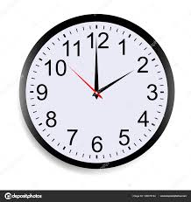
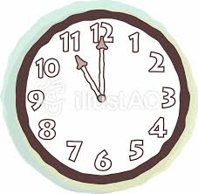
Telling Time
These terms are used to tell time: 点/点钟(diǎn/diǎn zhōng,o`clock), 半(bàn,half hour),刻(kè,quarter hour), and 分(fèn, minute).
钟(zhōng) can be omitted from 点钟(diǎn zhōng).
二点(钟) is not used.
两点(钟)
liǎng diǎn (zhōng)
十一点(钟)
shí yī diǎn (zhōng)

Slide 46
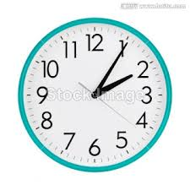
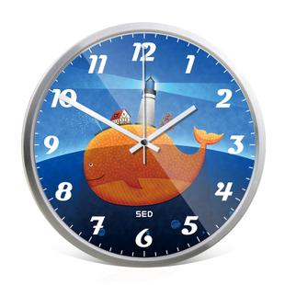
Telling Time
The term 零/〇(líng,zero) is usually added before a single-digit number of 分(fēn,minute), e.g.,两点零五分(liǎng diǎn líng wǔ fēn).分(fēn) can be omitted from the end of the expression if the number for the minutes appears in two syllables. Thus one can say 一点五十(yī diǎn wǔ shí ) and 两点零五(liǎng diǎn líng wǔ), but not 两点五(liǎng diǎn wǔ) or 一点十(yī diǎn shí)。
两点零五(分)
liǎng diǎn líng wǔ (fēn)
一点五十(分)
yī diǎn wǔ shí (fēn)

Slide 47
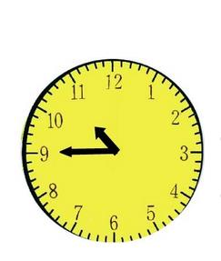
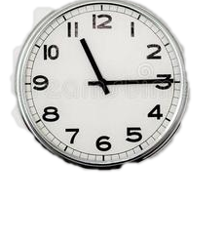
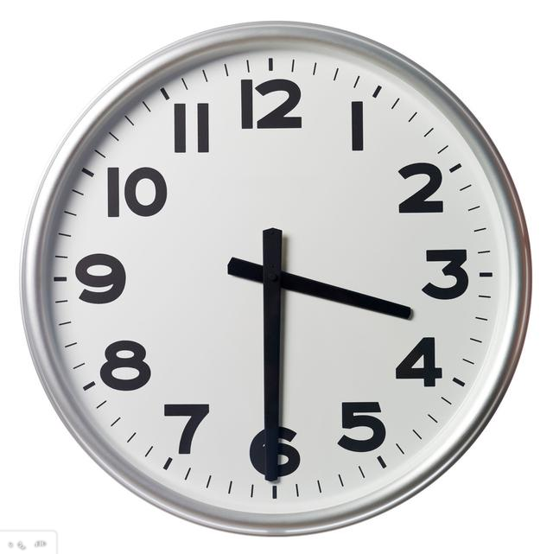
Telling Time
十一点一刻
shí yī diǎn yī kè
十点三刻
shí diǎn sān kè
三点半
sān diǎn bàn
两刻(liǎng kè,two quarters )(X)

Slide 48
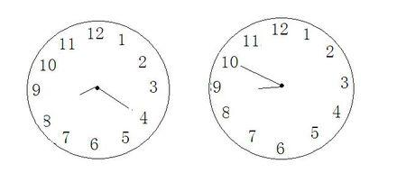
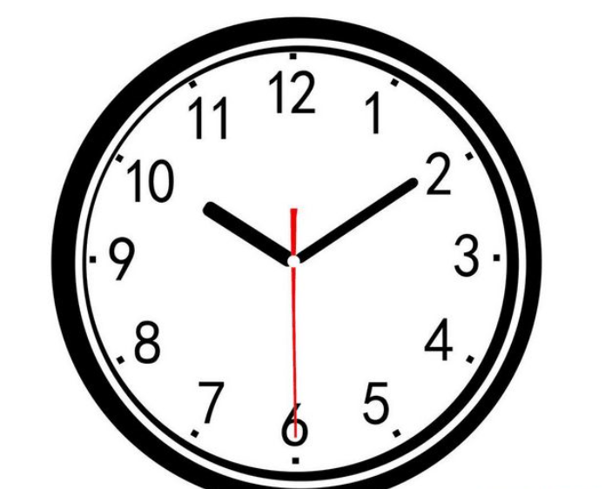
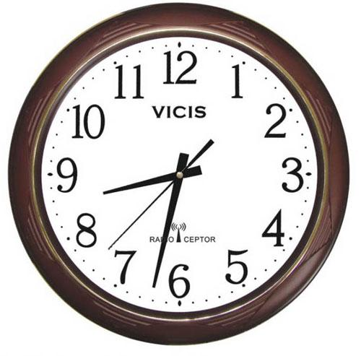
Practice

Slide 49
Vocabulary
早上
zǎo shang
morning
中午
zhōng wǔ
noon
wǎn shang
晚上
evening;night

Slide 50
7:00 p.m | 晚上七点(钟) | wǎn shàng qī diǎn (zhōng )
8:05 p.m | 晚上八点零五(分) | wǎn shang bā diǎn líng wǔ (fèn)
9:15 p.m | 晚上九点一刻 | wǎn shang jiǔ diǎn yí kè
10:30 p.m | 晚上十点半 | wǎn shang shí diǎn bàn

Slide 51
Practice
9:00 a.m. | 11:12 a.m. | 10:35 p.m. | 0:24 a.m. | 2:15 p.m.
8:30 p.m. | 7:45 a.m. | 6:12 a.m. | 5:37 p.m. | 1:34 a.m.
4:48 a.m. | 8:30 p.m. | 3:15 p.m. | 5:32 a.m. | 9:12 p.m.
8:39 p.m | 6:09 p.m. | 7:01 a.m. | 10:59 a.m. | 0:58 p.m.

Slide 52
Vocabulary
yīng guó
英国
Britain;England

Slide 53
ive
Pronouns as Modifiers and the Usage of the Particle 的(de)
When the personal pronouns 我(wǒ,I),你(nǐ,you), and 他(tā,he)are followed by a term indicating a close personal relationship such as 妈妈(mā ma,mother), 弟弟(dì di,younger brother), and 家(jiā,family) the word 的(de) can be omitted; e.g,我妈妈(wǒ mā ma,my mother),你弟弟(nǐ dì di,younger brother),我们家(wǒ men jiā,our family). Otherwise 的(de) is generally required; e.g,我的生日(wǒ de shēng rì,my birthday),他的医生(tā de yī shēng,his doctor).

Slide 54
ive
我请你吃饭(wǒ qǐng nǐ chī fàn )
1、明天李先生请你吃中国菜。
míng tiān lǐ xiān sheng qǐng nǐ chī zhōng guó cài 。
Mr.Li is inviting you to have Chinese food tomorrow.
2、今天晚上我请你和你妹妹吃美国菜，怎么样？
jīn tiān wǎn shang wǒ qǐng nǐ hé nǐ mèi mei chī měi guó cài,zěn me yàng ？
How about if I invite you and your younger sister to have American food tonight?

Slide 55
(是)...还是...((shì)...hái shì ...)
ive
The structure(是)...还是...((shì )...hái shì ..., ...or...) is used to form an alternative question. If there is another verb used in the predicate, the first 是(shì) often can be omitted.
A：你是中国人，还是美国人？
nǐ shì zhōng guó rén，hái shì měi guó rén ？
Are you Chinese or American?
B：我是中国人。
wǒ shì zhōng guó rén .
I am Chinese.

Slide 56
(是)...还是...
ive
A：你哥哥是老师，还是学生？
nǐ gē ge shì lǎo shī ，hái shì xué sheng ？
Is your older brother a teacher or a student?
B：我哥哥是老师。
wǒ gē ge shì lǎo shī .
My older brother is a teacher.

Slide 57
(是)...还是...
ive
A：(是)你请我吃饭，还是他请我吃饭？
(shì)nǐ qǐng wǒ chī fàn,hái shì tā qǐng wǒ chī fàn ？
Who is taking me to dinner, you or he ?
B：(是)我请你吃饭。
(shì)wǒ qǐng nǐ chī fàn
I am taking you to dinner

Slide 58
(是)...还是...
ive
A:他(是)喜欢吃中国菜，还是喜欢吃美国菜。
tā (shì)xǐ huān chī zhōng guó cài,hái shì xǐ huān chī měi guó cài .
Does he like to eat Chinese or American food?
B:中国菜、美国菜他都喜欢。
zhōng guó cài 、měi guó cài tā dōu xǐ huān .
He likes both Chinese food and American food.

Slide 59
Text
高文中：白英爱，九月十二号是星期几？
白英爱：是星期四。
高文中：那天是我的生日。
白英爱：是吗？你今年多大？
高文中:十八岁。
白英爱：我星期四请你吃饭，怎么样？
高文中：太好了。谢谢，谢谢。
白英爱：你喜欢吃中国菜还是美国菜？
高文中：我是英国人，可是我喜欢吃中国菜。
白英爱：好，我们吃中国菜。

Slide 60
Text
高文中：星期四几点？
白英爱：七点半怎么样？
高文中：好，星期四晚上见。
白英爱：再见。

Slide 61
question
ive
1、How old is Gao Wenzhong?
2、What kind of food are they going to have?
3、What time is the dinner?

Slide 62
ive
Language
Practice

